Slide 1
INTRODUCTION TO HUMAN COMMUNICATION
What and Why of Human communication
LECTURE 1 BY DR. RAPHAEL OGUTU, AFRICA NAZARENE UNIVERSITY
THE MAIN SOURCE OF REFERENCE: Adler, R.B. & Rodman, G. 2006. Understanding human communication. 9th edition. London: Oxford University Press.

Slide 2
Course Description
Designed to introduce you to the basic concepts of human communication, processes, and to investigate the cultural basis of human communication with emphasis on rhetorical forms available for the achievement, implementation of social power and interpersonal communication.
Topics related to culture, identity, organizations, communicating with social media, and relationships.
Also introduces you Public Speaking

Slide 3
Characteristics of communication
Preliminary Information, Principles, Concepts, Definitions, and Overview of Introduction to Human Communication.
Human communication is the process of creating meaning through symbolic interaction.
It occurs between humans
It is a process
It is symbolic

Slide 4
Communicating With Social Media
The Roles of Social and Mass Media
Mediated Versus Face-to-Face Communication
Understanding Change
Changing Technologies
Changing Discipline
Changing Demographics

Slide 5
The Self, Perception, and Communication
The ways in which we perceive ourselves and others shape our communication.
Self-Concept Defined
Communication and Development of the Self
The Self-Fulfilling Prophecy and Communication
perceiving others
Communication and identity management

Slide 6
Communication and Culture
Culture shapes communication.
Intercultural and Intergroup Communication
Understanding Cultures and Co cultures
How Cultural Values and Norms Shape Communication
Developing Intercultural Communication Competence

Slide 7
Language
The complexity of language is a tool to more skillfully improve everyday interaction.
The Nature of Language
The Power of Language
Troublesome Language or linguistic misunderstandings
Differences between the way men and women speak.
The way language is used across cultures

Slide 8
Listening
We spend more time in listening to others than in any other type of communication.
The Value of Listening
Faulty Listening Habits or misconceptions about Listening
Overcoming Challenges to Effective Listening
Informational, critical and supportive Listening

Slide 9
Nonverbal Communication
Week 7: MID-TERM QUIZ (WEEK covering content from week 1 to 6)
It is virtually impossible to avoid using nonverbal communication.
Characteristics of Nonverbal Communication
Functions of Nonverbal Communication
Types of Nonverbal Communication
Influences affecting the ability to understand and use nonverbal communication.

Slide 10
Interpersonal Communication
Communication fosters interpersonal relationships but there are influences affecting our choices.
Understanding Interpersonal Communication
Characteristics of Interpersonal Communication
Communicating with Friends and Family
Communicating with Romantic Partners
Self-disclosure

Slide 11
Managing Conflict in interpersonal Comm.
Every communication relationship has a feeling, a mood, an emotional tone referred to as communication climate.
10.1 Understanding Interpersonal Conflict
10.2 Communication Climates
10.3 Conflict Communication Styles
The resolution of conflicts

Slide 12
Communication in Groups, Teams, and Organizations
Communicating For Career Success
Setting the Stage for Career Success
Pursuing the Job You Want
Organizational Communication Factors

Slide 13
Introduction to Public Communication
Public speaking is made easier if the proper tools are used to design and deliver your thoughts effectively.
Preparing and Presenting Your Speech
Getting Started
Analyzing the Speaking Situation
Gathering Information
Managing Communication Apprehension
Presenting Your Speech
Guidelines for Delivery

Slide 14
Types of Speeches
Introduction to Informative Speaking
Introduction to Persuasive Speaking
Characteristics of Informative speeches
Characteristics of Persuasive speeches

Slide 15
Types or Levels of Communication
Intrapersonal Communication
Dyadic/Interpersonal Communication
Small Group Communication
Organizational Communication
Public Communication
Mass Communication

Slide 16
Intrapersonal Communication
Intrapersonal Communication By definition,intrapersonal communication means “communicating with oneself.”
For examples, You can tune in to one way that each of us communicates internally by listening to the little voice that lives in your mind. Take a moment and listen to what it is saying. Try it now, before reading on. Did you hear it? It may have been saying something like “What little voice? I don’t have any little voice!” This voice is the “sound” of your thinking.

Slide 17
Dyadic/Interpersonal Communication
Social scientists call two persons interacting a dyad, and they often use the term dyadic communication to describe this type of communication.
The qualities that characterize interpersonal communication aren’t limited to twosomes. They can be present in threesomes or even in small groups.

Slide 18
Small group and Organizational Communication
In small group communication every person can participate actively with the other members. Small groups are a common fixture of everyday life. Your family is a group. Members have strong relationships, norms, roles, need to belong, and so on.
Organizational Communication is a type of communication that occurs among a structured collection of people in order to meet a need/pursue a goal within an organization.

Slide 19
Public Communication
Public communication occurs when a group becomes too large for all members to contribute. Characteristics of public communication Include:
An unequal amount of speaking.
One or more people are likely to deliver their remarks to the remaining members or audience.
It has limited and delayed verbal feedback.

Slide 20
Mass Communication
In Mass communication messages are transmitted to large, widespread audiences via electronic and print media: newspapers, magazines, television, radio, and so on.
Most of the messages are less personal sent via mass communication channels are developed, or at least financed, by large organizations.
Controlled by many gatekeepers who determine what messages will be delivered to consumers, how they will be constructed, and when they will be delivered

Slide 21
Computer- mediated communication
Computer- mediated communication includes: Communication between people that takes place through some computer connection, for example E- mail, Chat room, News group, instant messaging, website and blog communication.

Slide 22
Satisfactions caused by Communication
Communication helps satisfy a number of needs in our lives:
■ Physical needs
■ Identity needs
■ Social needs
■ Practical needs

Slide 23
Physical and Identity needs
Physical needs: Personal communication is essential for our wellbeing, research evidence show that an absence of satisfying communication can jeopardize life itself such as early deaths, terminal cancers, common cold, and coronary disease and so on depending on the nature of isolation.
Identity needs: our sense of identity comes from the way we interact with other people. The others’ messages shaping who we think we are, the messages we create often are attempts (some more conscious than others) to get others to view us the way we want to be seen.

Slide 24
Social and practical needs
Social needs: communication provides a vital link with others. Some of social needs we satisfy by communicating are Pleasure, affection, inclusion, escape, relaxation and control.
Practical needs: communication is an important key to effectiveness in a variety of everyday settings for example, a survey of over 400 employers identified “communication skills” as the top characteristic that employers seek in job candidates. Communication is important for any practical instruction to be carried out

Slide 25
Modeling Communication
Models of communication help us understand what is involved in this process.
■ The linear model is familiar, but overly simplistic
■ The transactional model better describes how people communicate

Slide 26
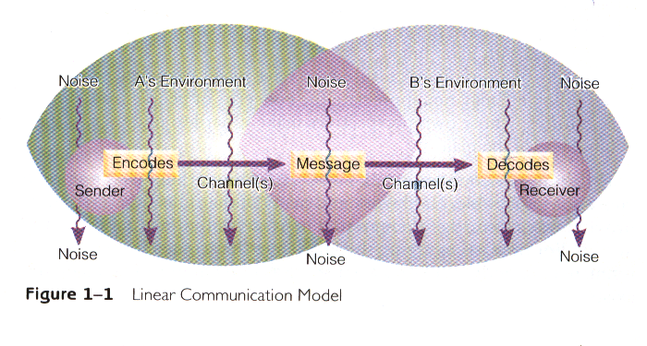
Linear Model

Slide 27
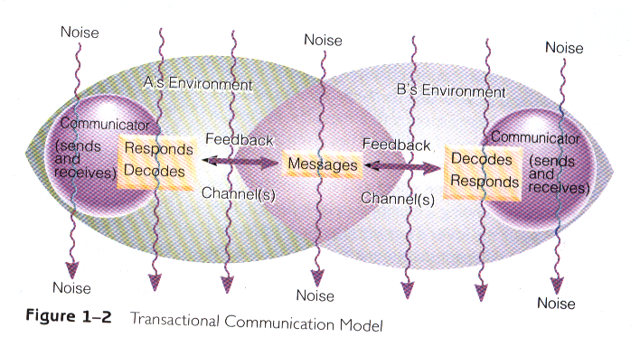

Slide 28
Communication competence
Communication competence is a measure of a person’s effectiveness. This chapter explores competence by:
■ Defining the nature of competence and how it is acquired
■ Outlining the characteristics of competent communicators

Slide 29
Characteristics of communication competence.
There is no ideal way to communicate the type of communication that succeeds in one situation may be a colossal blunder in another.
Competence is situational it is more accurate to talk about degrees of competence or areas of competence
Competence can be learned communication is a set of skills that anyone can learn at any level of life
Competence is relational because communication is transactional it is something we do with others rather than to them

Slide 30
Misconceptions about communication
Clarifying certain misconceptions about communication helps us understand how the process works effectively. We will consider the following clarifications of common misconceptions:
■ Communication doesn’t always require complete understanding
■ Communication isn’t always a good thing
■ No single person or event causes another’s reaction

Slide 31
Misconceptions about communication (Cont.)
■ Communication won’t solve all problems
■ Meanings rest in people, not words
■ Communication isn’t as simple as it often seems
■ More communication isn’t always better

Slide 32
SUMMARY
This lesson began by defining Human communication that is the process of human beings responding to the symbolic behavior of other persons.
It introduced types of Communication : intrapersonal, dyadic, small group, organizational, Public, Mass and Computer Mediated Communication.
The lesson also identified several types of needs that communication satisfies: physical, identity, social, and practical.
A linear and a transactional communication model were developed, demonstrating the superiority of the transactional model
The lesson went on to explore the difference between effective and ineffective exchanges by discussing communication competence.
The lesson concluded by discussing several common misconceptions about communication.

Slide 33
THANK YOU
LECTURE 1
THE MAIN SOURCE OF REFERENCES: Adler, R.B. & Rodman, G. 2006. Understanding human communication. 9th edition. London: Oxford University Press.

