Slide 1
INTRODUCTION TO HUMAN COMMUNICATION
Interpersonal Communication : Managing Conflict
LECTURE 10 BY DR. RAPHAEL OGUTU, AFRICA NAZARENE UNIVERSITY
THE MAIN SOURCE OF REFERENCE: Adler, R.B. & Rodman, G. 2006. Understanding human communication. 9th edition. London: Oxford University Press.

Slide 2
Intended Learning Outcomes
At the end of this class, you should be able to:
Understanding Interpersonal Conflict and Conflict defined
Explain Communication Climates
Identify disconﬁrming messages and replace them with conﬁrming ones,
Use the Gibb categories of supportive communication.
Apply the approaches to an interpersonal conﬂict resolution.
Conflict Communication Styles

Slide 3
UNDERSTANDING INTERPERSONAL CONFLICT
UNDERSTANDING INTERPERSONAL CONFLICT
Conflict defined
Expressed Struggle
Interdependence
Perceived Incompatible Goals
Perceived Scarce Resources

Slide 4
Conflict defined
Conflict is an expressed struggle between at least two interdependent parties who perceive incompatible goals, scarce resources, and interference from the other party in achieving their goals.
Or fight, battle, war an armed conflict. 2a : competitive or opposing action of incompatibles : antagonistic state or action (as of divergent ideas, interests, or persons) a conflict of principles: Conflict | Definition of Conflict by Merriam-Webster

Slide 5
Expressed struggle
  Expressed struggle captures the notion that conflict does not exist unless all the people involved know that the disagreement exists even if the expressed struggle is not verbalized.
  Conflict has to be an expressed struggle. This is more than an internal disagreement; it has to be expressed either verbally or nonverbally.

Slide 6
incompatible goals and scarce resources
  Perceived incompatible goals is a situation where it seems as if the goals of those involved are mutually exclusive, but that is not always the case, as mutually satisfying answers can be agreed upon.
  Perception of scarce resources occurs when people believe there are not enough resources, such as time, money, affection and space to go around.

Slide 7
Interdependence and Inevitability
  Interdependence is another feature that captures the notion that people in a conflict are dependent upon each other.
  Inevitability addresses that fact that conflicts are impossible to avoid; the challenge is to handle them effectively when they occur.

Slide 8
Characteristics of Conflict
There are certain characteristics of conflict in addition to it being natural, normal, and important. Conflict can be expressed directly or indirectly, and it can be beneficial or harmful.
Conflict is often expressed directly, through the verbal channel, or through spoken words. This route can lead to emotional escalation and increase the seriousness of the conflict, though it can also lead to a quicker resolution.
It is also often expressed indirectly, through the nonverbal channel…

Slide 9
Characteristics of Conflict
or through gestures and movements, such as door-slamming; facial expressions, such as eye rolling; and nonverbal utterances, such as scoffing.
Indirect expressions of conflict can be considered passive aggressive, but sometimes this route is preferred in order to avoid a confrontation and potentially put strain on the relationship.
The major drawback to indirect expressions of conflict is that while it may be easier and more comfortable, it can leave the matter unresolved for a longer period of time. Which approach you take will depend upon the situation, your goals, the person with whom you're interacting, and the importance of the desired outcome.

Slide 10
Functional conflict versus Dysfunctional conflict
According to Adler, Rosenfeld, and Proctor II (2012), in a functional conflict, participants achieve the best possible outcome, unlike a dysfunctional conflict, where the outcome falls short of what is possible. The following concepts are key in these types of conflicts:
Integration versus polarization
Cooperation versus opposition
Agreement versus coercion
De-escalation versus escalation
Focusing versus drifting
Foresight versus shortsightedness
Positive versus negative results

Slide 11
Functional conflict versus Dysfunctional conflict
  Integration versus polarization describes how participants in a dysfunctional conflict regard each other as polar opposites, while participants in a functional conflict recognize that they are integrated or in a difficult situation together.
  Cooperation versus opposition means that cooperation is possible in interpersonal conflicts, although participants in a dysfunctional conflict see each other as opponents.

Slide 12
Functional conflict versus Dysfunctional conflict
  Confirmation versus disconfirmation occurs in functional conflicts, where participants disagree but are not disagreeable.
  Agreement versus coercion is described when, in destructive conflicts, participants use coercion to get what they want instead of finding ways to reach an agreement.

Slide 13
Functional conflict versus Dysfunctional conflict
  De-escalation versus escalation addresses the fact that in functional conflicts the participants solve more problems than they create, while in dysfunctional conflicts the problems grow larger instead of smaller.
  Focusing versus drifting is the idea that, in dysfunctional conflicts, the participants drift away from the original problem and bring in other issues.

Slide 14
Functional conflict versus Dysfunctional conflict
  Foresight versus shortsightedness occurs when foresight is a feature of functional conflicts, while shortsightedness can produce dysfunctional conflicts.
  Positive versus negative results describes the notion that functional conflicts have positive results, such as finding a solution that works, while a dysfunctional conflict has negative results, such as neither participant receiving what they want, and threatens the future of the relationship.

Slide 15
COMMUNICATION CLIMATES IN INTERPERSONAL RELATIONSHIPS
Every communication relationship has a feeling, a mood, an emotional tone referred to as communication climate.
Personal relationships are a lot like the weather. Some are fair and warm, whereas others are stormy and cold; some are polluted, and others healthy. Some relationships have stable climates, whereas others change dramatically calm one moment and turbulent the next.

Slide 16
Communication Climate
Refers to the emotional tone of a relationship More concerned with the way people feel about one another than the tasks they perform Determined by the degree to which people see themselves as valued.
Consider two communication classes, for example. Both meet for the same length of time and follow the same syllabus. It’s easy to imagine how one of these classes might be a friendly, comfortable place to learn, whereas the other might be cold and tense even hostile.
The same principle holds for families, coworkers, and other relationships: Communication climates are a function more of the way people feel about one another than of the tasks they perform.

Slide 17
Confirming and Disconfirming Messages
What makes some climates positive and others negative? A short but accurate answer is that the Communication climate is determined by the degree to which people see themselves as valued.
When we believe others view us as important, we are likely to feel good about our relationship. On the other hand, the relational climate suffers when we think others don’t appreciate or care about us. Messages that show you are valued have been called conﬁrming responses.

Slide 18
Confirming Messages
Confirming Responses Occurs in three increasingly positive levels:
Recognition: the most fundamental act of confirmation
Acknowledgement: interested in another’s ideas
Endorsement: agreeing with another’s ideas

Slide 19
Recognition
The most fundamental act of confirmation is to recognize the other person.
Recognition seems easy and obvious, and yet there are many times when we do not respond to others on this basic level. Failure to write or visit a friend is a common example. So is failure to return a phone message. Avoiding eye contact and not approaching someone you know on campus, at a party, or on the street send a negative message.
Of course, this lack of recognition may simply be an oversight. Nonetheless, if the other person perceives you as avoiding contact, the message has the effect of being disconﬁrming.

Slide 20
Acknowledgment
Acknowledging the ideas and feelings of others is a stronger form of confirmation.
Listening is probably the most common form of acknowledgment. Of course, counterfeit listening ambushing, stage hogging, pseudolistening, and so on has the opposite effect of acknowledgment.
More active acknowledgment includes asking questions, paraphrasing, and reﬂecting.

Slide 21
Endorsement
Whereas acknowledgment means you are interested in another’s ideas, endorsement means that you agree with them.
It’s easy to see why endorsement is the strongest type of conﬁrming message, because it communicates the highest form of valuing.
The most obvious form of endorsement is agreeing. Fortunately, it isn’t necessary to agree completely with another person in order to endorse her or his message.
Nonverbal endorsement can also enhance the quality of a relational climate. For example, women rate men who agree with them as more physically attractive than those who fail to do so.

Slide 22
Disconfirming Messages
Disconfirming Responses
Show lack of regard for the other; Either by disagreeing, Disputing or Ignoring
Disconfirming messages occur when the speaker is attacked instead of the message or idea

Slide 23
How Communication Climates Develop
After a climate is formed, it can take on a life of its own and grow in a self-perpetuating spiral: a reciprocating communication pattern in which each person’s message reinforces the others.
  In positive spirals, one partner’s conﬁrming message leads to a similar response from the other person. This positive reaction leads the ﬁrst person to be even more reinforcing.
  Negative spirals are just as powerful, though they leave the partners feeling worse about themselves and each other.

Slide 24
How Communication Climates Develop
Escalatory conflict spirals are the most visible way that disconfirming messages reinforce one another. One attack leads to another until a skirmish escalates into a full-ﬂedged battle.
Although they are less obvious, de-escalatory conﬂict spirals can also be destructive. Rather than ﬁghting, the parties slowly lessen their dependence on one another, withdraw, and become less invested in the relationship.
Spirals rarely go on indeﬁnitely. Most relationships pass through cycles of progression and regression.

Slide 25
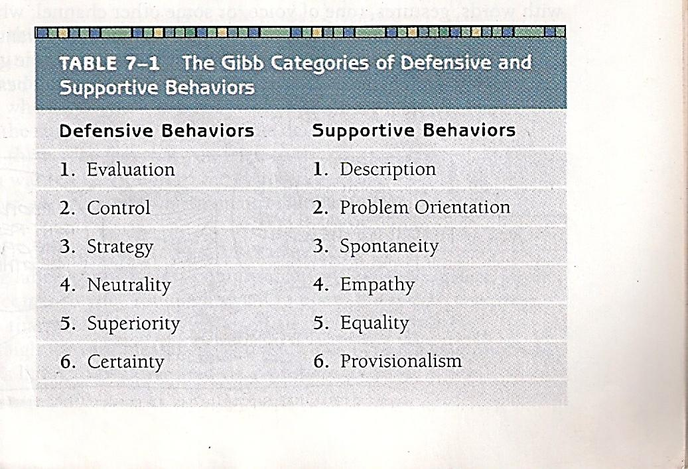
Creating Positive Communication Climates
Jack Gibb isolated six types of defense-arousing communication and six contrasting behaviors.
Source: Adler, R.B. & Rodmann, G. (2006) Understanding human communication. 9th edition. London: Oxford University Press.

Slide 26
Gibb categories
The contrasting defense-arousing versus actions aimed at reducing a threat, can create increasingly positive or negative climates.
  One challenge is evaluative communication, "you" language, against descriptive communication, "I" language.
  Another compares a controlling message versus problem orientation,
  and behavior manipulation strategy versus honest spontaneity.
  Neutrality indicates indifference, whereas empathy implies acceptance of feelings.
  Superiority triggers defensiveness, whereas equality signals worth;
  and certainty is unyielding, in contrast to provisionalism, which introduces and acknowledges practical considerations.

Slide 27
Methods of Conflict Resolution
Methods of Conflict Resolution
No matter what the relational style, gender, or culture of the participants, every conﬂict is a struggle to have one’s goals met.
Sometimes that struggle succeeds, and at other times it fails. In the remainder of this chapter we’ll look at various approaches to resolving conﬂicts and see which ones are most promising.

Slide 28
WIN–LOSE
Win–lose conﬂicts are ones in which one party achieves its goal at the expense of the other. People resort to this method of resolving disputes when they perceive a situation as being an “either-or” one: Either I get what I want, or you get your way.
The most clear-cut examples of win–lose situations are certain games, such as baseball or poker, in which the rules require a winner and a loser.
Power is the distinguishing characteristic in win–lose problem solving, because it is necessary to defeat an opponent to get what you want. The most obvious kind of power is physical.

Slide 29
LOSE–LOSE
In lose–lose problem solving, neither side is satisﬁed with the outcome. Although the name of this approach is so discouraging that it’s hard to imagine how anyone could willingly use it, in truth lose–lose is a fairly common way to handle conﬂicts.
In many instances the parties will both strive to be winners, but as a result of the struggle, both end up losers. On the international scene many wars illustrate this sad point.
On an interpersonal level the same principle holds true. Most of us have seen battles of pride in which both parties strike out and both suffer.

Slide 30
COMPROMISE
Unlike lose–lose out comes; a compromise gives both parties at least some of what they wanted, though both sacrifice part of their goals.
People usually settle for compromises when they see partial satisfaction as the best they can hope for.
Although a compromise may be better than losing every-thing, this approach hardly seems to deserve the positive image it has with some people.
For example, if a divorced couple compromise on child care by haggling over custody and then finally grudgingly agree to split the time with their children, it’s hard to say that anybody has won.

Slide 31
WIN–WIN
In Win–win problem solving, the goal is to find a solution that satisfies the needs of everyone involved. Not only do the parties avoid trying to win at the other’s expense, but also they believe that by working together it is possible to ﬁnd a solution that allows both to reach their goals.
Some compromises approach this win–win ideal. You and the seller might settle on a price for a used car that is between what the seller was asking and what you wanted to pay.
Although a win–win approach sounds ideal, it is not always possible, or even appropriate.

Slide 32
Conflict Management
  Conflict management in practice has guidelines to best approach win-win problem solving.
    Define your needs by deciding what you want or need.
    Share your needs with the other person when the time and place is suitable and you are at your best.
    Listen to the other person's needs.
      Generate possible solutions by brainstorming.
      Evaluate the possible solutions and choose the best one once all possibilities have been exhausted.
      Implement the solution.
      Follow up the solution to review the effects of the solution.

Slide 33
SUMMARY
This chapter explored several factors that help make interpersonal relationships satisfying or unsatisfying. We began by defining Conflict is an expressed struggle between at least two interdependent parties who perceive incompatible goals, scarce resources, and interference from the other party in achieving their goals.
  Expressed struggle captures the notion that conflict does not exist unless all the people involved know that the disagreement exists even if the expressed struggle is not verbalized.
  Perceived incompatible goals is a situation where it seems as if the goals of those involved are mutually exclusive, but that is not always the case, as mutually satisfying answers can be agreed upon.
  Perception of scarce resources occurs when people believe there are not enough resources, such as time, money, affection and space to go around.
  Interdependence is another feature that captures the notion that people in a conflict are dependent upon each other.
  Inevitability addresses that fact that conflicts are impossible to avoid; the challenge is to handle them effectively when they occur.

Slide 34
SUMMARY
The chapter continued by examining Communication climate, which is the emotional tone of a relationship as it is expressed in the messages being sent and received.
We examined types of confirming and disconfirming messages, and then looked in detail at Gibb’s categories of defensiveness-arousing and supportive behaviors. Then interpersonal conflict; we saw that conflict is a fact of life in every relationship and that the way conflicts are handled plays a major role in the quality of a relationship. We saw that conﬂict styles are affected by both gender and culture. There are four outcomes to conflicts: win–lose, lose–lose, compromise, and win–win. The ﬁnal section of the chapter outlined the steps in win–win problem solving.

Slide 35
THANK YOU
LECTURE 10
THE MAIN SOURCES OF REFERENCES: Adler, R.B. & Rodman, G. 2006. Understanding human communication. 9th edition. London: Oxford University Press.
Adler, R.B., Rosenfeld, L. B., and Proctor II, R. F. (2012) Interplay: The process of Interpersonal Communication 12th edition https://global.oup.com/us/companion.websites/9780199827428/student/chapt11/outline/ Accessed on October 23, 2021
Universalclass.com, Characteristics of Conflict in Communication https://www.universalclass.com/articles/writing/business-communication/conflict-resolution/the-characteristics-of-conflict-in-communication.htm#:~:text=According%20to%20research%2C%20conflict%20is,to%20be%20an%20expressed%20struggle. Accessed on October 23, 2021

