Slide 1
ENGLISH
PHONETICS AND PHONOLOGY
Week 1 – Chapter 1
Introduction to Phonetics and Phonology,
The Organs of Speech
Lecturer: Maria Dewi Rosari, M.Pd.

Slide 2
INTRODUCTION
AIM OF THE COURSE
WEEK 1 – LEARNING OBJECTIVES
For advanced learners of English
For those who are interested in AE (American English)
For those who are non-native speakers
What is phonetics?
What makes phonetics different from phonology?
Speech organs

Slide 3
1.1. Phonetics – The Sounds of Language
When you know a language → you know the sounds of that language + you know how to combine those sounds into words.
When you know English → you know English sounds that are represented by the letters s, b, and u. You know they can make up the words sub and bus.
Languages contain different sounds that constitute a class of sounds that the human vocal tract is designed to make.
Notes:
Phonetics. It is defined as the study of sounds of language.
When you know a language … → asking students to repeat the question, asking students to find other three letters and try to make one word out of them
When you know English….
Although languages may contain different sounds, the sounds of all the languages of the world together constitute a class of sounds that the human vocal tract is designed to make. This chapter will discuss these speech sounds, how they are produced, and how they may be classified.

Slide 4

1.2. Phonetics – Sound Segments
The person in the picture spelled the words incorrectly. Which one do you think the right spelling?
KEEP OUT
KEE POUT
Notes:
The title
Imagine someone asking you to make a board sign with the words “KEEP OUT” on it. How will you write those words?
Discuss the picture
Discuss how can someone know the spelling of those words?

Slide 5
1.2. Phonetics – Sound Segments
The study of speech sounds is called phonetics.
Describing speech sounds → knowing individual sound + how each of them is different from others.
For example, in the word bus, we know that it is pronounced in a continuous sound. Yet, we also know that there are three individual pieces of sounds inside it.
That being said, if someone speaks English, he can separate keepout into two words: keep and out, not kee and pout.
Notes:
Read poin 1 and 2
Discuss a bit about the one in the picture.
This is not as easy as it may seem, for when we speak, the sounds seem to run together and it isn’t at all obvious where one sound ends and the next begins. But when we know the language being spoken, we hear the individual sounds in our “mind’s ear” and are able to make sense of them, unlike the sign painter in the cartoon.
A speaker of English will know that there are 3 sounds in the word bus, yet physically the word is just one continuous sound. When we are able to identify the elements in a continuous sound, it means we are able to segment that continuous sound into individual pieces because we know the language, we know English.

Slide 6
1.2. Phonetics – Sound Segments (cont.)
The sound of someone clearing throat will not be segmented into an individual sound because we know that such sound is not speech.
Let’s practice! Listen to your professor and spell the words! Do not click the slide because it will reveal the answers!
ACTOR | 4. CARRY | 7. DINNER
2. BAG | 5. CAT | 8. EVEN
3. BLOOD | 6. COFFEE | 9. FINISH

Slide 7
1.2. Phonetics – Sound Segments (cont.)
In addition to being able to identify the individual pieces of sound, it is also important to be able to break between words sounded.
Some phrases and sentences are clearly different when printed but they may be ambiguous when spoken.
See the following example:
Now, it is time for practice. Listen to your lecturer and write down the two English words you hear. Do not click the slide because it will reveal the answers!
I SCREAM | ICE CREAM
THE SUN’S RAYS MEET | THE SONS RAISE MEAT
GRADE A | GRAY DAY

Slide 8
1.2. Phonetics – Sound Segments (cont.)
Sometimes spoken words come with lack of breaks. This creates confusion to non-native English speakers.
However, if you know the language:
No difficulty of segmenting the continuous sounds of speech
Know how to segment sentences into words
Know how to segment words into sounds
Example: You can write down the lyrics of an English rap song.

Slide 9
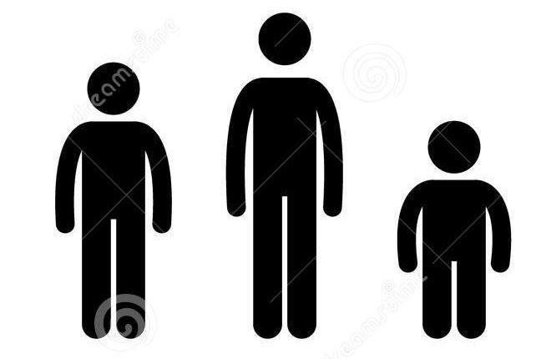
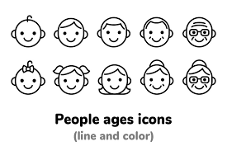
1.3. Phonetics – Speech Sounds, Like Snowflakes
The ability to understand the individual words in an utterance when being given the continuity of speech signal is truly amazing.
It is even more amazing knowing that no two speakers ever say the same word identically. For example, the pronunciation of cat.
The different sound production is caused by:
People’s size
People’s age
People’s gender

Slide 10
1.3. Phonetics – Speech Sounds, Like Snowflakes (cont.)
Our knowledge of a language determines when we judge physically different sounds to be the same.
Our knowledge of a language also tells us which sounds are linguistically important and which ones are not.
See the following example:
Our linguistic knowledge makes us possible to ignore nonlinguistic differences in speech.
Can you mention other nonlinguistic sounds that may appear in a conversation?
How are you? | How (sneeze) are you?

Slide 11
1.4. Phonetics – The Phonetic Alphabet
We need to be able to differentiate between sound of language and orthography (spelling).
Phonetics is a science. To be scientific, we must find a way for the same sound to be spelled with the same letter every time it is used. We also need a way to make sure the same letter to be sounded the same every time.
Our Roman alphabet is not enough for that task. See the following example:
Did he believe that Caesar could see the people seize the seas?
The silly amoeba stole the key to the machine.

Slide 12
1.4. Phonetics – The Phonetic Alphabet (cont.)
Our Roman alphabet is inadequate for carrying out the task. See the following example:
The same sound is represented variously by e, ie, ae, ee, eo, ei, ea, y, oe, ey, and i.
On the other hand, check another sentence below:
The letter a represents the various sounds in father, wanted, many, and others.
Did he believe that Caesar could see the people seize the seas?
The silly amoeba stole the key to the machine.
My father wanted many a village dame badly.

Slide 13
1.4. Phonetics – The Phonetic Alphabet (cont.)
Other things to show that our Roman alphabet is inadequate to represent all sounds consistently is shown in the next cases below:
Some words have a combination of letters that sometimes represent a single sound:
Also, some words contain of some letters that have no sound at all (silent letters):
Shoot | Thomas
Theater | Rough
Plain | Coat
Honest | Knot
Psychology | Knife
Hole | Hour

Slide 14
1.4. Phonetics – The Phonetic Alphabet (cont.)
This then leads to the need of inventing a phonetic alphabet. It is an alphabet that can guarantee one sound = one symbol correspondence.
We call the alphabet as INTERNATIONAL PHONETIC ALPHABET (IPA). It consists of ORDINARY LETTERS and INVENTED SYMBOLS, all of which to represent the sounds across all languages in the world.
See the table of phonetic alphabet taken from Fromkin, Rodman, and Hyams’ (2019) book entitled An Introduction to Language in the next slide.

Slide 15
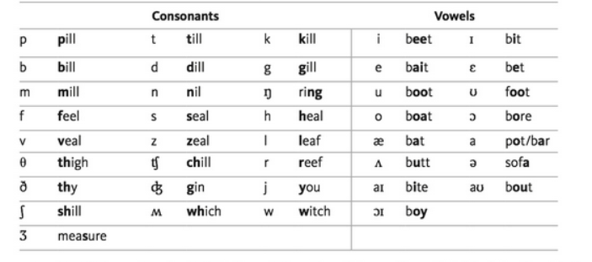
1.4. Phonetics – The Phonetic Alphabet (cont.)
Taken from: Fromkin, Rodman, and Hyams’ (2019) An Introduction to Language page 187.

Slide 16
1.4. Phonetics – The Phonetic Alphabet (cont.)
Taken from: Fromkin, Rodman, and Hyams’ (2019) An Introduction to Language page 187.

Slide 17
1.4. Phonetics – The Phonetic Alphabet (cont.)
Now, can you write down the phonetic transcription for the following English words? You have 2 minutes to complete the exercise.
Reader
Book
Tough
Though
Fine
Seal
You are allowed to go to the next slide once you have completed the exercise. Find the answer key in the next slide!

Slide 18
1.4. Phonetics – The Phonetic Alphabet (cont.)
Now, check your answer! How many correct answers did you get? ☺
– THE ANSWER KEY
Reader
Book
Tough
Though
Fine
Seal
/ˈriːdɚ/
/bʊk/
/tʌf/
/ðoʊ/
/faɪn/
/siːl/

Slide 19
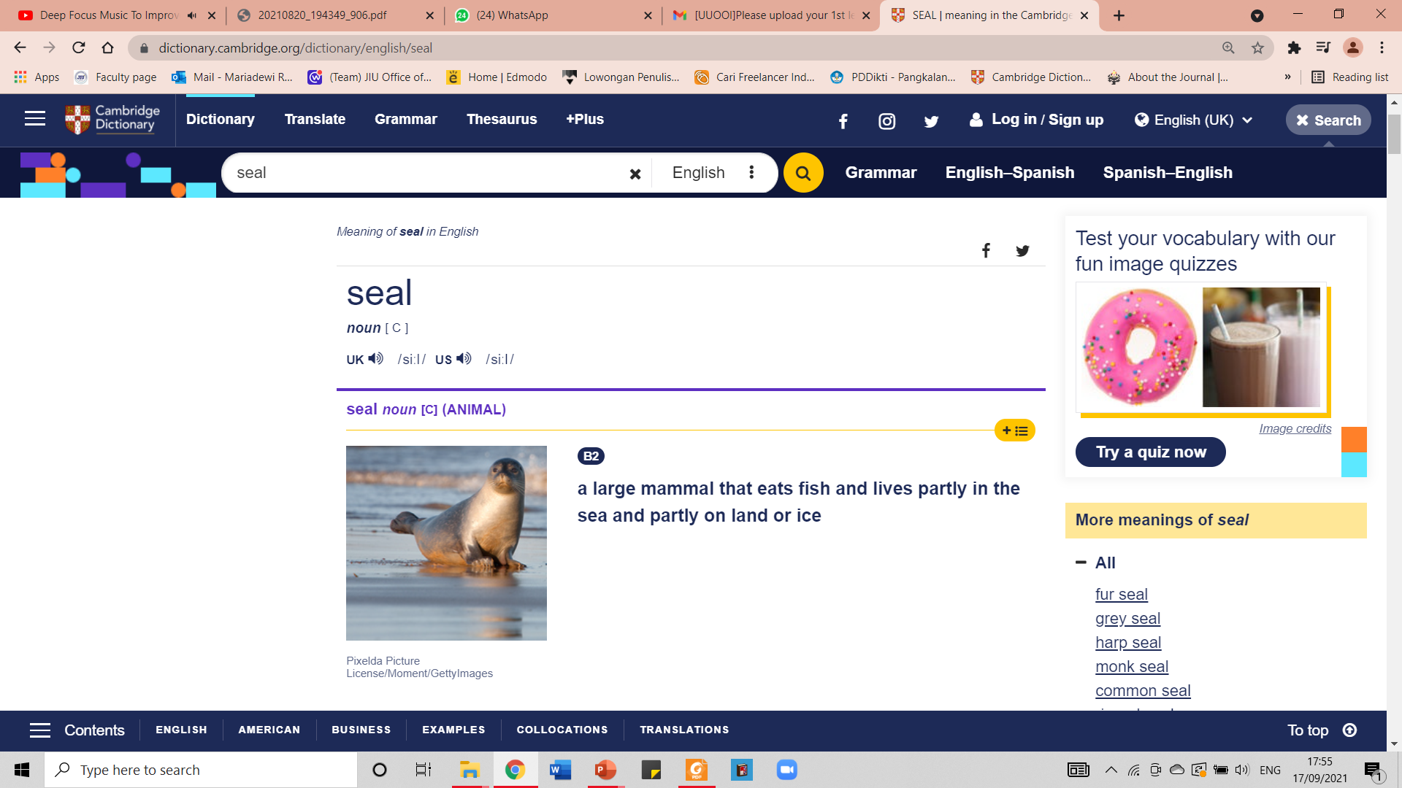
1.4. Phonetics – The Phonetic Alphabet (cont.)
TIPS: You can always find the right phonetic transcription of English words in dictionary. For instance, check Cambridge Dictionary below:
Phonetic Transcription of the word

Slide 20
2.1. Phonetics vs Phonology
Having learned the previous materials, you may question: “So, what is phonetics? What makes it different from phonology? How do they relate to each other?”
Phonetics | Phonology
The study of the speech sounds. For example, it studies the characteristics of the speech sound. It is made of symbols | It is the description of the systems and patterns of speech sounds in a language. It is the rules that every speaker of a language knows about the patterns of that language, unconsciously. An example of one such rule would be the understanding that the words “eighth” and “butter” both have the letter [t], but they are pronounced differently based on the other letters around them.

Slide 21
2.1. Phonetics vs Phonology
Phonetics deals more with the study of the sounds without knowledge of the language spoken while phonology is more about the patterns of sounds and the rules that are unconsciously internalized by the speakers of the language.
Here is a chart to make the difference between them clearer:
PHONETICS versus PHONOLOGY
Phonetics is descriptive language. | Phonology is theoretical linguistics.
Phonetics studies the production, transmission, reception of sound. | Phonology studies different patterns of sounds in different languages.
Phonetics does not study one specific language. | Phonology studies one specific language.

Slide 22
2.1. Phonetics vs Phonology
Phonetics deals more with the study of the sounds without knowledge of the language spoken while phonology is more about the patterns of sounds and the rules that are unconsciously internalized by the speakers of the language.
Here is a chart to make the difference between them clearer:
PHONETICS versus PHONOLOGY
Phonetics is descriptive language. | Phonology is theoretical linguistics.
Phonetics studies the production, transmission, reception of sound. | Phonology studies different patterns of sounds in different languages.
Phonetics does not study one specific language. | Phonology studies one specific language.

Slide 23
2.2. REVIEW
Before we go to the next section of this lesson, please review the materials that have been learned so far. Answer the following questions based on what you understand about phonetics and phonology. The answer key is provided in the next slide so do not proceed to the next slide before you complete the exercise. Good luck!
How do you define phonetics?
Mention 3 factors that influence different sound production among English speakers!
What are the examples of non-linguistics sound that usually occur in spoken language/conversation?
Since our Roman alphabet is not able to represent all sounds consistently, what kind of device that can guarantee one sound is for one symbol correspondence?
Write down the phonetic symbol for the letters below:
The “ng” in ring.
The “oy” in boy
The “o” in bore
How is phonetics different from phonology?

Slide 24
2.2. REVIEW – ANSWER KEY
How do you define phonetics?
Phonetics is the study of speech sound. For example, it studies the characteristics of speech sound.
Mention 3 factors that influence different sound production among English speakers!
People’s size, age, and gender.
What are the examples of non-linguistics sound that usually occur in spoken language/conversation?
Sneezing, coughing, the sound of “tsk!”
Since our Roman alphabet is not able to represent all sounds consistently, what kind of device that can guarantee one sound is for one symbol correspondence?
IPA or International Phonetics Alphabet
Write down the phonetic symbol for the letters below:
The “ng” in ring /ŋ/
The “oy” in boy /ɔɪ/
The “o” in bore /ɔː/
How is phonetics different from phonology?
Phonetics is descriptive linguistics, while phonology is theoretical one. Phonetics does not study one specific language only, while phonology studies one specific language.

Slide 25
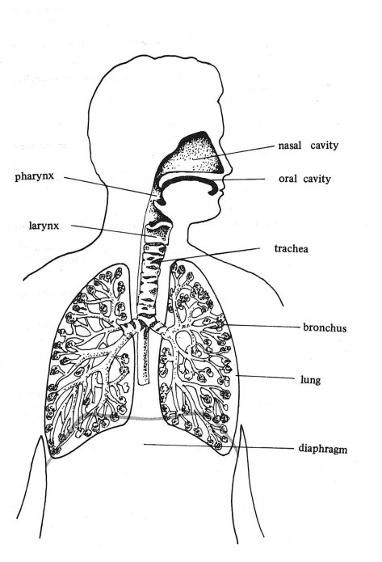
3.1. ORGANS OF SPEECH – WHAT IS IT?
Organs of speech or speech organs refers to the various organs human use to produce speech sounds. See the picture on the left side! Can you identify those organs of speech of yours?
There are systems that divides organs of speech into three groups:
The respiratory
The phonatory
The articulatory
Understanding organs of speech = learning phonetics and phonology better and easier
Taken from American English Pronunciation
Book of Bauer et al., (1980)

Slide 26
3.2. ORGANS OF SPEECH – THE RESPIRATORY SYSTEM
The first system dividing speech organs is the respiratory system.
There are three speech organs belong to this group:
Trachea or the wind-pipe
The bronchus
The lung
The lungs can be compared with a pair of bellows. Lungs can force air stream through the other two systems, where it can be modified to produce the speech sounds.
In several languages, however, there are certain segments produced without utilizing air flow from the lungs. The example for this is the production of sound usually written tut tut or tsk tsk in English.
Taken from American English Pronunciation
Book of Bauer et al., (1980)

Slide 27
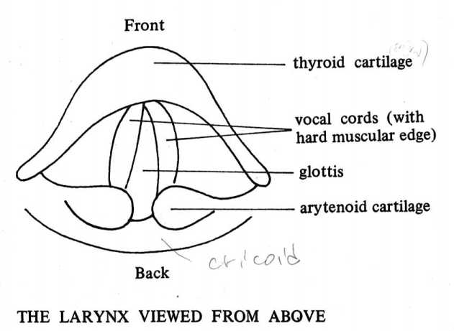
3.3. ORGANS OF SPEECH – THE PHONATORY SYSTEM
The second system dividing speech organs is the phonatory system.
The speech organ that belong to this system is the larynx or Adam’s apple.
Larynx → a box of cartilage consisting of 2 small muscles. They are called vocal cords.
The space between the vocal cords is named glottis.
Taken from American English Pronunciation
Book of Bauer et al., (1980)

Slide 28
3.4. ORGANS OF SPEECH – THE ARTICULATORY SYSTEM
The third system dividing speech organs is the articulatory system.
There are three speech organs belong to this group:
The pharynx
The oral cavity (mouth)
The nasal cavity (nose)
There are a lot of organs inside each of them. Can you mention speech organs in your mouth?

Slide 29
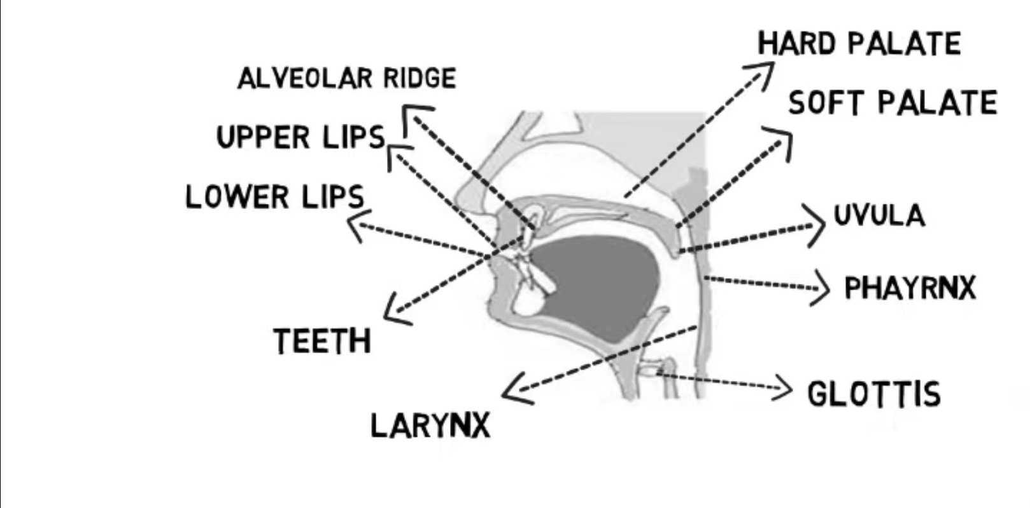
HARD PALATE
ALVEOLAR RIDGE
SOFT PALATE
UPPER LIPS
LOWER LIPS
UVULA
PHARYNX
TEETH
GLOTTIS
LARYNX
SEE THE PICTURE AND TRY TO GUESS THE NAME OF THE SPEECH ORGANS!

Slide 30

3.4.1. ORGANS OF SPEECH – LIPS
The two lips serve for creating different sounds:
Labial
Bilabial
Now, try producing the sounds of the following letters:
/p/ /b/ /m/

Slide 31
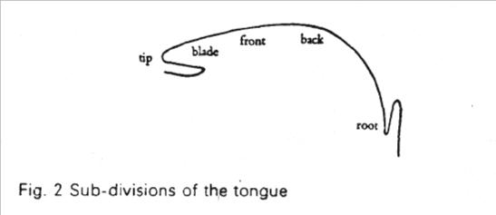
3.4.2. ORGANS OF SPEECH – TONGUE
It is the most important articulator in the organs of speech.
It moves in different ways in different shapes to produce the sounds of speech.
Tongue is divided into five parts:
Tip
Blade
Front
Back
Root
The sub-divisions of the tongue.

Slide 32
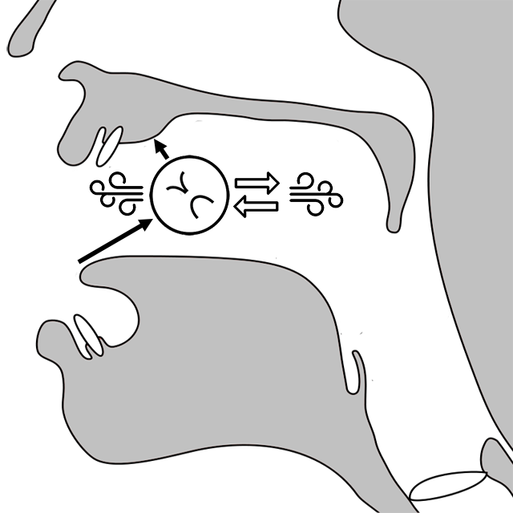
3.4.3. ORGANS OF SPEECH – ALVEOLAR RIDGE
It includes the area between the upper front teeth and the hard palate.
To produce alveolar consonant sounds.
Now, try producing the sounds of the following letters:
/l/ /n/ /s/ /z/

Slide 33

3.4.4. ORGANS OF SPEECH – HARD PALATE
It is the horizontal bony plate of the skull located in the mouth roof.
The interaction between the tongue and the hard palate is important in the production of certain speech sounds.
Now, try producing the sounds of the following letters:
/t/ /d/ /j/

Slide 34
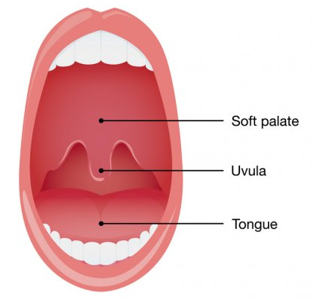
3.4.4. ORGANS OF SPEECH – SOFT PALATE
It is also known as velum.
It should have holes forming that function during speech to separate the oral cavity (mouth) from the nasal one (nose).
It is used to produce the oral speech sounds.

Slide 35
3.5. REVIEW
Please answer the following questions to review what you have learned about organs of speech. Do not go to the next slide before you completely answer all of them.
What is organs of speech?
Mention 3 systems that divide speech organs!
Trachea, bronchus, and lung belong to which system of speech organ?
Larynx belongs to which system of speech organ?
Where can we find vocal cords in phonatory system?
The space between our vocal cords is named…
Oral cavity or mouth and nasal cavity or nose belong to which system of speech organ?
Mention at least 5 speech organs inside our oral cavity!
What is the most essential organ of speech in our oral cavity?
Mention two sounds that need the role of both of our lips to be produced!

Slide 36
3.5. REVIEW
Please answer the following questions to review what you have learned about organs of speech. Do not go to the next slide before you completely answer all of them.
What is organs of speech?
The various organs human use to produce speech sounds.
Mention 3 systems that divide speech organs!
The respiratory, the phonatory, the articulatory
Trachea, bronchus, and lung belong to which system of speech organ?
The respiratory system
Larynx belongs to which system of speech organ?
The phonatory system
Where can we find vocal cords in phonatory system?
In Larynx or in the box of cartilage that consist of two small muscles
The space between our vocal cords is named…
Glottis
Oral cavity or mouth and nasal cavity or nose belong to which system of speech organ?
The articulatory system
Mention at least 5 speech organs inside our oral cavity!
Upper lips, lower lips, tongue, hard palate, soft palate
What is the most essential organ of speech in our oral cavity?
Tongue
Mention two sounds that need the role of both of our lips to be produced!
/p/ /m/

Slide 37
REFERENCES
Fromkin V., Rodman R., & Hyams N. (2019). An introduction to language. Boston: Cengage. Page 184 – 186
Bauer L., Dienhart M. J., Hartvigson H., & Jakobsen L. (1980). American English pronunciation. Copenhagen: Gyldendal. Page 5 – 7.

Slide 38
PICTURE SOURCES ON EACH SLIDE
Slide 9:
https://thumbs.dreamstime.com/z/man-body-figure-size-icon-26971683.jpg
https://creativemarket.com/irmirx/3110878-People-ages-icons
Slide 30: https://thumbs.dreamstime.com/z/pop-art-comic-lips-cartoon-mouth-woman-smiling-pop-art-comic-cartoon-black-white-149103477.jpg
Slide 31: https://studfile.net/html/2706/1262/html_uEvLkcnGsa.BltQ/htmlconvd-g7xiM074x1.jpg
Slide 32: https://bzzktt.com/wp-content/uploads/2018/05/alveolar-fricative-location-1.png
Slide 33:
https://icons.biorender.com/w200xh253/5d1f459c09f8320400b7f4e0/20190705124259/image/dentition-permanent-upper-schematic.png
Slide 34:
https://st2.depositphotos.com/4293685/9916/v/600/depositphotos_99164658-stock-illustration-top-view-of-upper-airway.jpg

