Slide 1
ENGLISH
PHONETICS AND PHONOLOGY
Week 3 – Chapter 3
Consonants: General Section
Lecturer: Maria Dewi Rosari, M.Pd.

Slide 2
INTRODUCTION
AIM OF THE COURSE
WEEK 3 – LEARNING OBJECTIVES
For advanced learners of English
For those who are interested in AE (American English)
For those who are non-native speakers
Consonant Inventory
Manner of Articulation of Consonants
Place of Articulation of Consonants
Force of Articulation
How to Describe a Consonant
Comparison with British English

Slide 3
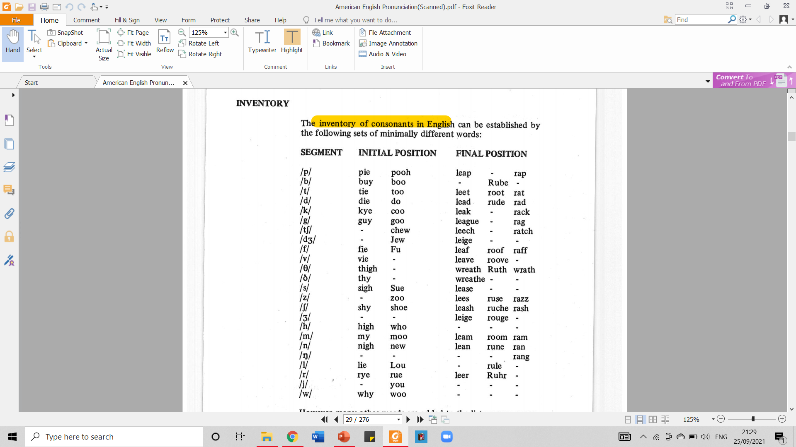
1.1. Inventory
The inventory of consonants in English can be established by the following sets of minimally different words:
We can provide the missing contrast by adding such pairs as cheer/veer for initial position and lab/lack for final position., i.e. by adding environments not used in the chart.
Taken from American English Pronunciation
Book of Bauer et al., (1980)

Slide 4

1.2. Inventory (cont.) – Written Exercise
Let’s have some practice! Please write the phonetic symbol of the consonants printed in bold of the following words.
The answer key is on the next slide.
Pain
Whole
Shout
Edge
Though
Though
Shoes
Bank
Chain
Seed
Jug
Tooth
Fever
Rain
Thumb

Slide 5
1.1. Inventory (cont.) –
Written Exercise
THE ANSWER KEY
Pain
Whole
Shout
Edge
Though
Though
Shoes
Bank
Chain
Seed
Jug
Tooth
Fever
Rain
Thumb
THE ANSWER KEY
/p/
/l/
/ʃ/
/dʒ/
/ð/
-
/z/
/ŋk/
/tʃ/
/d/
/dʒ/
/Ɵ/
/f/
/r/
/Ɵ/
Taken from American English Pronunciation
Book of Bauer et al., (1980)

Slide 6
1.3. Inventory (cont.) – Spoken Exercise
Listen to the words spoken by your professor. Then guess which phonetic symbol is right for the consonant specified in each number. Choose (a) or (b). The answer key is on the next slide!
No | a | b
1 | /p/ | /b/
2 | /d/ | /t/
3 | /tʃ/ | /dʒ/
4 | /f/ | /v/
5 | /l/ | /r/
6 | /s/ | /ʃ/
7 | /m/ | /n/
8 | /w/ | /v/
9 | /g/ | /k/
10 | /j/ | /dʒ/

Slide 7
1.3. Inventory (cont.) – Spoken Exercise – Answer Key
Listen to the words spoken by your professor. Then guess which phonetic symbol is right for the consonant specified in each number. Choose (a) or (b). The correct answer is shown in the red cells.
No | Word | a | b
1 | Pill | /p/ | /b/
2 | To | /d/ | /t/
3 | Chew | /tʃ/ | /dʒ/
4 | Vision | /f/ | /v/
5 | Lie | /l/ | /r/
6 | Ship | /s/ | /ʃ/
7 | New | /m/ | /n/
8 | Wave | /w/ | /v/
9 | Guy | /g/ | /k/
10 | John | /j/ | /dʒ/

Slide 8





2.1. Manner of Articulation of Consonant
One of the ways to classify consonant is by taking a look at the manner of articulation.
What does it mean by manner of articulation?
Consonants are subdivided according to the ways in which they are articulated.
Based on the manner of articulation, consonants are divided into:
Fricative
Consonant
Nasal
Consonant
Lateral
Consonant
Approximant
Consonant
Stop Consonant

Slide 9
2.1. Manner of Articulation of Consonant (cont.)
All those five consonants can be classified into two big groups: OBSTRUENT and SONORANTS.
Take a look at the following diagram to see their differences:
CONSONANTS
OBSTRUENTS
SONORANTS
Fricative
Consonant
Nasal
Consonant
Lateral
Consonant
Approximant
Consonant
Stop Consonant

Slide 10
2.1.1. Manner of Articulation of Consonant - Obstruent
Obstruent consonants are formed by obstructing airflow.
Obstruent consonants are divided into STOP AND FRICATIVE CONSONANTS.
Consonants in which the airstream is completely interrupted.
OBSTRUENTS
blocked
Consonants in which the air is forced through a stricture of close approximation.
Fricative
Consonant
Constricted,
creates friction
Stop Consonant

Slide 11
2.1.1. Manner of Articulation of Consonant – Obstruent (cont.)
Constricted,
creates friction
blocked
In producing STOPS, the airflow is not continuous.
The airflow stops for a while and is released.
These are /p, t, k, b, d, g, dʒ/
In producing FRICATIVES, there is a stricture which is so narrow as to give rise to audible friction.
The airflow is continuous without being stopped.
These are /f, Ɵ, s, ʃ, v, ð, z, ʒ/

Slide 12
2.1.2. Manner of Articulation of Consonant - Fricatives
Consonants which are neither stops nor fricatives are called SONORANTS.
Obstruent consonants are divided into NASAL, LATERAL, AND APPROXIMANT CONSONANTS.
Consonants formed with a complete closure in the oral cavity
SONORANTS
Consonants formed with the tip/blade of tongue makes firm contact with the alveolar ridge but with one or both sides of the tongue lowered so as to allow the air from lungs to escape
Nasal
Consonant
Lateral
Consonant
Approximant
Consonant
Consonants formed with a stricture of open approximation (i.e. a stricture which is not narrow enough to give rise to audible friction)

Slide 13
2.1.2. Manner of Articulation of Consonant – Fricatives (cont.)
front
front
airflow
airflow
tongue
When produced, soft palate is lowered so that the air coming from the lungs escapes unhindered through the nasal cavity.
These are /m, n, ŋ/
tongue
The tip/blade of tongue touches alveolar ridge
One/both tongue sides lowered to allow the air from the lung escapes.
This is /l/.
The air from the lung escape over the center of the tongue
These are /r, j, w/

Slide 14
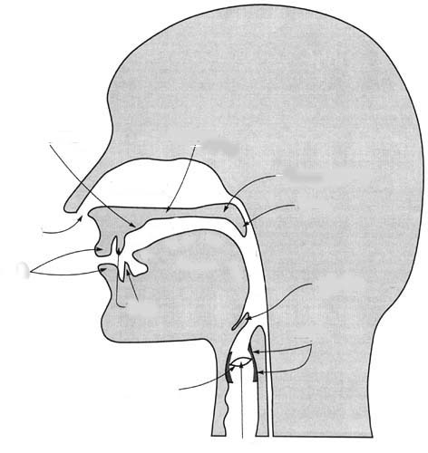
3.1. Place of Articulation of Consonants
Consonants can be articulated at any point along the upper surface of the oral cavity.
The point of this upper surface involved in the articulation of a consonant is called → PASSIVE ARTICULATOR (‘passive’ because it does not move)
The organ which is moved towards the passive articulator in producing a consonant is called → ACTIVE ARTICULATOR.
Can you mention what speech organs belong to passive
and active articulators? ☺

Slide 15
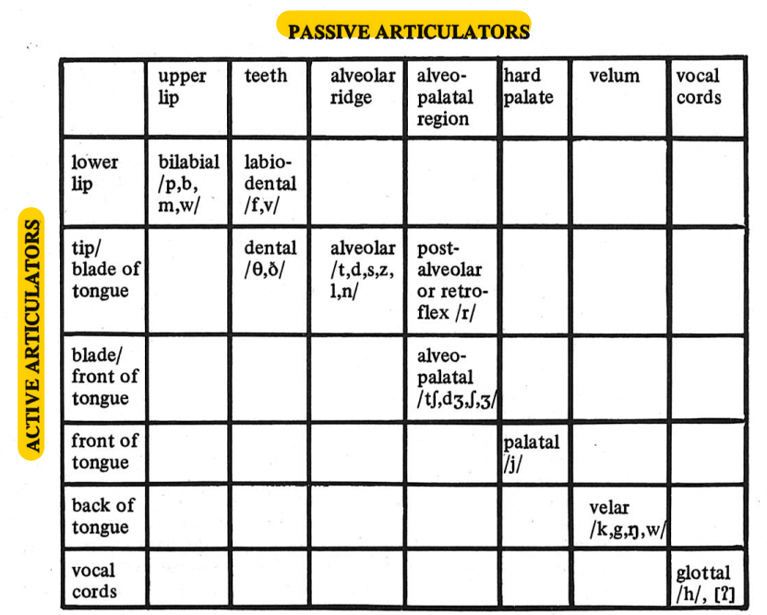
3.1. Place of Articulation of Consonants (cont.)
Classifying consonants based on their place of articulation means → analyzing their passive and active articulators.
Check the following chart to see the classification of consonants based on their place of articulation.
Let’s analyze each of the classification in details!
Taken from American English Pronunciation Book of Bauer et al., (1980)

Slide 16


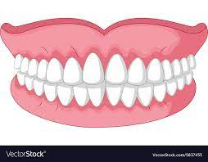
3.1. Place of Articulation of Consonants (cont.)
Bilabial consonants
Labiodental consonants
Dental consonants
PA: Upper lip
AA: Lower lip
/p, b, m, w/
PA: Front incisors / front teeth
AA: Lower lip and tongue tip/blade
/f, v/
PA: Front incisors / front teeth
AA: Lower lip and tongue tip/blade
/Ɵ, ð/

Slide 17
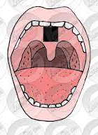
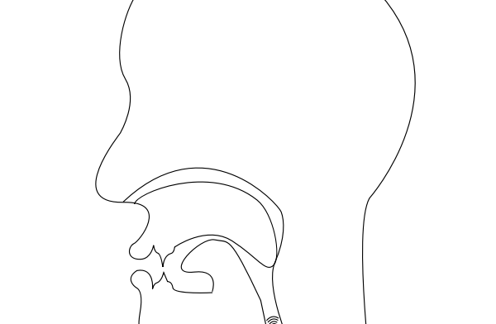
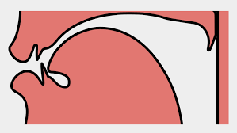
3.1. Place of Articulation of Consonants (cont.)
Post-alveolar/retroflex
consonants
Alveo-palatal consonants
Alveolar consonants
PA: Alveolar ridge
AA: Tongue tip/blade
/t, d, s, z, n, l/
PA: Area behind alveolar ridge
AA: Tip of the tongue
/r/
PA: Hard palate
AA: Tongue tip/blade along with the anterior part of the front of the tongue
/tʃ, dʒ, ʃ, ʒ/

Slide 18
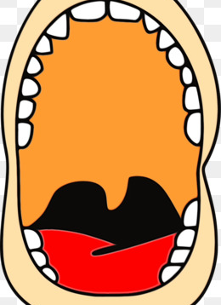
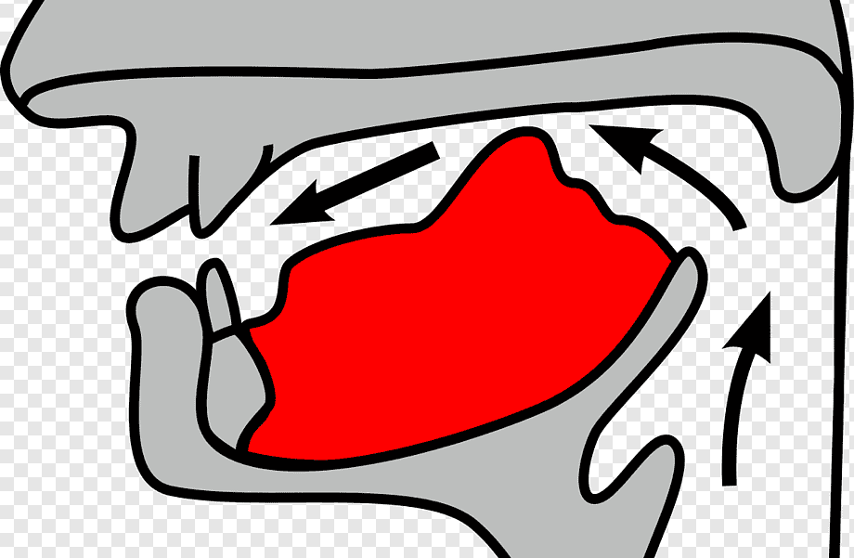
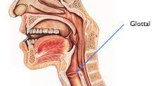
3.1. Place of Articulation of Consonants (cont.)
Velar consonants
Glottal consonants
Palatal consonants
PA: Hard palate
AA: Front of the tongue
/j/
PA: Velum
AA: Back of the tongue
/k, g, ŋ, w/
PA and AA: The vocal cords
/h/

Slide 19
3.2. REVIEW
Please group the following articulators into passive articulators and active articulators. The answer key is provided on the next slide.
Velum
Back of tongue
Hard palate
Front of tongue
Hard palate
Blade/front of tongue
Alveo-palatal region
Tip/blade of tongue
Alveolar ridge
Lower lip
Teeth
Upper lip
++ What is one speech organ that can function as both active and passive articulators?

Slide 20
3.3. REVIEW – ANSWER KEY
Please group the following articulators into passive articulators and active articulators. The answer key is provided on the next slide.
Velum
Back of tongue
Hard palate
Front of tongue
Hard palate
Blade/front of tongue
Alveo-palatal region
Tip/blade of tongue
Alveolar ridge
Lower lip
Teeth
Upper lip
PASSIVE ARTICULATORS | ACTIVE ARTICULATORS
1, 3, 7, 9, 11, 12 | 2, 4, 6, 8, 10
++ What is one speech organ that can function as both active and passive articulators?
The speech organ that can be both active and passive articulators is vocal cords.

Slide 21
4.1. FORCE OF ARTICULATION
The obstruent of English are divided into two groups according to their force of articulation.
This phonetic nature of “force of articulation” is still considered as a vague concept. There are several factors influencing this.
FORTIS CONSONANTS | LENIS CONSONANTS
Characterized by a relatively strong force of articulation | Characterized by a relatively weak force of articulation
/p, t, k, tʃ, f, Ɵ, s, ʃ/ | /b, d, g, dʒ, v, ð, z, ʒ/
The fortis and lenis distinction does not apply to the obstruent /h/ or to the sonorants.

Slide 22

4.1. FORCE OF ARTICULATION (cont.)
It has been suggested that various factors might play a role. These include:
Pressure with which the active articulator presses against the passive articulator in stop consonants;
Area of contact between the active and passive articulators;
Air-pressure inside the mouth during the articulation of the segment;
Duration of the segment.

Slide 23
4.1. FORCE OF ARTICULATION (cont.)
Fortis consonants, it is claimed, would show:
greater muscular pressure
greater air-pressure, wider area of contact, and longer duration of the segment
…compared to the corresponding lenis consonants.
Unfortunately, however, the evidence on these factors is extremely inconsistent, and no clear correlations can be set up.
Nevertheless, the vague notion of “force of articulation” is pedagogically useful, and is retained here.

Slide 24
5.1. HOW TO DESCRIBE A CONSONANT
An English consonant can be uniquely identified by naming its:
By this method, /p/ for example, can be classified as a:
Also, by this method, /v/ can be classified as a:
FORCE OF ARTICULATION
(where relevant)
PLACE OF ARTICULATION
MANNER OF ARTICULATION
FORTIS
BILABIAL
STOP
LENIS
LABIO-DENTAL
FRICATIVE

Slide 25
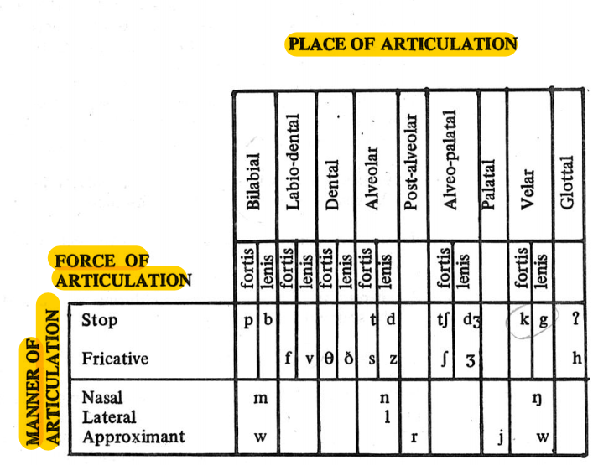
5.1. HOW TO DESCRIBE A CONSONANT (cont.)
See the following table for easily classifying an English consonant:
Taken from American English Pronunciation Book of Bauer et al., (1980)

Slide 26
5.2. HOW TO DESCRIBE A CONSONANT (cont.) - PRACTICE
Please describe the following consonants like the examples given on the previous slide. Remember that you have to describe the consonants by naming their force of articulation, place of articulation, and manner of articulation. You may take a look at the table on the previous slide to help you complete this exercise. The answer key is provided on the next slide.
/Ɵ/
/d/
/tʃ/
/j/
/ð/
/b/

Slide 27
5.3. HOW TO DESCRIBE A CONSONANT (cont.) – PRACTICE – ANSWER KEY
Please describe the following consonants like the examples given on the previous slide. Remember that you have to describe the consonants by naming their force of articulation, place of articulation, and manner of articulation. You may take a look at the table on the previous slide to help you complete this exercise. The answer key is provided on the next slide.
/Ɵ/
/d/
/tʃ/
/j/
/ð/
/b/
A fortis dental fricative
A lenis alveolar stop
A fortis alveo-palatal stop
A palatal approximant
A lenis dental fricative
A lenis bilabial stop

Slide 28

6.1. COMPARISON WITH BRITISH ENGLISH
The number of consonant phonemes is the same in AE and BE.
The differences
Distribution of /r, j/
Distribution of most other consonants
Articulations of /r, l/ and of /t/ in some positions

Slide 29
7.1. REVIEW
Please answer the following questions to review what you have learned about Consonants in General Section. Do not go to the next slide before you completely answer all of them.
Based on the manner of articulation, what are the classification of consonants? Mention the 5 divisions!
What makes obstruent consonants different from fricatives?
Consonants that are formed with a complete closure in the oral cavity is named… Mention the examples of this type of consonants!
Please explain the difference of how air from the lung escapes to our mouth in lateral and approximant!
Mention 2 passive articulators and 2 active articulators!
Group the following consonants into the right groups based on their place of articulation: /f, Ɵ, b, m, ð, r, ʃ, d, h, ŋ, j/
What makes fortis consonants different from the lenis ones?
Mention at least two factors that influence the strength of force of articulation!
Please describe the following consonants by naming its force of articulation, place of articulation, and manner of articulation! The consonants: /p/ and /r/.
Mention at least two things that make some phonemes in AE different from the ones in BE!

Slide 30
7.2. REVIEW – ANSWER KEY
Please answer the following questions to review what you have learned about Consonants in General Section. Do not go to the next slide before you completely answer all of them.
Based on the manner of articulation, what are the classification of consonants? Mention the 5 divisions!
Stop consonants, fricative consonants, nasal consonants, lateral consonants, and approximant consonants
What makes obstruent consonants different from fricatives?
Obstruent consonants are produced with formed by obstructing airflow, while sonorants are produced with a continuity of resonant sound. In sonorants sounds have no such obstructions so the sound resonates.
Consonants that are formed with a complete closure in the oral cavity is named… Mention the examples of this type of consonants!
It is called nasal. These are /m, n, ŋ/
Please explain the difference of how air from the lung escapes to our mouth in lateral and approximant!
In lateral, the tip/blade of tongue touches alveolar ridge and one/both tongue sides lowered to allow the air from lung escapes from the sides of the tongue. Meanwhile, in approximants, the air from the lung escape over the center of the tongue.
Mention 2 passive articulators and 2 active articulators!
PA: upper lip, teeth AA: tongue, lower lip

Slide 31
7.2. REVIEW – ANSWER KEY (cont.)
Please answer the following questions to review what you have learned about Consonants in General Section. Do not go to the next slide before you completely answer all of them.
Group the following consonants into the right groups based on their place of articulation: /f, Ɵ, b, m, ð, r, ʃ, d, h, ŋ, j/
Bilabial: /b, m/, Labiodental: /f/, Dental: /Ɵ, ð/, Alveolar: /d/, Alveo-palatal: /ʃ/, Palatal: /j/, Velar: /ŋ/, Glottal: /h/, Retroflex: /r/
What makes fortis consonants different from the lenis ones?
It is due to the strength of force of articulation. Fortis has a relatively strong force of articulation, while lenis has a relatively weak force of articulation.
Mention at least two factors that influence the strength of force of articulation!
They are pressure with which the active articulator presses against the passive one, area of contact between active and passive articulator, and duration of segment.
Please describe the following consonants by naming its force of articulation, place of articulation, and manner of articulation! The consonants: /p/ and /r/.
/p/ is a fortis bilabial stop and /r/ is a post-palatal approximant.
Mention at least two things that make some phonemes in AE different from the ones in BE!
The differences can come from the distribution of /r, j/ and the distribution of most other consonants as well as the articulations of /r, l/

Slide 32
REFERENCES
Bauer L., Dienhart M. J., Hartvigson H., & Jakobsen L. (1980). American English pronunciation. Copenhagen: Gyldendal. Page 19 – 24.

Slide 33
PICTURE SOURCE
Slide 4: https://www.crushpixel.com/static18/preview2/stock-photo-phonetic-transcription-rgb-color-icon-3056505.jpg
Stop consonant icon: https://png.pngtree.com/png-vector/20190118/ourlarge/pngtree-vector-stop-icon-png-image_327307.jpg
Fricative consonant: https://st2.depositphotos.com/4285885/44333/i/600/depositphotos_443339378-stock-photo-friction-text-written-purple-indigo.jpg
Sonorant consonant icon: https://user-images.githubusercontent.com/3951311/81201022-71e32280-8fcd-11ea-9b9d-6adcf7fa6394.png
Lateral consonant icon: https://encrypted-tbn0.gstatic.com/images?q=tbn:ANd9GcTUk1nwWQjuvgkUlU6D_vmk8vY2qEiF01LN2Q&usqp=CAU
Nasal consonant icon: https://www.123rf.com/photo_126839406_stock-vector-nose-line-icon-smell-nostril-front-anatomy-concept-vector-illustration-can-be-used-for-topics-like-e.html
Approximants consonant icon: https://www.kindpng.com/picc/m/188-1889809_approximately-approximate-math-symbol-icon-design-number-6.png
Slide 14: https://o.quizlet.com/36Rqe-OWcFotJ19Wge.Wyw_b.jpg
Bilabial: https://lh3.googleusercontent.com/proxy/e09wDSoGRlA150GT8yytrdhzUBu5HyKBxT2bqq4FIT2dfxVTnKKxcYfYBnM1_3N1eAR4CEheoF_8WDNPGdQuUfhgu3SMqug
Labiodental icon: https://www.vectorstock.com/royalty-free-vector/lips-with-teeth-cartoon-symbol-icon-design-vector-21868551
Alveolar: https://lessonpix.com/m/pictures/1271835/Alveolar+Ridge
Retroflex: https://freesvg.org/img/msd-r.png
Alveopalatal icon: https://www.jing.fm/iclip/iRRwbob_alveolo-palatal-consonant-voiceless-palatal-fricative/
Palatal icon: https://spng.subpng.com/20190726/exc/kisspng-pharyngeal-flap-surgery-palate-pharynx-5d3b05f38b53c9.1184857215641492355707.jpg
Velar icon: https://w7.pngwing.com/pngs/984/114/png-transparent-velar-consonant-voiced-velar-stop-phonetics-international-phonetic-alphabet-stop-consonant-palatal-expansion-love-white-text.png
Glotal icon: https://www.mimicmethod.com/ft101/place-of-articulation/
Dental icon: https://www.vectorstock.com/royalty-free-vector/cartoon-model-of-teeth-isolated-on-white-vector-5837455
Slide 22: https://cdn-icons-png.flaticon.com/512/240/240258.png
S28: https://d39eazhratf38c.cloudfront.net/Pictures/480xany/0/5/9/60059_155488_27676.jpg

