Slide 1
ENGLISH
PHONETICS AND PHONOLOGY
Week 4 – Chapter 4
Stop Consonants
Lecturer: Maria Dewi Rosari, M.Pd.

Slide 2
INTRODUCTION
AIM OF THE COURSE
WEEK 4 – LEARNING OBJECTIVES
For advanced learners of English
For those who are interested in AE (American English)
For those who are non-native speakers
Definition of Stop Consonants
The Three Phases of the Stop
Characteristics of English Stops
Comparison with British English
The articulation, variation, and comparison with BE of:
4.1. /p/ 4.2. /t/ 4.3. /k/ | 4.6. /b/ 4.7. /d/ 4.8. /g/

Slide 3

1.1. Definition of Stop Consonants
A stop consonant is one in which the stream of air coming from the lungs is completely interrupted.
This can be done in the following way:
By forming a complete closure in the oral cavity and at the same time shutting off the nasal cavity by raising the velum. This is the case for /p, t, k, b, d, g/
blocked

Slide 4
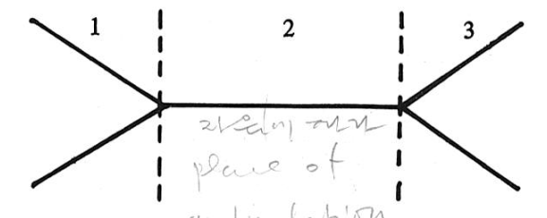
2.1. The Three Phases of the Stop
The complete articulation of a stop is made up of three phases:
1. The closing phase: during which the active articulator moves toward the passive articulator
2. The closed phase: where the active and passive articulators are together in a complete closure, behind which air pressure builds up;
3. The opening phase: during which the active articulator moves away from the passive articulator, and air is released.
This can be illustrated by the following diagram:
Taken from American English Pronunciation
Book of Bauer et al., (1980)
Phase 2, the closed phase, is always present in any stop consonant. Phase 1 and/or phase 3 may be absent.

Slide 5
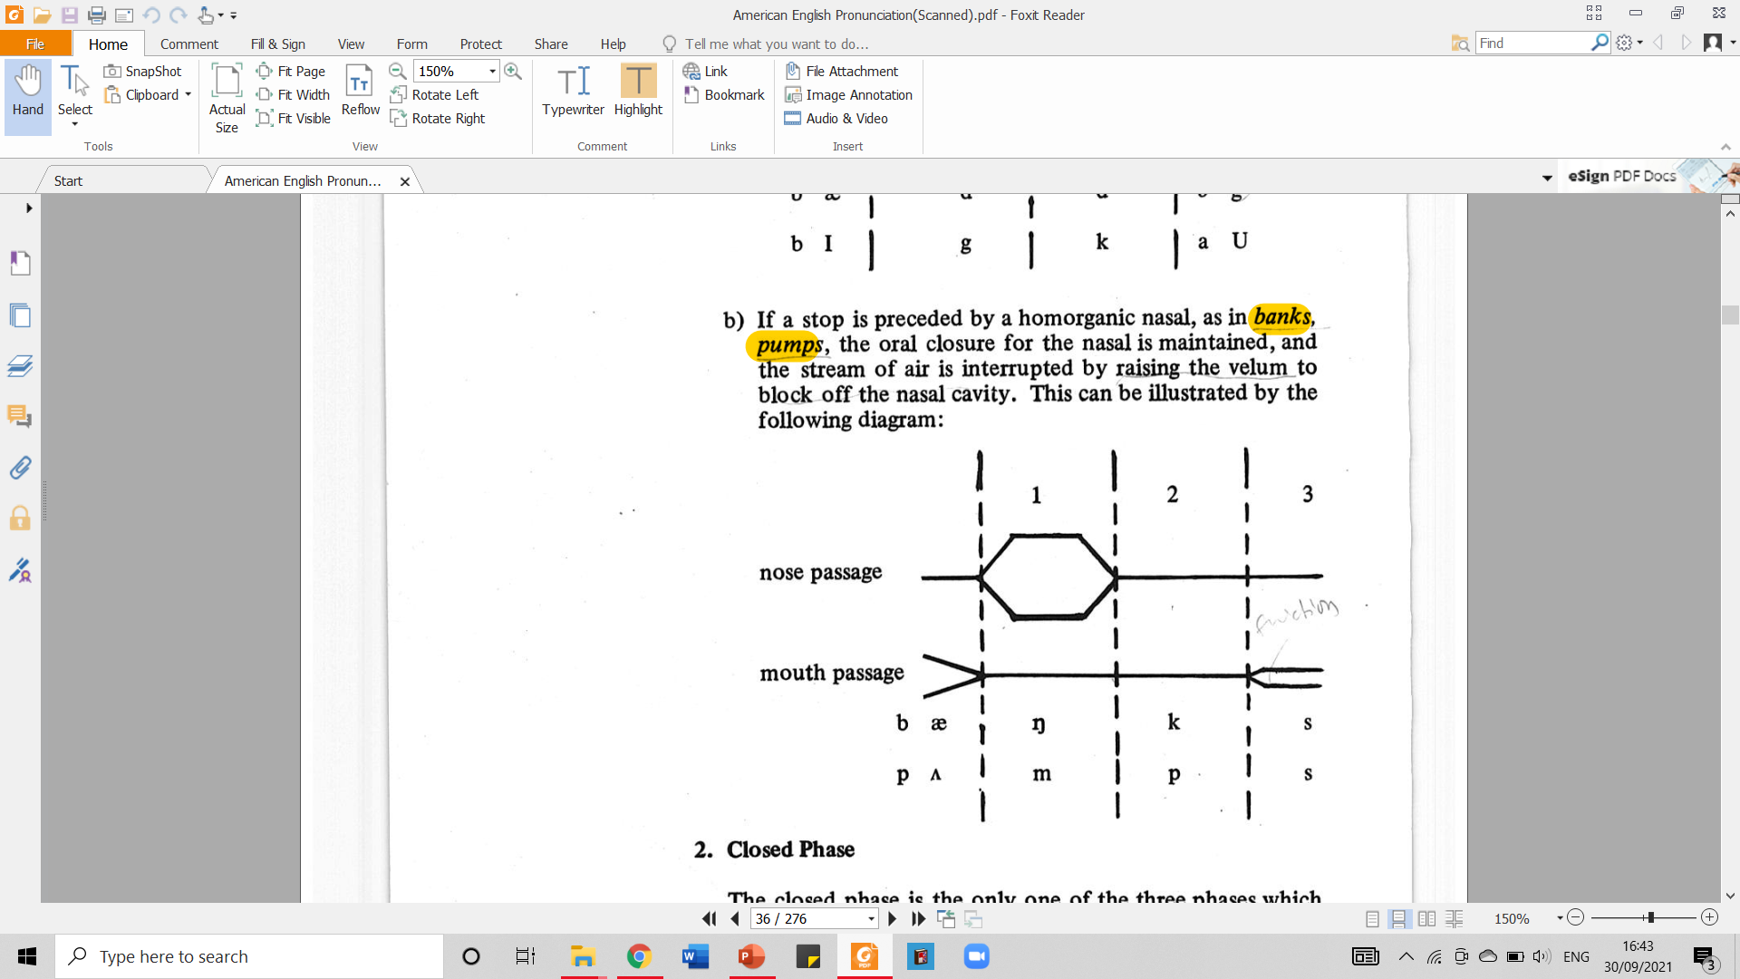
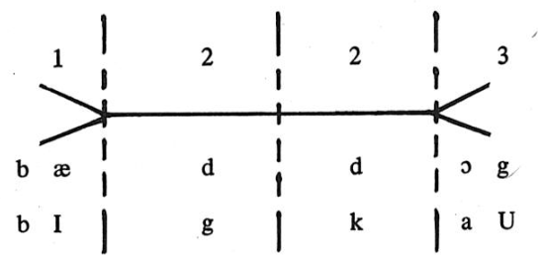
2.1.1. The Three Phases of the Stop –
Closing Phase
There is no closing phase when a stop is preceded by a homorganic stop as in bad, dog, big cow. Instead, the closed phases of the first and second stops merger. This can be illustrated by the following diagram.
If a stop is preceded by a homorganic nasal, as in banks, pumps, the oral closure for the nasal is maintained, and the stream of air is interrupted by raising the velum to block off the nasal cavity.
Taken from American English Pronunciation Book of Bauer et al., (1980)
Taken from American English Pronunciation Book of Bauer et al., (1980)

Slide 6
2.1.2. The Three Phases of the Stop –
Closed Phase
The closed phase is the only one of three phases which is always present.
When there are two adjacent homorganic stops as in big girl, top boy, there is only one (prolonged) closed phase.
Taken from American English Pronunciation Book of Bauer et al., (1980)

Slide 7
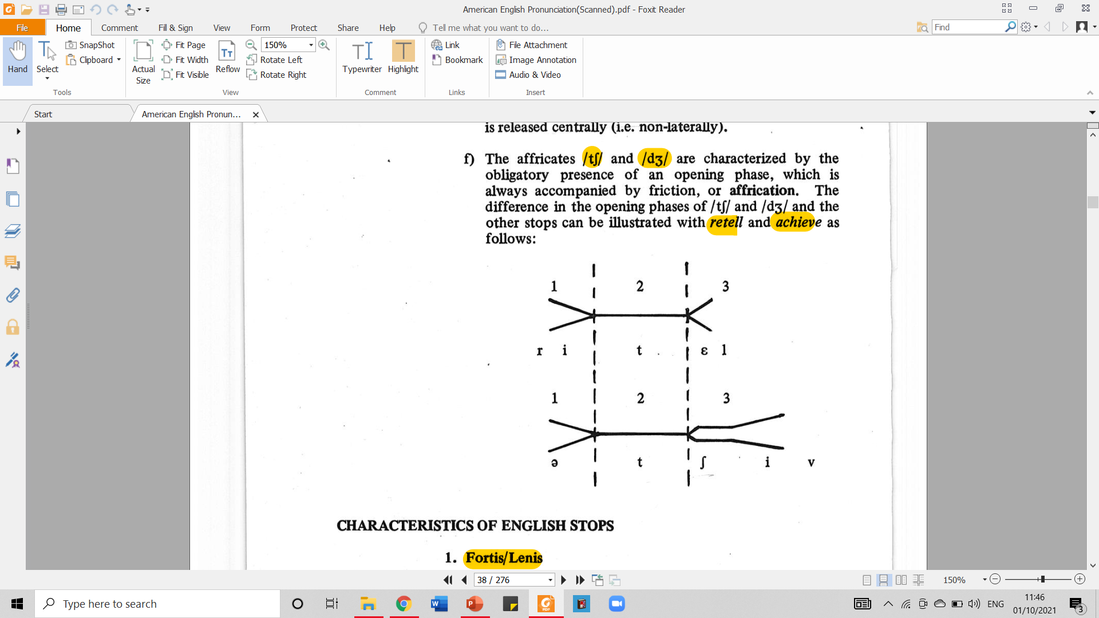
2.1.3. The Three Phases of the Stop –
Opening Phase
The opening phase is obligatory in the affricates /tʃ/ and /dʒ/.
Those affricates are characterized by the obligatory presence of an opening phase, which is always accompanied by friction, or affrication.
The difference in the opening phase of /tʃ/ and /dʒ/ and the other stops can be illustrated with retell and achieve as follows:
Taken from American English Pronunciation Book of Bauer et al., (1980)

Slide 8
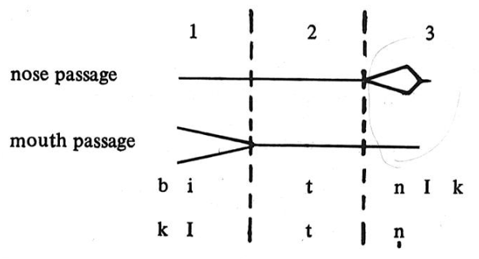
2.1.3. The Three Phases of the Stop –
Opening Phase (cont.)
When a stop is followed by a homorganic nasal, as in beatnik, kitten, lip movement, the closure for the stop is maintained and the stream of air is released by lowering the velum to allow the air to escape through the nasal cavity.
This nasal plosion can be illustrated by the following diagram:
Taken from American English Pronunciation Book of Bauer et al., (1980)

Slide 9
2.1.3. The Three Phases of the Stop –
Opening Phase (cont.)
Opening phase is not obligatory and can be absent under certain circumstances:
Finally before a pause, non-affricated stops need not to be released: shut up!, he’s mad! Come back!
There is no opening phase when a stop is followed by a homorganic stop, as in a bit dirty, top brass. Instead, the closed phase of the first and second stops merge.
It is when a stop is followed by another non-homorganic stop, as in drop dead, act, lockjaw. Although there is, in fact, an opening phase in these cases, it is normally inaudible.

Slide 10
3.1.1. Characteristics of English Stops – Fortis/Lenis
Fortis is characterized by being pronounced with greater muscular energy and hence greater air pressure.
English stops categorized into fortis are /p, t, k/
Lenis is characterized by being pronounced with smaller muscular energy and hence smaller air pressure.
English stops categorized into lenis are /b, d, g/

Slide 11
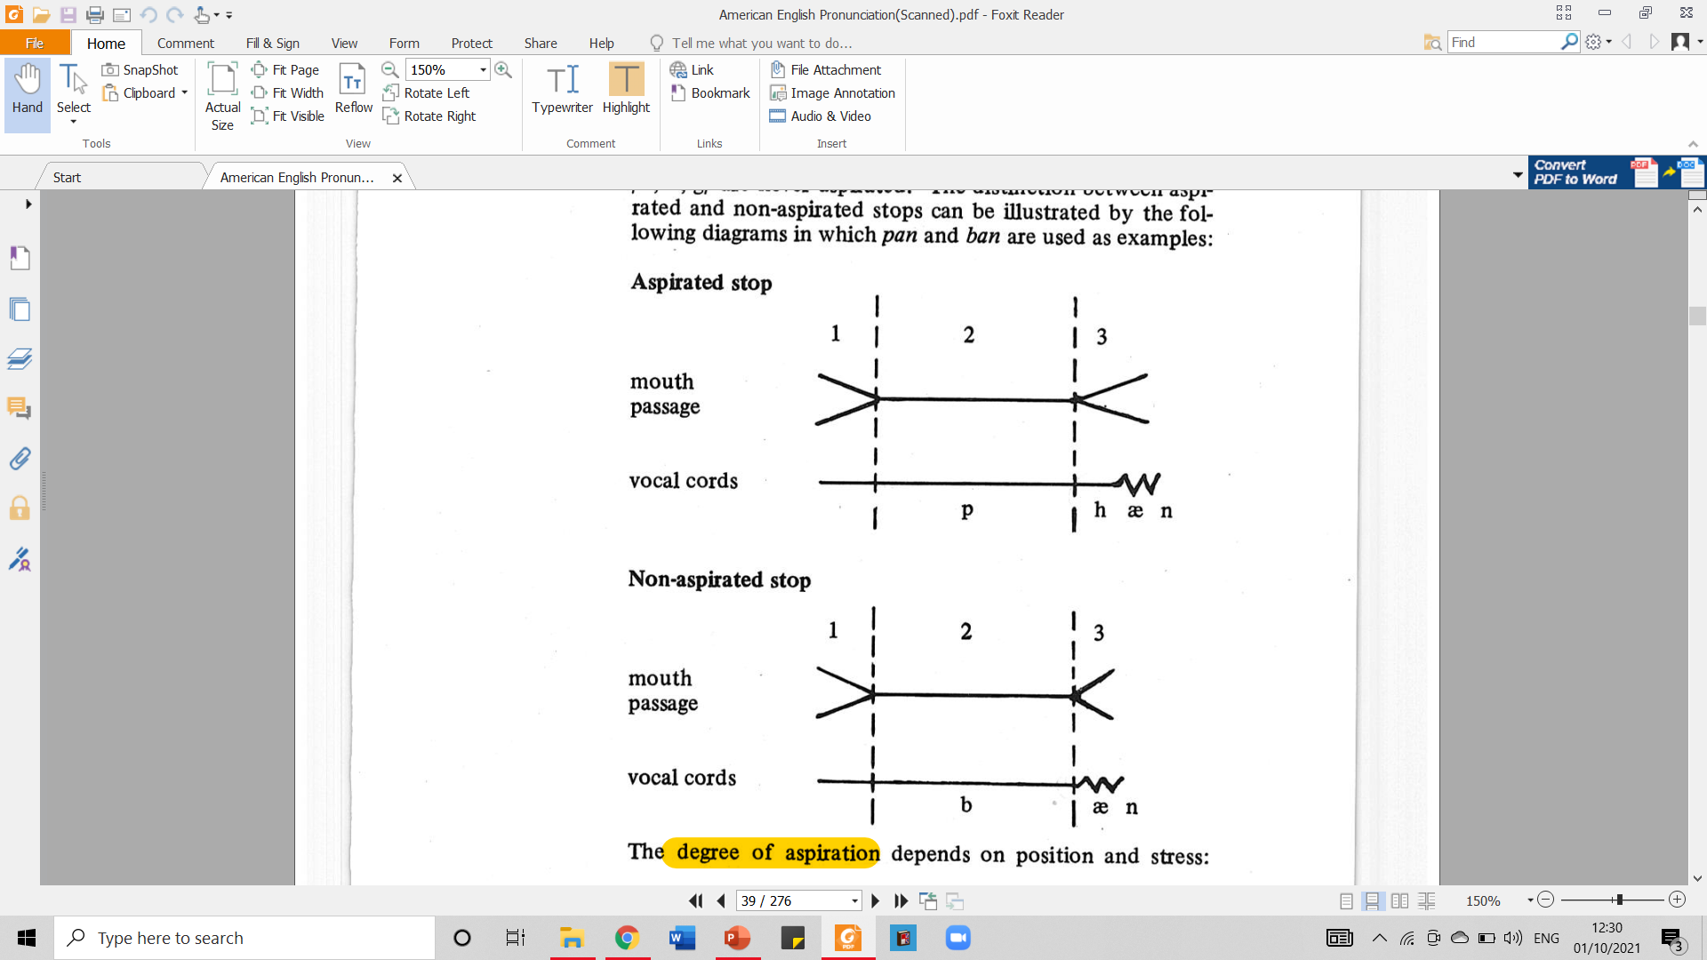
3.1.2. Characteristics of English Stops – Aspiration
/p, t, k/, if released, may be followed by cavity friction. It is an [h] sound or termed aspiration.
/b, d, g/ are never aspirated.
The distinction between aspirated and non aspirated stops can be illustrated by the following diagrams in which pan and ban are used as examples:
Taken from American English Pronunciation Book of Bauer et al., (1980)

Slide 12
3.1.3. Characteristics of English Stops – Length of the Preceding Sound
Vowels and sonorants are considerably shorter before fortis stops than they are before lenis stops.
Thus, the vowels in mat, roping, and batch are shorter than… | the vowels in mad, robing, and badge.
The sonorants in bent, heart, and felt are shorter than… | those in bend, hard, and felled.
Underlined in red are fortis stops.
Underlined in blue are lenis stops.

Slide 13
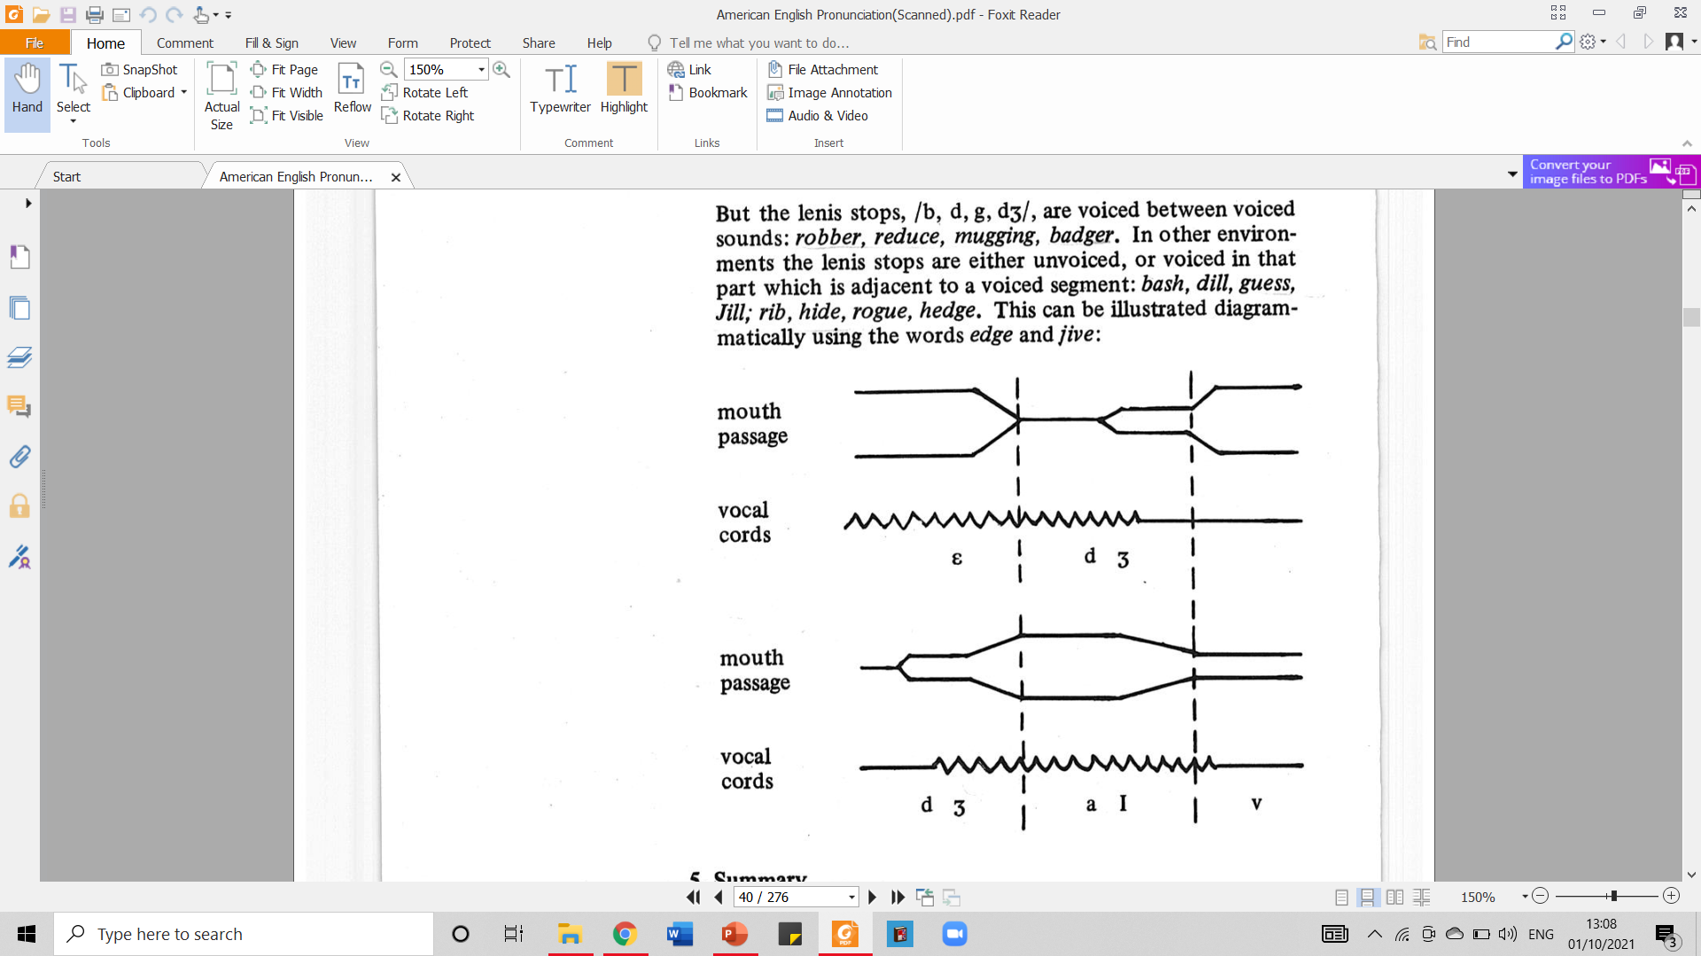
3.1.4. Characteristics of English Stops – Voicing
The fortis (/p, t, k/) are never voiced.
But the lenis stops /b, d, g/ are voiced between voiced sounds: robber, reduce, mugging, badger.
In other environments the lenis stops are either unvoiced or voiced in that part which is adjacent to a voiced segment: bash, dill, guess, Jill; rib, hide, rogue, hedge.
This can be illustrated in the following diagram that uses the words edge and jive.
Taken from American English Pronunciation Book of Bauer et al., (1980)

Slide 14

4.1. Comparison with British English
There is only one important difference between the stop systems of AE and BE:
words like latter and letter are pronounced with [t^{h}] in BE,
but with a flap-sound [D] in AE.
See the details about it under /t/ and /d/ in the next sections.

Slide 15
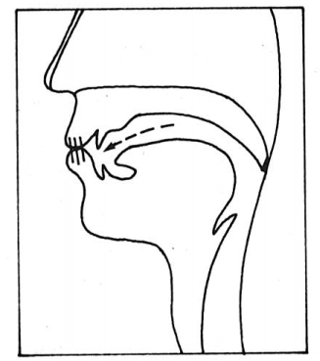
5.1.1. English Stops – /p/ - Articulation
It is a fortis, bilabial stop.
/p/ is articulated as follow:
The velum is raised so that no air can escape through the nasal cavity.
The lower lip is raised against the upper lip, forming a complete closure.
As a result, air pressure builds up in the oral cavity.
The plosion occurs when the lips are parted.
Taken from American English Pronunciation Book of Bauer et al., (1980)

Slide 16

5.1.2. English Stops – /p/ - Variation
/p/ has a strongly aspirated allophone [p^{h}] initially in stressed syllables before vowels. For example: pin, appear.
Before a syllabic sonorant or less strongly stressed vowel, /p/ is less strongly aspirated: apple, upper.

Slide 17
5.1.3. English Stops – /p/ - Comparison with BE
There are no major differences between AE and BE with regard to the pronunciation of /p/.
One minor (potential) difference may be mentioned: medial /p/ before an unstressed vowel or syllabic sonorant is normally weakly aspirated in both AE and BE.
In AE, however, such a /p/ seems sometimes to be softened to be a [b]-like sound in e.g. capital, property. This softening is not possible in BE.

Slide 18
5.2.1. English Stops – /b/ - Articulation
It is a lenis, bilabial stop.
Apart from the fact that /b/ is lenis whereas /p/ is fortis, these two sounds are articulated in the same way.
/b/ is articulated as follow:
The velum is raised so that no air can escape through the nasal cavity.
The lower lip is raised against the upper lip, forming a complete closure.
As a result, air pressure builds up in the oral cavity.
The plosion occurs when the lips are parted.
Taken from American English Pronunciation Book of Bauer et al., (1980)

Slide 19

5.2.2. English Stops – /b/ - Variation
/b/ is fully voiced ([b_{v}]) between voiced sounds: robber [rɑb_{v}ǝ^{r}], sibling [sɪb_{v}lɪŋ].
In other environments, it is either unvoiced ([b_{o}]), or voiced in that part which is adjacent to a voiced segment ([_{o}b_{v}], [_{v}b_{o}]): Bill [b_{o}ɪl] or [_{ov}bɪl], sob [sɑb_{o}] or [sɑb_{vo}]

Slide 20
5.2.3. English Stops – /b/ - Comparison with BE
There are no differences between AE and BE /b/.

Slide 21
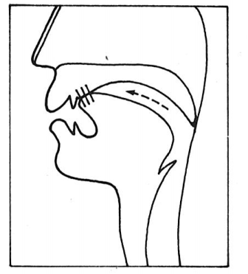
5.3.1. English Stops – /t/ - Articulation
It is a fortis, alveolar stop.
/t/ is articulated as follow:
The velum is raised so that no air can escape through the nasal cavity.
The tongue tip/blade is raised against the alveolar ridge, forming a complete closure.
As a result, air pressure builds up in the oral cavity.
The plosion occurs when the tongue is lowered from the alveolar ridge.
Taken from American English Pronunciation Book of Bauer et al., (1980)

Slide 22

5.3.2. English Stops – /t/ - Variation
/t/ has a strongly aspirated allophone [t^{h}] initially in stressed syllables before vowels: toy, intend.
/t/ is not aspirated before syllabic /l/ and /n/: little, button
/t/ is not aspirated at all after initial /s/ in the same syllable: stare, instill.

Slide 23
5.3.2. English Stops – /t/ - Variation (cont.)
The flap [D] is a voiced stop which is articulated by rapidly tapping the tip/blade of the tongue against the alveolar ridge.
[D] occurs as a variant of /t/ medially between vowels, the last of which is unstressed: hated, beating, better, throw it away.

Slide 24
5.3.3. English Stops – /t/ - Comparison with BE
The flap realization of /t/ does not occur in BE, which has a (weakly) aspirated /t/ where AE has [D]: hated, heating, better, bottom, at all.
Another difference is that before syllabic /l/, /t/ is unaspirated in AE, whereas it is aspirated in BE: the aspiration in BE occasions a partial devoicing of the /l/: little/subtle.

Slide 25
5.4.1. English Stops – /d/ - Articulation
It is a lenis, alveolar stop.
Apart from the fact that /d/ is lenis whereas /t/ is fortis, these two sounds are articulated in the same way.
/d/ is articulated as follow:
The velum is raised so that no air can escape through the nasal cavity.
The tongue tip/blade is raised against the alveolar ridge, forming a complete closure.
As a result, air pressure builds up in the oral cavity.
The plosion occurs when the tongue is lowered from the alveolar ridge.
Taken from American English Pronunciation Book of Bauer et al., (1980)

Slide 26

5.4.2. English Stops – /d/ - Variation
/d/ is fully voiced ([d_{v}]) between voiced sounds: harder [hɑrd_{v}ǝ^{r}], redeem [rɪd_{v}ɪm].
In other environments, it is either unvoiced ([d_{o}]), or voiced in that part which is adjacent to a voiced segment ([_{o}d_{v}], [_{v}d_{o}]): doom [d_{oum}] or [_{ov}dum], mad [mӕd_{o}] or [mӕd_{vo}]

Slide 27
5.4.2. English Stops – /d/ - Variation (cont.)
Medially /d/ has a flapped allophone, [D], in the same environment as /t/ has. See: heading, ladder, harder, he had it.
But /d/ is not flapped after /n/ or /l/: kinder, shoulder.
The fact that /d/ like /t/ can be a voiced flap, [D], means that AE speakers do not normally distinguish between the members of such pairs as ladder/latter, rider/writer.

Slide 28
5.4.3. English Stops – /d/ - Comparison with BE
In BE /d/ is never flapped: ladder, heading; apart from that, there is no difference between AE and BE /d/.

Slide 29
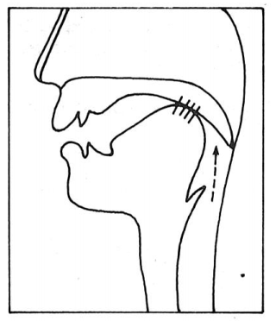
5.5.1. English Stops – /k/ - Articulation
It is a fortis, velar stop.
/k/ is articulated as follow:
The velum is raised so that no air can escape through the nasal cavity.
The back of the tongue is raised against the velum, forming a complete closure.
As a result, air pressure builds up behind the closure.
The plosion occurs when the back of the tongue is lowered from the velum.
Taken from American English Pronunciation Book of Bauer et al., (1980)

Slide 30

5.5.2. English Stops – /k/ - Variation
/k/ has a strongly aspirated allophone [k^{h}] initially in stressed syllables before vowels: keels, calf, occur.
/k/ is not aspirated at all after initial /s/ in the same syllable: skin, ascribe.

Slide 31
5.5.3. English Stops – /k/ - Comparison with BE
There are no major differences between AE and BE with regard to the pronunciation of /k/.
One minor (potential) difference may be mentioned: medial /k/ before an unstressed vowel or syllabic sonorant is normally weakly aspirated in both AE and BE.
In AE, however, such a /k/ may be softened to a [g]-like sound in words such as rickety. This softening is not possible in BE.

Slide 32
5.6.1. English Stops – /g/ - Articulation
It is a lenis, velar stop.
Apart from the fact that /g/ is lenis whereas /k/ is fortis, these two sounds are articulated in the same way.
/g/ is articulated as follow:
The velum is raised so that no air can escape through the nasal cavity.
The back of the tongue is raised against the velum, forming a complete closure.
As a result, air pressure builds up behind the closure.
The plosion occurs when the back of the tongue is lowered from the velum.
Taken from American English Pronunciation Book of Bauer et al., (1980)

Slide 33

5.6.2. English Stops – /g/ - Variation
/g/ is fully voiced ([g_{v}]) between voiced sounds: bigger [bɪg_{v}ǝ^{r}], haggle [hɑg_{v}l].
In other environments, it is either unvoiced ([g_{o}]), or voiced in that part which is adjacent to a voiced segment ([_{o}g_{v}], [_{v}g_{o}]): game [g_{o}em] or [_{ov}gem], big [bɪg_{o}] or [bɪg_{vo}]

Slide 34
5.6.3. English Stops – /g/ - Comparison with BE
There are no differences between AE and BE /g/.

Slide 35
6.1. REVIEW
Please answer the following questions to review what you have learned about Stop Consonants. Do not go to the next slide before you completely answer all of them.
How do we define stop consonants?
What are the phonemes that belong to the group of stop consonants?
Explain the phases of stop articulation!
During what circumstances does opening phase of stop consonant become absent?
How do we classify English stop consonants to fortis and lenis?
What is aspiration in stop consonants? Mention stop consonants that are aspirated!
In what system can we find the difference in the stop between AE and BE?
Mention the pairs of stop consonants that are articulated in the same way and that are only different from the way the are lenis/fortis.
How do we produce the flap [D] in the variation of /t/ and /d/?
The sounds of /p, t, k/ will be aspirated when they occur in which position and what kind of a syllable?

Slide 36
6.2. REVIEW – ANSWER KEY
Please answer the following questions to review what you have learned about Stop Consonants. Do not go to the next slide before you completely answer all of them.
How do we define stop consonants?
Stop consonants are the ones in which air coming from the lungs is completely interrupted.
What are the phonemes that belong to the group of stop consonants?
/p, t, k, b, d, g/
Explain the phases of stop articulation!
It is started with closing phases during which the active articulator moves toward the passive articulator. It is then continued with the closed phase where the active and passive articulators are together in a complete closure, behind which air pressure builds up. Finally, it comes to the opening phase during which the active articulator moves away from the passive articulator, and air is released.
During what circumstances does opening phase of stop consonant become absent?
Finally before a pause, non-affricated stops need not to be released; when a stop is followed by a homorganic stop; and when a stop is followed by another non-homorganic stop.
How do we classify English stop consonants to fortis and lenis?
It is based on the strength of the muscular energy. Fortis is with the greater muscular energy and thus greater air pressure. Fortis includes /p, t, k/, while lenis, with the smaller greater muscular energy, consists of /b, d, g/.

Slide 37
6.2. REVIEW – ANSWER KEY
Please answer the following questions to review what you have learned about Stop Consonants. Do not go to the next slide before you completely answer all of them.
What is aspiration in stop consonants? Mention stop consonants that are aspirated!
Aspiration is cavity friction that comes in the form of [h] sound. The aspirated stop consonants are /p, t, k/
In what system can we find the difference in the stop between AE and BE?
In the words like latter and letter are pronounced with [t^{h}] in BE but with a flap sound [D] in AE.
Mention the pairs of stop consonants that are articulated in the same way and that are only different from the way the are lenis/fortis.
/p/ and /b/; /t/ and /d/; /k/ and /g/
How do we produce the flap [D] in the variation of /t/ and /d/?
By rapidly tapping the tip/blade of the tongue against the alveolar ridge.
The sounds of /p, t, k/ will be aspirated when they occur in which position and what kind of a syllable?
It occurs when /p/, /t/, or /k/ sounds occur initially in stressed syllables before vowels.

Slide 38
REFERENCES
Bauer L., Dienhart M. J., Hartvigson H., & Jakobsen L. (1980). American English pronunciation. Copenhagen: Gyldendal. Page 25 – 53 .

Slide 39
PICTURE SOURCE
Stop consonant icon: https://png.pngtree.com/png-vector/20190118/ourlarge/pngtree-vector-stop-icon-png-image_327307.jpg
Slide 14: https://d39eazhratf38c.cloudfront.net/Pictures/480xany/0/5/9/60059_155488_27676.jpg
p icon: https://www.vectorstock.com/royalty-free-vector/isometric-colorful-capital-letter-p-from-abc-vector-27665967
b icon: https://www.123rf.com/photo_2838121_lowercase-letter-b-in-brown-leather-isolated-on-white.html
t icon: https://www.alamy.com/alphabet-small-wooden-vintage-lowercase-letter-pattern-beautiful-3d-isolated-on-white-background-design-consonant-t-image258864062.html
d icon: https://www.bigstockphoto.com/image-289689724/stock-photo-wood-letter-d-small-3d-wooden-plank-font-isolated-on-white-background-this-alphabet-is-perfect-for-creative-illustrations-related-but-not-limited-to-nature%2C-ecology%2C-decoration
k icon: https://c8.alamy.com/comp/W147J2/alphabet-small-wooden-vintage-lowercase-letter-pattern-beautiful-3d-isolated-on-white-background-design-consonant-k-W147J2.jpg
g icon: https://c8.alamy.com/comp/W147HH/alphabet-small-wooden-vintage-lowercase-letter-pattern-beautiful-3d-isolated-on-white-background-design-consonant-g-W147HH.jpg
tʃ icon: https://phuthuyphatam.edu.vn//uploads/cach-phat-am-am-ch.jpg
dʒ icon: https://media.beingles.com/wp-content/uploads/2019/05/16120223/dz_joy.png

