Slide 1
ENGLISH
PHONETICS AND PHONOLOGY
Week 5 – Chapter 5
Fricative Consonants
Lecturer: Maria Dewi Rosari, M.Pd.

Slide 2
INTRODUCTION
AIM OF THE COURSE
WEEK 5 – LEARNING OBJECTIVES
For advanced learners of English
For those who are interested in AE (American English)
For those who are non-native speakers
Definition of Fricative Consonants
Types of Fricatives
Characteristics of English Fricatives
Comparison with British English
The articulation, variation, and comparison with BE of:
5.1. /f/ 5.2. /v/ 5.3. /Ɵ/ 5.4. /ð/ | 5.5. /s/ 5.6. /z/ 5.7. /ʃ/ 5.8. /ʒ/

Slide 3

1.1. Definition of Fricative Consonants
A fricative consonant is one in which the stream of air coming from the lungs is forced through a stricture of close approximation.
The constriction in the vocal tract is narrow enough to create audible friction.
Constricted,
creates friction

Slide 4
2.1. Types of Fricatives
There are two types of fricatives, each of which has different characteristics. They are:
Sibilants
Characterized articulatory by a narrow longitudinal groove on the upper surface of the tongue, and acoustically by noise of relatively high intensity.
This produces the typical “hissing” noise of this class /s, z, ʃ, ʒ/ and of the fricative portions /tʃ, dʒ/
Non-sibilants
The upper surface of the tongue is not grooved when articulating /f, v, Ɵ, ð/. Acoustically these sounds are characterized by relatively low intensity of noise.

Slide 5
3.1.1. Characteristics of English Fricatives – Fortis/Lenis
Fortis is characterized by being pronounced with greater muscular energy and hence greater air pressure.
English fricatives categorized into fortis are /f, Ɵ, s, ʃ/
Lenis is characterized by being pronounced with smaller muscular energy and hence smaller air pressure.
English stops categorized into lenis are /v, ð, z, ʒ/

Slide 6
3.1.2. Characteristics of English Fricatives – Length of the Preceding Sound
Vowels and sonorants are considerably shorter before fortis fricatives than they are before lenis fricatives.
Thus, the vowels in calf, wreath, fleece, Asher are shorter than… | the vowels in calve, wreathe, fleas, azure, respectively.
Similarly, the sonorants in fence, false are shorter than… | those in fens, falls.
Underlined in red are fortis fricatives.
Underlined in blue are lenis fricatives.

Slide 7
3.1.3. Characteristics of English Fricatives – Voicing
The fortis fricatives (/f, Ɵ, s, ʃ/) are never voiced.
But the lenis fricatives (/v, ð, z, ʒ/) are voiced between voiced sounds: haversack, breathing, noisy, fusion.
When the lenis fricatives are initial, they are either fully voiced or voiced in that part which is adjacent to a voiced segment: veal, then, zeal.
When the lenis fricatives are final, they are either voiced in that part which is adjacent to a voice segment or they are voiceless: leave, breathe, please, rouge.

Slide 8

4.1. Comparison with British English
The fricative systems of AE and BE are identical, though there are minor differences in distribution (see under the individual phonemes)

Slide 9
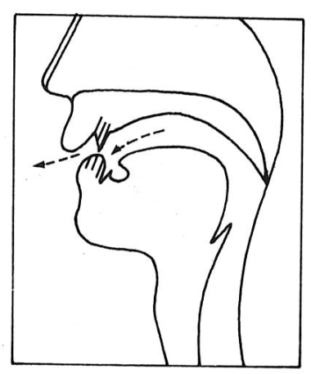
5.1.1. English Fricatives – /f/ - Articulation
It is a fortis, labio-dental fricative.
/f/ is articulated as follow:
The glottis is open.
The velum is raised. No air can escape through the nasal cavity.
The lower lip forms a stricture of close approximation with the upper teeth.
The air is forced out between the lower lip and the upper teeth, causing friction.
Taken from American English Pronunciation Book of Bauer et al., (1980)

Slide 10

5.1.2. English Fricatives – /f/ - Variation
There are no important variants of this phoneme.

Slide 11
5.1.3. English Fricatives – /f/ - Comparison with BE
There is no difference between AE and BE /f/.

Slide 12
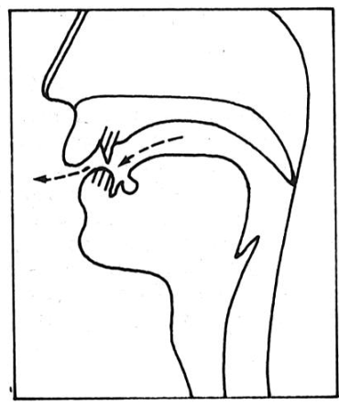
5.2.1. English Fricatives – /v/ - Articulation
It is a lenis, labio-dental stop.
Apart from the fact that /v/ is lenis whereas /f/ is fortis, these two sounds are articulated in the same way.
/v/ is articulated as follow:
The glottis is open.
The velum is raised. No air can escape through the nasal cavity.
The lower lip forms a stricture of close approximation with the upper teeth.
The air is forced out between the lower lip and the upper teeth, causing friction.
Taken from American English Pronunciation Book of Bauer et al., (1980)

Slide 13
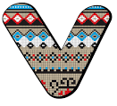
5.2.2. English Fricatives – /v/ - Variation
Initially, /v/ it is either voiced in that part which is adjacent to a voiced segment ([_{o}v_{v}]), or it is fully voiced ([v_{v}]): vie [_{v}v_{o}aɪ] or [_{v}vaɪ].
Finally, /v/ it is either voiced in that part which is adjacent to a voiced segment ([_{o}v_{v}]), or it is voiceless [v_{o}]: leave [liv_{vo}] or [liv_{o}].
Between voiced sounds, /v/ is fully voiced: leaving [liv_{v}ɪŋ].

Slide 14
5.2.3. English Fricatives – /v/ - Comparison with BE
There are no differences between AE and BE /v/.

Slide 15
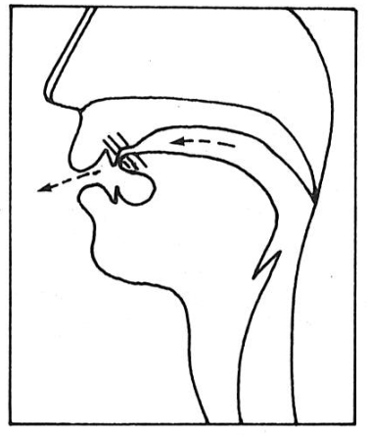
5.3.1. English Fricatives – /Ɵ/ - Articulation
It is a fortis, dental fricatives.
/Ɵ/ is articulated as follow:
The glottis is open.
The velum is raised so that no air can escape through the nasal cavity.
The tip (and blade) of the tongue form a stricture of close approximation with the upper teeth.
The air is forced out between the tongue and upper teeth, causing friction.
Some people articulate this sound with the blade of the tongue between the teeth.
Taken from American English Pronunciation Book of Bauer et al., (1980)

Slide 16

5.3.2. English Fricative – /Ɵ/ - Variation
There are no important variants of this phoneme.

Slide 17
5.3.3. English Fricatives – /Ɵ/ - Comparison with BE
There is no difference between AE and BE /Ɵ/.

Slide 18
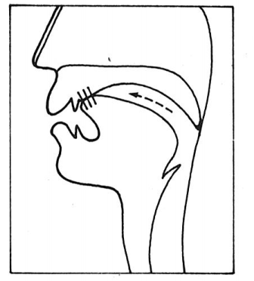
5.4.1. English Fricatives – /ð/ - Articulation
It is a lenis, dental fricatives.
Apart from the fact that /ð/ is lenis whereas /Ɵ/ is fortis, these two sounds are articulated in the same way.
/ð/ is articulated as follow:
The glottis is open.
The velum is raised so that no air can escape through the nasal cavity.
The tip (and blade) of the tongue form a stricture of close approximation with the upper teeth.
The air is forced out between the tongue and upper teeth, causing friction.
Some people articulate this sound with the blade of the tongue between the teeth.
Taken from American English Pronunciation Book of Bauer et al., (1980)

Slide 19

5.4.2. English Fricatives – /ð/ - Variation
Initially, /ð/ it is either voiced in that part which is adjacent to a voiced segment ([_{o}ð_{v}]), or it is fully voiced ([ð_{v}]): then [_{v}ð_{o}en] or [_{v}ðen].
Finally, /ð/ it is either voiced in that part which is adjacent to a voiced segment ([_{o}ð_{v}]), or it is voiceless [ð_{o}]: breath [brið_{vo}] or [brið_{o}].
Between voiced sounds, /ð/ is fully voiced: breathing [brið_{v}ɪŋ].

Slide 20
5.4.3. English Fricatives – /d/ - Comparison with BE
There is no difference between AE and BE /ð/.

Slide 21
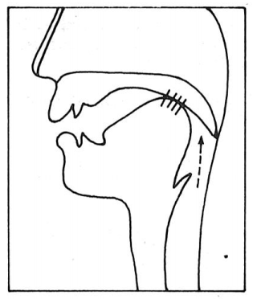
5.5.1. English Fricatives – /s/ - Articulation
It is a fortis, alveolar fricatives.
/s/ is articulated as follow:
The velum is raised so that no air can escape through the nasal cavity.
The blade of the tongue is raised toward the alveolar ridge in a stricture of approximation,
Some speakers have the tongue tip raised toward the alveolar ridge; others have it against the lower teeth or gum ridge;
The air is forced through a narrow groove in the center of the tongue, causing friction;
The lips are neutral, spread, or rounded depending on the nature of the adjacent sounds
Taken from American English Pronunciation Book of Bauer et al., (1980)

Slide 22

5.5.2. English Fricatives – /s/ - Variation
There are no important variants of this phoneme.

Slide 23
5.5.3. English Fricatives – /s/ - Comparison with BE
There is no difference between AE and BE /s/.

Slide 24
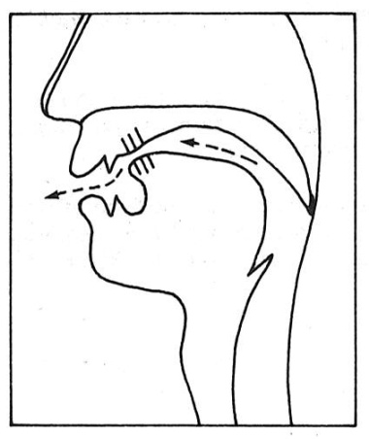
5.6.1. English Fricatives – /z/ - Articulation
It is a lenis, alveolar fricative.
Apart from the fact that /z/ is lenis whereas /s/ is fortis, these two sounds are articulated in the same way.
/z/ is articulated as follow:
The velum is raised so that no air can escape through the nasal cavity.
The blade of the tongue is raised toward the alveolar ridge in a stricture of approximation,
Some speakers have the tongue tip raised toward the alveolar ridge; others have it against the lower teeth or gum ridge;
The air is forced through a narrow groove in the center of the tongue, causing friction;
The lips are neutral, spread, or rounded depending on the nature of the adjacent sounds
Taken from American English Pronunciation Book of Bauer et al., (1980)

Slide 25

5.6.2. English Fricatives – /z/ - Variation
Initially, /z/ it is either voiced in that part which is adjacent to a voiced segment ([_{o}z_{v}]), or it is fully voiced ([z_{v}]): zoo [_{v}z_{o}u] or [_{v}zu].
Finally, /z/ it is either voiced in that part which is adjacent to a voiced segment ([_{o}z_{v}]), or it is voiceless [z_{o}]: rise [raiz_{vo}] or [raiz_{o}].
Between voiced sounds, /z/ is fully voiced: rising [riaz_{v}ɪŋ].

Slide 26
5.6.3. English Fricatives – /z/ - Comparison with BE
There are no differences between AE and BE /z/.

Slide 27
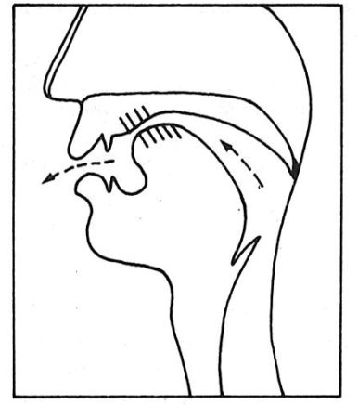
5.7.1. English Fricatives – /ʃ/ - Articulation
It is a fortis, alveo-palatal fricative.
/ʃ/ is articulated as follow:
The velum is raised so that no air can escape through the nasal cavity.
The blade of the tongue is raised toward the hard palate, creating a stricture of approximation just behind the alveolar ridge (and thus further back than for /s/);
Some speakers have the tongue tip raised toward the alveolar ridge; others have it down against the lower teeth or gum ridge;
The groove in the tongue is larger than that for /s/, so the air stream is more diffuse than for /s/;
The lips are somewhat rounded and protruding;
The airstream, which passes over the tongue and out between the teeth, produces a “hushing” sound which is considerably less “sharp” than the /s/ sound.
Taken from American English Pronunciation Book of Bauer et al., (1980)

Slide 28
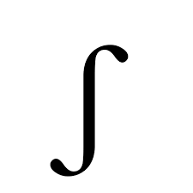
5.7.2. English Fricatives – /ʃ/ - Variation
There are no important variants of /ʃ/.

Slide 29
5.7.3. English Fricatives – / ʃ / - Comparison with BE
In articulation there is no difference between AE and BE /ʃ/.
In the distribution of /ʃ/, however, AE and BE differ slightly. Some of the differences are:
BE has /ʃ/ or /ʒ/ where AE has /ʒ/ in few words such as Asia, Persia, version;
Often BE has either /sj/ or /ʃ/ where /ʃ/ predominates in AE: issue, sensual;
There is a stronger tendency in BE to use /ʃ/ rather than /tʃ/ after /n/: mention, pension, provincial, lunch, etc.

Slide 30
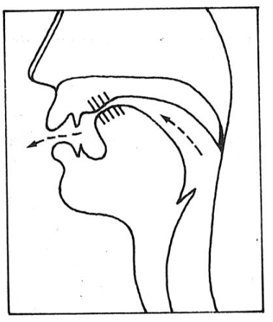
5.8.1. English Fricatives – /ʒ/ - Articulation
It is a lenis, alveo-palatal fricative.
Apart from the fact that /ʒ/ is lenis whereas /ʃ/ is fortis, these two sounds are articulated in the same way.
/ʒ/ is articulated as follow:
The velum is raised so that no air can escape through the nasal cavity.
The blade of the tongue is raised toward the hard palate, creating a stricture of approximation just behind the alveolar ridge (and thus further back than for /s/);
Some speakers have the tongue tip raised toward the alveolar ridge; others have it down against the lower teeth or gum ridge;
The groove in the tongue is larger than that for /s/, so the air stream is more diffuse than for /s/;
The lips are somewhat rounded and protruding;
The airstream, which passes over the tongue and out between the teeth, produces a “hushing” sound which is considerably less “sharp” than the /s/ sound.
Taken from American English Pronunciation Book of Bauer et al., (1980)

Slide 31
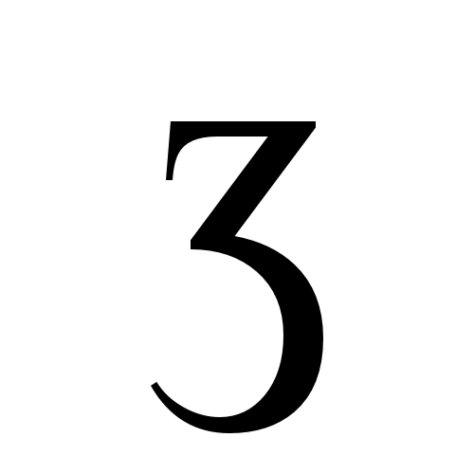
5.8.2. English Fricatives – /ʒ/ - Variation
/ʒ/ occurs initially only in foreign borrowings: genre, gendarme.
Finally /ʒ/ it is either voiced in that part which is adjacent to a voiced segment ([_{o}ʒ_{v}]), or it is voiceless ([ʒ_{o}]): rouge [ru_{vo}ʒ] or [ru_{o}ʒ].
Between voiced sounds ([ʒ_{v}]), /ʒ/ is fully voiced: lesion [liʒ_{v}n].
Note: some speakers final /ʒ/ alternates with /dʒ/ in words from French like garage, barrage, camouflage.

Slide 32
5.8.3. English Fricatives – /ʒ/ - Comparison with BE
In articulation there is no difference between BE and AE /ʒ/.

Slide 33
6.1. REVIEW
Please answer the following questions to review what you have learned about Fricative Consonants. Do not go to the next slide before you completely answer all of them.
How does the stream of air flow from the lungs before being released out of our oral cavity?
What is the result of the constriction in our vocal tract when producing fricatives?
What are the two types of fricatives and what make them different from each other?
Based on the force of articulation, how are fricatives consonants divided into fortis and lenis?
Mention the pairs of fricative consonants that are articulated in the same way and that are only different from the way they are lenis/fortis.
Mention AE fricatives consonants that are no different from the ones in BE!
Mention AE fricatives consonants that are different from the ones in BE!
In Roman alphabet spelling, how is /Ɵ/, /ʃ/, and /ʒ/ usually spelled? Provide some words for the examples!

Slide 34
6.2. REVIEW – ANSWER KEY
Please answer the following questions to review what you have learned about Fricative Consonants. Do not go to the next slide before you completely answer all of them.
How does the stream of air flow from the lungs before being released out of our oral cavity?
The stream of air coming from the lung is forced through a stricture of close approximation.
What is the result of the constriction in our vocal tract when producing fricatives?
It results in audible friction.
What are the two types of fricatives and what make them different from each other?
They are sibilants and non-sibilants. Sibilants are Characterized articulatory by a narrow longitudinal groove on the upper surface of the tongue, and acoustically by noise of relatively high intensity. Meanwhile, in non-sibilants, The upper surface of the tongue is not grooved when articulating /f, v, Ɵ, ð/. Acoustically these sounds are characterized by relatively low intensity of noise.
Based on the force of articulation, how are fricatives consonants divided into fortis and lenis?
/f, Ɵ, s, ʃ/ fricative consonants belong to fortis because they are pronounced with greater muscular energy and hence greater air pressure. Meanwhile, characterized with the opposite are /v, ð, z, ʒ/.

Slide 35
6.2. REVIEW – ANSWER KEY
Please answer the following questions to review what you have learned about Fricative Consonants. Do not go to the next slide before you completely answer all of them.
Mention the pairs of fricative consonants that are articulated in the same way and that are only different from the way they are lenis/fortis.
/f/ and /v/; /Ɵ/ and /ð/; /s/ and /z/; /ʃ/ and /ʒ/
Mention AE fricatives consonants that are no different from the ones in BE!
/f/, /v/, /Ɵ/, /ð/, /s/, /z/, /ʒ/
Mention AE fricatives consonants that are different from the ones in BE! Briefly explain their difference!
/ʃ/
/ʃ/ in BE can be /ʃ/ or /ʒ/ where AE has /ʒ/. There is a stronger tendency in BE to use /ʃ/ rather than /tʃ/ after /n/. Often BE has either /sj/ or /ʃ/ where /ʃ/ predominates in AE.
In Roman alphabet spelling, how is /Ɵ/, /ʃ/, and /ʒ/ usually spelled? Provide some words for the examples!
/Ɵ/ is always spelled th. The examples: Thames, Thomas, Esther.
/ʃ/ is frequently spelled sh as in shop, wash. But other spellings abound: ch (champagne), sch (Schwa), ss (assure), s (sugar), etc.
/ʒ/ is spelled in different ways: si (vision), s (usual), ge (beige), z (seizure).

Slide 36
REFERENCES
Bauer L., Dienhart M. J., Hartvigson H., & Jakobsen L. (1980). American English pronunciation. Copenhagen: Gyldendal. Page 54 – 71 .

Slide 37
PICTURE SOURCE
Fricative consonant: https://st2.depositphotos.com/4285885/44333/i/600/depositphotos_443339378-stock-photo-friction-text-written-purple-indigo.jpg
f icon: https://image.shutterstock.com/shutterstock/photos/1505318651/display_1500/stock-vector-letter-f-golden-letters-small-gold-letter-of-alphabet-vector-1505318651.jpg
v icon: https://www.vectorstock.com/royalty-free-vector/v-letter-small-vector-6362362
Ɵ icon: https://thumbs.dreamstime.com/b/greek-alphabet-theta-signage-icon-178107534.jpg
Ð icon: https://s3.amazonaws.com/static.graphemica.com/glyphs/i500s/000/007/350/original/00F0-500x500.png?1275321133
s icon: https://encrypted-tbn0.gstatic.com/images?q=tbn:ANd9GcQQO1cm1Kf3syQOm5tzcSKR87ZD_83i4Sl4vQ&usqp=CAU
z icon: https://www.vectorstock.com/royalty-free-vector/z-letter-small-vector-6362118
ʃ icon: https://id.pinterest.com/pin/188729040621885736/
ʒ icon: https://graphemica.com/%C6%B7/glyphs/times-new-roman-regular

