Slide 1
ENGLISH
PHONETICS AND PHONOLOGY
Week 6 – Chapter 6
Sonorant Consonants
Lecturer: Maria Dewi Rosari, M.Pd.

Slide 2
INTRODUCTION
AIM OF THE COURSE
WEEK 6 – LEARNING OBJECTIVES
For advanced learners of English
For those who are interested in AE (American English)
For those who are non-native speakers
Definition of Sonorant Consonants
Syllabicity
The articulation, variation, distribution and comparison with BE of:
3.1. /m/ 3.2. /n/ 3.3. /ŋ/ 3.4. /l/ | 3.5. w/ 3.6. /r/ 3.7. /j/

Slide 3



1.1. Definition of Sonorant Consonants
A sonorant is a consonant during the articulation of which the air coming from the lungs escapes continuously either through the oral cavity or through the nasal cavity with no audible friction.
There are three types of sonorants:
Nasal
Lateral
Approximant
SONORANTS
Nasal
Consonant
Lateral
Consonant
Approximant
Consonant

Slide 4
1.2. Definition of Sonorant Consonants – The Types
A nasal → a sonorant which is formed with a complete closure in the oral cavity but with the velum lowered so that the air coming from the lungs escapes unhindered through the nasal cavity.
There are three nasal phonemes in English: /m, n, ŋ/
Nasal
Consonant

Slide 5
1.2. Definition of Sonorant Consonants – The Types (cont.)
A lateral → a sonorant during the articulation of which the air coming from the lungs escapes freely over the side(s) of the tongue.
There is only one lateral phoneme in English: /l/
Lateral
Consonant
front
airflow
tongue

Slide 6
1.2. Definition of Sonorant Consonants – The Types (cont.)
An approximant → a sonorant during the articulation of which the air coming from the lungs escapes over the center of the tongue through a stricture, i.e. a stricture which is not so narrow as to give rise to audible friction.
There are three approximants in English: /w, r, j/.
front
airflow
tongue

Slide 7
2.1. Syllabicity
The lateral /l/ and the nasals /m/, /n/, and sometimes /ŋ/ differ from all other English consonants in that they can form syllables by themselves. This happens in words like battle, rhythm, button.
There are two situations in which a syllabic nasal cannot occur:
after another nasal, e.g. German /dʒermǝn/.
after nasal consonant + stop, e.g. London /lʌndǝn/.

Slide 8
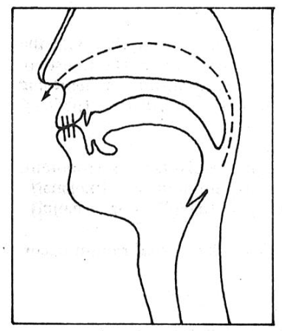
3.1.1. English Sonorants – /m/ - Articulation
It is a voiced, bilabial nasal.
/m/ is articulated as follow:
The vocal cords vibrate;
The velum is lowered so that the air from the lungs escapes through the nasal cavity;
The lower lip is raised against the upper lip forming a complete closure.
Taken from American English Pronunciation Book of Bauer et al., (1980)

Slide 9
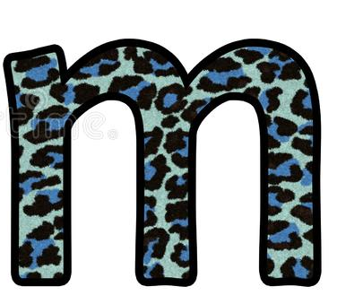
3.1.2. English Sonorant – /m/ - Variation
Articulation
In conjunction with /f, v/, /m/ can be realized as a labio-dental nasal [m,]: comfort, have more.
Voice
When a stressed syllable opens with /sm/, the /m/ may be partially devoiced [m_{ov}]: small, besmirch.
Syllabicity
/m/ is syllabic ([m’]) in words like chasm [kӕsm’].

Slide 10
3.1.3. English Fricatives – /m/ - Comparison with BE
There is no difference between AE and BE /m/.

Slide 11
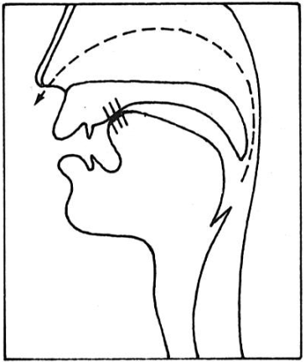
3.2.1. English Sonorants – /n/ - Articulation
It is a voiced, alveolar nasal.
/n/ is articulated as follow:
The vocal cords vibrate;
The velum is lowered so that the air from the lungs escapes through the nasal cavity;
The tip/blade of the tongue is raised against the alveolar ridge forming a complete closure.
Taken from American English Pronunciation Book of Bauer et al., (1980)

Slide 12

3.2.2. English Sonorants – /n/ - Variation
Articulation
In conjunction with /Ɵ, ð/, /n/ is realized as a dental nasal [n̪]: tenth, ban the bomb.
Voice
When a stressed syllable is opened by /sn/, the /n/ may be partially devoiced [n_{ov}]: sneeze, ensnare.
Syllabicity
/n/ is syllabic ([n’]) in words like listen [lɪsn’].

Slide 13
3.2.3. English Fricatives – /n/ - Comparison with BE
There are no differences between AE and BE /n/.
There is a greater tendency in BE to assimilate /n/ to /ŋ/ before /k, g/ in words such as enclosure, inglorious than there is in AE.
It is more acceptable to pronounce -ing as /ɪn/ in AE than it is in BE: Going away? /goɪn ǝwe/.

Slide 14
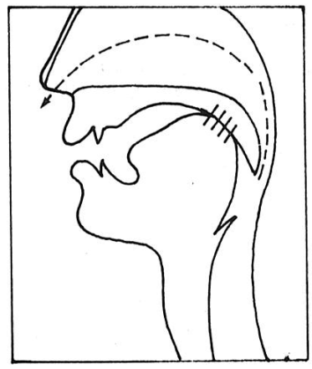
3.3.1. English Sonorant – /ŋ/ - Articulation
It is a voiced, velar nasal.
/ŋ/ is articulated as follow:
The vocal cords vibrate;
The velum is lowered so that the air from the lungs escapes through the nasal cavity;
The back of the tongue is raised against the velum forming a complete closure.
Taken from American English Pronunciation Book of Bauer et al., (1980)

Slide 15
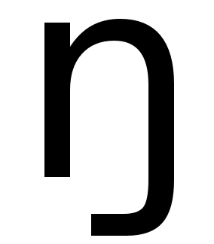
3.3.2. English Sonorants – /ŋ/ - Variation
The place of articulation of /ŋ/ depends on the preceding segment:
It is further forward after front vowels as in sing, length, sang, and further back after back vowels, as in song, longer.

Slide 16
3.3.3. English Sonorants – /ŋ/ - Distribution
/ŋ/ occurs only syllable-finally.

Slide 17
3.3.4. English Sonorants – /ŋ/ - Comparison with BE
There is no difference between AE and BE /ŋ/.
However, /ŋ/ may be used in fewer words in AE.

Slide 18
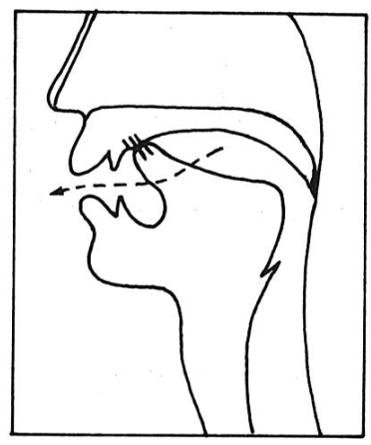
3.4.1. English Sonorants – /l/ - Articulation
It is a voiced, alveolar lateral.
/l/ is articulated as follow:
The vocal cords vibrate;
The velum is raised so that no air can escape through the nasal cavity;
The back of the tongue is raised (the height depending on phonetic environment)
The tongue tip/blade makes contact with the alveolar ridge while air is allowed to escape (without audible friction) over one or both sides of the tongue.
Taken from American English Pronunciation Book of Bauer et al., (1980)

Slide 19
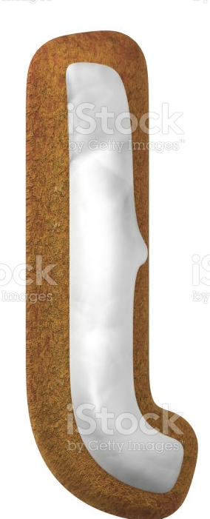
3.4.2. English Sonorants – /l/ - Variation
“Darkening”
The higher the back of the tongue is raised during the articulation of /l/ → the “darker” (i.e. the more velar) the quality of the /l/ sound.
Dark /l/ is symbolized [l].
The variants graded from the least dark (a) to the most dark (c):
Before stressed vowels: leap, left
Before stressed back vowels and before any unstressed vowel: loose, low
Before consonants, before pause, and when syllabic: called, bolt

Slide 20
3.4.2. English Sonorants – /l/ - Variation (cont.)
Voice
/l/ is (partially) voiceless ([l_{ov}] or [l_{o}]) after aspirated /p/ or /k/; and sometimes after /f, s/ in stressed syllables: please, reply, applicant, clue
Articulation
A dental (rather than alveolar) /l/ can be found adjacent to the dental fricatives /Ɵ/ and /ð/: wealth, breathless, kill them.
After /r/ the tip of the tongue is retracted and retroflexed: girl, parlor.
Syllabicity
/l/ is syllable ( [ l’ ] ) in words like cattle [kӕtl’].

Slide 21
3.4.3. English Sonorant – /l/ - Comparison with BE
The difference is in the difference of articulation between AE and BE /l/.
Unlike AE, BE has a very noticeable distinction between “light” (or “clear”) [l] on the one hand (no raising of the back of the tongue), and “dark” [l] on the other (tongue back raised).

Slide 22
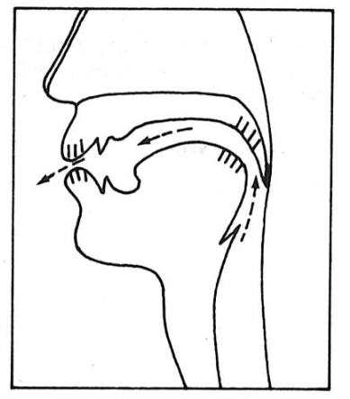
3.5.1. English Sonorants – /w/ - Articulation
It is a voiced, labio-velar approximant.
/w/ is articulated as follow:
The vocal cords vibrate;
The velum is raised so that no air can escape through the nasal cavity;
The back of the tongue is raised toward the velum to the position for /u/;
The lips are protruded and rounded;
Both the velar stricture and the labial stricture are ones of open approximation.
/w/ is characterized by a glide from the position described above to that of the following vowel.
Taken from American English Pronunciation Book of Bauer et al., (1980)

Slide 23

3.5.2. English Sonorants – /w/ - Variation
Articulation
Some speakers protrude and round their lips so strongly for /w/ that the resulting labial stricture may give rise to some degree of friction.
This narrow stricture is especially likely to occur before /u/: woo, womb.

Slide 24
3.5.3. English Sonorants – /w/ - Distribution
The distribution of /w/ is highly restricted:
It occurs syllable-initially before vowels (war, away), after syllable-initial stops (twine, quite), after /s/, /Ɵ/, and /sk/ (sweet, thwart, squirt);
An intrusive /w/ may very occasionally be heard intervocalically after a (half-)close back vowel sound: you are /juwɑr/, go on /gowɑn/, how are you /haʊwɑrjǝ/

Slide 25
3.5.4. English Sonorants – /w/ - Comparison with BE
The only difference between AE and BE with regard to /w/ is that this phoneme often follows /h/ in AE (which /hwɪtʃ/ vs witch /wɪtʃ/ but rarely in BE.

Slide 26
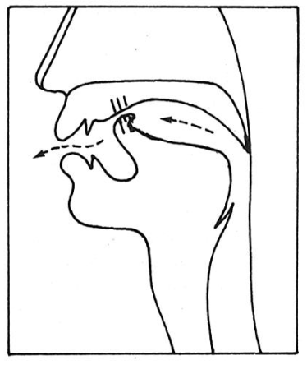
3.6.1. English Sonorants – /r/ - Articulation
It is a voiced, retroflex approximant.
/r/ is articulated as follow:
The vocal cords vibrate;
The velum is raised so that no air can escape through the nasal cavity;
The tip of the tongue points slightly backward (hence the term “retroflex”) toward the hard palate in a stricture of open approximation;
The front of the tongue has a hollow in it which is brought about laterally (the sides of the tongue are pressed against the upper molars) and longitudinally (the middle of the tongue is somewhat lower than the tip and the back);
Air escapes only over the tip of the tongue.
Taken from American English Pronunciation Book of Bauer et al., (1980)

Slide 27
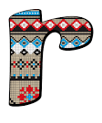
3.6.2. English Sonorants – /r/ - Variation
Articulation
The degree of lip-rounding accompanying the articulation of /r/ is determined by the adjacent sound(s): contrast poor and beer.
The duration of /r/ is considerably longer than normal in words like fur and father which have /ɜ/ and /ǝ/.

Slide 28
3.6.3. English Sonorants – /r/ - Comparison with BE
Articulation
BE /r/, unlike AE /r/, has little or no retroflexion.
Some BE speakers have a “flapped r” (mainly between vowels): porridge [pɒrɪdʒ], very [vεrɪ]. This variant of /r/ does not exist in AE. It is similar to the voiced flap [D] in AE.

Slide 29
3.6.3. English Sonorants – /r/ - Comparison with BE
Distribution
The distribution of /r/ is much more restricted in BE than in AE, BE /r/ occurring only before vowels, thus we find contrasts like the following:
 | BE | AE
Far | /fɑ/ | /fɑr/
More | /mƆ/ | /mƆr/
Cure | /kjʊǝ/ | /kjʊr/
Farm | /fɑm/ | /fɑrm/
Fur | /fɜ/ | /fɜr/

Slide 30
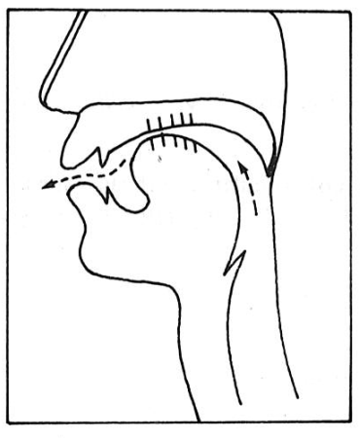
3.7.1. English Sonorants – /j/ - Articulation
It is a voiced, palatal approximant.
/j/ is articulated as follow:
The vocal cords vibrate;
The velum is raised so that no air can escape through the nasal cavity;
The front of the tongue is raised toward the hard palate to the position of /j/ or /ɪ/.
/j/ is characterized by a glide from the position described above to that of the following vowel.
Taken from American English Pronunciation Book of Bauer et al., (1980)

Slide 31
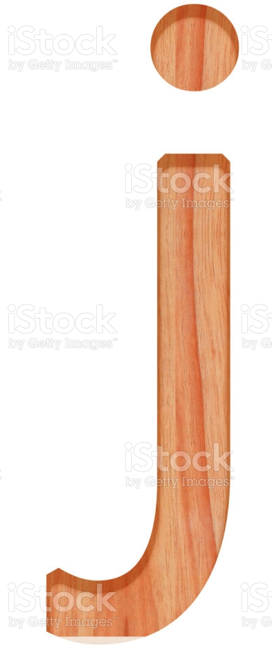
3.7.2. English Sonorants – /j/ - Variation
Articulation
Before the vowel /i/, /j/ is articulated so close to the hard palate that audible friction may arise: yield, yeast.
Before the vowel /ɪ/, the tongue position of /j/ is approximately that of /i/: Yiddish, yippie.
Before all other vowels, the articulation of /j/ is less close, the position of the tongue being approximately the same as that of /ɪ/: yes, yapping, yard, yawn, you.

Slide 32
3.7.3. English Fricatives – /j/ - Comparison with BE
Articulation
There is no difference in articulation between AE and BE /j/.
Distribution
Here there is a difference in that BE /j/ occurs in a larger number of environments that does AE /j/. Thus:
/j/ is found before stressed /u/ in BE (but not in most AE dialects) after consonants articulated with the tongue tip/blade. Thus words like the following are pronounced with /j/ in BE, but not (normally) in AE:
/tj/ | tunic, attune
/dj/ | due, endure
/nj/ | new, manure

Slide 33
3.7.3. English Fricatives – /j/ - Comparison with BE (cont.)
The following points are worthy of note:
BE sometimes has either /tj/ or /tʃ/ where /tʃ/ predominates in AE: statue, righteous, virtue
Be sometimes has either /dj/ or /dʒ/ where /dʒ/ predominates in AE: individual, education, graduate;
BE sometimes has either /sj/ or /ʃ/ where /ʃ/ predominates in AE: issue, sensual;
BE sometimes has either /zj/ or /ʒ/ where /ʒ/ predominates in AE: seizure, casual.

Slide 34
4.1. REVIEW
Please answer the following questions to review what you have learned about Sonorant Consonants. Do not go to the next slide before you completely answer all of them.
How does the air flow from our lungs to the oral cavity when producing sonorants?
Mention three types of sonorants!
Explain the position of each speech organ involved in the articulation of nasal consonants!
Explain the difference on the way air coming from the lungs flows to the tongue between lateral and approximant!
What is sonorant consonant that only occurs syllable-finally? Provide examples of words using the sonorant!
What does it mean by “darkening” in /l/? How is it produced?
Why is the phoneme /r/ called retroflex? What happen to our tongue when producing the sound of it?
Explain the difference of distribution between AE and BE /r/ and provide examples showing the difference!

Slide 35
4.2. REVIEW – ANSWER KEY
Please answer the following questions to review what you have learned about Sonorant Consonants. Do not go to the next slide before you completely answer all of them.
How does the air flow from our lungs to the oral cavity when producing sonorants?
The air coming from the lungs escapes continuously either through the oral cavity or through the nasal cavity with no audible friction.
Mention three types of sonorants!
Nasals, laterals, and approximants
Explain the position of each speech organ involved in the articulation of nasal consonants!
The mouth is in a complete closure. The velum is lowered so that air coming rom the lungs escapes unhindered though the nasal cavity.
Explain the difference on the way air coming from the lungs flows to the tongue between lateral and approximant!
In lateral, the air from the lungs escapes over the sides of the tongue, while in approximants the air from the lungs escapes over the center of the tongue.

Slide 36
4.2. REVIEW – ANSWER KEY
Please answer the following questions to review what you have learned about Sonorant Consonants. Do not go to the next slide before you completely answer all of them.
What is sonorant that only occurs syllable-finally? Provide examples of words using the sonorant!
It is /ŋ/. Examples: sing, bang, bingo
What does it mean by “darkening” in /l/? How is it produced?
Darkening means the articulation of /l/ becomes more velar. It is produced with the back of the tongue is raised during the articulation of the phoneme.
Why is the phoneme /r/ called retroflex? What happen to our tongue when producing the sound of it?
It is because when articulating /r/ the tip of the tongue points slightly backward (hence the term “retroflex”) toward the hard palate in a stricture of open approximation.
Explain the difference of distribution between AE and BE /r/ and provide examples showing the difference!
The distribution of /r/ is much more restricted in BE than in AE, BE /r/ occurring only before vowels, thus we find contrasts like the following: far /fɑ/ in BE and /fɑr/ in AE; more /mƆ/ in BE and /mƆr/ in AE.

Slide 37
REFERENCES
Bauer L., Dienhart M. J., Hartvigson H., & Jakobsen L. (1980). American English pronunciation. Copenhagen: Gyldendal. Page 72 – 90.

Slide 38
PICTURE SOURCE
Lateral consonant icon: https://encrypted-tbn0.gstatic.com/images?q=tbn:ANd9GcTUk1nwWQjuvgkUlU6D_vmk8vY2qEiF01LN2Q&usqp=CAU
Nasal consonant icon: https://www.123rf.com/photo_126839406_stock-vector-nose-line-icon-smell-nostril-front-anatomy-concept-vector-illustration-can-be-used-for-topics-like-e.html
Approximants consonant icon: https://www.kindpng.com/picc/m/188-1889809_approximately-approximate-math-symbol-icon-design-number-6.png
m icon: https://thumbs.dreamstime.com/b/d-leopard-print-letter-m-jaguar-skin-fur-creative-decorative-character-m-capital-letter-small-letter-black-blue-color-d-161131860.jpg
n icon: https://image.shutterstock.com/shutterstock/photos/706360015/display_1500/stock-photo-rough-metallic-lowercase-or-small-letter-n-in-a-d-illustration-with-a-rocky-texture-and-shiny-dark-706360015.jpg
Ŋ icon: https://s3.amazonaws.com/static.graphemica.com/glyphs/i500s/000/002/214/original/014B-500x500.png?1275291994
l icon: https://media.istockphoto.com/photos/gingerbread-font-christmas-cookie-alphabet-concept-small-letter-l-picture-id870019836
w icon: https://thumbs.dreamstime.com/z/w-letter-hand-drawn-symbol-vector-illustration-small-english-black-white-roman-alphabet-typographic-can-be-used-as-logo-203318687.jpg
r icon: https://www.vectorstock.com/royalty-free-vector/r-letter-small-vector-6362320
j icon: https://media.istockphoto.com/photos/alphabet-small-wooden-vintage-lowercase-letter-pattern-beautiful-3d-picture-id971513534

