Slide 1
ENGLISH
PHONETICS AND PHONOLOGY
Week 7 – Chapter 7
Vowels: General Section
Lecturer: Maria Dewi Rosari, M.Pd.

Slide 2
INTRODUCTION
AIM OF THE COURSE
WEEK 7 – LEARNING OBJECTIVES
For advanced learners of English
For those who are interested in AE (American English)
For those who are non-native speakers
Inventory
Articulation
Nasalization
Checked and Free Vowels
How to Describe A Vowel

Slide 3
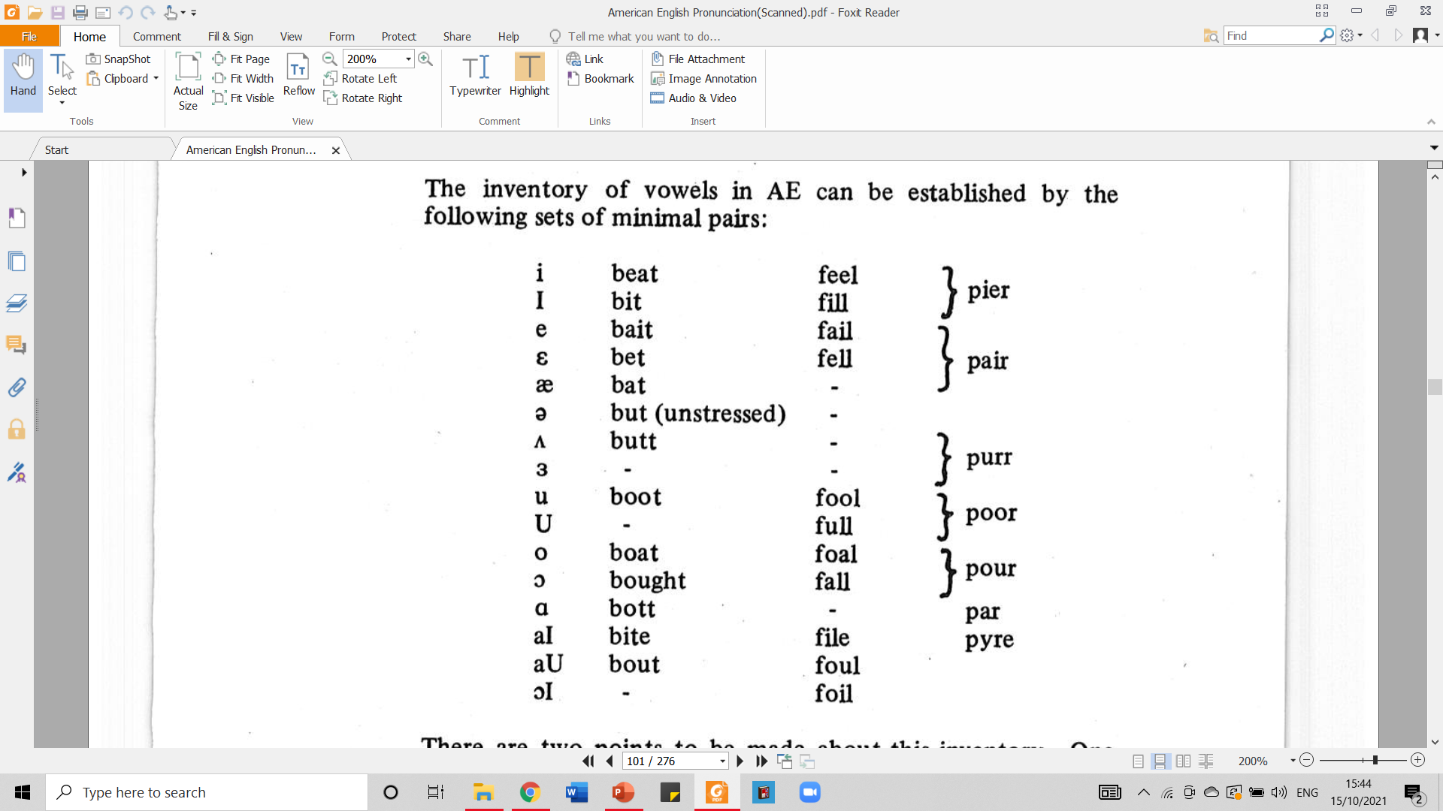
1.1. Inventory
The inventory of vowels in AE can be established by the following sets of minimal pairs:
There are two points to be made about this inventory. One concerns the vowels, the other concerns the occurrence of vowels before /r/. Each of these will be treated briefly in turn.
Taken from American English Pronunciation
Book of Bauer et al., (1980)

Slide 4
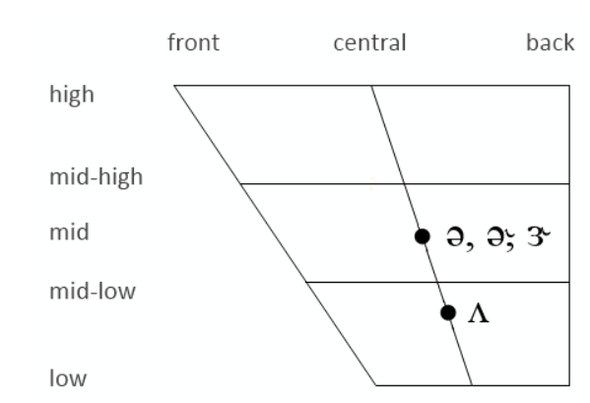
1.2. Inventory – Central Vowels
Central vowels = intermediate position
All central vowels are produced in an intermediate position between front and back vowels, with the body of the tongue raised towards the roof the mouth in the area where the hard and soft palates fuse.
There are 4 types of central vowel sounds in AE:
Taken from: https://www.sltinfo.com/ess101-central-vowels/

Slide 5
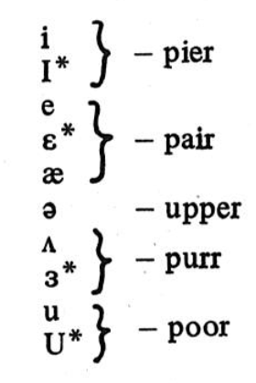
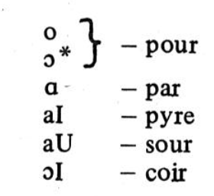
1.3. Inventory – Neutralization before /r/
Whereas there are 16 vowels in the inventory listed above, the maximum number of contrasts before /r/ is 10.
This is because there are a number of neutralizations of contrasts, so that there are no contrasts between the members of the sets marked by braces in the table below.
Where these neutralizations occur, the vowel heard may be any vowel sound which falls within the range defined by the extreme values for the phonemes in the set.
However, there are, in all cases, preferred variants, and these are marked with an asterisk in the table below.
Taken from American English Pronunciation
Book of Bauer et al., (1980)

Slide 6
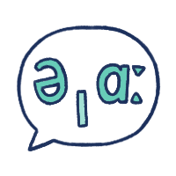
1.3. Inventory (cont.) – Written Exercise
Let’s have some practice! Please write the phonetic symbol of the vowels printed in bold of the following words.
The answer key is on the next slide.
File
Tell
But
Sit
Sheet
Buy
Man
Boil
Bowl
Table

Slide 7
1.3. Inventory (cont.) –
Written Exercise
THE ANSWER KEY
File
Tell
But
Sit
Sheet
Buy
Man
Boil
Bowl
Table
THE ANSWER KEY
/aɪ/
/e/
/ʌ/ or /ə/
/ɪ/
/iː/
/aɪ/
/æ/
/ɔɪ/
/oʊ/
/eɪ/
Taken from American English Pronunciation Book of Bauer et al., (1980)

Slide 8
1.4. Inventory (cont.) – Spoken Exercise
Listen to the words spoken by your professor. Then guess which phonetic symbol is right for the vowel specified in each number. Choose (a) or (b). The answer key is on the next slide!
No | a | b
1 | /i/ | /ɪ/
2 | /ʊ/ | /u/
3 | /ʊ/ | /u/
4 | /aɪ/ | /eɪ/
5 | /i/ | /ɪ/
6 | /ʊ/ | /u/
7 | /aɪ/ | /eɪ/
8 | /ɑ/ | /ʌ/
9 | /ʊ/ | /u/
10 | /ʊ/ | /u/

Slide 9
1.4. Inventory (cont.) – Spoken Exercise – Answer Key
Listen to the words spoken by your professor. Then guess which phonetic symbol is right for the vowel specified in each number. Choose (a) or (b). The correct answer is shown in the red cells.
No | a | b
1 | /i/ | /ɪ/
2 | /ʊ/ | /u/
3 | /ʊ/ | /u/
4 | /aɪ/ | /eɪ/
5 | /i/ | /ɪ/
6 | /ʊ/ | /u/
7 | /aɪ/ | /eɪ/
8 | /ɑ/ | /ʌ/
9 | /ʊ/ | /u/
10 | /ʊ/ | /u/

Slide 10
2.1. Articulation
All vowels are articulated with a stricture of open approximation (i.e. a stricture which does not give rise to audible friction) between the tongue and the roof of the mouth.
The articulation of vowels can be described in terms of four parameters:
1. HEIGHT
It concerns with the distance between the active articulator (the tongue), and the passive articulator (the roof of the mouth).
This van be varied either by moving the jaw or by moving the tongue.
We will distinguish between 5 heights: close, half-close, mid, half-open, and open.
Close vowels are /i/ and /u/.
Half-close vowels are /ɪ/, /ɜ/, and /ʊ/.
Mid vowels are /e/, /ǝ/, and /o/
Half-open vowels are: /ε/, /ʌ/, and / Ɔ /
Open vowels are: /ӕ/ and /ɑ/

Slide 11
2.1. Articulation (cont.)
2. DEPTH
It concerns the part of the tongue and the part of the roof of the mouth involved in the articulation of the vowel.
We will distinguish between three depths:
Front vowels
Articulated with the front of the tongue as the active articulator and the hard plate as passive articulator.
They are /i, ɪ, e, ε, ӕ/
Central vowels
Articulated with the area where hard palate and the velum meet as the passive articulator and the middle of the tongue as the active articulator.
They are /ǝ, ʌ, ɜ/
Back vowels
Articulated with the back of the tongue as active articulator and the velum as passive articulator.
They are /u, ʊ, o, Ɔ, ɑ/

Slide 12
2.1. Articulation (cont.)
3. LIP ROUNDING
Some AE vowels are pronounced with rounded lips and others are pronounced without such rounding.
The rounded vowels are: /u, ʊ, o, Ɔ/
Not all these vowels are equally rounded; for example, /u/ is much more rounded than /Ɔ/.
The unrounded vowels are /I, ɪ, e, ε, ӕ, ʌ, ɑ, ɜ/
These are not equally unrounded; for example, the lips are much more spread for /i/ than for /ɑ/.
4. DIPTHONGIZATION
A diphthong is defined as a vowel segment which occurs in a single syllable, acts as a single unit in the language.
It is characterized articulatorily by a glide from the position for one vowel toward the position for another.
Vowel sounds which always involved some glide movement are treated as diphthongs.
Vowel sounds which may, but do not always, involve some glide movement are treated as monophthongs.
Thus only /aɪ, aʊ, Ɔɪ/ will be treated as diphthongs, whereas /i, e, o, u/, for example, will be treated as monphtongs.

Slide 13
3.1. Nasalization
In the normal articulation for all vowels in English, the velum is raised blocking off the nasal cavity, so that all the air escapes through the mouth.
However, whenever a nasal consonant follows a vowel, the lowering of the velum is likely to be premature, occurring before the oral closure has been formed.
This means that (the last part of) the vowel is nasalized in words like Ann, dim, song (see the diagrams)

Slide 14
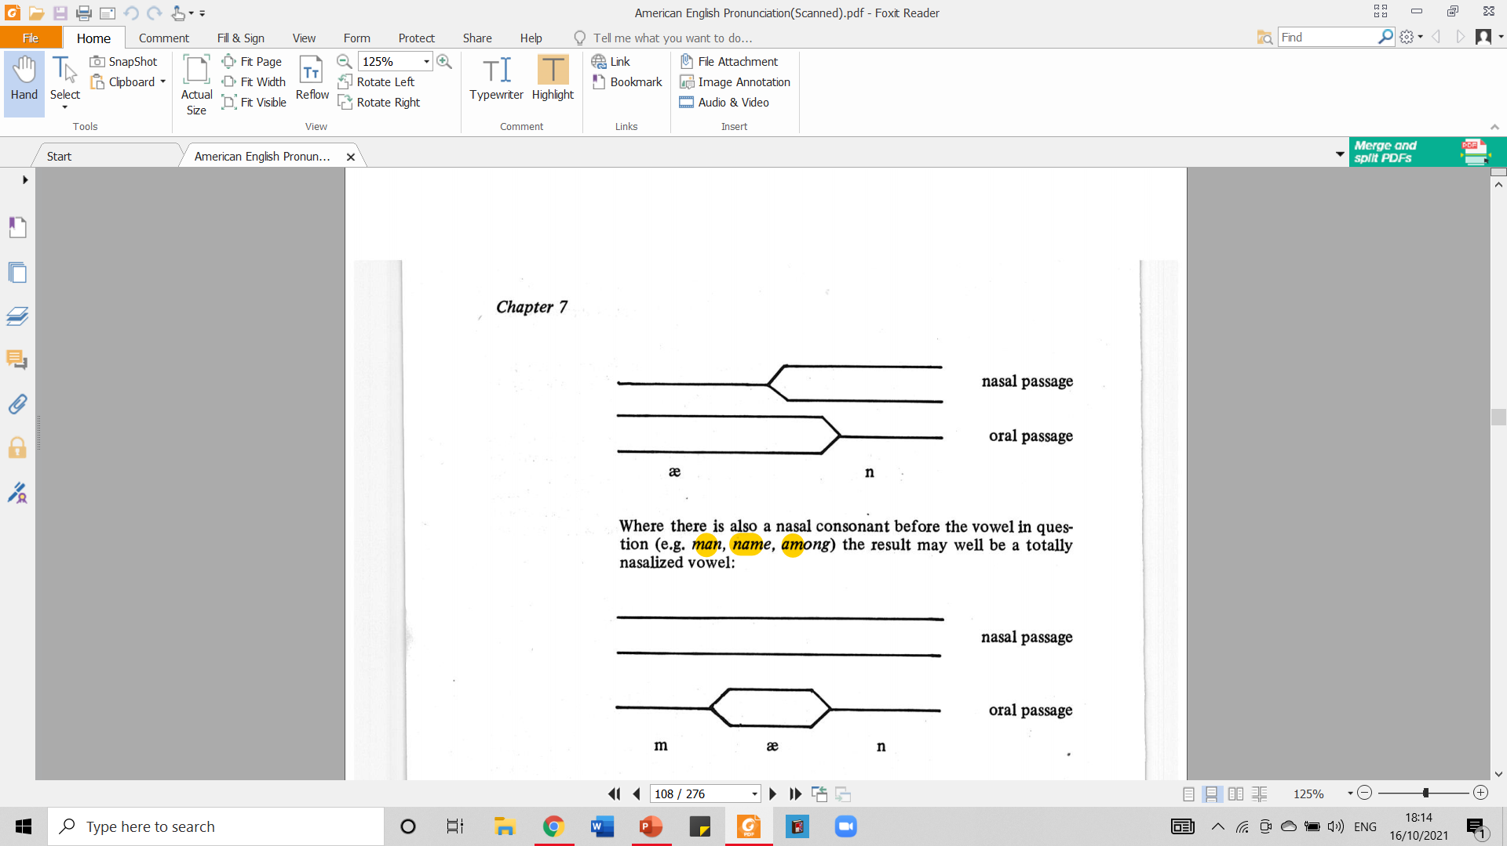
3.1. Nasalization (cont.)
Nasalization that happens in the word Ann
Velum is lifted
Vowel
Velum is lowered
Velum is lifted
Velum is lowered
Vowel
Taken from American English Pronunciation Book of Bauer et al., (1980)

Slide 15
3.1. Nasalization (cont.)
Where there is also a nasal consonant before the vowel in questions (e.g. man, name, among) the result may well be a totally nasalized vowel.
Velum is lowered
Velum is lowered
Velum is lifted
Taken from American English Pronunciation Book of Bauer et al., (1980)

Slide 16
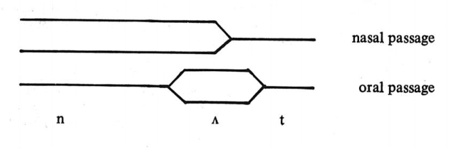
3.1. Nasalization (cont.)
Some AE speakers also nasalize a vowel which follows but is not followed by a nasal consonant: nut, mad, knock.
Velum is lifted
Velum is lowered
Velum is lowered
Velum is lifted
Taken from American English Pronunciation Book of Bauer et al., (1980)

Slide 17
4.1. Checked and Free Vowels
A distinction is sometimes made between vowels which, in stressed syllables, are obligatory followed by a consonant,
and vowels which may occur in stressed syllables without a following consonant.
CHECKED VOWELS
/ɪ, ε, ӕ, ʌ, ɜ, ʊ/
FREE VOWELS
/i, e, ɑ, Ɔ, o, u, aɪ, aʊ, Ɔɪ/

Slide 18
4.1. Checked and Free Vowels (cont.)
CHECKED VOWELS
FREE VOWELS
See the following examples to see how checked vowels can occur in words:
These vowels can, but need not, occur without a following consonant as illustrated below:
 | free | checked
i | bee | beat
e | bay | bait
ɑ | bah | bar
Ɔ | law | bought
o | low | boat
u | boo | boot
aɪ | buy | bite
aʊ | bough | bout
Ɔɪ | boy | boil
ɪ | pit
ε | pet
ӕ | pat
ʌ | pert
ɜ | putt
ʊ | put

Slide 19
4.1. Checked and Free Vowels (cont.)
Since checked and free vowels are defined with respect to their behavior in stressed syllables, /ǝ/ does not fall under the classification since it never occurs in a stressed syllable.
Distinction which roughly correspond to this dichotomy are sometimes made in different terms:
Tense/Lax
Long/Short
Distribution before /ŋ/

Slide 20
4.2. Tense/Lax Vowels
LAX | TENSE
ɪ | i
ε | e
ӕ | ɑ
ʌ | -
ǝ | ɜ
- | Ɔ
- | O
ʊ | u
- | aɪ
- | aʊ
- | Ɔɪ
It is sometimes claimed that the distinction between, for instance, /i/ and /ɪ/ is supported by a difference in muscular tension during the articulation of the sounds.
Thus /i/, it is said, is pronounced with greater muscular energy than /ɪ/. /i/ is termed a “tense” vowel, /ɪ/ a “lax” vowel.
The vowels in each series are listed below:

Slide 21
4.3. Long/Short Vowels
It is generally claimed that “free” vowels are inherently longer than “checked” vowels, a notable exception being /ӕ/, which is checked but quite long.
Note that length comparisons can be made only when the phonetic environment remains constant.

Slide 22
4.4. Distribution before /ŋ/
All the “checked” vowels except /ʊ/ and /ɜ/ can occur before /ŋ/.
None of the “free” vowels except /Ɔ/ and /ɑ/ can occur before /ŋ/.
That is, the only vowels which can occur before /ŋ/ are /ɪ/ (sing), /ε/ (length), /ӕ/ (sang), /ʌ/ (sung), /Ɔ/ (song), and /a/ (Congo).
/ǝ/ occurs before /ŋ/ only in a rapid speech in forms like unclear, and come (/ǝŋklɪr/, /ǝŋkʌm/).

Slide 23
5.1. How to Describe a Vowel - Monophthongs
An AE monophthongs can be uniquely identified by naming its height and “depth”.
In practice, however, it is useful also to specify the position of the lips. Thus the AE /i/ is usually described as a close, unrounded front vowel.
The classification of the AE monophthongs is represented in the table below: firstly, a Cardinal Vowel chart with the AE monophthongs marked, and secondly a chart to show the labels, where encircled vowels are rounded and others are unrounded.

Slide 24
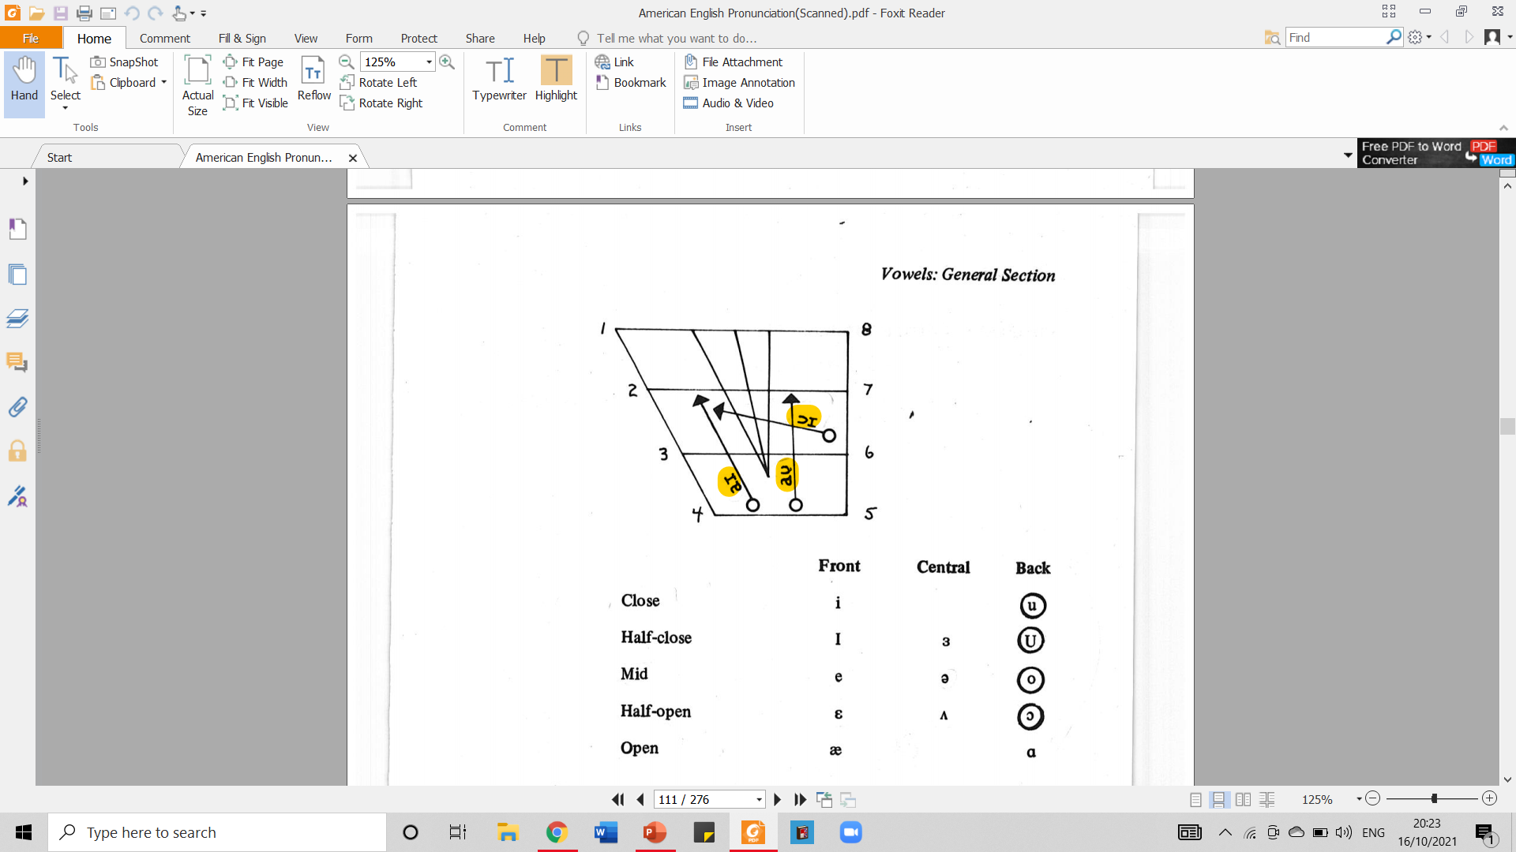
5.1. How to Describe a Vowel – Monophthongs (cont.)
front
central
back
high
close
high mid
half close
close mid
rounded
low mid
half open
open mid
low
open
Taken from American English Pronunciation Book of Bauer et al., (1980)

Slide 25
5.2. How to Describe a Vowel - Diphthongs
To describe a diphthong, it is useful to consider it a sequence of two monophthongs and to describe it accordingly.
Thus AE /aɪ/ can be described as a diphthong gliding:
a central open unrounded vowel
a front half-close unrounded vowel
from
toward
a
ɪ

Slide 26
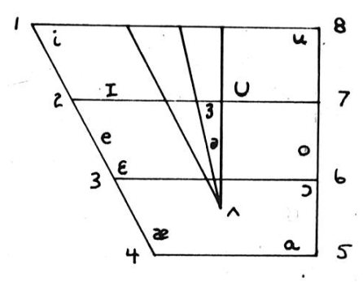
5.2. How to Describe a Vowel – Diphthongs (cont.)
The classification of the AE diphthongs of the AE diphthongs is represented in the vowel chart below:
front
central
back
high
close
low
open

Slide 27
6.1. REVIEW
Please answer the following questions to review what you have learned about Vowels in General Section. Do not go to the next slide before you completely answer all of them.
Find English words who have the following vowels: (a) /ɪ/, (b) /aɪ /, and (c) /ʌ/!
What does it mean by central vowels? How are they produced?
When does vowel neutralization before /r/ happen?
How are vowels articulated?
What are the four parameters used in explaining the articulation of vowels?
Lip rounding parameter divide vowel articulation into two. What are they and how they are produced?
What is diphthongization parameter about?
What happen in vowel nasalization? What changes?
Mention three examples of English words whose vowels are nasalized!
What is the difference between how to describe a vowel between diphthongs and monophthongs?

Slide 28
6.2. REVIEW – ANSWER KEY
Please answer the following questions to review what you have learned about Vowels in General Section. Do not go to the next slide before you completely answer all of them.
Find English words who have the following vowels: (a) /ɪ/, (b) /aɪ /, and (c) /ʌ/!
(a) Ship, dip; (b) buy, five; (c) gun, bun
What does it mean by central vowels? How are they produced?
Central vowels mean the ones located in intermediate position. They are produced in an intermediate position between front and back vowels, with the body of the tongue raised towards the roof the mouth in the area where the hard and soft palates fuse
When does vowel neutralization before /r/ happen?
It happens because there are no contrasts between the members of the sets of vowels such as /i/ and /ɪ/ and /e/ and /ε/
How are vowels articulated?
All vowels are articulated with a stricture of open approximation (i.e. a stricture which does not give rise to audible friction) between the tongue and the roof of the mouth.
What are the four parameters used in explaining the articulation of vowels?
Height, depth, lip rounding, and diphthongization

Slide 29
6.2. REVIEW – ANSWER KEY (cont.)
Please answer the following questions to review what you have learned about Vowels in General Section. Do not go to the next slide before you completely answer all of them.
Lip rounding parameter divide vowel articulation into two. What are they and how they are produced?
The vowel articulation based on lip rounding parameter is divided into 2: rounded and unrounded vowels. Rounded vowels are pronounced with rounded lips and others are pronounced without such rounding. Meanwhile, unrounded vowels are pronounced with lips which are spread.
What is diphthongization parameter about?
It is about a vowel segment which occurs in a single syllable and that acts as a single unit in the language. It also explains about how the vowel segment is characterized: characterized articulatorily by a glide from the position for one vowel toward the position for another. The examples are /aɪ, aʊ, Ɔɪ/.
What happen in vowel nasalization? What changes?
In the normal articulation for all vowels in English, the velum is raised blocking off the nasal cavity, so that all the air escapes through the mouth. However, whenever a nasal consonant follows a vowel, the lowering of the velum is likely to be premature, occurring before the oral closure has been formed.
Mention three examples of English words whose vowels are nasalized!
Man, Ann, and
What is the difference between how to describe a vowel between diphthongs and monophthongs?
Monophthongs can be uniquely described by naming its height and depth. For example, /i/ is described as a close, unrounded front vowel. Meanwhile, diphthongs can be described by considering its sequence

Slide 30
REFERENCES
Bauer L., Dienhart M. J., Hartvigson H., & Jakobsen L. (1980). American English pronunciation. Copenhagen: Gyldendal. Page 91 – 103.

Slide 31
PICTURE SOURCE
Slide 6: https://improveyouraccent.co.uk/vowel-chart/

