Slide 1
ENGLISH
PHONETICS AND PHONOLOGY
Week 8 – Chapter 8
The Individual Vowels (Part 1)
Lecturer: Maria Dewi Rosari, M.Pd.

Slide 2
INTRODUCTION
AIM OF THE COURSE
WEEK 8 – LEARNING OBJECTIVES
For advanced learners of English
For those who are interested in AE (American English)
For those who are non-native speakers
The articulation, variation, distribution, orthographic notes, and comparison with BE of:
1.1. /i/ 1.2. /ɪ/ 1.3. /e/ 1.4. /ε/ | 1.5. /ӕ/ 1.6. /ǝ/ 1.7. /ɜ/ 1.8. /ʌ/

Slide 3
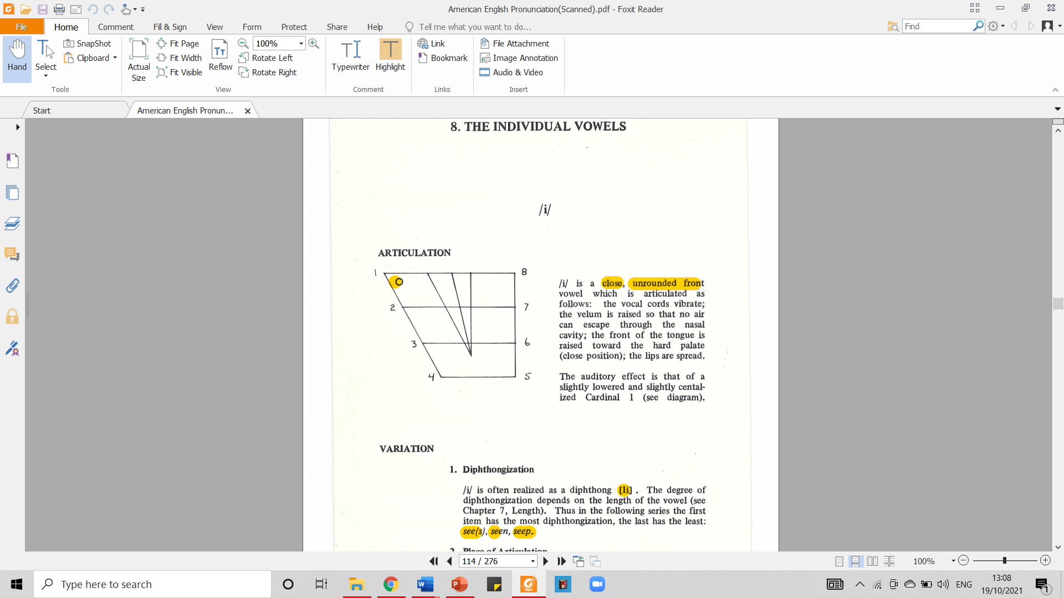
1.1.1. English Vowel – /i/ - Articulation
It is a close, unrounded front vowel.
/i/ is articulated as follow:
The vocal cords vibrate.
The velum is raised so that no air can escape through the nasal cavity.
The front of the tongue is raised toward the hard palate (close position).
The lips are spread.
Taken from American English Pronunciation Book of Bauer et al., (1980)
The auditory effect is that of a slightly lowered and slightly centralized Cardinal 1.

Slide 4

1.1.2. English Vowel – /i/ - Variation
DIPHTHONGIZATION
/i/ is often realized as a diphthong [ɪi].
The degree of diphthongization depends on the length of the vowel.
Thus in the following series the first item has the most diphthongization, the last has the least: see(s), seen, seep.
PLACE OF ARTICULATION
/i/ has a retracted allophone [i] which is common when adjacent to consonants with velar articulation (i.e. /k, g, w/ and [l]): keep, league, weep, real

Slide 5
1.1.3. English Vowel – /i/ - Distribution
/i/ can occur in open stressed syllables (tea, key), and is thus a potentially free vowel.
/i/ does not occur before /ŋ/.
Before /r/ (pier, fear) the distinction between /i/ and /ɪ/ is neutralized. For most AE speakers the vowel in this case is nearer /ɪ/ than /i/.
There is free variation between /i/ and /ε/ in economic(s), economical(ly), penalize.
In some words with the prefixes anti- and semi-, there is free variation between /i/ and /aɪ/: anti-war, semi-annual.

Slide 6
1.1.4. English Vowel – /i/ - Comparison with BE
AE and BE /i/ are articulated in the same way.

Slide 7
1.1.5. English Vowel – /i/ - Orthographic Notes
/i/ is normally spelled:
ee : bee
ea : tea
But other spellings abound: field, machine, he, receive, people, key.

Slide 8
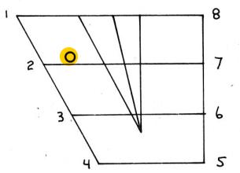
1.2.1. English Vowel – /ɪ/ - Articulation
It is a half-close, unrounded front vowel.
/ɪ/ is articulated as follow:
The vocal cords vibrate.
The velum is raised so that no air can escape through the nasal cavity.
The front of the tongue is raised toward the hard palate (half-close position).
The lips are slightly spread or neutral.
Taken from American English Pronunciation Book of Bauer et al., (1980)
The auditory effect is that of a retracted and slightly raised Cardinal 2.

Slide 9

1.2.2. English Vowel – /ɪ/ - Variation
DIPHTHONGIZATION
/ɪ/ is occasionally somewhat diphthongized [ɪ^{ǝ}].
The degree of diphthongization depends on the length of the vowel.
Thus /ɪ/ is more likely to be realized as [ɪ^{ǝ}] in hid than in hit.
PLACE OF ARTICULATION
/ɪ/ has a retracted allophone [ɪ] which is common when adjacent to consonants with velar articulation (i.e. /k, g, ŋ, w/ and [l]): kid, big, sing, win, Jill.

Slide 10
1.2.3. English Vowel – /ɪ/ - Distribution
/ɪ/ cannot occur in open stressed syllables and is thus a checked vowel.
Before /r/ (pier, fear) the distinction between /i/ and /ɪ/ is neutralized. For most AE speakers the vowel in this case is nearer /ɪ/ than /i/.
/ɪ/ is in free variation with /ǝ/:
In unstressed syllables in many words:
initial: believe, rely
medial: hemisphere
final: kitchen, cottage, April
In the suffixed /ɪd/, /ɪz/, and /ɪst/: lasted, padded; paces, watches; strongest, shortest

Slide 11
1.2.4. English Vowel – /ɪ/ - Comparison with BE
ARTICULATION
AE and BE /ɪ/ are articulated in the same way.
VARIATION
BE /ɪ/ does not have the allophone [ɪ^{ǝ}]

Slide 12
1.2.5. English Vowel – /i/ - Orthographic Notes
/ɪ/ is normally spelled:
i : sit, wing
But other spellings abound: waited, private, bargain, women.

Slide 13
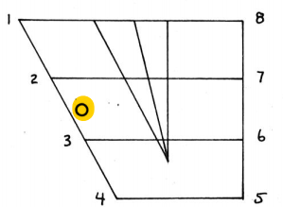
1.3.1. English Vowel – /e/ - Articulation
It is a mid, unrounded front vowel.
/e/ is articulated as follow:
The vocal cords vibrate.
The velum is raised so that no air can escape through the nasal cavity.
The front of the tongue is raised toward the hard palate (mid position).
The lips are slightly spread or neutral.
Taken from American English Pronunciation Book of Bauer et al., (1980)
The auditory effect is that of a vowel approximately half-way between Cardinal 2 and Cardinal 3.

Slide 14
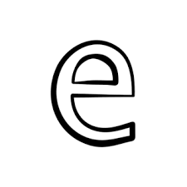
1.3.2. English Vowel – /e/ - Variation
DIPHTHONGIZATION
/e/ is often realized as a diphthong [eɪ].
The degree of diphthongization depends on the length of the vowel.
Thus in the following series the first item has the most diphthongization, the last has little or none: play(s), plane, plate, chaotic.

Slide 15
1.3.3. English Vowel – /e/ - Distribution
/e/ can occur in open stressed syllables (say, tray, delay) and is thus a potentially free vowel.
/e/ does not occur before /ŋ/.
There is free variation between /e/ and /ӕ/ in some words: apical, apricot, matrix; this is especially common in the negative prefix a-: amoral, asymmetric.

Slide 16
1.3.4. English Vowel – /e/ - Comparison with BE
ARTICULATION
BE /eɪ/ is always a diphthong.
DISTRIBUTION
The distribution of AE /e/ and BE /eɪ/ are almost identical.

Slide 17
1.3.5. English Vowel – /e/ - Orthographic Notes
/e/ is normally spelled:
a (in the words that end in e), ai, and ay: gate, stain, say.
Note also the spellings in the following words: chaotic, obey, they, vein, great, steak, break.

Slide 18
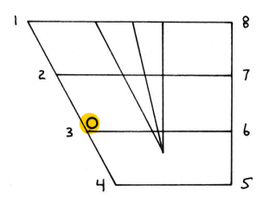
1.4.1. English Vowel – /ε/ - Articulation
It is a half-open, unrounded front vowel.
/ε/ is articulated as follow:
The vocal cords vibrate.
The velum is raised so that no air can escape through the nasal cavity.
The front of the tongue is raised toward the hard palate (half-open position).
The lips are slightly spread or neutral.
Taken from American English Pronunciation Book of Bauer et al., (1980)
The auditory effect is that of a slightly raised and slightly retracted Cardinal 3.

Slide 19

1.4.2. English Vowel – /ε/ - Variation
A retracted variety of /ε/ is found before /ɪ/ (fell, tell).

Slide 20
1.3.3. English Vowel – /ε/ - Distribution
/ε/ cannot occur in open stressed syllables and is thus a checked vowel.
A few AE speakers distinguish between /e/, /ε/, and /ӕ/ before /r/ in words like Mary, merry, and marry.
Some speakers have only a two-way distinction here, between /ε/ and /ӕ/
For such speakers Mary and merry have the same vowel quality (/ε/), which is distinct from that in marry (/ӕ/).
For most speakers, however, Mary, merry, and marry are all pronounced alike.

Slide 21
1.4.4. English Vowel – /ε/ - Comparison with BE
DISTRIBUTION
BE distinguishes between /eǝ/, /ε/, and /ӕ/ before /r/ in words like Mary, merry, marry respectively. This is not the case in AE.
Lever is pronounced /lεvǝr/ (more rarely /lɪvǝr/) in AE but only /lɪvǝ/ in BE.

Slide 22
1.4.5. English Vowel – /ε/ - Orthographic Notes
/ε/ is regularly spelled e and ea: red, bread. Before r it may also be spelled a: marry, Marry.
Other spellings abound: any, many, Thames, friend.
Note the irregular spelling of bury /bεrɪ/

Slide 23
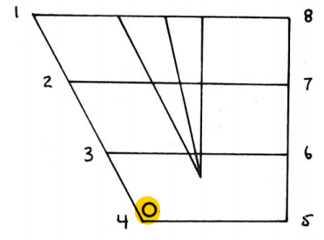
1.5.1. English Vowel – /ӕ/ - Articulation
It is an open, unrounded front vowel.
/ӕ/ is articulated as follow:
The vocal cords vibrate.
The velum is raised so that no air can escape through the nasal cavity.
The front of the tongue is raised toward the hard palate (open position).
The lips are slightly spread or neutral.
Taken from American English Pronunciation Book of Bauer et al., (1980)
The auditory effect is that of a slightly raised Cardinal 4.

Slide 24

1.5.2. English Vowel – /ӕ/ - Variation
DIPHTHONGIZATION
/ӕ/ is occasionally somewhat diphthongized [ӕ^{ǝ}].
The degree of diphthongization depends on the length of the vowel.
Thus /ӕ/ is more likely to be realized as [ӕ^{ǝ}] in had than in hat.
NASALIZATION
The nasalization tends to be particularly strong for /ӕ/.

Slide 25
1.5.3. English Vowel – /ӕ/ - Distribution
/ӕ/ does not occur in open stressed syllables and is thus a checked vowel.
There is free variation between /ӕ/ and /e/ in some words: apical, apricot, matrix, patronize; this is especially common in the negative prefix a-: amoral, asymmetric.

Slide 26
1.5.4. English Vowel – /ӕ/ - Comparison with BE
DISTRIBUTION
In about 150 common words spelled with a followed by /n/ plus a consonant, by /f/, or by /s/ BE has /ɑ/ whereas AE has /ӕ/: aunt, chance, branch, staff, laugh.
In the majority of words so spelled, however, both BE and AE use /ӕ/: ant, mantle, mass, passage.

Slide 27
1.5.5. English Vowel – /ӕ/ - Orthographic Notes
/ӕ/ is regularly spelled
a: man, have cat.
Note, however, the spellings au in aunt, laugh,
and…
ai in plaid.

Slide 28
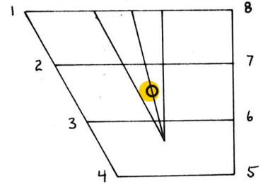
1.6.1. English Vowel – /ǝ/ - Articulation
It is a mid, unrounded central vowel.
/ǝ/ is articulated as follow:
The vocal cords vibrate.
The velum is raised so that no air can escape through the nasal cavity.
The middle of the tongue is raised toward the area where the hard palate and the velum meet (mid position).
The lips are in neutral position.
Taken from American English Pronunciation Book of Bauer et al., (1980)
The auditory effect of this vowel, called “schwa” [ʃwa], cannot be described in relation to any single Cardinal Vowel, since it is “dead-center”.

Slide 29

1.6.2. English Vowel – /ǝ/ - Variation
FINAL POSITION
Before a pause, /ǝ/ has a lowered variant: It’s practically a villa!; He went first to Cuba, then to Africa, and finally to China.
When such words are not followed by a pause, this lowered variant does not occur: There’s a villa for sale next door; Those are lovely China cups.

Slide 30
1.6.3. English Vowel – /ǝ/ - Distribution
/ǝ/ never occurs in stressed syllables.
/ǝ/ alternates with most English vowels as the position of main stress changes, e.g.
/ǝ/ vs. /ӕ/: rapid /’rӕpɪd/ vs
rapidity /rǝpɪdɪti/
/ǝ/ vs. /o/: impose /ɪm’poz/ vs
imposition /ɪmpǝ’zɪʃǝn/

Slide 31
1.6.4. English Vowel – /ǝ/ - Comparison with BE
DISTRIBUTION
The major difference between AE and BE is that BE /ǝ/ never occurs before /r/ in the same syllable, since BE does not have post-vocalic /r/.

Slide 32
1.6.5. English Vowel – /ǝ/ - Orthographic Notes
/ǝ/ can be spelled with every one of the vowel letters:
ɑ about, Cuba
e enough, open
i alibi
o opponent, position
u upon, suppose

Slide 33
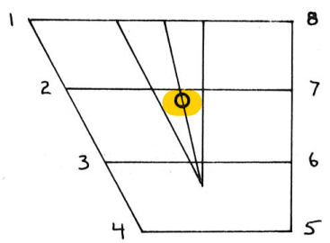
1.7.1. English Vowel – /ɜ/ - Articulation
It is a half-close, unrounded central vowel.
/ɜ/ is articulated as follow:
The vocal cords vibrate.
The velum is raised so that no air can escape through the nasal cavity.
The middle of the tongue is raised toward the area where the hard palate and the velum meet (half-close position).
The lips are neutral.
Taken from American English Pronunciation Book of Bauer et al., (1980)
The auditory effect of this vowel is that of a raised /ǝ/.

Slide 34
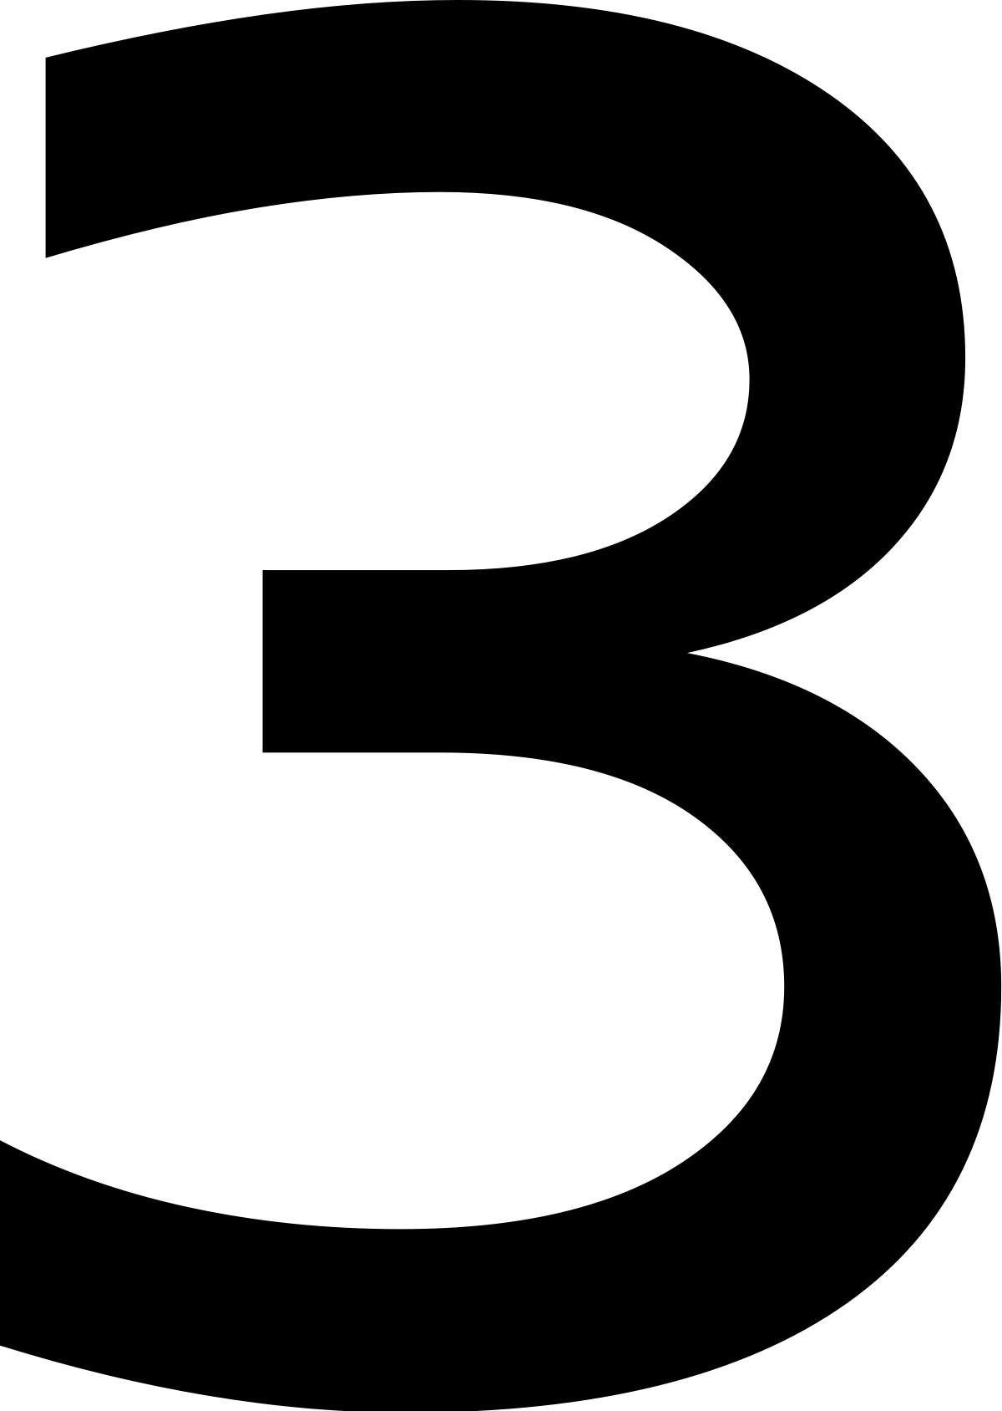
1.7.2. English Vowel – /ɜ/ - Distribution
Since /ɜ/ occurs only before /r/, it is a checked vowel.
Note, however, that the phonetic manifestation [ɜ^{v}] may occur without a following consonant (fur [fɜ^{v}]).

Slide 35
1.7.3. English Vowel – /ɜ/ - Comparison with BE
ARTICULATION
The main difference between AE and BE is that BE does not have [ɜ^{v}] but only [ɜ]; thus fur, curt are [fɜ^{v}], [kɜ^{v}t] in AE [fɜ], [kɜt] in BE.

Slide 36
1.7.4. English Vowel – /ɜ/ - Orthographic Notes
/ɜ/ is spelled
u (fur),
o (word),
e (perk),
i (sir),
ea (earth),
ou (courage).

Slide 37
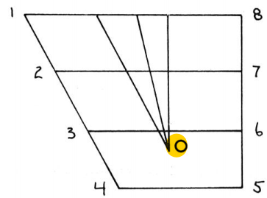
1.8.1. English Vowel – /ʌ/ - Articulation
It is a half-open, unrounded central vowel.
/ʌ/ is articulated as follow:
The vocal cords vibrate.
The velum is raised so that no air can escape through the nasal cavity.
The middle of the tongue is raised toward the area where the hard palate and the velum meet (open position).
The lips are neutral.
Taken from American English Pronunciation Book of Bauer et al., (1980)
The auditory effect of this vowel is that of a lowered and slightly retracted /ǝ/.

Slide 38

1.8.2. English Vowel – /ʌ/ - Variation
There are no important variants of /ʌ/.

Slide 39
1.8.3. English Vowel – /ʌ/ - Distribution
/ʌ/ cannot occur in open stressed syllables and is thus a checked vowel.
In the words from, of, wasn(n’t), and what, /ʌ/ is gaining ground at the expense of /ɑ/. Similarly, /ʌ/ appears to be replacing /Ɔ/ in because.

Slide 40
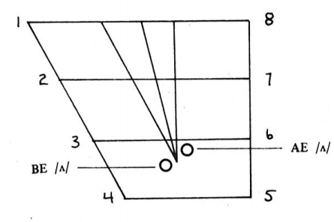
1.8.4. English Vowel – /ʌ/ - Comparison with BE
ARTICULATION
The corresponding BE phoneme is more open and more fronted than AE /ʌ/.
Taken from American English Pronunciation Book of Bauer et al., (1980)

Slide 41
1.8.5. English Vowel – /ʌ/- Orthographic Notes
/ʌ/ is generally spelled
u (nut, shut)
ou (enough, country)
oo (blood, flood)
oe (does)

Slide 42
2.1. EXERCISE
The complete review section about English vowels is provided at the end of lesson 9. For now, please kindly answer the following questions related to several English vowels discussed in today’s lesson! The answer key is provided on the next slide!
1. a. What are the similarities in the pronunciation of /i/ and /ɪ/?
b. What are the differences in the pronunciation of /i/ and /ɪ/?
2. Explain at least 3 environments in which there is free variation between /i/ and /ɪ/!
3. Mention and explain the environments in which we can find free variation of /ɪ/ with /ǝ/!
4. a. How is the vowel /e/ articulated?
b. Explain the free variation between /e/ and /ӕ/ and provide some examples of English words where we
can find it!
c. How is the vowel /e/ usually spelled in English words? Provide some examples!

Slide 43
2.2. REVIEW – ANSWER KEY
See the following discussion to check your answer on the questions provided on the previous slide!
1. a. What are the similarities in the pronunciation of /i/ and /ɪ/?
When we pronounce /i/ and /ɪ/ our lips are not rounded.
When we pronounce both vowels the velum is raised, and the front tongue is moved to the hard palate
b. What are the differences in the pronunciation of /i/ and /ɪ/?
The different is /i/ is close and /ɪ/ is a half close.
The lips in /i/ is spread while in /ɪ/ is neutral.
2. Explain at least 3 environments in which there is free variation between /i/ and /ɪ/!
a. In unstressed final position
b. In unstressed position before vowels
c. In some words, with the prefixes anti- and semi-

Slide 44
2.2. REVIEW – ANSWER KEY
See the following discussion to check your answer on the questions provided on the previous slide!
3. Mention and explain the environments in which we can find free variation of /ɪ/ with /ǝ/!
In unstressed syllables in many words:
Initial believe, rely, deride
Medial legislate, hemisphere, arbitrate
Final kitchen, cottage, April
In the suffixes /ɪd/, /ɪz/, /ɪst/:
lasted, padded, paces, watches, strongest, shortest
4. a. How is the vowel /e/ articulated?
b. Explain the free variation between /e/ and /ӕ/ and provide some examples of English words where we
can find it!
c. How is the vowel /e/ usually spelled in English words? Provide some examples!
a./e/ articulated as follow: the vocal cords vibrate; the velum is raised so that no air can escape through the nasal cavity; the front of the tongue is raised toward the hard palate; the lips are slightly spread or neutral.
b. the is free variation between /e/ and /ae/ happen in some words such as : apical, apricot, etc.
c. /e/ is regularly spelled a, ai, ay: gate, stain, say.

Slide 45
REFERENCES
Bauer L., Dienhart M. J., Hartvigson H., & Jakobsen L. (1980). American English pronunciation. Copenhagen: Gyldendal. Page 104 – 122.

Slide 46
PICTURE SOURCE
/i/ icon: https://icon-library.com/icon/information-i-icon-22.html
/ɪ/ icon: http://www.rw-designer.com/icon-detail/20775
/e/ icon: https://www.freeiconspng.com/images/letter-e-icon-png
/ε/ icon: https://en.wiktionary.org/wiki/%C9%9B
/ӕ/ icon: https://pcmac.download/app/1088728172/emon-phonetic-dictionary
/ǝ/ icon: https://meta.wikimedia.org/wiki/File:WiktLogo-Bubble-schwa-Gentium-red.svg
/ɜ/ icon: https://en.wiktionary.org/wiki/%C9%9C
/ʌ/ icon: https://esllibrary.com/courses/130/lessons/3359

