Slide 1
ENGLISH
PHONETICS AND PHONOLOGY
Week 9 – Chapter 9
The Individual Vowels (Part 2)
Lecturer: Maria Dewi Rosari, M.Pd.

Slide 2
INTRODUCTION
AIM OF THE COURSE
WEEK 9 – LEARNING OBJECTIVES
For advanced learners of English
For those who are interested in AE (American English)
For those who are non-native speakers
The articulation, variation, distribution, orthographic notes, and comparison with BE of:
1.1. /u/ 1.2. /ʊ/ 1.3. /o/ 1.4. /Ɔ/ | 1.5. /ɑ/ 1.6. /aɪ/ 1.7. /aʊ/ 1.8. /Ɔɪ/

Slide 3
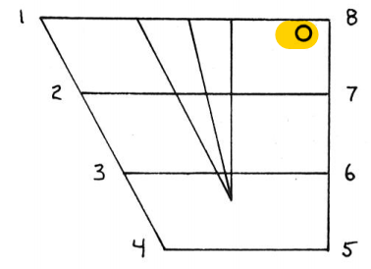
1.1.1. English Vowel – /u/ - Articulation
It is a close, rounded back vowel.
/u/ is articulated as follow:
The vocal cords vibrate.
The velum is raised so that no air can escape through the nasal cavity.
The back of the tongue is raised toward the velum(close position).
The lips are rounded and may be slightly protruded.
Taken from American English Pronunciation Book of Bauer et al., (1980)
The auditory effect is that of a slightly lowered and centralized Cardinal 8.

Slide 4

1.1.2. English Vowel – /u/ - Variation
DIPHTHONGIZATION
/u/ is often realized as a diphthong [Uʊ].
The degree of diphthongization depends on the length of the vowel.
Thus in the following series the first item has the most diphthongization, the last has the least: coo(s), coon, coop.
PLACE OF ARTICULATION
/u/ has a fronted allophone [u] after /j/: pew, view, news, humorous.
Some speakers use a somewhat fronted, unrounded variety [u_{u}] in all positions.

Slide 5
1.1.3. English Vowel – /u/ - Distribution
/u/ can occur in open stressed syllables (two, coo), and is thus a potentially free vowel.
/u/ does not occur before /ŋ/.
Before /r/ (poor, fury) the distinction between /u/ and /ʊ/ is neutralized, i.e. we find either /u/ or /ʊ/ or something in between.
In some words spelled with oo there is free variation between /u/ and /ʊ/ : broom, hoof, roof, room, soot.

Slide 6
1.1.4. English Vowel – /u/ - Comparison with BE
ARTICULATION
There are no important differences between AE and BE /u/.
DISTRIBUTION
The free variation between /u/ and /ʊ/ is less common in BE than in AE: in BE we find it only in broom, groom, room.

Slide 7
1.1.5. English Vowel – /u/ - Orthographic Notes
/u/ is normally spelled:
oo : choose, loop
But other spellings abound: shoe, lose, soup, tune, suit, sue, through.

Slide 8
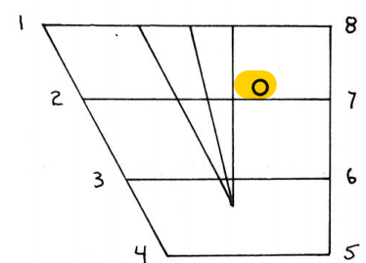
1.2.1. English Vowel – /ʊ/ - Articulation
It is a half-close, rounded back vowel.
/ʊ/ is articulated as follow:
The vocal cords vibrate.
The velum is raised so that no air can escape through the nasal cavity.
The back of the tongue is raised toward the velum (half-close position).
The lips are slightly rounded or neutral.
Taken from American English Pronunciation Book of Bauer et al., (1980)
The auditory effect is that of a fronted and slightly raised Cardinal 7.

Slide 9

1.2.2. English Vowel – /ʊ/ - Variation
DIPHTHONGIZATION
/ʊ/ is occasionally somewhat diphthongized [ʊ^{ǝ}]. The degree of diphthongization depended on the length of the vowel.
Thus /ʊ/ is more likely to be realized as [ʊ^{ǝ}] in good than in foot.

Slide 10
1.2.3. English Vowel – /ʊ/ - Distribution
/ʊ/ cannot occur in open stressed syllables and is thus a checked vowel.
Before /r/ (poor, fury) the distinction between /u/ and /ʊ/ is neutralized, i.e. we find /u/ or /ʊ/ or something in between.
/ʊ/’s distribution is quite heavily restricted: it does not occur word-initially (except in a few exotic items like oomph, umlaut and it does not occur before /ŋ/.
In some words spelled with oo there is free variation between /u/ and /ʊ/ : broom, hoof, roof, room, soot.

Slide 11
1.2.4. English Vowel – /ʊ/ - Comparison with BE
ARTICULATION
There are no important differences between AE and BE /ʊ/.
VARIATION
The free variation between /u/ and /ʊ/ is less common in BE than in AE: in BE we find it only in broom, groom, room.

Slide 12
1.2.5. English Vowel – /ʊ/ - Orthographic Notes
/ʊ/ is normally spelled:
oo : stood, took, wood
u : bull, bush, cushion
Rare spellings are ou (could, should, would) and o (bosom, wolf, woman).

Slide 13
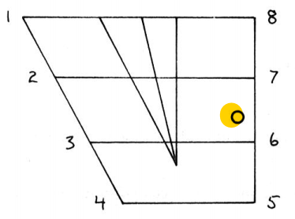
1.3.1. English Vowel – /o/ - Articulation
It is a mid, rounded back vowel.
/o/ is articulated as follow:
The vocal cords vibrate.
The velum is raised so that no air can escape through the nasal cavity.
The back of the tongue is raised toward the velum (mid position).
The lips are slightly rounded or neutral.
Taken from American English Pronunciation Book of Bauer et al., (1980)
The auditory effect is that of a vowel approximately half-way between Cardinal 6 and Cardinal 7.

Slide 14

1.3.2. English Vowel – /o/ - Variation
DIPHTHONGIZATION
/o/ is often realized as a diphthong [oʊ].
The degree of diphthongization depends on the length of the vowel.
Thus in the following series the first item has the most diphthongization, the last has little or none: know(s), known, note, oasis.

Slide 15
1.3.3. English Vowel – /o/ - Distribution
/o/ can occur in open stressed syllables (show, no, toe) and is thus a potentially free vowel.
/o/ does not occur before /ŋ/.
For many speakers, /o/ and /Ɔ/ are neutralized before /r/. Such speakers pronounce horse and hoarse identically; for these speakers the vowel tends to be nearer /Ɔ/ than /o/, so that both can be transcribed /hƆrs/

Slide 16
1.3.4. English Vowel – /o/ - Comparison with BE
ARTICULATION
AE /o/ corresponds to BE /ǝʊ/, which is always a diphthong.
BE /ǝʊ/ starts from a much more central position than the AE vowel.
DISTRIBUTION
The distinction made by some AE speakers between horse, hoarse, etc. has no parallel in BE, where all such words are pronounced with /Ɔ/.

Slide 17
1.3.5. English Vowel – /o/ - Orthographic Notes
/o/ is often spelled:
o no, mope, old, folk
oa soap, toast
oe potatoes, toe
ow show, know
There are also other spellings: soul, though

Slide 18
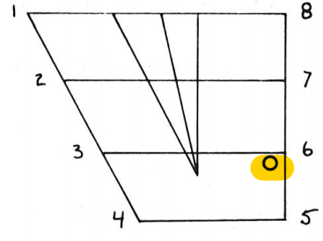
1.4.1. English Vowel – /Ɔ/ - Articulation
It is a half-open, rounded back vowel.
/Ɔ/ is articulated as follow:
The vocal cords vibrate.
The velum is raised so that no air can escape through the nasal cavity.
The back of the tongue is raised toward the velum (half-open position).
The lips are slightly rounded.
Taken from American English Pronunciation Book of Bauer et al., (1980)
The auditory effect is that of a very slightly fronted and very slightly lowered Cardinal 6.

Slide 19

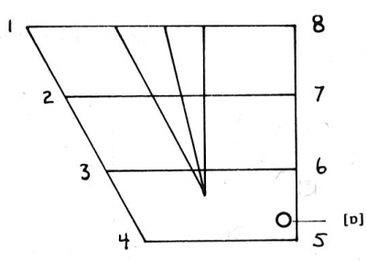
1.4.2. English Vowel – /Ɔ/ - Variation
Some speakers have a lowered variant /ɒ/ in cases like those dealt with in Distribution 2 below.
Taken from American English Pronunciation Book of Bauer et al., (1980)

Slide 20
1.4.3. English Vowel – /Ɔ/ - Distribution
/Ɔ/ can occur in open stressed syllables (law, saw) and is thus a potentially free vowel.
In order to account for the incidence of /Ɔ/ , including its alternation with /ɑ/, it is pedagogically useful to rely on a combination of orthography and phonology. /Ɔ/ alternates with /ɑ/:
/Ɔ/ occurs to the practical exclusion of /ɑ/ → in words spelled with aun followed by a consonant: gaunt, laundry
There is only /Ɔ/ → in some words spelled with ua or wa: quarter, wall
There is only /ɑ/ → in some words spelled with ua or wa: wander, quad
/a/ occurs when the words spelled with o: common; hog; gong; foreign.

Slide 21
1.4.4. English Vowel – /Ɔ/- Comparison with BE
ARTICULATION
AE /Ɔ/ is considerably more open than BE /Ɔ/.
DISTRIBUTION
Before /l/ plus a consonant, AE has /Ɔ/ while BE has /ɒ/ or /Ɔ/: fault, salt;

Slide 22
1.4.5. English Vowel – /Ɔ/ - Orthographic Notes
/Ɔ/ is regularly spelled
au taught
ou fought
aw awful
Other spellings are: a (before /l/ or after /w/: salt, water); o (foreign); oa (board); oo (odor).

Slide 23
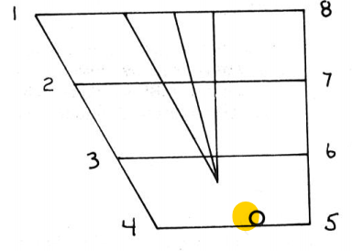
1.5.1. English Vowel – /ɑ/ - Articulation
It is an open, unrounded back vowel.
/ɑ/ is articulated as follow:
The vocal cords vibrate.
The velum is raised so that no air can escape through the nasal cavity.
The back of the tongue is raised toward the velum (open position).
The lips are slightly spread or neutral.
Taken from American English Pronunciation Book of Bauer et al., (1980)
The auditory effect is that of a fronted Cardinal 5.

Slide 24
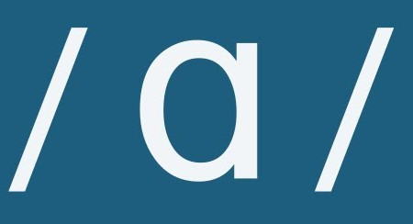
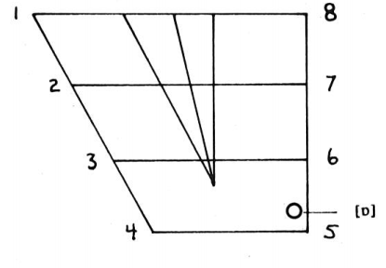
1.5.2. English Vowel – /ɑ/ - Variation
Some speakers have a slightly rounded and retracted variant [ɒ].
Taken from American English Pronunciation Book of Bauer et al., (1980)

Slide 25
1.5.3. English Vowel – /ɑ/ - Distribution
/ɑ/ can occur in open stressed syllables (ah!, ma, pa) and is thus a potentially free vowel.
The distribution of /ɑ/ and /Ɔ/.
The letter o represents /ɑ/:
before stops other than /g/: stop, pot, lock
before affricates: botch, lodge, dodge
before /ʃ/: gosh, posh
before /l/: doll, holly
In pro- in some words: proverb, progress

Slide 26
1.5.3. English Vowel – /ɑ/ - Distribution (cont.)
In other environments in words spelled with o, /ɑ/ alternates with /Ɔ/:
before /n/ and /m/: on; common
(here /ɑ/ is the more likely except in gone, which normally has /Ɔ/)
before /g/: hog, fog (here /Ɔ/ is the more likely); in clog, jog, soggy (here /ɑ/ is the more likely)
before intervocalic /r/: foreign, sorry
before /ŋ/, /s/, /f/, /Ɵ/: gong, glossary, officer, Goth
/ɑ/ is yielding to /ʌ/ in the words from, of, was(n’t), and what

Slide 27
1.5.4. English Vowel – /ɑ/ - Comparison with BE
ARTICULATION
Though the main variant of AE /ɑ/ is somewhat more fronted than BE /ɑ/, the auditory difference is slight.

Slide 28
1.5.5. English Vowel – /ɑ/ - Orthographic Notes
/ɑ/ is regularly spelled a (car) or o (pot).
Other spellings include ea (heart).

Slide 29
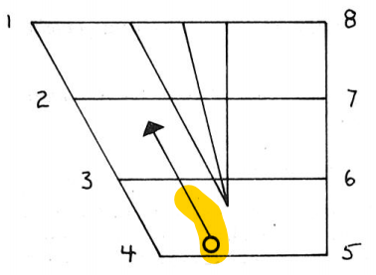
1.6.1. English Vowel – /aɪ/ - Articulation
/aɪ/ is articulated as follow:
The vocal cords vibrate.
The velum is raised so that no air can escape through the nasal cavity.
The tongue glides from the position for an open central vowel toward the position for a half-close front vowel, without necessarily reaching this final position.
The lips are neutral or slightly spread throughout.
Taken from American English Pronunciation Book of Bauer et al., (1980)
The auditory effect is that of a glide from between Cardinal 4 and Cardinal 5 toward a centralized Cardinal 2.

Slide 30
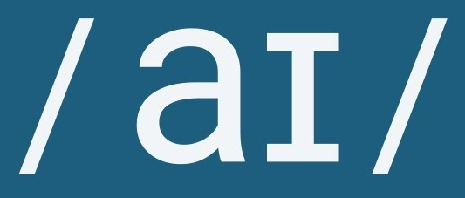
1.6.2. English Vowel – /aɪ/ - Variation
The first element of the diphthong varies between an open central vowel and an open back vowel.
The pronoun I is often pronounced [a] or [ɑ], particularly when unstressed or in the contracted form I’ll.

Slide 31
1.6.3. English Vowel – /aɪ/ - Distribution
/aɪ/ can occur in open stressed syllables (fly, sigh) and is thus a potentially free vowel.
/aɪ/ does not occur before /ŋ/.

Slide 32
1.6.4. English Vowel – /aɪ/ - Comparison with BE
ARTICULATION
There are no important differences in the articulation of AE and BE /aɪ/.
DISTRIBUTION
In words like fertile, hostile, docile BE has [aɪl] where AE has [ll], [ǝl] or [l].
Vitamins is pronounced /’vaɪtǝmɪn/ in AE but normally /’vɪtǝmɪn/ in BE.

Slide 33
1.6.5. English Vowel – /aɪ/ - Orthographic Notes
/aɪ/ is regularly spelled i (in words that end in e) and y: mine.
Note, however, the spellings in the following words: aisle, buy, choir, dye, eye, height, idea, liar, right.

Slide 34
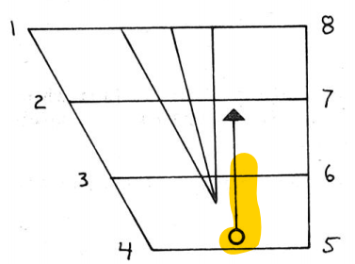
1.7.1. English Vowel – /aʊ/ - Articulation
/aʊ/ is articulated as follow:
The vocal cords vibrate.
The velum is raised so that no air can escape through the nasal cavity.
The tongue glides from the position for an open central vowel toward the position for a half-close back vowel, without necessarily reaching this final position.
The lips start in neutral position, and become rounded in the course of the articulation of the sound.
Taken from American English Pronunciation Book of Bauer et al., (1980)
The auditory effect is that of a glide from between Cardinal 4 and Cardinal 5 toward a centralized Cardinal 7.

Slide 35
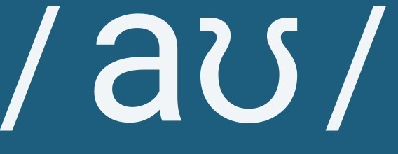
1.7.2. English Vowel – /aʊ/ - Variation
The first element of the diphthong varies between a central open vowel and a back open vowel.

Slide 36
1.7.3. English Vowel – /aʊ/ - Distribution
/aʊ/ can occur in open stressed syllables (now, bough) and is thus a potentially free vowel.

Slide 37
1.7.4. English Vowel – /aʊ/ - Comparison with BE
There are no differences between BE and AE /aʊ/.

Slide 38
1.7.5. English Vowel – /aʊ/ - Orthographic Notes
/aʊ/ is regularly spelled ou, ow: sound, now.
Since /o/ is also spelled ow, some orthographic forms have the two pronunciations with a corresponding difference in meaning, e.g.:
 | /aʊ/ | /o/
bow | /baʊ/ ‘incline the head’ | /bo/ ‘tied ribbon’
row | /raʊ/ ‘argument’ | /ro/ ‘propel a boat with oars’
sow | /saʊ/ ‘female pig’ | /so/ ‘disperse seed’
/aʊ/ is also spelled ough in a few words like bough, drought.

Slide 39
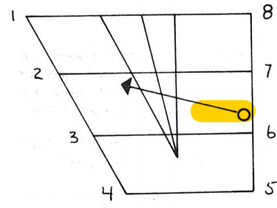
1.8.1. English Vowel – /Ɔɪ/ - Articulation
/Ɔɪ/ is articulated as follow:
The vocal cords vibrate.
The velum is raised so that no air can escape through the nasal cavity.
The tongue glides from the position for a mid back vowel toward the position for a half-close front vowel without necessarily reaching this final position.
The lips are slightly rounded or neutral for the first element and neutral or slightly spread for the second element.
Taken from American English Pronunciation Book of Bauer et al., (1980)
The auditory effect is that of a glide from between Cardinal 6 and 7 toward a centralized Cardinal 2.

Slide 40
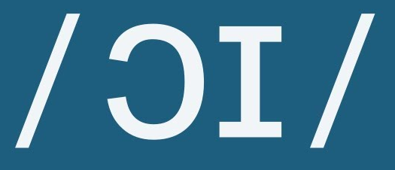
1.8.2. English Vowel – /Ɔɪ/ - Variation
The starting point of the diphthong varies between a lowered Cardinal 7 and a raised, rounded Cardinal 5.

Slide 41
1.8.3. English Vowel – /Ɔɪ/ - Distribution
/Ɔɪ/ can occur in open stressed syllables (toy, deploy) and is thus a potentially free vowel.

Slide 42
1.8.4. English Vowel – /Ɔɪ/ - Comparison with BE
ARTICULATION
The starting point for the BE diphthong tends to be in the lower part of the range for the AE diphthong, though there is a lot of variation in both AE and BE.
DISTRIBUTION
There are no important differences in distribution between BE and AE /Ɔɪ/.

Slide 43
1.8.5. English Vowel – /Ɔɪ/ - Orthographic Notes
/Ɔɪ/ is spelled oi and oy (soil, boy).

Slide 44
2.1. EXERCISE
Please answer the following questions about The Individual Vowels discussed in lesson 8 and 9. The answer key is provided on the next slide!
When is the distinction between /u/ and /ʊ/ neutralized? Provide some examples!
What happen to the articulation of /o/ when it occurs before /r/? Explain and provide some examples of English word!
In what environment does the letter o represent /ɑ/? Provide some examples!
How do AE speakers differentiate the sound between /e/, / Ɛ/, and /ӕ/! Answer it by explaining the vowel quality!
Explain the environment in which the vowel /ӕ/ and /e/ have free variation!
How does our tongue glide when articulating /aɪ/?
How does our lip move when articulating /aʊ/?
How does our tongue glide when articulating /Ɔɪ/?

Slide 45
2.2. REVIEW – ANSWER KEY
See the following discussion to check your answer on the questions provided on the previous slide!
When is the distinction between /u/ and /ʊ/ neutralized? Provide some examples!
Before /r/ the distinction between /u/ and /ʊ/ is neutralized. Example: poor, fury.
What happen to the articulation of /o/ when it occurs before /r/? Explain and provide some examples of English word!
When /o/ occurs before /r/, the vowel tends to be nearer /ɔ/ than /o/ . The examples are horse /hɔrs/ and for /fɔr/
In what environment does the letter o represent /ɑ/? Provide some examples!
Before stops other than /g/: stop, pot; Before affricate; botch, Scotch; lodge, dodge; Before /sh/: gosh, Oshkosh, posh; Before /l/: doll, golly, holly; In pro- in some words: proverb, prominent, progress.
How do AE speakers differentiate the sound between /e/, / Ɛ/, and /ӕ/! Answer it by explaining the vowel quality!
American English speakers distinguish between /e/, / Ɛ/ and / ӕ / before /r/ just like in the words of Mary, merry, marry.

Slide 46
2.2. REVIEW – ANSWER KEY
See the following discussion to check your answer on the questions provided on the previous slide!
Explain the environment in which the vowel /ӕ/ and /e/ have free variation!
There is free variation between /ӕ/ and /e/ in some word: Apical, apricot, azure, matrix, patronize. This is especially common in the negative prefix a- amoral, atypical, asymmetric.
How does our tongue glide when articulating /aɪ/?
The tongue glides from the position for an open central vowel toward the position for a half-close front vowel without necessarily reaching this final position.
How does our lip move when articulating /aʊ/?
The lips start in neutral position and become rounded in the course of the articulation of the sound.
How does our tongue glide when articulating /Ɔɪ/?
The tongue glides from the position for a mid back vowel toward the position for a half-close front vowel without necessarily reaching this final position.

Slide 47
REFERENCES
Bauer L., Dienhart M. J., Hartvigson H., & Jakobsen L. (1980). American English pronunciation. Copenhagen: Gyldendal. Page 123 – 143.

Slide 48
PICTURE SOURCE
/u/ icon: http://cdn.onlinewebfonts.com/svg/img_525173.png
/ʊ/ icon: https://esllibrary.com/courses/130/lessons/3380
/o/ icon: https://www.vectorstock.com/royalty-free-vector/letter-o-logo-icon-design-template-elements-vector-15238096
/Ɔ/ icon: https://en.wikipedia.org/wiki/Open-mid_back_rounded_vowel
/ɑ/ icon: https://i.ytimg.com/vi/R5CY1UniS68/maxresdefault.jpg
/aɪ/ icon: https://i.ytimg.com/vi/8uD-GuuSgyk/maxresdefault.jpg
/aʊ/ icon: https://i.ytimg.com/vi/-V690OA75bA/maxresdefault.jpg
/Ɔɪ/ icon: https://i.ytimg.com/vi/ZfjPBN22mK8/maxresdefault.jpg

