Slide 1
ENGLISH
PHONETICS AND PHONOLOGY
Week 10 – Chapter 10
Syllable Structure and Phonotactics
Lecturer: Maria Dewi Rosari, M.Pd.

Slide 2
INTRODUCTION
AIM OF THE COURSE
WEEK 10 – LEARNING OBJECTIVES
For advanced learners of English
For those who are interested in AE (American English)
For those who are non-native speakers
Definition of the Syllable
The Structure of the Syllable
2.2. The Onset
2.3. The Coda
Comparison with British English

Slide 3
1.1. Definition of the Syllable
Many of the terms we have used so far in this lesson are terms which are not part of the common core vocabulary of English.
We should have been using phoneme, formant, aspiration, and many others.
Syllable is not such a term.
Rather, it is a term which is used also by people who have received no phonetic training.

Slide 4
1.1. Definition of the Syllable (cont.)
Although it is referred to by phoneticians, e.g. in descriptions of stress and intonation, numerous attempts at defining the syllable have not resulted in a definition which is generally accepted.
One problem which the phonetician faces is that it is not clear what kind of unit the syllable is.
Is it an acoustic unit?
Is it an articulatory unit?
Is it an auditory unit?
Should it be defined in terms of the phonemic patterning of a language?
Should a distinction be made between different types of syllable defined in different terms?

Slide 5
1.1. Definition of the Syllable (cont.)
The analysis we will adopt here is based on the concept of sonority?
But what is sonority? What does it mean by being sonorous?
Utterances are described as sequences of peaks of sonority separated from each other by troughs of sonority.
The number of syllables in an utterance equals the number of peaks of sonority.
The sonority of a sound depends primarily on the extent to which air is allowed to pass unhindered thought the vocal tract during its articulation.

Slide 6
1.1. Definition of the Syllable (cont.)
The more open the vocal tract, the higher the degree of sonority and vice versa.
On this basis it is possible to set up a hierarchy of sonority.
vowels
most sonorous
sonorant
consonants
obstruent
least sonorous

Slide 7
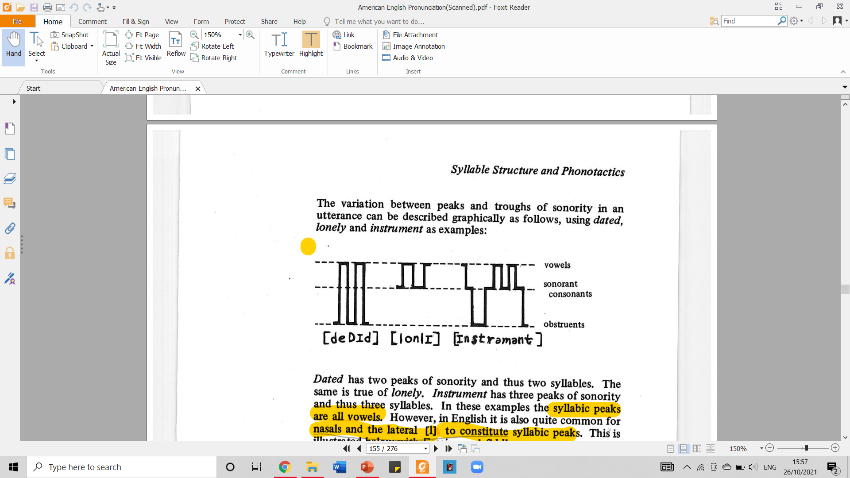
1.1. Definition of the Syllable (cont.)
The variation between peaks and troughs of sonority in an utterance can be described graphically as follows, using dated, lonely, and instruments as examples:
peak
trough
Taken from American English Pronunciation Book of Bauer et al., (1980)

Slide 8
1.1. Definition of the Syllable (cont.)
e
ɪ
d
d
d
Taken from American English Pronunciation Book of Bauer et al., (1980)

Slide 9
1.1. Definition of the Syllable (cont.)
o
ɪ
ɪ
ǝ
ǝ
n
r
n
l
n
l
m
s
t
t
Taken from American English Pronunciation Book of Bauer et al., (1980)
Taken from American English Pronunciation Book of Bauer et al., (1980)
lonely
instrument

Slide 10
1.1. Definition of the Syllable (cont.)
Dated has two peaks of sonority and thus two syllables. The same is true of lonely. Instrument has three peaks of sonority and thus three syllables.
In these examples the syllabic peaks are vowels.
Normally native speakers will agree on the number of syllables in a given utterance. There are cases, however, where uncertainty may arise.
This happens particularly when postvocalic /r/ and /l/ are involved as in sour /saʊr/, wire /waɪr/; peel /pɪl/, squirrel /skwʒrl/.
Words like these may be perceived as having one or two syllables.

Slide 11
1.1. Definition of the Syllable (cont.)
So far we have been looking at the problem of determining the number of syllables in an utterance.
This leaves us with two questions.
The first: whether the description of the English syllable as consisting of a peak of sonority surrounded by troughs of sonority can be made more precise.
The second: whether it is possible to determine the exact boundaries between adjacent syllables.

Slide 12
2.1. The Structure of The Syllable
It is customary to analyze the syllable as consisting of an obligatory peak which may be preceded by an optional onset and followed by an optional coda:
peak
onset
coda
consists of segments with increasing sonority
consist of segments with decreasing sonority
In order to determine what are possible onsets and possible codas in English it is useful to investigate which combinations of consonants or clusters occur at the beginning and end of English words, respectively.
The study of the combinatory possibilities of segments is called phonotactics.

Slide 13
2.1. The Structure of The Syllable (cont.)
σ (sigma)
peak
onset
rhyme
onset
coda
nucleus
coda
The important part is the nucleus.
Every syllable must have a nucleus.
Nucleus is the one with the highest sonority (loudness). It usually vowels because they are high in sonority.

Slide 14
2.1. The Structure of The Syllable (cont.)
σ (sigma)
Step 1: CAT → /kӕt/
Step 2: find the nucleus
Step 3: analyze the other components
onset
rhyme
k
nucleus
coda
ӕ
t

Slide 15
2.1. The Structure of The Syllable (cont.)
1. PAY
2. THING
/peɪ/
/Ɵɪŋ/
σ (sigma)
σ (sigma)
onset
rhyme
onset
rhyme
p
Ɵ
nucleus
coda
nucleus
coda
eɪ
ɪ
ŋ

Slide 16
2.2. The Structure of The Syllable – The Onset
In English the onset may consist of 0, 1, 2, or 3 consonants.
ZERO ONSET
σ (sigma)
σ (sigma)
σ (sigma)
It can be illustrated with the examples like the following: earth, I, ought.
onset
rhyme
onset
rhyme
onset
rhyme
nucleus
coda
nucleus
coda
nucleus
coda
ǝ
rƟ
aɪ
Ɔ
t

Slide 17
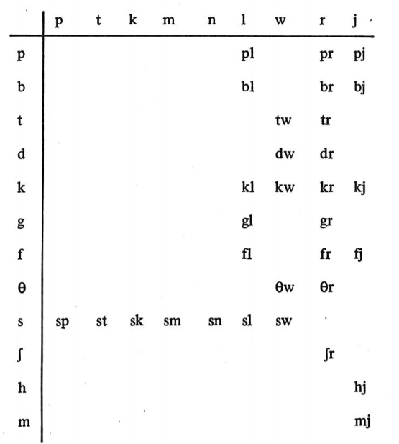
2.2. The Structure of The Syllable – The Onset
TWO-CONSONANT ONSET
The range of possible two-consonant onsets is set out in the following table:
The two-consonant onsets displayed in the table can be exemplified as follows: plead, blame, twig
Check the next slides for the analysis.
Taken from American English Pronunciation Book of Bauer et al., (1980)

Slide 18
2.2. The Structure of The Syllable – The Onset
TWO-CONSONANT ONSET
σ (sigma)
σ (sigma)
σ (sigma)
The two-consonant onsets displayed in the table can be exemplified as follows: plead, blame, twig
onset
rhyme
onset
rhyme
onset
rhyme
pl
bl
tw
nucleus
coda
nucleus
coda
nucleus
coda
i:
d
eɪ
m
ɪ
g

Slide 19
2.2. The Structure of The Syllable – The Onset
THREE-CONSONANT ONSET
The three-consonant onsets that occur in English all consist of /sp, st, sk/ followed by a sonorant:
/spl/: spleen
/spr/: spree
/spj/: spew
/str/: street
/skw/: squeeze
/skl/: sclerosis
/skr/: screech
/skj/: skew
SPLEEN
SPREE
σ (sigma)
σ (sigma)
onset
rhyme
onset
rhyme
spl
spr
nucleus
coda
nucleus
coda
i:
n
i:

Slide 20
2.3. The Structure of The Syllable – The Coda
In English the coda may consist of 0, 1, 2, 3, or 4 consonants.
ZERO CODA
σ (sigma)
σ (sigma)
σ (sigma)
It can be illustrated with the examples like the following: bay, tea, coo.
A syllable with zero coda is called an open syllable; syllables with codas consisting of one or more consonants are called closed syllables.
onset
rhyme
onset
rhyme
onset
rhyme
b
t
k
nucleus
coda
nucleus
coda
nucleus
coda
eɪ
i:
u:

Slide 21
2.3. The Structure of The Syllable – The Coda
ONE CODA
As one-consonant codas we find all English consonants except /h/, /w/, /j/, e.g.: top, mad, leave.
σ (sigma)
σ (sigma)
σ (sigma)
onset
rhyme
onset
rhyme
onset
rhyme
t
m
l
nucleus
coda
nucleus
coda
nucleus
coda
ɒ
p
ӕ
d
i:
v

Slide 22
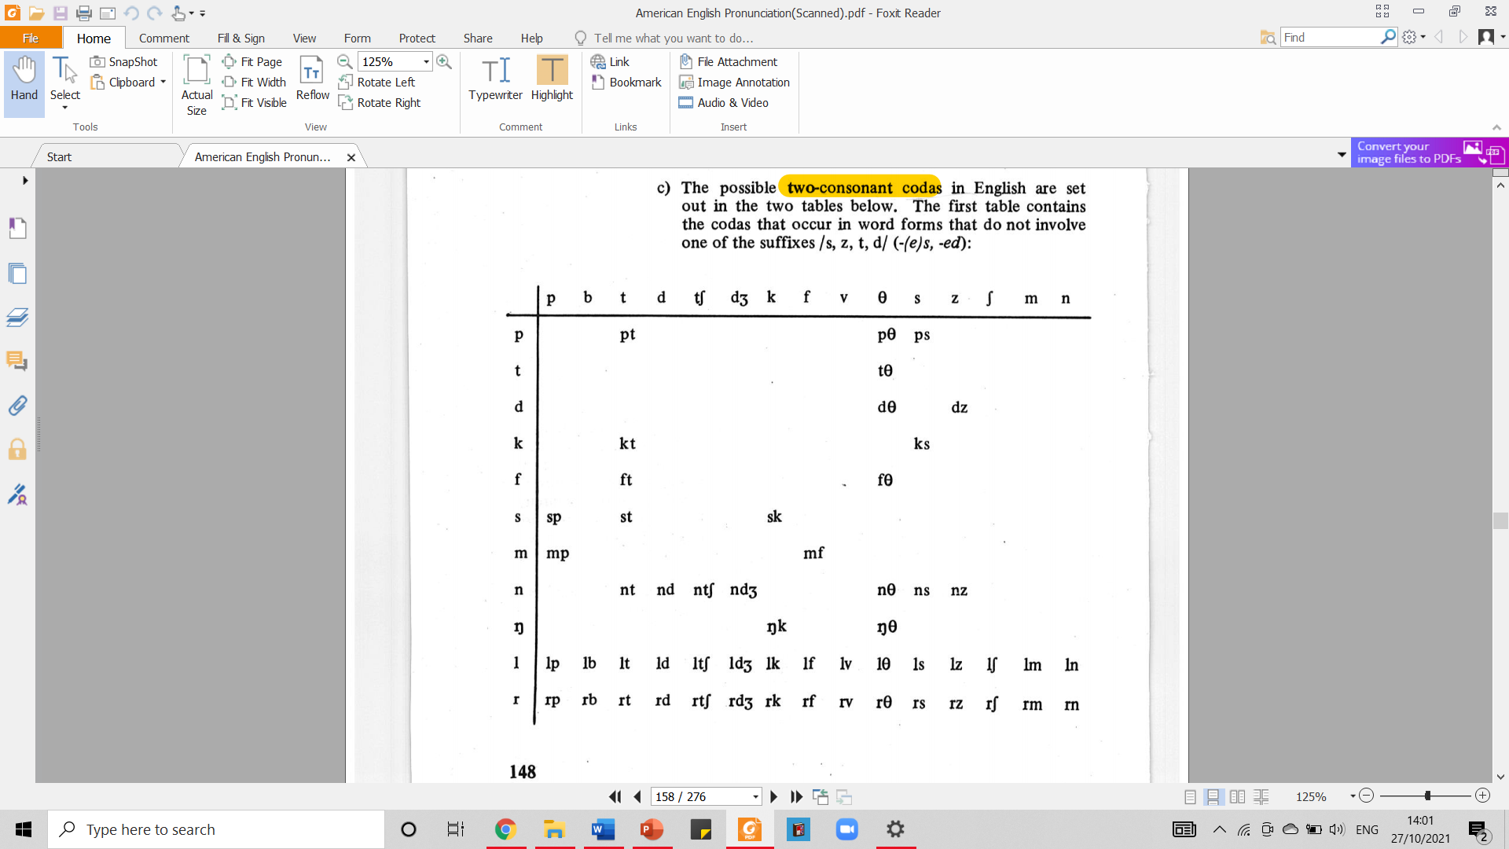
2.3. The Structure of The Syllable – The Coda
TWO-CONSONANT CODAS
The possible two-consonant codas in English are set out in the two tables below.
The first table contains the coda that occur in word forms that do not involve one of the suffixes /s, z, t, d/ (-(e)s, -ed):
These codas can be illustrated with the following examples: apt, strict, last.
Taken from American English Pronunciation Book of Bauer et al., (1980)

Slide 23
2.3. The Structure of The Syllable – The Coda
TWO-CONSONANT CODA
σ (sigma)
σ (sigma)
σ (sigma)
These codas can be illustrated with the following examples: apt, strict, last.
onset
rhyme
onset
rhyme
onset
rhyme
str
l
nucleus
coda
nucleus
coda
nucleus
coda
ӕ
pt
ɪ
kt
ɑ:
st

Slide 24
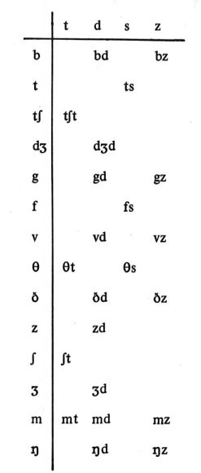
2.3. The Structure of The Syllable – The Coda
TWO-CONSONANT CODA
To these two-consonant codas can be added clusters which occur only with suffixation of /s, z, t, d/.
These codas can be exemplified as follows: robs, watched, lags
Taken from American English Pronunciation Book of Bauer et al., (1980)

Slide 25
2.3. The Structure of The Syllable – The Coda
TWO-CONSONANT CODA
σ (sigma)
σ (sigma)
σ (sigma)
These codas can be exemplified as follows: robs, watched, lags
onset
rhyme
onset
rhyme
onset
rhyme
r
w
l
nucleus
coda
nucleus
coda
nucleus
coda
ɒ
bz
ɑ:
tʃt
ӕ
gz

Slide 26
2.3. The Structure of The Syllable – The Coda
THREE-CONSONANT CODA
/dst/ | midst
/kst/ | next
/ksƟ/ | sixth
/mpt/ | tempt
/mps/ | mumps
/nst/ | against
/ŋkt/ | sacrosanct
/ŋks/ | jinx
/lpt/ | sculpt
/lkt/ | mulct
/lks/ | calx
/lfƟ/ | twelfth
/rkt/ | infarct
/rmƟ/ | warmth
/rpt/ | excerpt
/rps/ | corpse
Three-consonant codas that do not involve suffixation of /s, z, t, d/ are relatively few:
To these codas can be added clusters that result from the addition of one of the suffixes /s, z, t, d/ to the two-consonant codas, e.g. flasks, lisped.

Slide 27
2.3. The Structure of The Syllable – The Coda
FOUR-CONSONANT CODA
σ (sigma)
σ (sigma)
Four-consonant codas only occur in examples where suffixation is involved: tempts, excerpts.
onset
rhyme
onset
rhyme
t
s
nucleus
coda
nucleus
coda
e
mpts
ɜ:
rpts

Slide 28

3.1. Comparison with British English
There are two important phonotactic differences between AE and BE:
Postvocalic /r/
In AE, /r/ is possible as (a first element of) a coda, for example, par /pɑr/, park /pɑrk/, and parks /pɑrks/.
This is not the case in BE, where these words would be /pɑ/, /pɑk/, and /pɑks/.
Onset with /j/ as a Second Element
The clusters /tj, stj, dj, Ɵj, sj, nj, lj/ are found as onsets in BE in words like tune, stew, dune, Thucydides, sue, new, lewd.
These onsets are not found in AE, which has /t, st, d, Ɵ, s, n, l/ in these and similar words.

Slide 29
3.1. Comparison with British English (cont.)
AE
BE
σ (sigma)
σ (sigma)
Postvocalic /r/
AE → park /pɑrk/
BE → park /pɑk/
onset
rhyme
onset
rhyme
p
p
nucleus
coda
nucleus
coda
ɑ
rk
ɑ
k

Slide 30
3.1. Comparison with British English (cont.)
AE
BE
σ (sigma)
σ (sigma)
Onset with /j/ as a Second Element
AE → tune /tu:n/
BE → tune /tʃu:n/
onset
rhyme
onset
rhyme
t
tʃ
nucleus
coda
nucleus
coda
u:
n
u:
n

Slide 31
4.1. REVIEW
Please answer the following questions to review what you have learned about syllable structure and phonotactics. Do not go to the next slide before you completely answer all of them.
Based on the concept of sonority, how are (a) utterances described? And (b) the numbers of syllables counted?
What define the degree of sonority?
What is the definition of: (a) onset, (b) coda.?
Please analyze the structure of the syllable of the following words: top, plead, leave.
In what kind of cases do native speakers may not agree on the number of syllables in a given utterance? Provide some examples of English words!
Please show that the word “tea” doesn’t have coda!
Please show that the word “ought” doesn’t have onset!

Slide 32
4.2. REVIEW – ANSWER KEY
Please answer the following questions to review what you have learned about syllable structure and phonotactics. Do not go to the next slide before you completely answer all of them.
Based on the concept of sonority, how are (a) utterances described? And (b) the numbers of syllables counted?
(a) Based on the concept of sonority utterances are described as sequences of peaks of sonority separated from each other by trough of sonority. (b) the number of syllable in an utterance equals the number of peaks sonority. So if a word have 1 syllable it has one peak of sonority.
What define the degree of sonority?
The degree of sonority is defined by the extent to which air is allowed to pass unhindered. The more open the vocal tract, the higher the degree of sonority.
What is the definition of: (a) onset, (b) coda.?
(a) Onset is the one consisting segments with increasing sonority. (b) Coda is the one consisting segments with decreasing sonority.
Please analyze the structure of the syllable of the following words: top, plead, leave.
σ (sigma)
σ (sigma)
σ (sigma)
onset
rhyme
onset
rhyme
onset
rhyme
t
pl
l
nucleus
coda
nucleus
coda
nucleus
coda
ɒ
p
i:
d
i:
v

Slide 33
4.2. REVIEW – ANSWER KEY
Please answer the following questions to review what you have learned about syllable structure and phonotactics. Do not go to the next slide before you completely answer all of them.
In what kind of cases do native speakers may not agree on the number of syllables in a given utterance? Provide some examples of English words!
Normally native speakers will agree on the number of syllables in a given utterance. However, there are cases where uncertainty may arise. This happens particularly when postvocalic /r/ and /l/ are involved as in sour /saʊr/, wire /waɪr/; peel /pɪl/, squirrel /skwʒrl/. Words like these may be perceived as having one or two syllables.
Please show that the word “tea” doesn’t have coda!
Please show that the word “ought” doesn’t have onset!
6.
7.
σ (sigma)
σ (sigma)
onset
rhyme
onset
rhyme
t
nucleus
coda
nucleus
coda
i:
Ɔ
t

Slide 34
REFERENCES
Bauer L., Dienhart M. J., Hartvigson H., & Jakobsen L. (1980). American English pronunciation. Copenhagen: Gyldendal. Page 144 – 153.

Slide 35
PICTURE SOURCES ON EACH SLIDE
S28: https://d39eazhratf38c.cloudfront.net/Pictures/480xany/0/5/9/60059_155488_27676.jpg

