Slide 1
ENGLISH
PHONETICS AND PHONOLOGY
Week 11 – Chapter 11
Assimilation
Lecturer: Maria Dewi Rosari, M.Pd.

Slide 2
INTRODUCTION
AIM OF THE COURSE
WEEK 11 – LEARNING OBJECTIVES
For advanced learners of English
For those who are interested in AE (American English)
For those who are non-native speakers
Introduction
Allophonic and Phonemic Assimilation
Assimilation within the Word and across the Word Boundaries
Regressive and Progressive Assimilation
Articulatory Parameters of Assimilation
Assimilation of Vowels
Elision
Use of Assimilation

Slide 3
1.1. Introduction
In the sections on consonants and vowels, at the head of the description of each segment, an “ideal” pronunciation of that segment was described.
This is the kind of pronunciation that might be expected if the segment were pronounced in isolation. However, segments are rarely pronounced in isolation. They are pronounced in conjunction with other segments, and as a result are influenced by and influence adjacent segments.
This has been discussed to a certain extent under the heading of Variation under each individual segment, but it has broader perspectives than have been illustrated there.

Slide 4
1.1. Introduction (cont.)
A segment may influence or be influenced by a neighboring segment in two ways:
If the two segments become more like each other, we speak of assimilation.
If they become less like each other, we speak of dissimilation.
Examples of dissimilation are rare. Here we shall discuss only assimilation.

Slide 5
2.1. Allophonic and Phonemic Assimilation
In some cases, we recognize the assimilated form as a bound variant of the original phoneme.
This is true, for example, of the [n̪] in anthem, enthuse [ӕn̪Ɵm, ɪn̪Ɵʊz], which is taken as a bound variant of /n/.
In other cases, we recognize the assimilated form as an allophone not of the original phoneme, but of a different phoneme.
This is true, for example, in the pronunciation [hӕf tә] of have to where have in isolation would be pronounced with a final [v].

Slide 6
3.1. Assimilation within the Word and across Word Boundaries
Assimilation can happen in two situations:
Thus, for example, tenth, is pronounced [ten̪Ɵ] with a dental [n̪].
Similarly in thinking can be pronounced [ɪn Ɵɪŋkɪŋ] with a dental [n̪]: the same process occurs both within the word and across word boundaries.
WITHIN A WORD
ACROSS WORD

Slide 7
3.1. Assimilation within the Word and across Word Boundaries (cont.)
In happen and ten minutes there is frequently phonemic assimilation of /n/ to /m/ within a word and across a word boundary respectively: /hӕpm, tem mɪnɪts/.
Can you find other examples of assimilation of within the word and across word?

Slide 8
4.1. Regressive and Progressive Assimilation
Assimilation can work both forwards and backwards.
A segment can influence either the segment which comes before it or the segment which comes after it.
An example where a segment has influenced a preceding segment is /aɪŋ gǝnǝ kʌm/ I’m gonna come where the /m/ that would be expected in a careful pronunciation of I’m has become an /ŋ/ because of the influence of the following /g/.

Slide 9
4.1. Regressive and Progressive Assimilation (cont.)
This type of assimilation is called regressive assimilation, because the influence works backwards.
The opposite case is exemplified by /hӕpm/ happen, where the /p/ influences the nasal so that /m/ results.
This is called progressive assimilation because the influence works forwards.
a ɪ ŋ
g ә n ә
h ӕ p
m

Slide 10
4.2. Quick Quiz!
Find at least one example for each type of the following assimilation and explain how the assimilation occurs! Do not go to the next slide before you finish answering this quiz!
Assimilation within the word
Assimilation across word
Regressive assimilation
Progressive assimilation

Slide 11
4.2. Quick Quiz! – Answer Example
Assimilation within the word
hand bag → /hӕnd/ /bӕg/ → [h ӕ m b ӕ g] Alveolar → nasal
Assimilation across word
good night → /gʊd/ /naɪt/ → [gʊnaɪt] Alveolar → nasal
Regressive assimilation
love me → /lʌv/ /mi:/ → /lʌm mi:/ Labiodental → nasal
Progressive assimilation
Read These /ri:d ði:z/ → /ri:d di:z/ Dental → alveolar

Slide 12
5.1. Articulatory Parameters of Assimilation
Assimilation can be seen as a minimization of movements of the organs of speech.
Considering the problem from this point of view, there are three main parameters of assimilation:
Assimilation of place of articulation
Assimilation of nasality
Assimilation of fortis/lenis
Finally, there are also cases involving more than one of these parameters.

Slide 13
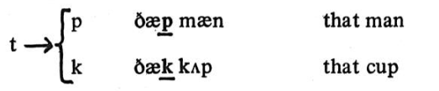
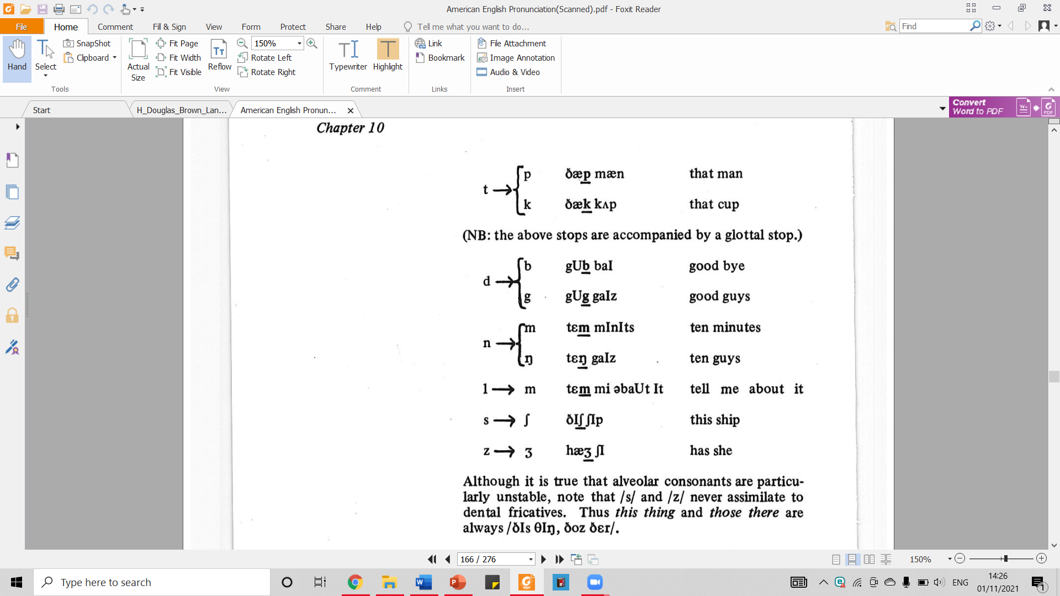
5.2. Articulatory Parameters of Assimilation – Place of Articulation
Assimilation of place of articulation is the most common kind of assimilation in English.
It is particularly common for a word-final alveolar consonant to be assimilated to the place of articulation of a following consonant:

Slide 14
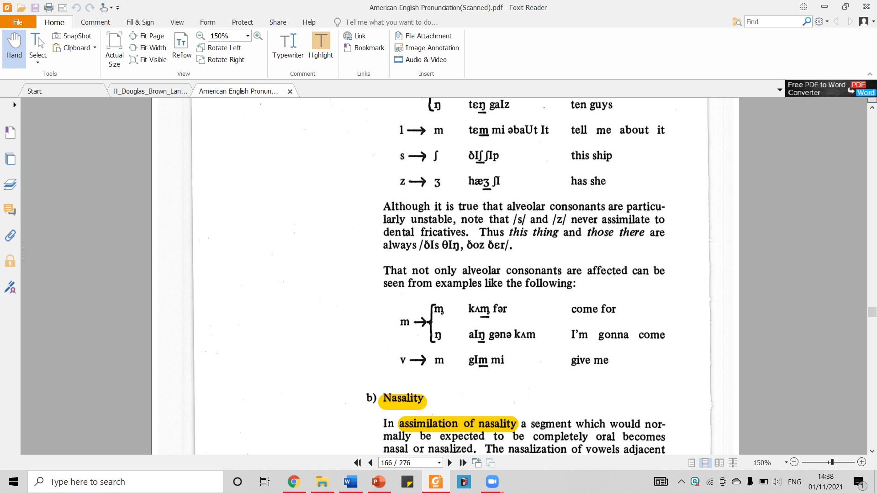
5.2. Articulatory Parameters of Assimilation – Place of Articulation (cont.)
Although it is true that alveolar consonants are particularly unstable, not that /s/ and /z/ never assimilates to dental fricatives. Thus this thing and those there are always /ðɪz Ɵɪŋ, ðoz ðεr/
That not only alveolar consonants are affected can be seen from examples like the following:

Slide 15
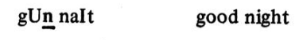
5.3. Articulatory Parameters of Assimilation – Nasality
In assimilation of nasality a segment which would normally be expected to be completely oral becomes nasal or nasalized.
The assimilation of a non-nasal consonant to a nasal consonant is rare, but is occasionally found in a phrase like

Slide 16
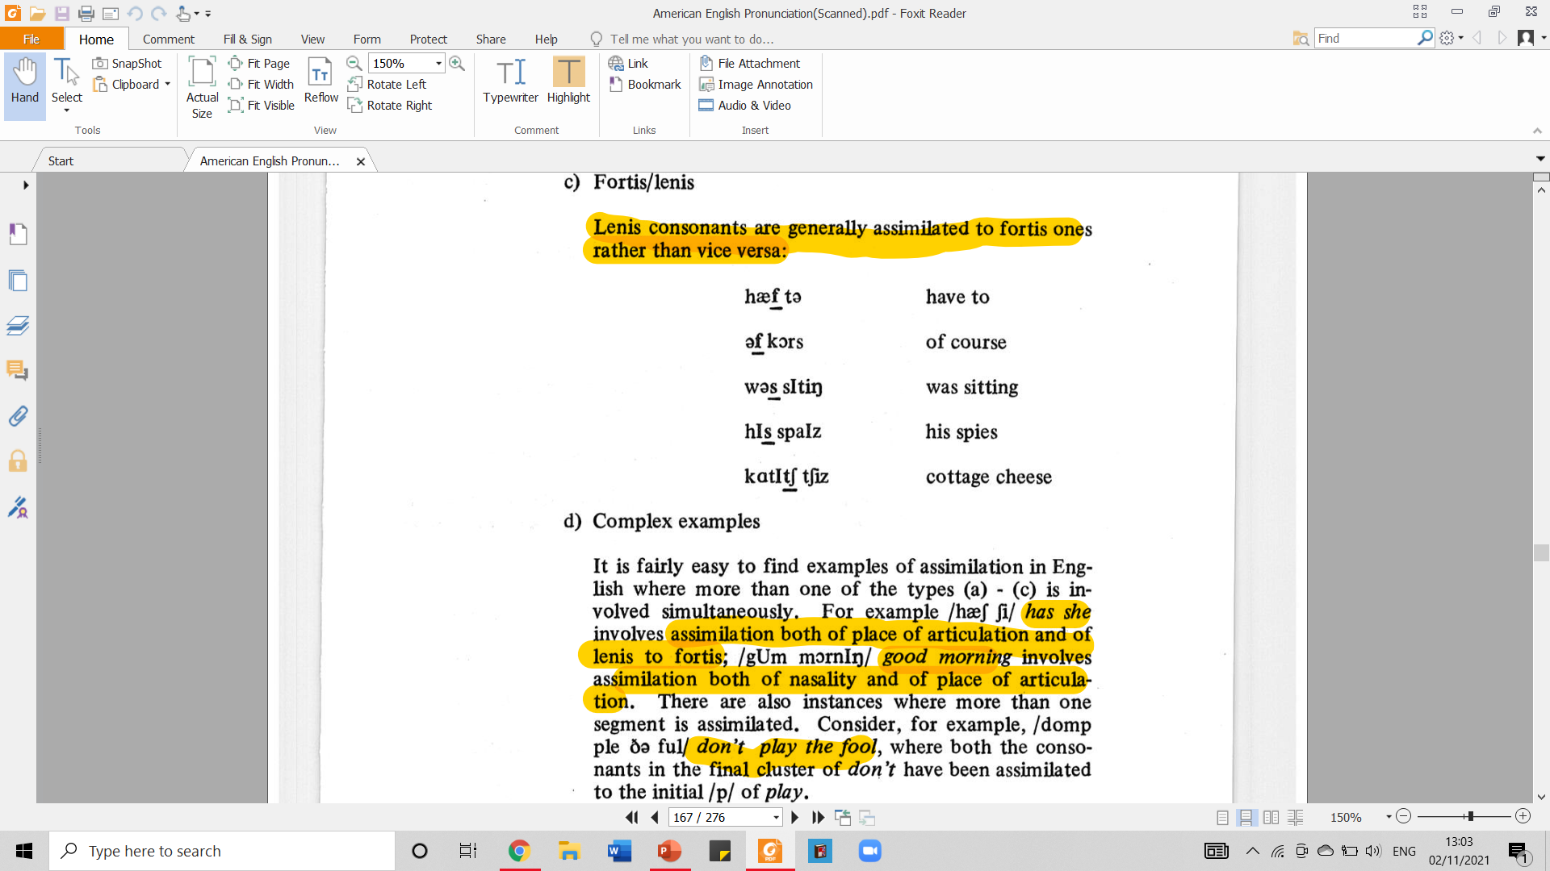
5.4. Articulatory Parameters of Assimilation – Fortis/lenis
Lenis consonants are generally assimilated to fortis ones rather than vice versa.
fortis fricative
fortis fricative
fortis fricative
fortis affricatives
fortis fricatives

Slide 17
5.5. Articulatory Parameters of Assimilation – Complex Examples
It is fairly easy to find examples of assimilation in English where more than one of the types (5.2 – 5.4) is involved simultaneously.
/hӕʃ ʃi/ has she
assimilation of place of articulation | assimilation of lenis to fortis
alveolar → alveo-palatal /s/ → /ʃ/ | /ʃ/
/gʊm mƆrnɪŋ/ good morning
assimilation of nasality | assimilation of place of articulation
stop to nasal /d/ to /m/ | alveolar → nasal /d/ → /m/, from /gʊd/ to /gʊm/

Slide 18
5.5. Articulatory Parameters of Assimilation – Complex Examples (cont.)
There are also instances where more than one segment is assimilated.
Consider the following example:
/domp ple ðә fu:l/ don’t play the fool
Both the consonants in the final cluster of don’t have been assimilated to the initial /p/ of play.

Slide 19
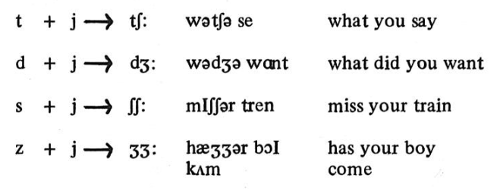
5.5. Articulatory Parameters of Assimilation – Complex Examples (cont.)
One type of complex assimilation that is particularly common in English is:

Slide 20
5.6. Quick Quiz
Answer the following questions regarding the parameters of assimilation. Do not go to the next slides before you finish answering them.
Point out the differences of each of the parameters of assimilation!
What make those parameters of assimilation different from the one that belongs to complex assimilation?

Slide 21
5.6. Quick Quiz – Answer Key
Point out the differences of each of the parameters of assimilation!
Parameter of place of articulation usually occurs for a word-final alveolar consonant to be assimilated to the place of articulation.
Parameter of nasality deals with a segment which would normally be expected to be completely oral becomes nasal or nasalized.
Parameter of fortis/lenis deals with how lenis consonants can be assimilated to fortis ones.
What make those parameters of assimilation different from the one that belongs to complex assimilation?
The parameters of assimilation explain a single case of assimilation that occur in a single segment of a word. Meanwhile, complex assimilation occurs by involving more than one parameter of assimilation and involving more than one segment.

Slide 22

6.1. Assimilation of Vowels
Almost all the examples discussed above have involved assimilation of consonants.
This is because assimilation of vowels is much less common.
Apart from nasalization, which was mentioned in the previous section, the most common types of vowel assimilation are:

Slide 23
6.1. Assimilation of Vowels (cont.)
/u/ is realized a fronted [ü] after /j/: few [fjü], cute [kjüt]
/ɪ/ and /ε/ are realized by retracted variants before [l], as in pill, bell.

Slide 24
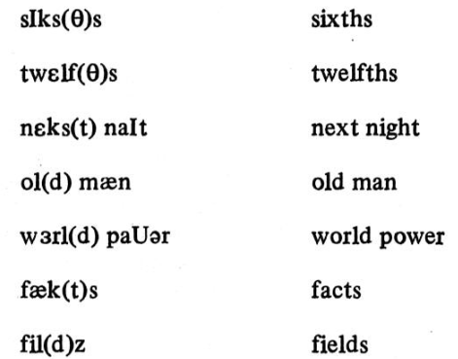
7.1. Elision
An extreme form of assimilation occurs when the principle of least effort is taken so far that a segment is elided completely. This is particularly frequent:
with initial /h/
Where three or more consonants would otherwise occur together; /t/ and/d/ are particularly likely to be elided:

Slide 25
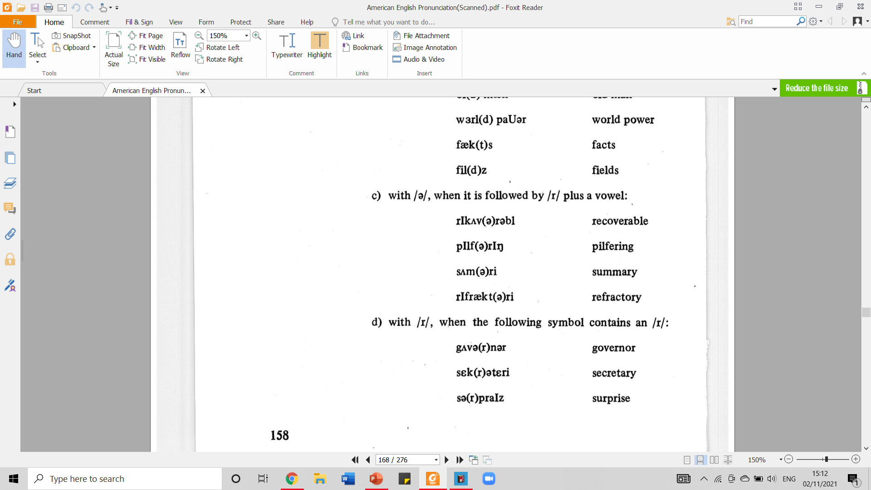
7.1. Elision (cont.)
with /ә/, when it is followed by /r/ plus a vowel:
with /r/, when the following symbol contains an /r/:

Slide 26
8.1. Use of Assimilation
It is impossible to list every potential assimilation – there are too many places where it can occur.
Although assimilation is more common in fast colloquial speech than in very formal speech, it is always present, and the speaker who does not use it will sound stilted and foreign.
The student is therefore advised to note assimilation in the speech of native speakers, and to imitate this feature of natural English.

Slide 27
9.1. REVIEW
Please answer the following questions to review what you have learned about assimilation. Do not go to the next slide before you completely answer all of them.
What is the difference between assimilation and dissimilation?
Why is it important to learn about assimilation?
Explain one case where assimilated form functions as a bound variant of the original phoneme!
Explain one case where assimilated form functions as an allophone not of the original phoneme, but of a different phoneme!
What makes regressive assimilation different from progressive one?
Explain why assimilation can be seen as a minimization of movements of the organs of speech!
What are the three parameters of assimilation?
What happen when nasality parameter takes place?
What happen when fortis/lenis parameter takes place?
What does it mean with complex assimilation?
Where does assimilation commonly take place?
What is the downside of not using assimilation? And what is advised about the use of assimilation?

Slide 28
9.2. REVIEW – ANSWER KEY
Please answer the following questions to review what you have learned about assimilation. Do not go to the next slide before you completely answer all of them.
What is the difference between assimilation and dissimilation?
Assimilation is when two segments become more like each other. Dissimilation is when two segments become less like each other.
Why is it important to learn about assimilation?
It is because segments cannot be always pronounced in isolation. Segments are pronounced in conjunction with other segments, and as a result are influenced by and influence adjacent segments.
Explain one case where assimilated form functions as a bound variant of the original phoneme!
In some cases, we recognize the assimilated form as a bound variant of the original phoneme. The example is anthem whose /n/ takes the form of its variant [n̪].
Explain one case where assimilated form functions as an allophone not of the original phoneme, but of a different phoneme!
In other cases, we recognize the assimilated form as an allophone not of the original phoneme, but of a different phoneme. The example is in the pronunciation of have to [hӕf tә] where have in isolation would be pronounced with a final [v].

Slide 29
9.2. REVIEW – ANSWER KEY
Please answer the following questions to review what you have learned about assimilation. Do not go to the next slide before you completely answer all of them.
What makes regressive assimilation different from progressive one?
Regressive assimilation is assimilation whose influence works backwards, while progressive assimilation is the one whose influence work forward.
Explain why assimilation can be seen as a minimization of movements of the organs of speech!
Assimilation can be viewed as a process which facilitates the pronunciation of a word or phrase by making adjacent sounds as similar as possible without distorting the message. It is one manifestation of the principle of least effort. This means that assimilation can be seen as a minimization of movements of the organs of speech.
What are the three parameters of assimilation?
They are assimilation of place of articulation, assimilation of nasality, and assimilation of fortis/lenis.
What happen when nasality parameter takes place?
In assimilation of nasality a segment which would normally be expected to be completely oral becomes nasal or nasalized.

Slide 30
9.2. REVIEW – ANSWER KEY
Please answer the following questions to review what you have learned about assimilation. Do not go to the next slide before you completely answer all of them.
What happen when fortis/lenis parameter takes place?
When this parameter takes place lenis consonants are generally assimilated to fortis ones rather than vice versa.
What does it mean with complex assimilation?
It is the type of assimilation where more than one parameter of assimilation is involved simultaneously.
Where does assimilation commonly take place?
Assimilation is more common in fast colloquial speech than in very formal speech, it is always present.
What is the downside of not using assimilation? And what is advised about the use of assimilation?
Speakers who do not use assimilation will sound stilted and foreign. The student is therefore advised to note assimilation in the speech of native speakers, and to imitate this feature of natural English.

Slide 31
REFERENCES
Bauer L., Dienhart M. J., Hartvigson H., & Jakobsen L. (1980). American English pronunciation. Copenhagen: Gyldendal. Page 154 – 159.

Slide 32
PICTURE SOURCES ON EACH SLIDE
Slide 20: https://encrypted-tbn0.gstatic.com/images?q=tbn:ANd9GcQ1z-eYZcj-XHxa0rXsYkRtNXuBOQKjJSXWwQ&usqp=CAU

