Slide 1
ENGLISH
PHONETICS AND PHONOLOGY
Week 12 – Chapter 12
Stress/Intonation (Part 1)
Lecturer: Maria Dewi Rosari, M.Pd.

Slide 2
INTRODUCTION
AIM OF THE COURSE
WEEK 12 – LEARNING OBJECTIVES
For advanced learners of English
For those who are interested in AE (American English)
For those who are non-native speakers
Introduction
Stress in Non-Compounds
Root Stress Rule (RSR)
Consonant Cluster Condition (CCC)
Suffixation Stress Rule (SSR)
Trace Rule (TR)
Prefixation Stress Rule (PSR)

Slide 3
1.1. Introduction
When words of more than one syllable are uttered in isolation, one syllable is generally felt to be more prominent than the other(s):
RApid, aLONE,
forEVer, stuPIDity
The prominence of a syllable depends on a combination of the factors listed below:
quantity | a prominent syllable is often longer than a non-prominent one
quality | the peak of a prominent syllable may be any vowel except /ǝ/; the peak of a non-prominent syllable may be /ǝ/, /ɪ/, /ʊ/ or a syllabic sonorant
stress | there is greater muscular activity involved in the articulation of a prominent syllable than in that of a non-prominent one
pitch variation | there is more pitch variation associated with prominent syllables than with non-prominent syllables; this variation may be due either to movement on the prominent syllable itself, or to a step up or down in the immediate neighborhood of the prominent syllable

Slide 4
1.1. Introduction (cont.)
In keeping with common practice, we shall refer to prominence as stress, though strictly speaking stress is only one of the contributing factors.
We shall distinguish between three degrees of stress.
A syllable is said to have primary stress (marked ‘) if it displays all four of the above characteristics: rápid, alóne, foréver, stupídity.
A syllable is said to have secondary stress (marked `) if it displays the first three but not the fourth of these characteristics: dínosàur, ùnivérsal, náturalìze, bróadcàst.
A syllable is said to be unstressed if it has none of the above characteristics. These are the syllables which are unmarked in the above examples.

Slide 5
1.1. Introduction (cont.)
Every polysyllabic word, uttered in isolation, will have one syllable which receives primary stress.
There may or may not be a syllable with secondary stress. Very long words may have two (rarely three) secondary stress: pèrpendìculárity, rèconcìliátion.
In some languages, the placement of stress in isolated words is easily predictable. This is the case, for example, in Finnish, where stress generally falls on the first syllable of a word, and in Turkish, where it generally falls on the last.
English is much more complex. In fact, it can be argued that because of the complexity of the English word stress system, the foreign learner is best advised to assume that stress in English words is irregular, and to learn the correct stress for each new word by looking it up in a dictionary.

Slide 6
1.1. Introduction (cont.)
We shall formulate a small set of rules which can account for stress placement in a large number of English words.
In formulating the rules (or tendencies) we shall make use of the following concepts: number of syllables, root, and affix.
The number of syllables in any word is the same as the number of peaks of sonority. Thus, pea and more have one syllable, button and alone have two, impatience three, undoubtedly four, etc.
We shall require four labels to refer to syllable position: initial, antepenultimate (=the last syllable but two), penultimate (= last syllable but one), and final.
Thus, in the word:
bútton the primary stress falls on the initial syllable (it is also the penultimate),
impátience it falls on the penultimate, and
undóubtedly on the antepenultimate.
In the word like alóne it falls on the final syllable.

Slide 7
1.1. Introduction (cont.)
We can use the word undoubtedly to illustrate the distinction between root and affix:
Root → doubt
Affixes → un-, -ed, -ly
An affix which precedes the root is called a prefix; an affix which follows the root is called a suffix.
Thus, un- is a prefix, whereas –ed and –ly are suffixes.
We can distinguish between “non-compound” words and “compound” words on the basis of the number of roots they contain:
A non-compound (boat, kindness, replay) has one and only one root.
Compounds (blackboard, forget-me-not, underdog) contain two or more roots.

Slide 8
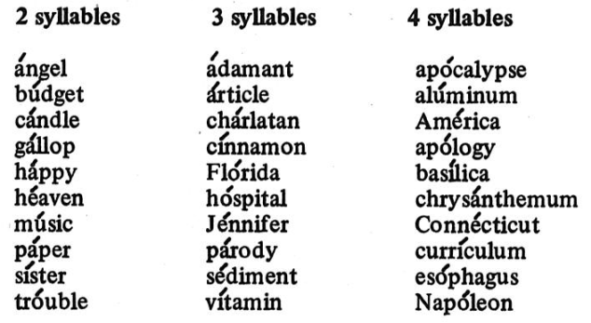
2.1. Stress in Non-Compounds
Non-compounds can be subcategorized as follows:
root only
root + suffixes
prefix + root
prefix(es) + root + suffix(es)
It is in this order that the words will be discussed.
ROOT ONLY
The Root Stress Rule
Consider the following words, which are ordered according to the number of syllables they contain:
Primary stress assignment in all three coloumns can be accounted for by the following general rule:
Taken from Bauer et al.’s American English Pronunciation book (1980)

Slide 9
3.1. Root Stress Rule (RSR)
Note that column three contains only roots of 4 syllables. This is because roots of more than 4 syllables are decidedly rare.
Such possible candidates as ànnivérsary and Pìthecánthropus show that the rule is operative on longer items as well.
The examples also illustrate that the longer the word, the more likely it is to have a secondary stress as well as a primary stress – a point we shall discuss in more detail when we consider affixation below.
Taken from Bauer et al.’s American English Pronunciation book (1980)
In roots of 3 syllables or less (column 1 and 2), primary stress is on the initial syllable.
In roots of >3 syllables (column 3), primary stress is on the antepenultimate syllable.

Slide 10
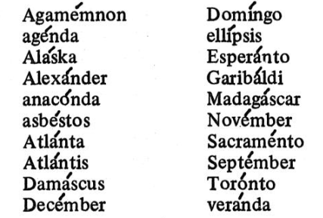
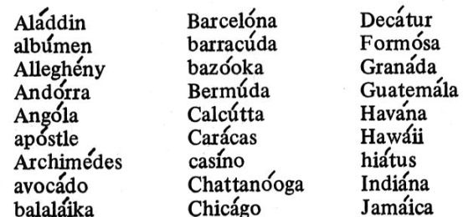
4.1. Consonant Cluster Condition (CCC)
If the penultimate vowel is followed by a cluster of two or more consonants, primary stress generally falls on the penultimate syllable.
The following list contains a sampling of roots of this type
It should be added that there are a few roots which take initial or antepenultimate stress despite the presence of a consonant cluster after the penultimate vowel: adjective, algebra, orchestra.
It is more difficult to generalize regarding the final group of words, which take penultimate stress. That the number of items involved is quite extensive is indicated by the following list:
Taken from Bauer et al.’s American English Pronunciation book (1980)
Taken from Bauer et al.’s American English Pronunciation book (1980)

Slide 11
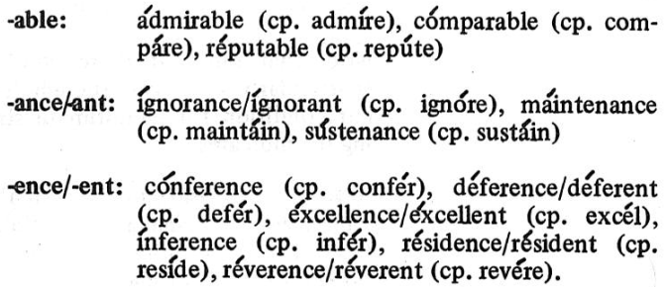
2.1. Stress in Non-Compounds (cont).
2. ROOT + SUFFIX(ES)
In many cases, suffixation results in a shift of primary stress.
When this happens, it is a shift to the right, not to the left.
There are only a few exceptions to this generalization, most of which are listed below:
Since such exceptions constitute but a drop in the vast ocean of suffixed forms, the foreign learners can safely adopt the following general principle: a suffixed form is stressed at least as far right as its un-suffixed counterpart.
On the basis of how they affect primary stress, English suffixes can be divided into three groups:
regular suffixes
strong suffixes
weak suffixes
The next section will show the rules that define and characterizes each of these three types of suffix.
Taken from Bauer et al.’s American English Pronunciation book (1980)

Slide 12
5.1. Stress in Non-Compounds
When a regular suffix is added, primary stress shift to the right, if this is necessary to ensure antepenultimate stress.
When a strong suffix is added, primary stress shifts to the right, onto (the first syllable of) the suffix.
When a weak suffix is added, primary stress is not affected.
We shall now examine each of these three types of suffix in turn.

Slide 13
5.1. Stress in Non-Compounds (cont).
a. Regular Suffix
To see how a regular suffix functions, consider the following examples of root plus regular suffix where
The suffix is held constant, and the root increases in number of syllables
joy + ous = jóyous
cáncer + ous = cáncerous
mélody + ous = melódious
The root is held constant, and the suffix increases in number of syllables
cárbon + ite = cárbonite
cárbon + ium = carbónium
cárbon + iferous = càrboníferous

Slide 14
5.1. Stress in Non-Compounds (cont).
These examples illustrate that even when suffixation is involved, we still apply the Root Stress Rule to the root; the addition of a regular suffix has no effect until it creates a word of more than three syllables.
However, once a word of more than 3 syllables is created (melódious, carbónium, càrboníferous), primary stress is pulled to the right so that it falls on the (new) antepenultimate syllable.
It is because suffixed forms of this type obey the same constraints as simple roots, that we call such suffixes “regular”.

Slide 15
5.1. Stress in Non-Compounds (cont).
Note that if the primary stress is pulled at least two syllables to the right (càrboníferous), it leaves a trace, in the form of a secondary stress, on the syllable it used to occupy.
The conditions are stated in the next section about Trace Rule (TR)

Slide 16
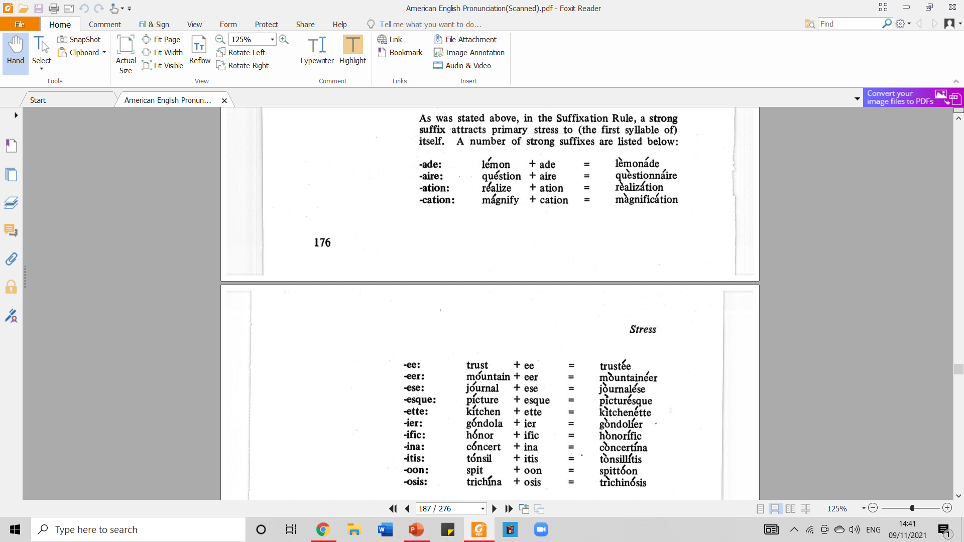
5.1. Stress in Non-Compounds (cont).
b. Strong Suffixes
In the suffixation rule, a strong suffix attracts primary stress to (the first syllable of) itself.
A number of strong suffixes are listed below:
Taken from Bauer et al.’s American English Pronunciation book (1980)

Slide 17
5.1. Stress in Non-Compounds (cont).
Note: the items listed in the picture may be compared with the following items, which appear to consist of a simple root rather than of root plus suffix: vacátion, jàmborée, venéer, terrífic, osmósis, etc.
They illustrate stress patterns which are parallel to, and presumably reinforced by, the cases where a suffix is involved.
Note again that when primary stress is shifted to the right, a trace in the form of a secondary stress appears whenever the conditions stated in our Trace Rule are met, e.g. lèmonáde.
Taken from Bauer et al.’s American English Pronunciation book (1980)

Slide 18
5.1. Stress in Non-Compounds (cont).
c. Weak Suffixes
A weak suffix is one which has no effect at all on primary stress.
Such suffixes may be non-syllabic (-s: élephant+s), mono-syllabic (-ly: ádamant+ly), or polysyllabic (-ism: párallel+ism).
Even when strung together, they do not affect primary stress:
ágitate + ed + ly = ágitatedly
móment + ary + ness = mómentariness

Slide 19
5.1. Stress in Non-Compounds (cont).
It should be pointed out, however, that when too many unstressed syllables pile up to the right of a primary stress, the primary stress may shift to the antepenultimate syllable. See the following example:
árbitrarily may shift to arbitrárily
nécessarily may shift to necessárily
There are a number of weak suffixes, both inflectional and derivational. In fact, all English inflectional suffixes are weak:
-(e)d : past tense/past participle: cúlminate+d
-(e)s : plural : esóphagus+es
genitive : Béatrice + s
3rd pres. ind : púlverize + s
-ing : present participle/gerund: mágnify+ing

Slide 20
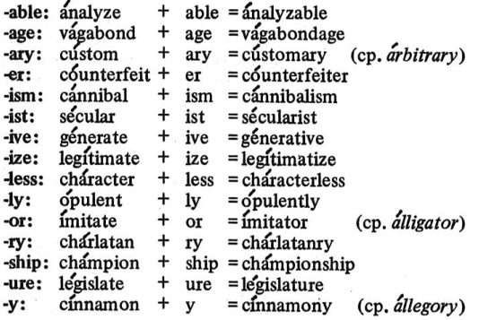
5.1. Stress in Non-Compounds (cont).
Inflectional suffixes are not the only weak suffixes. The following list contains a number of derivational suffixes which are weak as well.
Taken from Bauer et al.’s American English Pronunciation book (1980)

Slide 21
5.1. Stress in Non-Compounds (cont).
There are several other suffixes whose weak status is difficult to demonstrate since, like the adjective forming –y, they are generally attached to roots of fewer than 3 syllables: -dom, -ful, -hood, -ish, -ment, -ness, -some, -ward(s), -wise.
But when these items show up in suffix strings and in nonce constructions of more than 3 syllables, their status is evident:
móment + ary + ness = mómentariness
tróuble + some + ish = tróublesomeish
Kénnedy + wise = Kénedy-wise

Slide 22
2.1. Stress in Non-Compounds (cont).
3. PREFIX(ES) + ROOT
a. Strong vs. Weak Prefixes
The class of prefixes is somewhat more difficult to specify than is the class of suffixes.
This is due primarily to the fact that prefixation tends to be more cohesive than suffixation, in the sense that the root frequently is bound to the prefix – that is, the root frequently cannot stand alone: ad + mit, pro + nounce, re + ply.
Justification for viewing such items as consisting of prefix plus bound root can be found in paradigms like the following, where we can vary the prefix while holding the root constant:
-mit: admit, permit, remit
-nounce: announce, denounce, pronounce
-ply: apply, comply, reply

Slide 23
2.1. Stress in Non-Compounds (cont).
or vary the root while holding the prefix constant:
com-: command, commit, comply
per-: perceive, permit, pervade
re-: receive, remit, reply
It is generally the case that in construction of this type, the semantic content of both prefix and root tends to be opaque, and native speakers do not normally view such items as containing two components of meaning.
We shall label prefixes in such words weak.

Slide 24
2.1. Stress in Non-Compounds (cont).
One further characteristics of such prefixes is that, chameleon-like, they frequently adapt their form to the form of the root.
Consider, for example, the prefix ad-, which has the following variants:
 | precedes | Examples
ac- | c/qu | accept, acquire
af- | f | affect
ag- | g | aggress
al- | l | allow
an- | n | announce
ap- | p | apply
ar- | r | arrive
as- | s | assert
at- | t | attempt

Slide 25
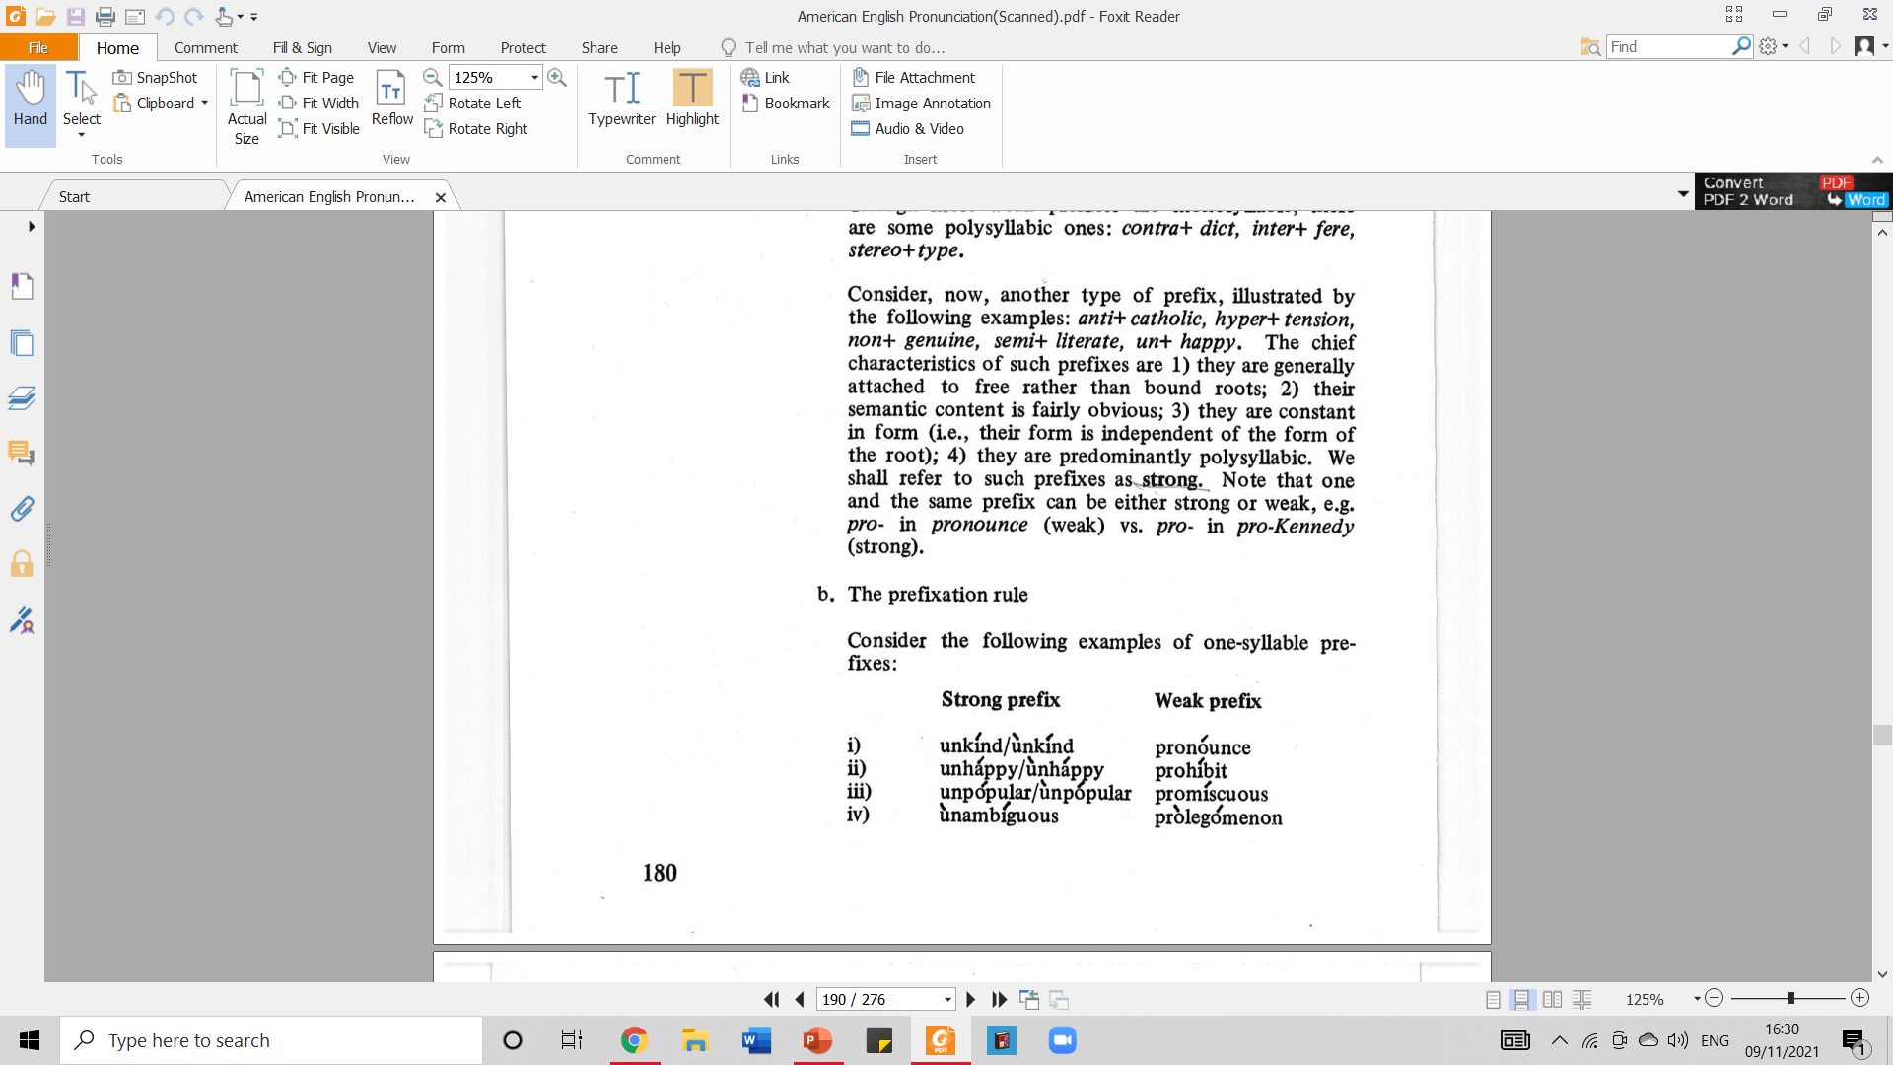
2.1. Stress in Non-Compounds (cont).
3. PREFIX(ES) + ROOT
b. The prefixation rule
Consider the following examples of one-syllable prefixes:
1) Regarding Primary Stress
Were it not for our Root Stress Rule (RSR), it would be difficult to account for the fact that primary stress falls on the final syllable in (i), on the penult in (ii), and on the antepenult in (iii) and (iv).
Each root receives the appropriate primary stress by application of the RSR.
We see, then, that prefix addition (unlike suffix addition) generally has no effect on the placement of primary stress.
Taken from Bauer et al.’s American English Pronunciation book (1980)

Slide 26
2.1. Stress in Non-Compounds (cont).
3. PREFIX(ES) + ROOT
b. The prefixation rule
Consider the following examples of one-syllable prefixes:
2) Regarding Secondary Stress
If the prefix, be it strong or weak, precedes an unstressed syllable (iv), it generally receives a secondary stress.
Note, however, that strong prefixes, unlike weak prefixes, may take secondary stress even when immediately followed by a syllable with primary stress (i, ii, and iii)
Taken from Bauer et al.’s American English Pronunciation book (1980)

Slide 27
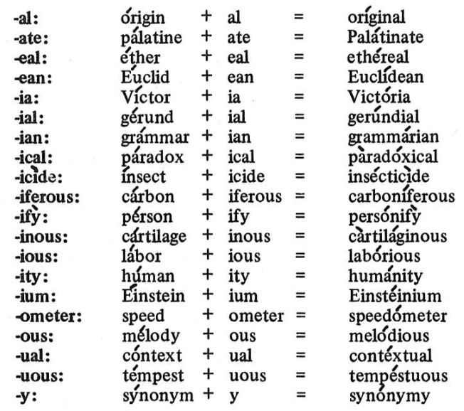
6.1. Trace Rule
A primary stress is shifted more than one syllable to the right, leave a trace in the form of a secondary stress where the primary stress used to be.
If primary stress is shifted only one syllable to the right, the trace appears on the syllable preceding the old primary stress, if there is such a syllable; other wise, no trace appears.
Taken from Bauer et al.’s American English Pronunciation book (1980)

Slide 28
7.1. Prefixation Stress Rule (PSR)
Unlike suffixation, prefixation generally has no effect on the location of primary stress.
But prefixation frequently does result in an increase in the number of secondary stress as follow:
Monosyllabic prefixes
A weak prefix is unstressed unless it precedes an unstressed syllable.
In which case it takes a secondary stress; a strong prefix may take a secondary stress even when it immediately precedes a stressed syllable;
Polysyllabic prefixes
Each polysyllabic prefix generally takes a secondary stress on its initial syllable
example: semi + il + literate → sèmi-illíterate

Slide 29
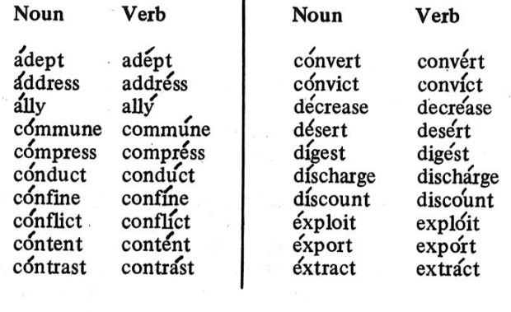
7.1. Prefixation Stress Rule (PSR) (cont.)
The basic type of exception involves cases where primary stress falls on (the initial syllable of) the prefix in nouns: áddict, ádverb, pérmit, súspect; ántechàmber, ántidòte, psýchopàth, sémi-cìrcle; bíbliophìle.
This existence of this nominal stress pattern gives rise to a number of contrasting noun/verb pair (primarily disyllabic), most of which are contained in the following list:
Taken from Bauer et al.’s American English Pronunciation book (1980)

Slide 30
7.1. Prefixation Stress Rule (PSR) (cont.)
The existence of a contrasting verb form is not, of course, a necessary condition for such nouns to take initial stress, as the following random sample indicates:
with monosyllabic prefixes
ábsence, ádvent, cómfort, éxpert, pércept, próblem
with disyllabic prefixes
ántidòte, bénefìt, íntercòurse
with trisyllabic prefixes
rádiogràm, héterochròme
The point is that this stress pattern is the norm for nouns whose second element is monosyllabic; and those nouns (such as advíce, commánd, exchánge) which do not conform to this pattern are the “deviant” ones.

Slide 31
2.1. Stress in Non-Compounds (cont).
4. PREFIX(ES) + ROOT + SUFFIXES
Many English words involve both prefixation and suffixation.
No new rules are needed in such cases, however; we simply call into play all of the rules discussed above.
For convenience we shall repeat the rules here, and then present a few examples to show how these rules interact.

Slide 32
REFERENCES
Bauer L., Dienhart M. J., Hartvigson H., & Jakobsen L. (1980). American English pronunciation. Copenhagen: Gyldendal. Page 165 – 183.

