Slide 1
ENGLISH
PHONETICS AND PHONOLOGY
Week 14 – Chapter 14
What is Phonology? &
Phonetics and Phonology Research
Lecturer: Maria Dewi Rosari, M.Pd.

Slide 2
INTRODUCTION
AIM OF THE COURSE
WEEK 14 – LEARNING OBJECTIVES
For advanced learners of English
For those who are interested in AE (American English)
For those who are non-native speakers
Introduction
Phonetics – The Manifestation of Language Sound
Phonology – The Symbolic Perspective on Sound
3.2. Symbolic Representation of Segments
3.3. The Concerns of Phonology
The example of conducting a research in this field

Slide 3
1.1. Introduction
Phonology is one of the core fields that compose the discipline of linguistics, which is the scientific study of language structure.
One way to understand the subject matter of phonology is to contrast it with other fields within linguistics.
A very brief explanation is that phonology is the study of sound structure in language, which is different from the study of sentence structure (syntax), word structure (morphology), or how languages change over time (historical linguistics).
But, such explanation about phonology is not sufficient.

Slide 4
1.1. Introduction (cont.)
An important feature of the structure of a sentence is how it is pronounced – its sound structure.
The pronunciation of a given word is also a fundamental part of the structure of the word. And certainly, the principles of pronunciation in a language are subject to change over time. So, phonology has a relationship to numerous domains of linguistics.
An important question is: how does phonology differ from the closely related discipline of phonetics?

Slide 5
1.1. Introduction (cont.)
Making a principled separation between phonetics and phonology is difficult – just as it is difficult to make a principled separation between physics and chemistry, or sociology, and anthropology.
While phonetics and phonology both deal with language sound, they address different aspects of sound.
PHONETICS | PHONOLOGY
It delas with “actual” physical sounds as they are manifested in human speech, and concentrates on acoustic waveforms, formant values, measurements of duration measured in milliseconds, of amplitude and frequency. | It is an abstract cognitive system dealing with rules in a mental grammar: principles of subconscious “though” as they relate to language sound.
It deals with the physical principles underlying the production of sounds, namely vocal tract resonant, and the muscles and other articulatory structures used to produce those resonances.

Slide 6
1.1. Introduction (cont.)
Yet once we look into the central questions of phonology in greater depth, we will find that the boundaries between the disciplines of phonetics and phonology are not entirely clear cut.
As research in both of these fields has progressed, it has become apparent that a better understanding of many issues in phonology requires that you bring phonetics into consideration, just as a phonological analysis is a prerequisite for phonetic study of language.

Slide 7
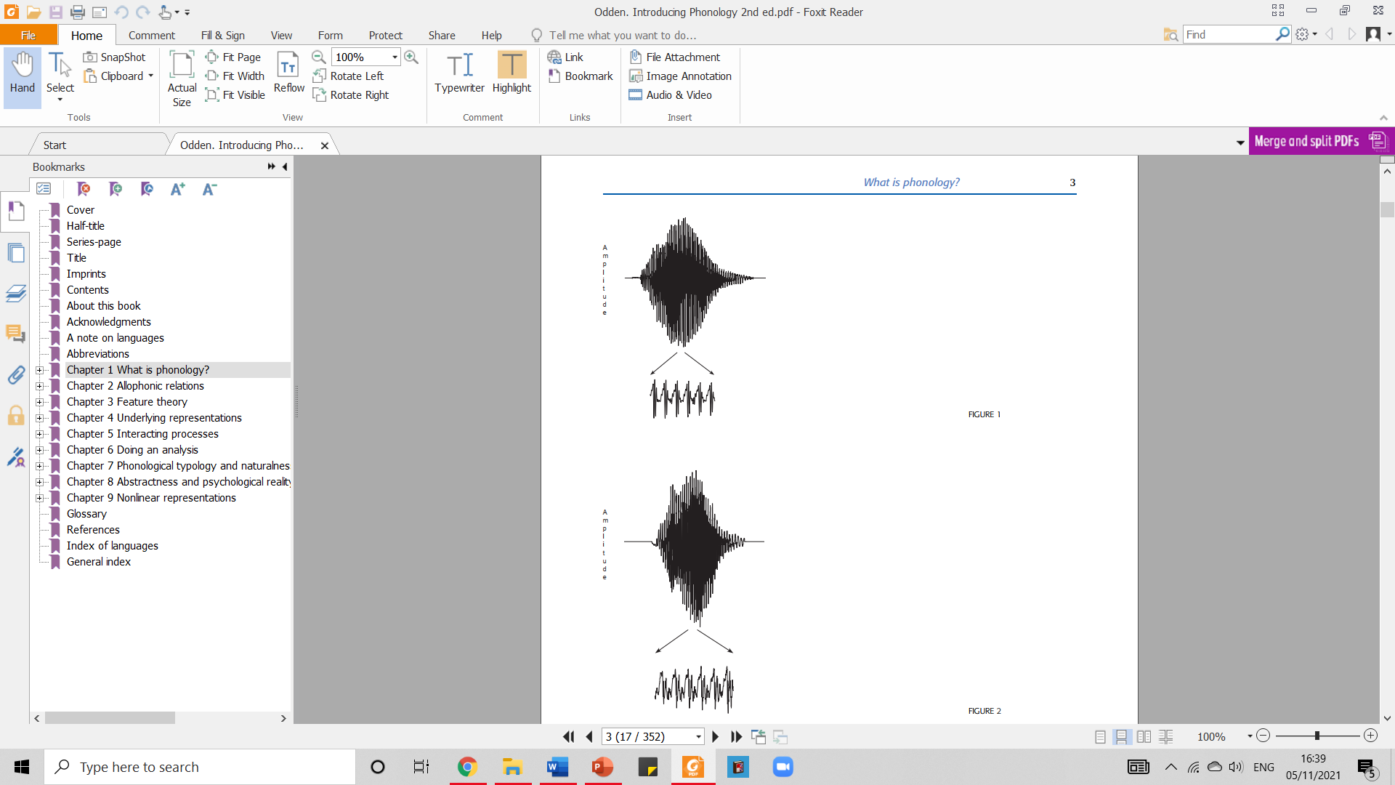
2.1. Phonetics – The Manifestation of Language Sound
Ashby and Maidment (2005) →
a detailed introduction to the subject area of phonetics covering greater detail on the acoustic and articulatory properties of language sounds, transcriptions using IPA.
The waveform of a pronunciation of the word wall, with an expanded view of the details of the wave form at the center of the vowel between w and ll.
Phonetic perspective →
Sound is the mechanical pressure waves and the sensitive arising when such a pressure wave strikes your ear.
In a physical sound, the wave changes continuously, and can be graphed as a waveform showing the amplitude on the vertical axis and time on the horizontal axis.
The waveform of a pronunciation of the word will, which differs from wall just in the choice of the vowel.
Taken from Introducing Phonology Book of Odden (2013)

Slide 8
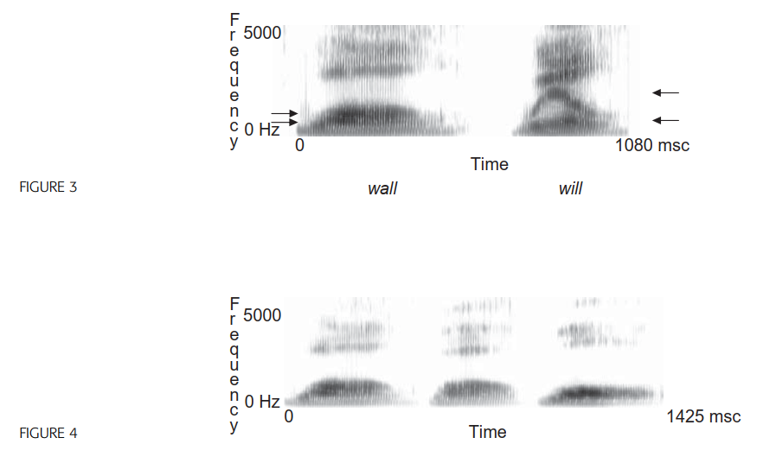
2.1. Phonetics – The Manifestation of Language Sound (cont.)
It is difficult to characterize those physical differences from the waveform, but an analytical tool of phonetics, the spectrogram, provides a useful way to describe the differences, by reducing the absolute amplitude properties of a wave at an exact time to a set of (less precise) amplitude characteristics in different frequency and time areas.
The tools of phonetic analysis can provide very detailed and precise information about the amplitude, frequency and time characteristics of an utterance – a typical spectrogram of a single-syllable word in English could contain around 100,000 bits of information. The problem is that this is too much information – a lot of information needs to be discarded to get at something more general and useful
Taken from Introducing Phonology Book of Odden (2013)

Slide 9
3.1. Phonology: The Symbolic Perspective on Sound
Physical sound is too variable and contains too much information to allow us to make meaningful and general statements about the grammar of language sound.
We require a way to represent just the essentials of language sounds, as mental objects which grammars can manipulate.
A phonological representation of an utterance reduces this great mass of phonetic information to a cognitive minimum, namely a sequence of discrete segments.

Slide 10
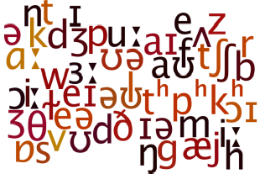
3.2. Phonology: The Symbolic Perspective on Sound – Symbolic Representation of Segments
Phonetic transcription → the basic tool for converting the continuous stream of speech sound into discrete units.
The idea behind phonetic transcription → the variability and continuity of speech can be reduced to sequences of abstract symbols whose interpretation is predefined, a symbol standing for all the concrete variants of the sounds.

Slide 11
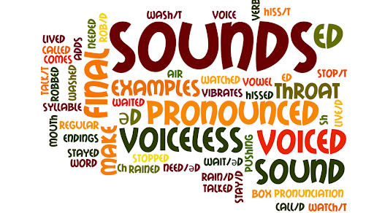
3.2. Phonology: The Symbolic Perspective on Sound – Symbolic Representation of Segments (cont.)
Phonology then is the study of higher-level patterns of language sound, conceived in terms of discrete mental symbols, whereas phonetics is the study of how those symbols are manifested as continuous muscular contractions and acoustic waveform, or how such waveforms are perceived as the discrete symbols that the grammar acts on.
The idea of reducing an information-rich structure such as an acoustic waveform to a small repertoire of discrete symbols is based on a very important assumption, namely systematic limits on possible speech sounds in human language.

Slide 12
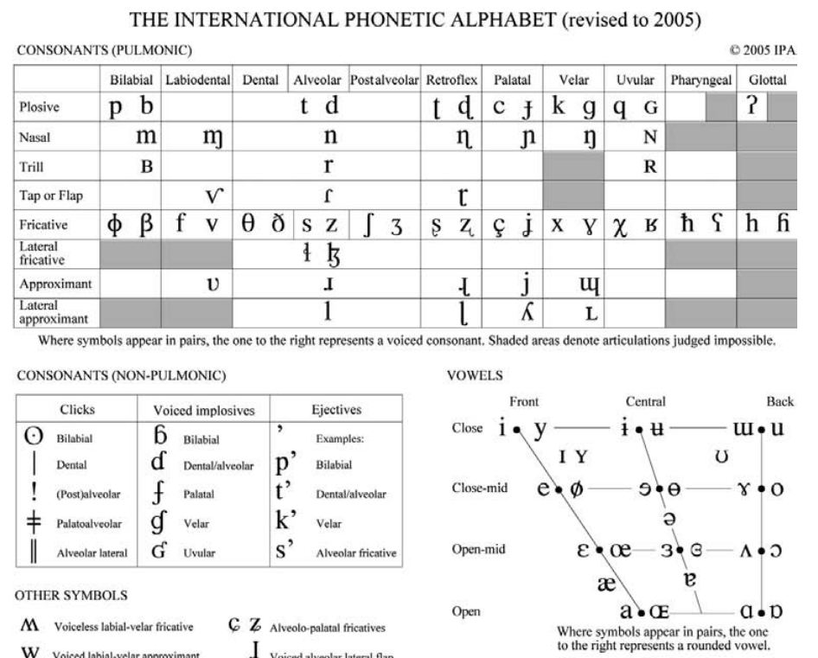
3.2. Phonology: The Symbolic Perspective on Sound – Symbolic Representation of Segments (cont.)
This assumption embodied in systems of symbols and associated phonetic properties such as the International Phonetic Alphabet (IPA).
The IPA chart is arranged to suit the needs of phonetics analysis. The phonetic analysis covers, for instance:
plosive and non plosive consonants,
consonants based on their place of articulation and manner of articulation
the height, backness, and roundness of vowels, frontness of the tongue in vowels → resulting in up to 30 vowels.
Taken from Introducing Phonology Book of Odden (2013)

Slide 13
3.2. Phonology: The Symbolic Perspective on Sound – The Concerns of Phonology
The “sounds” which phonology is concerned with a→ symbolic sounds. They are cognitive abstractions.
The cognitive abstractions represents but are not the same as physical sounds.
THE SOUNDS OF LANGUAGE
One aspect of phonology investigates what the “sounds” of a language are.
Examples:
Vowel [Ø] exists in
German: (schön ‘beautiful’)
French: (spelled eu, as in jeune ‘young’)
Norwegian: (øl ‘beer’)
But not in English
Consonant [Ɵ] exists in
English (e.g. thing, path), Icelandic, Modern Greek, North Saami
But not in German, French, Latin American Spanish

Slide 14
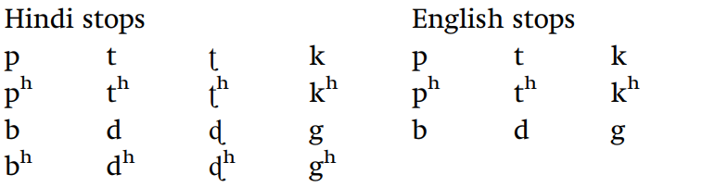
3.2. Phonology: The Symbolic Perspective on Sound – The Concerns of Phonology (cont.)
Sounds in languages are not just isolated atoms; they are part of a system. The systems of stops in Hindi and English, for example, are as follow:
The stop systems of these languages differ in three ways.
English does not have a series of voiced aspirated stops like Hindi [b^{h} d^{h} ɖ^{h} g^{h}], nor does it have a series of retroflex stops [ʈ ʈ^{h} ɖ ɖ^{h}].
Furthermore, the phonological status of the aspirated sounds [p^{h} t^{h} k^{h}] is different in the languages, in that they are basic lexical facts of words in Hindi, but are the result of applying a rule in English.

Slide 15
3.2. Phonology: The Symbolic Perspective on Sound – The Concerns of Phonology (cont.)
RULES FOR COMBINING SOUNDS
Another aspect of language which a phonological analysis takes account of:
in any language, certain combinations of sounds are allowed, but other combinations are systematically impossible.
Example:
English has the words [bɹɪk] brick, [bɹejk] break, [bɹɪdʒ] bridge, [bɹɛd] bread
there is no restriction against having words that begin with the consonant sequence br;
There are many words which begin with bl, such as [bluw] blue, [bleʔn̩ t] blatant, [blæst] blast, [blɛnd] blend, [blɪŋk] blink
→ there is no rule against words beginning with bl

Slide 16
3.2. Phonology: The Symbolic Perspective on Sound – The Concerns of Phonology (cont.)
RULES FOR COMBINING SOUNDS
Another aspect of language which a phonological analysis takes account of:
in any language, certain combinations of sounds are allowed, but other combinations are systematically impossible.
The question is, why is there no word *blick in English?
The best explanation for the nonexistence of this word is simply that it is an accidental gap – not every logically possible combination of sounds which follows the rules of English phonology is found as an actual word of the language.
Native speakers of English have the intuition that while blick is not a word of English

Slide 17
3.2. Phonology: The Symbolic Perspective on Sound – The Concerns of Phonology (cont.)
VARIATIONS IN PRONUNCIATION
A phonological analysis also explains:
other general patterns in the pronunciation of words.
EXAMPLES:
There is general rule of English phonology which dictates that
plural suffix on nouns will be pronounced as [iz], represented in spelling as es,
there is a certain set of consonants such as [ʃ] (spelled sh) as in bushes,
[t^{ʃ}] (spelled as ch) as in churches,
[d^{ʒ}] (spelled j, ge, dge) as in cages, bridges
This pattern of pronunciation is not limited to the plural, so despite the difference in spelling, the possessive suffix s is also subject to the same rules of pronunciation: thus, plural bushes is pronounced the same as the possessive bush’s, and plural churches is pronounced the same as possessive church’s.

Slide 18
3.2. Phonology: The Symbolic Perspective on Sound – The Concerns of Phonology (cont.)
This is the sense in which phonology is about the sounds of language.
From the phonological perspective → a “sound” is a specific unit which combines with other such specific units, and which represents physical sounds.
What phonology is concerned with is how sounds behave in a grammar.
SUMMARY
Phonetics and phonology both study language.
PHONOLOGY
Examines language sounds as mental units, encapsulated symbolically for example as [ӕ] or [g], Focuses on how these unit function in grammars Discovers the cognitively important properties and how they function in language
PHONETICS
Examines how symbolic sound is manifested as a continuous physical phenomenon, Focuses on which phenomenon is important and possible because not all physical properties of speech sounds are cognitively important.

Slide 19
4.1. The example of conducting a research in this field
We can benefit a lot from having the knowledge of phonetics and phonology.
Let’s discuss how we can conduct a research in the field of English Phonetics and Phonology.
Helping our students learn sounds in English
Contributing to broadening research horizon in English Phonetics and Phonology
WHAT
WHY
HOW

Slide 20
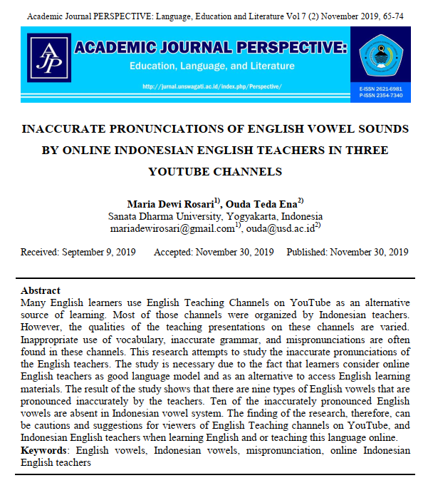
4.1. The Example of Conducting a Research in This Field (cont.)
http://dx.doi.org/10.33603/perspective.v7i2.2557

Slide 21
4.1. The Example of Conducting a Research in This Field (cont.)
BACKGROUND OF STUDY
Many English learners use English Teaching Channels on YouTube as an alternative source of learning.
Most of those channels were organized by Indonesian teachers. However, the qualities of the teaching presentations on these channels are varied.
Inappropriate use of vocabulary, inaccurate grammar, and mispronunciations are often found in these channels.
This research attempts to study the inaccurate pronunciations of the English teachers.
The study is necessary due to the fact that learners consider online English teachers as good language model and as an alternative to access English learning materials, especially for those living in rural areas who have less qualified teachers and limited learning materials such as books (Hossain, 2016; Rahmadi, Istiqamah, Adriyanto, 2010)

Slide 22
4.1. The Example of Conducting a Research in This Field (cont.)
BACKGROUND OF STUDY
Of all kinds of mispronunciations, one of them is vowel confusions (Meng, Lo, Wang, and Lau, 2007) that become the focus of this study.
Indonesian (here referred as L1) and English language (as L2) have some similarities and differences in terms of phonemic oppositions and phonetic features (Pallawa, 2013).
Kosasih’s (2017) research result suggested that there were 20 English vowel sounds and only 13 Indonesian vowel sounds.
There are some English vowels that do not exist in Indonesian vowels. Those English vowels are [ɑ:], [ɜ:], [əʊ], [eə], [ɪə], [eɪ], [ʊə].

Slide 23
4.1. The Example of Conducting a Research in This Field (cont.)
BACKGROUND OF STUDY
RESEARCH QUESTIONS
Kosasih (2017) furtherly explained that the differences between Indonesian and English vowel sounds and also the absence of some English vowel sounds in Indonesian trigger some factors influencing English vowel sound mispronunciation made by Indonesian English learners.
One of the factors is Indonesian pronunciation habit of using a single vowel sound (Kosasih, 2017).
To what extent do online Indonesian English teachers produce English vowel mispronunciations?
What are the factors influencing the English vowel mispronunciations?

Slide 24
4.1. The Example of Conducting a Research in This Field (cont.)
METHOD
RESULTS AND DISCUSSION
The research was conducted by collecting five English teaching videos taken from three channels of YouTube websites.
To obtain the data, the researchers critically listened to each video and then listed any mispronounced English vowel produced by the online Indonesian English teachers in the research’s blueprint by referring to the 12 kinds of English vowels by Roach (2003).
Then, validation process was conducted.
After that, the analysis process was done.
The researchers discovered nine (9) vowels that were inaccurately pronounced by the online Indonesian English teachers from the total of 19 English vowel sounds (Roach, 2013).
Those vowels are [ɪ], [ӕ], [ᴧ], [ɒ], [ɑ:], [ɪǝ], [eɪ], [aɪ], and [oʊ] with the diphthongs as the most frequently mispronounced English vowels.
The inaccurate pronunciations occurred because of two major factors. The first factor is the interference of Indonesian pronunciation habit as found in 19 out of 25 findings, such as in the mispronunciation of English diphthongs of [eɪ], [oʊ], and non-diphthongs of [ɪ], [ᴧ], and [ɒ].

Slide 25
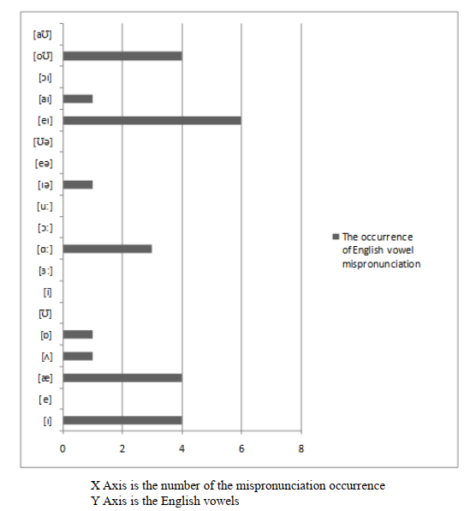
4.1. The Example of Conducting a Research in This Field (cont.)
RESULTS AND DISCUSSION
This factor covers the Indonesian learners’ difficulties in differentiating long and short English vowels and the tendency of using sound generalization.
The teachers tend to pronounce some words in Indonesian if the words were similar or identical with Indonesian words.

Slide 26
4.1. The Example of Conducting a Research in This Field (cont.)
RESULTS AND DISCUSSION
SUGGESTIONS AND RECOMMENDATION
Following this factor, another factor comes from the absence of English vowel in Indonesian that was found in 10 out of 25.
Based on the findings, researchers recommend that teaching of pronunciation as part of language teaching aspects should be taken into a serious consideration.
Following to that, teachers need to increase their awareness toward the English vowel sounds that were mispronounced in the findings.
Moreover, teachers not only need to focus on the vowel mispronunciation but also need to pay more attention to factors that caused the mispronunciations.

Slide 27
4.1. The Example of Conducting a Research in This Field (cont.)
FURTHER RESEARCH
You can conduct the same research by involving your own mother tongue.
If you are Indonesian, you can conduct similar research by analyzing the consonants of between English and Indonesian.
If you are from a country with a lot of local languages like Indonesia, you can use the comparison of the language features of between any local language in your country and English.
You may analyze the pronunciation error further by taking into account any background that may influence the errors, e.g. social background and educational background.

Slide 28
5.1. REVIEW – part 1
Please answer the following questions to review what you have learned about what phonology is. Do not go to the next slide before you completely answer all of them. This first part of the review requires you to match the statements on the left to either phonetics or phonology, asking you to analyze the difference between them.
“actual” physical sounds as they are manifested in human speech | •
the scientific study of language structure | •
concentrates on acoustic waveforms, formant values, measurements of duration measured in milliseconds, of amplitude and frequency. | •
is an abstract cognitive system dealing with rules in a mental grammar | •
deals with the physical principles underlying the production of sounds | •
studies the muscles and other articulatory structures | •
studies the symbolic representation of segments | •
studies the systems of stops in, for instance, Hindi and English | •
studies certain combinations of sounds that are allowed and not allowed | •
analyzing which physical properties of speech sounds are cognitively important | •
PHONETICS
PHONOLOGY

Slide 29
5.1. REVIEW – part 1 - ANSWER KEY
Please answer the following questions to review what you have learned about what phonology is. Do not go to the next slide before you completely answer all of them. This first part of the review requires you to match the statements on the left to either phonetics or phonology, asking you to analyze the difference between them.
“actual” physical sounds as they are manifested in human speech | •
the scientific study of language structure | •
concentrates on acoustic waveforms, formant values, measurements of duration measured in milliseconds, of amplitude and frequency. | •
is an abstract cognitive system dealing with rules in a mental grammar | •
deals with the physical principles underlying the production of sounds | •
studies the muscles and other articulatory structures | •
studies the symbolic representation of segments | •
studies the systems of stops in, for instance, Hindi and English | •
studies certain combinations of sounds that are allowed and not allowed | •
analyzing which physical properties of speech sounds are cognitively important | •
PHONETICS
PHONOLOGY

Slide 30
5.2. REVIEW – part 2
Please answer the following questions to review what you have learned about what phonology is. Do not go to the next slide before you completely answer all of them.
Why is it needed to invent phonetic transcription as the symbolic representation of segments to replace the use of waveform?
What are the possible phonetic analyses to be done using IPA chart?
What are the concerns of phonology?

Slide 31
5.2. REVIEW – part 2 – ANSWER KEY
Please answer the following questions to review what you have learned about what phonology is. Do not go to the next slide before you completely answer all of them.
Why is it needed to invent phonetic transcription as the symbolic representation of segments to replace the use of waveform?
It is because physical sound is too variable and contains too much information to allow us to make meaningful and general statements about the grammar of language sound. We require a way to represent just the essentials of language sounds. Phonetic transcription accommodates these needs by being the basic tool for converting the continuous stream of speech sound into discrete units. The variability and continuity of speech can be reduced to sequences of abstract symbols whose interpretation is predefined, a symbol standing for all the concrete variants of the sounds.
What are the possible phonetic analyses to be done using IPA chart?
IPA chart accommodates the following phonetic analysis: defining plosive and non-plosive consonants, identifying consonants based on their place of articulation and manner of articulation, and identifying the height, backness, and roundness of vowels, frontness of the tongue in vowels. Those analyses about vowels result in up to 30 vowels in English.
What are the concerns of phonology?
Phonology concerns about what the “sounds” of a language are, the rules for combining sounds of a language (resulting in what combinations of sounds are allowed and which ones are not allowed), and also variations in pronunciations (explaining other general patterns in the pronunciation of words).

Slide 32
REFERENCES
Odden, D. (2013). Introducing Phonology. New York: Cambridge University Press. Page 2 – 11.
Rosari, M.D., Ena, O. T. (2019). Inaccurate pronunciations of English vowels sounds by online Indonesian English teachers in three YouTube channels. Academic Journal Perspective: Language, Education and Literature, 7(2), 65-74. http://dx.doi.org/10.33603/perspective.v7i2.2557

Slide 33
PICTURE SOURCES ON EACH SLIDE
Slide 10: https://www.eltconcourse.com/training/imagesgraphics/phoneme_cloud310.png
Slide 11: https://www.eltconcourse.com/training/imagesgraphics/phoneme_cloud310.png

