Slide 1

Business English Course
Chapter 1
Manufacturing and services
Lecturer: N.A.Mukhitdinova, PhD

Slide 2
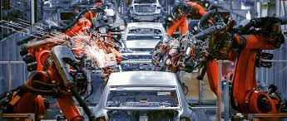
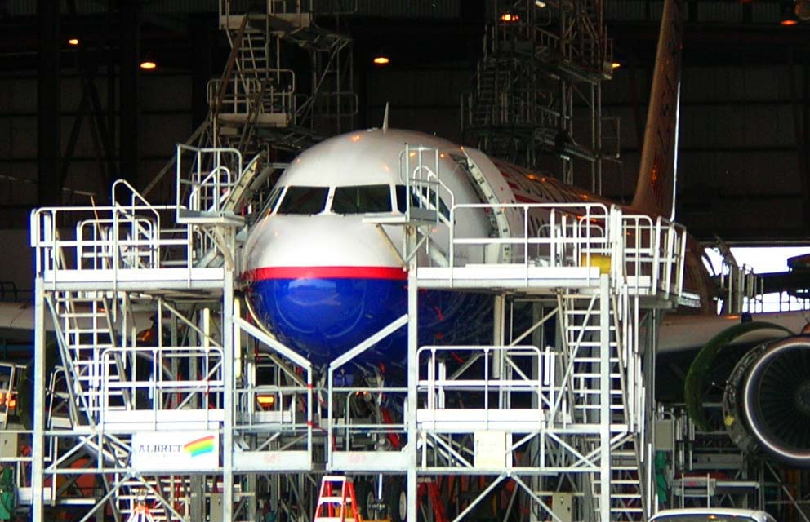
Any general business activity or commercial enterprise that can be isolated from others, such as the tourist industry or the entertainment industry.
Industry (uncountable) is the production of materials and goods. An industry (countable) is a particular type of business activity, not necessarily production.
Industry

Slide 3
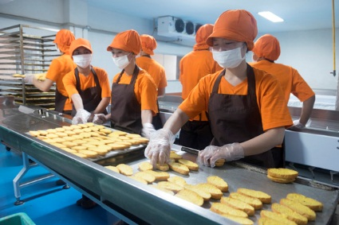
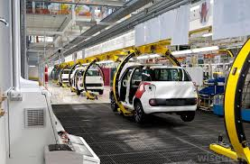
Manufacturing, any industry that makes finished products from raw materials by the use of manual labor or machinery and that is usually carried out systematically with a division of labor. In a more limited sense, manufacturing denotes the fabrication or assembly of components into finished products on a fairly large scale. Among the most important manufacturing industries are those that produce aircraft, automobiles, chemicals, clothing, computers, consumer electronics, electrical equipment, furniture, heavy machinery, refined petroleum products, ships, steel, and tools and dies...
What is Manufacturing?

Slide 4
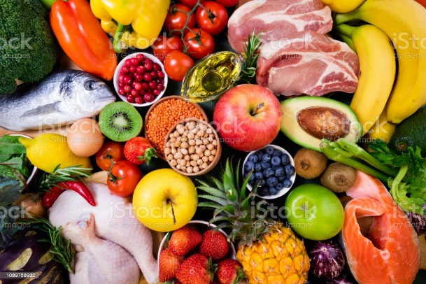
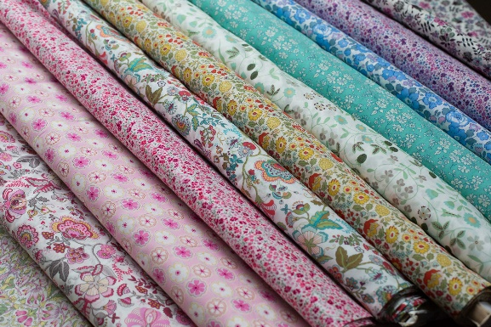
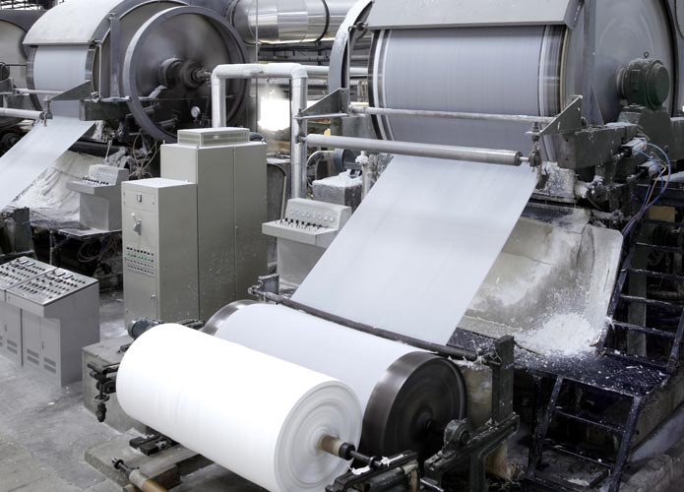
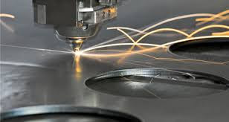
Here are some Manufacturing industries that make up the manufacturing sector:
The food sector of manufacturing transforms agricultural or livestock products into products for consumption, examples are baked goods, grains, fruit and vegetable preserves, and animal meat.
Textile manufacturers turn fibers into usable fabrics that will eventually be transformed into consumer goods, examples are fiber, yarn, thread, and fabric mills.
Paper Manufacturing
Paper manufacturers make pulp, paper, or converted paper products.
Petroleum and Coal Manufacturing
This industry deals with transforming crude petroleum and coal into usable consumer products.
The metal manufacturing sector produces metals like iron, steel, aluminum, etc.

Slide 5
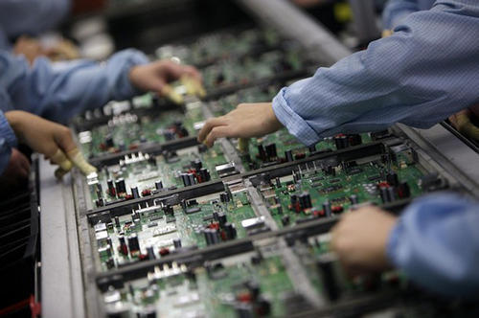
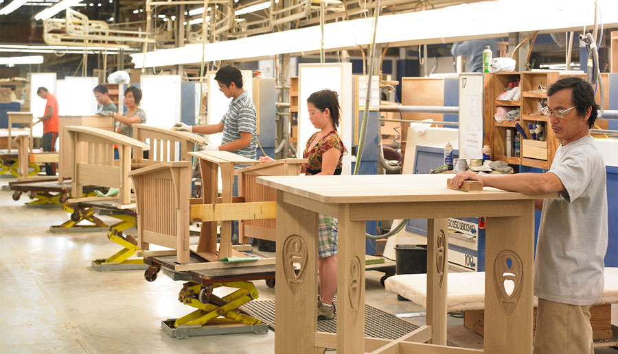
Computer and Electronics Manufacturing
This sector is rapidly growing and continues to grow. This grouping includes computers, communications equipment, and audio and visual equipment.
Furniture Manufacturing
This sector includes the production of various furniture and all other related products like mattresses, blinds, cabinets, and lighting. Goods that are manufactured in this sector are functional and have a well-thought-out design.
There are many processes that can go into manufacturing furniture examples are cutting, shaping, finishing, and attaching wood to make a table.

Slide 6
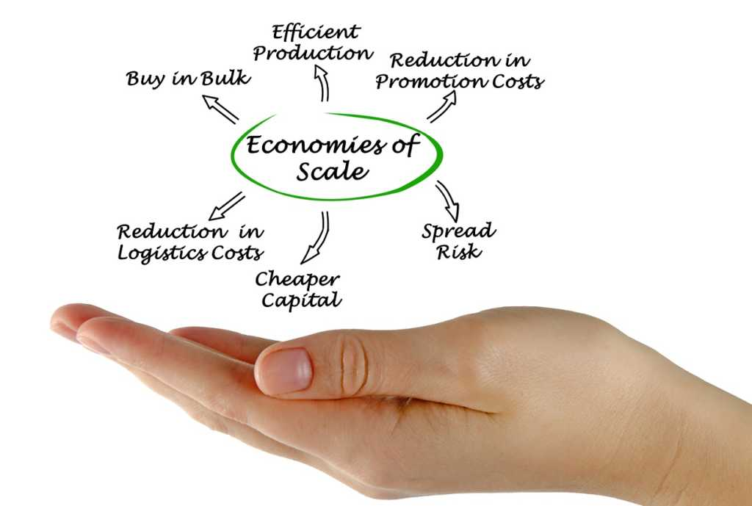
Economies of scale are cost advantages reaped by companies when production becomes efficient. Companies can achieve economies of scale by increasing production and lowering costs. This happens because costs are spread over a larger number of goods.
What Are Economies of Scale?

Slide 7
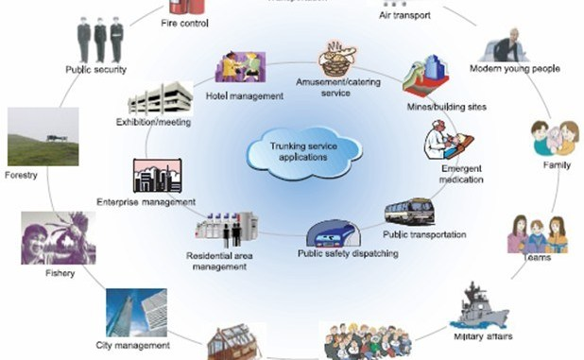
A service industry provides people with intangible products or services and completes tasks that are useful to customers, clients, businesses or the general public. Service industries, unlike manufacturing and production industries, do not rely on the sale of material goods and products to earn a profit. Instead, the individuals who work in the service sector focus on completing tasks and providing services...
What is the Service Sector?

Slide 8






There are several types of nonmaterial goods and products that service industries provide to people, including:

Slide 9

Examples of Service Industries
Many people do not realize the huge number of businesses and industries that combine to make up the service sector.
But if you stop and take some time to think about all the various service-related businesses, then it becomes very easy to see why the service sector is, by far, the largest sector of the economy in developed nations such as the US, the UK, Canada, Australia, Germany, and Japan.
The following are brief descriptions of just a few of the many businesses that comprise some of the major industries contained within the service sector.
Travel Industry
Travel refers to the act of moving from one location to another. This can refer to long-distance travel, short-distance travel, overseas travel,
domestic travel and various other forms. Crucially, travel
also includes both round trips and one-way journeys, and
it covers a wide variety of different travel purposes. Hotels,
motels, and the entire hospitality industry are also considered
part of the travel and tourism industry.

Slide 10

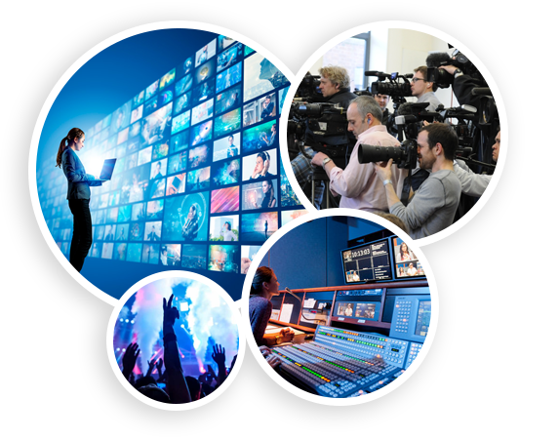
2. Information technology industry
The IT industry is composed of virtually anything and everything related to computers, information, communication technology, and software – except for the manufacturing of necessary hardware such as computers themselves.
Online education, one of the most rapidly growing industries worldwide, also falls under the broad umbrella of the information technology industry.
3. Media and entertainment industry
Technological inventions and advancements have also created a huge expansion of the media and entertainment industry. News used to be distributed by radio stations, print newspapers, and network television channels.

Slide 11
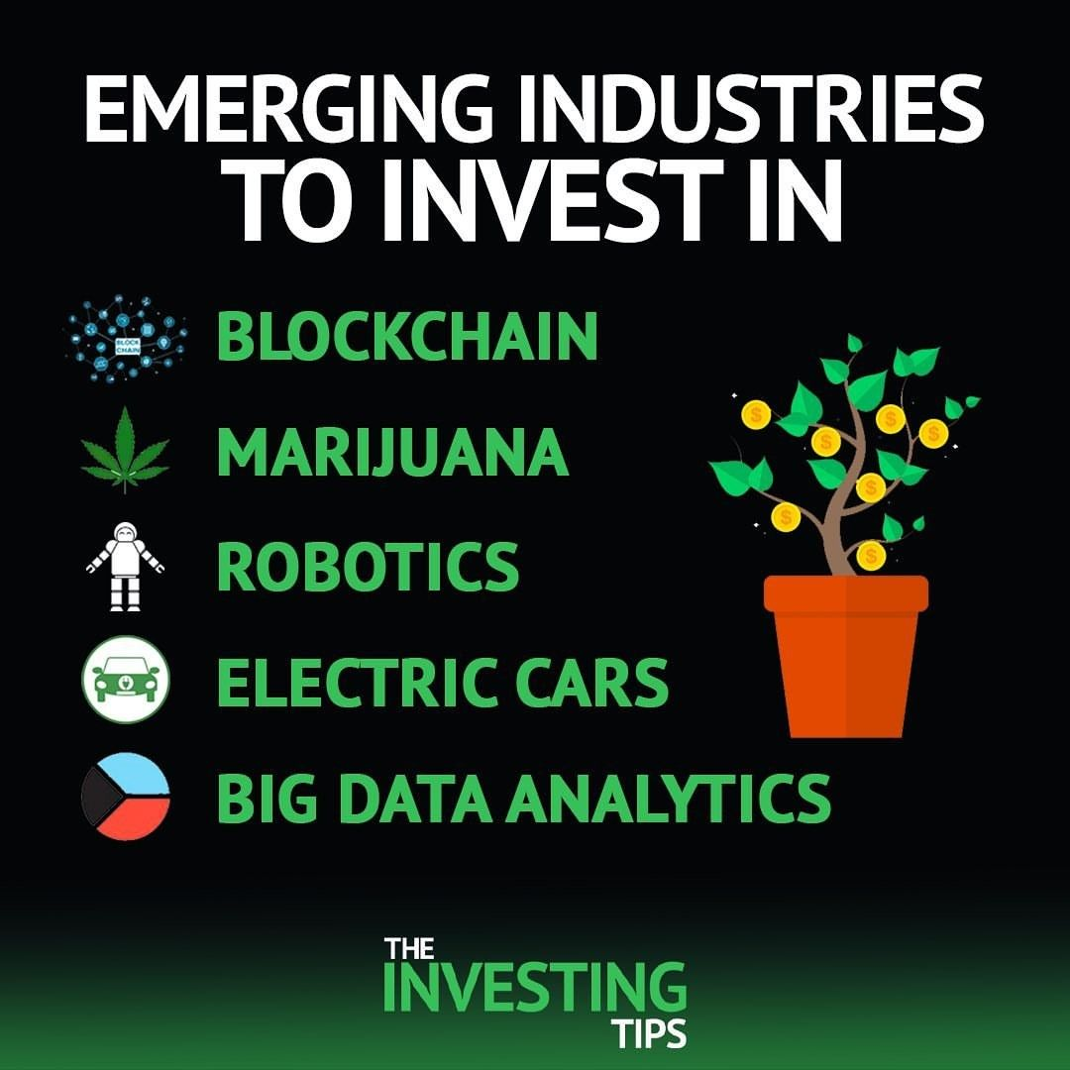
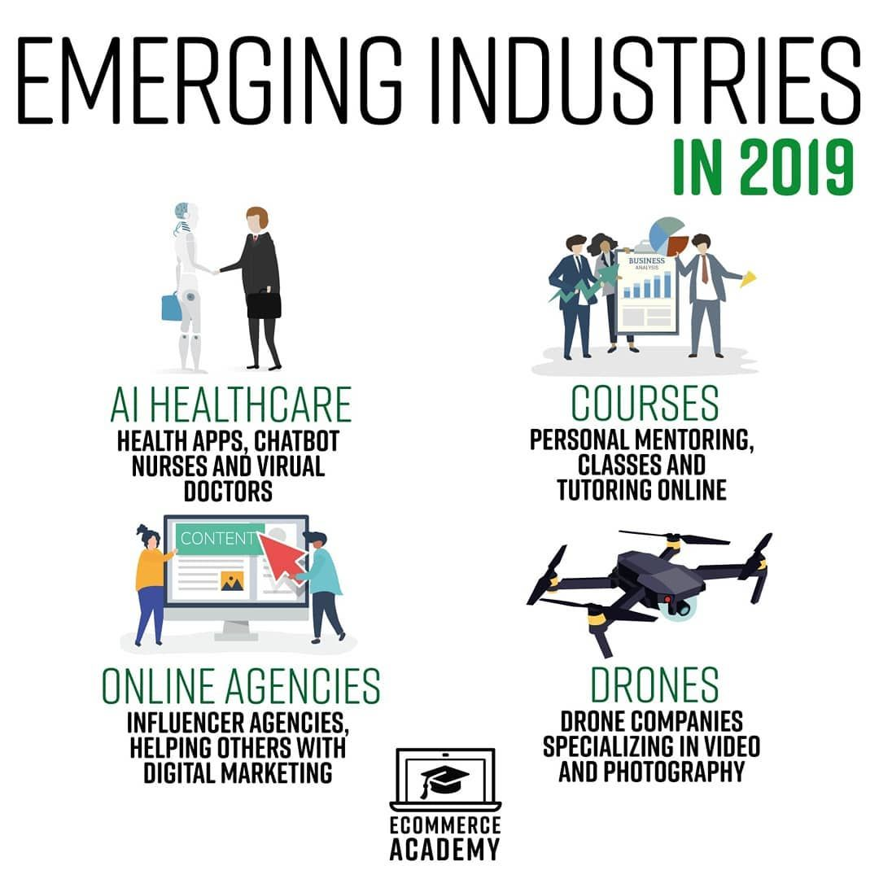
Emerging industries - entirely new or restructured industrial sectors, growing at a rate faster than the overall economy. Such industries usually come into being when customers need change, new technologies replace older ones, or when new socio-economic conditions emerge.
In 1950, Brazil was a relatively poor country, with most people living and working on the land.
The government decided to industrialize, and one of the new emerging industries in the 60s was the building of aircraft.
Industries

Slide 12
Reference
1. Business Vocabulary in use, Bill Mascull, Cambridge University Press, 2017.
2. Business Vocabulary builder, Paul Emmerson, MACMILLAN, 2009.
3. https://www.Vedantu.Com/geography/what-are-manufacturing-industries
4. https://www.Britannica.Com
5. https://www.Indeed.Com
6. https://www.revfine.com

