Slide 1

Business English Course
Chapter 2
Development process
Lecturer: N.A.Mukhitdinova, PhD

Slide 2
Content
Market Research;
Market research data;
Sources of Primary Market Research;
Questionnaires or surveys;
Testing process.

Slide 3
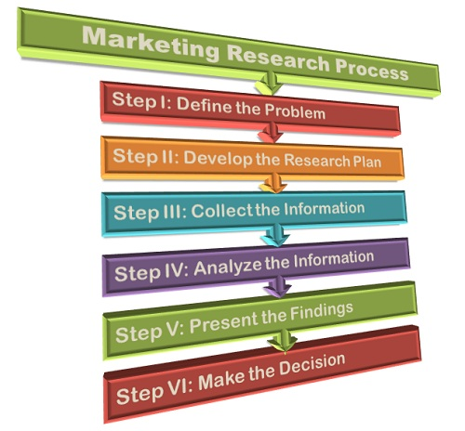
What Is Market Research?
Market research is the process of determining the viability of a new service or product through research conducted directly with potential customers. Market research allows a company to discover the target market and get opinions and other feedback from consumers about their interest in the product or service.

Slide 4


How to do market research?
There are two types of market research data: primary information and secondary information.
Primary information is first-hand data gathered from original sources. You either collect the data yourself or hire someone to do it for you. The bottom line is that you control the process from A to Z.
Secondary information is information and data that has been gathered by others and is publicly available either online or offline. This could be data published in newspapers, reports, journals and so on, or information freely available online. The downside is that everyone has access to this information and you have had no control over the collection methods.

Slide 5
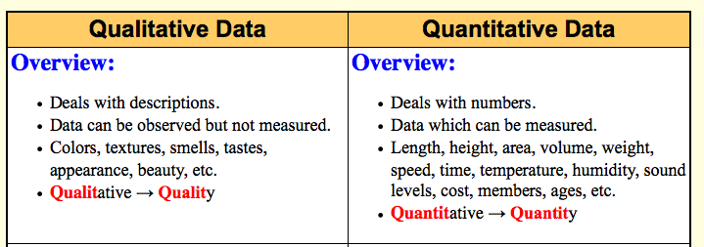
Types of information collected through both primary and secondary sources can be either qualitative or quantitative.
Qualitative information helps you gain a better understanding of how people feel about certain topics. You can ask them what they think and how/why they make choices that they do. The best sources to collect qualitative information include in-depth interviews, focus groups, and direct observations.
Quantitative information is statistical data and tends to be more structured. Closed question questionnaires and surveys fall under this type of information.

Slide 6


Primary research is often more expensive and time-consuming. But it is the best way to get the information that your business needs. The most popular primary research tools are:
Customer surveys. Surveys conducted via phone, in person, on paper or using an online survey software like SurveyMonkey, are hugely informative. It’s a list of questions crafted in a way that gives you the best possible insight into how a customer feels about your product or service, your brand and the experience you provide. It can be as broad or as specific as you want.
In-depth interviews. Carried out either by phone or face-to-face, in-depth interviews give you an opportunity to ask more probing questions. You can also follow-up with an interviewee wherever necessary to obtain satisfactory answers.
Sources of Primary Market Research

Slide 7


Sources of Primary Market Research
Focus groups. A focus group is an organized session with a group of 6-8 people that share some common characteristics. These characteristics include age, location, buying habits, etc. They will participate in a discussion of a predefined topic led by a moderator. It’s an expensive but effective method of getting feedback on bigger scale upgrades, product features or new products.
Observation. It involves watching or video-recording how consumers interact with a product or service in a natural setting. Although a time-consuming method, it has the advantage of providing unbiased research. This is because consumers are not under any pressure and will behave naturally.

Slide 8
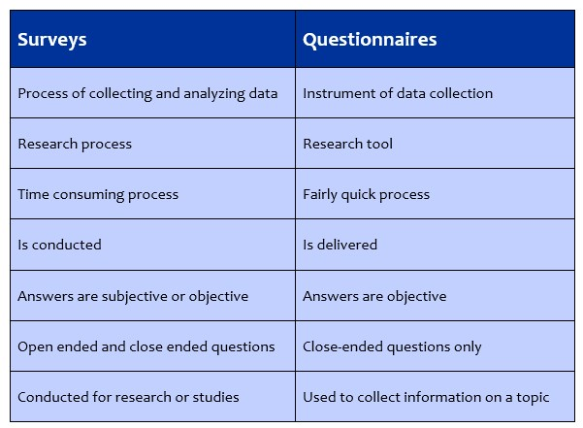
.
Questionnaires or surveys
A questionnaire is a research instrument consisting of a series of questions (or other types of prompts) for the purpose of gathering information from respondents.
A survey - Marketing: A detailed study of a market or geographical area to gather data on attitudes, impressions, opinions, satisfaction level, etc., by polling a section of the population.

Slide 9
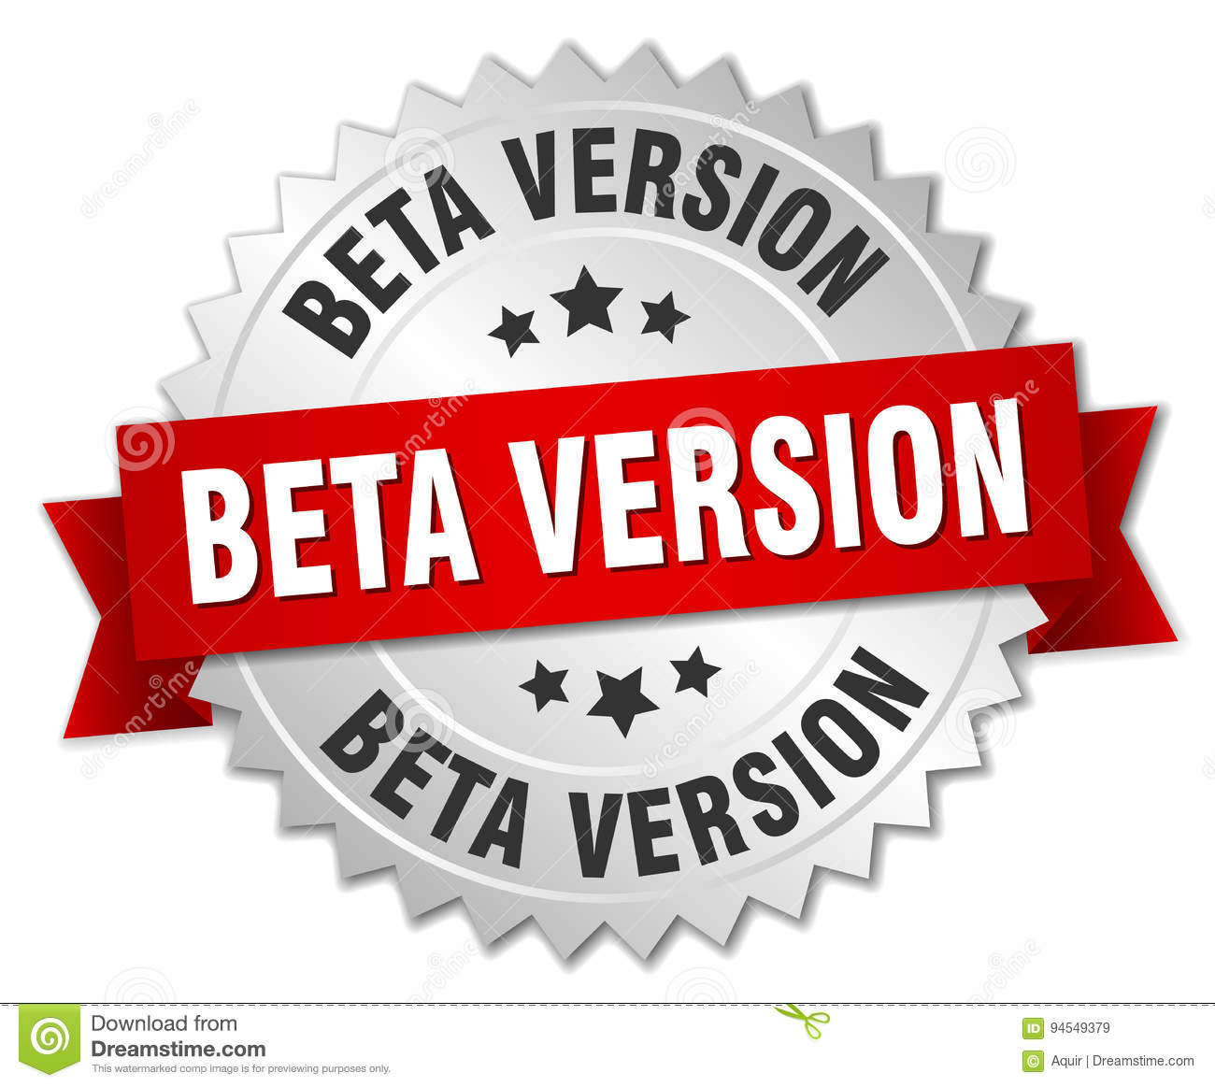
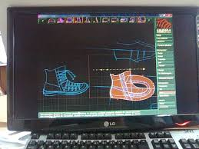
When software developers have finished the beta version – first version – of a program, they release this on the internet and users are asked to try it out and to identify bugs or problems.
CAD/CAM stands for computer-assisted design & computer-assisted manufacturing. CAD/CAM software is used to design and manufacture prototypes, finished products, and production runs. An integrated CAD/CAM system offers one complete solution for design through manufacturing.

Slide 10

Researchers in laboratories may take years to develop new drugs, testing or trialing them in trials to show not only that they are effective, but also that they are safe. Drugs need to be made on an industrial scale – that is on a scale suitable, intended, or necessary for industrial use before they can be sold

Slide 11

A product launch
A product launch is when a company decides to launch a new product in the market. Product launch can be of an existing product which is already in the market or it can be a completely new innovative product which the company has made.

Slide 12
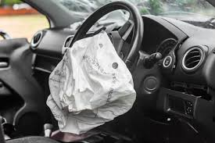
A Design defect
Frailty or shortcoming of an item resulting from a defect in its concept, and which can be avoided only through an alteration or redesign of the item.
If a design defect or design fault is found in a product after it has been launched, the company may have to recall it, asking those who have bought the product to return it, perhaps so that the defect can be corrected.

Slide 13
Reference
1. Business Vocabulary in use, Bill Mascull, Cambridge University Press, 2017.
2. Business Vocabulary builder, Paul Emmerson, MACMILLAN, 2009.
3. https://corporatefinanceinstitute.com
4. https://meaningkosh.com
5. https://www.Britannica.Com
6. https://www.oberlo.com/ecommerce-wiki/market-research

Slide 14
Thank you for your attention!

