Slide 1

Business English Course:
Chapter 3
Innovation and Invention
Making things
Lecturer: N.A.Mukhitdinova, PhD

Slide 2
Content:
1. Innovation;
2. Invention;
3. Product development;
4. Patents and intellectual property;
5. Product.

Slide 3
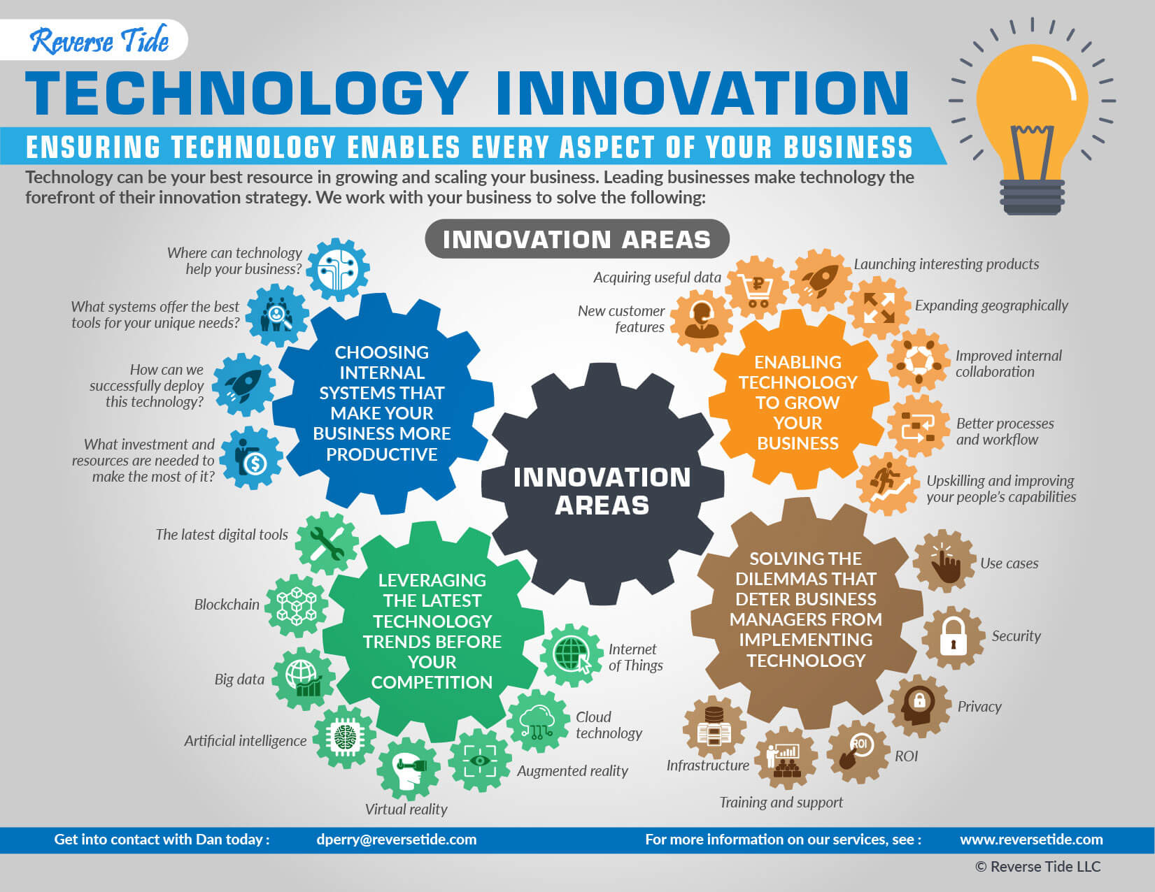
The process of translating an idea or invention into a good or service that creates value or for which customers will pay.
To be called an innovation, an idea must be replicable at an economical cost and must satisfy a specific need. Innovation involves deliberate application of information, imagination and initiative in deriving greater or different values from resources, and includes all processes by which new ideas are generated and converted into useful products. In business, innovation often results when ideas are applied by the company in order to further satisfy the needs and expectations of the customers.
Innovation

Slide 4

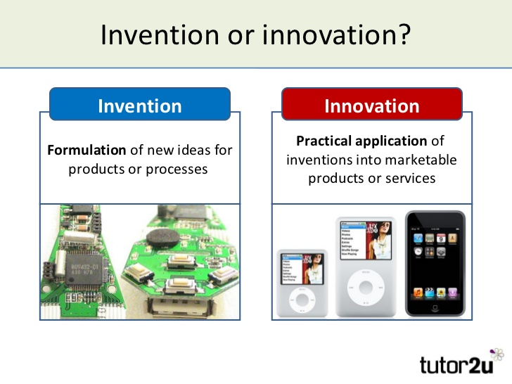
New scientific or technical idea, and the means of its embodiment or accomplishment. To be patentable, an invention must be novel, have utility, and be non-obvious. To be called an invention, an idea only needs to be proven as workable. But to be called an innovation, it must also be replicable at an economical cost, and must satisfy a specific need. That's why only a few inventions lead to innovations because not all of them are economically feasible.
Invention

Slide 5
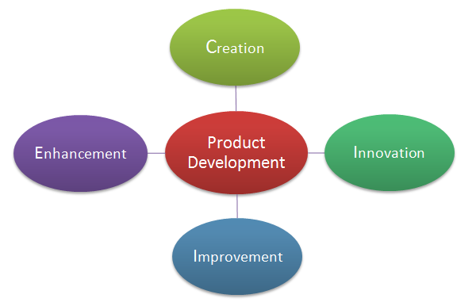
The creation of products with new or different characteristics that offer new or additional benefits to the customer.
Product development may involve modification of an existing product or its presentation, or formulation of an entirely new product that satisfies a newly defined customer want or market niche.
Product development

Slide 6

Systematic activity combining both basic and applied research, and aimed at discovering solutions to problems or creating new goods and knowledge. R&D may result in ownership of intellectual property such as patents. In accounting for R&D costs, the development costs may be carried forward but the basic and applied research costs are often written-off as incurred.
Research and development

Slide 7
Research and technology
Google carries out research and development (R&D) at its research center in Mountain View, California. Its laboratories are some of the most innovative in the computer industry.
Google has made many new breakthroughs – innovations. Users can try out these products before they are released in their final version.
The company is a leader in the technology of internet search. They are at the cutting edge (the most modern stage of development in a particular type of work or activity) or leading edge (the most advanced position in an area of activity) of this technology – none of their competitors has better products than them. Everything they do is state-of-the-art (- very modern and using the most recent ideas and methods and the most advanced techniques available).
Of course, the hi-tech products of today become the low-tech products of tomorrow. Products that are no longer up-to-date because they use old technology are obsolete. Like all companies, Google never wants to get into that situation: they want to develop technology that is future-proof.

Slide 8

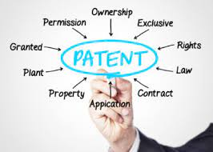
Patents and intellectual property
Information or knowledge that belongs to an individual or company is proprietary. A product developed using such information may be protected in law by patents so that others cannot copy its design.
Other companies may pay to use a design under license in their own products. These payments may be referred to as royalties.
In publishing, if a text, picture, etc. is copyright, it cannot be used by others without permission: this is copyright infringement. An example of this is illegal downloading of music, films and software from the internet: this is piracy.
Another form of piracy is when fake products, often luxury products such as Rolex or Chanel, are sold without the permission of the company that owns the brand name or trademark – a recognizable symbol used on the product.
The area of law relating to patents, copyright and trademarks is intellectual property.

Slide 9
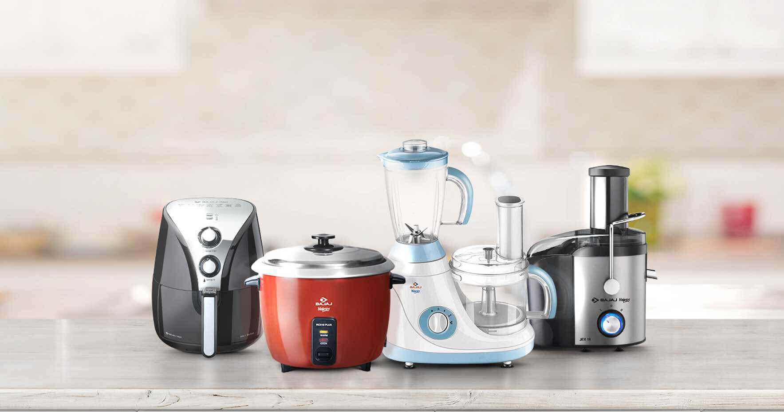

Product
A product is the item offered for sale. A product can be a service or an item. It can be physical or in virtual or cyber form. Every product is made at a cost and each is sold at a price. The price that can be charged depends on the market, the quality, the marketing and the segment that is targeted. Each product has a useful life after which it needs replacement, and a life cycle after which it has to be re-invented. In FMCG parlance, a brand can be revamped, re-launched or extended to make it more relevant to the segment and times, often keeping the product almost the same.

Slide 10
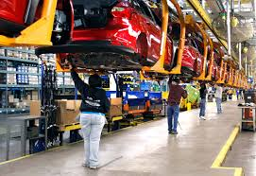
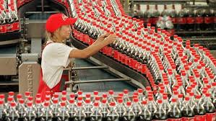
Mass production is the manufacture of large quantities of standardized products often using assembly lines or automation technology. Mass production refers to the efficient production of a large number of similar products. Mechanization is used to achieve high volume, detailed organization of material flow, careful control of quality standards, and division of labor.
Mass production

Slide 11
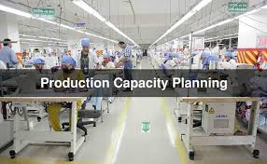
The capacity of something such as a factory, industry, or region is the quantity of things that it can produce or deliver with the equipment or resources that are available.
Output - the act of turning out; production: -the factory's output of cars; artistic output.
The quantity or amount produced, as in a given time: - to increase one's daily output.
Capacity and output

Slide 12
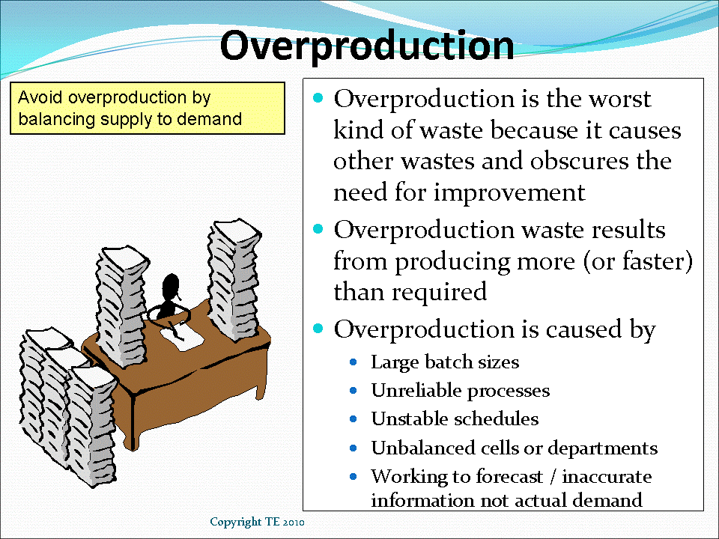
Productivity is a measure of how much is produced in relation to the number of employees. High output per employee = high productivity.
The maximum amount that a particular plant, company or industry can produce is its capacity. If it is producing this amount, it is working at full capacity. If it is producing more than what is needed, there is overproduction or: excess capacity, overcapacity, spare capacity, surplus capacity…
.

Slide 13
Reference
1. Business Vocabulary in use, Bill Mascull, Cambridge University Press, 2017.
2. Business Vocabulary builder, Paul Emmerson, MACMILLAN, 2009.
3. https://archive.unescwa.org/innovation
4. https://corporatefinanceinstitute.com

Slide 14
Thank you for your attention!

