Slide 1

Business English Course:
Chapter 4
Materials and suppliers
Lecturer: N.A.Mukhitdinova

Slide 2
Content
1. Inputs;
2. Suppliers and outsourcing;
3. Just-in-time.

Slide 3
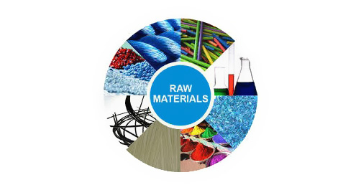
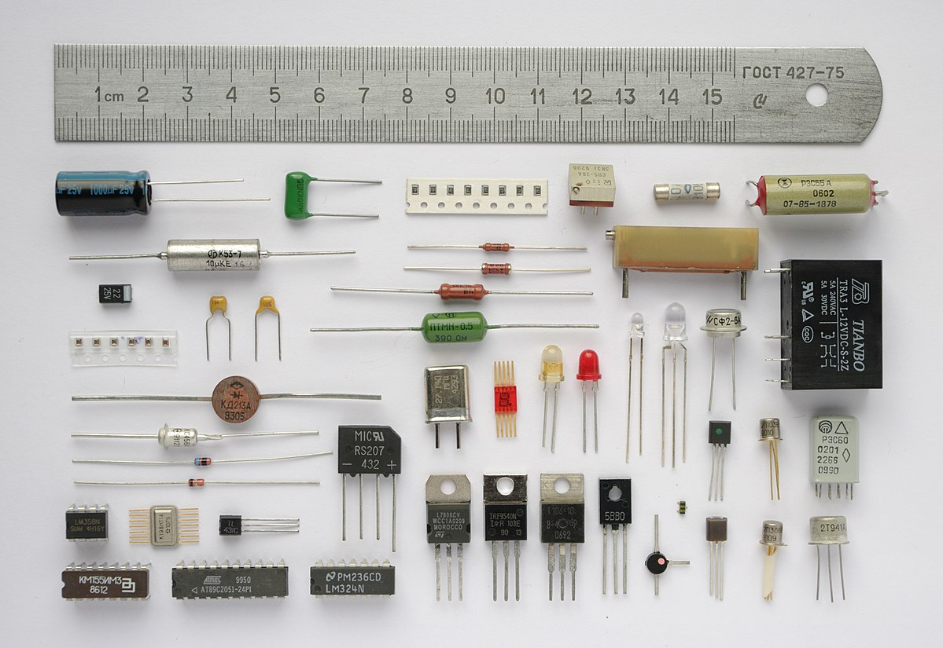
Inputs
raw materials – raw materials are materials or substances used in the primary production or manufacturing of goods. Raw materials are commodities that are bought and sold on commodities exchanges worldwide.
components - Uniquely identifiable input, part, piece, assembly, system that (1) is required to complete or finish an activity, item, or job, (2) performs a distinctive and necessary function in the operation of a system, or (3) is intended to be included as a part of a finished, packaged item.

Slide 4
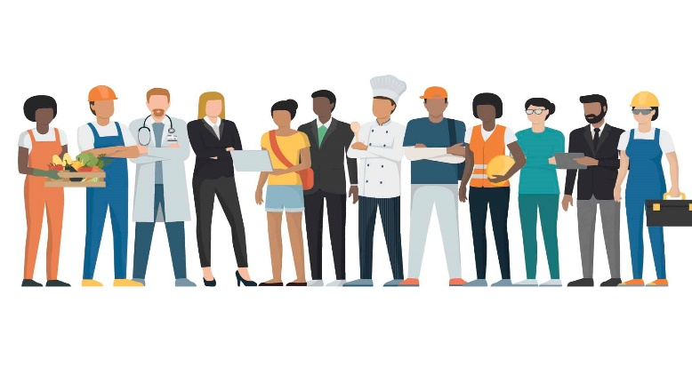

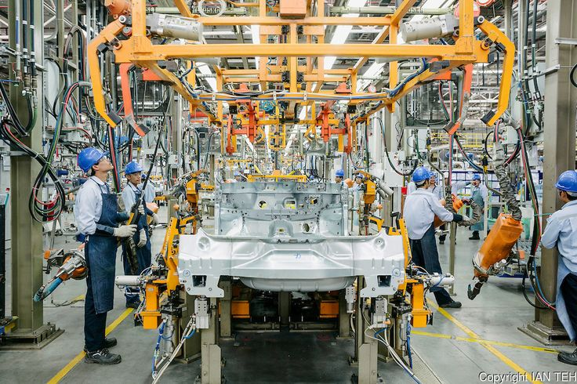
labor - workers, especially people who do practical work with their hands; capital - wealth, esp. money used to produce more wealth through investment or a new business; work-in-progress - something that is being developed or suggested but that is not yet complete.

Slide 5
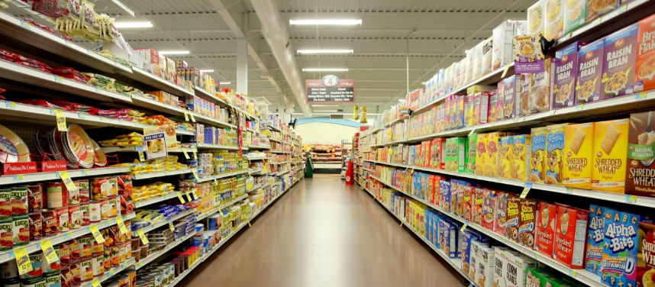
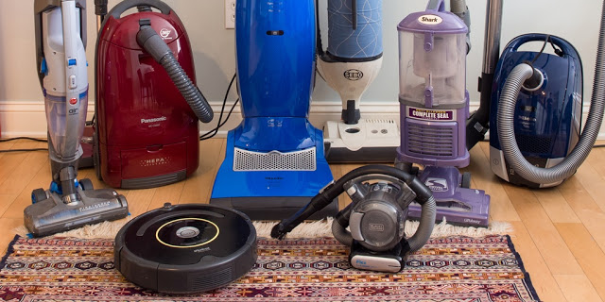
goods - A commodity, tangible item that satisfies some human want or need, or something that people find useful or desirable and make an effort to acquire it. finished goods - Materials or products which have received the final increments of value through manufacturing or processing operations, and which are being held in inventory for delivery, sale, or use.

Slide 6
Dyson makes vacuum cleaners. It takes raw materials like steel and plastic, and makes some of the components – or parts – used in its products. (Other components are made by other companies.)
Here are some typical combinations:
Materials and parts are just some of the inputs. The others are labor – workers and managers – and capital – money. Knowledge is also important because Dyson is a leader in vacuum technology.
Vacuum cleaners that are in the course of being made are work-in-progress. At any one time, Dyson has goods worth millions of dollars in its factories and warehouses; these are both the materials and components used to make its products, and its finished goods – the products that have been made.
Quantities of raw materials, components, work-in-progress and finished goods in a particular place are stocks.

Slide 7
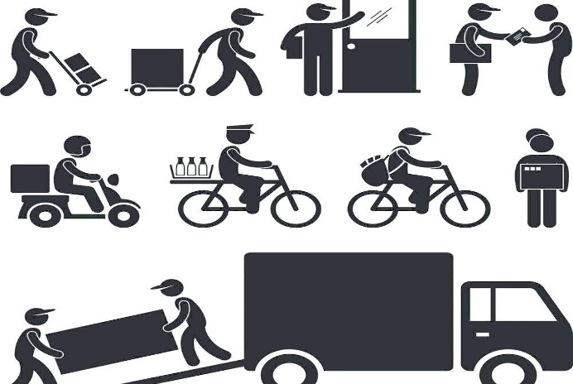

suppliers – a person, company or country that provides goods of a particular kind. subcontracting - a business practice where main contractor hires additional individuals or companies called subcontractors to help complete a project.

Slide 8
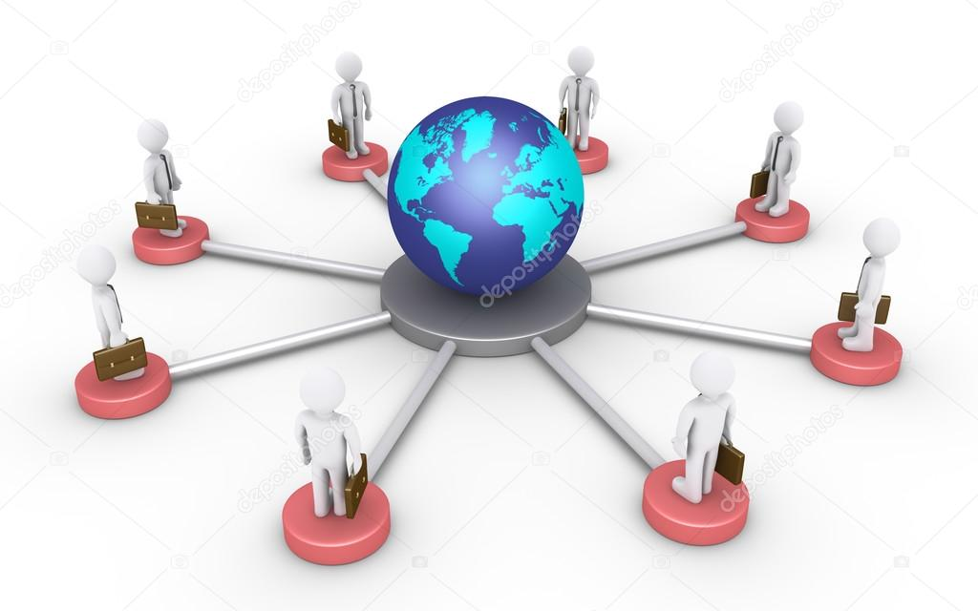

outsourcing – the process of paying to have part of a company's work done by another company; in-house - done by someone employed by a company on their premises, not by an outside contractor;

Slide 9

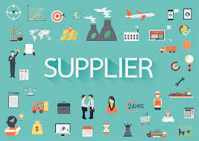
Suppliers and outsourcing
Dyson has its own manufacturing operation, but it works with its suppliers – companies that provide materials and components. Some companies refer to their suppliers as partners.
The company uses subcontracting – which means using outside suppliers to provide components and services. In other words, it uses outsourcing rather than doing these activities in-house – within the company.

Slide 10
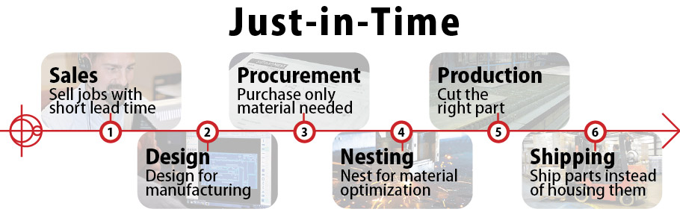
Just-in-time - a just-in- time system of manufacturing (producing goods) is based on preventing waste by producing only the amount of goods needed at a particular time and not paying to produce and store more goods than are needed.

Slide 11
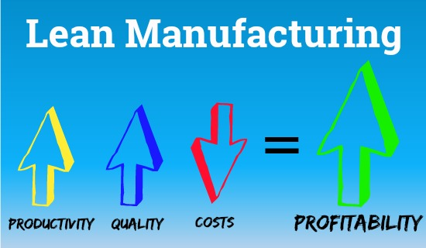
It costs money to keep components and goods available for customers to buy in stock. Stocks have to be financed – paid for. They also have to be stored – kept in special buildings called warehouses – and handled – moved from one place to another. So Dyson is asking its suppliers to provide components just-in time – when they are needed.
This is part of lean production or lean manufacturing, in which products are made in the most efficient way – doing things as quickly and cheaply as possible, without waste.

Slide 12
  Reference
Business Vocabulary in use, Bill Mascull, Cambridge University Press, 2017.
Business Vocabulary builder, Paul Emmerson, MACMILLAN, 2009.
https://m.boschrexroth.com
https://www.investopedia.com

Slide 13
Thank you for your attention!

