Slide 1

Business English Course:
Chapter 5
Business philosophies
Lecturer: N.A.Mukhitdinova

Slide 2
Content
1. Total quality management (TQM);
2. Mass customization;
3. Continuous improvement;
4. BPR – Business process re-engineering.

Slide 3
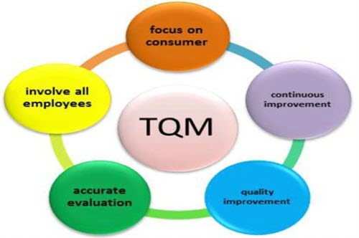
TQM - A core definition of total quality management (TQM) describes a management approach to long-term success through customer satisfaction. In a TQM effort, all members of an organization participate in improving processes, products, services, and the culture in which they work.
For example: An important feature of our TQM system is that every employee in our company feels responsibility for customer satisfaction.

Slide 4
Total quality management (TQM) is an ongoing process of detecting and reducing or eliminating errors.
It is used to streamline supply chain management, improve customer service, and ensure that employees are trained.
The focus is to improve the quality of an organization's outputs, including goods and services, through the continual improvement of internal practices.
Total quality management aims to hold all parties involved in the production process accountable for the overall quality of the final product or service.

Slide 5
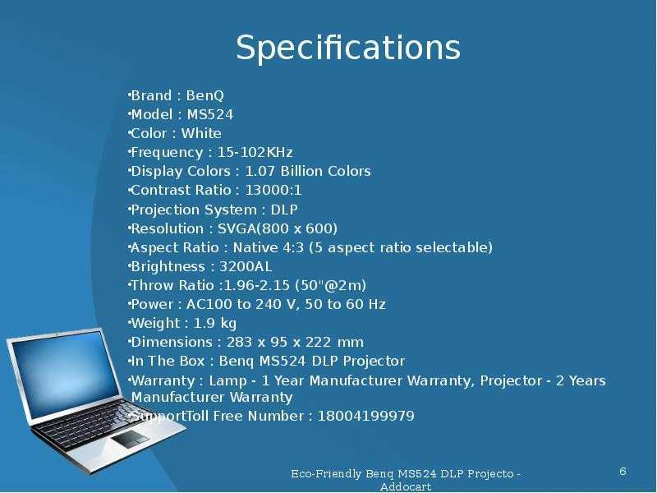
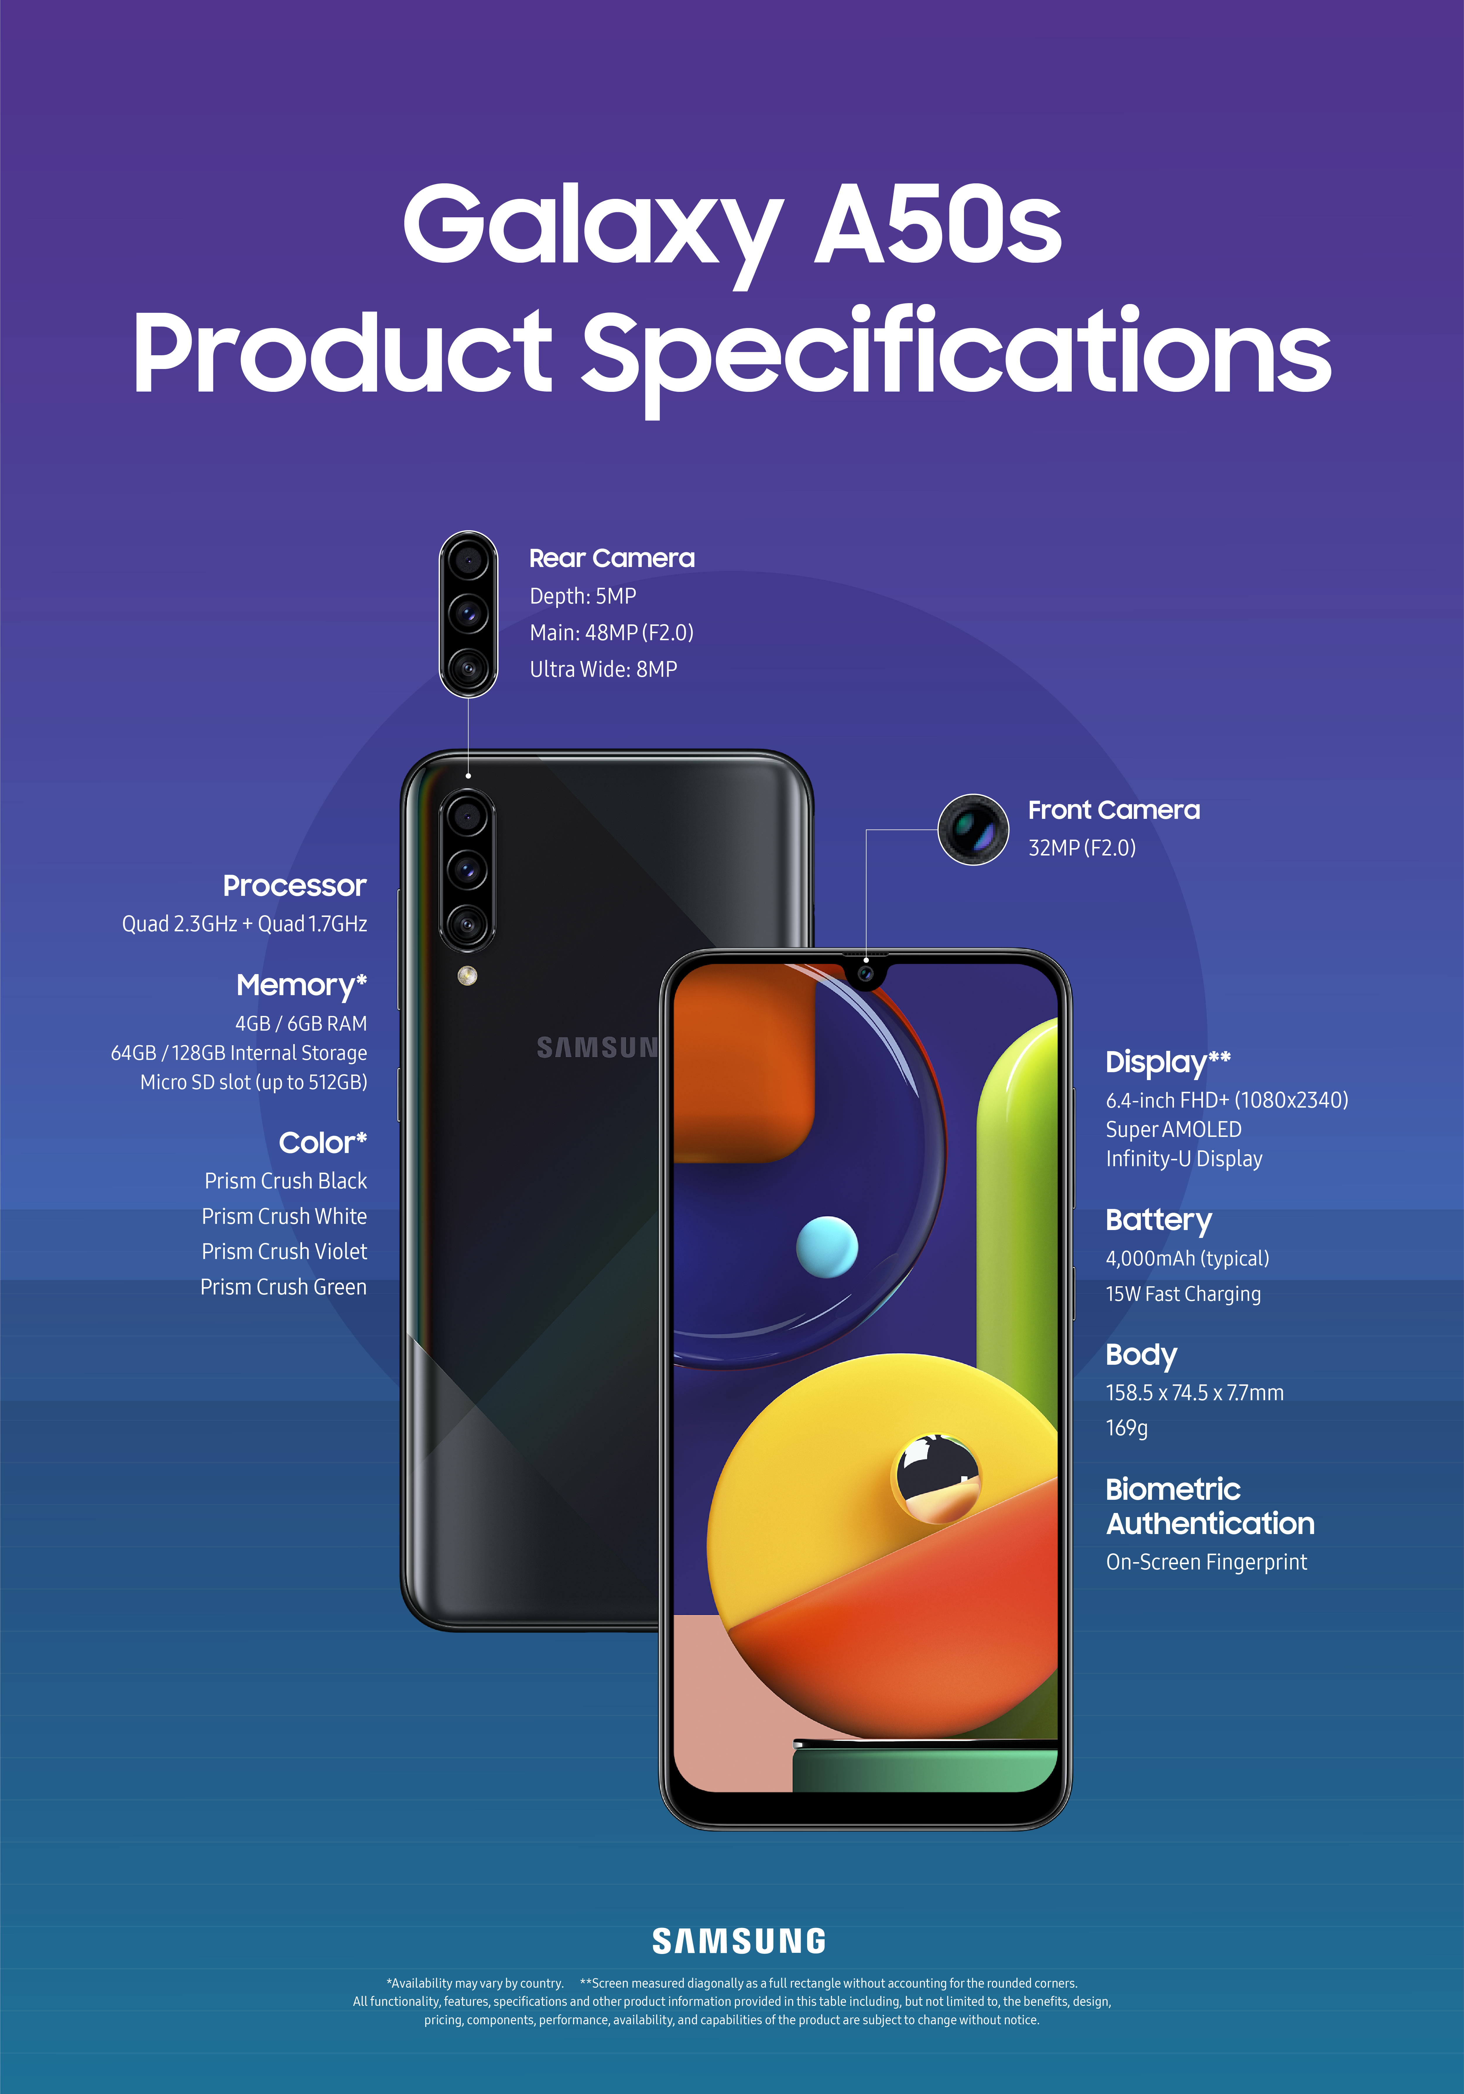
Specifications – a detailed description of how something should be done, made, etc.
Exact statement of the particular needs to be satisfied, or essential characteristics that a customer requires (in a good, material, method, process, service, system, or work) and which a vendor must deliver.

Slide 6
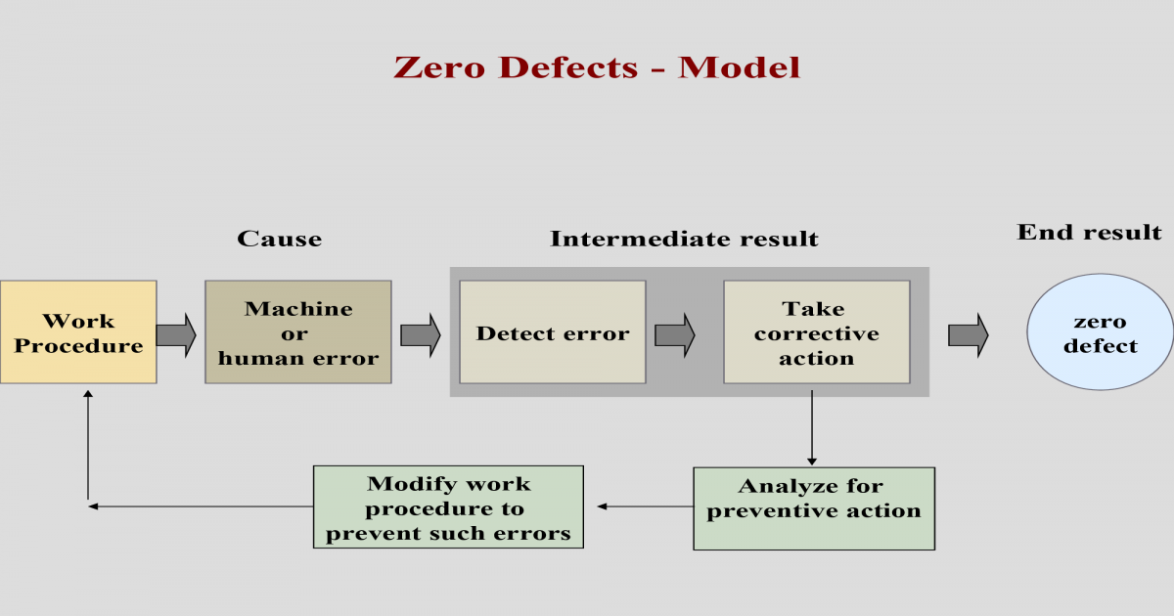
Zero defects – a system that tries to make certain that a company’s products or services contain no problems that will cause them not to work correctly.
Right first time - if something is done right first time, it is done perfectly every time, and no time and money is wasted correcting errors caused by doing it too fast or without controlling quality.

Slide 7
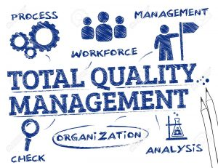
Tom Dryden, of Dryden Vacuum Cleaners, believes in quality: “The specifications or specs of a product are exact instructions about its design, including its dimensions (size), how it is to be made, the materials to be used, etc. The objective of quality control is conformity to specifications, the idea that the product should be made exactly as it was intended, with zero defects: no faults at all. Things should be done right first time so we don’t have to correct mistakes later in a process of reworking. We do spot checks every few minutes during production to ensure everything is going well. We have a system of total quality management (TQM), including quality circles: groups of employees who meet regularly to suggest improvements”.

Slide 8
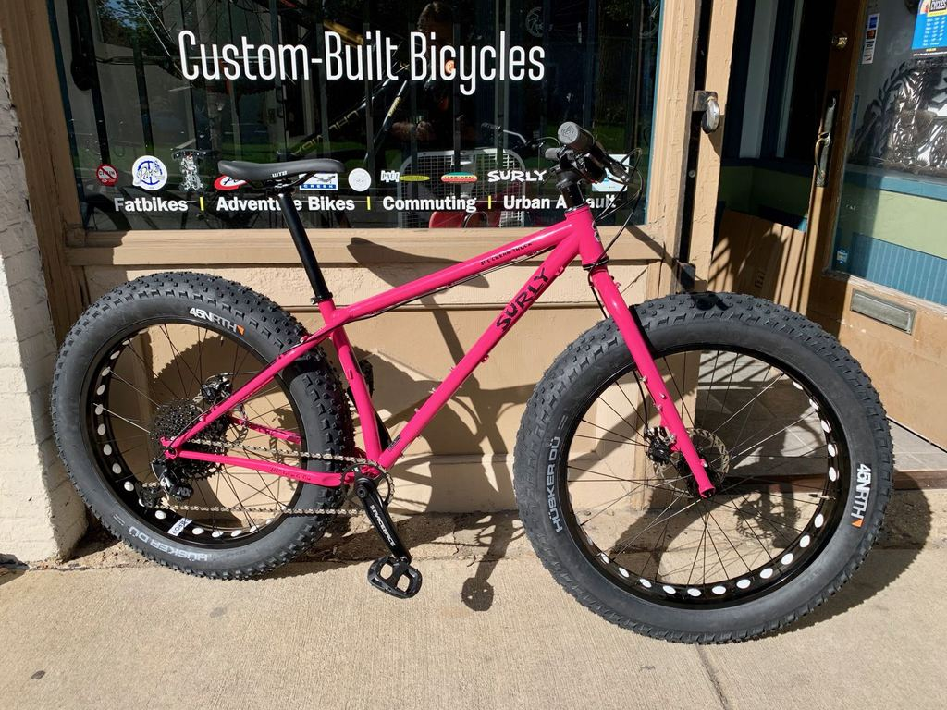
Mass customization
Production lines are good for mass production – producing large numbers of similar products. Manufacturers try to make standard products, with few variations, that as many people as possible will want to buy. Standardization is the most important factor.
Custom-built or tailor-made products,
where each product is made to meet the
specifications, requirements or needs
of a particular customer, are more expensive
to produce, of course.
The management thinker Joseph Pine and others talk about the possibilities of mass customization, where products are made in large quantities, but each one is made to the specifications of the buyer – the person or organization buying it. Dell Computers, where each computer is made for a particular buyer, is the best-known example of this.

Slide 9
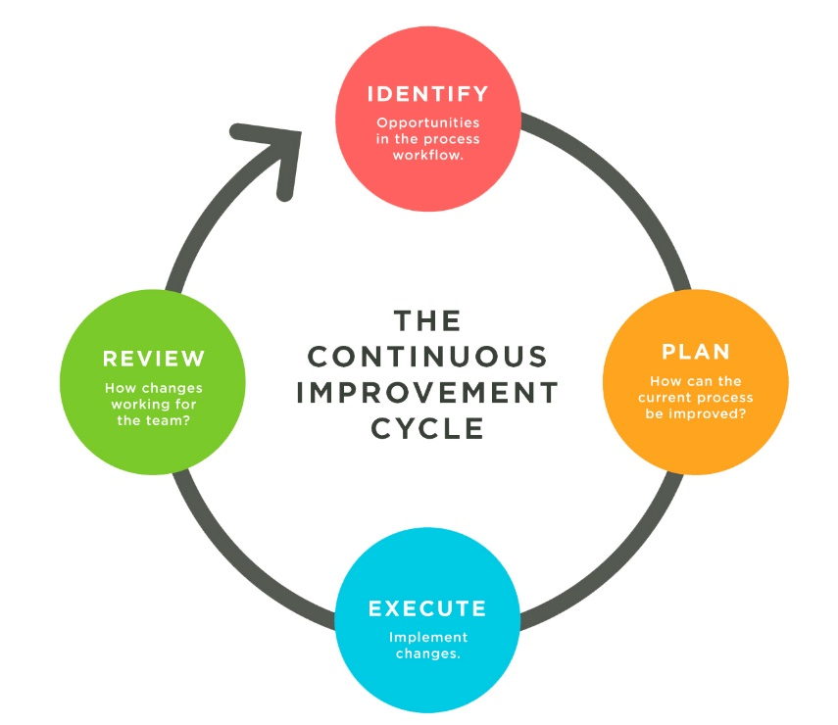
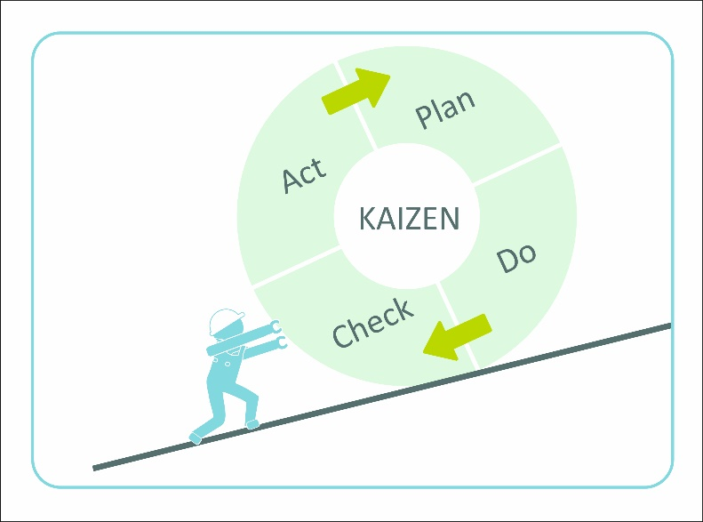
Continuous improvement – the process of making regular small changes and improvements to the products, services, etc. of a company rather than a few big changes.
Enhancement – a change or a process of change, that improves something or increases its value.
Kaizen – a Japanese way of running a company by always trying to improve the way people work and they do.

Slide 10


Mystery shoppers – someone employed to test the service in shops and businesses by pretending to be a normal customer.

Slide 11
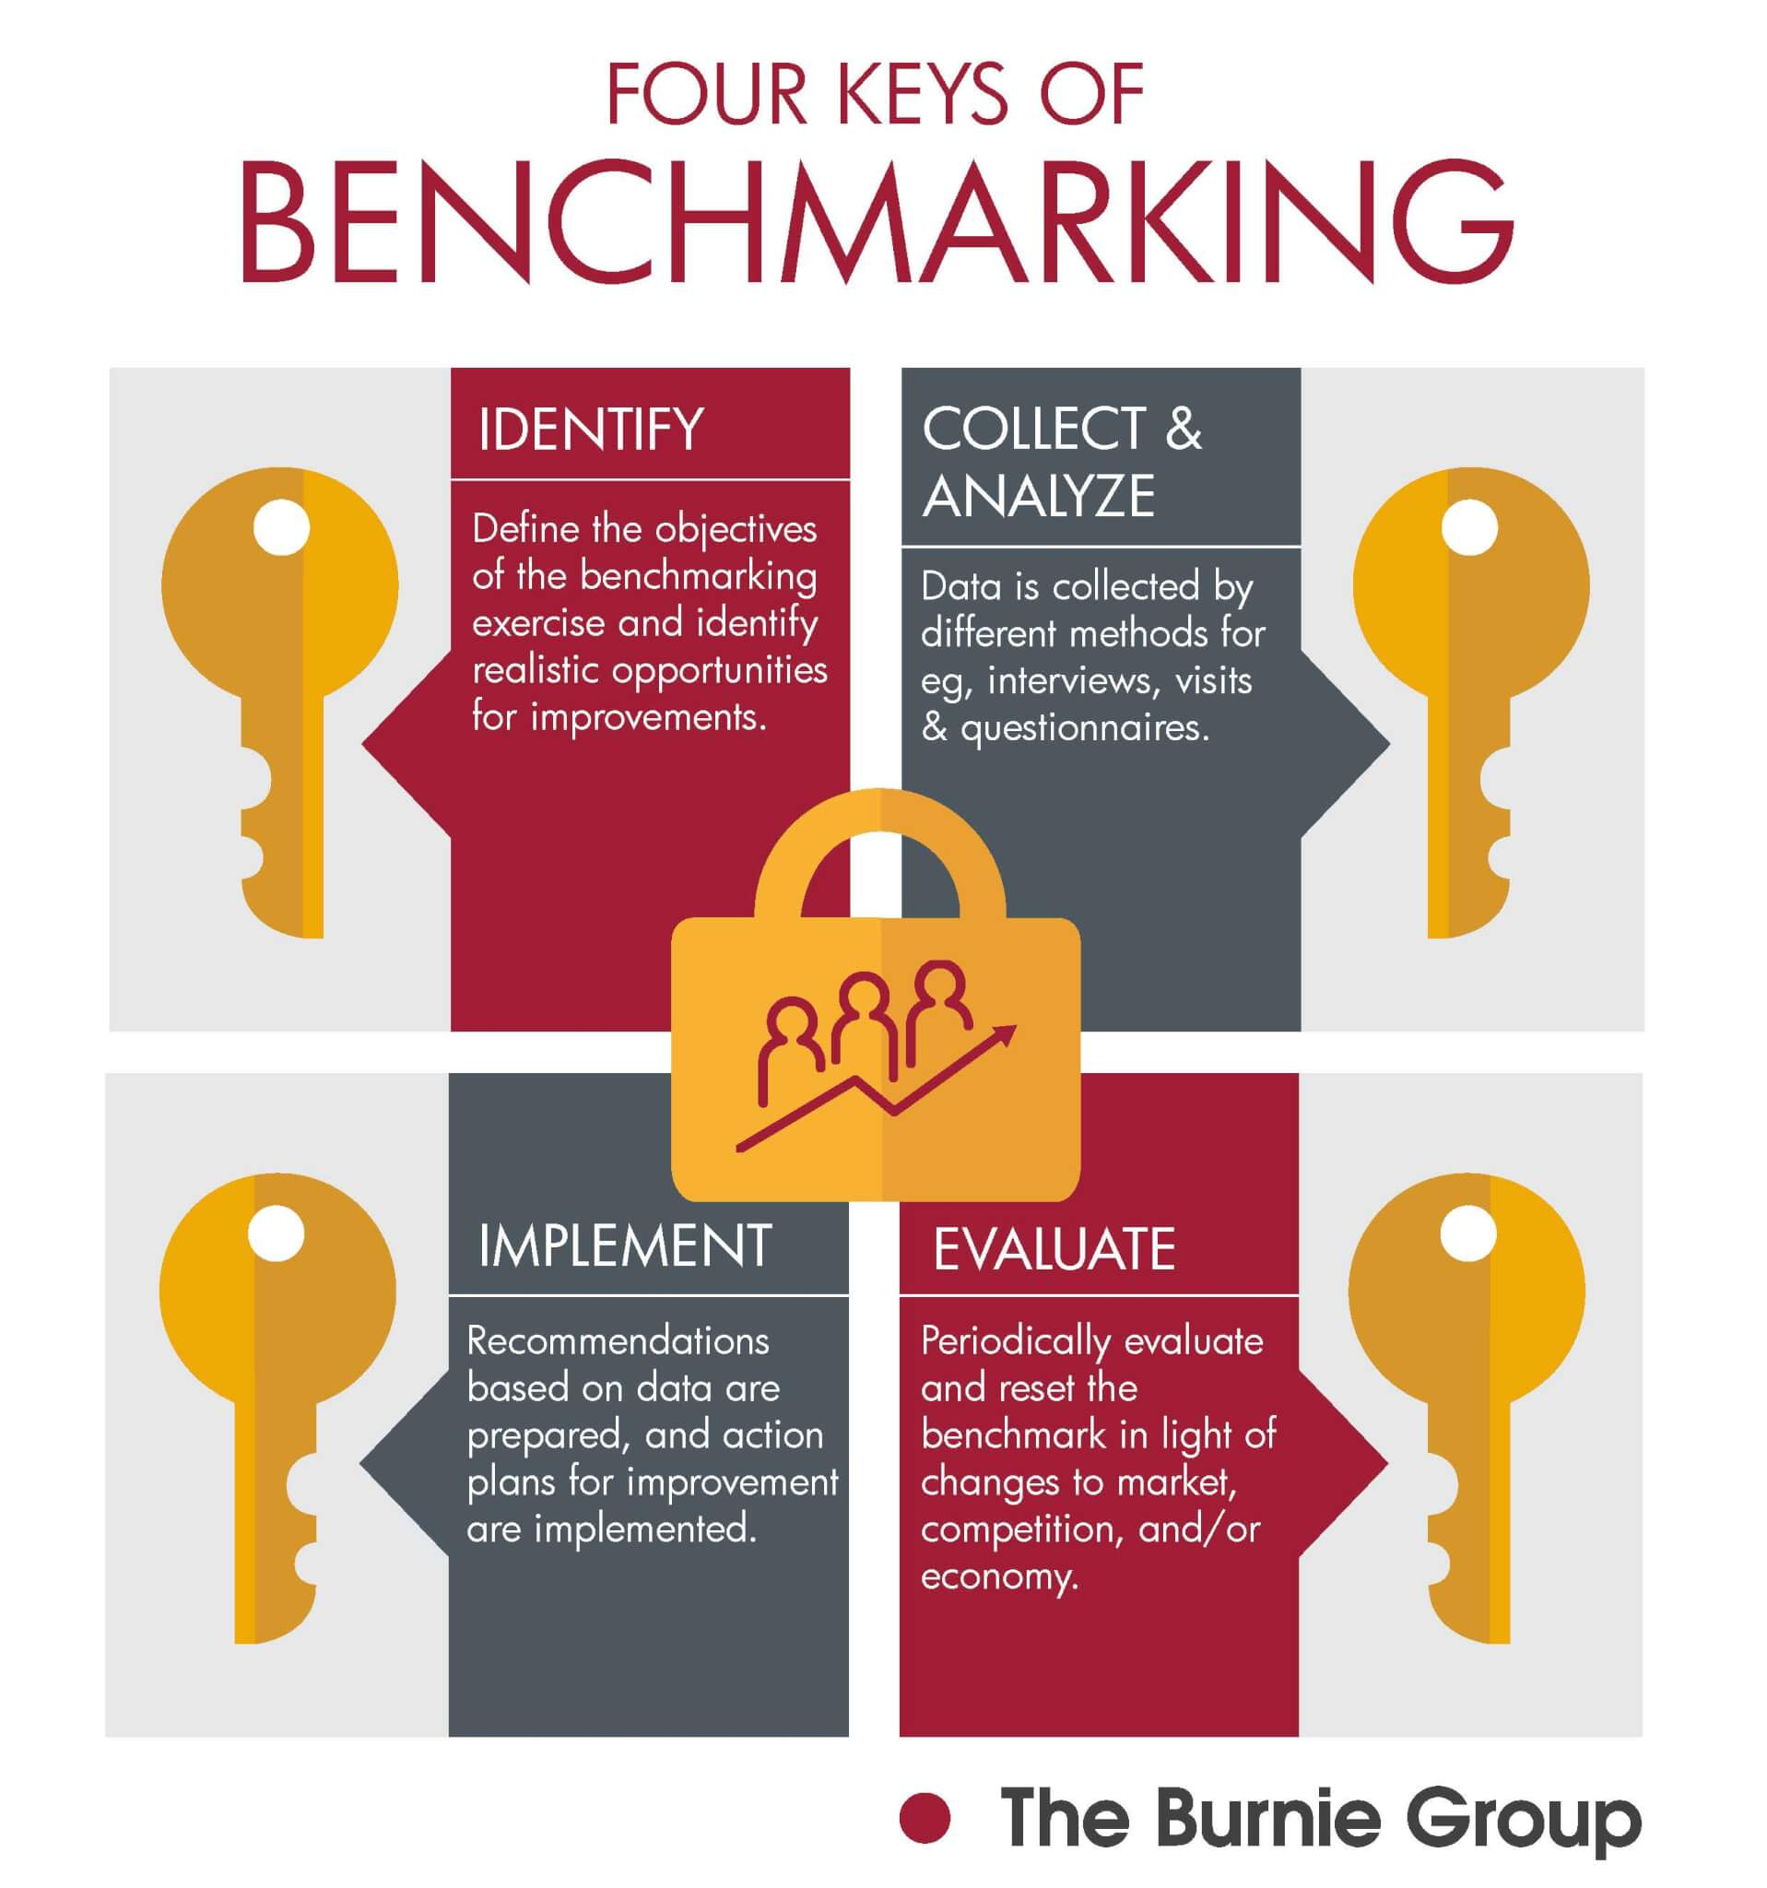
Benchmarking – a measurement of the quality of an organization's policies, products, programs, strategies, etc., And their comparison with standard measurements.
The objectives of benchmarking are (1) to determine what and where improvements are called for, (2) to analyze how other organizations achieve their high performance levels, and (3) to use this information to improve performance best practice – the way of running a business or providing a service that is recognized as correct or most effective.

Slide 12
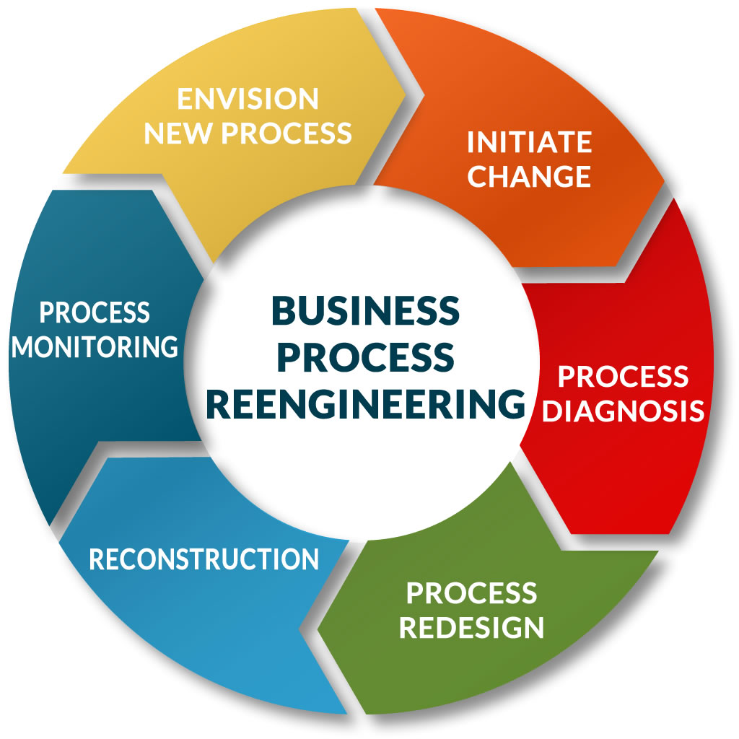
BPR – Business process re-engineering - is a business management strategy, originally pioneered in the early 1990s, focusing on the analysis and design of workflows and business processes within an organization. BPR aimed to help organizations fundamentally rethink how they do their work in order to improve customer service, cut operational costs, and become world-class competitors

Slide 13
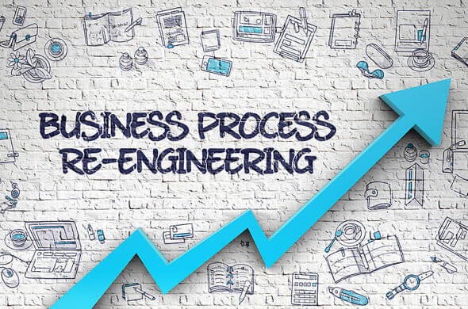
- Customer complaints and refund requests are rising;
- Staff stress, disputes, and turnover are high;
- Chaos reigns after experienced employees depart or go out on leave;
- Profitability is falling;
- Sales leads are not being followed up upon quickly;
- Corporate governance has been lacking;
- You are struggling with your cash flow;
- Your inventory levels are rising;
- You can’t fill customer orders quickly enough.
When is Business Process Re-Engineering Required?
The need for business process re-engineering surfaces in a variety of ways. Here are some indicators that it may be time for a BPR project.

Slide 14
  Reference
Business Vocabulary in use, Bill Mascull, Cambridge University Press, 2017.
Business English, Course handbook, Giedre Rimkiene, SMK University of Applied Social Sciences, 2014.
www.integrify.com
https://www.businessenglishpod.com

Slide 15
THANK YOU FOR YOUR ATTENTION!

