Slide 1

Business English Course:
Chapter 7
Marketing and market orientation
Products and brands
Lecturer: N.A.Mukhitdinova

Slide 2
Content
1. Marketing;
2. 4 Ps;
3. Market orientation;
4. Products.

Slide 3
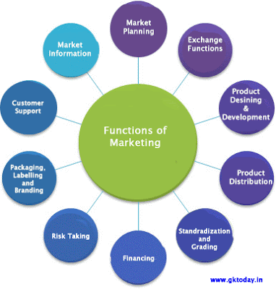
marketing - marketing is the activity, set of institutions, and processes for creating, communicating, and exchanging offerings that have value for customers, clients, partners, and society at large. Marketing also refers to activities undertaken by a company to promote the buying or selling of a product or service. Marketing includes advertising, selling, and delivering products to consumers or other businesses.

Slide 4
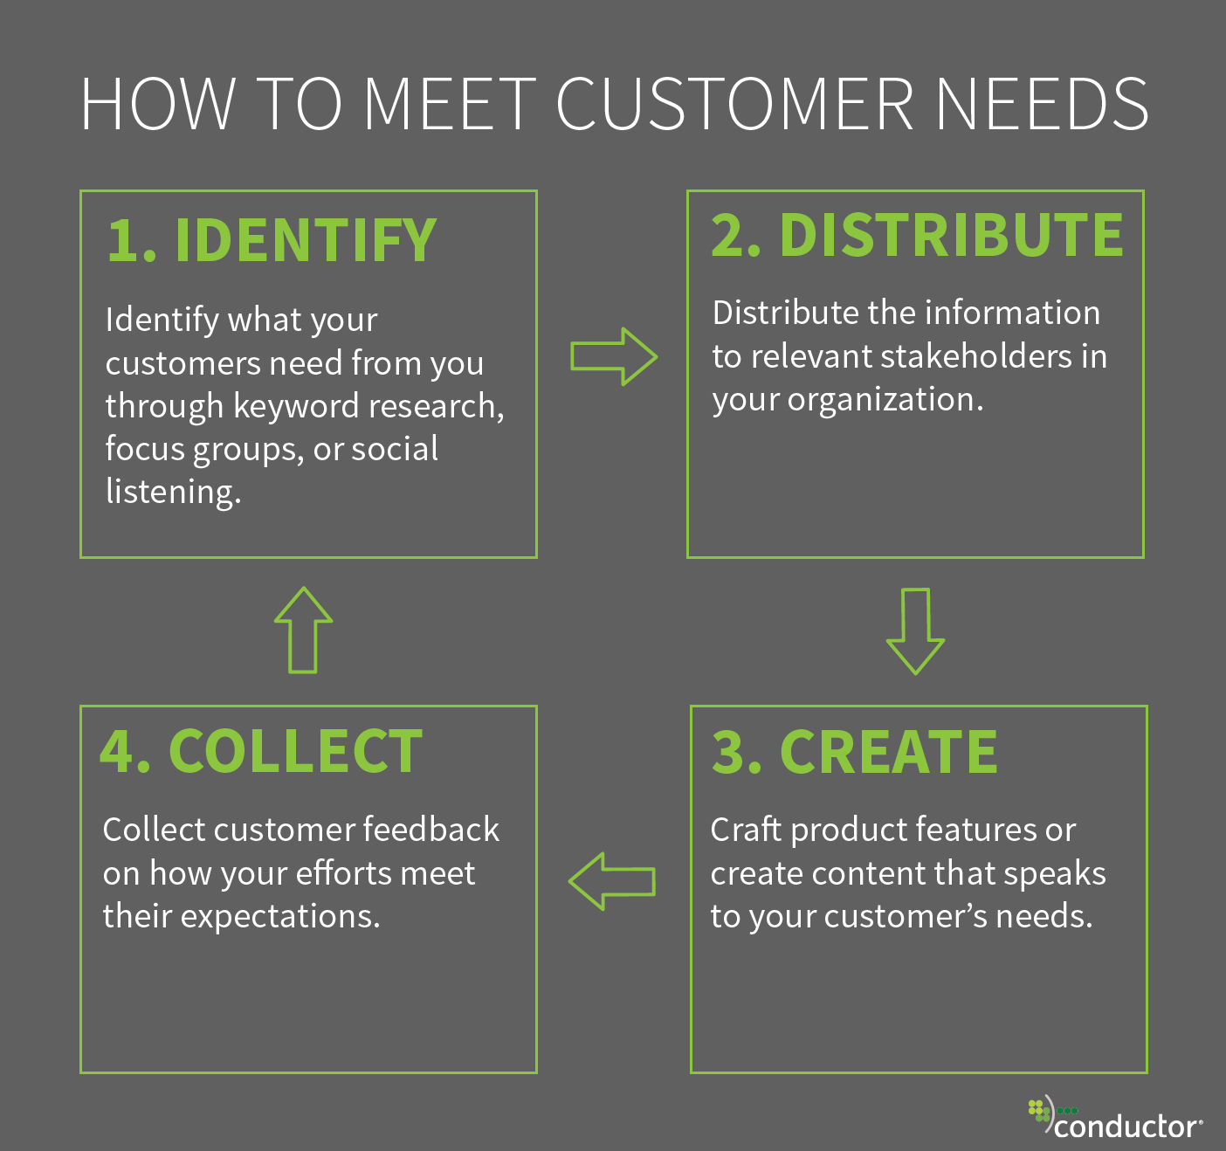
customer needs – a)problems that customers intend to solve with the purchase of a good or service.
b)particular characteristics and specifications of a good or service as determined by a customer;
features – means of providing benefits to customers. A feature is a distinctive characteristic of a good or service that sets it apart from similar items.

Slide 5
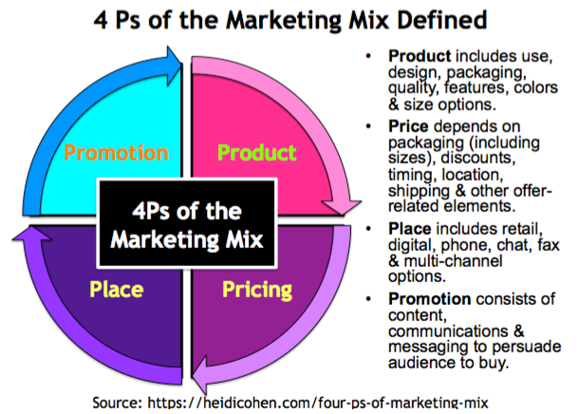
What Are the 4 Ps?
The four Ps of marketing are the key factors that are involved in the marketing of a good or service. They are the product, price, place, and promotion. Often referred to as the marketing mix, the four Ps are constrained by internal and external factors in the overall business environment, and they interact significantly with one another.

Slide 6
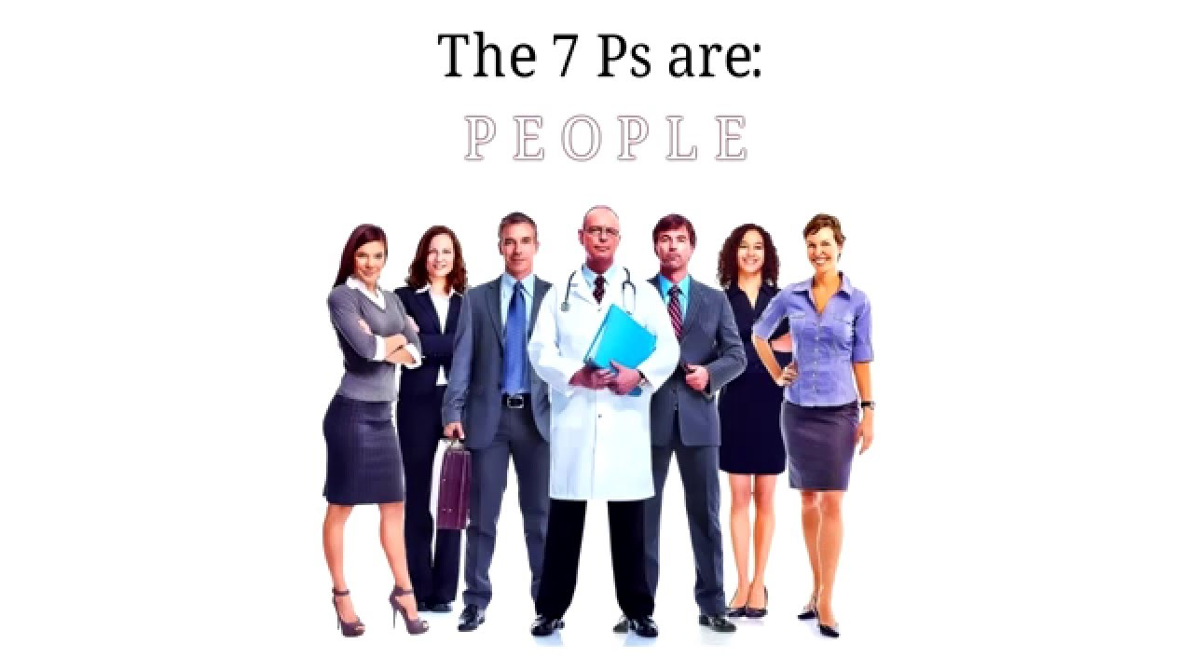
“People” is our 5th brand building block because great brands are all about People. They’re about the people who came up with the big idea, they’re about those who produced the brand as well as the products or services, those who brought them to market and those that continue to manage the brand. “People” also includes your brand champions; those who work at your company, and the customers who regularly refer others to your brand, your products or your services.

Slide 7
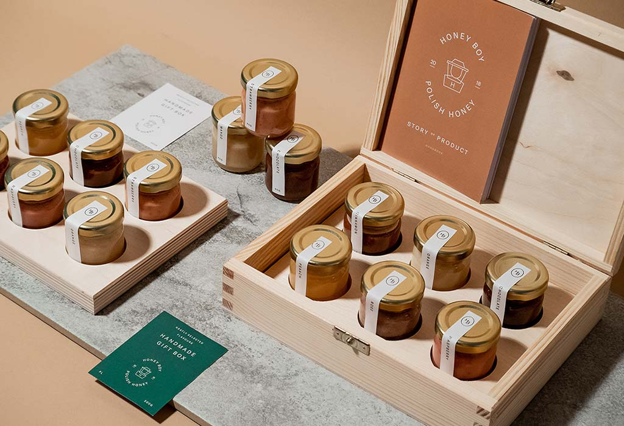
Packaging: Your packaging is the gold star of your marketing mix – it can dictate how well your strategy is working, and it involves each one of the points above. Packaging is what shows off your product in the best light, displays the price and value of the product, communicates the product’s benefits to consumers, and it what physically appears in your various distribution points. Your product may be the very best on the market, but its packaging needs to be the main tool that represents this. It’s the first thing people see, and it has the ability to catch or divert their attention within seconds.

Slide 8
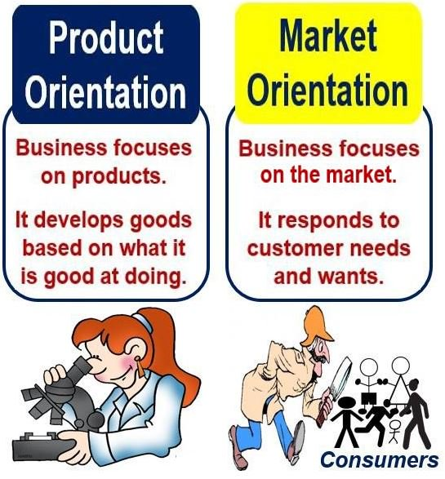
Market orientation - Market orientation is an approach to business that prioritizes identifying the needs and desires of consumers and creating products that satisfy them;
Product orientation is defined as the orientation of the company’s sole focus on products alone. Hence, a product oriented company put in maximum effort on producing quality product and fixing them at the right price so that consumer differentiates the company’s products and purchase it.

Slide 9
Products
product | catalogue | a company’s products, as a group
 | mix
 | portfolio
 | line | a company’s products of a particular type
 | range
 | lifecycle | the stages in the life of a product, and the number of people who buy it at each stage
 | positioning | how a company would like a product to be seen in relation to its other products, or to competing products
 | placement | when a company pays for its products to be seen in films and TV programmers

Slide 10
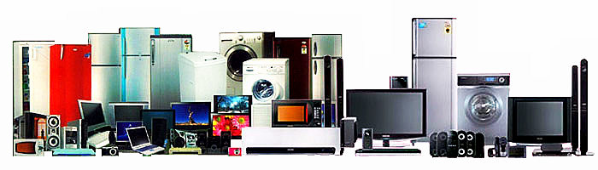
consumer durables – are a category of consumer products that do not have to be purchased frequently because they are made to last for an extended period of time (typically more than three years). They are also called durable goods or durables.

Slide 11
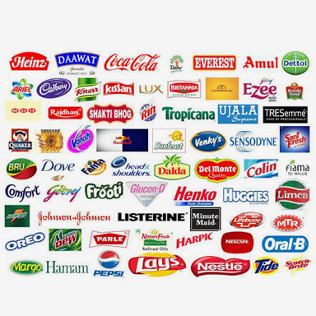
FMCG – fast-moving consumer goods have a short shelf life because of high consumer demand (e.g., soft drinks and confections) or because they are perishable (e.g., meat, dairy products, and baked goods). These goods are purchased frequently, are consumed rapidly, are priced low, and are sold in large quantities. They also have a high turnover when they're on the shelf at the store.

Slide 12
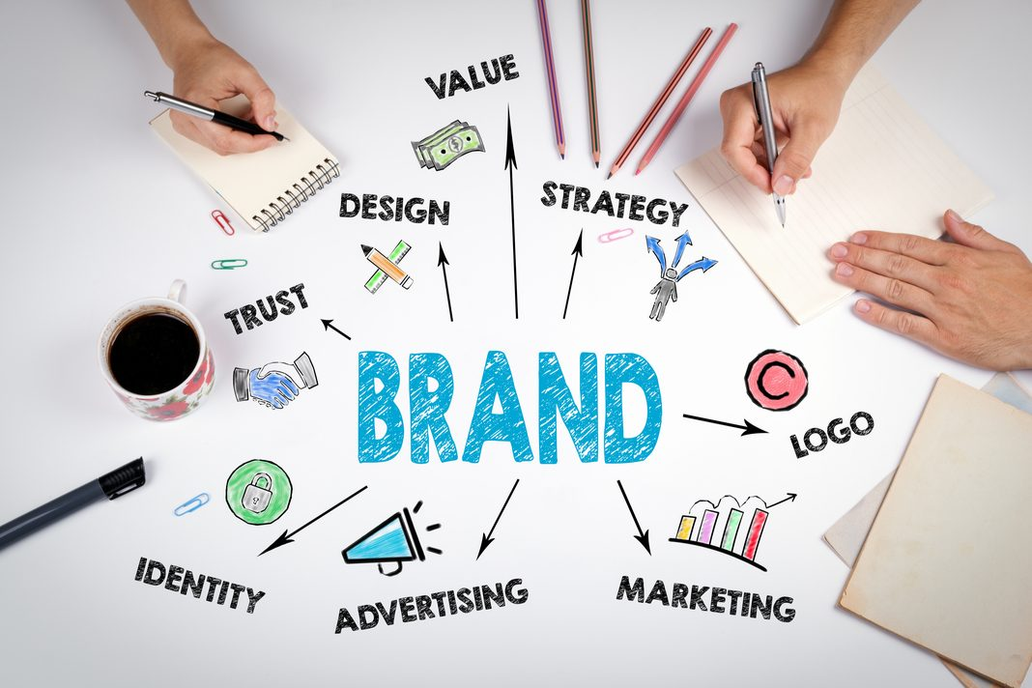
A brand is an identifying symbol, mark, logo, name, word and/or sentence that companies use to distinguish their product from others. A combination of one or more of those elements can be utilized to create a brand identity. Legal protection given to a brand name is called a trademark;
Branding - The process involved in creating a unique name and image for a product in the consumers' mind, mainly through advertising campaigns.

Slide 13
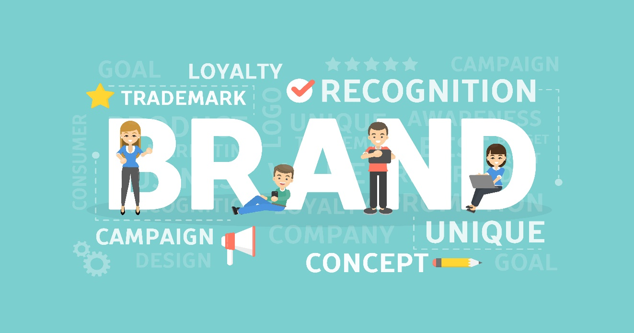
brand awareness - is a marketing term that describes the degree of consumer recognition of a product by its name. Creating brand awareness is a key step in promoting a new product or reviving an older brand. Ideally, awareness of the brand may include the qualities that distinguish the product from its competition.

Slide 14
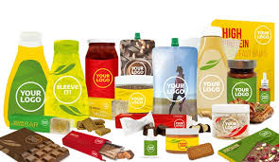
Own-brand product - Own brands are products which have the trademark or label of the shop which sells them, especially a supermarket chain. They are normally cheaper than other popular brands;
Own-label products - used to describe a product that has the name of the store where you buy it, rather than a name used by the company that made it.

Slide 15
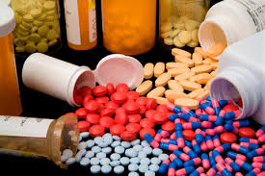
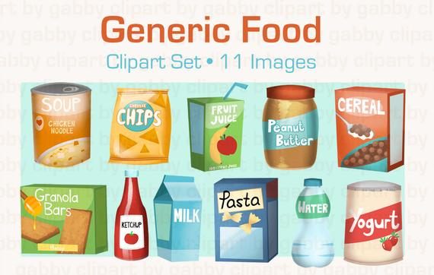
generic product (generics) - in business, refers to products that companies market without a trademark, brand name, or other distinguishing feature. It is typically not heavily marketed and competes with other brand name products largely on a price basis. Packaged food and drugs are commonly offered to shoppers as generic products.

Slide 16
1. Business vocabulary in use, bill Mascull, Cambridge university press, 2017.
2. Business English, course handbook, Giedre Rimkiene, SMK university of applied social sciences, 2014.
3. https://blog.hubspot.com/service/customer-needs
4. https://neilpatel.com
5. https://www.investopedia.com
Reference

Slide 17
THANK YOU FOR YOUR ATTENTION!

