Slide 1

Business English Course:
Chapter 8
Price; Place
Lecturer: N.A.Mukhitdinova

Slide 2
Content
1. Pricing;
2. Upmarket and downmarket;
3. Mass markets and niches;
4. Shops;
5. Direct marketing.

Slide 3
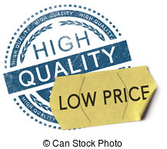
Price
In commerce, price is determined by what (1) a buyer is willing to pay, (2) a seller is willing to accept, and (3) the competition is allowing to be charged. With product, promotion, and place of marketing mix, it is one of the business variables over which organizations can exercise some degree of control.

Slide 4
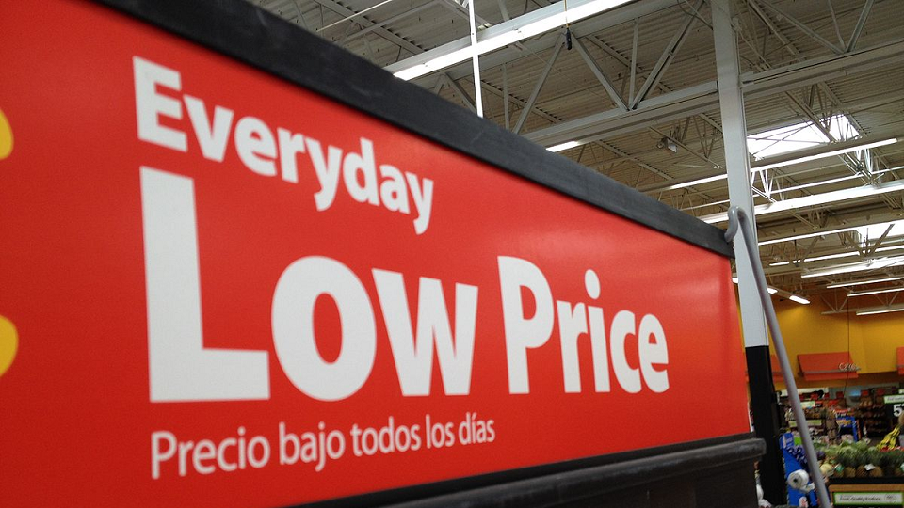
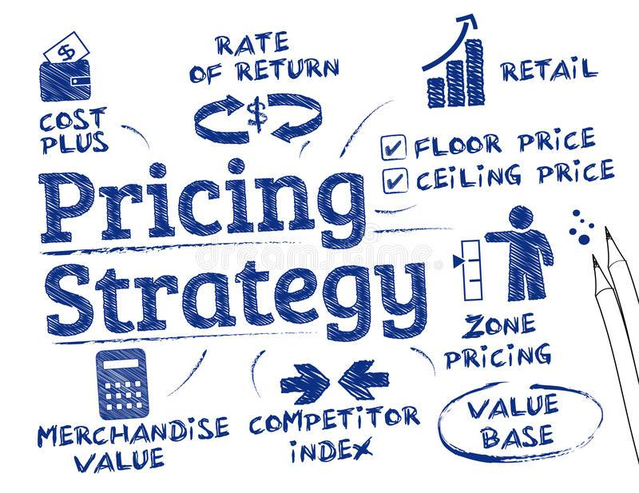
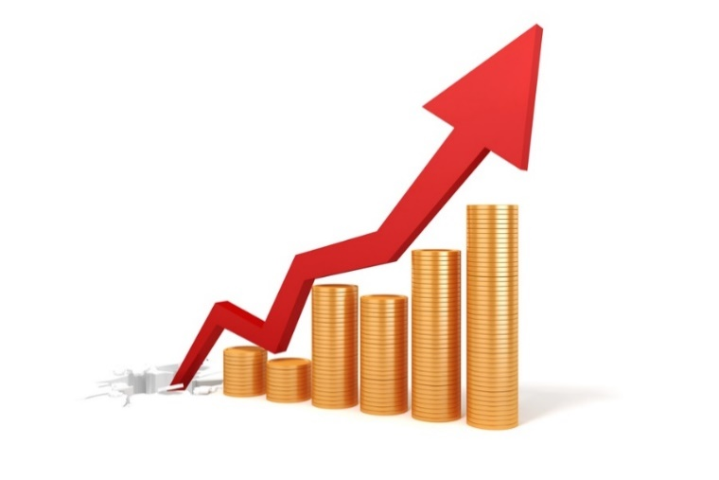
low-priced - used to describe things that do not cost much;
high-priced - costing more than the average; expensive; costly;
mid-priced – used to describe a product or service that is neither very cheap nor very expensive compared to other products or services of the same type;
pricing – the level at which prices are set by a company.

Slide 5

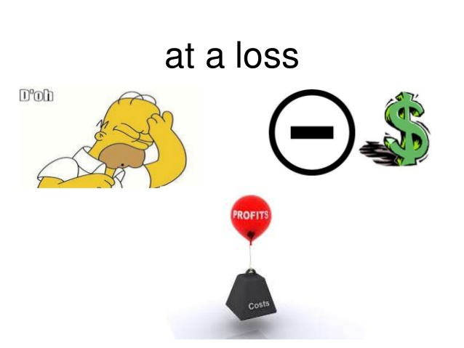
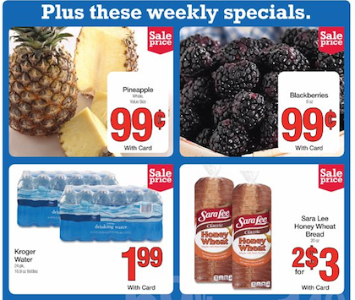
charge - to ask an amount of money for something, especially a service or activity;
at cost - if you sell something at cost, you sell it for the same amount that you spent when you made it or bought it; without a profit;
at a loss - at less than the cost of buying, producing, or maintaining (something);
loss leader - a loss leader is an item that is sold at such a low price that it makes a loss in the hope that customers will be attracted by it and buy other goods at the same shop.

Slide 6
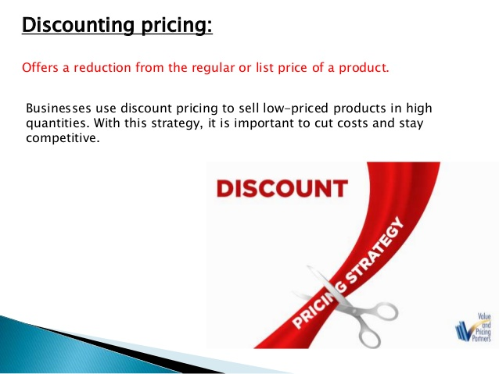
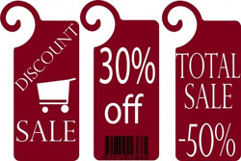
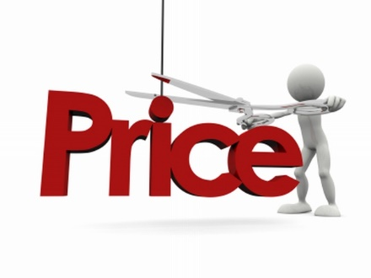
discounting – the activity of reducing prices in order to sell larger quantities of goods or services;
at a discount - for less than the usual price;
recommended retail price – the selling price of a product officially suggested by a manufacturer to a retailer;
undercut - to offer a good or service at a price that is deliberately set below the price charged by the competitor(s).

Slide 7
The owner of Allmart Stores talks about its prices:
‘As you know, our goods are low-priced and this permanently low pricing means we charge low prices all the time. Our competitors say their goods are more expensive because they provide customer service. But we believe that our customers are interested in cheap goods and don’t want to pay extra for service.
‘It is true that we have loss-leaders – these are cheap items which are there to attract customers. We have a policy of selling our goods below the ‘official’ list price or recommended retail price. This policy of discounting – selling at a discount to the list price – has been very successful.’ The owner of Luxmart says:
‘Allmart’s goods are cheap – low-priced but not of high quality. Our top-quality goods are high-priced, I agree, but we have high levels of customer service. In fact, most of our goods are midpriced – not cheap and not expensive. But Allmart are undercutting us on some products – selling the same ones at lower prices than us.’

Slide 8
price | boom – a good period for sellers, when prices are rising quickly;
 | controls – government efforts to limit price increases;
 | cut – a reduction in price;
 | hike – an increase in price;
 | war – when competing companies reduce prices in response to each other;
 | leader – a company that is first to reduce or increase prices;
 | tag – label attached to goods, showing the price; also means ‘price’.

Slide 9
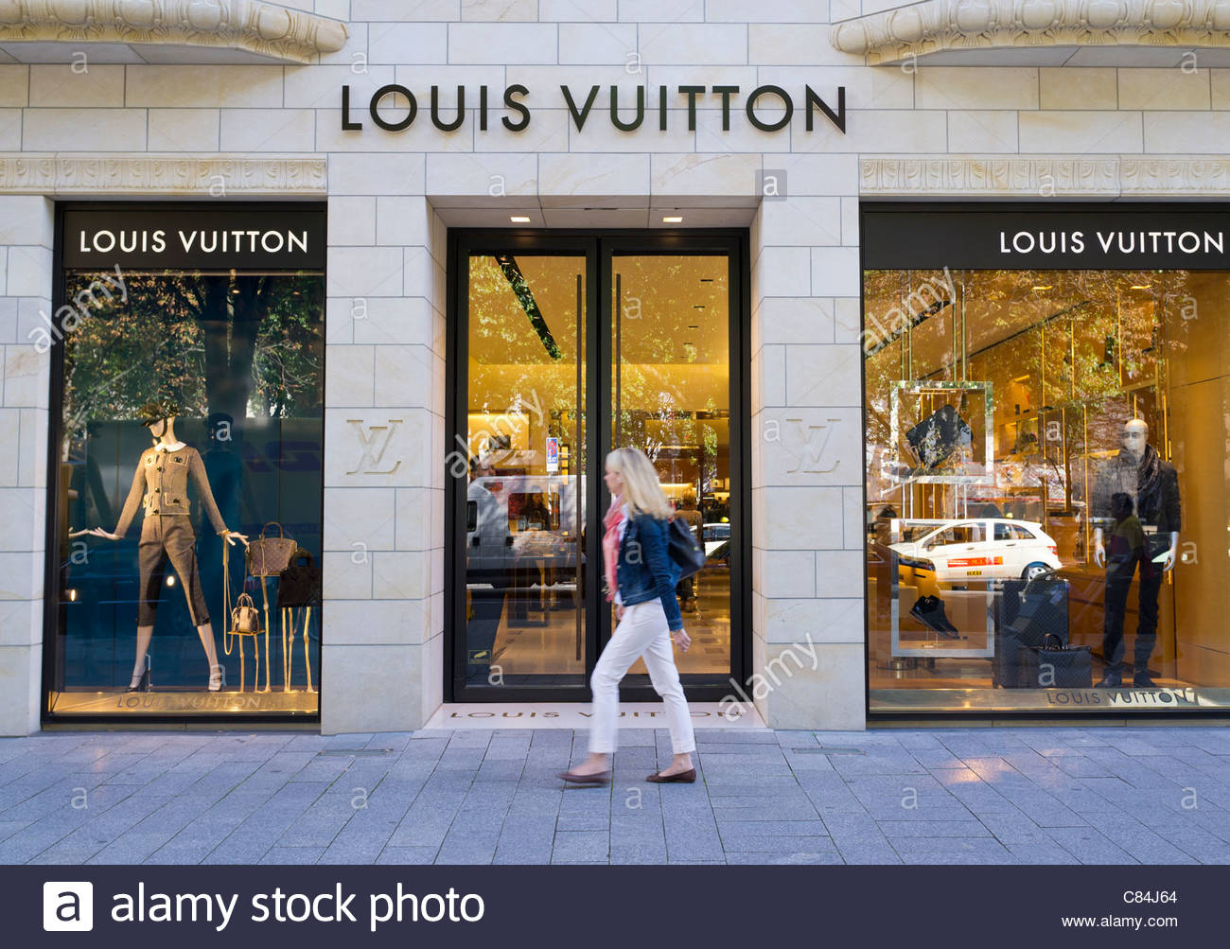
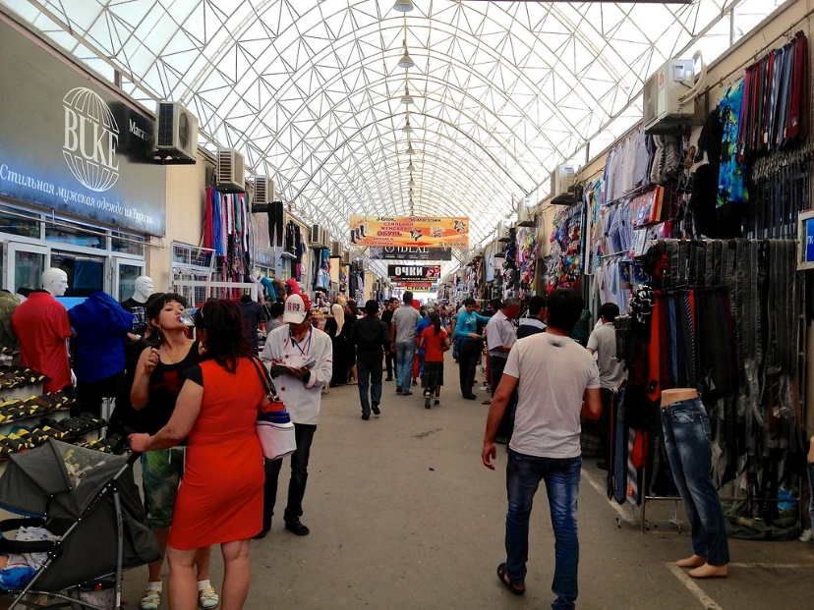
upmarket - more expensive or appealing to a wealthy section of the population;
high-end (top-end) – intended for people who want very good quality products and who do not mind how much they cost;
down market - cheaper or appealing to a less wealthy section of the population;
low-end (bottom-end) - a type of pricing method where a business sets a comparatively low price in order to enhance the demand for its product among consumers, as well as its competitive position in the market.

Slide 10


entry-level – is used to describe low-cost versions of products such as cars or computers that are suitable for people who have no previous experience or knowledge of them; the cheapest or simplest version of a particular product or service;
mid-range - you can use mid-range to describe products or services which are neither the most expensive nor the cheapest of their type;
trade up - if someone trades up, they sell something such as their car or their house and buy a more expensive one;
trade down - to spend less money when you buy things than you did before.

Slide 11
Products exist in different models. Take skis for example. Some are basic and others more sophisticated and exclusive. The cheapest skis are low-end or bottom-end. The most expensive ones are high-end, top-end or premium products – designed for very experienced users (or people with a lot of money!). The cheapest entry-level skis are intended for beginners who have never bought skis before. Those in between are mid-range. When you buy more sophisticated skis to replace basic ones, you trade up and move upmarket.
If you buy cheaper skis after buying more expensive ones, you trade down and move downmarket. To say that something is downmarket often shows disapproval. For example, if a publisher takes a newspaper downmarket, they make it more popular, less cultural, etc. in an attempt to increase the number of readers.

Slide 12
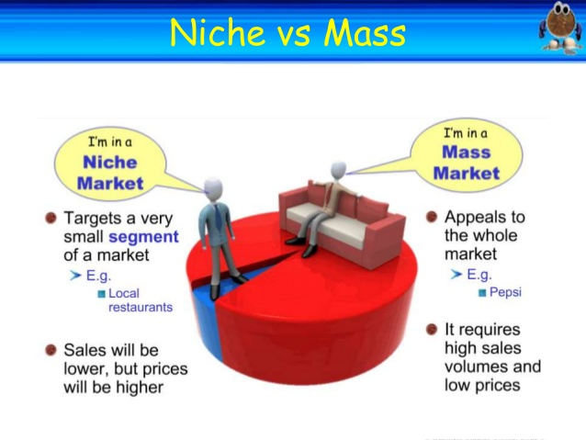
mass market – a product that is designed for the mass market is intended to be bought by as many people as possible, not just by people with a lot of money or a special interest;
niche market – a small area of trade within the economy, often involving specialized products.

Slide 13
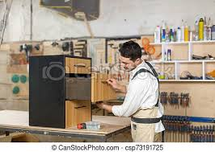
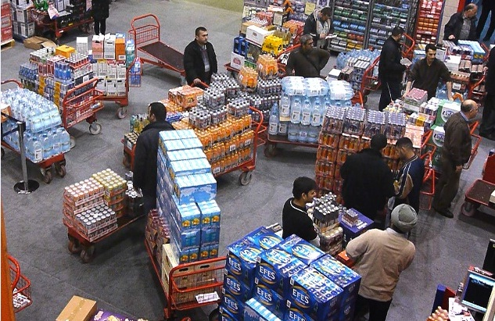
producer – a company, country or person that provides goods, especially those that are produced by an industrial process or grown or obtained through farming, usually in large amounts;
wholesaler – someone who buys and sells goods in large amounts to shops or businesses;
retailer – the activity of selling goods to the public, usually in shops;
dealer – is a person whose business involves buying and selling things.

Slide 14
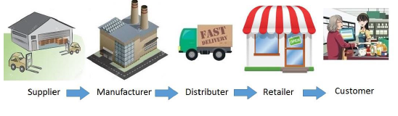
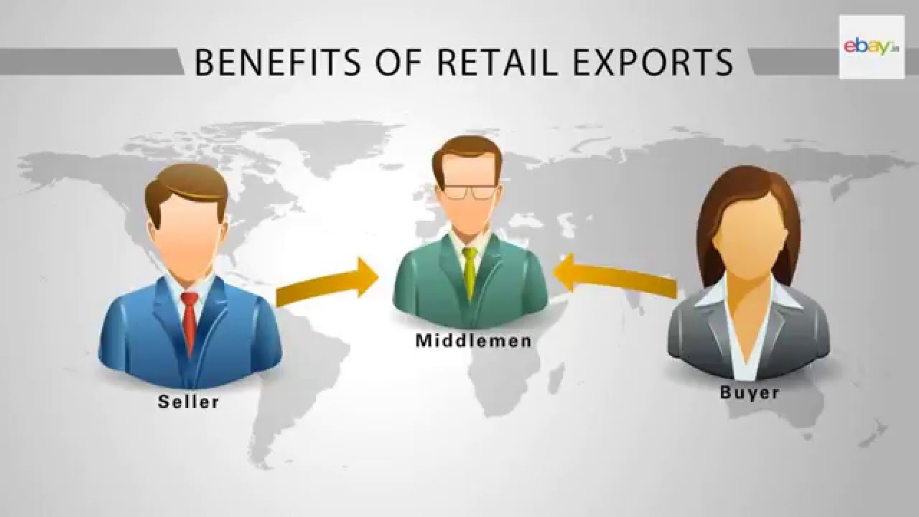
distributor – is a person or organization that supplies goods to shops or other businesses;
reseller – is a person or organization that buys products from manufacturers and sells them to customers; resellers are known to conduct operations on the internet through sites on the web;
middleman – a person who buys goods from the company that has produced them and makes a profit by selling them to a shop or a user.

Slide 15
SHOPS
chain store - part of a group of shops, all with the same name;
convenience store - small shop in a residential area and open long hours;
deep discounter - a supermarket with very low prices;
department store - very large shop with a wide variety of goods, usually in a town center;
drugstore - shop in a town center in the US which sells medicines; you can also have coffee and meals there;
hypermarket - very large shop with a wide variety of goods, usually outside a town;
supermarket - very large shop, selling mainly food.

Slide 16
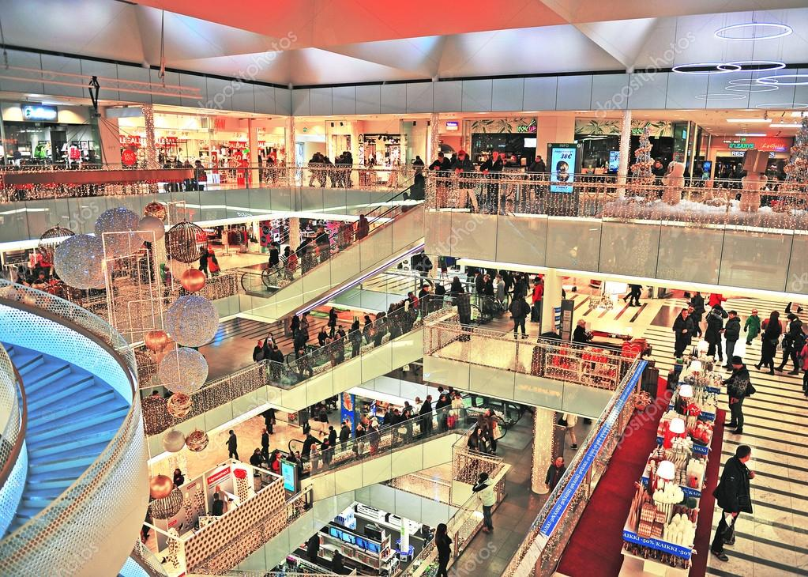
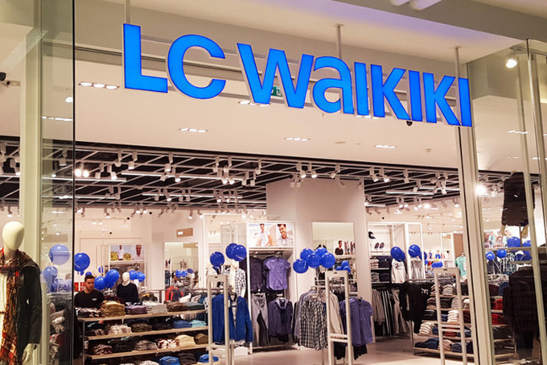
shopping center (precinct) – an area of a town or city in which no vehicles are allowed and where there are a lot of stores; a group of shops with a common area for cars to park;
a shopping mall - is a specially built covered area containing shops and restaurants which people can walk between, and where cars are not allowed, usually outside towns;
a franchise - is an authority that is given by an organization to someone, allowing them to sell its goods or services or to take part in an activity which the organization controls.

Slide 17
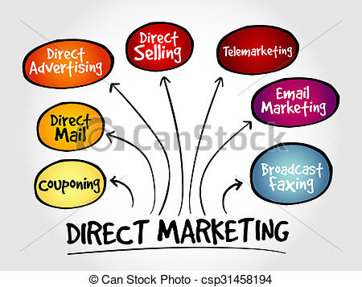

direct marketing - is a form of communicating an offer, where organizations communicate directly to a customer;
mailing - the act of sending letters, packages, or electronic messages to a lot of people at one time;
direct mail - is a method of marketing which involves companies sending advertising material directly to people who they think may be interested in their products;
junk mail - letters or eemails, usually advertising products or services, that are sent to people although they have not asked to receive them.

Slide 18

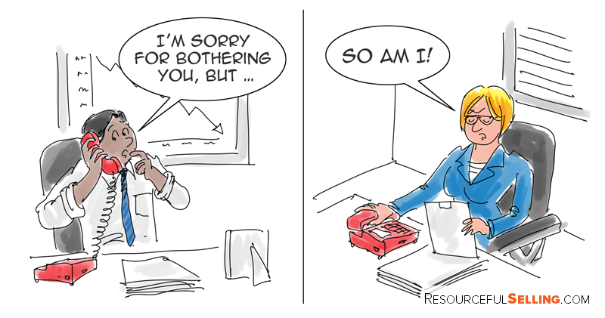
telemarketing - is a method of selling in which someone employed by a company telephones people to try and persuade them to buy the company's products or services;
cold call - if someone makes a cold call, they telephone or visit someone they have never contacted, without making an appointment, in order to try and sell something;
call centre – a large office in which a company's employees provide information to its customers, or sell or advertise its goods or services, by phone.

Slide 19
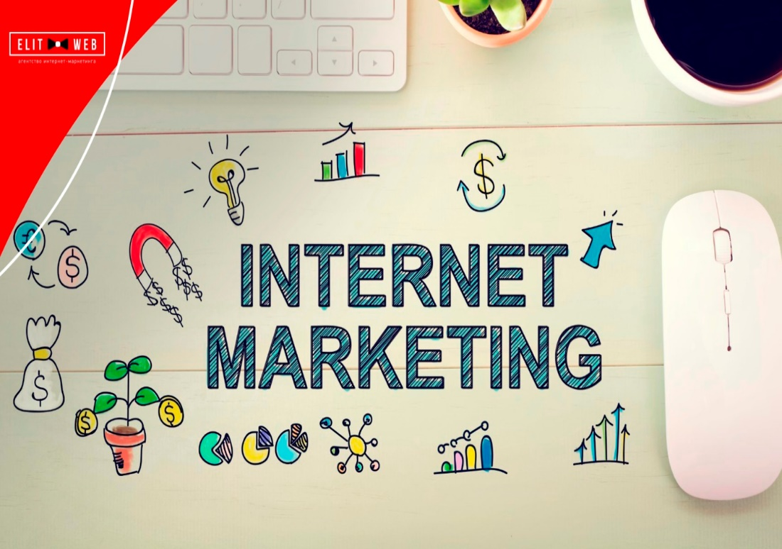
‘Hi, I’m Beatrice and I work in a direct marketing company in Brussels. We organize mailings, sending information by post for everything from magazines to vacations. We call this direct mail, but the people who dislike receiving it sometimes call it junk mail. Of course, we target our mailing lists very carefully – choose who to send them to. There’s no point in sending mailshots for garden tools to people who live in apartments!
‘We also do telemarketing – selling by telephone from our call centers. The most difficult thing is making cold calls to people who have had no contact with us before.’

Slide 20
Reference
Business vocabulary in use, bill Mascull, Cambridge university press, 2017.
Business English, course handbook, Giedre Rimkiene, SMK university of applied social sciences, 2014.
https://www.investopedia.com
https://www.collinsdictionary.com
http://projectbritain.com

Slide 21
THANK YOU FOR YOUR ATTENTION!

