Slide 1

Business English Course:
Chapter 9
Promotion
Lecturer: N.A.Mukhitdinova

Slide 2
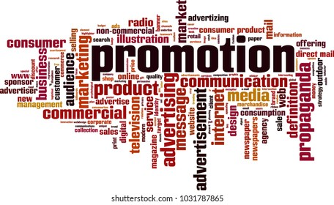
Content
1. Types of advertising medium;
2. The sales force;
3. What Is the Importance of a Sales Department?;
4. Promotional activities.

Slide 3
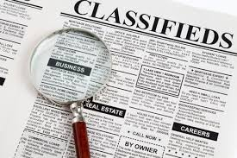

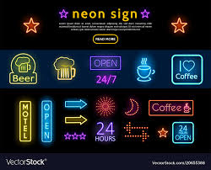
Types of advertising medium
classified advertisement – a small advertisement that you put in a newspaper or a magazine, usually because you want to sell or buy something or to find or offer a job;
neon signs - an illuminated sign constructed from fluorescent lights in the form of bent glass tubes.
hoarding (BrE) (billboard (AmE) -a large board used for displaying advertising posters, as by a road;

Slide 4
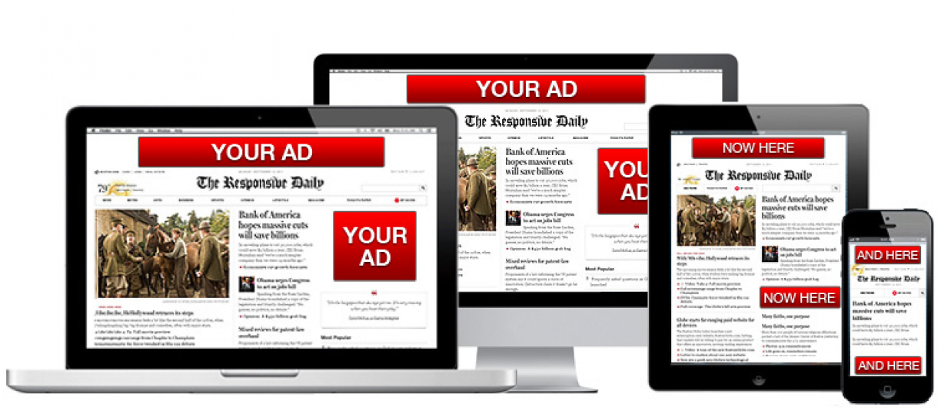

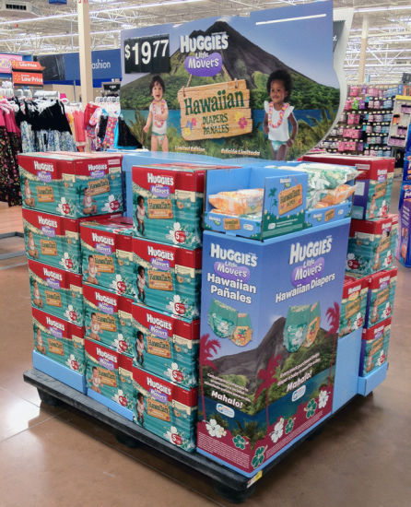
display advertisements – display ads are a lucrative method of advertising for marketers looking for ways to reach and acquire customers. They make generous use of visual media in the form of texts, images, or even videos to catch people's attention.
TV commercial – television commercials are fundamental advertisements that are broadcasted through the television.
special display - printing or page design to attract people’s attention, used in advertisements

Slide 5
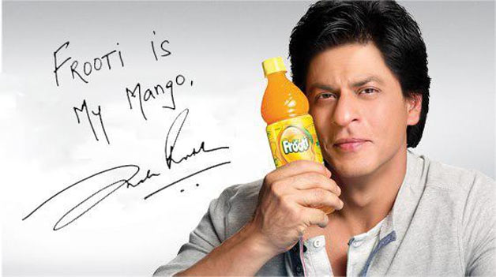
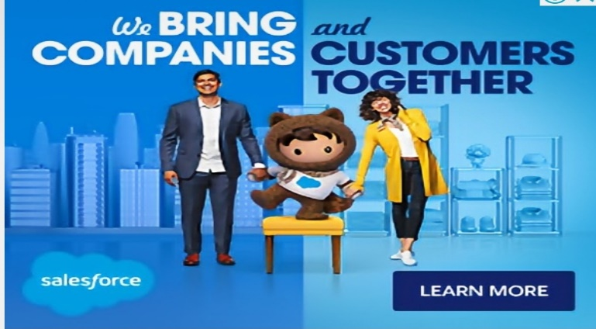

product endorsement - a product endorsement involves a celebrity, a relevant professional or a business giving its approval for the virtue of a product and recommending it to the customers as a good and safe product.
advertising agency is a company whose business is to create advertisements for other companies or organizations.
advertising campaign - a planned series of advertisements that will be used in particular places at particular times in order to advertise a product or service and persuade people to buy it or use it

Slide 6
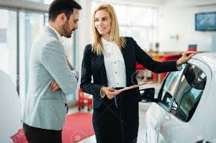

salesperson - is a person who sells things, either in a shop or directly to customers on behalf of a company;
salesforce – all the employees of a company whose job is persuading customers to buy their companies’ products or services;
sales area – one of the areas where a company sells its products or services, often an area for which a particular sales person or particular sales people are responsible;
sales manager - a person in charge of a company's sales activities and its sales force.

Slide 7
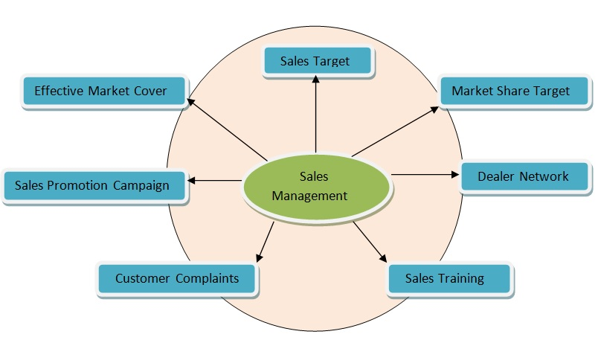
What Is the Importance of a Sales Department?
A sales department is the direct link between a company’s product or service and its customers. However, a well-trained sales department does more than making sales. Your sales staff builds relationships with your customers. Further, a quality salesperson helps identify a customer’s unique needs and makes sure that those needs are met. Since salespeople have direct contact with your customers on an ongoing basis, they become privy to personal information that helps make sales interactions smoother and friendlier. A highly trained sales professional tailors sales pitches to the individual customer and learns the ins and outs of their needs.

Slide 8
For example, say you own an office supply business. A customer calls your sales team and says that they need printer paper. The salesperson will ask what type of printer the business is using, how long it takes the office to go through a sheaf of paper and whether they need a higher-quality paper for any reason. A design firm printing work samples might need a higher quality paper than a nonprofit that is only looking to print handouts for meetings. Your salesperson ensures that the customer is getting what they need, in the right volume and at the right price.
Further, a sales department promotes the growth of your business as well as customer retention. A quality salesperson builds an ongoing, long-term relationship with your customers. The importance of personal relationships in business can’t be understated. A personal connection makes customers feel valued and encourages them to remain loyal to your company. Plus, a happy customer will recommend your brand to others.

Slide 9

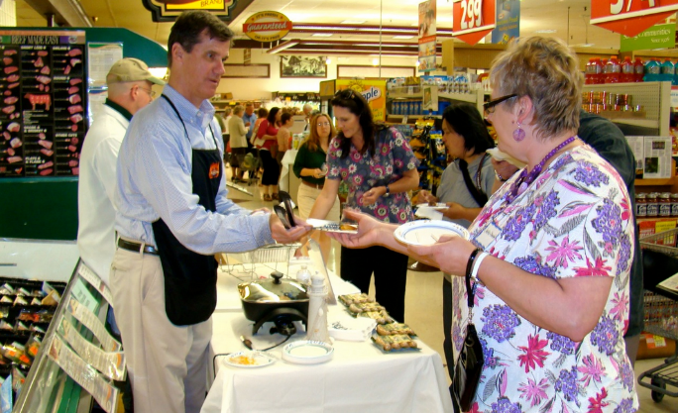
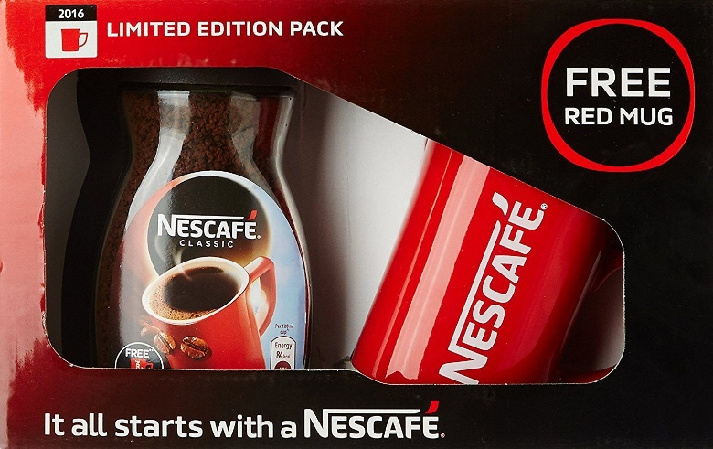
a special offer – a product, service, or program that is offered at reduced prices or rates for a short period of time;
a free sample – a specimen or small amount of a product given free of charge to potential buyers to try or taste;
a free gift – a product that is given to a customer free when they buy something in order to encourage people to buy more of it;

Slide 10
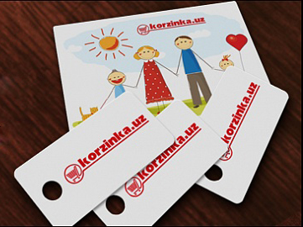
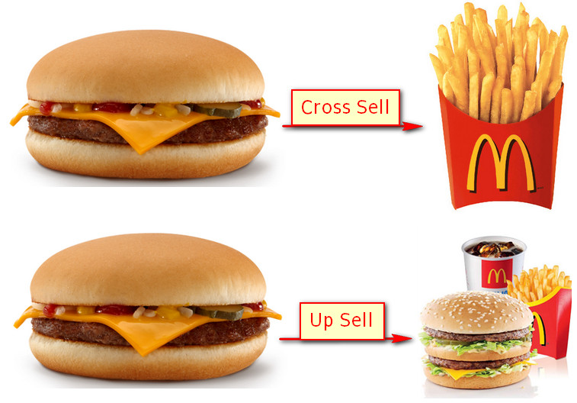
loyalty cards – a plastic card that some shops give to regular customers. Each time the customer buys something from the shop, points are electronically stored on their card and can be exchanged later for goods or services;
cross-promotion - the use of one product or service to promote another.

Slide 11
Reference
1. Business vocabulary in use, bill Mascull, Cambridge university press, 2017.
2. Business English, course handbook, Giedre Rimkiene, SMK university of applied social sciences, 2014.
3. https://www.investopedia.com
4. https://aeroleads.com/
5. https://bizfluent.com/

Slide 12
Thank you for attention!

