Slide 1

Business English Course:
Chapter 10
The Internet and e-commerce
Lecturer: N.A.Mukhitdinova

Slide 2
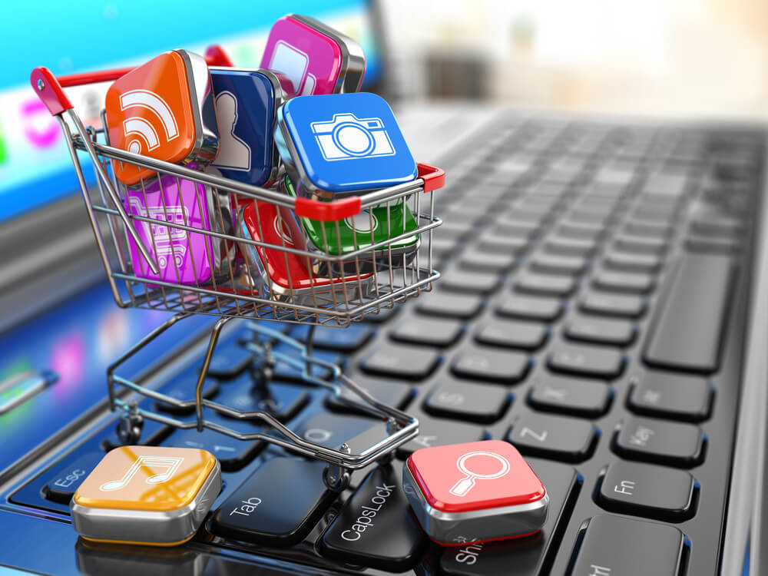
Content
1. The Internet;
2. Click and mortar;
3. bricks and mortar;
4. B2C, B2B and B2G.

Slide 3
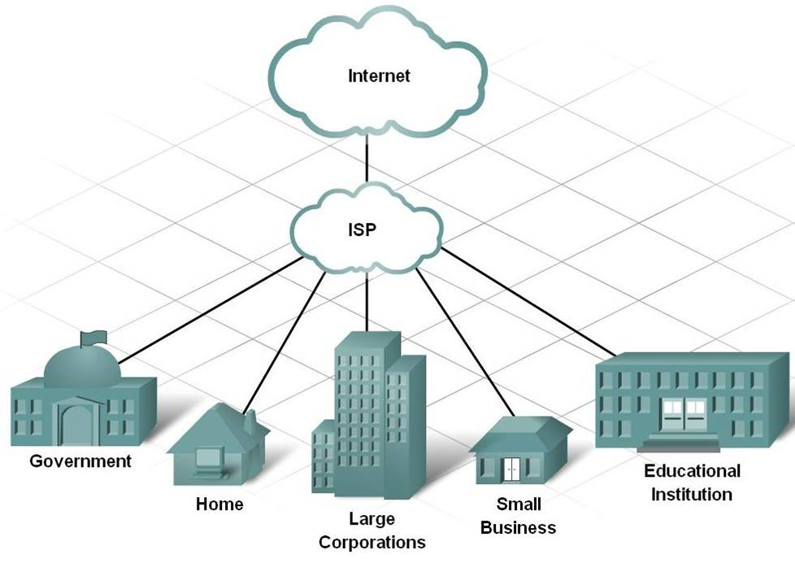
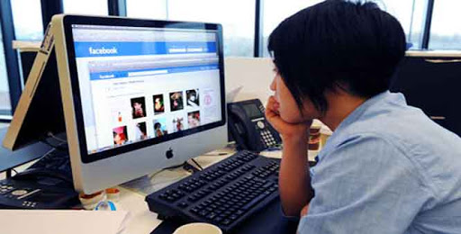
ISP - an ISP (Internet service provider) is a company that provides individuals and other companies access to the Internet and other related services;
internet access - the process of connecting to the internet using personal computers, laptops or mobile devices by users or enterprises;
register – to make or secure official entry of in a register;
surf the internet – spend time finding and looking at things on the internet;

Slide 4

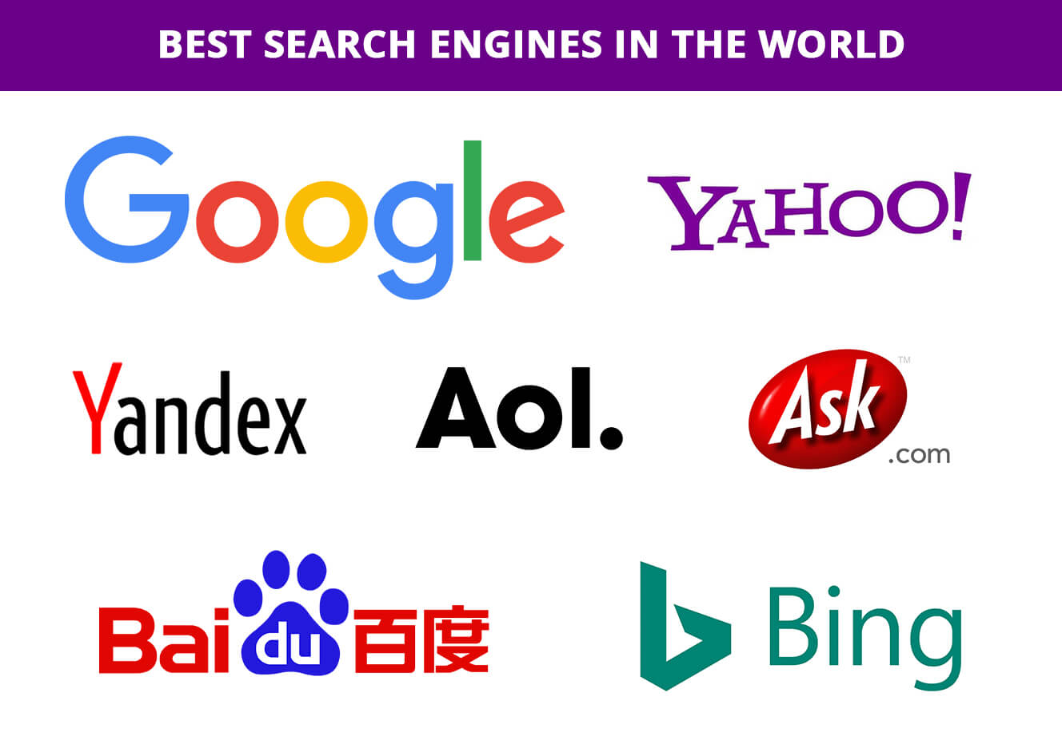
WWW – a computer system which links documents and pictures into a database that is stored in computers in many different parts of the world and that people everywhere can use;
search engine - computer software used to search data (such as text or a database) for specified information;
log on – to connect a computer to a computer system by typing your name, so that you can start working;
log off - to stop using a computer system or program by giving a particular instruction;

Slide 5
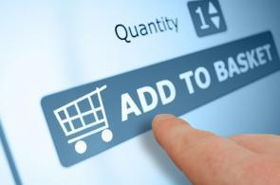
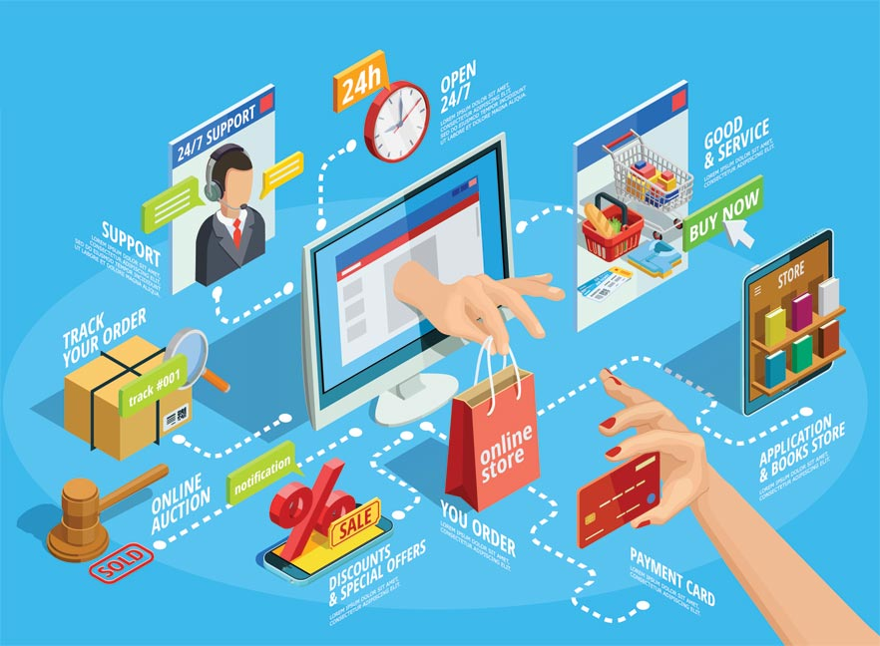
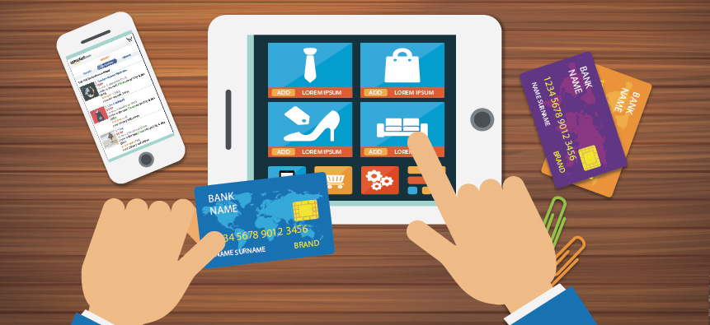
e-commerce - or electronic commerce means buying and selling of goods, products, or services over the internet. E-commerce is also known as electronic commerce or internet commerce;
shopping cart – a shopping cart is a piece of software that keeps the record of the items a buyer has ‘picked up’ from the online store;
securely – in a way that avoids someone or something being harmed by any risk, danger, or threat;

Slide 6
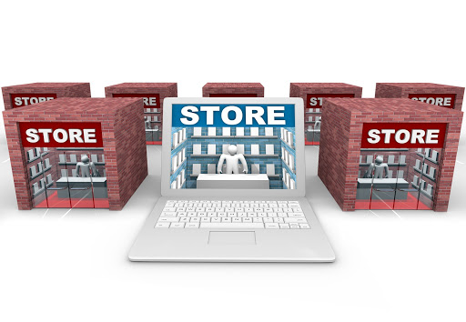
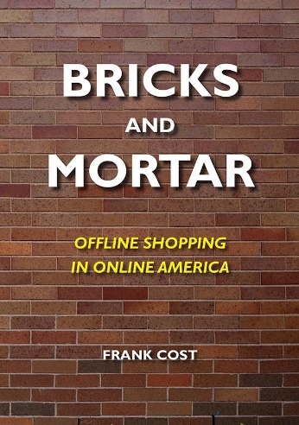
bricks and mortar -the term "brick-and-mortar" refers to a traditional street-side business that offers products and services to its customers face-to-face in an office or store that the business owns or rents. The local grocery store and the corner bank are examples of brick-and-mortar companies.

Slide 7
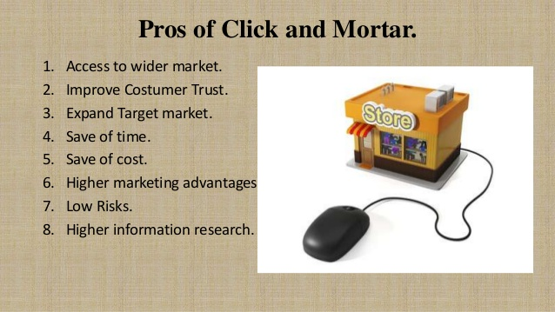
Click and mortar is a type of business model that has both online and offline operations, which typically include a website and a physical store. A click-and-mortar company can offer customers the benefits of fast online transactions and traditional face-to-face service and is thus potentially more competitive than a traditional "bricks and mortar" type of business, which is offline only.

Slide 8
My name is John, and I own a chain of sports shops. Last year, I started and e-commerce operation, selling goods over the Internet. We've done well. Visitors don't have trouble finding what they want, adding items to their shopping cart and paying for them securely by credit card. Last year we had two million unique users (different individual visitors) who generated 35 million hits or page views. That means our web pages were viewed a total of 35 million times!
E-commerce or e-tailing has even acted as a form of advertising and increased levels of business in our traditional bricks-and-mortar shops! Pure Internet commerce operations are very difficult. To succeed, I think you need a combination of traditional retailing and e-commerce: clicks-and-mortar. In our case, this has also helped us solve the last mile problem, the physical delivery of goods to Internet customers: we just deliver from our local stores!

Slide 9
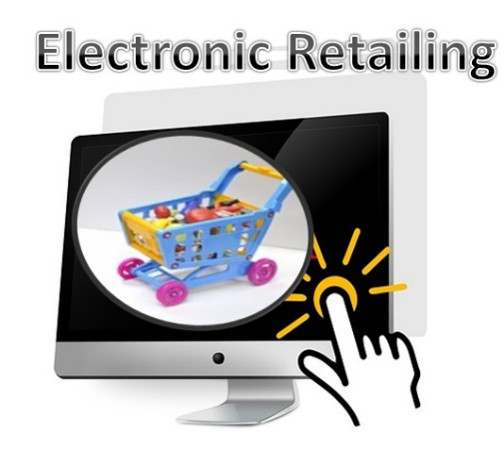
e-tailing – The Electronic Retailing - is the process of selling the goods and services through electronic media, particularly the internet. Simply, the sale of retail goods and services online is called as electronic retailing.

Slide 10
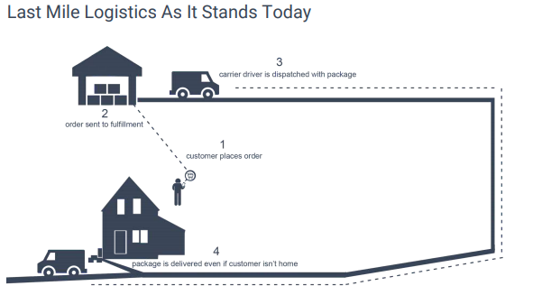
Last mile is used to describe the short geographical segment of delivery of communication and media services or delivery of products to customers located in dense areas. Last-mile logistics tend to be complex and costly to providers of goods and services who deliver to these areas;
physical delivery - delivery of actual commodity in the settlement of a futures contract, also called physical settlement.

Slide 11
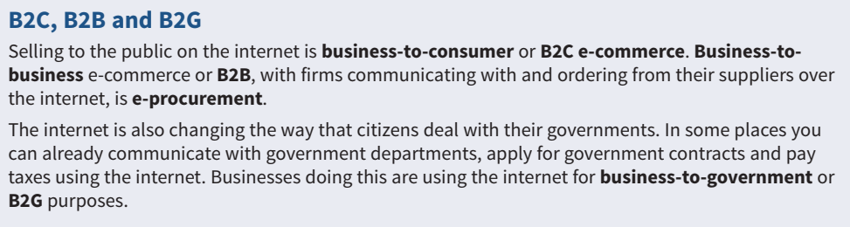
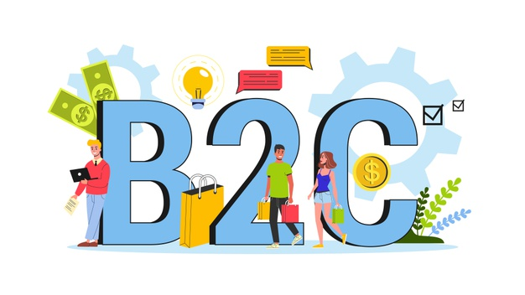
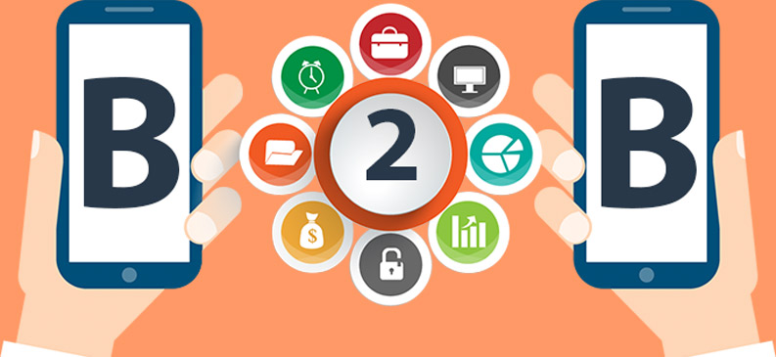

Slide 12
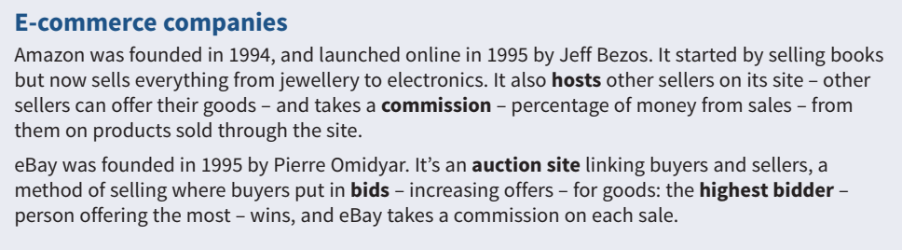
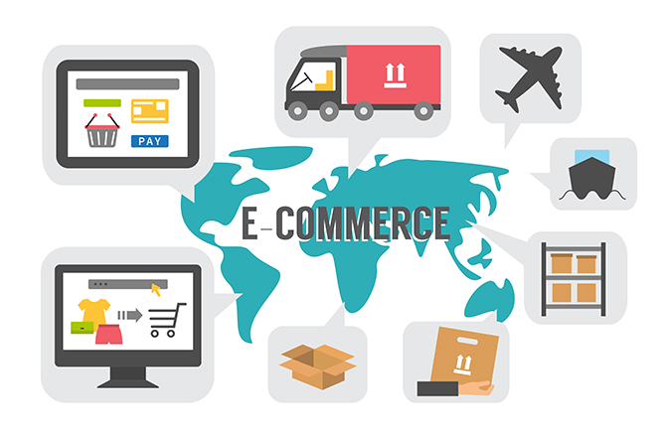
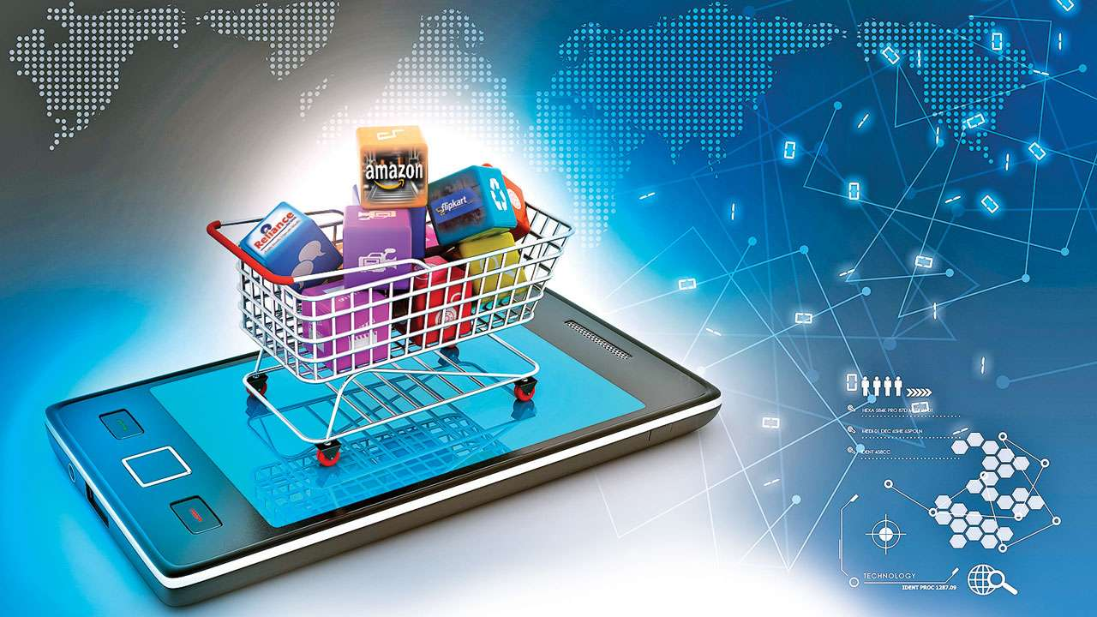

Slide 13
Reference
1. Business vocabulary in use, bill Mascull, Cambridge university press, 2017.
2. Business English, course handbook, Giedre Rimkiene, SMK university of applied social sciences, 2014.
3. https://www.investopedia.com
4. http://webhost.bridgew.edu/
5. www.techopedia.com/definition

Slide 14
THANK YOU FOR YOUR ATTENTION!

