Slide 1

Business English Course:
Chapter 11
Sales and Costs
Lecturer: N.A.Mukhitdinova

Slide 2
Content
1. Sales;
2. Revenue vs Turnover Key Differences;
3. Costs;
4. Margins and mark-ups.

Slide 3
sales – The activity or business of selling products or services;
sales figures – the value or amount of the total sales of an industry's or company's products for a particular period;
turnover – Sales turnover is the company's total amount of products or services sold over a given period of time - typically an accounting year;
sales revenue - The income generated from sale of goods or services;
sales volume - The quantity or number of goods sold or services sold in the normal operations of a company in a specified period.

Slide 4
Revenue vs Turnover Key Differences
The key differences between Revenue vs Turnover are as follows –
Revenue represents the amount of money a company makes by selling its goods or services to the customers. On the other hand, turnover refers to the number of times a company burns through assets like inventory, cash, and workers;
Revenue is considered important because it helps in understanding the strength of the business, the customer base, size and also the market share. An increase in revenues is a sign of stability and showcases confidence in the business. For a company to get loans and capital on credit it is important for them to have stable revenues. Accounts receivable turnover and inventory turnover are the most commonly used metrics which help in determining the liquidity position of the company;
Revenue is mentioned as Sales on the income statement and is mandatory for all the public companies to report. Turnover, on the other hand, is not mandatory to report and is calculated for understanding these reported statements better;

Slide 5
Revenue can be of Operating and Non-operating. Operating revenue is the revenue earned from regular business activities while non-operating revenues are the additional revenue generated through other activities like rent, dividends etc.;
Revenue is calculated as Total sales less any returns while Turnover ratios are calculated as Cash turnover – Net Sales/Cash, Total asset Turnover – Net Sales/Average Total Assets and Fixed Asset turnover – Fixed Assets/Net Fixed Assets;
Revenue affects the profitability of the company while turnover affects the efficiency of the company;
Revenue for a computer selling company can be determined by multiplying the number of units sold by price per revenue while turnover can be determined by the number of computers sold in a year;
Revenue is important to understand as it helps in determining the growth and the sustainability of the company, on the other hand, understanding the turnover is important to manage production levels and ensure that nothing is left idle as inventory for an extended period of time.

Slide 6

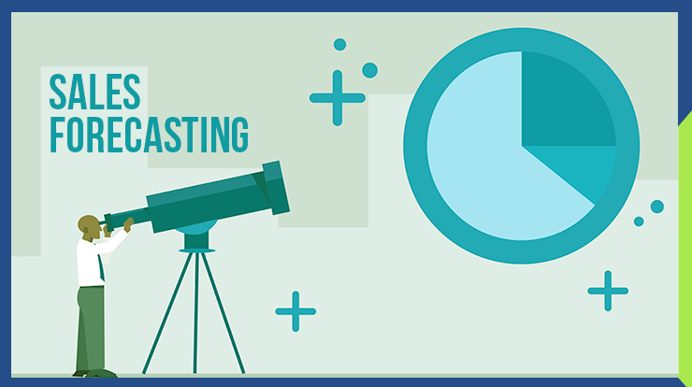
sales growth – the amount by which the average sales volume of a company's products or services has grown, typically from year to year;
sales forecast – sales forecasting is the process that enables a business to estimate future sales;

Slide 7
The goods and services that a business sells, and the money it receives for them from customers, are its sales. Denise van Beek of Nordsee Marine works in sales. In fact, she is sales director, in charge of the sales department. Denise is talking to her sales team at a sales meeting.
‘Our sales figures last year were good and revenue or turnover – money from sales – was €14.5 million, on sales volume or unit sales of 49 boats. This was above our target for the year of €13 million. We estimate our sales growth next year at 10 per cent as the world economy looks good and there is demand for our products, so my sales forecast for next year is nearly €16 million.’

Slide 8

Here are some more uses of the word “sale”:
make a sale – to sell something;
be on sale – be available to buy;
unit sales – the number of things sold;
Sales - a company department;
A sale – a period when a shop is charging less than usual for goods;
The sales – a period when a lot of shops are having a sale.

Slide 9
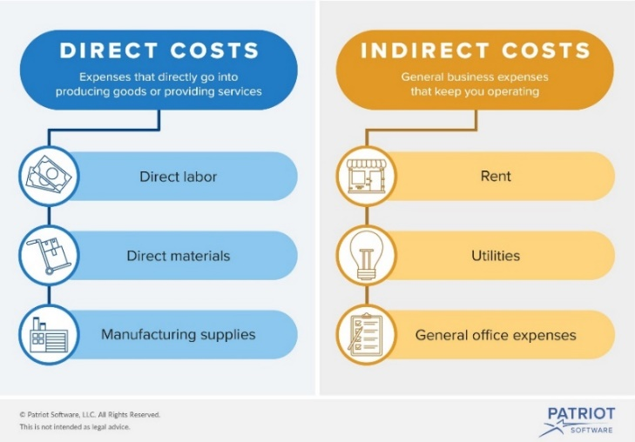
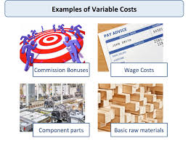
The money that a business spends are its costs:
Direct costs – a direct cost is a price that can be directly tied to the production of specific goods or services. (e.g. salaries);
Fixed costs – A fixed cost is a cost that does not change with an increase or decrease in the amount of goods or services produced or sold (e.g. rent, heating, etc.);
Variable costs – Variable costs increase or decrease depending on a company's production volume; they rise as production increases and fall as production decreases. Examples of variable costs include the costs of raw materials and packaging;

Slide 10
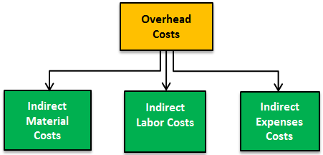
Cost of goods sold (COGC) –refers to the direct costs of producing the goods sold by a company. This amount includes the cost of the materials and labor directly used to create the good. It excludes indirect expenses, such as distribution costs and sales force costs;
Indirect costs, overhead costs or overheads - Overhead refers to the ongoing business expenses not directly attributed to creating a product or service. It is important for budgeting purposes but also for determining how much a company must charge for its products or services to make a profit;

Slide 11
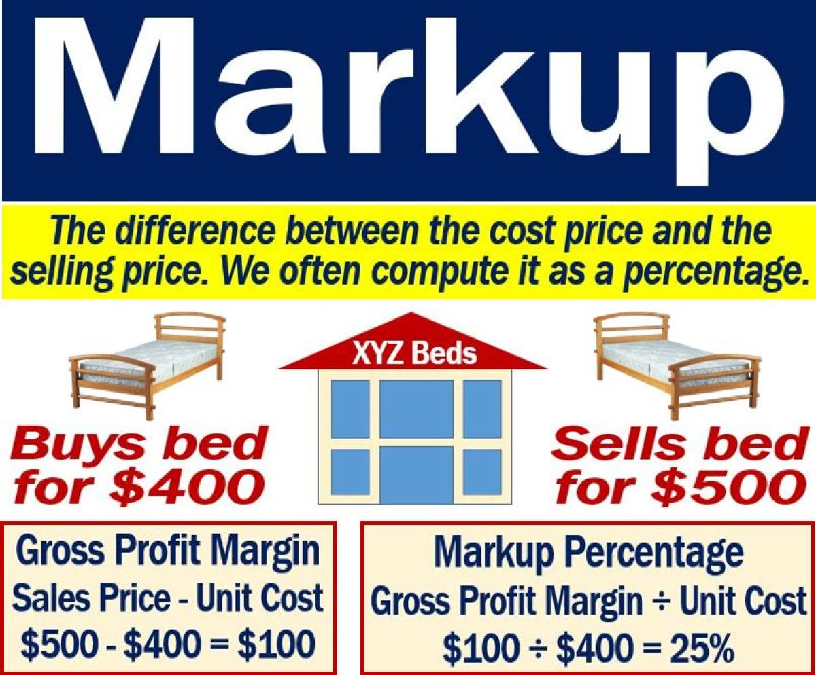
Example of calculation
Selling price = 50,000 euros;
Direct production costs = 35,000 euros
Selling price minus direct production costs = gross margin = 15,000 euros;
Total costs (Unit cost) = 40,000 euros;
Selling price minus total costs = net margin, profit margin or mark-up = 10,000 euros

Slide 12
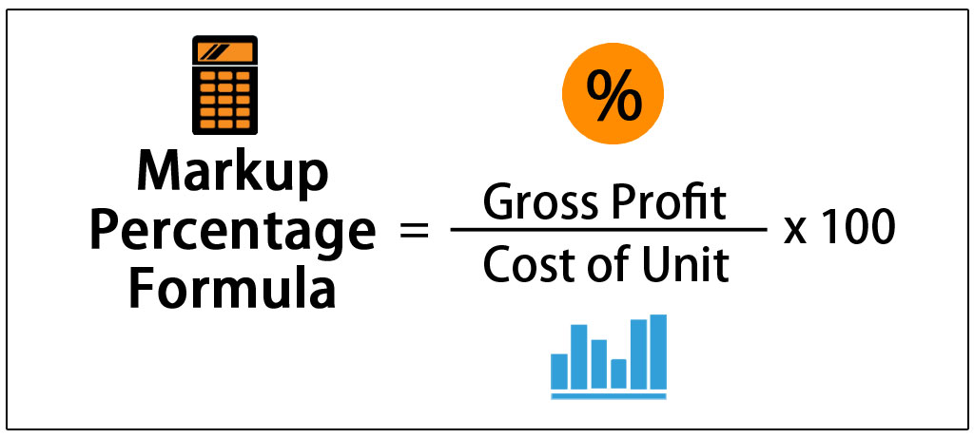
The net margin or profit margin is usually given as a percentage of the selling price, in the above mentioned case 20 %.
The mark-up is usually given as a percentage of the total costs, in the above mentioned case 25 %

Slide 13
Reference
1. Business vocabulary in use, bill Mascull, Cambridge university press, 2017.
2. Business English, course handbook, Giedre Rimkiene, SMK university of applied social sciences, 2014.
3. https://www.investopedia.com
4. https://www.wallstreetmojo.com/revenue-vs-turnover/
5. https://corporatefinanceinstitute.com/

Slide 14
THANK YOU FOR YOUR ATTENTION!

