Slide 1

Business English Course
Lesson 1 Jobs and industries
Lecturer: Nasiba Valieva

Slide 2
Outline
1. Business cards
2. Grammar:
- The use of article a/an
- Use question words such as what, who and where to ask for information
- Use the verb to be to describe people
3. Speak about your job
4. Countries and nationalities
5. Places and departments
6. Home task
7. Reference

Slide 3
Business cards

Slide 4

The use of article a/an and question words
We use a before words beginning with a consonant sound: e.g. a receptionist
We use an before words beginning with a vowel sound: e.g. an engineer
We don’t use a or an with plural nouns: They are economists.
Say the correct article for each job
accountant | artist | architect | cashier | dentist
executive optician personal assistant (PA) | manager lawyer engineer | journalist consultant pilot | director doctor receptionist | office worker research analyst economist

Slide 5

We use question words such as what, who and where to ask for information.
Study the table and have a short question-answer session.
Question | Example answer | Your answer
What’s your job? | I am a lawyer.
What’s your wife’s job? | She‘s an economist.
Where’s your office? | It’s in Bukhara.
Who’s your boss? | Ulughbek Maksudov.
Where are you from? Where’s he from? | I’m from Uzbekistan. He’s Russian.

Slide 6
The use of verb to do in the Present Simple
I do We do
You do They do
He/she does
Note! The verb do after question words shows the tense and the person.
Complete the questions with do or does.
What ______ you do?
What ______ she do?
What ______ Richard do?
What ______ Aiko and Matsuko do?
What ______ they do?
do
does
does
do
Good job !
do

Slide 8
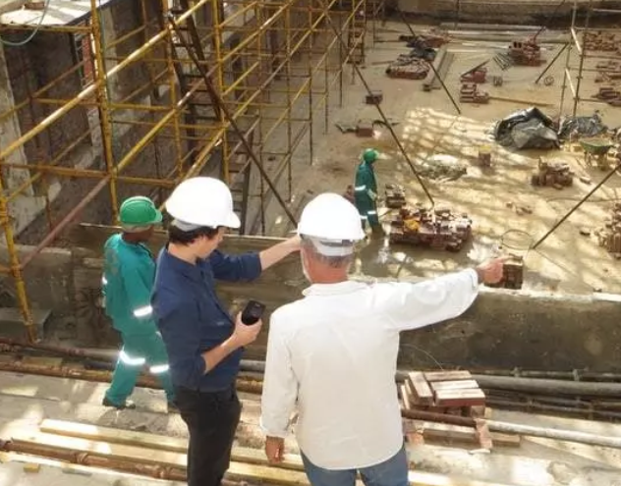
What do you do? I am (= I’m ) in construction (= building)
I’m in retail (shops)
I’m in IT (information technology= computers)
What is your job? I am in financial services (banks)
What | does does does do | He/she | do?
 |  | Jasur (he)
 |  | Malika (she)
 |  | they
She is (=she’s) a computer programmer.
b. He is (=he’s) an engineer.
c. Jasur’s an industrial photographer.
d. He’s a construction worker.
e. She’s a company receptionist.
f. Malika’s a personal assistant.
They are (=they’re) in financial services. Lola’s a
banker. Anvar’s an accountant.

Slide 9
Complete the sentences with appropriate job.
Use a/an where necessary.
receptionist, builder, financier, lawyer, sellers, teachers
Nodir is __________ - he builds offices.
2. Nargiz is __________ -she helps people with legal problems.
3. I’m _________ - I work with money.
4.Ravshan and Shavkat - are ________ - they give lessons at the college.
5. Fatima and I work at Korzinka – we’re __________ .
6 Aziza is _________ - she welcomes visitors to the company.

Slide 10
Complete these sentences. Use the words from the box
Financial service, salesman, construction, work for, buy, manage, sell, design.
work for
buy
financial service
work for
manage
salesman
work for
Now it is your turn to speak about your job.
sell
construction
work for
designs

Slide 11
Complete the chart of countries and nationalities below using the words from the box.
Uzbek Germany Kuwait Greek China Turkish French
Country | Nationality -an | Nationality -ese | Nationality -ish | Nationality - other
Uzbekistan | ----------- | ----------- | -----------
 | German | ----------- | ----------- | -----------
 | ----------- | Chinese | ----------- | -----------
Turkey | ----------- | ----------- |  | -----------
France | ----------- | ----------- | -----------
 | ----------- | ----------- | ----------- | Kuwaiti
Greece | ----------- | ----------- | -----------

Slide 12
Use the verb to be to describe people:
Mansur Umarov is CEO of Success Ltd. He is Uzbek. He is married.
Pronoun | To be | Nationality
I | am/ am not | Uzbek
You They | are/ are not
He/she/it | is / is not
We can talk about nationality in different ways.
I’m from Britain. I’m from Asia. | I’m British. I’m Asian. | It’s a British company. It’s an Asian company.

Slide 13
Choose the correct word in italics.
We’re Britain/British but we live in China/Chinese.
There are a lot of USA/American workers in Hong Kong.
I am from Uzbekistan/Uzbek and I live in Tashkent.
Two of our employees are in Russia/Russian on a project.
5. Is this your first visit to Kuwait/Kuwaiti?

Slide 14

John Devlin and Rob Shaw meet at a conference. Complete the conversation with the correct form of to be.
John: _____ you Rob Shaw?
Rob: Yes. I ______.
John: Hi. I_____ John Devlin. I’m with Karlsco.
Rob: Hi, John. _____ Karlsco an American company?
John: No, it _____ a German company. You _____ with Retcop, aren’t you?
Rob: Yes, I _____ . _____ you an engineer?
John: No, I _____. I _____ a sales manager.
Are
am
Press on the sign to listen
am
Is
is
are
am
Are
am not
am

Slide 15
Look at the pictures and say as in the example.

Slide 16
Complete these sentences with “in”, “at” or “ on”
in
on
at
in
in
in
in

Slide 17
Where | does | he she | work?
 | do | they
He She | works | in a shop. at head office. in Shanghai.
They | work
Which department | do | you | work in?
 | does | he/she
 | do | they
I work in the production department. We make the company’s products.
She works in the training department. She organizes training courses.
They work in the sales department. They sell the company’s products.

Slide 18
Read and practice introducing yourself.
Laura Miles
Hi. I’m from Sydney. I work in the Shawcross office in
Australia. I am a manager in the finance department. I have
lots of good ideas. I am a member of three other teams. I
usually play sport after work and at the weekend.

Slide 19
Home Task 1 Complete this information about Maristella with short forms of the verb to be.
My name ……(1) Maristella. I ……(2) Brazilian and I …… (3) from Sao Paulo. I ……(4) a research analyst for an investment bank in New York. I …… (5) married with two children, a boy and a girl. They ……(6) at high school in Scarsdale. My husband ……(7) American and he ……(8) a doctor. My sister ……(9) in New York, too. She ……(10) a student at Columbia University. We ……(11) all interested in sports and movies. My son …… (12) a good tennis player.

Slide 20
Home Task 2 Match the departments 1-8 with the definitions a-h.
Marketing | a. makes products
2.IT | b. sells to customers
3.Production | c. buys products or services for the company
4.Finance | d. deals with the company’s accounts
5. Buying | e. hires new employees and organizes training
6.Sales | f. maintains the company’s computer systems
7.Human Resources (HR) | g. invents and develops new products
8.Research and Development (R&D) | h. promotes products or services

Slide 21
References
1. Bill Mascull, Business Vocabulary in use. Elementary to pre-intermediate, Cambridge University Press, 2010
2. Irene Barrall, Nikolas Barrall, Intelligent Business. Elementary. Skills book, Pearson Longman, 2008
3. Christine Johnson. Intelligent Business.Elementary.Course book, Pearson Education Limited, 2010.

Slide 22
THANK YOU FOR ATTENTION.

