Slide 1


Business English Course
Lesson 1 Types of work
Lecturer: Nasiba Valieva

Slide 2
OUTLINE
Types of labour
New words and expressions
Asking questions about your company
Describing a company
Hometask
References

Slide 3
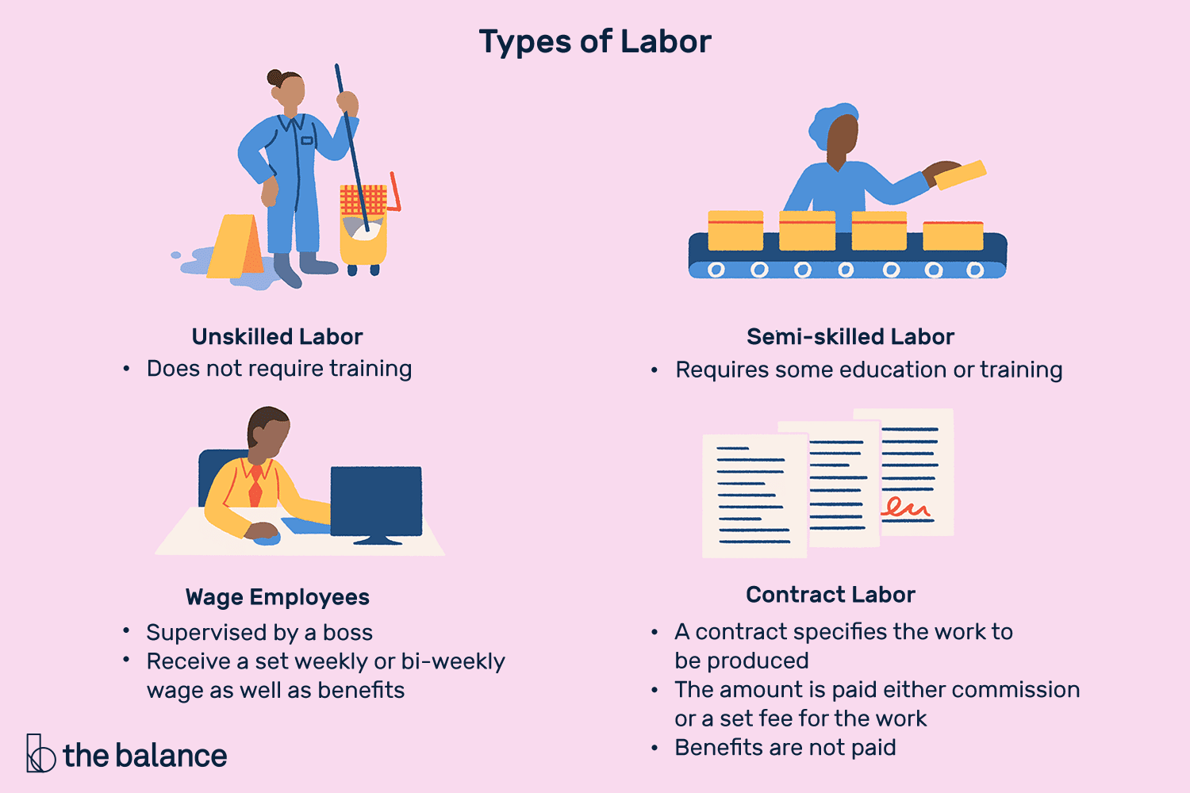

Slide 4

When an employee works from home it is called remote working or teleworking.

Slide 5
New Words and Expressions
employees = people who work for a company
full-time employees = they usually work around 40 hours a week
a part-time job = people work 20 hours a week.
do overtime = when employees work longer and get more money
permanent job = employees have no finish date to work in company
do temporary work = work in company for a short period.
a contract = an agreement about how long they work, when they work, etc.
retire = stop work because of the age
resign = (an employee)tell the company he\she leaving.
make people redundant = (a company) offer employee other position or ask to find another job
dismiss or fire = (company)ask an employee to leave the company

Slide 6
Reading
A Marks and Spencer (c) manager talks about the company:
‘I work for Marks and Spencer. In our shops, we have employees who have full-time jobs. Full-time employees usually work around 40 hours a week, but they can do overtime.
‘Some employees have a part-time job. For example, some people work 20 hours a week.
‘Most people at M&S have a permanent job.
‘Some people here do temporary work.
‘Every employee has a contract.

Slide 7
‘When employees at M&S are 65, they retire. They receive a good pension.
‘If someone leaves the company, for example to move to another company, they resign.
‘We make people redundant if we don’t have work for them or if we have financial problems.
‘If someone has done something wrong or stupid, then we dismiss or fire them.’

Slide 8
How many of the words and phrases in this pyramid can you translate into your own language?
full-time job
part-time job
work for
permanent job
to do overtime
temporary work
make redundant
employees dismiss / fire
colleagues suppliers retire
contract pension employer

Slide 9
Read the sentences and find out the hidden words.
1.Someone who works for a company
2.My job only lasts two months: it’s……..
3.People who work only part of the day or week have a………..
4.If company doesn’t need employees any more, it makes them …………
5.When you work more than the normal hours, you do ………….
6.An agreement about how much you work, what you do, etc. …………….
7.Money you get after you stop work
8.To tell someone to leave their job because they have made a mistake
employee
temporary work
part-time work
redundant
overtime
contract
pension
dismiss

Slide 10
Asking questions about a company
Match the questions with the answers.
1. What’s the name of your company? | a. In the UK.
2. What kind of company is it? | b. Harry Flanagan.
3. What does it make/sell/produce? | c. No, it doesn’t.
4. Where are the headquarters? | d. It’s a manufacturing company.
5. Does it have subsidiaries? (a company controlled by a holding company) | e. It’s called Keele Machines Ltd.
6. How many employees are there? | f. About 980.
7. What are your sales figures? | g. It makes office equipment.
8. Who is the CEO? | h. £120 million a year
e
d
g
a
c
f
h
b

Slide 11
Conversation is easier when your partner responds to what you say. In the conversation below, Laura responds by asking questions. She also responds by making comments about what Miles says.
I don’t know Riva. Ah! That’s interesting. OK. Really?
Example:
Laura: So, who do you work for, Miles?
Miles: It’s a company called Riva.
Laura: I don’t know Riva. What type of company is it?

Slide 12
Conversation
Miles: Hi, I’m Miles Norton.
Laura: Hi, nice to meet you. I’m Laura Clark.
Miles: It’s a good conference, isn’t it?
Laura: Yes, it is. So, who do you work for, Miles?
Miles: It’s a company called Riva
Laura: I don’t know Riva. What type of company is it?
Miles: It’s a retail company.
Laura: Ah! And what does it do?
Miles: It sells art and photographs to multinational companies.
Laura: That’s interesting. Is it a big company?
Miles: Well, it employs 120 people.
Laura: OK. And where is your company based?
Miles: It’s based in Milan.
Laura: Really? I love Milan.
Miles: And we also have offices in Madrid and Paris.

Slide 13
Use the information to ask questions about your partner’s company.
Who do you work for?
Company name: ………………….
Type of company: ………………….
It sells: ………………..
Number of employees:…………….
Based in:………………….
Offices in: …………………
What type of company is it?
And what does it do?
Is it a big company?
And where is your company based?
Do you have offices in other countries?

Slide 14
Describing a company
Name: Sarkor Telecom
Kind of company: services
Industry:Cable,Internet&Tele-phone providers
Nationality: Uzbek
Based in: Uzbekistan
Headquarters: Tashkent
(main office)
Use the language below to write six sentences about it.
The company is called…………
It’s a manufacturing/retail/services company.
It produces …/sells…/develops…./ makes…..
It’s an Uzbek/ an American/ a Japanese/ a French company
It’s based in …….(country).
The headquarters are in ……….(place)

Slide 15
Hometask
Task 1 Read definitions and find the words
employees usually work around 40 ·hours a week – f...-…. …
work longer and get more money – o…….
some people work 20 hours a week – p…-…. …
work for a short period – t…….. ….
payment for people who retire – p……
ask employee to leave the company- f…
people that work with me– c……..
people who buy our products –c……..
an agreement about how long they work, when they work, etc. – c…….
people who work for our company- e…….

Slide 16
Task 2
Match the questions 1-5 with the phrases a-f.
Try to complete the sentences (a-f) using your own information.
1. What type of company is it? | a. The company is called …
2. How many employees does it have? | b. It’s based in……
3. What is the company called?/ Who do you work for? | c. It has offices/factories in …..
4. What does it do? | d. It’s a ……..(manufacturing) company.
5.Where is it based? | e. It makes/sells ……..(cars)
6. Where are its factories? | f. It employs …..(250) people

Slide 17
REFERENCES
1. Bill Mascull, Business Vocabulary in use. Elementary to pre-intermediate, Cambridge University Press, 2010;
2. Irene Barrall, Nikolas Barrall, Intelligent Business. Elementary. Skills book, Pearson Longman, 2008;
3. Christine Johnson. Intelligent Business.Elementary.Course book, Pearson Education Limited, 2010.

Slide 18


