Slide 1

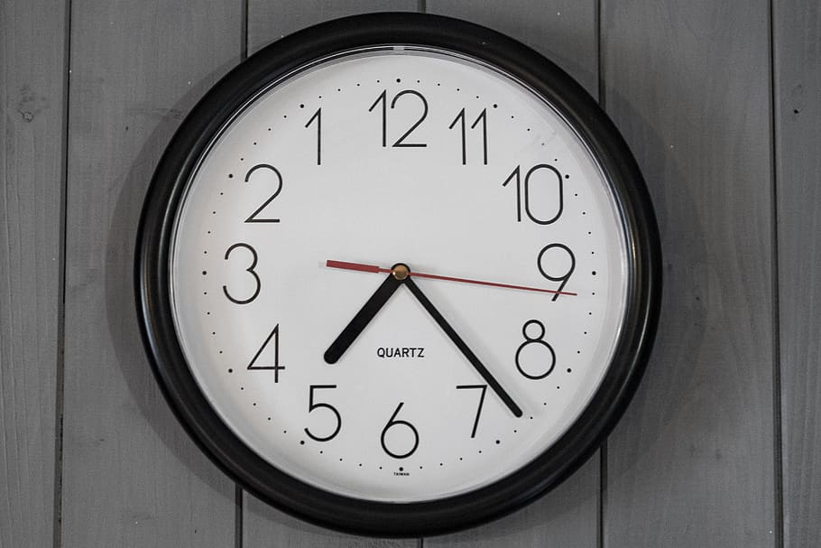
Business English Course
Lesson 4 Time and numbers
Lecturer: Nasiba Valieva

Slide 2

OUTLINE
1.Years, decades and centuries
2. Talking about the time
3. Adverbs of frequency
4. Describe your daily routine
5. Prepositions of time at, on,and in
6. Hometask
7. References
Time and numbers

Slide 3
Years, decades and centuries
There are different ways to say the years like 2011.
BrE: twenty eleven or two thousand and eleven
AmE: two thousand eleven
1800 | eighteen hundred | 2008 | two thousand and eight
1805 | eighteen oh five | 2011 | two thousand and eleven
1969 | nineteen sixty-nine | 2015 | two thousand and fifteen
2000 | two thousand | 2020 | two thousand and twenty
Time and numbers
A decade is a period of ten years, for example the nineteen-eighties (1980-1989).
A century is a period of 100 years, for example the twenty-first century (2000-2099)

Slide 4

Talking about the time
What’s the time? or What time is it?
It’s two o’clock | 2:00 | It’s two o’clock
It’s two fifteen or It’s quarter past two. (BrE) | 2:15 | It’s two fifteen or It’s quarter after two. (AmE)
It’s two thirty or It’s half past two. (BrE) | 2:30 | It’s two thirty or It’s half after two. (AmE)
It’s three o’clock. | 3:00 | It’s three o’clock.
It’s three fifty-five or It’s five to four. (BrE) | 3:55 | It’s three fifty-five or It’s five of four. (AmE)
Time and numbers

Slide 5
We can talk about the time in different ways.
Time and numbers
Marc starts work at …
seven o’clock
seven o’clock in the morning
seven
Marc finishes work at …
half past five
half past five in the afternoon/evening
five thirty
In more formal situations, we can also use am and pm to show if time is in the morning or afternoon: 7 am/ 5:30 pm
For travel times, we often use the twenty-four-hour clock:
21:30 (twenty one thirty) and 17:30 (seventeen thirty)

Slide 6

Match the sentences 1-6 with the times a-f.
1. Maria usually eats dinner at 9:30 pm. | a. Nine thirty in the morning
2. Jack often has breakfast meeting at 8 am. | b. One fifteen in the morning
3.Kenji has a video conference at 9:30 am. | c. Eight in the evening
4. Sergie always has lunch at 1:15 pm. | d. One fifteen in the afternoon
5. Michelle sometimes gets the train home from work at 20:00 | e. Nine thirty in the evening
6. Lukas’s plane leaves at 01:15. | f. Eight o’clock in the morning
Time and numbers

Slide 7

12:00 = It’s twelve/noon/midday/midnight
From 12 at night till 12 at noon = am, e.g. at 8 am(=in the morning); at 2 am (= at night)
From 12 at noon till 12 at midnight = pm, e.g. at 3 pm (= in the afternoon), at 8 pm (= in the evening)
Time and numbers

Slide 8

I | always | go to work early/on time/late.
 | usually
 | often
 | sometimes
 | Hardly ever
 | never
Time and numbers
How often do you arrive at work on time?
I usually arrive at work on time.
!!!Usually and sometimes can also go at the beginning or end of sentences, but the other adverbs can only go before the verb.

Slide 9

Describe your daily routine
Wayne Carr, the customer services manager describes his daily routine. Number the activities in the order that he does them each day.
I usually travel to work by train.
I leave work at 5 or 5:30 pm.
I start work at 8:30 am.
In the afternoon, we sometimes have a team meeting.
The first thing I do is read my emails.
In the evening, I often go out with my colleagues.
I usually have lunch at 12 o’clock.
1
6
Time and numbers
2
5
3
7
4

Slide 10

Prepositions of time: AT
At is used before the expression ….the end of…:
at the end of the month, at the end of the week, at the end of the day;
At is used before the time: at 8 am., at 5 pm.;
At is used with the expression at the moment;
At is used before the word night, the weekend, midnight, Christmas, saying the time: at 9 pm, at Christmas.
Time and numbers

Slide 11
Prepositions of time: on and in
On is used before days, holidays like New Year’s Day, Independence Day, Christmas Day, etc., and with dates 29th October 2007. Example: on Independence Day, on 3d November 2021.
In is used before a month, a part of the day, year, season. Example: in November, in 2022.
In has the future meaning = after
In two hour’s time= after two hours, in 20 minutes= after 20 minutes.
We don’t use a preposition with yesterday and last (night,week,etc.) No preposition (at, in) is used before the words this, next, last and every: next Tuesday, this afternoon, every September.
Time and numbers

Slide 12

Complete the time phrases in the sentences with at or in. Write XX if no word is missing.
1 Can I see you …… next Tuesday?
2 They'll deliver the goods ……the end of the month.
3 We need to have a meeting ……this afternoon.
4 The office closes…… 6:oo p.m.
5 There's a staff party ……every December.
6 Our visitors arrive ……three hours' time.
7 She worked very hard ……last winter.
8 Hurry up! The bank closes ……ten minutes.
9 He travelled to China ……1999.
10 I'm sorry. Mrs Moor's in a meeting…… the moment.
XX
at
XX
Time and numbers
at
XX
in
XX
in
in
at

Slide 13

Complete the sentences using in, on, at or no preposition (-)
The project started ___ May 2007.
Are you free ____ Monday morning?
Charles visited the factory ____ last February.
What do you usually do _____ New Year’s Day?
Ask Sunil to finish the budget ____ the morning.
The client wanted to see the plant _____ three thirty.
in
on
Time and numbers
---
on
in
at

Slide 14
Time expressions
Early or late?
I arrived I was | at the meeting | -early (before the start time). -half an hour early. -30 minutes early. on time (just before or at the start time). -late (after the start time) -three quarters of an hour late. -45 minutes late.
Time and numbers

Slide 15
Are you free on Friday?
Are you free on Friday?
Yes, I’m free on Friday afternoon. Where shall we meet? When shall we meet?
Time and numbers
Let’s meet | at | My/your office. A restaurant for lunch. A café.
 | for | a coffee.
How about What about | 12:30? Three o’clock? 3:30? After work?

Slide 16
I don’t have time
Look at this diary:
Can we meet on Monday?
No, I’m afraid I don’t have time to meet on Monday. I’m busy. I’m going to a sales meeting in the morning and I have an appointment with the dentist in the afternoon.
What are doing on Tuesday?
Mon 11 - am 10:00 Sales meeting
pm 2:30 appointment with dentist
Tues 12 - am 9:15 visit customer
pm 2:00 work in the office
Wed 13 - am 10:15 visit customer
pm 2:00 work on customer orders
Thurs 14 - am -----
pm -----
Fri 15 - am 9:30 see manager
pm -----
Time and numbers
I’m | going to a sales meeting. going to the dentist/doctor. meeting a customer. working at the office. seeing my manager. playing tennis. having lunch with a customer.

Slide 17
Dialogue
Practice the dialogue
- Can we meet on Wednesday afternoon?
- I can’t make Wednesday, what about Thursday?
- Yes, that’s good for me. Are you free at 10 o’clock?
- I can’t make 10 o’clock. How about 11:30?
- Yes, that’s fine.
- Great, I’ll see you on Thursday at 11:30.
- I’m looking forward to it. See you then.
Time and numbers

Slide 18
Hometask 1- Your daily routine
Lorenza Muller is telling her partner about her day at the office. Match the beginning of each sentence on the left (1-13)with a phrase on the right (a-m).
8:45 am. I looked at _____ a. The monthly figures to Mr. Kazoulis.
9:00 am. I wrote _____ b. an appointment with a client.
9:30 am. I made _____ c. the minutes of the meeting.
10:00 am. I went to _____ d. a representative of the safety committee.
11:00 am. I took _____ e. the company magazine.
11:30 am. I fixed _____ f. three or four replies.
12:00 I met _____ g. two or three telephone calls.
1:00 pm I had _____ h. the office Christmas party with Cynthia.
2:00 pm. I read _____ i. a 10$ million deal.
2:30 pm. I discussed _____ j. my e-mails.
3:00 pm I presented _____ k. lunch with Tom in Accounts.
5:30 pm I negotiated _____ l. tired but happy.
8:00 pm I came home _____ m. the weekly departmental meeting.
Time and numbers

Slide 19
Hometask 2- Your daily routine
Make similar sentences to talk about your day at work.
1. ______________________________________________
2. ______________________________________________
3. ______________________________________________
4 .______________________________________________
5. ______________________________________________
6. ______________________________________________
7. ______________________________________________
8. ______________________________________________
9. ______________________________________________
10.______________________________________________
11.______________________________________________
12.______________________________________________
13.______________________________________________
Use Past simple of the verbs. To form Past simple add –ed to regular verb. For irregular verb see the table of irregular verbs.
Time and numbers

Slide 20
References
1. Bill Mascull, Business Vocabulary in use. Elementary to pre-intermediate, Cambridge University Press, 2010;
2. . Christine Johnson. Intelligent Business. Elementary. Course book, Pearson Education Limited, 2010.
3.Steve Flinders. Test your Professional English. Business: General. Longman.Pearson,2003
Time and numbers

Slide 21
THANK YOU FOR ATTENTION.
Time and numbers

