Slide 1

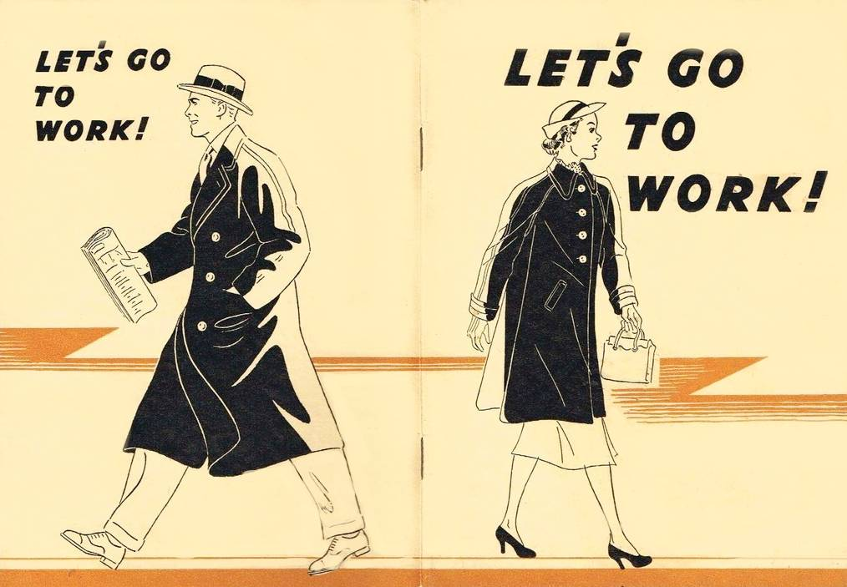
Business English Course
Lesson 5 Getting to work
Lecturer: Nasiba Valieva

Slide 2
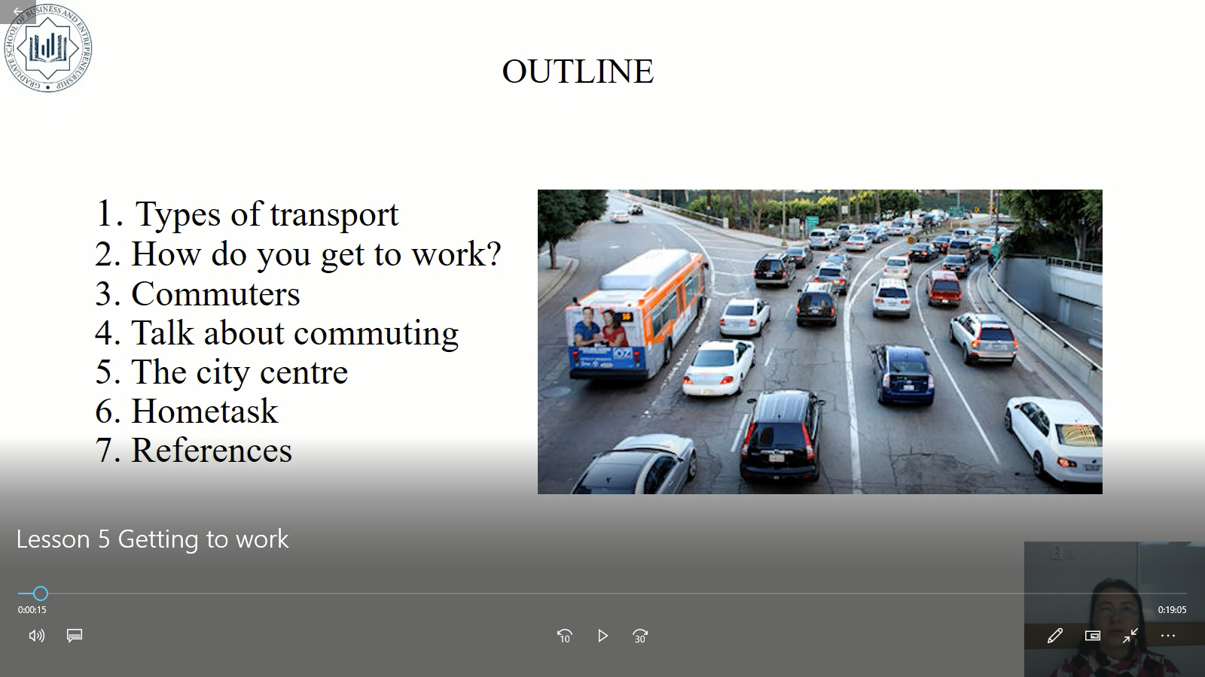
OUTLINE
Ways of getting to work
How do you get to work?
Commuters
Talk about commuting
The city centre
Hometask
References

Slide 3

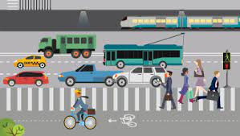
Ways of getting to work
A train
A truck
A trolleybus
A taxi
A van
Drive to work
To walk
To cycle

Slide 4

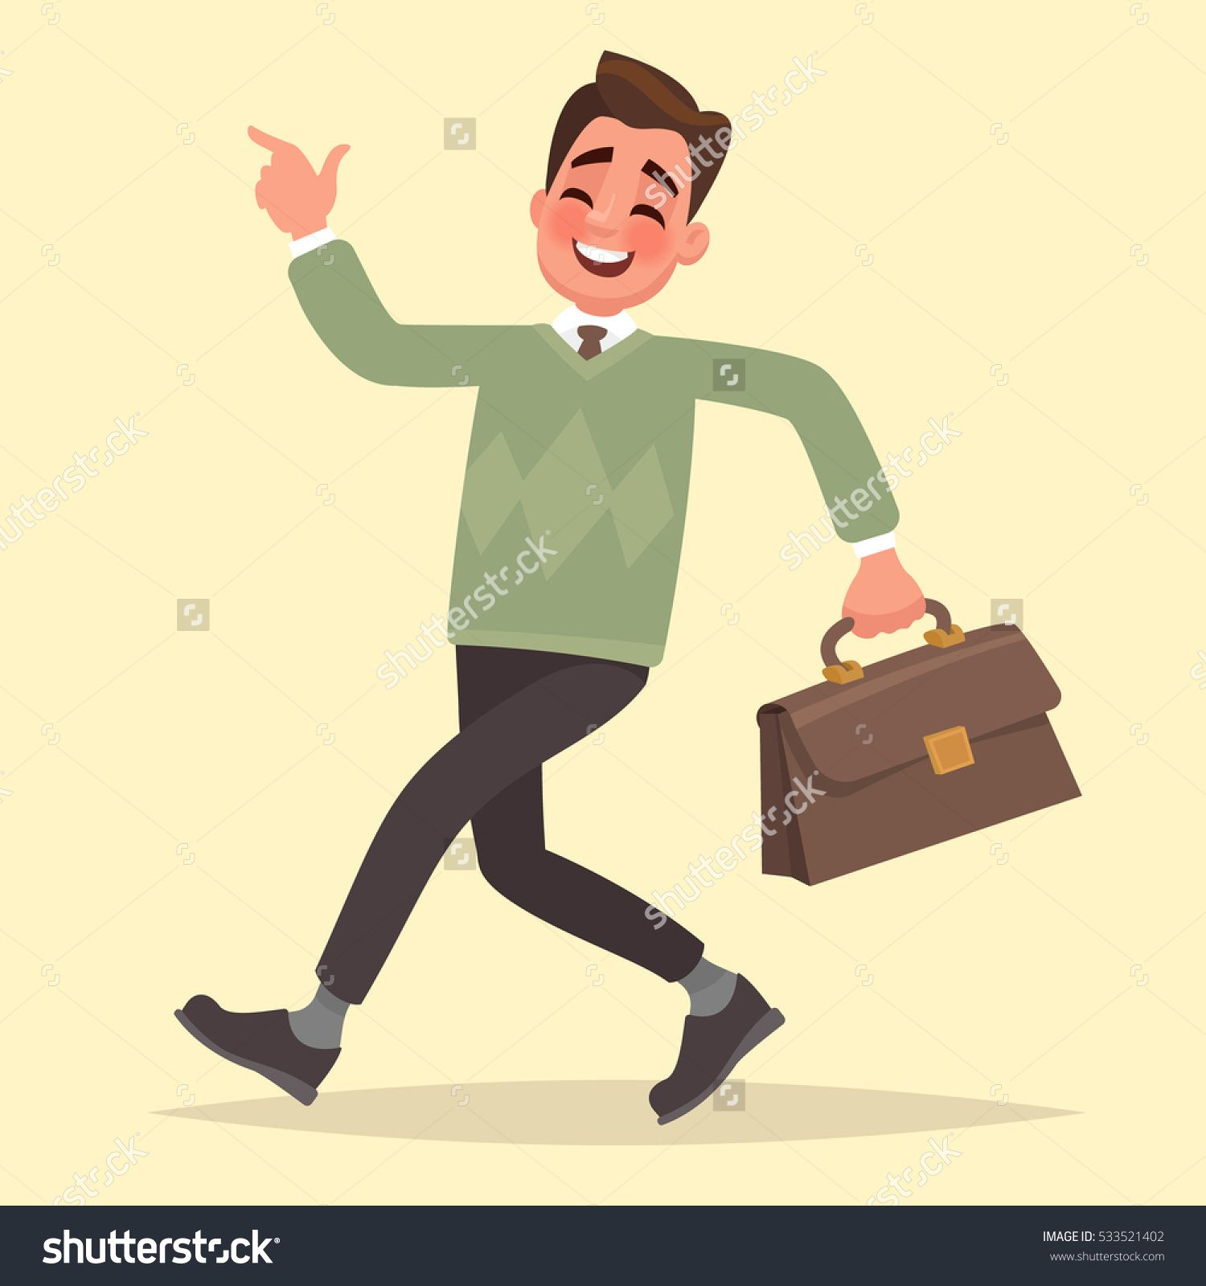
How do you get to work – go to work?
I go by metro/underground/subway.
You/we get the bus.
They take the train.
I drive.
You/we walk.
They cycle.
She goes by bus.
He gets the train.
She takes the metro.

Slide 5

Complete these sentences with the correct verb forms.
Aleksandr ______(get) home at about 7 pm.
He ______(not get) to work before 9:30 am.
He never______ (leave) work before 6:30 pm.
He _______(go)home by metro. On the metro, he ________(read) Kommersant.
e. On his way to work, he ________ (stop) at a café for a coffee.
f. Aleksandr ______(walk) to work. He likes the air.
gets
doesn’t get
leaves
goes
reads
stops
walks

Slide 6

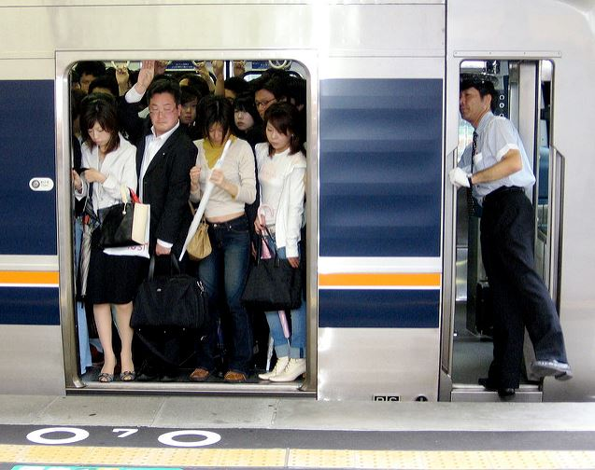
Commuters
We call people who are on their way to work from home or vice-versa commuters. If I say: “The train was full of commuters,” it means that there were many people going to or returning from work.
A commuter train is a train full of people traveling to or from work.
LEXICO has the following definition of the term commute:
“Travel some distance between one’s home and place of work on a regular basis.”
https://marketbusinessnews.com/financial-glossary/commute-definition/

Slide 7

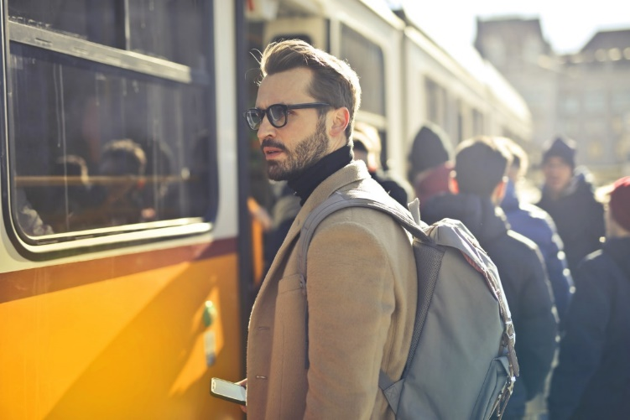
We don’t use the term if a person’s trip to work is extremely short. Typically, they travel outside the boundary of their community if they commute.
We also use the word as a noun, as in: “During my commute last week, I saw a man fall onto the railway track. Fortunately, he was pulled out before the next train came.”

Slide 8
Commuting
Anita lives in Ghaziabad, but she works in the city centre, in an office near Connaught Place. Every day, she commutes by train from Connaught Place to New Delhi. She’s a commuter. She likes commuting because she can do a lot of work on train.
Vijay lives in Mehrauli. He also commutes to the city centre. He takes the bus.
Daljit lives in Mehrauli too, but she doesn’t commute. She works in a business park near where she lives.

Slide 9
When you talk about commuting, you can say:
I leave home at 7:45 am and I get to work at 9:00.
Vijay leaves home at 7:30 am and he gets to work at about 8:30.
Daljit leaves work at 6:30 pm and she gets home at 6:45.

Slide 10
Whether you commute by train, car, bus, bike or on foot, and whether it’s a long haul or a 10-minute door-to-door jaunt, it doesn’t have to be a drag. It’s time to reclaim your commute as one of the best parts of your day.
“Commutes are no longer downtime, it’s productivity time,” said Mitchell Moss, director of the Rudin Center for Transportation Policy and Management at New York University.

Slide 11

Match the two parts of what these people say about how they get to work.
1 I get the train. | a. I enjoy the fresh air.
2 I walk. | b. I can listen to music on the radio.
3 I take the tram. | c. It’s dangerous and I don’t like it when it rains.
4 I don’t cycle. | d. It stops just outside my house.
5 I drive. | e. It’s hot down there in the summer!
6 I take the underground. | f. I read on my way to work and the station is near my house.

Slide 12
When used as nouns, city center means the central business area of a city, whereas downtown means the main business part of a city or town, usually located at or near its center. Downtown is also adverb with the meaning: in or towards the central business district.

Slide 13
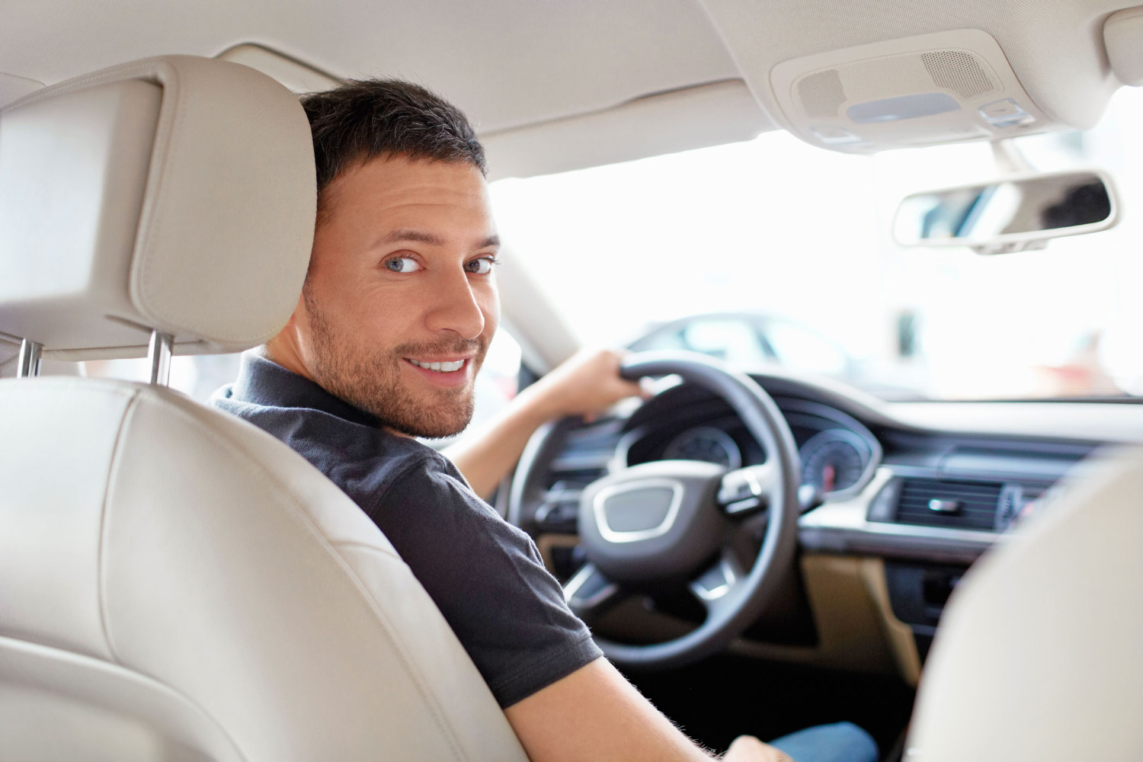
Are you a commuter? Speak about how do you commute to work? What are the benefits and drawbacks of commuting to work?

Slide 14

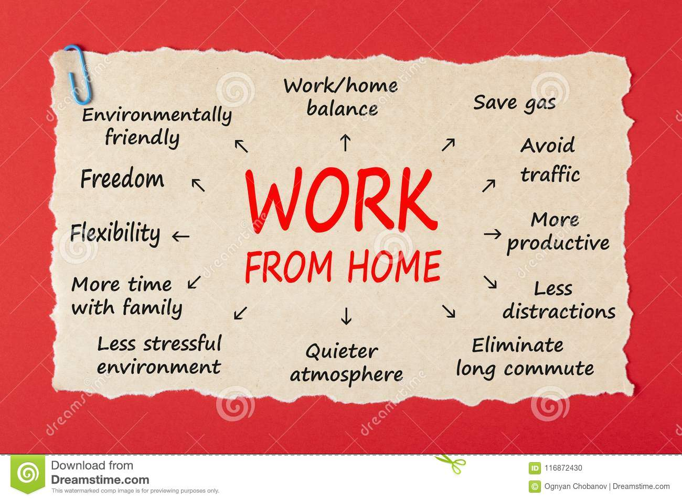
Some people work from home. Look at the advantages of teleworking.

Slide 15
Hometask 1 Complete the text with the correct form of the verbs in the box.
I (1)_______ live in a house with two people, Andrea and Rob. We (2)_______ for the same company, but in different departments. Andrea is a design manager, and Rob (3)_______ in HR. Andrea usually (4)_______ to work because she (5)_______ her job at 8:00am. Rob and I (6)_______ work at 9:30am, so we often travel by train. On Friday, we all start at 9:00am and we (7)_______ to the office together. Rob often goes out and (8)_______ lunch in a restaurant, but Andrea and I usually (9)_______ lunch at our desks because we're busy. On Thursday, we (10)_______ colleagues from other departments after work.
have (x2), start (x2), work (x2), drive (x2), meet, live

Slide 16
Hometask 2. Put the following sentences in the right order.
Mavlon gets home at about 8 pm.
b. He doesn’t get to work before 9:30 am.
c. He never leaves work before 7.30.
d. He goes home by metro. On the metro, he reads Xalq So’zi.
e. On his way to work, he stops at a café for a coffee.
f. Mavlon walks to work. He likes the fresh air.

Slide 17
References
1. Bill Mascull, Business Vocabulary in use. Elementary to pre-intermediate, Cambridge University Press, 2010;
2. https://marketbusinessnews.com/financial-glossary/commute-definition/
3. https://www.dreamstime.com/images

Slide 18
THANK YOU FOR ATTENTION.

