Slide 1
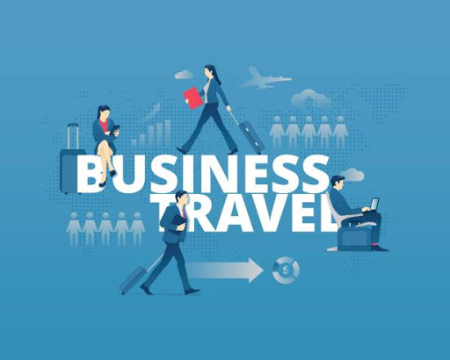

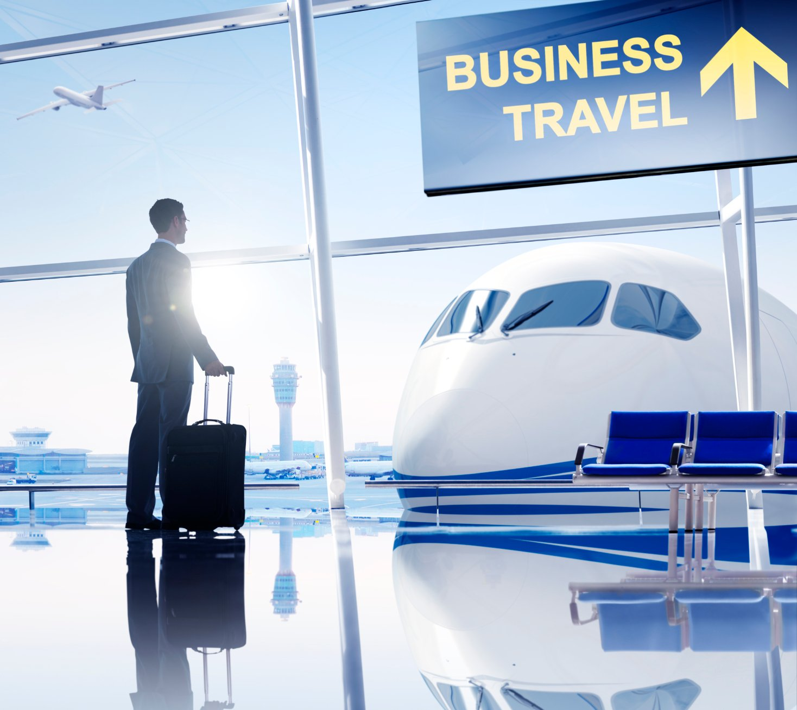
Business English Course
Lesson 6 Business travel
Lecturer: Nasiba Valiyeva

Slide 2
OUTLINE
1.The business bag
2.Business travel
3.Travel adjectives
4.Getting to the airport, at the airport; airport announcements
5.Checking into a hotel, making contact
6.Hometask
7.References

Slide 3
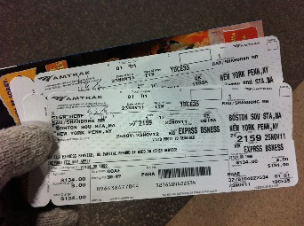
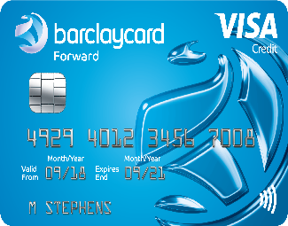
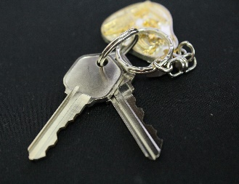
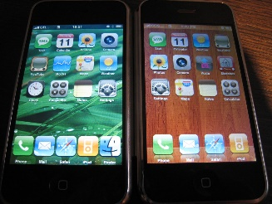
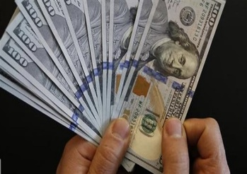
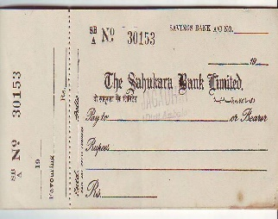
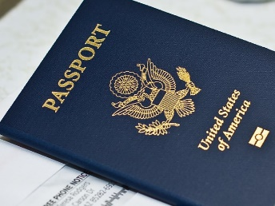
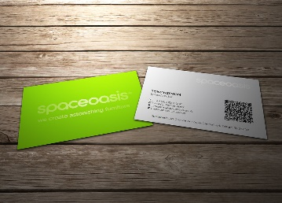
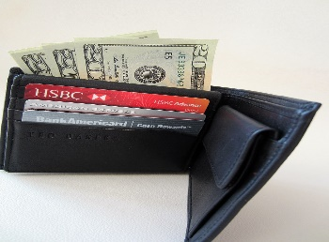
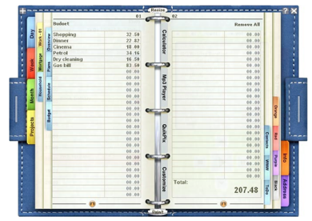

The business bag
Empty a manager’s bag and pockets or purse and what do you find?
tickets
credit card
keys
mobile phone
cash
chequebook
passport
business card
wallet
personal organizer
adapter

Slide 4
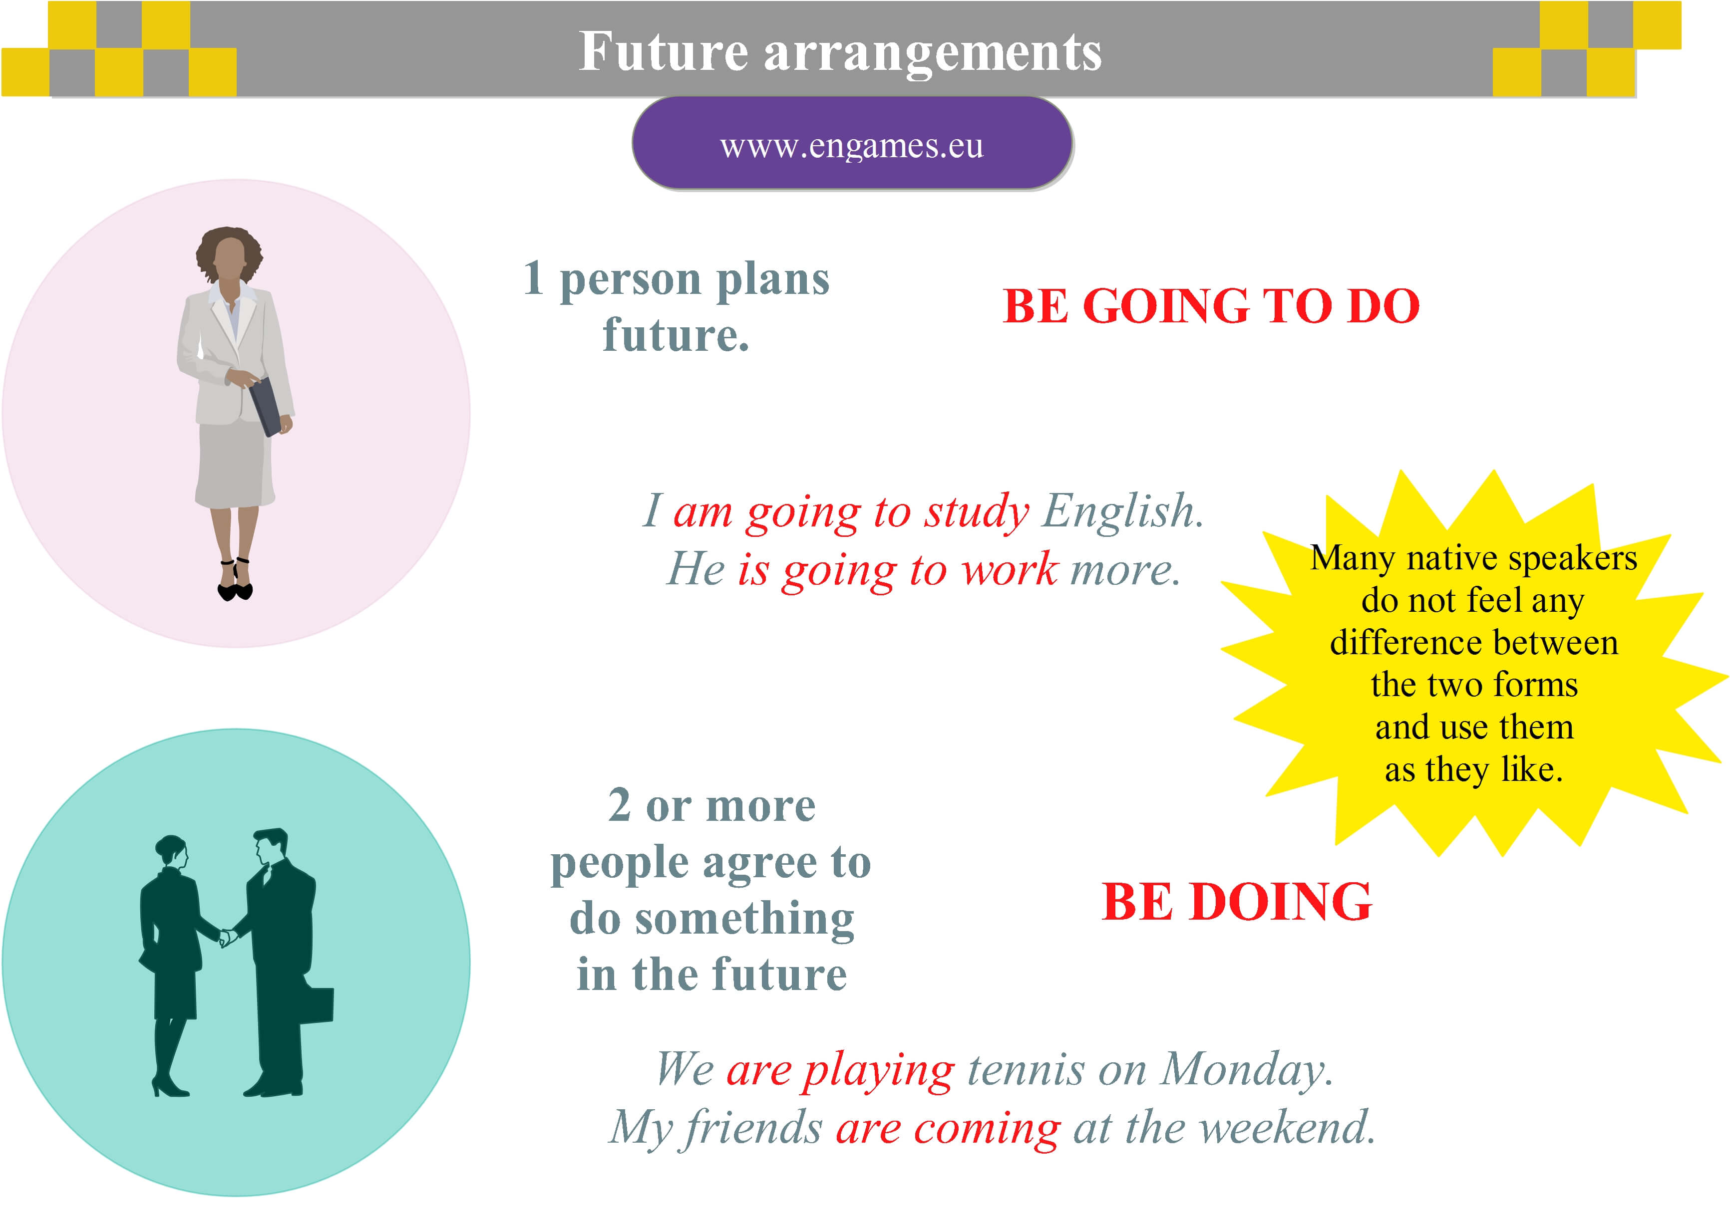
Business travel
Getting to the airport
John Cheng, a Hong Kong businessman, is on a business trip to meet customers in different cities in Africa. He booked* his flights on a travel site on the internet. He is in Nairobi and he is going to fly business class to Lagos.
He gets a taxi to the airport.
But the road is very busy and he gets stuck in traffic – his taxi moves very slowly.
He gets to the airport an hour late. But, luckily, his flight is delayed, so he doesn’t miss* it.
He checks in* at the check-in desk. He checks in one item of baggage and gets his boarding card.
*To book BrE only- buy by making a call or via intyernet;
=to reserve BrE and AmE;
=to make a reservation BrE and AmE.
*Miss the flight= not be able to join the flight
*check in = get registered

Slide 5
Travel adjectives
The flight was delayed.
The plane is full.
Mr Jabbarov always flies business class. The seats are very comfortable.
The service is very efficient. The flight attendants are very friendly and helpful.
The food is delicious.
The in-flight entertainment is very varied. There are lots of different music and film channels.

Slide 6
Travel adjectives
The flight was delayed.
The plane is full.
Mr Jabbarov always flies business class. The seats are very comfortable.
The service is very efficient. The flight attendants are very friendly and helpful.
The food is delicious.
The in-flight entertainment is very varied. There are lots of different music and film channels.

Slide 7
Getting to the airport
He goes through passport control and shows his passport.
He goes through security.
He goes to the duty-free shops.
He goes to the departure lounge next to the gate.
He boards his flight and finds his seat.
The plane takes off.
Three hours later, Mr Cheng lands in Lagos.

Slide 8
Airport announcements
1.Would Mr Cheng, passenger on flight KQ 932 to Lagos, please proceed ( =come) immediately to gate 14 where his flight is ready to depart (=leave)?
2.Kenya Airways announce (=say in microphone)that flight KQ 932 to Lagos is ready for boarding ( =getting on the plane). Would all passengers please proceed to gate 14?
3.There are great special offers at our duty-free shop. You can purchase (= buy) all French perfumes at 20 per cent off the normal price.
4.Only one item of hand baggage is permitted (= may be taken with). All other baggage must be checked in.
5. If you have a laptop computer, please remove (= take out) it from its bag.

Slide 9
Checking into a hotel
Welcome to the Otuwa Hotel, Lagos
Dear Guest,
All guest rooms are equipped with a full range of facilities(=complete services): tea- and coffee-making facilities, minibar and satellite TV. All rooms have a large safe (= strong box for valuable things).
The Africa Lounge on the first floor serves breakfast from 7 until 11. The Horison Rooftop Restaurant serves lunch from 12 till3 and dinner from 6 till midnight.
Food is available in your room at any time, of course. Just dial(=call) 8 for room service(=you can get food brought to your room).
And there is a gym and a pool on the ground floor where you can work out (=take exercise). At reception, our receptionists are here to help make you stay as pleasant as possible.
And when you leave, we have an express check-out service – under two minutes.
Have a nice stay!

Slide 10
Making contact
Daniel Achebe: | Ah, Mr Cheng, good morning. Very nice to meet you. How are you feeling this morning? What’s your hotel like? Did you have a good rest?
John Cheng: | Yes, thanks. The hotel’s very comfortable and the room service is very efficient. I had something to eat in my room and then I slept very well.
Daniel Achebe: | Yes, the Otuwa Hotel has an excellent reputation – people say a lot of good things about it. Let’s have some coffee, and then we’ll get down to business.
After Let’s never use to, you don’t say Let’s to have some coffee.

Slide 11
Hometask 1 Airport announcements. Match what Mr Cheng thought (1-5) when he heard each announcement (a-e).Pay attention to the underlined words.
1. I must get some for my wife. | a. Would Mr Cheng, passenger on flight KQ 932 to Lagos, please proceed immediately to gate 14 where his flight is ready to depart?
2. That’s me. I must get to the gate. | b. Kenya Airways announce that flight KQ 932 to Lagos is ready for boarding. Would all passengers please proceed to gate 14?
3.Going through security is always so slow, but it’s necessary. | c. There are great special offers at our duty-free shop. You can purchase all French perfumes at 20 per cent off the normal price.
4. That’s my flight, but I’ve got plenty of time. | d.Only one item of hand baggage is permitted. All other baggage must be checked in.
5. Oh no, I have two bags. I must put one inside the other. | e. If you have a laptop computer, please remove it from its bag.

Slide 12
Hometask 2 Complete the sentences with words from the box.
Ail, bill, check-in desk, connection, excess baggage, hand luggage,
reservation, room service, seat belt, single, tip, waiter
The taxi driver took me the long way to the airport. I didn’t give him a ……….. .
I got to the ……….. ten minutes before take-off. Fortunately the plane was late.
I had a very heavy suitcase and two pieces of ……….. .
The suit and one of the other bags were too heavy and I had to pay an ……….. charge.
I wanted a window seat but I could only get an ……….. Seat.
The weather was bad and I had to wear my ……….. All through the trip.
The first plane arrived very late and so I missed my ……….. . I waited three hours in the airport for another flight.
At last I arrived at my hotel. They could not find my ……….. .
I wanted a double room but I had to take a ……….. .
I went to the hotel restaurant but could find a ……….. .
I went back to my room and tried ……….. but there was no reply.
In the morning I asked for my ……….. . I don’t need to tell you: they had got it wrong!

Slide 13
References
1.Bill Mascull, Business Vocabulary in use. Elementary to pre-intermediate, Cambridge University Press, 2010;
2.Steve Flinders. Test your Professional English. Business: General. Longman.Pearson,2003

Slide 14
THANK YOU FOR ATTENTION.

