Slide 1

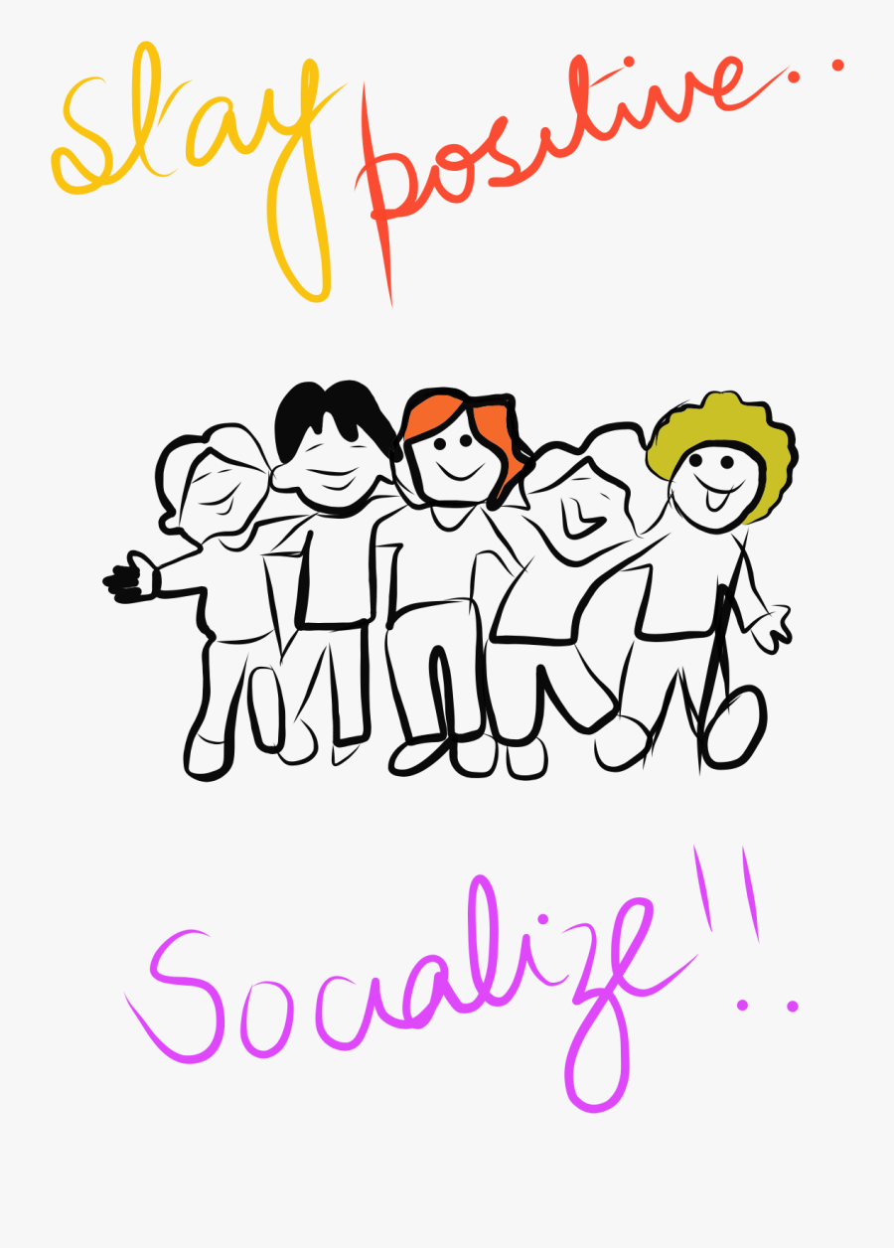

Business English Course
Lesson 7 Socializing
Lecturer: Nasiba Valieva

Slide 2
OUTLINE
At the airport
At the office
Saying goodbye
Small talk
Saying yes/ saying no
Hometask
References

Slide 3
At the airport
Rebecca: Excuse me. Are you Kate Thomas? I'm Rebecca Melesi.
Kate: Hello. Nice to meet you.
Rebecca: Hello. Nice to meet you too. How was the flight?
Kate: Very good, thanks. No problems
at all.
Rebecca: I'll take you to your hotel and
then we'll go out to dinner.
Kate: Thank you. That would be nice.

Slide 4
At the office
Rebecca: | Good morning, Kate. How are you?
Kate: | Very well, thanks. And you?
Rebecca: | Fine, thanks. Take a seat. Would you like something to drink? There’s coffee, tea and orange juice.
Kate: | Juice, please.
Rebecca: | Here you are.
Kate: | Thank you.

Slide 5
Complete the sentences with the appropriate words.
Leslie: Take a …………… . Would you like …………… to drink?............... coffee, tea and apple juice.
Leslie: Brian, …………… is Georgina Osborne from SPL in Dublin. Georgina, this is Brian, our production manager.
Brian: Nice to meet you, Georgina. …………… you …………… to Melbourne before?
Brian: ……………. are you staying?
Brian: What’s it ……………… ?
seat
something
There’s
this
Have
been
Where
like

Slide 6
At the office
Rebecca: | Steve, this is Kate Thomas from Adventure Travel in London. Kate, this is Steve Smith, our marketing manager.
Kate: | Hello, Steve. Pleased to meet you.
Steve: | Nice to meet you, Kate. Have you been to Botswana before?
Kate: | No, this is my first time.
Steve: | Where are you staying? What’s it like?
Kate: | At the Intercontinental. It’s very comfortable, thanks.

Slide 7
Match (1-5) with the sentences (a-e).
Leslie: Take a seat. Would you like something to drink? There’s coffee, tea and apple juice.
Leslie: Brian, this is Georgina Osborne from SPL in Dublin. Georgina, this is Brian, our production manager.
Brian: Nice to meet you, Georgina. Have you been to Melbourne before?
Brian: Where are you staying?
Brian: What’s it like ?
At the Hilton.
Pleased to meet you.
Tea, please.
Very comfortable, thanks.
Yes, I was here about ten years ago.

Slide 8
You say Nice to meet you when you meet someone for the first time. You say Nice meeting you when you say goodbye.
Saying goodbye
Steve: | It was nice meeting you, Kate.
Kate: | Nice meeting you too, Steve.
Steve: | Have a good trip back to London.
Kate: | Thanks. I’ll be in touch soon.
Steve: | I look forward to seeing you next time.
Kate: | Yes, me too. Bye.
Steve: | Goodbye.

Slide 9
Small talk is when people talk in a friendly way about things that are not important.
Rebecca: | Do you live in London?
Kate: | No, I live in Brighton, on the south coast, about an hour from London. I commute. What about you?
Rebecca: | I commute too. It takes about 20 minutes by car. Do you mind commuting?
Kate: | It’s OK if the train isn’t late. I read and I listen to music. And you?
Rebecca: | It’s fine if there isn’t too much traffic. What do you do in your spare time?
Kate: | I play a lot of golf.
Rebecca: | Really? I play golf too. How about a game tomorrow after our meeting?
Kate: | Good idea.

Slide 10
At the office Looking forward to the weekend? Have you worked here long? I can't believe how busy/quiet we are today, can you? Has it been a long week? You look like you could use a cup of coffee. What do you think of the new computers? At a social event So, how do you know Justin? Have you tried the cabbage rolls that Sandy made? Are you enjoying yourself? It looks like you could use another drink. Pretty nice place, huh? I love your dress. Can I ask where you got it?

Slide 11
Talking about the weather Beautiful day, isn't it? It looks like it's going to snow. It sure would be nice to be in Hawaii right about now. We couldn't ask for a nicer day, could we? How about this weather? Did you order this sunshine? Talking about current events Did you catch the news today? Did you hear about that fire on Fourth St? What do you think about this transit strike? I read in the paper today that the Sears Mall is closing. I heard on the radio today that they are finally going to start building the new bridge. How about those Reds? Do you think they're going to win tonight?

Slide 12
Saying Yes
Fill in the gaps using the words from the box.
help isn’t it it is kind right ahead here appreciate
Positive reply Is this your first visit to Bucharest? - Yes (1)…………. . I didn’t expect to see so many tourists. You speak English, don’t you? - Yes,that’s (2)………., although I’m not fluent.
Agreeing It’s really cold today. - Yes, it is (3)………. . It’s freezing. Japanese is a difficult language. - Yes, it’s probably one of the most difficult languages.
Accepting an offer of help Do you want a hand? - Oh, thanks very much. I’d (4)…………that. Would you like me to carry those? - Oh, that’s very (5) ………… of you.
Giving permission Can I have another cup of coffee? - Of course. (6)…………yourself. Could I use your phone? - Certainly. Please go (7)…………….. .
Emphasis Will you let me know by next week? - Yes, of course.
Passing an object Is the dictionary over there? - Yes, (8)…………. you are.
It is
right
isn’t it ?
appreciate
kind
Help
ahead
here

Slide 13
Saying No
isn’t sure policy inconvenient actually afraid manage so
b. Fill in the gaps using the words from the box.
Negative reply Is this your first visit to Bucharest? You speak German, don’t you? | No, it (1)……….., actually. I was here last year. No, I’m (2)……….. not.
Disagreeing Your brother’s quite like you, isn’t he. She seems happy in her new job. | Do you think (3)………………? Really? I’m not so (4) ……………. about that.
Refusing an offer of help Do you want a hand? Would you like me to carry those? | No, thanks, I can (5)…………. . No, it’s all right, thanks.
Refusing a request Could you give me a lift to the station? Can I pay in cash? | (6)……………, it’s a bit (7) …………. right now. I’m sorry, but it’s against company (8)……………. .
Emphasis Will there be any delay? | - No, of course not.
isn’t
afraid
so
sure
manage
Actually
inconvenient
policy

Slide 14
Hometask 1 Choose the correct response (a or b) in each of the exchanges (1-7).
1. Nice to meet you. | Nice to meet you too. Fine, thanks.
2.How was the flight? | That would be nice. Very good-no problem at all.
3. I’ll take you to your hotel and then we’ll go out to dinner. | a. Fine, thanks. b. Thank you. That would be nice.
4. Would you like something to drink? | Coffee, please. Here you are.
5. Have you been to Tashkent before? | No, this is my first time. Pleased to meet you.
6. This is my first time. | Where are you staying? Where are you living?
7. This is Hafiz from Ipak Yuli bank in Tashkent. | Nice meeting you. Pleased to meet you.
8. It was nice meeting you. | Very well, thank you. Nice meeting you too.

Slide 15
Hometask 2
a.Write a yes reply to the following questions. Add an example of your own.
1. Is this the way to the marketing seminar? | - Yes, it is. I’m going there myself.
2. Can I send you the deposit next week? | - …………………………………….?
3. Would you like a lift to the airport? | - ……….……………………………?
4. It’s a beautiful day today, isn’t it? | - …………………………………….?
5. May I just interrupt for a moment? | - …………………………………….?
6. You’re Alice Matthews, aren’t you? | - ……………………………………….?
7. Can you pass the salt? | - ……………………………………….?
8………………………………………….? | - ……………………………………………………….?

Slide 16
b. Write a no reply to the following questions. Add an example of your own.
1.Have you got last year’s figures with you? | - No, so, I haven’t. I can fax them to you tomorrow.
2.Coffee? | ………………………………………?
3.You always have a siesta in Italy, don’t you? - | ………………………………………?
4.Would you be willing to give us a discount? | ………………………………………?
5.Hot in here, isn’t it ? | ………………………………………?
6.Can I let you know by next week? | ………………………………………?
7.Shall I call you a taxi? | ………………………………………?
8. ………………………………………? | ………………………………………?

Slide 17
References: Bill Mascull, Business Vocabulary in use. Elementary to pre-intermediate, Cambridge University Press, 2010; Paul Emmerson, Business Builder. Macmillan Publishers Ltd 2002; https://www.englishclub.com/speaking/small-talk_conversation-starters.htm.

Slide 18
THANK YOU FOR ATTENTION.

