Slide 1


Business English Course
Lesson 8: Career
Lecturer: Nasiba Valieva

Slide 2
OUTLINE
Career: new words and expressions
Interviews
Present perfect, question types, Past simple
Managers and employees/Managing departments
Getting to the top
Hometask
References

Slide 3
In the past, workers often stayed with one company for their whole career (=working activity) until they retired (=reach the age to leave work). Now employees regularly change companies, perhaps because they want promotion (=better position)and a higher salary (=money for each month). When we apply for a job (=hand in/send resume to a new workplace), things like pay (=money), working conditions (=working hours, working environment) and pension (money given when a person is old) can be important. Many modern employees also want jobs that give them enough free time to spend with their family and friends.

Slide 4
Interviews
When we go for job interviews, we usually answer questions about our work experience. Look at the following examples of interview questions and translate into your own language.
a. Do you enjoy working with people?
b. How long have you been [in sales]?
c. Have you ever worked [in marketing] ?
d. Have you ever lived in a different country?
e. What do you do in your free time?
f. Why do you want this job?
g. Can you tell me about your present job?

Slide 5
Present perfect
Form - the present perfect is formed by using have or has and the past participle of the verb.
They have lost the contract.
Has he seen the visitors?
I have never been to the Madrid office.
We use the present perfect + for and + since to answer the question How long ... ?
How long have you lived in this town? - I've lived here since 2005. / I've lived here for three years.

Slide 6
The present perfect has the following use:
activities that started in the past and continue to the present
How long have you worked for J&C? - I've worked in this job for six months. (I'm still in this job.)
I have been with the company since 2006. (I'm still with the company.)
talking about experience (often with ever / never)
We've been to Venice. Have you ever visited the pyramids? No, I haven't.

Slide 7
Question types: general and special
General questions begin with verb and the answer must be Yes or No. Then you can also add some information.
a. Do you enjoy working with people?
c. Have you ever worked [in marketing] ?
d. Have you ever lived in a different country?
g. Can you tell me about your present job?
Try to answer the above questions.

Slide 8
Question types: general and special
Special questions begin with words like what,where,why,how and the answer must be complete.
How long have you been [in sales]?
What do you do in your free time?
Why do you want this job?
Try to answer the above questions.

Slide 9
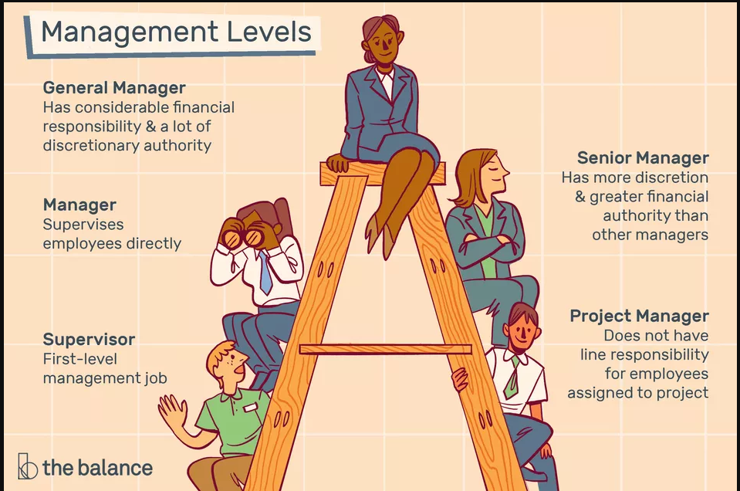
Study Management Levels and Job Titles
discretion= freedom to act or decide;
assigned= chosen

Slide 10
Managers and employees
This is part of the organization chart for Exquifoods, an Asian company that makes food products. The managers are responsible for (=duty to do main things at work) different activities. For example, the research and development director is in charge of (=responsible for) developing products.
Chief executive officer (CEO) or chief executive
finance director
research and development
(R&D) director
production director
sales director
employees
formal: chief executive, manager
informal: boss

Slide 11
Who is in charge of the following?
After such expressions as …..responsible for and ……in charge of the verb+ing is used.
the production director
Making the products -
Getting the money to develop the products-
3. Running the whole company -
4. Finding customers for the products -
5. Thinking of new ideas for products -
the finance director
the chief executive officer
the sales director
research and development
(R&D) director

Slide 12
Managing departments
Kajan Lim is the sales director at Exquifoods - he is the head of the sales department. There are 38 people who work under Kajan - 2 sales managers, 35 salespeople and his personal assistant (PA), Shindu Chan. Shindu helps Kajan with his work. For example, Shindu is responsible for organizing Kajan's meetings.
Now it is your turn to speak about yourself using new expresions.
Sales director
Kajan Lim
personal assistant (PA)Shindu Chan
2 sales managers
singular: salesperson,salesman,saleswoman
plural: salespeople
35 salespeople

Slide 13
Past simple
We use the past simple to talk about events and situations that are finished.
The verb to be in the past simple has 2 forms was (for singular) and were (for plural).
Positive form
I was in Moscow last year.
He/she was in Spain 3 years ago.
You/we/they were late for the class.
Negative form: was+not (wasn’t), were+not (weren’t).
I wasn’t in Moscow last year.
He/she wasn’t in Spain 3 years ago.
You/we/they weren’t late for the class.
Question form: place the verb was/were in the first place of the sentence.
Was I in Moscow last year? Where were you last year?
Was he/she in Spain 3 years ago? When was he in Spain?
Were you/we/they late for the class?

Slide 14
Look at these past time phrases. Put them in order, starting with the most recent.
1,000 years ago last month last week last year six weeks ago yesterday the day before yesterday two hours ago
Two hours ago, …
yesterday
the day before yesterday
last week
last month
six weeks ago
last year
1,ooo years ago

Slide 15
English verbs may be regular or irregular. They form past simple in different ways.
To the regular verb we add –ed or –d work - worked join - joined Study - studied (y=ie)
The irregular verb has its special form that we can see in the irregular verbs list. become - became do - did get - got go - went leave - left

Slide 16
Getting to the top 1
Mary Wu is the chief executive of Exquifoods. This is her profile.
Mary Wu - chief executive, Exquifoods.
Her father and mother were both office workers.
She was born in Singapore in 1955.
She went to school there.
She got very good grades - results - at secondary school.
Then, in 1973, she got into the National University of Singapore to study psychology.
In 1979 she joined Asiasavours, another food company, as a trainee - learning her job as she did it.
In 1991, she left Asiasavours and moved to Exquifoods.
She got a job working in the human resources department.
In 1999, she became head of the human resources department.
In 2009, she became the chief executive of Exquifoods.
In 2015, she's hoping to buy another food company.

Slide 17
Getting to the top 2
Here are some questions and answers about Lee Kuo,
head of research and development at 34 Exquifoods, and his career.
What did his parents do? - They were both farmers.
• Where was he born? - He was born in Hong Kong in 1964 and went to school there.
• When did he leave school? - He left school in 1982 and went to the University of California.
• What did he study at university? - He studied chemistry.
• What did he do next? - In 1985, he went to Harvard University to do an MS in food chemistry.
• Which company did he join after that? - In 1987, he joined a soft drink company in the US and worked in the research department.
• When did he go back to Asia? - He went back to Asia in 2003 and joined Exquifoods as head of research and development.

Slide 18
Hometask 1 Complete the sentences using ‘responsible for’ with the information from the slide 4.
1. The production director is responsible for making the products.
2. The finance director …………………………………………… .
3. The chief executive officer ……………………………………. .
4. The sales director ……………………………………………… .
5. Research and development (R&D) director ………………….. .

Slide 19
Hometask 2 Write the answers to the questions about you.
What did your parents do? –
Where were you born? –
When did you leave school? -
What did you study at university? –
What did you do next? –
Which company did you join after that? -

Slide 20
References
1. Bill Mascull, Business Vocabulary in use. Elementary to pre-intermediate, Cambridge University Press, 2010;
2. Christine Johnson. Intelligent Business.Elementary.Course book, Pearson Education Limited, 2010.
3. Image is taken from the balance

Slide 21
THANK YOU FOR ATTENTION.

