Slide 1

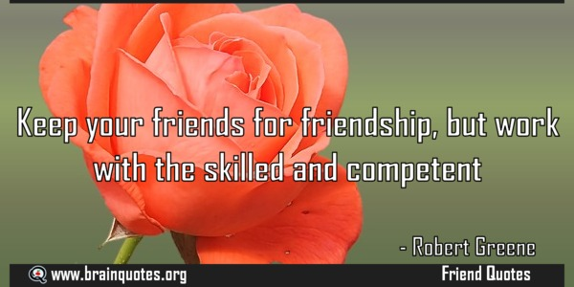

Business English Course
Lesson 9 Skills
Lecturer: Nasiba Valiyeva

Slide 2
OUTLINE
How to speak about skills
Skilled and unskilled workers
Qualification and training, e-learning
Essential Skills of the Manager
Top 10 soft skills for customer service jobs
Hometask
References

Slide 3
Are you good with people?
Mary is very good with people.
She is good with figures.
She isn’t very good with languages.
Lee is very good with figures.
He is good with computers.
He isn’t very good with people.

Slide 4
Have/has ………… skills
Mary has people skills - she is very good with people. She doesn't have language skills – she isn't very good with languages. | Lee has computer skills - he is good with computers. He doesn't have people skills - he isn't very good with people.

Slide 5
Mary also has very good:
• management skills - she's a very good manager.
• listening skills - she listens carefully to what people say.
• presentation skills - she explains things very clearly.
Lee also has very good:
• problem-solving skills - he finds an answer to every problem.
• negotiating skills - he is good at discussing things when people don't agree.
• language skills - he grew up speaking Cantonese, and he also speaks very good English and Japanese.

Slide 6
Read the sentences about Ricardo and Fabia, and decide what they are (not)(very) good with. Look at the example before you begin.
1. Ricardo likes computers and he knows how they work.
He’s (very) good with computers.
2. When Fabia uses a computer, she has problems.
________________________________________
3. When employees are unhappy, Fabia can help them.
________________________________________
4. When employees are unhappy, Ricardo can’t help them.
________________________________________
5. Ricardo speaks Chinese and Japanese very well.
________________________________________
6. Fabia doesn’t speak any other languages.
________________________________________
7. When Ricardo looks at the company’s figures, he knows how to make them better.
________________________________________
8. When Fabia looks at the company’s figures, she doesn’t understand.
________________________________________
Fabia is not very good with computers
Fabia is very good with people.
Ricardo is not good with people.
Ricardo is very good with languages.
Fabia is not good with languages.
Ricardo is very good with figures.
Fabia is not good with figures.

Slide 7
What skills do employees need if a company wants to do the following?
1.sell to countries where they speak another language -
2. find answers to their problems -
3. tell people clearly about their ideas and products -
4. sell products at the right price when the customers
don't want to pay that price -
5. understand what people want -
6. manage the company well -
Language skills
Problem solving skills
Presentation skills
Negotiating skills
Listening skills
Management skills

Slide 8
Skilled and unskilled workers
At Exquifood, there are a lot of skilled workers - people with special skills, sometimes called specialists or experts, for example production specialists and research workers. There are also unskilled workers - people without special skills, for example production workers and cleaners.

Slide 9
Questions to you
What are you (very) good with? What are you not very good with?
• Think of a colleague. What skills does he or she have?

Slide 10
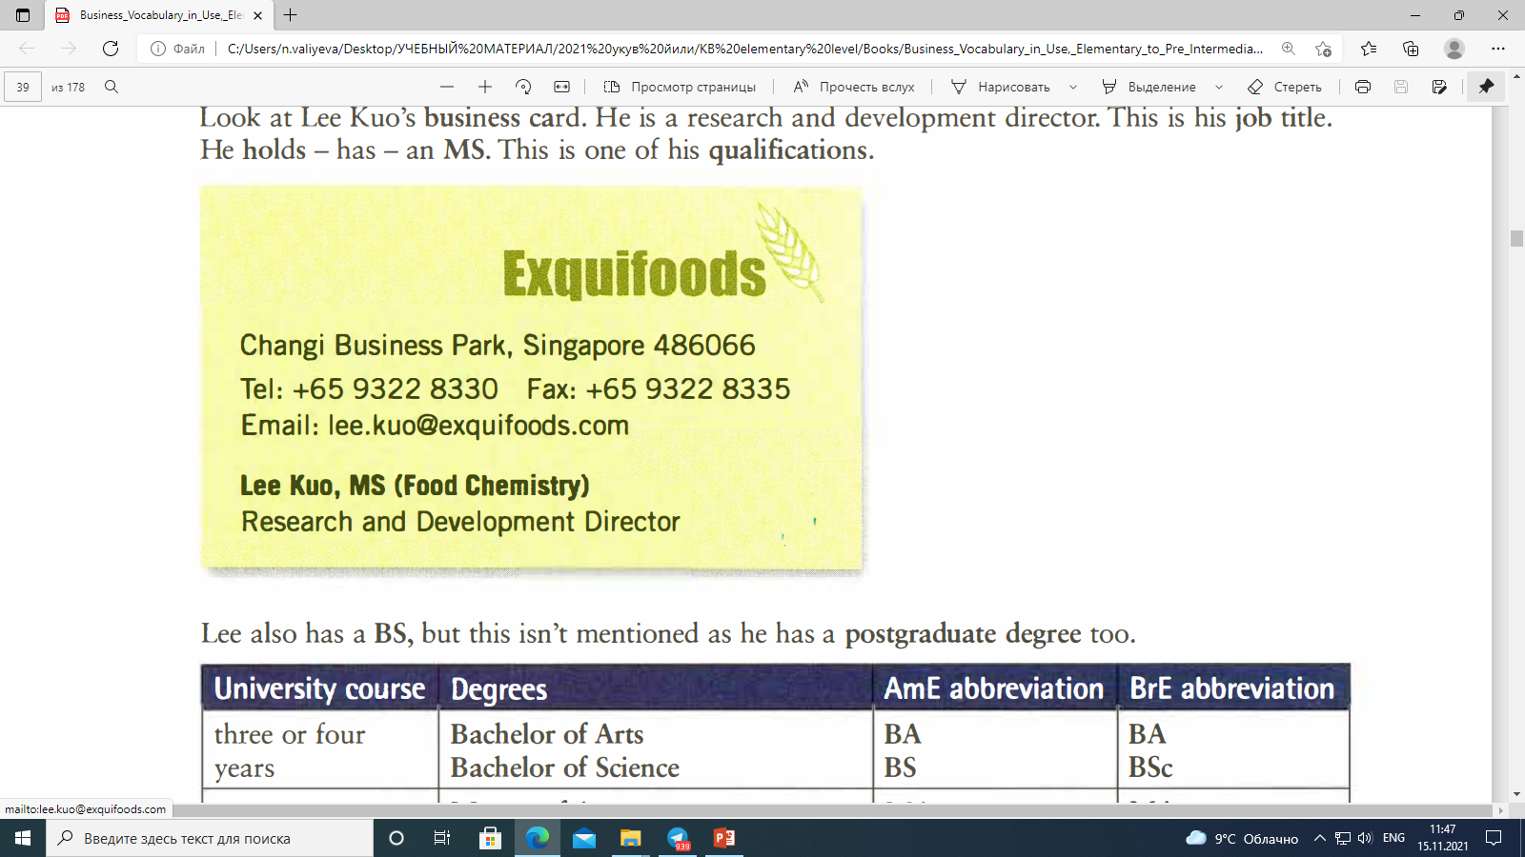
QUALIFICATIONS AND TRAINING
Qualifications
Look at Lee Kuo's business card. He is a research and development director. This is his job title. He holds - has - an MS. This is one of his qualifications.
Lee also has a BS, but this isn't mentioned as he has a postgraduate degree too.

Slide 11
University course | Degrees | AmE abbreviation | BrE abbreviation
three or four years | Bachelor of Arts Bachelor of Science | BA BS | BA BSc
One more year | Master of Arts Master of Science Master of Business Administration These are all Master's or postgraduate degrees. | MA MS MBA | MA MSc MBA

Slide 12
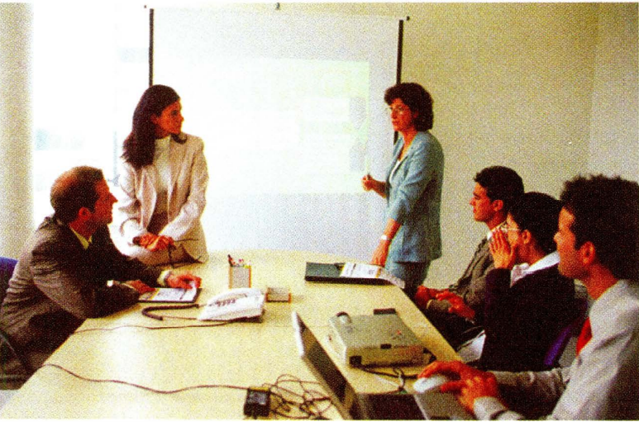
Training
Training is teaching or learning for a specific job. For example, you can train as a doctor, an architect, an accountant, an engineer or a lawyer.
You can go on a training course to gain, get or learn specific skills in computers, management and other areas - subjects. A lot of people now
have on-the-job training - they go on courses which are organized by their company. And they gain experience and learn things while they are working.

Slide 13
Questions to you
Think of your job or one you would like. Are qualifications needed? Is training important? Explain why.

Slide 14
E-learning
When there are people together in a room with a trainer, the training is face-to-face. But you can do more and more courses at a distance - for example, you can get a degree with distance learning by studying online. You don't have to go to the university: you study on the Internet. This is e-learning - electronic learning.
On the Internet, you can:
• download materials to your computer and upload assignments - written work - that you have done for your tutor - teacher - to read. You can do this by email, for example.
• watch and listen to lectures • talk to your tutor via - with - a webcam
Teachers typically work in schools. Lecturers work in universities, giving lectures to large numbers of students. Tutors work in one-to-one situations, like online learning. Trainers work in companies.

Slide 15
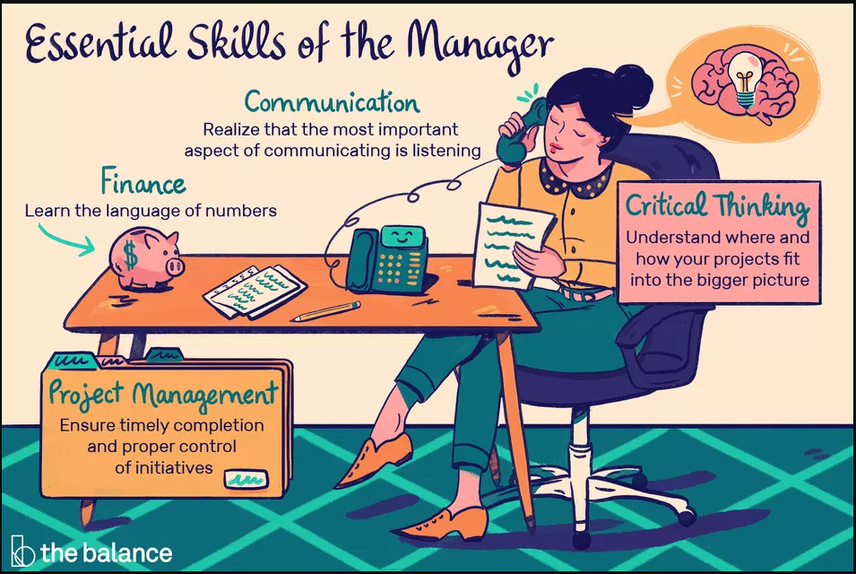

Slide 16
Essential Skills of the Manager
Managers need to develop and hone (make perfect) the following skills:
Leadership:
A manager has to be able to set priorities and motivate your team members. This involves self-awareness, self-management, social awareness, and relationship management. The manager needs to radiate energy, empathy, and trust. And, remember that effective leaders work daily to develop team members through positive, constructive feedback and coaching.
Communication:
The manager must become a student of effective communication in all of its applications, including one-on-one, small groups, large groups, email, remote working, and social media. Good managers realize that the most important aspect of communicating is listening.
Collaboration:
The manager serves as a role model for working together. You support cross-functional efforts and model collaborative behaviors to set the example for your team members.

Slide 17
Essential Skills of the Manager
Critical Thinking:
The manager strives to understand where and how your projects fit into the bigger picture to enhance your effectiveness. The manager reviews priorities in light of larger organizational goals. He or she translates this understanding into meaningful goals and objectives for their team members who need to understand where their work fits in the big picture.
Finance:
A manager needs to learn the language of numbers. Managers must strive to understand how company funds are invested and to ensure that these investments earn a good return for the firm. While you don't need to be an accountant to be a manager, it is imperative that you learn and apply the basics of solid financial understanding. For example, how many employees can produce the most quality product for the least cost?
Project Management:
Nearly every initiative in an organization turns into a project. And, projects can become complex and unwieldy. Today’s managers understand and leverage formal project management practices to ensure timely completion and proper control of initiatives.

Slide 18
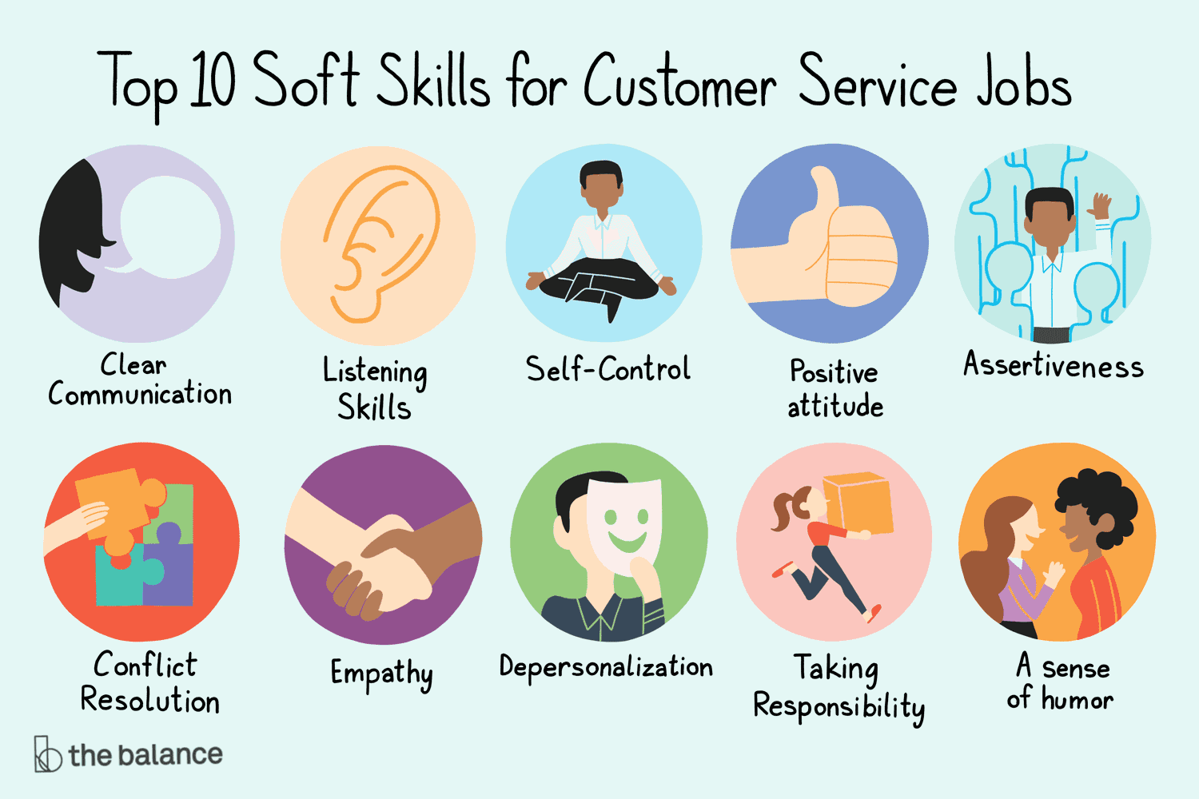
Top 10 Soft Skills for customer service jobs
-Clear communication
-Listening skills
-Self-control
-Positive attitude
-Assertiveness
-Conflict resolution
-Empathy
-Depersonalization
-Taking responsibility
-A sense of humor

Slide 19
Hometask 1 Are these sentences true (T) or false (F)?
A specialist is someone without skills.
2. Cleaners are unskilled workers.
3. Research workers in laboratories are unskilled.
4. Experts have skills in a particular area.
5. All production workers are production specialists.
6. Skilled work are usually paid less than unskilled ones.

Slide 20
Hometask 2 Complete this interview with Olivia, an Italian car designer. You can use some expressions more than one.
Training, train as, go on a training course, gain, get, learn skills, areas, on-the-job training, gain experience.
Interviewer: Olivia, how many cars have you designed?
Olivia: More than 20.
Interviewer: So you have a lot of ……………..(1) . Do you use English in your work?
Olivia: Yes, I do. But I trained (2) ............................................... . a designer in the 1970s and English wasn't so important then.
Interviewer: So what did you do to (3) ............................... ................. (3 expressions) English language (4) ·················································?
Olivia: I went on short courses at work - you know, (5)…. - ….-……language training.
Interviewer: Was that enough?
Olivia: No, it wasn’t. So I decided to go on a three-month(6)………. ……………… in the US a few years ago to get these skills. Now, people tell me that I speak English very well!

Slide 21
References
1. Bill Mascull, Business Vocabulary in use. Elementary to pre-intermediate, Cambridge University Press, 2010;
2. Christine Johnson. Intelligent Business.Elementary.Course book, Pearson Education Limited, 2010.
3. brainquotes.org

Slide 22
THANK YOU FOR ATTENTION.

