Slide 1

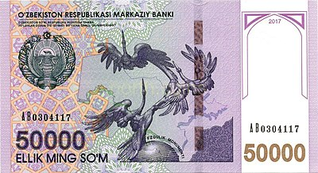
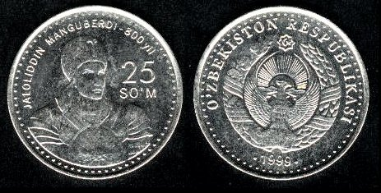
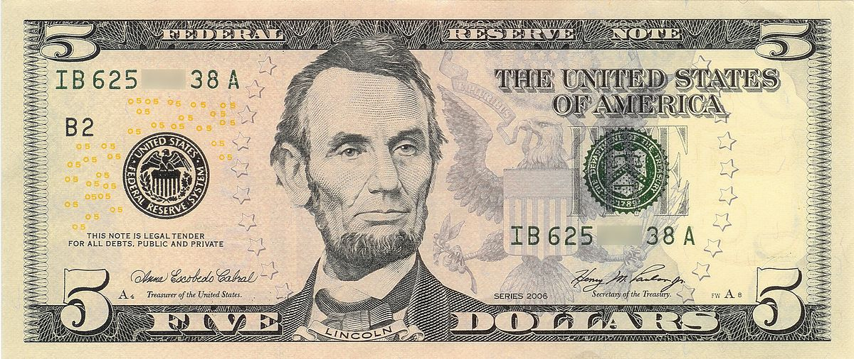
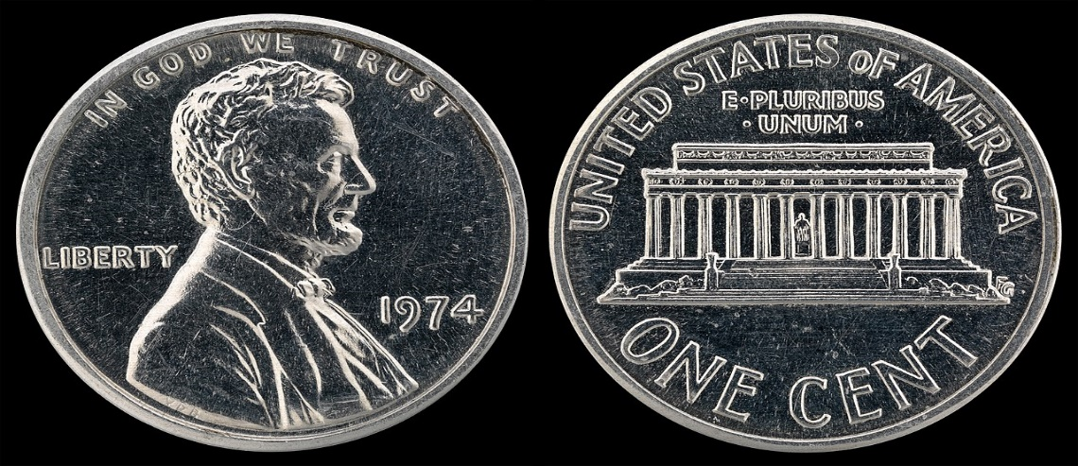
Business English Course
Lesson: Money
Lecturer: Nasiba Valieva

Slide 2
OUTLINE
New words and phrases
How do you say these numbers?
Some, any, how much/many
Money and its forms
Reading
Hometask
References

Slide 3
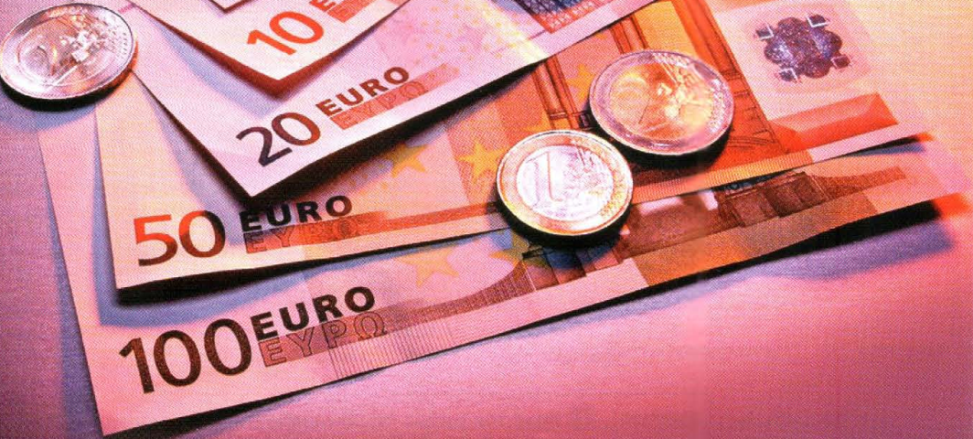
Money
different - turli
currencies- pul birligi
exchange rate- valyuta kursi
change- o’zgarmoq
cost of living- yashash darajasi
price- narx
pay for- to’lamoq
goods- maxsulot
choose - tanlamoq
supplier- ta’minotchi
it is possible- imkoniyat bor
to negotiate- muzokara
a discount on large orders – katta buyurtmaga chegirma

Slide 4
Different countries have different currencies and the exchange rate usually changes every day. This can change the cost of living and the price we pay for goods. Price is also important when we choose a supplier. Sometimes it is possible to negotiate a discount on large orders.

Slide 5
Money
Notes and coins
In Canada there are notes or banknotes for:
$100 $ 50 $20 $10 $5
The Canadian dollar is divided into 100 cents. There are coins for:
$1 50 cents 25 cents 10 cents 5 cents 1 cent
The notes and coins of a country are its currency.

Slide 6
Money can be notes (a €50 note) or coin (€1 coin).
We can pay for things:
with cash
by cheque
using a credit card
You put the symbol ($,£,€, etc.) before the number, not after.
BrE: note, banknote AmE: bill
Things can cost 100 dollars or 25 cents (plural), but the
singular form is used before note, e.g. a hundred-dollar
note, and coin, e.g. a 25-cent coin.

Slide 7
Abbreviations
Here are some countries’ currencies and their abbreviations:
Say as in the example: The currency in China is the yuan.

Slide 8
When we talk about exchange rates, we can say
the decimal point (.).
$1.34 There are one point three four US dollars to the euro.
¥239.34 There are two hundred and thirty-nine point three four Japanese yen to the British pound.
When we say prices, we do not say the decimal point (.).
€ 13.95 thirteen euros ninety-five cents
Thirteen euros ninety-five
Thirteen ninety-five

Slide 9
How do you say these numbers?
When saying prices
1.$30.25(cents) 2.£420.88 (pence) 3. 2,000 (riyal) 4. ¥730 5. €18.52(cents)
1. $10 2. €7.50 3. £4.95 4. $285 5. €5,650
Tell your partner how much you usually pay for these items in your country.
A liter of petrol a liter of cooking oil
A cup of coffee a bottle of mineral water
3. A kilo of meat a kilo of sugar
Start with I usually pay for _______

Slide 10
Changing money
Marion is going on holiday to Canada. To change or exchange money, she goes to a bank or bureau de change. She asks these questions:
What is the currency in Canada?
What’s the exchange rate? How many Canadian dollars are there to the euro?
How much commission do you charge?
If I have some Canadian currency at the end of my holiday, can I change it back into euros?
Commission is the money that you have to pay when you change money.

Slide 11
Note: money is uncountable, but notes, coins, dollars, etc. are countable!
we use some with uncountable nouns in affirmative sentences: I'd like some information about prices.
some, any, how much/many
• we use some in affirmative sentences but we use any in negative sentences and real questions; we use any with both countable and uncountable nouns:
There aren't any documents on the desk.
Do you have any red pens?
Is there any water in the bottle?
We don't have any money in the bank.

Slide 12
Note: we use some for requests and offers
Could I have some water?
• we use how many with countable nouns for questions about quantity
How many managers are there?
• we use how much with uncountable nouns for questions about quantity and price
How much time do we have? How much is the coffee?

Slide 13
Look at the phone conversation between a customer and a sales assistant in a bureau de change. Complete the conversation using some, any, much or many.
Customer: Good morning, I'd like to change (1) ____ money. Do you have (2) ____ Australian dollars?
Sales assistant: Yes, sir. How (3)_____ dollars would you like?
Customer: 1,500. How (4)______ is the commission?
Sales assistant: 1%. Do you need (5) _____other currencies, sir?
Customer: Yes. Can I have (6)_______ Mexican pesos, please?
Sales assistant: How (7) _______ ?
Customer: 2,000, please.
Practice the conversation with partner.
some
any
many
much
any
some
many

Slide 14
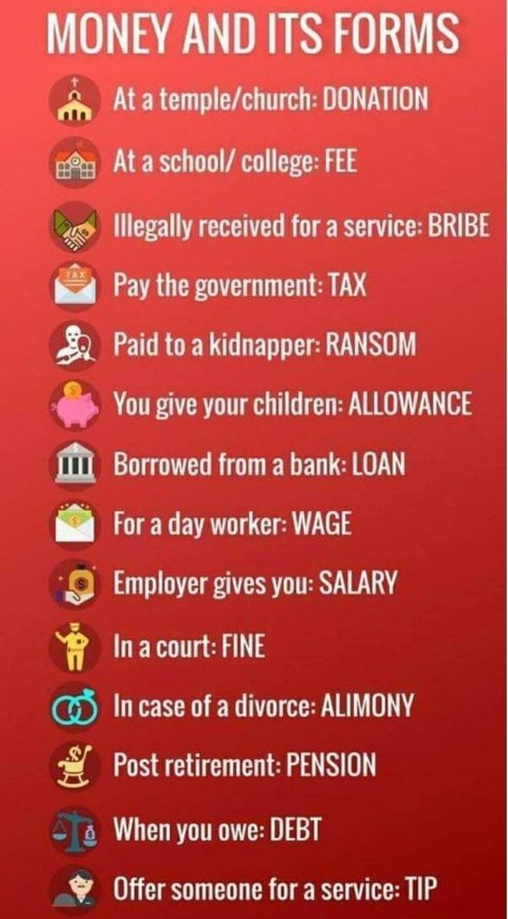

Slide 15
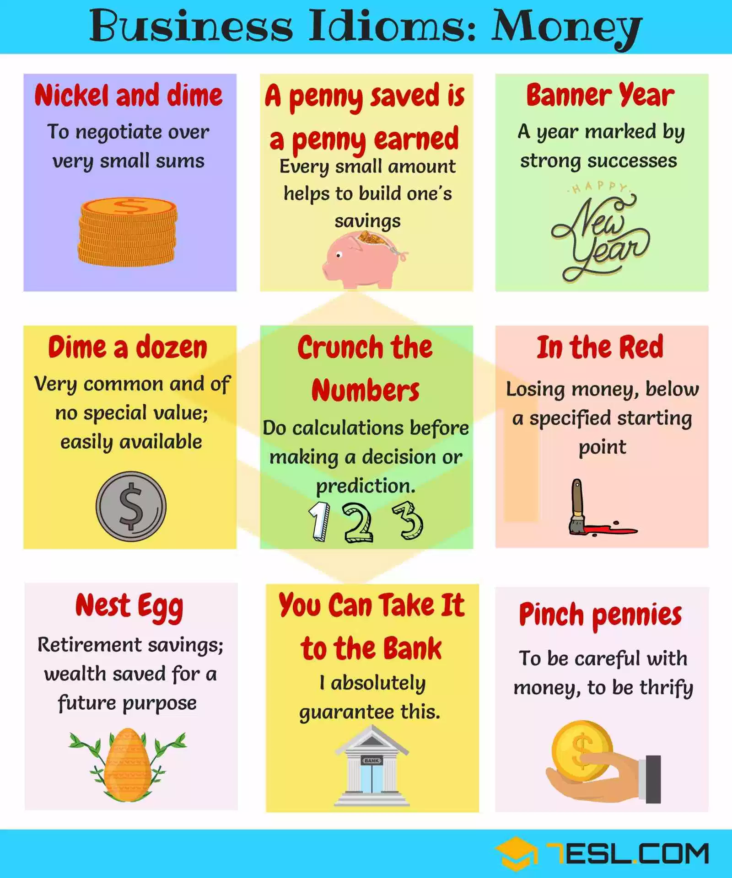

Slide 16
Read the article The Business of giving and find the answers to the following questions.
What American companies does the article talk about?
What currencies does the article mention?
What do reach people in the USA often give money to build?
What problems can rich people help find solutions to?

Slide 17
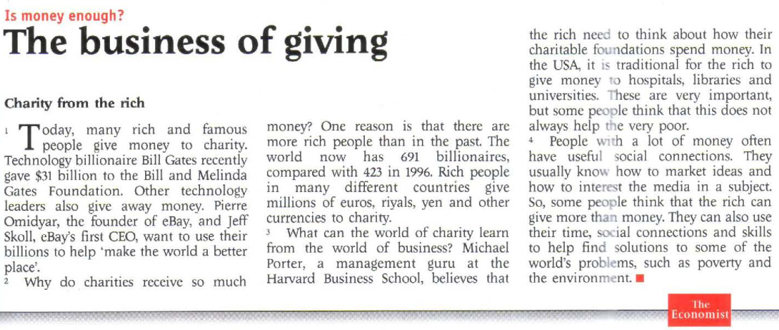

Slide 18
Hometask 1 Match the counties 1-5 with the currency symbols a-e and how to say the currency A-E.
Currency form | We write | We say
1 Italy | a | A dollar
2 The UK | b ¥ | B pound
3 Japan | c £ | C yen
4 The USA | d € | D riyal
5 Saudi Arabia | e $ | E euro
Write as in the example: The currency in Italy is the euro.

Slide 19
Hometask 2 Write the prices.
1. $30.25 (cents)................................................
2 £420.88 (pence) ................................................
3 2,500 ................................................
4 ¥ 730 5 ................................................
5. €l852 (cents) ................................................

Slide 20
References
1. Bill Mascull, Business Vocabulary in use. Elementary to pre-intermediate, Cambridge University Press, 2010;
2. Christine Johnson. Intelligent Business.Elementary.Course book, Pearson Education Limited, 2010.
3. ESL.COM

Slide 21
THANK YOU FOR ATTENTION.

