Slide 1
INTRODUCTION TO HUMAN COMMUNICATION
Interpersonal Communication
LECTURE 9 BY DR. RAPHAEL OGUTU, AFRICA NAZARENE UNIVERSITY
THE MAIN SOURCE OF REFERENCE: Adler, R.B. & Rodman, G. 2006. Understanding human communication. 9th edition. London: Oxford University Press.

Slide 2
Intended Learning Outcomes
At the end of this class, you should be able to:
Define Interpersonal Communication;
Distinguish interpersonal relationship from impersonal ones;
Analyze the role of metacommunication in conveying relational messages;
Explain reasons for self- disclosure
Apply the Johari window of self- disclosure in your own context.

Slide 3
Interpersonal communication Defined
Interpersonal communication occurs when people treat one another as unique individuals, regardless of the context in which the interaction occurs or the number of people.
Relationship is ‘the mode in which two or more things stand to one another’.
Interpersonal relationships involve the way people deal with one another socially. Interpersonal communication is by context, looking at the number of people involved. All dyadic communication is a good example of interpersonal.
To be more precise Interpersonal relationships is an association in which the parties meet each other’s social needs to a greater or lesser degree.

Slide 4
Why form relationships?
Whom do you find most attractive – a confident person, a nice person, or a “player”? The Science of Attraction
Take Note :
Interpersonal communication focuses on relationships and the key word here is developing relationships that are qualitative in nature.
Scarcity of qualitatively interpersonal interactions contributes to their value.
Relationships can be enhanced by mediated communication; but when personal face-to-face interaction commences, the majority of these relationships are terminated.

Slide 5
Why we form relationships?
How does interpersonal communication differ from other types of interactions?
Scientists believe that ALL relationships – both impersonal and personal – are based on the social exchange theory. We seek out people who can give us rewards (tangible or intangible) that are greater than or equal to the costs we encounter in dealing with them Rewards – Cost = Outcome

Slide 6
Characteristics of interpersonal relationship
Interpersonal versus Impersonal communication
In interpersonal communication we treat others as individuals whereas in impersonal communication we treat them as objects. This definition does not mean that all impersonal communication is cruel or that you need to establish a warm relationship with every person you meet.
The fact to remember is that not all two people interacting are interpersonal. For example when you chat with the shopkeeper or fellow passengers on bus or plane is impersonal.
It is treated as interpersonal when people treat one another as unique individuals, regardless of the context in which the interaction occurs or the number of people involved.

Slide 7
Uniqueness
no two interpersonal relationships are alike, and the communication patterns reflect these differences. Unlike the distinctive quality of interpersonal relationships, impersonal ones are governed by the kind of standardized rules such as “please” and “thank you” and so on. These rules are followed for a while until we have created our own interpersonal conventions.

Slide 8
Irreplaceability
Irreplaceability: because interpersonal relationships are unique, they cannot be replaced.
This explains the reason why we usually feel so sad when a close friendship or love affair cools down.
People in less personal relationships are much easier to replace.

Slide 9
Interdependence
Interdependence: in interpersonal relationships the fate of the parties is connected.
For example you might be able to brush off anger, affection, excitement or depression of someone you are not involved interpersonally, but in an interpersonal relationship the other’s life affects you.

Slide 10
Disclosure
Disclosure: the amounts of information the parties share with one another are more.
In impersonal relationships we don’t reveal much about ourselves, but in interpersonal ones we feel more comfortable sharing our thoughts and feelings, which can be positive or negative.

Slide 11
Intrinsic rewards
Intrinsic rewards: Communication in interpersonal relationships is its own reward.
It doesn’t matter what you talk about; developing the relationship is what is important.
On the contrary impersonal communications most of the time seek payoffs that have little to do with the people involved.

Slide 12
Scarcity
Scarcity: Like precious jewels and one-of-a-kind artwork, interpersonal relationships are special because of their scarcity.
Most of us do not have the time or energy to create personal relationship with everyone we encounter. Therefore because it take time and trust it is scarce.

Slide 13
Characteristics of interpersonal relationship
Meta communication
Social scientist uses the term Metacommunication to describe messages that refer to other messages.
Metacommunication is simply communication about communication. Whenever we discuss a relationship with others we are Metacommunicating, for example “I wish we could stop arguing so much.” “I appreciate how you honest you have been.”
Metacommunication is an essential ingredient in successful relationships. It is an important method of solving conflicts in a constructive manner.
It provides a way to shift discussion from the content level to relational questions, where the problem often lies and is also a way to reinforce the good aspect is of a relationship.

Slide 14
Characteristics of interpersonal relationship Content and relational messages
Every verb statement contains two kinds of messages.
a. Content messages, which focus on the subject being discussed, are the most obvious. The content of such statements as “It’s your turn to the dishes” or “I’m busy Saturday night” is obvious. Content messages aren’t the only kinds that are exchanged when two people interact.
b. In addition, virtually all communication- both verbal and nonverbal- contain relational messages, which makes statements about how the parties feel toward one another. These relational messages deal with one or more social needs most often inclusion, control, affection, or respect.

Slide 15
Intimacy in Interpersonal Relationships
Dimensions of Intimacy
The dictionary defines intimacy as arising from “close union, contact, association, or acquaintance.” This definition suggests that the key element of intimacy is closeness, one element that “ordinary people” have reported as characterizing their intimate relationships. However, it doesn’t explain what kinds of closeness can create a state of intimacy. In truth, intimacy can have several qualities:
Physical
Intellectual
Emotional
Shared Activities

Slide 16
Physical and Intellectual
–Physical: athletic events, emergencies, and children are continually nourished by physical intimacy: being rocked, fed, hugged, and held. As we grow older, the opportunities for physical intimacy are less regular, but still possible and important.
Some, but by no means all, physical intimacy is sexual.
–Intellectual: such as when you engage another person in an exchange of important ideas, a kind of closeness develops that can be powerful and exciting.

Slide 17
Emotional and Shared activities
–Emotional: exchange of important feelings
–Shared activities: can provide another way to achieve this state. Shared activities can include everything from working side by side at a job to meeting regularly for exercise workouts.
Although shared activities are no guarantee of intimacy, people who spend time together can develop unique ways of relating that transform the relationship from an impersonal one that could be done with anybody to one with interpersonal qualities.
For example, both friendships and romantic relationships are often characterized by several forms of play.

Slide 18
Male and Female Intimacy Styles
Unlike women who value personal talk, men grow close to one another by doing things.
In one study more than 75 percent of the men surveyed said that their most meaningful experiences with friends came from activities other than talking.
The amount and depth of information exchanged, female-female relationships are at the top of the disclosure list. Male-female relationships come in second, whereas relationships between men have less disclosure than any other type.
At every age, women disclose more than men, and the information they disclose is more personal and more likely to involve feelings. Although both sexes are equally likely to reveal negative information, men are less likely to share positive feelings.

Slide 19
Cultural Influences on Intimacy
Culture also plays a role in shaping intimacy- the Japanese seem to expect more intimacy in friendships, whereas Americans look for more intimacy in romantic relationships with a boy or girlfriend, fiancée, or spouse.
In collectivist cultures there is an especially great difference in the way members communicate with members of their “ingroups”(such as family and close friends) and with those they view as outsiders.
Individualistic cultures like the United States and Australia make less of a distinction between personal relationships and casual ones. They act more familiar with strangers and disclose more personal information, making them excellent “cocktail party conversationalists.”
Social psychologist Kurt Lewin noted that Americans are easy to meet but difficult to get to know, whereas Germans are difficult to meet but then easy to know well.

Slide 20
Characteristics of Relational Development & Maintenance
Qualitatively interpersonal relationships aren’t stable. Instead, they are constantly changing. Communication scholars have described the way relationships develop and shift in two ways.
Relational Development
Mark .l Knapp’s Developmental Model: Knapp’s relationship model explains how relationships grow and last and also how they end.
This model is categorized into ten different stages which come under two interrelating stages are Knapp’s relationship escalation model and Knapp’s relationship termination model.
This helps to understand how a relationship progresses and deteriorates. Diverse levels of speed and altered time between each step can be seen and experienced when a relationship grows.
The steps can be even skipped out while the progression or deterioration of a relationship

Slide 21
Relational Development
The ten Stages of Relational Development include:
1. Initiating: Making contact with another person
2. Experimenting: emergence of “small-talk.”
3. Intensifying: expression of feelings; spending more time together
4. Integrating: Identity as one social unit is created
5. Bonding: symbolic public gestures to show commitment
6. Differentiating: re-establish individual identity
7. Circumscribing: shrinking interest and commitment
8. Stagnation: boredom
9. Avoiding: when stagnation becomes unpleasant
10. Termination: ending

Slide 22
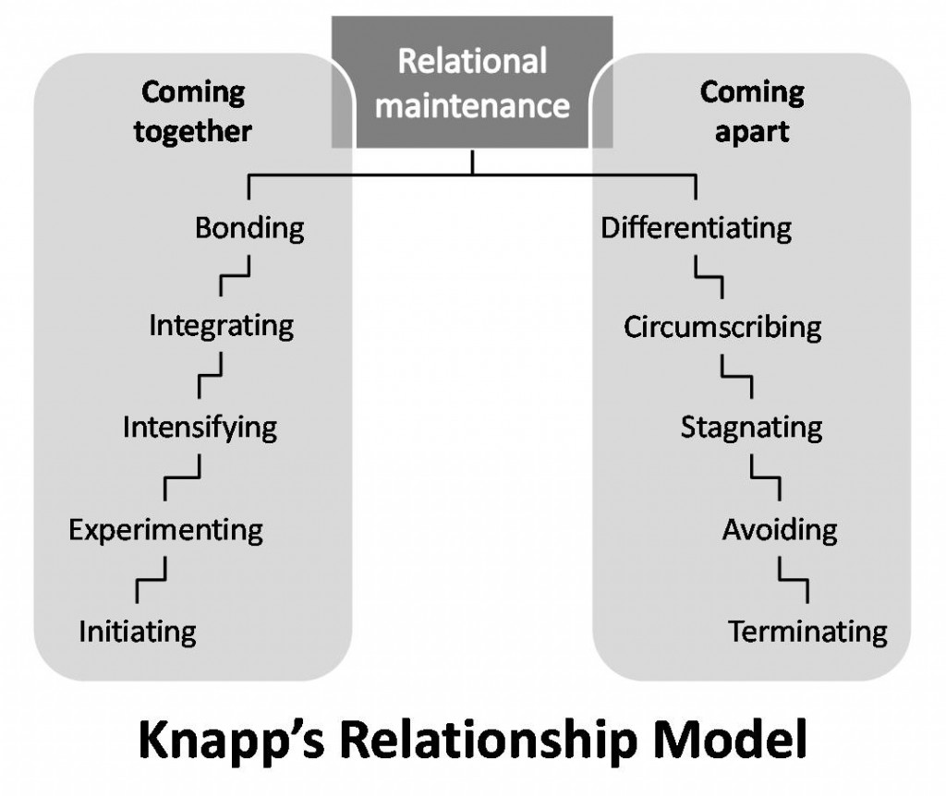
Knapp’s Developmental Model
Source: https://www.communicationtheory.org/knapps-relationship-model/

Slide 23
SELF-DISCLOSURE IN INTERPERSONAL RELATIONSHIPS
Self-disclosure is the process of deliberately revealing information about oneself that is significant and that would not normally be known by others.
Self-disclosure must be deliberate. If you accidentally mentioned to a friend that you were thinking about quitting a job or proposing marriage, that information would not fit into the category we are examining here.
Self-disclosure must also be significant. Revealing relatively trivial information—the fact that you like fudge, for example—does not qualify as self-disclosure.
The third requirement is that the information being revealed would not be known by others.

Slide 24
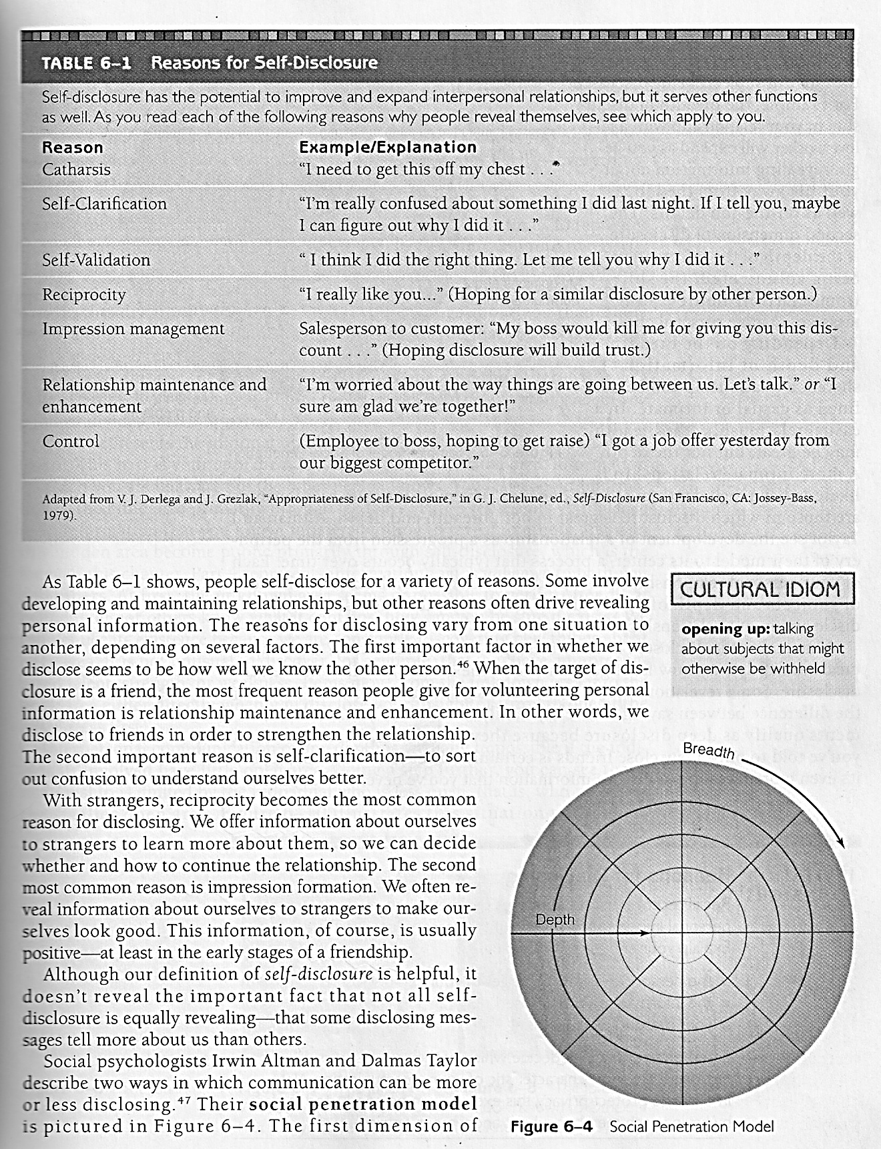
The reasons for disclosing

Slide 25
Models of Self-Disclosure
Over several decades, social scientists have created various models to represent self-disclosure.
Breath and Depth: Social Penetration, Social psychologists Irwin Altman and Dalmas Taylor describe two ways in which communication can be more or less disclosing. The Onion” is one of the most identifiable analogies in Social Penetration Theory. The layers of the onion represent various aspects of a person’s personality. Their social penetration model is pictured in the next slide.
The first dimension of self-disclosure in this model involves the breadth of information volunteered—the range of subjects being discussed. The second dimension of disclosure is the depth of the information being volunteered, the shift from relatively none revealing messages to more personal ones.

Slide 26
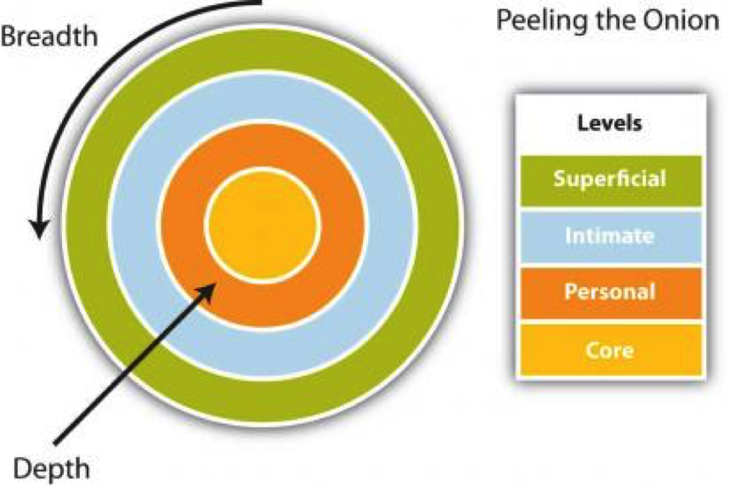
Social Penetration Model source: https://slcc.instructure.com/courses/429441/pages/social-penetration-theory?module_item_id=5082530

Slide 27
The Johari window of Self-disclosure
The Johari window is named after its creators Joseph Luft and Harrington Ingham. The Johari Window offers one way of looking at different aspects of ourselves.
The Johari window can be applied to a variety of interpersonal interactions in order to help us understand what parts of ourselves are open, hidden, blind, and unknown.
To help understand the concept, think of a window with four panes illustrated in the next slide:

Slide 28
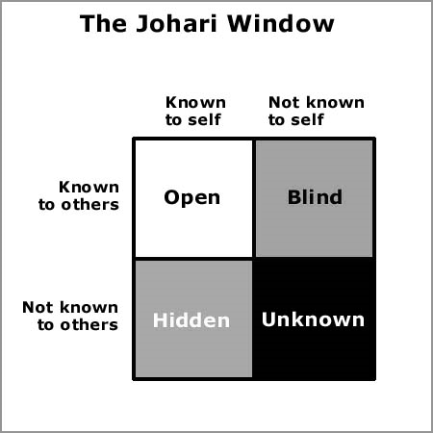
The Johari Window

Slide 29
The Johari Window
The quadrant labeled Open represents the information that we know about ourselves and that also is obvious to others.
The quadrant labeled Hidden represents personal information that is known only to us: our life experiences, our thoughts, feeling, dreams
The quadrant labeled Blind refers to information that others know about us, but that we don’t know about ourselves.
The last quadrants titled Unknown refers to personal information that is known to no one—not even us. It is information that is outside of our awareness but still may affect how we think, feel, and behave.

Slide 30
Guidelines for self-disclosure
There are guidelines for the appropriate expression of self-disclosure.
  Is the other person important to you, and is the contemplated disclosure worth the risk?
  Is the amount and type appropriate and relevant to the situation?
  Will the self-disclosure be reciprocated, understood, and beneficial for both?
Although honesty is desirable, we often are not completely truthful at times of discomfort.
  Altruistic lies are sometimes considered helpful.
  Equivocal language often is used to avoid unpleasantness.
  Hints are more direct but involve relational messages that can be missed.

Slide 31
SUMMARY
Communication fosters interpersonal relationships but there are influences affecting our choices.
Dyadic communication is contextually interpersonal; but treating one another as unique individuals makes it qualitatively interpersonal.
Virtually every verbal statement contains a content message and a relational message.
  Content focuses on the subject, while relational indicates feelings.
  Affinity, respect, immediacy, and control can affect relational messages by adding or subtracting dimensions.
  Metacommunication, the messages we send referring to other messages, involves analysis and should be used carefully.
  A developmental model of the rise and fall of relationships shows how these connections are formed and fall apart.
    Relationships commence with an initial stage and come together via experimenting, intensifying, integrating, and bonding.

Slide 32
SUMMARY
    When the individuals involved seek to reestablish their separate identities, the process of differentiating is occurring. That can lead to circumscribing, stagnating, avoiding, and eventually terminating actions. Then the relationship is over.
  Communicators seek important goals through all relationships in a dialectical model suggesting simultaneous dialectical tensions.
    Managing the dialectical tensions presents challenges. Strategies include denial, disorientation, selection, alternation, segmentation, moderation, reframing, and reaffirmation.
  Our communication is affected by the conflicting drives for intimacy versus distance.
    Intimacy can be simply defined as closeness.
    Women are more willing than men to share their thoughts and feelings.
    Men grow close by doing things together.
    Collectivist and individualistic cultures vary in degrees of self-disclosure and personal familiarity.

Slide 33
SUMMARY
  Self-disclosure is the process of deliberately revealing about oneself information that is significant and would not normally have been known by others.
    Social penetration models of self-disclosure involve breadth and depth.
    The Johari Window model represents self-awareness and the relational quality of knowledge about you from others.
    Self-disclosure is influenced by culture, usually occurs in dyads, is usually symmetrical, occurs incrementally, and is relatively scarce.
  There are guidelines for the appropriate expression of self-disclosure.
    Is the other person important to you, and is the contemplated disclosure worth the risk?
    Is the amount and type appropriate and relevant to the situation?
    Will the self-disclosure be reciprocated, understood, and beneficial for both?
  Although honesty is desirable, we often are not completely truthful at times of discomfort.
    Altruistic lies are sometimes considered helpful.
    Equivocal language often is used to avoid unpleasantness.
    Hints are more direct but involve relational messages that can be missed.

Slide 34
THANK YOU
LECTURE 3
THE MAIN SOURCES OF REFERENCES: Adler, R.B. & Rodman, G. 2006. Understanding human communication. 9th edition. London: Oxford University Press.
Lucas, Stephen E. The Art of Public Speaking. 9th Edition. McGraw Hill, 2004.
Adler, R.B., Rodmann, G. and Hutchinson, C.C. (2011) global.uop.com Understanding human communication.11th edition. London: Oxford University Press. https://global.oup.com/us/companion.websites/9780199747382/student/chapter4/

