Slide 1
Principles of Advertising
Introduction to Advertising
LECTURE 1 BY DR. RAPHAEL OGUTU,
Mass Communication Department,
AFRICA NAZARENE UNIVERSITY.
THE MAIN SOURCE OF REFERENCE: Advertising & IMC: Principles and Practice., Moriarty, Sandra Mitchell, Nancy D and Wells, William D. 14th edition. Pearson Prentice Hall Inc., 2009.

Slide 2
Course Description
Discussion of the syllabus
  This course aims to build student knowledge in the discipline of advertising locally, regionally and globally.
  It introduces basic techniques of advertising, marketing, & copywriting for both electronic and print media students.
  It introduces the role of advertisement in the economic, social, communication, and marketing structure;
  Exposes students to a basic understanding of the advertising industry. Student will gain knowledge on how media and internet plays a key role as channels of communication, branding, and publicity for newspapers, magazines, radio, internet and television.

Slide 3
Course Goals and Objectives
1. Show an understanding of the theory, principles and function of advertising; and the basic principles that guides its practitioners in the market.
2. Analyze the role of advertisement in the economic, social and marketing structure; Have a basic understanding of the advertising industry locally, regionally and globally.
3. Understand advertisement design for newspapers, magazines, radio, internet and television; apply basic communication theories and concepts for commercial advertising purposes.
4. Critic the basic structure of an advertising agency, how each functional department contributes to the final communication piece, the strengths and limitations of an advertisement/advertising campaign.

Slide 4
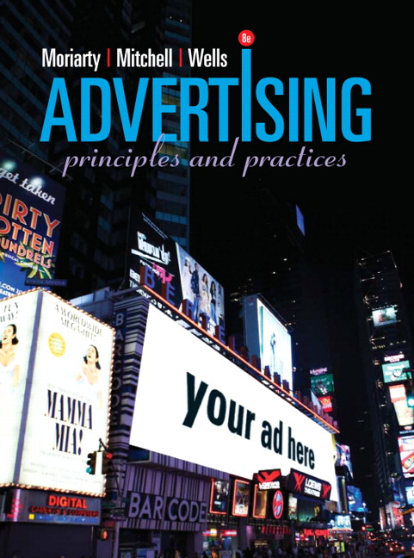
Introduction, principles and function of advertising
Learning Outcomes
At the end of the course, the you should be able to:
• Understand the concepts about Introduction to Principles of Advertising.
• Explain the mandate for effectiveness
• Apply what makes an ad effective
• Analyze the world of advertising

Slide 5
The World of Advertising
Advertising defined:
The American Marketing Association defines advertising as any paid form of non-personal presentation and promotion of ideas, goods or services by an identified sponsor.
A complex form of communication using objectives and strategies to impact consumer thoughts, feelings, and actions.
A form of marketing communication (all the techniques marketers use to reach their customers and deliver their messages).
Advertising is simply a way to sell a product

Slide 6
Defining Modern Advertising
WHAT IS ADVERTISING?
What is Advertising?
The Evolution of Advertising
Identification
  Simple images found in ancient Babylonia, Egypt, Greece, and Rome identified a business, manufacturer, or store.
Information
  Gutenberg’s movable type mechanized printing leading to mass communication.
Promotion
  The Industrial Revolution led to surplus goods, improved transportation, and the need for new media.
Sales
  Advertisers became concerned about making ads that worked and defining standards of effective advertising. (Moriarty, Mitchell and Wells, 2009).

Slide 7
Defining Modern Advertising
Advertising:
is a paid form of persuasive communication that uses mass and interactive media to reach broad audiences in order to connect an identified sponsor with buyers (a target audience) and provide information about products (goods, services, and ideas). (Moriarty, Mitchell and Wells, 2009. P55).

Slide 8
Defining Modern Advertising
Five Basic Factors of Advertising
Paid communication but some forms of advertising such as Public Service Announcements (PSA) use donated space and time.
Sponsor is identified
Tries to inform or persuade
Reaches a large audience
Message conveyed through many different kinds of largely nonpersonal mass media (Moriarty, Mitchell and Wells, 2009).
Principle:
An effective advertisement is one that can be proven to meet its objectives.

Slide 9
The mandate for effectiveness
Advertising can cause you to:
  stop and watch, or even stop and think.
  laugh, or squirm in your seat, or bring tears to your eyes.
  be inspired to read about a new product or remember a favourite brand when you are walking down the aisle in a super market.
  change the channel or turn a page without being aware of having seen the ad at all.
  The effectiveness of any business depends on how well its advertising works. It must deliver the intended message, connect with customers, and create impact with creative messages that are attention getting and memorable

Slide 10
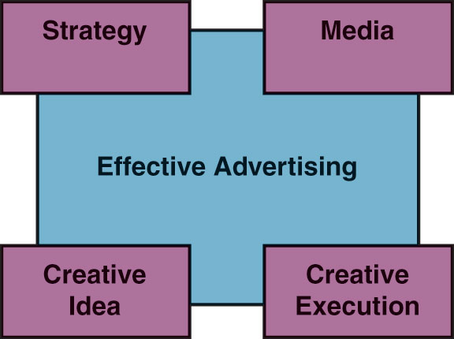
Four Components of Effective Advertising
Source: Moriarty, Mitchell and Wells, (2009)

Slide 11

Advertising Strategy
The strategy is the logic and planning behind the ad that gives it direction.
Advertisers develop ads to meet objectives.
Advertisers direct ads to identified audiences.
Advertisers create a message that speaks to the audience’s concerns.
Advertisers run ads in the most effective media.
Example: Ipod and VW united ad campaign.
Source: Moriarty, Mitchell and Wells, (2009)

Slide 12
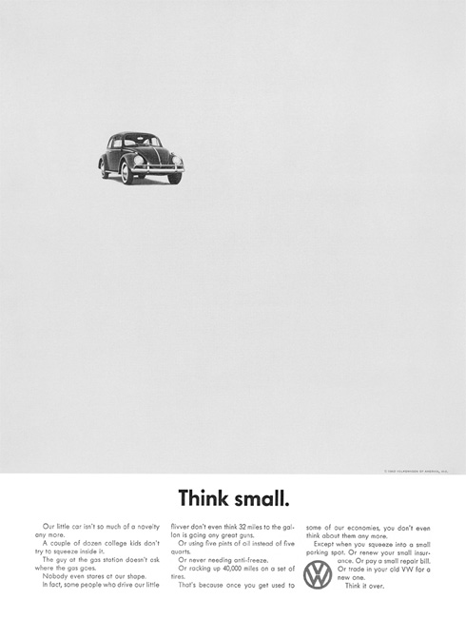
Advertising Creative Idea
The creative concept is the central idea that grabs the consumer’s attention and sticks in memory.
Planning strategy requires creative problem solving.
Research involves creativity.
Buying and placing ads requires creative thinking.
Source: Moriarty, Mitchell and Wells, (2009)

Slide 13

Advertising Creative Execution
Effective ads are well executed reflecting the highest production values in the industry.
Clients demand the best production the budget allows.
Source: Moriarty, Mitchell and Wells, (2009)

Slide 14

Advertising Media Planning/Buying
Television, Internet, magazines, and other media are used to reach a broad audience.
Deciding how to deliver the message requires creativity.
Principle:
In advertising how you say something and where you say it is just as important as what you say.
Source: Moriarty, Mitchell and Wells, (2009)

Slide 15
Roles of Advertising
The Marketing Role
Marketing is satisfying customer wants and needs by providing products (goods, services, and ideas).
The marketing department is responsible for selling the product using the 4 Ps (product, price, place/distribution, and promotion) and brand development. NOTE: Today we have 7Ps.
The Communication Role
Advertising is a message to a consumer about a product, designed to create a response.
It is also a form of marketing communication.
Advertising uses mass communication to transmit product information to connect buyers and sellers in them marketplace.

Slide 16

Roles of Advertising
3. The Economic Role
Because it reaches large groups of people, advertising makes marketing more cost-efficient and lowers prices for consumers.
Advertising creates a demand for a brand using hard sell (persuading) and soft sell (image building) techniques.
4. The Societal Role
Informs consumers about innovations and issues
Helps us compare products and features
Mirrors fashion and design trends
Teaches consumers about new products and how to use them
Helps shape consumer self-image
Facilitates self-expression through purchases
Presents images about diversity in our world

Slide 17
Strengths of Advertising
Strengths
Can reach a large audience
Introduces products and brands
Builds awareness of products
and brands
Creates brand images
Provides information
Reminds and reinforces
Persuades
Source: Moriarty, Mitchell and Wells, (2009)
Examples
A commercial in the Super Bowl can reach more than 100 million consumers.
The “1984” commercial for the Apple McIntosh sold out the entire inventory in one day.
The success of the launch of the iPod was due in part to the great silhouette posters that showed people dancing to the music on their iPods.
The success of the new VW Beetle was largely built on its ability to connect with the anti-status image of the original “lowly” Beetle.
The truth® campaign informs teens that “Tobacco kills 1,200 people a day.”
Procter & Gamble’s Ivory Soap has been advertised continuously since the late 1800s.
Nike campaigns, with the “Just do it” personal achievement message, have helped increase sales by 300 percent during the 1990s.

Slide 18

Types of Advertising
Brand Advertising
Focused on long-term brand identity and image
Retail or Local Advertising
Focused on selling merchandise in a geographical area
Direct Response Advertising
Tries to stimulate a sale directly
Business-to-Business
Sent from one business to another
Principle:
All types of advertising demand creative, original
messages that are strategically sound and well executed.

Slide 19

Types of Advertising
Institutional Advertising
Focused on establishing a corporate identity or winning the public over to the organization’s point of view
Service Advertising
Usually produced and run for free on behalf of a good cause
Directory advertising: used by people to find how to buy a product or service Public

Slide 20
Types of Advertising
Political Advertising
  Politicians - vote for them or their ideas
–Interactive advertising: delivered to individual consumers who have access to a computer and the Internet
-Nonprofit Advertising. Advertisements for non-profit organizations such as Charities, foundations, associations, hospitals, museums and religious institutions, they are directed to their members, customers and volunteers, as well as for donations and other forms of program participation.
Moriarty, Mitchell and Wells, (2009)

Slide 21

REVIEW QUESTIONS
The case study of Pods unite advertisement.
What is the standard definition of advertising?
A modern definition, then, would be: Advertising is paid persuasive communication that uses nonpersonal mass media—as well as other forms of interactive communication—to reach broad audiences and to connect an identified sponsor with a target audience.

Slide 22
REVIEW QUESTIONS
The case study of Pods unite advertisement.
Advertising plays four general roles in society. Define and explain each one.
• Advertising Strategy: Strategy is the logic and planning behind the advertisement that gives it direction and focus. Every effective ad implements a sound strategy.
The advertiser develops the ad to meet specific objectives, carefully directs it to a certain audience, creates its message to speak to that audience’s most important concerns, and runs it in media (print, broadcast, or the Internet, for instance) that will reach its audience most effectively.

Slide 23
REVIEW QUESTIONS
The case study of Pods unite advertisement.
Creative Idea: The creative concept is the ad’s central idea that grabs your attention and sticks in your memory.
The “Pods Unite” campaign for VW connects two innovative products in a way that relates to the emotional connection Volkswagen owners have with their cars.
The word creative describes a critical aspect of advertising that drives the entire field of advertising.
Planning the strategy calls for imaginative problem solving: The research efforts need to be creative, and the buying and placing of ads in the media require creative thinking.

Slide 24
REVIEW QUESTIONS
The case study of Pods unite advertisement.
Creative Execution: Effective ads are also well executed.
That means that the details, the photography, the writing, the acting, the setting, the printing, and the way the product is depicted all reflect the highest production values available to the industry.
Advertising often sets the standard or establishes the cutting edge for printing, broadcasting, and Internet design because clients demand the best production their budgets allow.
The “Pods Unite” campaign for VW has employed great printing techniques.

Slide 25
REVIEW QUESTIONS
The case study of Pods unite advertisement.
Creative Media: Every message has to be delivered somehow. Most advertisers use media that reach a broad audience, such as television, magazines, or the Internet.
Deciding how to deliver the message sometimes can be just as creative as coming up with the big idea for the message, a point we’ll discuss more in future class engagements.
The “Pods Unite” campaign for VW has employed media, which could be newspapers, magazines, brochures, outdoor billboards or even branded transit means.

Slide 26
REVIEW QUESTIONS
The case study of Pods unite advertisement.
What social role does the VW advertising play?
VW advertising has a number of social roles. It informs us about new and improved products, helps us compare products and features, and generally keeps us informed about innovations and issues.
It also mirrors fashion and design trends and add to our aesthetic sense.
It has an educational role in that it teaches about new products and how to use them.
It helps us shape an image of ourselves by setting up role models that we can identify with, and it gives us a way to express ourselves in terms of our personalities and sense of style through the things we wear and use.

Slide 27
REVIEW QUESTIONS
The case study of Pods unite advertisement.
  Explain what advertisers hope to accomplish when they use advertising.
  Describe the seven key functions advertising performs for VW.
  • Builds awareness of products and brands
  • Creates a brand image
  • Provides product and brand information
  • Persuades people
  • Provides incentives to take action
  • Provides brand reminders
  • Reinforces past purchases and brand experiences

Slide 28
REVIEW QUESTIONS
The case study of Pods unite advertisement.
What do the terms advertiser, client, and account refer to?
The advertiser is the person or organization that uses advertising to send out a message about its products.
The advertiser becomes the agency’s client. As the client, the advertiser is responsible for monitoring the work and paying the bills for the agency’s work on its account.
That use of the word account is the reason agency people refer to the advertiser as “the account” and the agency person in charge of that advertiser’s business as “the account manager.

Slide 29
REVIEW QUESTIONS
The case study of Pods unite advertisement.
Why does an advertiser use an outside agency?
An advertiser uses an outside agency because it believes the agency will be more efficient in creating an advertisement or a complete campaign than the advertiser would be on its own.

Slide 30
REVIEW QUESTIONS
The case study of Pods unite advertisement.
What is the difference between an advertising department and an in-house agency?
Most large businesses have advertising departments. Their primary responsibility is to act as a liaison between the marketing department and the advertising agency (or agencies) and other vendors. Companies that need closer control over their advertising have their own in-house agencies. An in-house agency performs most, and sometimes all, of the functions of an outside advertising agency.

Slide 31
REVIEW QUESTIONS
The case study of Pods unite advertisement.
Define target audience.
All advertising strategy starts with the identification of the customer or prospective customer that is the audience who are the desired audience for the advertising message. This is called the target audience.
How do we recognize when an ad is effective?
In general, an ad or campaign works if it creates an impression for a product or brand, influences people to respond in some way, and separates the product or brand from the competition in the mind of the customer.

Slide 32
REVIEW QUESTIONS
What do we mean by the “new” advertising?
New advertising is more personal and interactive and more likely to employ creative new uses of communication opportunities beyond the traditional mass media (Radio, television, newspapers, magazines, transit, billboards etc).
Electronic media are making advertising more intimate, interactive, and personalized. Advertising must evolve to keep up with technology.
Creativity involves more than just the ad’s big idea, but finding new ways to engage consumers beyond traditional mass media.

Slide 33
REVIEW QUESTIONS
Explain why the localization vs. globalization debate is important for advertisers.
Advertisers must decide whether to practice global or local advertising: They must decide if they should standardize ads or advertising strategies across all cultures or adapt their strategies to local markets. In addition, they must decide how much consistency the brand and its advertising need to maintain as it moves across borders.

Slide 34
SUMMARY
Advertising is a form of communication used to encourage or persuade an audience (viewers, readers or listeners; sometimes a specific group of people) to continue or take some new action. Most commonly, the desired result is to drive consumer behaviour with respect to a commercial offering, although political and ideological advertising is also common.
The purpose of advertising may also be to reassure employees or shareholders that a company is viable or successful. Advertising messages are usually paid for by sponsors and viewed via various traditional media; including mass media such as newspaper, magazines, television commercial, radio advertisement, outdoor advertising or direct mail; or new media such as blogs, websites or text messages.

Slide 35
Commercial advertisers often seek to generate increased consumption of their products or services through "branding," which involves the repetition of an image or product name in an effort to associate certain qualities with the brand in the minds of consumers.
Non-commercial advertisers who spend money to advertise items other than a consumer product or service include political parties, interest groups, religious organizations and governmental agencies.
Nonprofit organizations may rely on free modes of persuasion, such as a public service announcement (PSA).

Slide 36
THANK YOU
LECTURE 1 BY DR. RAPHAEL OGUTU,
Mass Communication Department,
AFRICA NAZARENE UNIVERSITY.
THE MAIN SOURCE OF REFERENCE: Advertising & IMC: Principles and Practice., Moriarty, Sandra Mitchell, Nancy D and Wells, William D. 14th edition. Pearson Prentice Hall Inc., 2009.

