Slide 1
Principles of Advertising
The players, structure, and evolution of advertising
LECTURE 2 BY DR. RAPHAEL OGUTU,
Mass Communication Department,
AFRICA NAZARENE UNIVERSITY.
THE MAIN SOURCE OF REFERENCE: Advertising & IMC: Principles and Practice., Moriarty, Sandra Mitchell, Nancy D and Wells, William D. 14th edition. Pearson Prentice Hall Inc., 2009.
Contemporary Advertising and integrated marketing communications. Arens, William. F., Weigold, Michael. F., and Arens, Christian.. 13th Ed. McGraw Hill Higher Education. 2011

Slide 2
Course Goals and Objectives
The lesson will address classifications of advertising, development or evolution of advertising and the five main key players in the advertising industry.
At the end of this week, students should be able to…
Know other classifications of advertising
Distinguish it from other forms of marketing communications
Trace the evolution of advertising
Analyze the roles of the key players in this industry.

Slide 3
Classification of advertising
An effective advertising specialist must have a broad understanding of the whole marketing process in order to know what type of advertising to use in a given situation.
Companies and organizations use many different types of advertising, depending on their particular marketing strategy.
The marketing strategy will determine who the targets of advertising should be, where ads should appear, what media should be used, and what advertising should accomplish.
(Arens, William, and Arens, 2011).

Slide 4
Classification of advertising
By Target Audience
Consumer advertising: Aimed at people who buy the product for their own or someone else’s use.
Most of the advertising we see in the mass media—TV, radio, newspapers, and magazines—falls under the broad category of consumer advertising .
Usually sponsored by the producer (or manufacturer) of the product or service, these ads are typically directed at consumers , people who buy the product for their own or someone else’s personal use.
Business advertising: Aimed at people who buy or specify products and services for use in business.
Since business advertising (also called business-to-business , or B2B , advertising ) rarely uses consumer mass media, it is typically invisible to consumers.

Slide 5
Classification of advertising
By Target Audience
?
Business Advertising
However, some business-to-business ads, by computer manufacturers or firms such as FedEx, do appear on TV and in consumer magazines.
In addition to general business advertising, there are three specialized types of business advertising: trade, professional, and agricultural.
• Trade: Aimed at wholesalers and retailers of products and services who buy for resale to their customers.
• Professional: Aimed at people licensed under a code of ethics or set of professional standards.
• Agricultural: Aimed at people in farming
or agribusiness.
(Arens, William, and Arens, 2011).

Slide 6
Classification of advertising
By Geographic Area
The third element of marketing strategy, distribution, also affects the type of advertising used. Global marketers such as Coca-Cola, Toyota, and Kodak may use global advertising , in which messages are consistent in ads placed around the world.
Local (retail) advertising: Advertising by businesses whose customers come from only one city or local trading area.
Regional advertising: Advertising for products sold in one area or region but not the entire country.
National advertising: Advertising aimed at customers in several regions of the country.
International advertising: Advertising directed at foreign markets.

Slide 7
Classification of advertising
By Medium
Print advertising: Newspapers, magazines.
Broadcast (electronic) advertising: Radio, TV.
Out-of-home advertising: Outdoor, transit.
Direct-mail advertising: Advertising sent
through the Postal Service and by e-mail.
Interactive advertising: Internet, kiosks, etc.
(Moriarty, Mitchell and Wells, 2009).
(Arens, William, and Arens, 2011).
Principle:
In advertising how you say something and where you say it is just as important as what you say.

Slide 8
Classification of advertising
By Purpose
Advertising can be defined on the basis of the sponsor’s objectives:
Product advertising: Promotes the sale of products and services.
Nonproduct (corporate or institutional) advertising: Promotes the organization’s mission or philosophy rather than a specific product.
Commercial advertising: Promotes products, services, or ideas with the expectation of making a profit.

Slide 9
Classification of advertising
By Purpose
Noncommercial advertising: Sponsored by or for a charitable or nonprofit institution, civic group, or religious or political organization.
Action advertising: Attempts to stimulate immediate action by the reader.
Awareness advertising: Attempts to build the image of a product or familiarity with the product’s name and package.
Source: Arens, William, and Arens (2011).

Slide 10
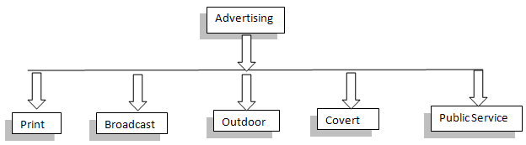
Classification of advertising PERSPECTIVE II
There are several branches or types of advertising which can be used by the companies
SOURCE: Classification of Advertising (managementstudyguide.com)

Slide 11
Print Advertising
The newspapers and magazines are quite popular modes of advertising for different companies all over the world.
Companies can also promote their products through brochures and fliers.
The newspaper and magazines sell the advertising space and the cost depends on several factors.
The quantity of space, the page of the publication, and the type of paper decide the cost of the advertisement.
So an ad on the front page would be costlier than on inside pages.
Similarly an ad in the glossy supplement of the paper would be more expensive than in a mediocre quality paper.

Slide 12
Broadcast advertising
It consists of television, radio, or Internet advertising. The ads on the television have a large audience and are very popular.
The cost of the advertisement depends on the length of the ad and the time at which the ad would be appearing. For example, the prime time ads would be more costly than the regular ones.
Radio advertising is not what it used to be after the advent of television and Internet, but still there is specific audience for the radio ads too.
The radio jingles are quite popular in sections of society and help to sell the products.

Slide 13
Outdoor Advertising
The billboards, kiosks, and events and tradeshows are an effective way to convey the message of the company.
The billboards are present all around the city but the content should be such that it attracts the attention of the customer.
The kiosks are an easy outlet of the products and serve as information outlets for the people too.
Organizing events such as trade fairs and exhibitions for promotion of the product or service also in a way advertises the product.

Slide 14
Covert and Public Service Advertising
Covert is a unique way of advertising in which the product or the message is subtly included in a movie or TV serial.
This practice is most-commonly found in films. For example, billboards of the products may be shown in the film for a prolonged period of time.
Or a character in the film may mention the name of the brand again and again.
At other times the director may present the product as an integral part of the film.
For example, the cars featured in several action flicks. Remember the Cadillac in Matrix Reloaded and BMWs in James Bond movies.

Slide 15
Public Service Advertising
public service advertising aims at spreading awareness about issues that are relevant to public interest.
Such ads may quote a political viewpoint, a philosophy, or a religious concept.
Most of the PSA ads use celebrities in order to gain attention.
Such humanitarian ads are usually broadcasted on the radio or television, though they can also appear in newspapers and magazines.
A PSA or Public Service Announcement is aimed to alter public attitudes on issues ranging from health, safety, and conservation.

Slide 16
Integrating Marketing Communications
Integrated marketing provides an opportunity to improve the precision and effectiveness of marketing programmes by handling all aspects of marketing through a single source.
An integrated marketing solution uses the most appropriate media and communications techniques to achieve marketing objectives.
Integrated marketing provides many important business benefits, including creative integrity, consistency of messages, unbiased marketing recommendations, better use of communications media, greater marketing precision, improved operational efficiency and cost savings.
There is a risk, and it is important to review its potential and implications through a pilot project or test campaign before committing to a single source solution.
looking closely at internal structures and selecting the right agency are important stages in a successful transition to integrated marketing.
Source: The Practice of Advertising, Mackay, Adrian R. 5th Edition, Elsevier Butterworth-Heinemann. 2005

Slide 17
Integrating Marketing Communications
The result has been a growing understanding on the part of corporate management that:
(1) The efficiencies of mass media advertising are not what they used to be;
(2) Consumers are more sophisticated, cynical, and distrusting than ever before;
(3) Tremendous gaps exist between what companies say in their advertising and what they actually do; and
(4) In the long run, nourishing good customer relationships is far more important than making simple exchanges.
Source: Moriarty, Mitchell and Wells, (2009)

Slide 18
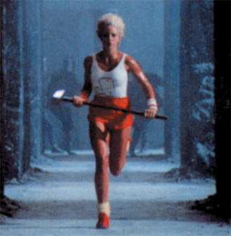
The Key Players
Advertising industry is complex and made of different organizations that are interrelated, and these are:
The advertiser
The agency
Media
Suppliers
Target audience

Slide 19
The Key Players: the Advertiser
Person or organization that Wants to send out a message about its business
Initiates effort by identifying a problem that advertising can solve
Selects the target audience, sets the budget, and approves the ad plan
Hires the agency
  Agency of record (AOR) does the most business; manages other agencies

Slide 20
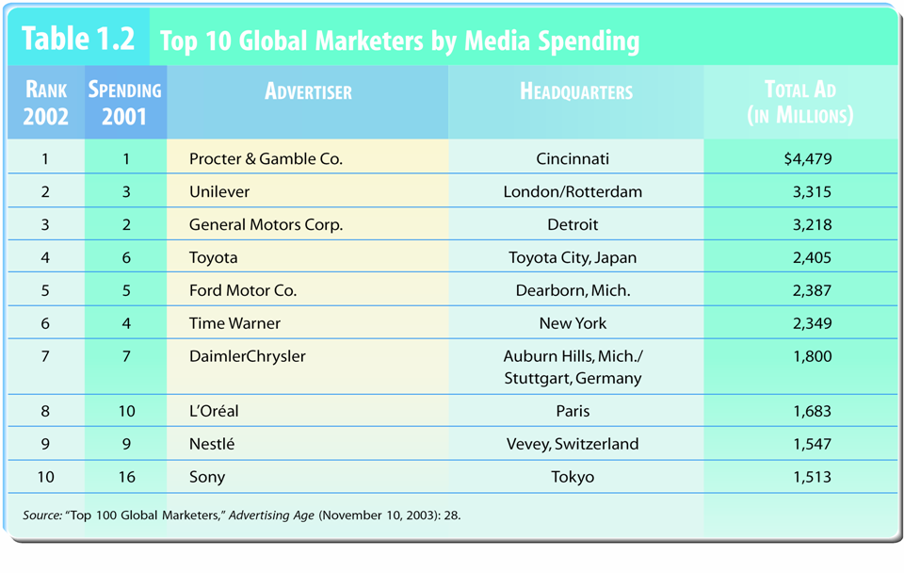
The Key Players: the Advertiser

Slide 21
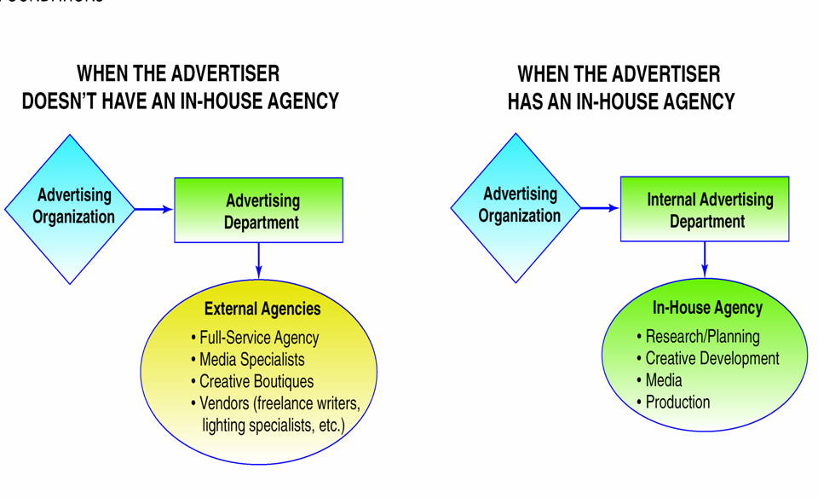
Key Players: Agency
Agencies have the strategic and creative expertise, media knowledge, talent, and negotiating abilities to operate more efficiently than the advertiser.
Some large advertisers have in-house departments.

Slide 22
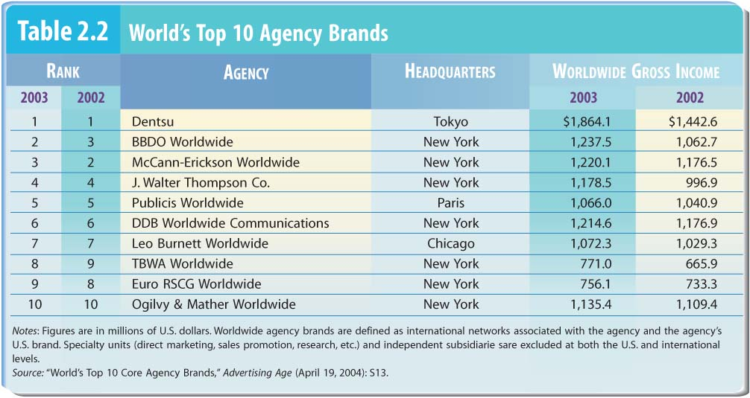
Key Players: Agency

Slide 23
Key Players: Media
Channels of communication - carry message from advertiser to audience
Internet - from audience back to advertiser : interactive media.
Mass media – traditional mass media are Print and broadcast that reach mass audience
Media - channels of communication or media vehicles - companies

Slide 24
Key Players: Suppliers or Vendors
  Group of service organizations that assist advertisers, ad agencies & media to create & place ads
  Array of suppliers mirrors - variety of tasks - put together ad
  These are Artists, writers, photographers, directors, producers, printers, freelancers, and consultants
  Why hire a vendor?
    Advertisers - no expertise in area
    May be overloaded
    Want fresh perspective
    Cheaper than services of someone in-house

Slide 25
Key Players: Target Audiences
Customer or prospective ones : People to whom an ad is directed—their responses determine if advertising is effective.
Targeting is the process of identifying the people in the desired audience.
Interactive technology allows ads to be customized to the target audience’s individual needs-important to know target audience & create ads that speak to individual needs
  Character of target audience - direct bearing on overall advertising strategy
  Purchasers - not always product users
  Critical - recognize & know well - target audiences
  Interactive technology - ads customized to individuals

Slide 26
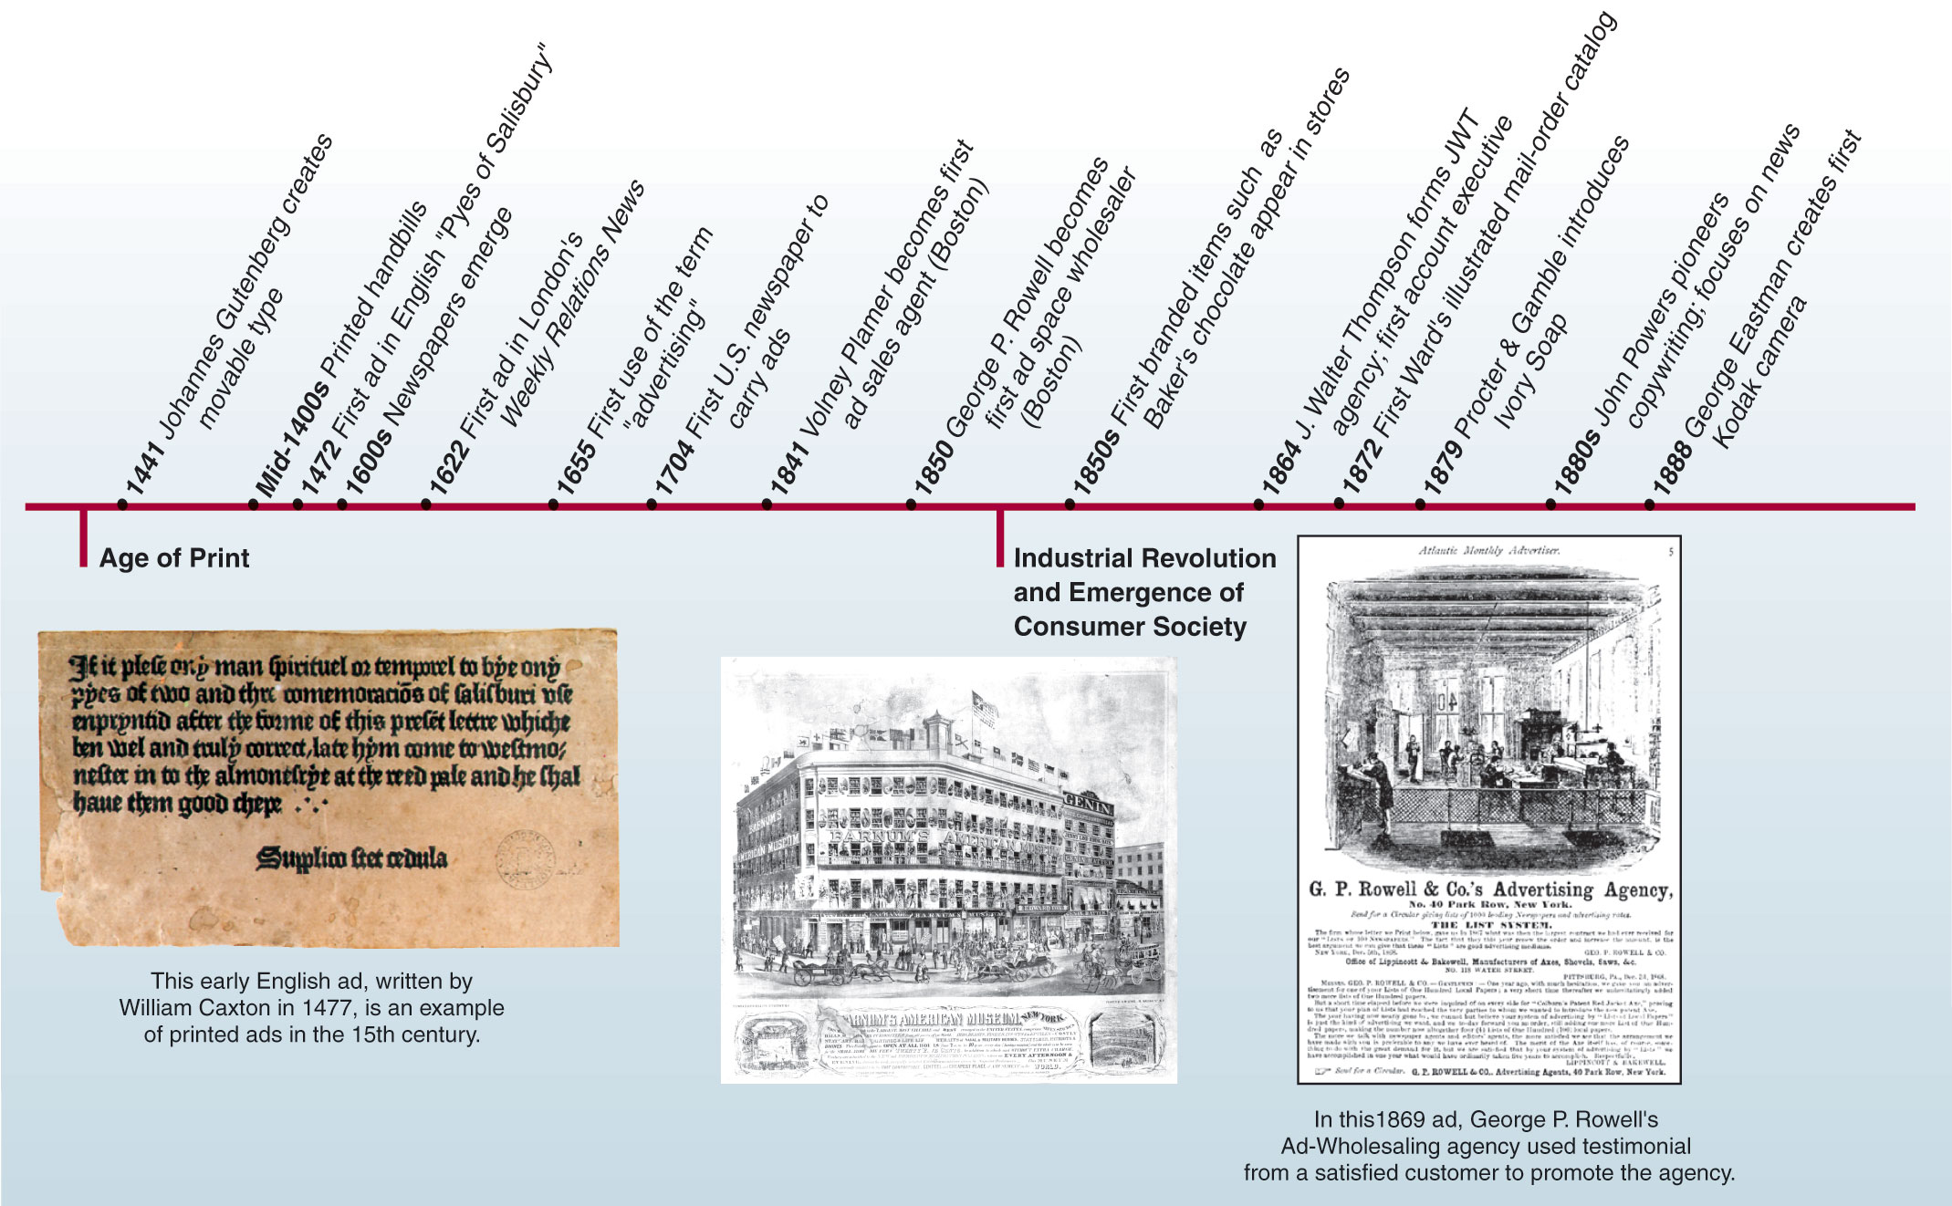
The Development of Advertising

Slide 27
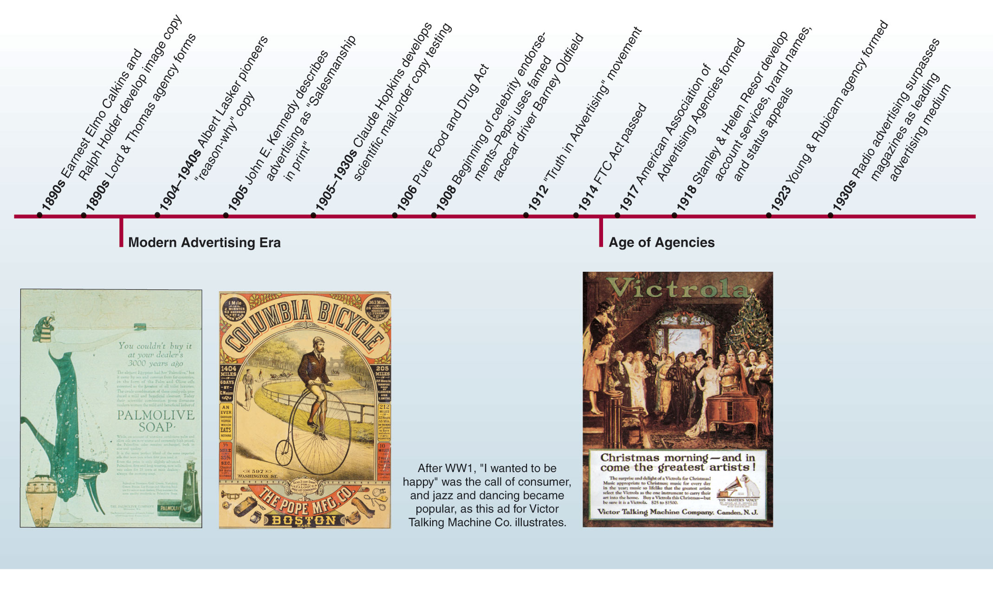
The Development of Advertising

Slide 28
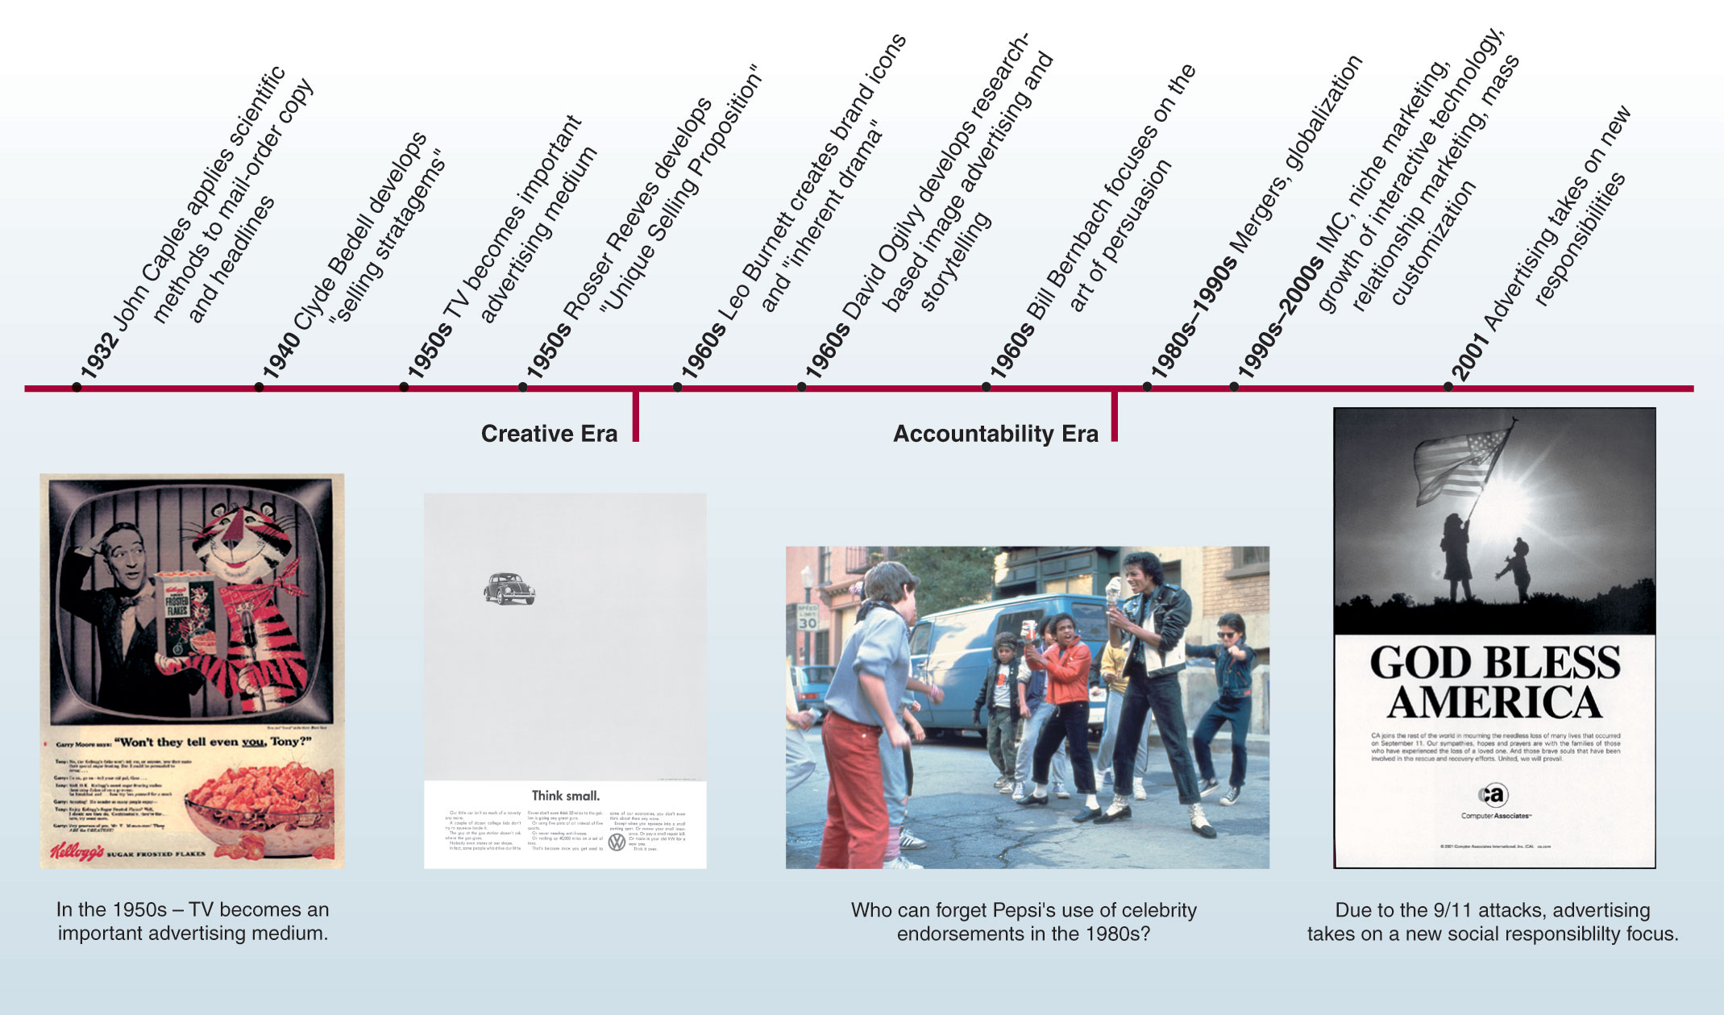
The Development of Advertising

Slide 29
Current Developments
The New Advertising
Electronic media are making advertising more intimate, interactive, and personalized.
Advertising must evolve to keep up with technology.
Creativity involves more than just the ad’s big idea, but finding new ways to engage consumers beyond traditional mass media.

Slide 30
Current Developments
Interactivity
Buzz is getting people to talk about the event, idea or brand.
People contact companies by phone, the Internet, and through friends.
Advertising must change to also become more interactive.

Slide 31
Current Developments
Integrated Marketing Communication (IMC)
IMC means unifying all marketing communication messages and tools to send a consistent, persuasive message promoting the brand’s goals.
Stakeholders are also important in IMC.
Synergy means messages have more impact working jointly than on their own.

Slide 32
Current Developments
Globalization
The elimination of trade barriers in the 1990s opened huge international markets.
Agencies are forming multinational operations to to address these markets.
Should advertisers practice local or global advertising?
Video Snippet
Harley-Davidson talks about the foundation of a global marketing strategy.

Slide 33
SUMMARY
We have seen:
● classifications of advertising, development or evolution of advertising and the five main key players in the advertising industry.
● that looking closely at internal structures and selecting the right agency are important stages in a successful transition to integrated marketing.
How integrated marketing provides many important business benefits, including creative integrity, consistency of messages, unbiased marketing recommendations, better use of communications media, greater marketing precision, improved operational efficiency and cost savings.
The New Advertising: Electronic media are making advertising more intimate, interactive, and personalized.

Slide 34
THANK YOU
LECTURE 2 BY DR. RAPHAEL OGUTU,
Mass Communication Department,
AFRICA NAZARENE UNIVERSITY.
THE MAIN SOURCE OF REFERENCE: Advertising & IMC: Principles and Practice., Moriarty, Sandra Mitchell, Nancy D and Wells, William D. 14th edition. Pearson Prentice Hall Inc., 2009.
Contemporary Advertising and integrated marketing communications. Arens, William. F., Weigold, Michael. F., and Arens, Christian.. 13th Ed. McGraw Hill Higher Education. 2011

