Slide 1
Principles of Advertising
Advertising ‘s Role in Marketing: Part I
LECTURE 3 BY DR. RAPHAEL OGUTU,
Mass Communication Department,
AFRICA NAZARENE UNIVERSITY.
THE MAIN SOURCE OF REFERENCE: Advertising & IMC: Principles and Practice., Moriarty, Sandra Mitchell, Nancy D and Wells, William D. 14th edition. Pearson Prentice Hall Inc., 2009.

Slide 2
Course Goals and Objectives
At the end of this class the student should be able to explain and discuss:
Define the role of advertising in marketing
Explain how the four key concepts in marketing relate to advertising
Identify the key players in marketing and how the organization of the industry affects advertising
Discuss the old and new marketing mix and how advertising fits in.

Slide 3
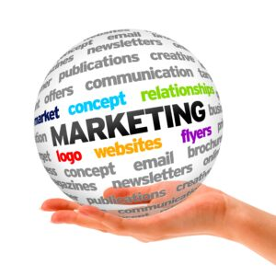
What is marketing?
What is Marketing?
The way a product is designed, tested, produced, branded, packaged, priced, distributed, and promoted.
“An organizational function and a set of processes for creating, communicating, and delivering value to customers and for managing customer relationships in ways that benefit the organization and its stakeholders.”—American Marketing Association
(Moriarty, Mitchell and Wells, 2009)

Slide 4
Key Concepts in Marketing
The Key concepts in Marketing include the following:
The Marketing Concept: Focus on consumers
Exchange
Differentiation & Competitive Advantage
Added Value
Branding

Slide 5
Key Concepts:
The Marketing Concept
Marketing should focus first on identifying the needs and wants of the consumer, rather than building products the consumer may not want.
To compete effectively, marketers must focus on the customers’ problems and try to develop products to solve them
Two steps of the marketing concept:
  Determine customer needs and wants through research.
  Develop, manufacture, market, and service goods that fill those needs and wants—solve customers’ problems.

Slide 6
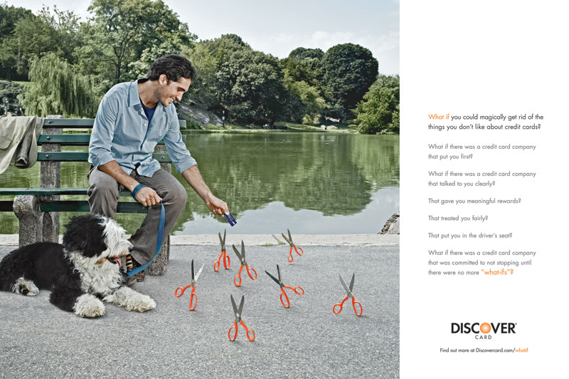
Example of Consumer-First Approach
Do you think this is a believable ad?
Does it ring true to you?
Do you think it works to attract new customers to the Discover card?
focus first on identifying the needs and wants of the customer rather than on finding ways to build and sell products those consumers may or may not want.
(Moriarty, Mitchell and Wells, 2009).
Principle:
An company that operates with a marketing concept philosophy focuses on satisfying its customers’ needs and wants.
(Moriarty, Mitchell and Wells, 2009)

Slide 7
Exchange
Exchange
Exchange is the act of trading a product or service for something of value (money) Money is exchanged for goods or services. Demand, however, drives the exchange.
Two types of exchange: economic and communication; information (facts, ideas, and brand image cues) and the opportunity for customer-company interaction.
Money
Goods
Money
Goods

Slide 8
Differentiation & Competitive Advantage
A brand’s competitive advantage is where it’s different from its competitors and superior in some way.
In marketing, this concept is called differentiation.
  Price
  Design
  Performance
  distribution
  Brand image
  Reliability
(Moriarty, Mitchell and Wells, 2009).

Slide 9
Added Value
Added value is a marketing or advertising activity that makes the product more valuable, useful or appealing to consumers.
Other ways to add value:
  More convenient to buy
  Lower price
  More useful features
  Higher quality
  Status symbol
  More knowledgeable employees

Slide 10
Branding
Branding is the way marketers create a special meaning for a product.
Branding transforms by creating an emotional connection between consumers and their favorite brands such as Mercedes-Benz, Coke or Pepsi, Safaricom, etc.
Brand image is based on communication and on the consumer’s personal experiences with the product.
Brand Equity refers to the financial value based on the reputation and meaning the brand name has acquired over time.
Principle:
Effective branding transforms a product by creating a special meaning based on an emotional connection.
Source: Moriarty, Mitchell and Wells, (2009)

Slide 11
Types of Markets
The market originally meant the place where the exchange between buyer and seller takes place.
Today we speak of a market not only as a place, but also as a particular type of buyer- for example, the youth market or the motorcycle market etc.
Market share is the percentage of the total market in a product category that buys a particular brand
Source: Moriarty, Mitchell and Wells, (2009)

Slide 12
Types of Markets
Consumer Markets
  Those who buy products or services for personal use.
Business-to-Business Markets
  Companies that buy products or services to use in their own business or to make products.
Institutional Markets
  Nonprofits such as hospitals, governments, schools that provide goods and services for the benefit of society.
Channel Markets
  Resellers and intermediaries who buy finished or semi-finished products and resell them for a profit.
Source: Moriarty, Mitchell and Wells, (2009)

Slide 13
The Marketing Plan
Steps in the Marketing Process
The research process helps marketers make a set of key strategic and tactical decisions that guide the deployment of the marketing mix.
Research the consumer marketplace and competitive marketplace and develop a situation analysis or SWOT analysis.
Set objectives for the marketing effort.
Assess consumer needs and wants, segment the market into groups, target specific markets.
Differentiate and position the product relative to the competition.
Develop the marketing mix strategy.
Evaluate the effectiveness of the strategy.
Source: Moriarty, Mitchell and Wells, (2009)

Slide 14
Marketing Research
Marketing Research
Research markets, product categories, consumers, and the competitive situation.
Planners need to know as much as they can about the marketplace so they can make informed, insightful strategic decisions.
SWOT (Strengths, Weaknesses, Opportunities, Threats) helps managers turn data into insights.
Principle:
Marketing research is about more than just the compilation of information; it also produces insights into marketing situations and consumer behavior.
Source: Moriarty, Mitchell and Wells, (2009)

Slide 15
Marketing Research
Key Strategic Decisions
Objectives—increase sales, share of market, or broader distribution
Segmenting and targeting
  Target market
  Segmenting
  Target audience
Differentiating and positioning.
  The point of differentiation positions the product within the competitive environment, relative to consumer needs.
  Positioning is how consumers view the brand relative to others in the category.

Slide 16
Marketing Mix Strategies
The traditional marketing mix includes four primary elements, sometimes referred to as the “four Ps”: the product, its price and place of distribution, and its promotion (marketing communication).
A marketing mix (a mix of many tactical marketing tools) is the set of those factors which a company can leverage to make the consumer purchase its products.
In the 1950s Neil Borden popularized the term marketing mix which contained more than ten elements of marketing. The fundamental among them was the 4 Ps of marketing. Later in the 1960s, Jerome McCarthy devised the 7 Ps model, refining the essentials from the marketing mix. Over time many Ps have been crystallized like 5Ps, 8Ps, etc. But the 4Ps of marketing is like the purest crystal which cannot be refined further.

Slide 17
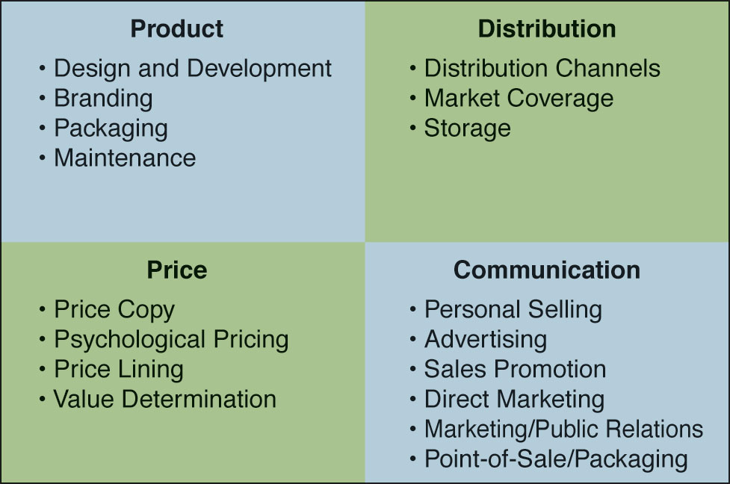
The Marketing Mix

Slide 18
The Marketing Mix
Product
Includes product design and development, product operation and performance, branding, and physical packaging.
Product design, performance, and quality are key to a product’s success. Distribution (Place)
The channels used to move a product from manufacturer to buyer.
Types of distribution:
  Direct marketing to consumer
  Channel marketing through resellers and retailers
Strategic distribution decisions:
  Market coverage strategy
  Push strategies
  Pull strategies

Slide 19
The Marketing Mix
Pricing
Price is based on:
  Cost of making and marketing the product and seller’s expected profit level.
  Also, based on what the market will bear, competition, economic well-being of customer, value of product, and the consumer’s ability to gauge the value.
Pricing strategies:
  Customary pricing—movies
  Psychological pricing for affluent customers

Slide 20
The Marketing Mix
Marketing Communication (Promotion)
Includes personal selling, advertising, public relations, sales promotion, direct marketing, events and sponsorships, point of sale, packaging.
Personal sales uses face-to-face contact with customers to create immediate sales.
Marketing communication is about “Big Ideas.”
Moriarty, Mitchell and Wells, (2009)

Slide 21
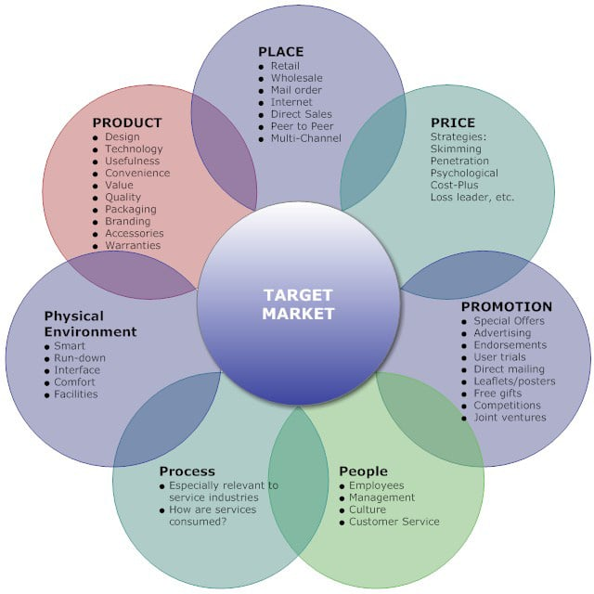
7Ps Marketing Mix
https://marketingmix.co.uk/marketing-mix-7ps/

Slide 22
7Ps:The case of Beyoncé’s marketing strategy of her album Lemonade
· Place
Place is applicable to Beyoncé’s marketing strategy as the sales of her album Lemonade are involved with retail, wholesale, mail order, the internet, direct sales and multi-channel services.
Her album may have started out exclusively on Tidal which was internet only but since then the album can be picked up physically within stores or ordered online.
https://emsysmarketing.wordpress.com/2017/03/23/beyonce-the-7ps/

Slide 23
7Ps:The case of Beyoncé’s marketing strategy of her album Lemonade
Price
Strategy was involved when the decision was made to exclusively release Lemonade on Tidal as to access it people had to pay a certain subscription fee.
This gained Tidal more subscribers creating more profit. The album is also slightly more expensive than the average album, costing around £12-£13.
However, it is still affordable and appeals to consumers as the CD comes with a DVD too. Therefore, the price is relatively low for what you are getting.
https://emsysmarketing.wordpress.com/2017/03/23/beyonce-the-7ps/

Slide 24
7Ps:The case of Beyoncé’s marketing strategy of her album Lemonade
Promotion
o Beyoncé released a teaser video on HBO for a “world premiere event” that would air the following Saturday night. As fans watched HBO, it became apparent that Beyoncé had created a full visual concept album.
Her Super Bowl performance caused an uproar as her backing dancers were dressed as black panthers- this created further publicity for her as people protested against her.
Social media played a huge part in promotion. For example, Beyoncé used Instagram to announce the release of her album on Tidal – a complete surprise to fans everywhere.
Her marketing strategy relies heavily on surprise marketing which is when a marketer is able to build value in a product or service through genuine excitement, anticipation and surprise.

Slide 25
7Ps:The case of Beyoncé’s marketing strategy of her album Lemonade
Product
Product is mostly applicable although maybe some aspects don’t apply in the case of Lemonade.
The album itself is a great product in terms of marketing. The album art is beautiful and would appeal to Beyoncé fans. Design is very applicable in this case.
The album features famous guests including Kendrick Lamar on a track, Serena Williams in one of the videos and Trayvon Martin and Eric Garner all make cameos – This helps to attract fans of the celebrities featured on Lemonade, making it an attractive product.
The album seeks to help the public delineate feminism, especially black feminism, misogyny, and society’s racial tensions.

Slide 26
7Ps:The case of Beyoncé’s marketing strategy of her album Lemonade
People
This would be very applicable to this product as a lot of management has gone into the product itself as well as into all the promotional tools used.
There are many people involved from different business sectors including from the music industry, law sector, manufacturing firms etc. people both create the product and provide a service to help it become a successful product.
https://emsysmarketing.wordpress.com/2017/03/23/beyonce-the-7ps/

Slide 27
7Ps:The case of Beyoncé’s marketing strategy of her album Lemonade
Process
This P also applies as it takes into consideration the whole process of how the album came about. There would have been a planning process (blue printing), writing process, recording process and then marketing and manufacturing process.
The process continues as the people involved with the product will be monitoring the success and sales of Lemonade and may use these stats to plan a future release.
https://emsysmarketing.wordpress.com/2017/03/23/beyonce-the-7ps/

Slide 28
7Ps:The case of Beyoncé’s marketing strategy of her album Lemonade
Physical Environment
This one seems less applicable as selling the album isn’t really a service as such. However, stores where it is sold can be taken into consideration.
It can also be argued that rather than the album itself fitting into this category, then the actual live performances would fit better with this category as that is more a service to the public.
Overall it could be considered whether live music as opposed to the album itself would fit better with many of the 7P’s as it is more hands on and direct and links more directly to consumers too who will be experiencing the product in ‘real’ time with Beyoncé actually there.
https://emsysmarketing.wordpress.com/2017/03/23/beyonce-the-7ps/

Slide 29
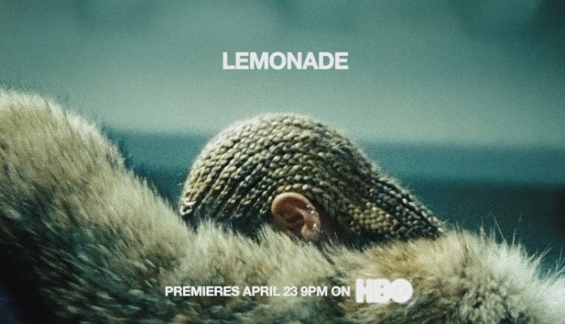
The Development of Advertising

Slide 30
Summary
1. How is marketing defined, what is the marketing process, and what are marketing’s key concepts? Marketing is the way a product is designed, branded, distributed, and promoted, as well as a set of processes for creating customer relationships that benefit the organization and its stakeholders. Key concepts that affect the planning of marketing communication include the marketing concept, which refers to a focus on customers; the exchange, which refers to communication and interaction, as well as money traded for goods or services; competitive advantage, which means that the product is differentiated and superior in some way to its competitors, and added value, which refers to the way that a product takes on features that are valued by consumers at each step of the marketing process.

Slide 31
Summary
How does marketing communication contribute to the development of a brand? A brand is a perception created from information as well as experiences with the company and its line of products. It’s intangible but it generates value in the form of brand equity.
A brand perception takes on meaning by transforming the product into something unique and distinctive and by making a promise that sets customers’ expectations.
The branding process includes establishing a brand identity through both name and symbols, defining the brand image and personality, and developing brand relationships with loyal customers that contribute to the financial value of the brand, called brand equity.

Slide 32
Summary
What is integrated marketing communication and what are its key concepts? IMC can be described as total communication, which means that everything that sends a message is monitored for its impact on the brand image. Central to IMC is the practice of unifying all marketing communication messages and tools to send a consistent brand message. Not only does this maximize consistency, it also creates synergy, such that a group of coordinated messages has more impact than marketing communications that are independent of each other.

Slide 33
Summary
How is brand communication evolving during a time of change? Accountability and global marketing are two key emergent themes. Tough economic times have led to increased calls for accountability. Investments in marketing communication must show that they are money well spent. This focus highlights the need for developing tools to measure the effectiveness of the investments. Growth in global marketing demonstrates a strategic opportunity to build business internationally.

Slide 34
THANK YOU
LECTURE 1 BY DR. RAPHAEL OGUTU,
Mass Communication Department,
AFRICA NAZARENE UNIVERSITY.
THE MAIN SOURCE OF REFERENCE: Advertising & IMC: Principles and Practice., Moriarty, Sandra Mitchell, Nancy D and Wells, William D. 14th edition. Pearson Prentice Hall Inc., 2009.
BEYONCÉ – THE 7PS https://emsysmarketing.wordpress.com/2017/03/23/beyonce-the-7ps/ Retrieved on 31st March 2022.

