Slide 1
Principles of Advertising
Advertising and Society.
LECTURE 5 BY DR. RAPHAEL OGUTU,
Mass Communication Department,
AFRICA NAZARENE UNIVERSITY.
THE MAIN SOURCE OF REFERENCE: Advertising & IMC: Principles and Practice., Moriarty, Sandra Mitchell, Nancy D and Wells, William D. 14th edition. Pearson Prentice Hall Inc., 2009.

Slide 2
Course Goals and Objectives
Intended Learning Outcomes
At the end of this class the student should be able to :
Explain Advertising’s Social Role
Review the Regulation of Advertising in their country
Analyze Advertising’s Regulatory Environment
Discuss Media Review of Advertising
Critic Self-Regulation
Critic Advertising Ethics
Determine What is Ethical or not

Slide 3
Introduction advertising and society
Overview
advertising and other forms of marketing communication are used effectively for social marketing, as well as for selling stuff, which also can be a good thing.
Advertising can be used to counter bad behaviors and promote good behavior.
Advertising sometimes draws criticism for its social impact and much of the discussion that follows is focused on advertising because it is so highly visible.
Three topics generate debate about advertising and marketing communication’s role in society. They focus on demand creation, shaping versus mirroring of social trends, and the over-commercialization of society.

Slide 4
Advertising’s ROLE IN SOCIETY
Demand Creation Debate
Does advertising create a materialistic culture or does it simply reflect it? Does advertising create demand for products people don’t need?
Critics say advertising creates demand, driving consumers to buy products unnecessarily.
  Do some products improve consumers’ lives?
Proponents say companies invest in research to find out what consumers want.
Audiences can refuse to buy products they don’t need.
Principle
If people do not want the products being marketed, they do not buy them.

Slide 5
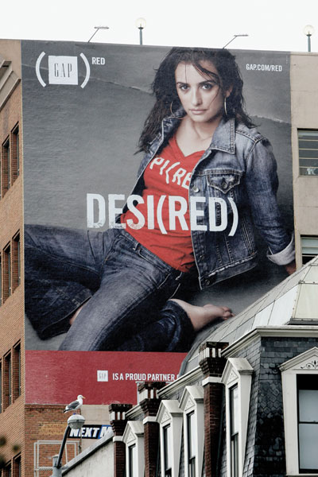
Shape vs. Mirror Debate
WHAT IS ADVERTISING?
Does advertising create or reflect social values?
  Critics say advertising abuses its influence on children and teenagers.
Critics say advertising creates social trends, dictating how people think and act.
Advertisers say they spot trends and develop messages that connect with them.
Advertising both mirrors and shapes. Advertising planners spend huge amount of money and time trying to identify people’s motivations before they develop message strategies.
(Moriarty, Mitchell and Wells, 2009).

Slide 6
Overcommercialization Debate
Does advertising make people materialistic?
  Critics say advertising abuses its influence on vulnerable groups like children and teenagers.
  The world we live in is driven by a materialistic consumer culture. Did advertising create this culture, or does it simply reflect it?
Critics say the lines between advertising and news and entertainment are blurred.
  How do you know sponsors aren’t influencing content and how their product is perceived.
  Does product placement change how we view programming?
(Moriarty, Mitchell and Wells, 2009.)

Slide 7
Other Social Responsibility Issues: An Overview
Summary
Poor taste and offensive advertising
Stereotyping
Body and self-image problems
Targeting strategies
Problems with advertising claims and other message strategies
The issues surrounding the advertising of controversial products
(Moriarty, Mitchell and Wells, 2009).

Slide 8
Poor Taste and Offensive Advertising
Viewer reaction may be affected by sensitivity to:
  The product category, the timing, whether the viewer is alone or with others, and the context
Creating general guidelines is difficult because people’s idea of “good taste” varies.
What is considered “offensive” changes over time.
Principle:
Testing is needed to find the right balance
when one group that sees the advertisement finds the message offensive, even through the primary target market may think the message is appropriate.

Slide 9
Sex in Advertising
Sex appeals, body image
Advertising that portrays people as sex objects is considered demeaning.
Playing on consumers’ insecurities about their appearance can lead to dangerous practices.
Responsible advertisers now use models of normal size and weight to reduce pressure on young people.
It’s becoming more blatant, especially when it’s not relevant to the product.
  Paris Hilton’s “soft-core porn” ad for Carl’s Jr. restaurants
Should sex be used to sell pizza, tacos, and truck parts?
  Should sex only be used to advertise products purchased for sexual reasons, like clothes or exercise equipment.
  Does it, in fact, distract or hinder the communication or persuasion to the target?
  Does sex really sell?
Source: Moriarty, Mitchell and Wells, (2009)

Slide 10
Portraying Diverse People
A stereotype is a representation of a cultural group that emphasizes a trait or traits that may or may not communicate an accurate representation.
Common problems include:
  Gender stereotypes
  Body image and self-image
  Racial and ethnic stereotypes
  Cultural differences in global advertising
  Age-related stereotypes
  Advertising to children
Principle:
Stereotyping is negative when it reduces
a group of people to a caricature.
Source: Moriarty, Mitchell and Wells, (2009)

Slide 11
Message-related Issues
False advertising is a message that is untrue.
Misleading claims are grossly exaggerated claims made by advertisers about products.
Puffery is “advertising or other sales representations, which praise the item to be sold with subjective opinions, superlatives, or exaggerations, vaguely and generally, stating no specific facts.”
Source: Moriarty, Mitchell and Wells, (2009)
Principles:
Advertising claims are unethical if they are false, misleading, or deceptive.
Puffery may be legal, but if it turns off the target audience then nothing is gained by using such a message strategy.

Slide 12
Message-related Issues
Comparative advertising is a legitimate message strategy, regulations govern those uses that are challenged as misleading.
  The Lanham Act permits awards of damages from an advertiser who “misrepresents the nature, characteristics, qualities, or geographic origin in comparative advertising.”
An endorsements or testimonial is any advertising message that consumers believe reflects the opinions, beliefs, or experiences of an individual, group, or institution.
  It’s misleading if the endorser doesn’t use the product or if consumers can reasonably ascertain that a message does not reflect the announcer’s opinion.
Source: Moriarty, Mitchell and Wells, (2009)

Slide 13
Message-related Issues
Demonstrations should not mislead the consumer.
It’s difficult for some food products so these are evaluated by the FTC on case-by-case basis.
  Shooting ice cream under hot lights
  Milk looks gray on TV so a water and glue mixture is used
Some advertisers use disclaimers or “supers” to indicate exceptions.
Advertising controversial products like firearms, gambling, condoms, etc. reflects the client’s ethics.
Source: Moriarty, Mitchell and Wells, (2009)

Slide 14
Product-related Issues
Unhealthy or dangerous products—agencies must consider if they can honestly promote these products including fast food, tobacco, liquor, or beer.
  Though it is acceptable to advertise these products, it is still offensive to some
In 1997, the FDA loosened controls on drug companies, and prescription drug ads skyrocketed.
Principle:
The ethical responsibility for selling a controversial or unsafe product lies with the marketing department; however, advertising is often in the spotlight because it is the
visible face of marketing.

Slide 15
Reactions to Concerns about Unhealthy or Dangerous Products
McDonald’s and Disney both added healthier choices to their menus.
In 1996, the FDA restricted tobacco advertising within 1,000 feet of a school, and said ads in publications with 55% readership under age 18 could only run black and white text ads.
The FDA’s Master Settlement Agreement required the tobacco industry to pay $206 billion over 25 years to 46 states, half of which supports antismoking ads targeting children.
Tobacco companies voluntarily curbed ads to youth.
Liquor companies and television networks have voluntarily reduced alcohol advertising.

Slide 16
How is advertising regulated?
The following monitor and regulate advertising:
Laws
Government regulations and regulatory bodies
Media
Industry self-regulation
Professional oversight groups
Public/community organizations

Slide 17
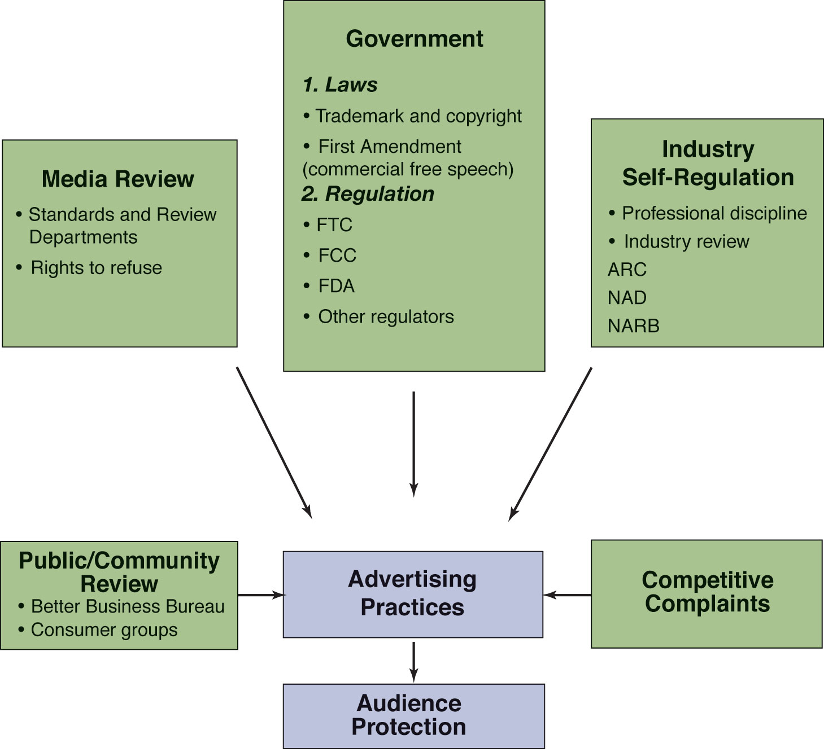
Organizations That Oversee Advertising

Slide 18
Legal Environment
Trademark Protection
A trademark is a brand, corporate or store name, or a distinctive symbol that identifies the seller's brand and thus differentiates it from the brands of other sellers.
  Registering a trademark through the Trademark Office gives the organization exclusive use, as long as it’s used to identify a specific product.
  The Lanham Trademark Act of 1947 protects unique trademarks from infringement
  URLs can now be registered and protected

Slide 19
Legal Environment
Copyright Protection
A copyright gives an organization the exclusive right to use or reproduce original work, such as an advertisement or package design, for a period of time.
  Copyright infringement is when a product is used in an ad without proper permission.
  Ads that use another ad’s message (copycat) can be subject to copyright infringement charges.

Slide 20
Legal Environment
International Laws and Regulations
Pricing and distribution laws and regulatory restrictions vary by country.
Some countries ban ads for certain product
  Thailand, Hungary, Hong Kong, and Malaysia have bans on certain types of tobacco advertising
  Truthful ads can be banned for the public good
  Federal ban on junk faxes is valid
Contests, promotions, and direct mail are illegal in some countries.

Slide 21
Regulatory Environment
Federal Trade Commission (FTC)
Established in 1914, the FTC regulates deceptive and misleading advertising, focusing on:
  Fairness: unfair competition and deceptive practices
  Deception: issues cease and desist orders
  Violations: can fine companies for violating 1) a trade regulation rule or, (2) cease and desist order.
  Consumer participation: funds consumers groups and other interest groups in making rules
  Also oversees advertising involving weight loss products, children and elderly, telemarketing, and the entertainment industry.

Slide 22
Regulatory Environment
The FTC and Children’s Advertising
The Children’s Advertising Review Unit (CARU) evaluates ads to children under 12.
The Children’s Television Advertising Practice Act (1990) placed ceilings on ads during TV programs.
  10.5 minutes per hour on weekends
  12 minutes per hour on weekdays
  Ads clearly separated from programs
As of 1996, all stations must air 3 hours per week of educational programming.

Slide 23
Regulatory Environment
Regulating Deception
Deceptive advertising intends to mislead consumers by making false or by failing to fully disclose important facts, or both.
Current policy contains three elements:
  Misleading—representation, omission, practice
  Reasonableness—“reasonable consumer”
  Injurious—must cause material injury
Deception is difficult to prove due to vague and hard-to-measure criteria.

Slide 24
Regulatory Environment
Regulating Substantiation
Does the advertiser have a reasonable basis to make a claim about product performance?
Factors considered:
  Type and specificity of claim made
  Type of product
  Possible consequences of the false claims
  Degree of reliance on the claims by consumers
  Type and accessibility of evidence available for making the claim
  Injurious—must cause material injury

Slide 25
Regulatory Environment
Remedies for Deception and Unfair Advertising
Consent decrees
  Advertiser agrees to stop the deceptive practice
Cease and desist order
  A process similar to court trial precedes the order
Corrective advertising
  Advertiser runs messages correcting the false impressions
Consumer redress
  Cancel or reform contracts, refund money or return property, pay for damages, or public notification
Ad agency legal responsibility
  Agency is liable along with advertiser and subject to the same penalties

Slide 26
Regulatory Environment
Food and Drug Administration (FDA)
Regulatory division of the Department of Health and Human Services
Oversees package labeling, ingredient listings, and advertising for food and drugs
Determines the safety and purity of foods, cosmetics
Watchdog for drug advertising, specifically direct-to-consumer ads for prescription drugs

Slide 27
Regulatory Environment
Federal Communications Commission (FCC)
Regulates radio and television broadcast communications (media, not advertisers)
Can issue and revoke licenses, ban deceptive messages, or those in poor taste
Responds to complaints but doesn’t initiate actions
Works closely with FTC to eliminate false and deceptive advertising

Slide 28
Regulatory Environment
Other Regulatory Bodies
The Bureau of Alcohol, Tobacco, and Firearms (BATF) within the Treasury Department regulates deception in advertising and establishes labeling requirements for the liquor industry.
The U.S. Postal Service regulates direct mail and magazine advertising including the areas of obscenity, lotteries, and fraud.
The States’ Attorneys General regulates advertising at the state level.

Slide 29
Media Review of Advertising
The media attempts to regulate advertising by screening and rejecting ads that violate their standards of truth and good taste.
Most networks have a Standards and Practices Department that screens every ad and gives approval before the ad can run. The First Amendment lets publishers refuse to run ads.
The FTC pressures magazines and newspapers to stop running misleading weight loss ads.
CBS refused to run an anti-Bush ad endorsed by the MoveOn organization.

Slide 30
Self Regulation
There are three types of Self Regulation:
1. Self-Discipline
Organizations exercise self-discipline when they develop, use, or enforce norms within its own practices.
Most major advertisers and advertising agencies have in-house ad review procedures.
Several U.S. companies have their own codes of behavior and criteria for acceptability of advertising.

Slide 31
Self Regulation
2. Industry Self-Regulation
When the development, use, and enforcement of norms come from the industry, the term used is industry self-regulation.
3.Self-Regulation by Public and Community Group
Local groups like the Better Business Bureau advise local businesses on legal aspects of advertising.
  Also receives and investigates complaints, maintains files on violators, and assists law enforcement officials in prosecuting violators.
Consumer Activist Groups
  Action for Children’s Advertising monitors advertising to children and files complaints.
  Public Citizen group pushed for warnings on print ads for nicotine products.
  Cultural Environment Movement is a nonprofit coalition focused on fairness, diversity, and justice in media communications.

Slide 32

What guides ethical behavior?
Ethics
  “shoulds” and “oughts”; the “right thing to do”
Morals
  Frameworks for right actions often based in religion
Principle:
Decisions about ethics are made based on laws and regulations, professional codes, but more importantly, on an internal moral compass that senses when something is right or wrong.

Slide 33
What guides ethical behavior?
Personal Ethics
  Ethical decisions are complex and involve conflicting forces—strategy vs. ethics, costs vs. ethics, effectiveness vs. ethics.
Professional Ethics
  In Gallup poll, advertising practitioners ranked just above HMO managers and car salesmen
  The American Association of Advertising Agencies publishes a code of standards
International Standards and Codes
  Singapore, Malaysia, the Netherlands, and Sweden all have standards of professional behavior

Slide 34
SUMMARY
(Arens, William, and Arens, 2011).
In short, while advertising can be criticized for giving less than complete information and for creating some unwanted externalities, it also contributes to the free enterprise system by encouraging many buyers and sellers to participate in the process, thereby serving the self-interest of all.
Under growing pressure from consumers, special-interest groups, and government regulation, advertisers have developed higher standards of ethical conduct and social responsibility. Advertisers confront three levels of ethical consideration: the primary rules of ethical behavior in society, their personal value systems, and their personal philosophies of singular ethical concepts.
(Arens, William, and Arens, 2011).

Slide 35
SUMMARY
The federal and state courts are involved in several advertising issues, including First Amendment protection of commercial speech, and infringements on the right to privacy. Advertising is regulated by federal, state, and local government agencies, business-monitoring organizations, the media, consumer groups, and the advertising industry itself. All of these groups encourage advertisers to give more complete information to consumers and eliminate any externalities in the process.
The Federal Trade Commission, the major federal regulator of advertising in the United States, is responsible for protecting consumers and competitors from deceptive and unfair business practices.
The Food and Drug Administration (FDA) monitors advertising for food and drugs and regulates product labels and packaging. The Federal Communications Commission (FCC) has jurisdiction over the radio and TV industries, although deregulation has severely limited its control over advertising in these media.
(Arens, William, and Arens, 2011).

Slide 36
THANK YOU
LECTURE 1 BY DR. RAPHAEL OGUTU,
Mass Communication Department,
AFRICA NAZARENE UNIVERSITY.
THE MAIN SOURCE OF REFERENCE:
Advertising & IMC: Principles and Practice., Moriarty, Sandra Mitchell, Nancy D and Wells, William D. 14th edition. Pearson Prentice Hall Inc., 2009.
Contemporary Advertising and integrated marketing communications. Arens, William. F., Weigold, Michael. F., and Arens, Christian. 13th Ed. McGraw Hill Higher Education. 2011.

