Slide 1
Great Civilizations of the Ancient World
Archaeology as a Science

Slide 2
WELCOME TO THE
Great Civilizations of the Ancient World
Introduction to the course
Multidisciplinary nature of archaeology

Slide 3
Jargalan Burentogtokh, Senior Lecturer, National University of Mongolia
BA National University of Mongolia 2007
MA National University of Mongolia 2009
MPhil Yale University 2013
Ph.D. Yale University 2017
Research interests: Eurasian archaeology, archaeology of nomads, habitation archaeology, archaeological theories, social complexity, paleoclimate, and domesticated animals and plants.

Slide 4
COURSE THEME
ARCHAEOLOGICAL SCIENCE
ANTHROPOLOGICAL ARCHAEOLOGY

Slide 5
This course covers major social transformations in human life:
---emergence of “culture”
---origins of farming and settled villages
---rise of “complex societies” such as states
---development and nature of early civilizations—some in areas with historical records, some in areas with no written records

Slide 6
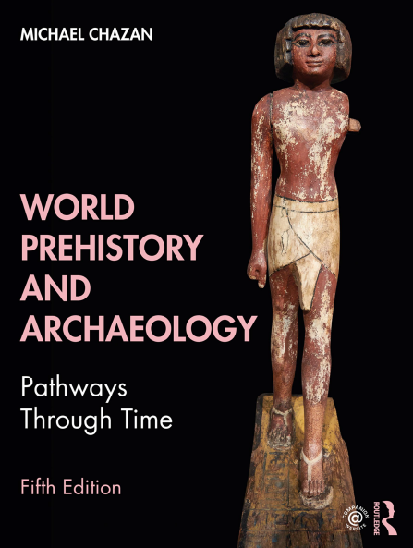
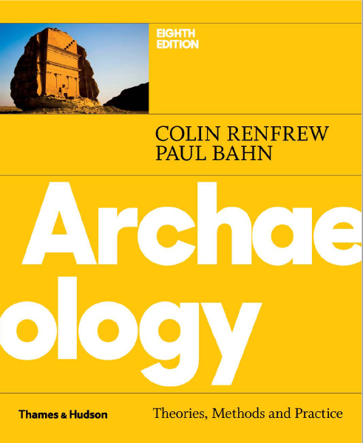
SUGGESTED TEXTBOOKS

Slide 7
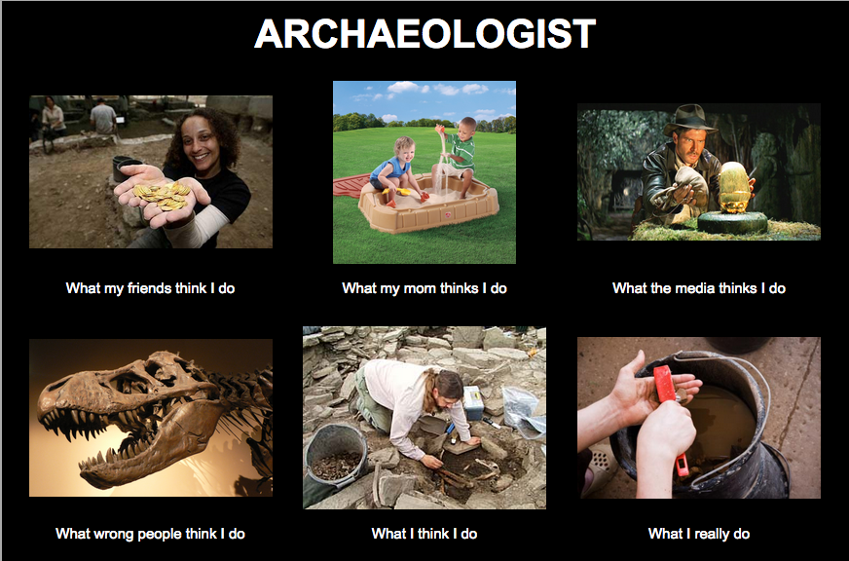
https://blogs.brown.edu/arch-0100-s01-fall-2015/2015/09/03/hello-world/

Slide 8
Archaeology is a unique discipline giving us the opportunity to study human life on our planet from a long-term perspective based on material evidence

Slide 9
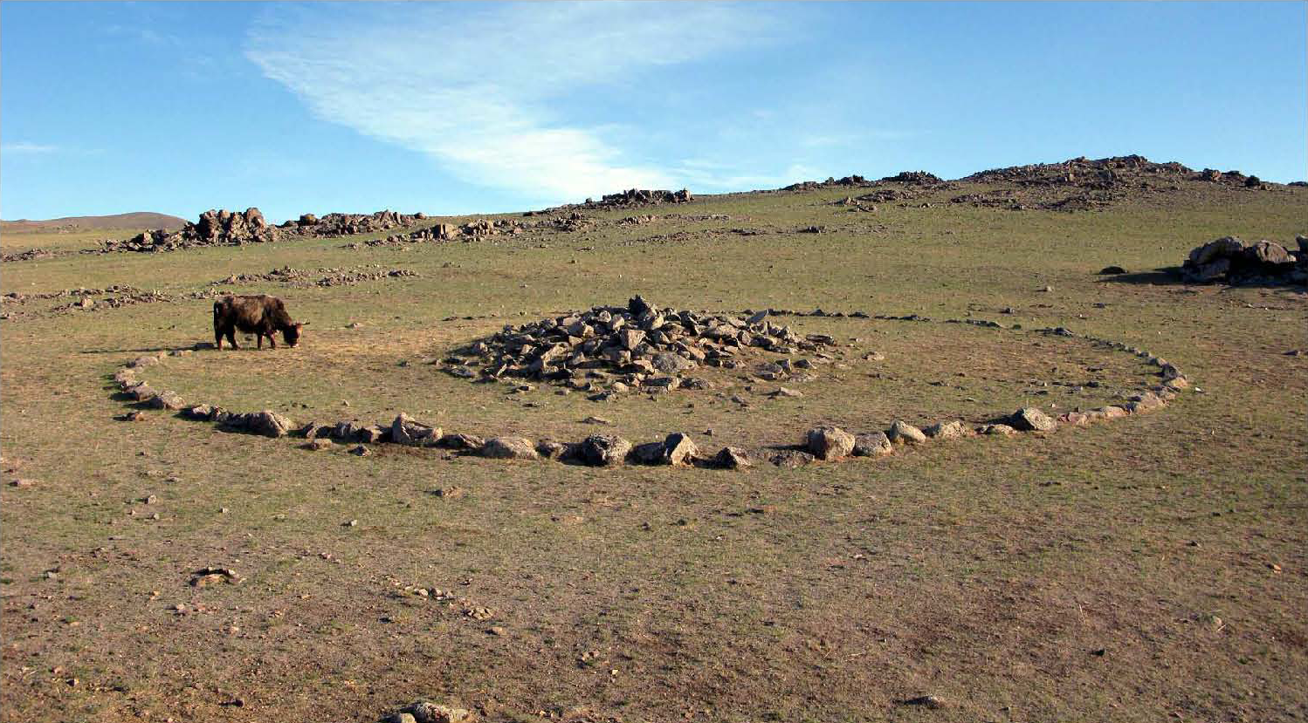
Archaeological Research:
Research question
Hypothesis
- Material Expectation
- Research Methods: survey, excavation, analysis
Interpretation

Slide 10
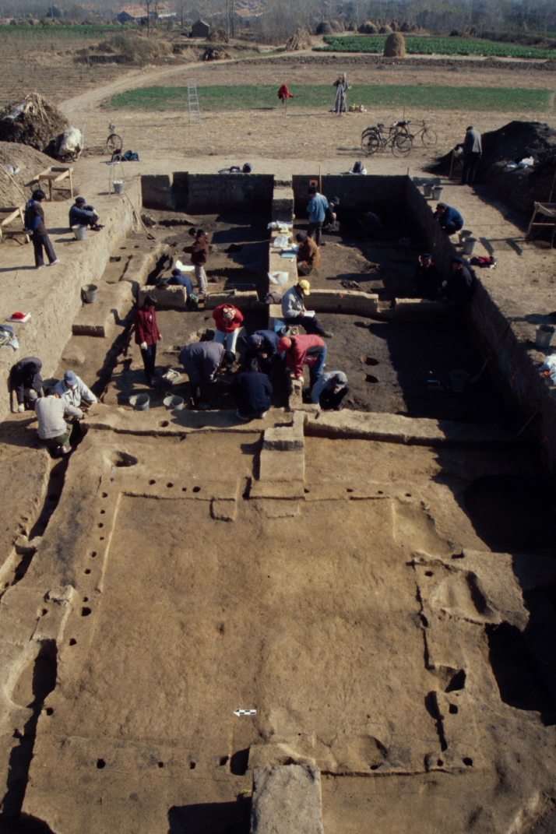
Research Design:
a detailed plan for the fieldwork and analysis that is developed
on the basis of your goals, or your specific research questions
(background – research question – hypothesis – material expectation – methodology – analysis - interpretation)
We will discuss different examples during the semester, starting next
week for the world’s oldest archaeological sites
Methods of Finding and Excavating Sites:

Slide 11
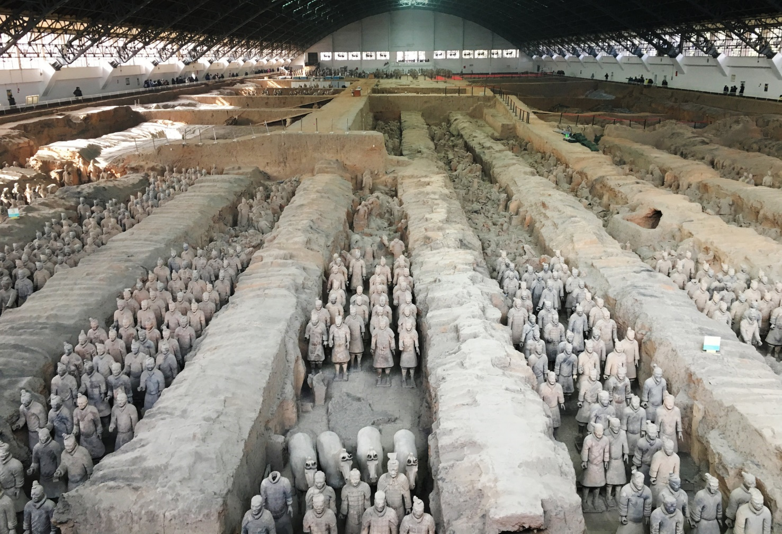
Major methods of finding sites and interpreting a region:
1) Accidental discovery from construction ---huge factor in every country
https://www.nytimes.com/2018/02/23/travel/xian-china-budget-affordable.html

Slide 12
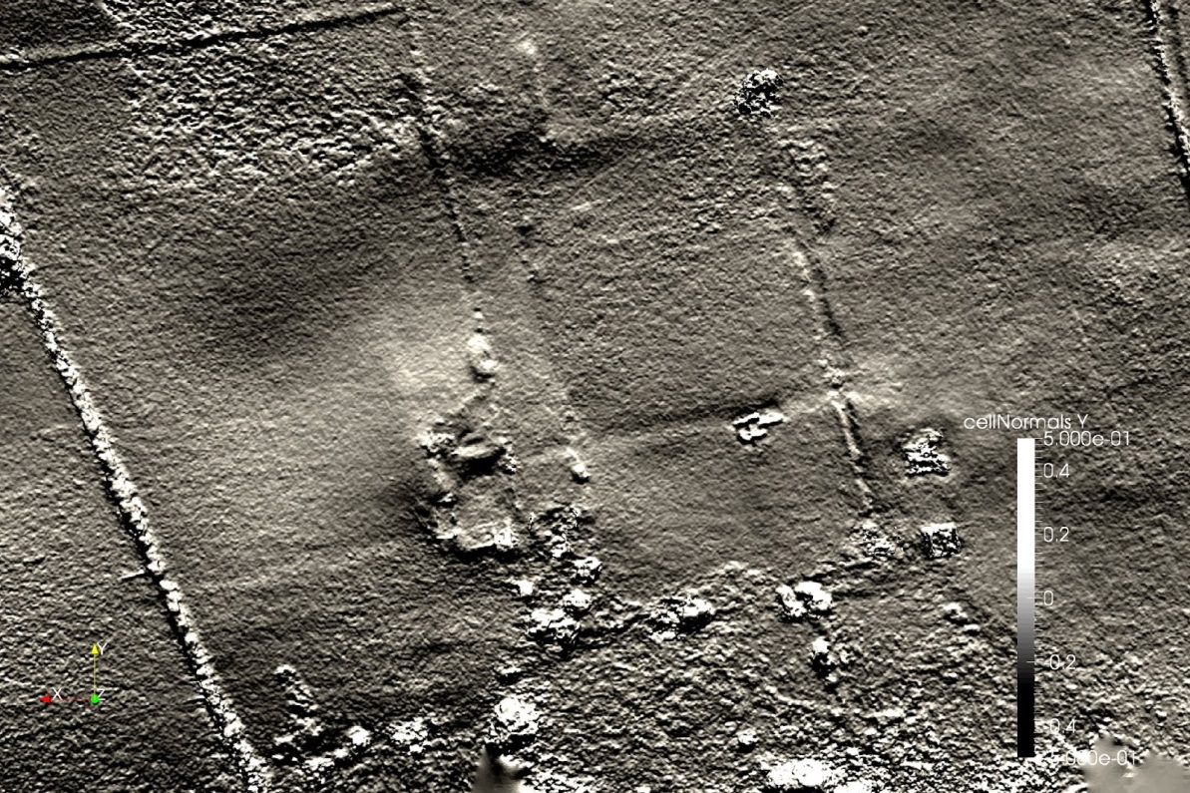
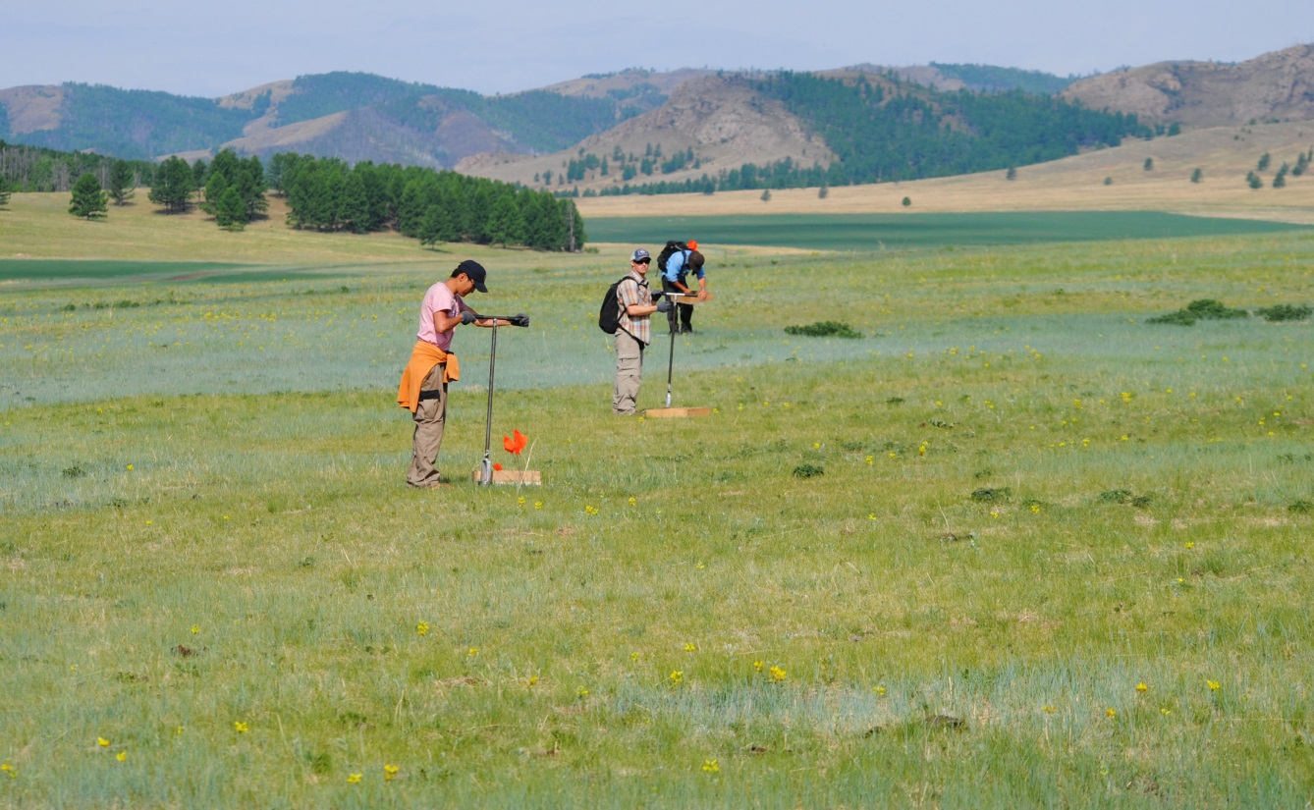
Planned “Reconnaissance Survey”, or “Survey”:
A. Analysis of aerial or satellite images [Yale’s CEO]
B. Ground survey, walking over the landscape

Slide 13
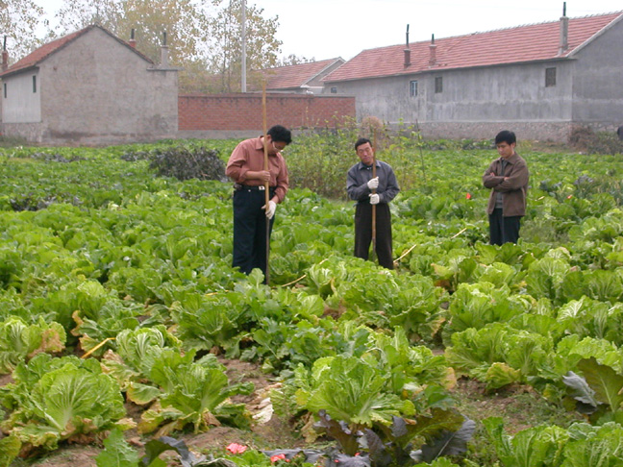
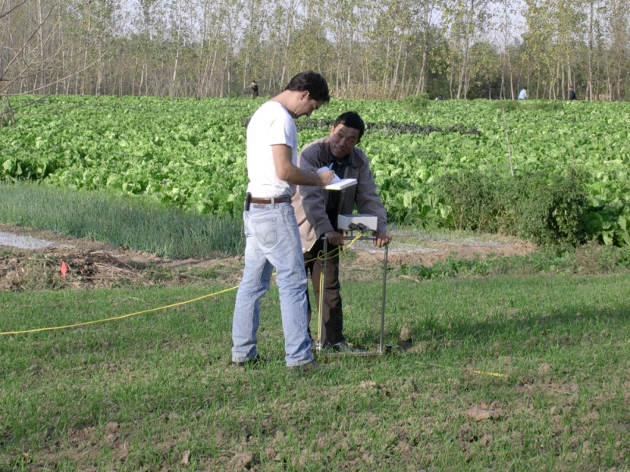
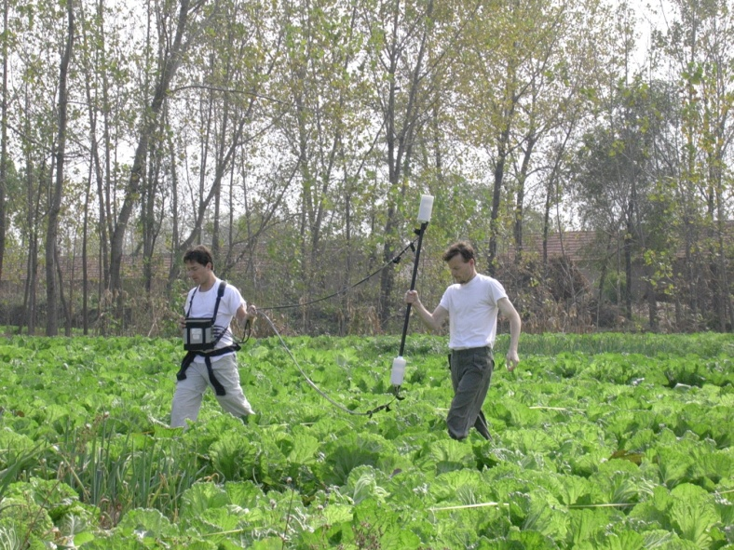
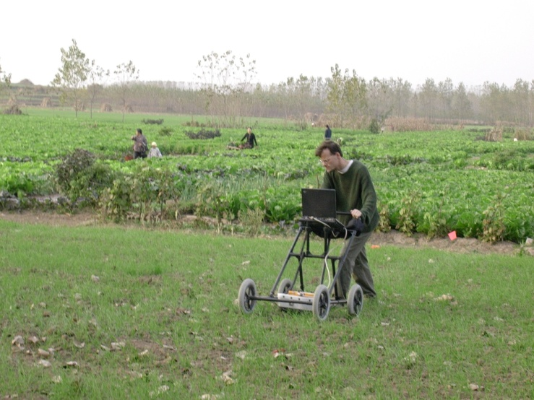
3. Planned “Reconnaissance Survey”, or “Survey”: Probing and Remote sensing for locating sites and making detailed maps of individual sites
probing
resistivity
magnetometer
Ground penetrating radar (GPR)

Slide 14
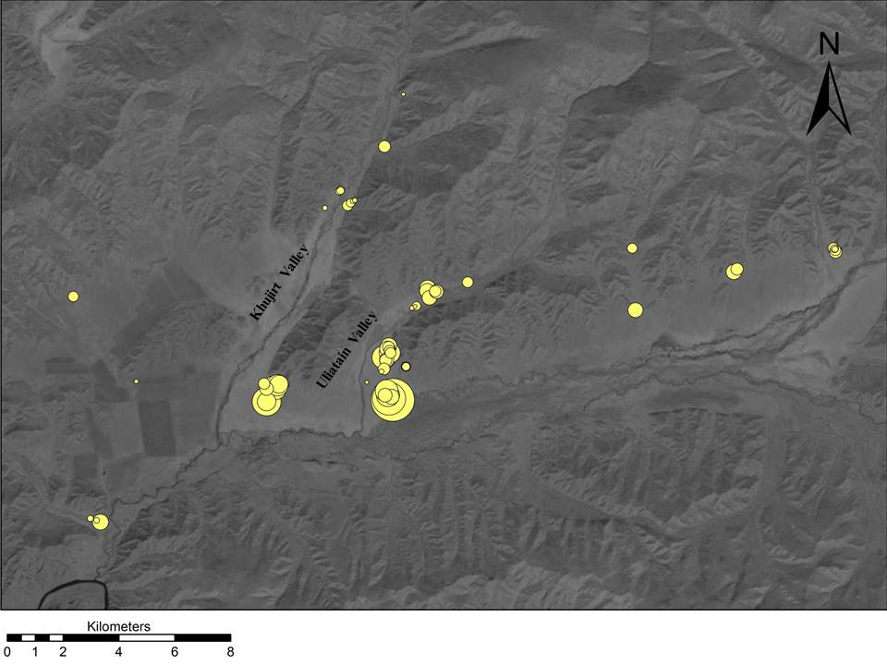
all surveys: analyze the regional distribution of sites by plotting the locations on maps, using GPS systems or other methods
GIS to analyze different kinds of spatial relationships such as site location to different kinds of resources

Slide 15
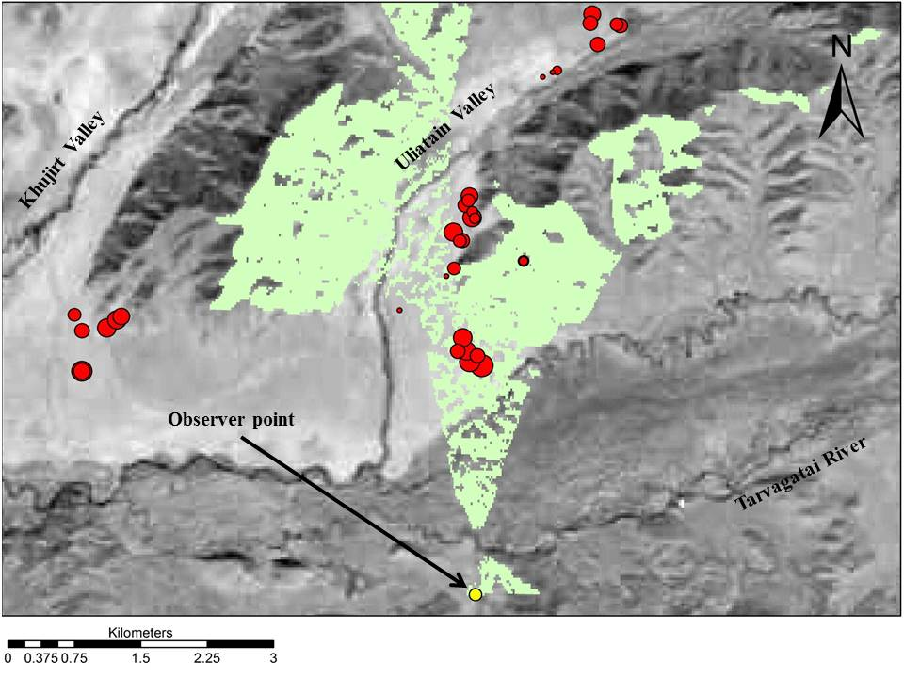

Slide 16
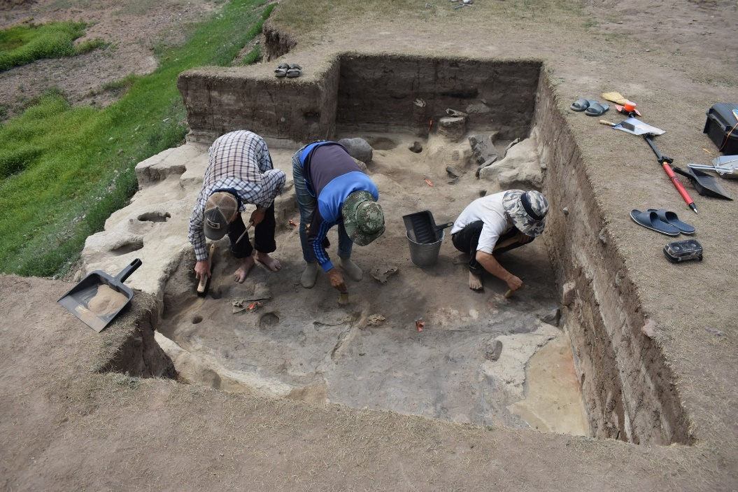
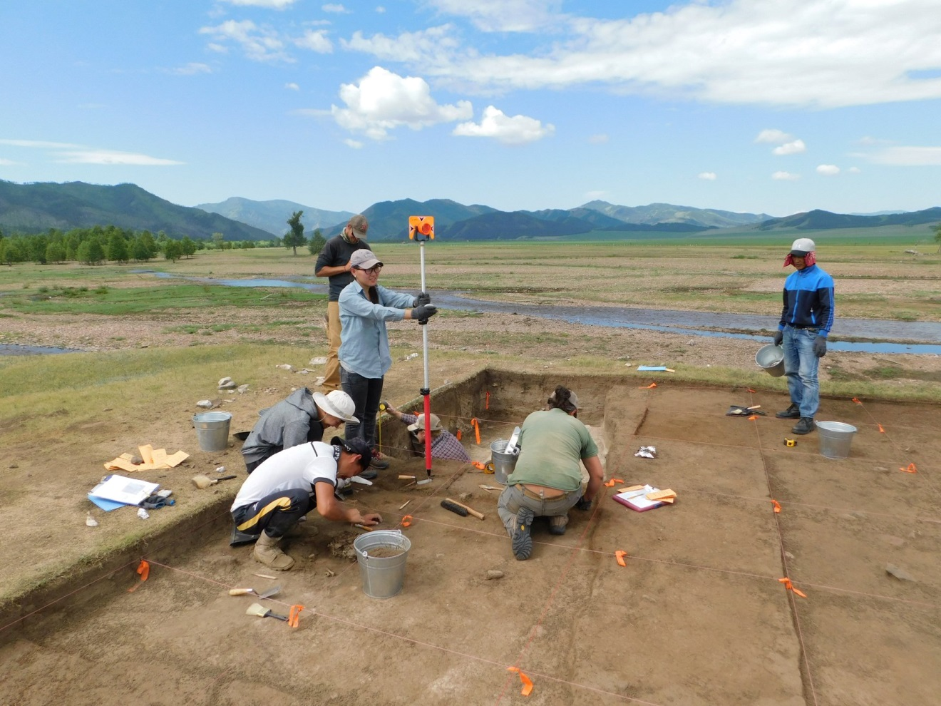
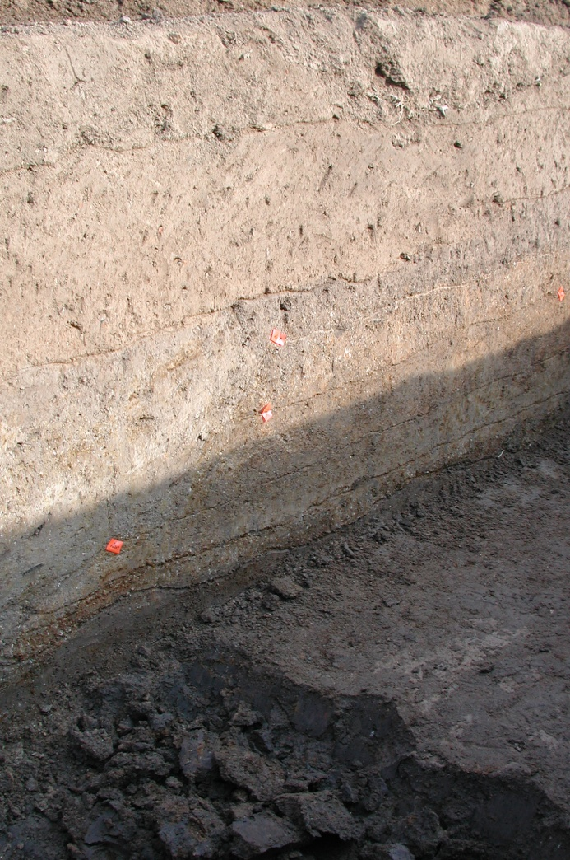
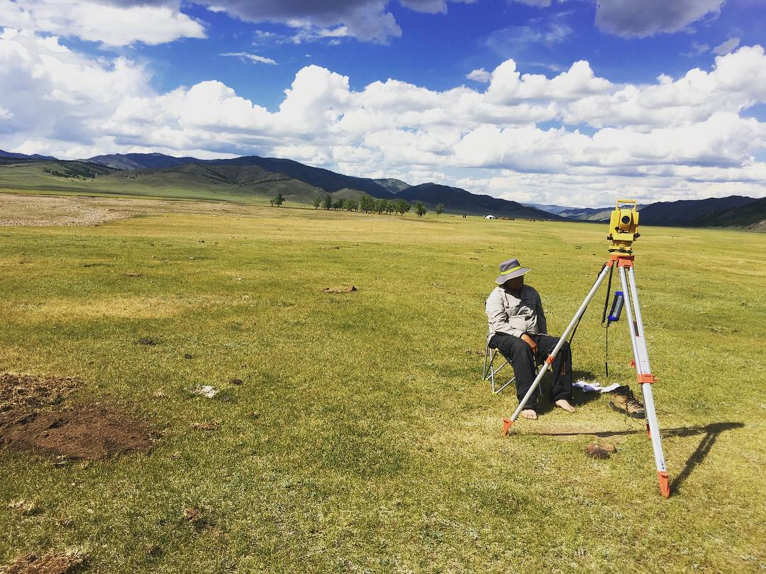
recording context during excavation
excavation involves removing and destroying the original context
It requires photography and mapping of horizontal and vertical spatial relationships, on a site-wide basis and for individual areas

Slide 17
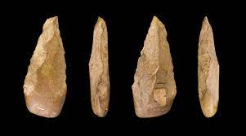
1. how styles give clues about relative age of artifacts versus “absolute” age
technology, how they were made (from acquisition of raw material to production)
whether the objects were traded
function, or how objects were used and valued
discard, or how the objects were thrown away—
How did they wind up in an archaeological site?
Analysis of artifacts:
https://www.cbsnews.com/news/making-of-stone-tools-could-have-led-to-emergence-of-human-language/

Slide 18
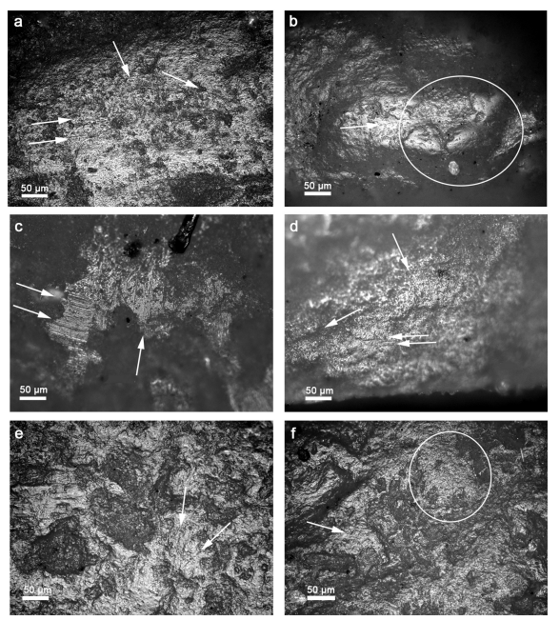
using replicated tools to better understand the characteristics of the raw material
Fullagar et al. 2021. A functional study of denticulate sickles amd knives, ground stone tools from the early Neolithic Peligang culture, Chima. Archaeological Research in Asia, https://doi.org/10.1016/j.ara.2021.100265

Slide 19
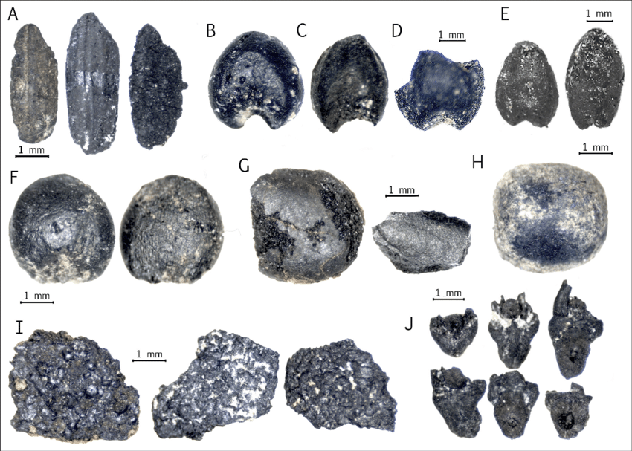
Ecofacts:
collection of
plant remains (macrobotanical) such as carbonized seeds for information on diet, seasonality by means of
flotation
https://www.researchgate.net/figure/Selected-macrobotanical-remains-of-crops-from-Golbai-Sasan-and-Gopalpur-A-Oryza-sativa_fig10_326381825

Slide 20
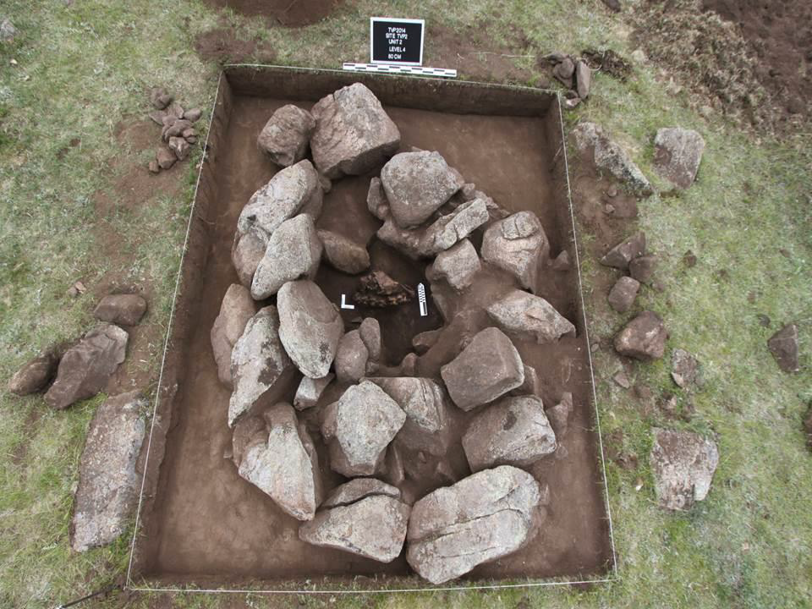
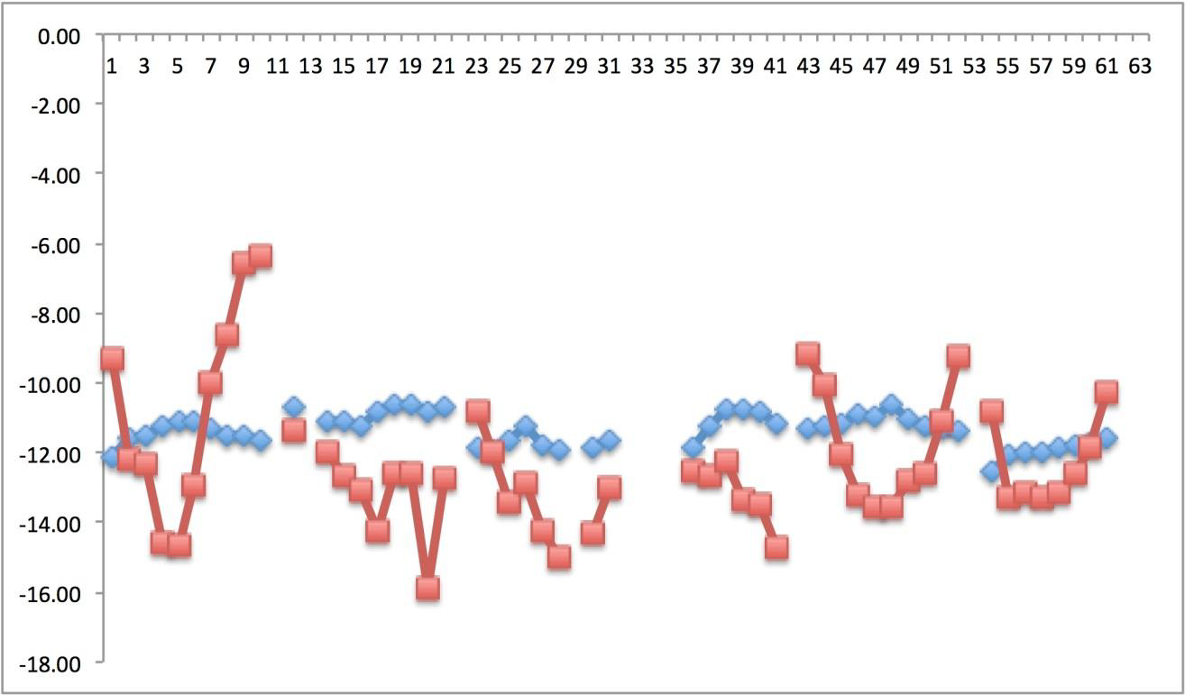
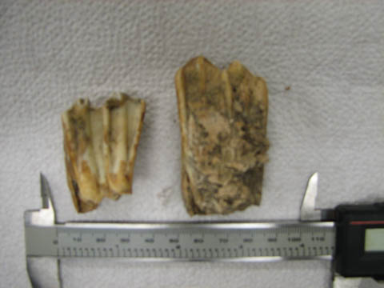
analysis of animal bone
for information on diet and much more

Slide 21
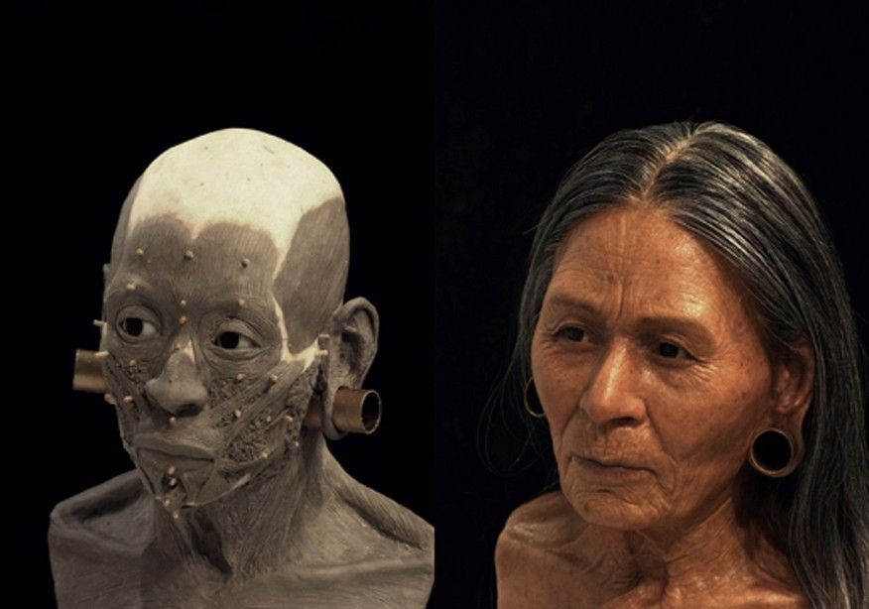
What can we learn from human bones:
Age, sex, stature of the deceased
Direct information on diet—isotopic analysis
Disease and general health—occupational
hazards etc.
Forensic issues—cause of death and facial reconstruction
https://www.pinterest.com/pin/121949102394122812/

Slide 22
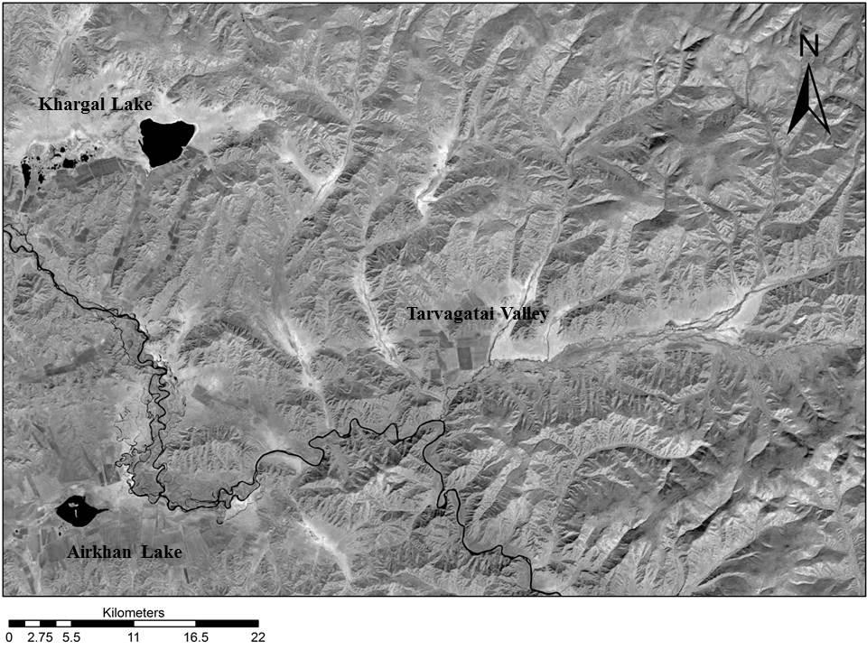
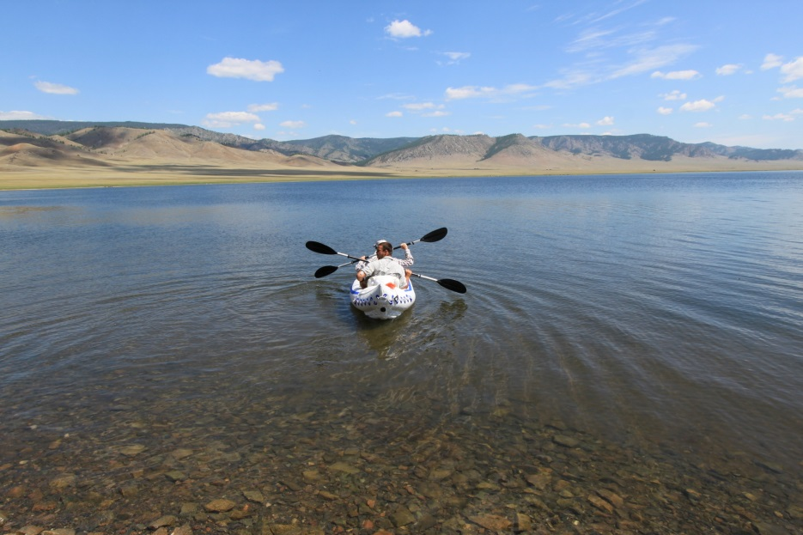
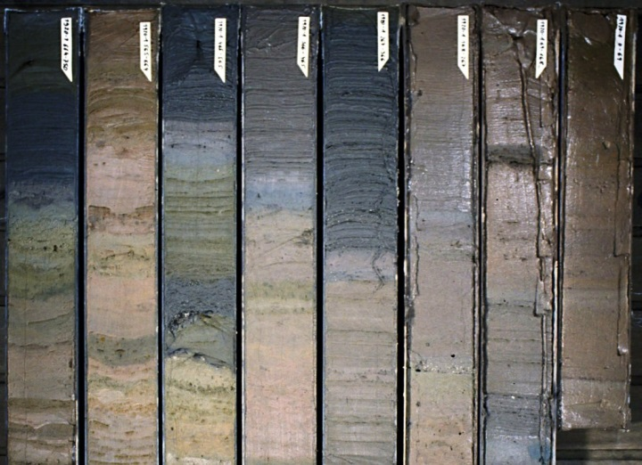
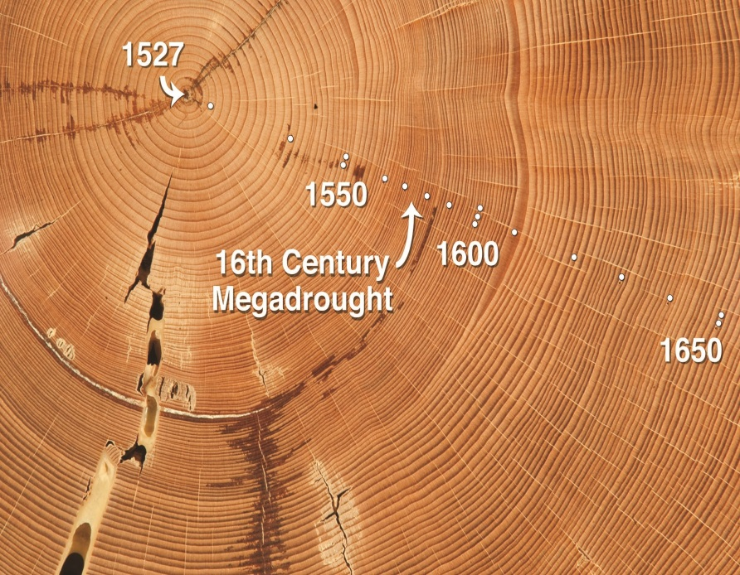
Paleoclimate

Slide 23
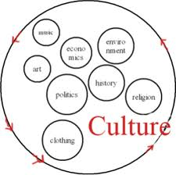
What is anthropological archaeology?
First, what is anthropology?
Anthropology is the study of humankind, the diverse life ways in the world, past and present.
This involves the study of culture: a holistic study of distinct, socially learned traditions including behavior, economic practices, rituals, beliefs, and different kinds of social relationships

Slide 24
Anthropological archaeology involves an emphasis on understanding the people (actions and decision making) who made and used the ancient objects—understanding the cultural context
goals of understanding intangible aspects of culture such as craft specialization, trade, social classes, belief systems
often closely related goals with
art history and other disciplines

Slide 25

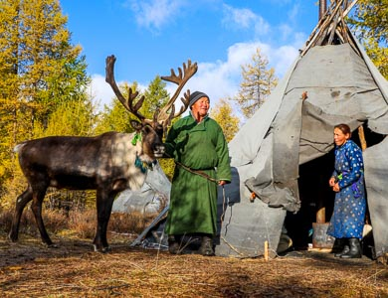
Ethnoarchaeology
Reindeer herders of Mongolia
Todd Surovell, University of Wyoming
https://www.viewmongolia.com/reindeer-people-dukha-tribe-mongolia.html

Slide 26
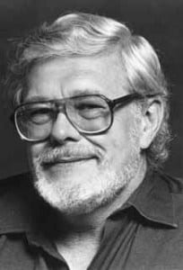
“New Archaeology” of the 1960’s and 1970’s, complete reliance on scientific methods: hypothesis testing, belief in completely objective analysis of the past
“Processual Archaeology”
emphasis on cultural
systems and adaptation
to different environments,
processes of cultural change from environmental perspective
Lewis Binford
https://www.ucpress.edu/blog/13270/in-memoriam-lewis-binford/
Willard Libby and radiocarbon dating

Slide 27
Main weaknesses of processual archaeology
Environmental determinism
- Lack of human agency (how knowledgeable, individual actors
can cause cultural change)
- View of cultures as homeostatic
Gender, ethnicity, identity, social relations, etc. are
not considered

Slide 28
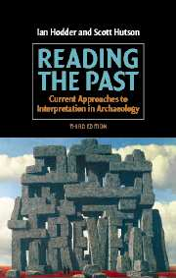
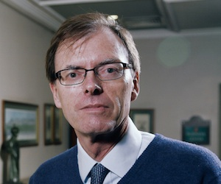
Ian Hodder and “postprocessual” archaeology, 1980’s---:
a new focus on the impact of beliefs of individuals and ideology on life ways and on cultural change, to understand the meaning behind specific kinds of material remains
agency, or how knowledgeable, individual actors
can cause cultural change
https://www.cambridge.org/mn/academic/subjects/archaeology/archaeological-theory-and-methods/reading-past-current-approaches-interpretation-archaeology-3rd-edition?format=PB
http://scienceandbigquestions.com/experts-old/ian-hodder

Slide 29
Current North American anthropological archaeology in comparison to archaeology in other countries:
North American anthropological archaeology:
--comparative perspective (such as characteristics of civilizations)
--use of ethnographic analogy (cross-cultural, or specific to one area)
Some other countries such as Mongolia:
--most people doing archaeology feel they are learning about their direct
ancestors
--there is more use of historical texts to reconstruct the past

Slide 30
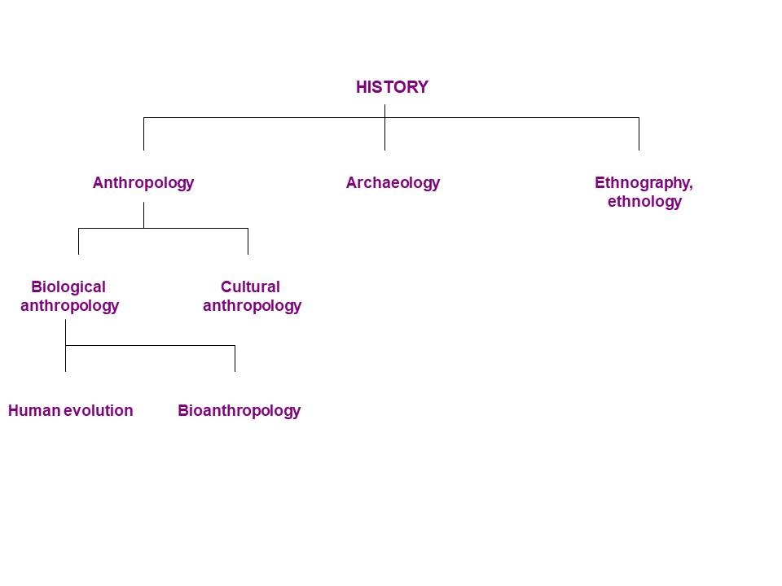
ANTHROPOLOGY
Biological anthropology
Cultural anthropology
Linguistic anthropology
Archaeology
Human
evolution
Bioanthropology
Ethnohistory
Ethnography, ethnology

Slide 31
Relevance of archaeology to modern life:
---Long term perspective
---Response of human populations to climate change (and cultural causes of environmental change)
---Understanding problems such as warfare
---Appreciating our global cultural heritage and cultural diversity
--Cultural Resource Management (CRM)

Slide 32
Careers in archaeology:
Academia—professors, or high school
Contract archaeology—Cultural Resource Management
(CRM), rescue excavations
Museums
Journalism—magazines, newspapers, the internet
(more needed!)

Slide 33
References
Chazan, M. (2021). World prehistory and archaeology: pathways through time. Routledge, New York.
Haas, R., Surovell, T., and O’Brien, M. Occupancy and the Use of Household Space Among the Dukha. https://doi.org/10.1080/19442890.2018.1440510
Portal, J. (2007). The First Emperor: China's Terracotta Army. Harvard University Press, Cambridge.
Renfrew, C. and Bahn, P. (2020). Archaeology: theories, methods and practice. Thames and Hudson, London.

