Slide 1
Origins of Modern Human
Great Civilizations of the Ancient World

Slide 2
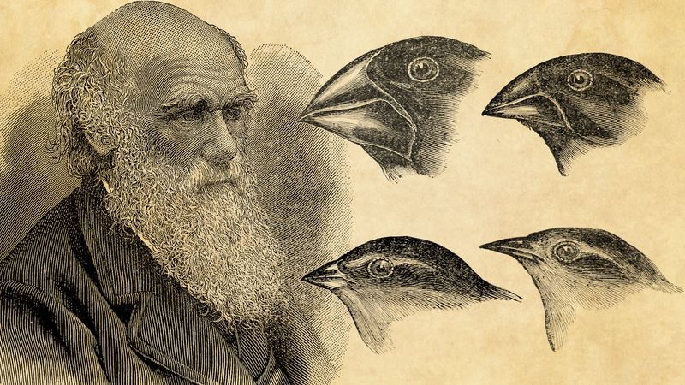
Charles Darwin and the Evolutionary Theory
https://www.britannica.com/biography/Charles-Darwin

Slide 3
Reconstructing the past:
Archaeology
Biological anthropology
Paleoanthropology
Paleoecology
Genetics, etc.

Slide 4
Meaning of “hominin”
To all members of the human lineage after it split with the chimpanzee lineage, scholars refer to them as Hominins

Slide 5
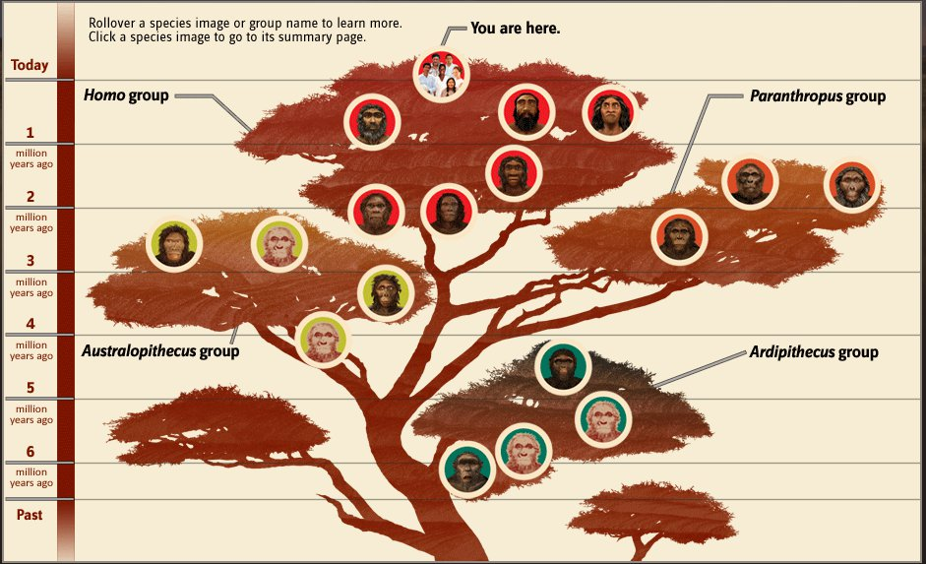
https://arstechnica.com/science/2015/09

Slide 6
A. Most significant physical changes to monitor for human evolution to modern humans:
--development of fully developed bipedal locomotion with erect posture
--increase in brain size over time
-- some facial characteristics
B. Most significant cultural changes to monitor:
--initial emergence of culture: ability to use and make tools: most references say this began about 2.5-2.6 MYA but new evidence constantly challenges this
- Emergence of rituals, belief

Slide 7
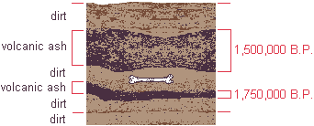
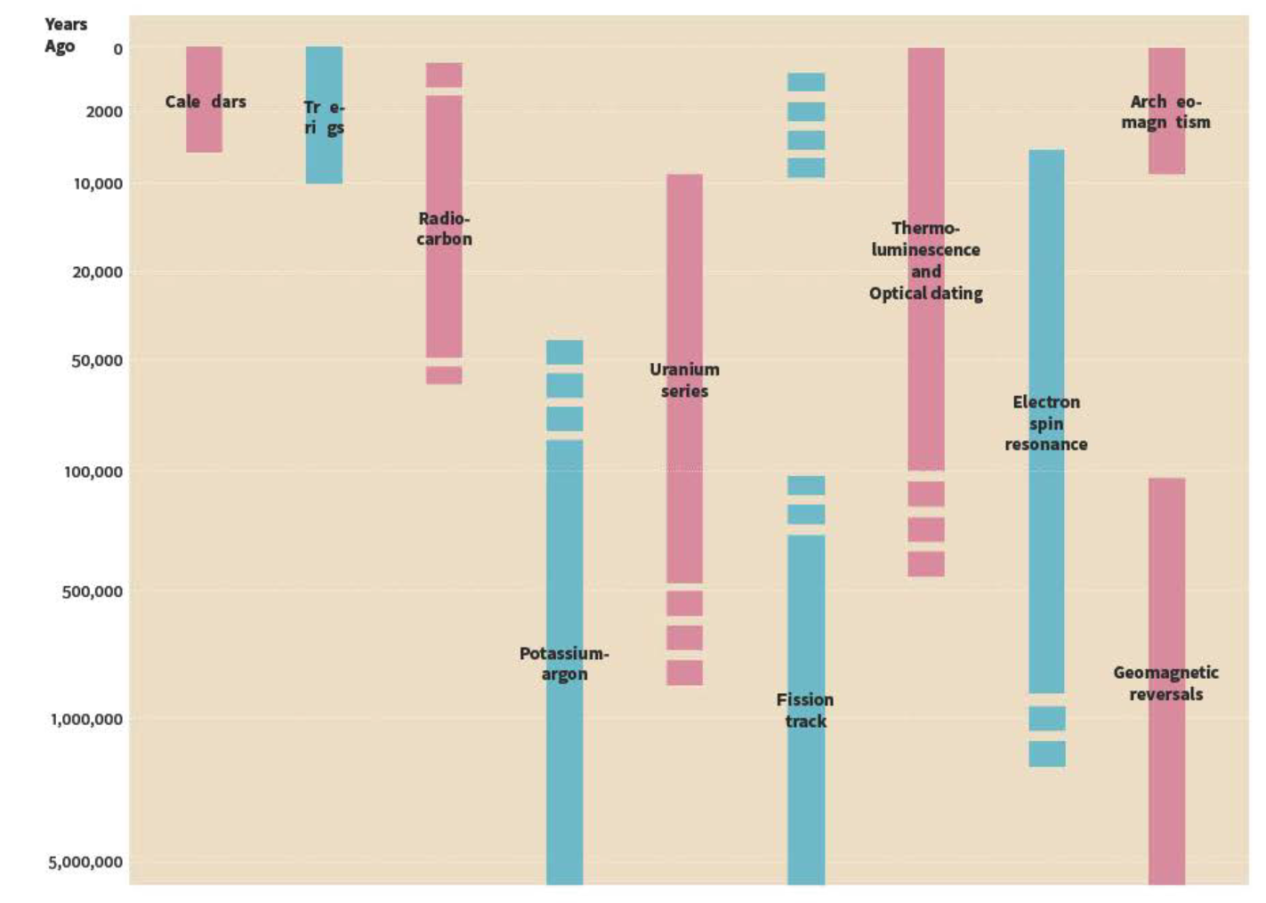
Dating the earliest sites by
“absolute” methods: dates consist of a range
Potassium argon dating
(or “argon dating)”
volcanic tuff above and below
archaeological deposits (bone)
https://www2.palomar.edu/anthro
Renfrew, C. and Bahn, P. (2020). Archaeology: theories, methods and practice. Thames and Hudson, London.

Slide 8
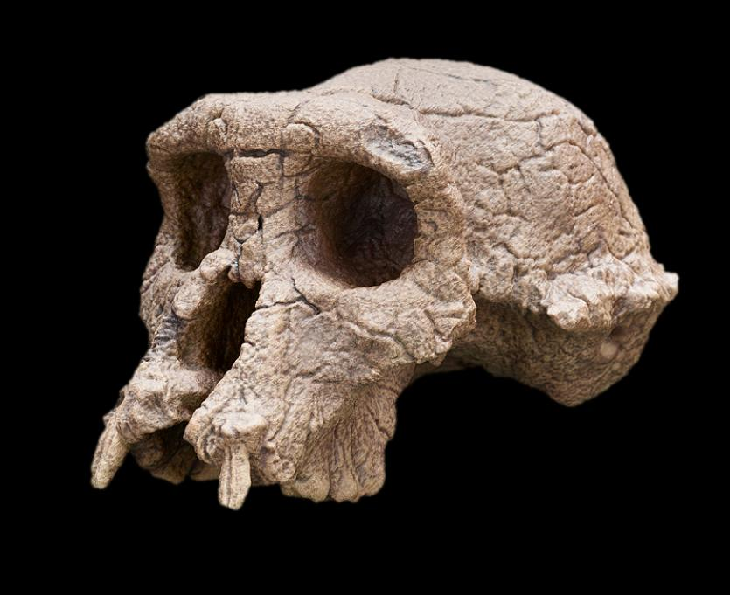
Sahelanthropus tchadensis, 7-6 million years ago
Ape-like features:
Small brain
Sloping face
Very prominent browridges
Elongated skull
Human-like features
Small canine teeth
Short middle part of the face
Spinal cord opening
Brunet ,M., et al. 2002. A new hominid from the Upper Miocene of Chad, central Africa. Nature 418(6894), 145-151

Slide 9
Genus Ardipithecus (several species, including ramidus) :
Ca. 5.3 MYA, Ethiopia (and Kenya)
a relatively recent discovery; different species that have several hominin features while retaining ape-like features
Ardipithecus ramidus: debates about whether it belongs to the genus Australopithecus instead on the basis of teeth size and shape

Slide 10
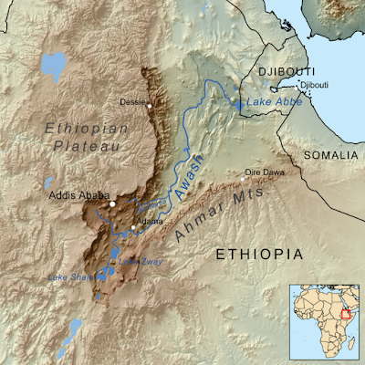
Middle Awash area of Ethiopia: key area for many different kinds of hominins
https://sites.google.com/site/discoveringmiddleawash

Slide 11
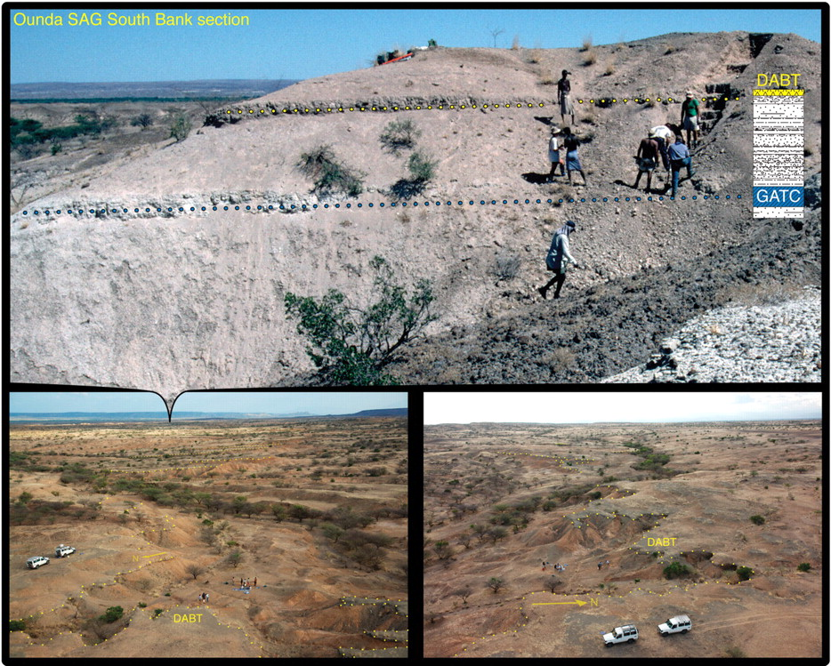
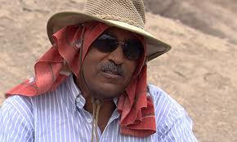
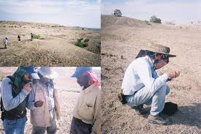
Fieldwork in the Ardipithecus
site area, Middle Awash, Ethiopia:
Surveying for sites and
sifting through surface finds
Paleoanthropologist
Berhane Asfaw, Rift Valley Research Service
https://www.science.org/doi/10.1126/science.1175802

Slide 12
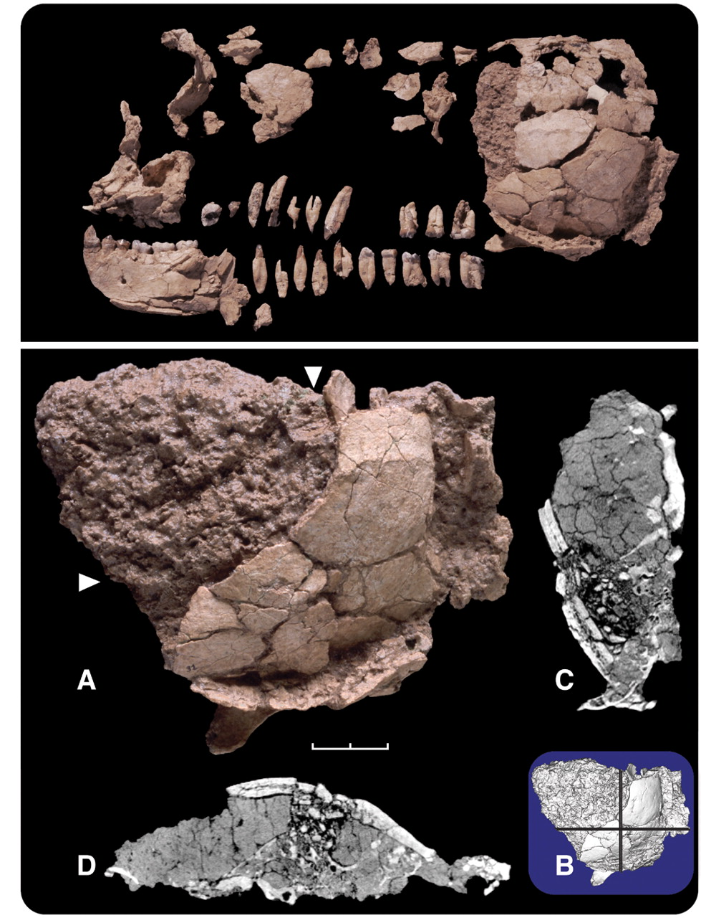
the crushed and fragmented skull of Ardipithecus was too fragile to pick apart and reassemble into a complete skull
https://www.science.org/doi/10.1126/science.1175825

Slide 13
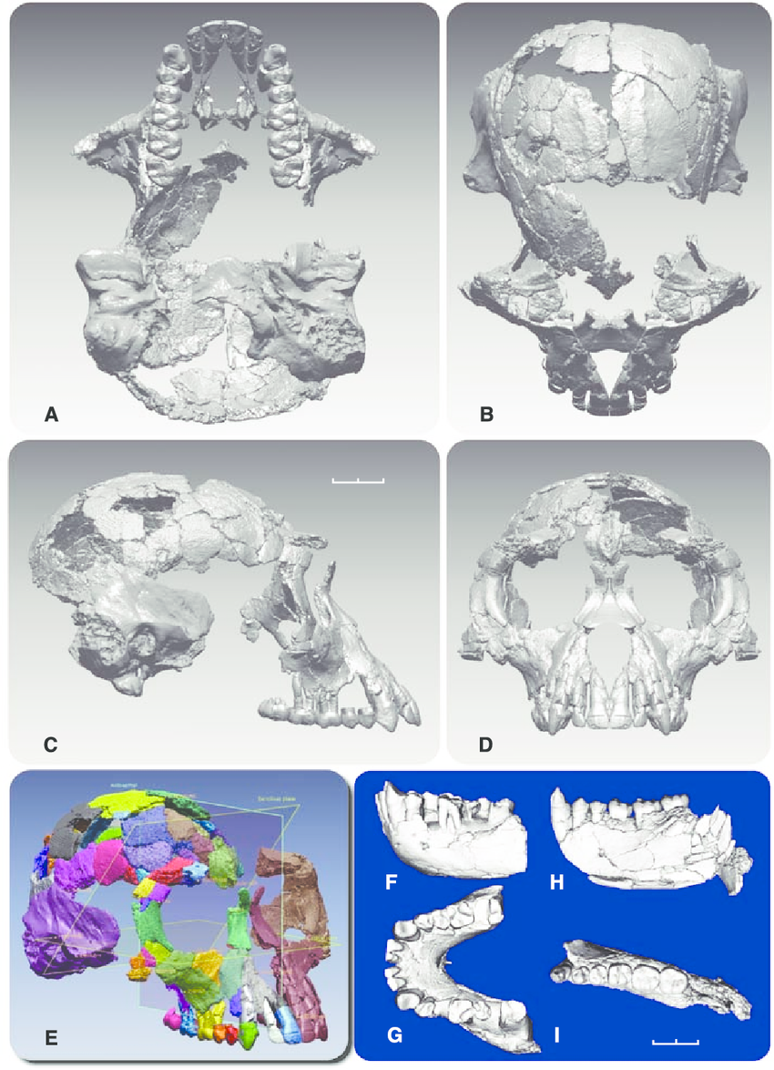
Gen Suwa, University of Tokyo, digitally reconstructed a partial skull
using micro-computed tomography (CT), using more than 5000 CT
images of the fossils; then he rebuilt a virtual skull to show the missing parts
Gunz et al. (2009) Principles for the virtual reconstruction of hominin crania. Journal of Human Evolution, 57: 48-62.
https://www.researchgate.net/figure/Digital-representations-of-the-Ar-ramidus-cranium-and-mandible-A-to-D-The_fig2_40446787

Slide 14
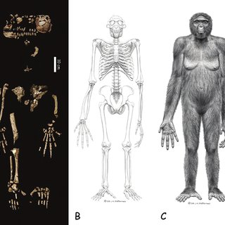
reconstruction
Ardipithecus ramidus
The opposable big toe was
suited for grasping branches but not for walking on all four limbs; the long fingers and flexible wrists
helped with movement in trees
https://www.researchgate.net/publication/235351215_Ardipithecus_Ramidus_and_the_Birth_of_Humanity

Slide 15
https://arstechnica.com/science/2015/09

Slide 16
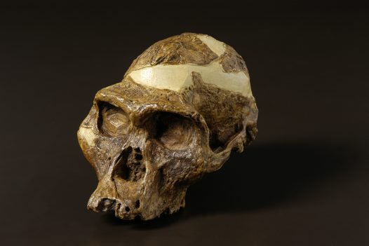
radiation or diversification of hominins, ca. 4-2 MYA:
3 genera: Kenyapithecus, Paranthropus, Australopithecines (several species), many debates about classification
mainly East (Kenya, Tanzania, Ethiopia) and South Africa—
“more gracile” forms of Australopithecines:
A.africanus, A. bahrelghazali, A. anamensis, A. garhi, A, sediba
https://australian.museum/learn/science/human-evolution/australopithecus-africanus

Slide 17
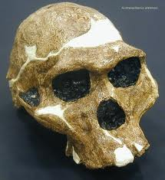
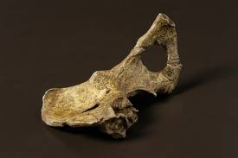
significance of Lucy, ca. 3.7-3.0 MYA: Australopithecus afarensis, almost complete skeleton, discovered in the Hadar region of Ethiopia by Donald Johanson
A. afarensis skull; larger brain c. 450-475 cc
A. afarensis pelvis: early bipedalism
https://www.sciencefriday.com/segments/lucys-bones

Slide 18
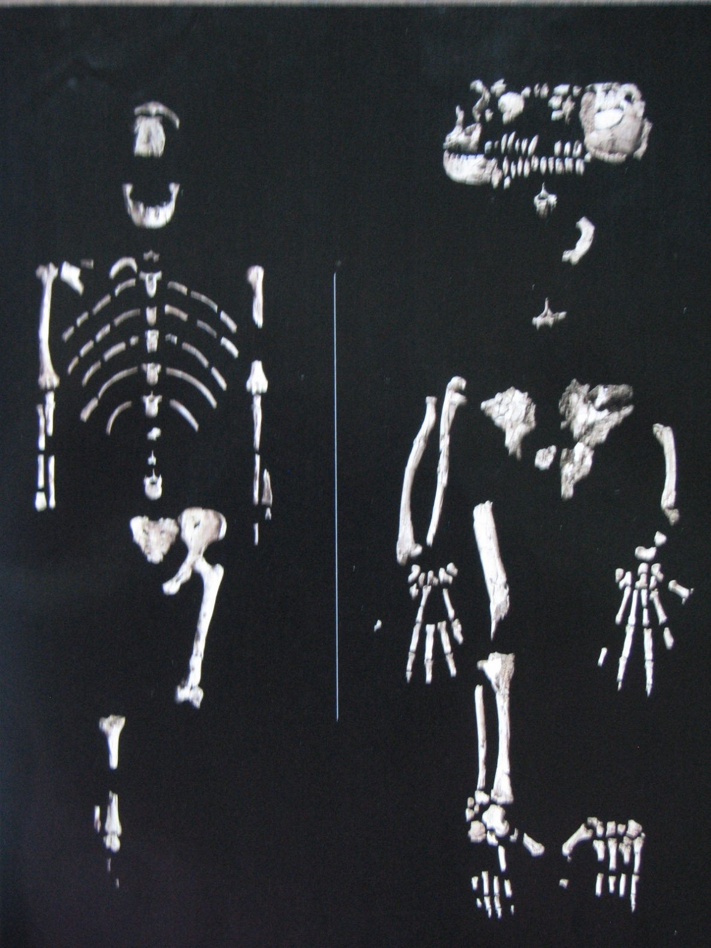
“Lucy”
A. afarensis
“Ardi”
Ardipithecus ramidus
c. 3.2 MYA
pelvis and
limbs show
more fully
developed
bipedalism
c. 4.5 MYA ago
https://www.bbc.com/mundo/noticias-56326266

Slide 19
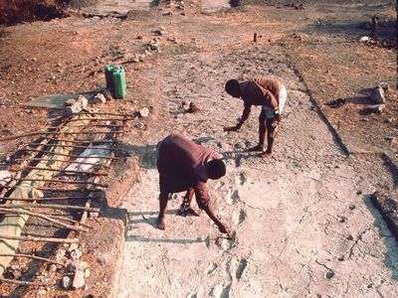
other evidence for bipedalism:
Laetoli, Tanzania
footprints of hominins
in volcanic ash dated ca. 3.8 MYA
likely A. afarensis, fossil remains
from those deposits
https://www.britannica.com/place/Laetoli

Slide 20
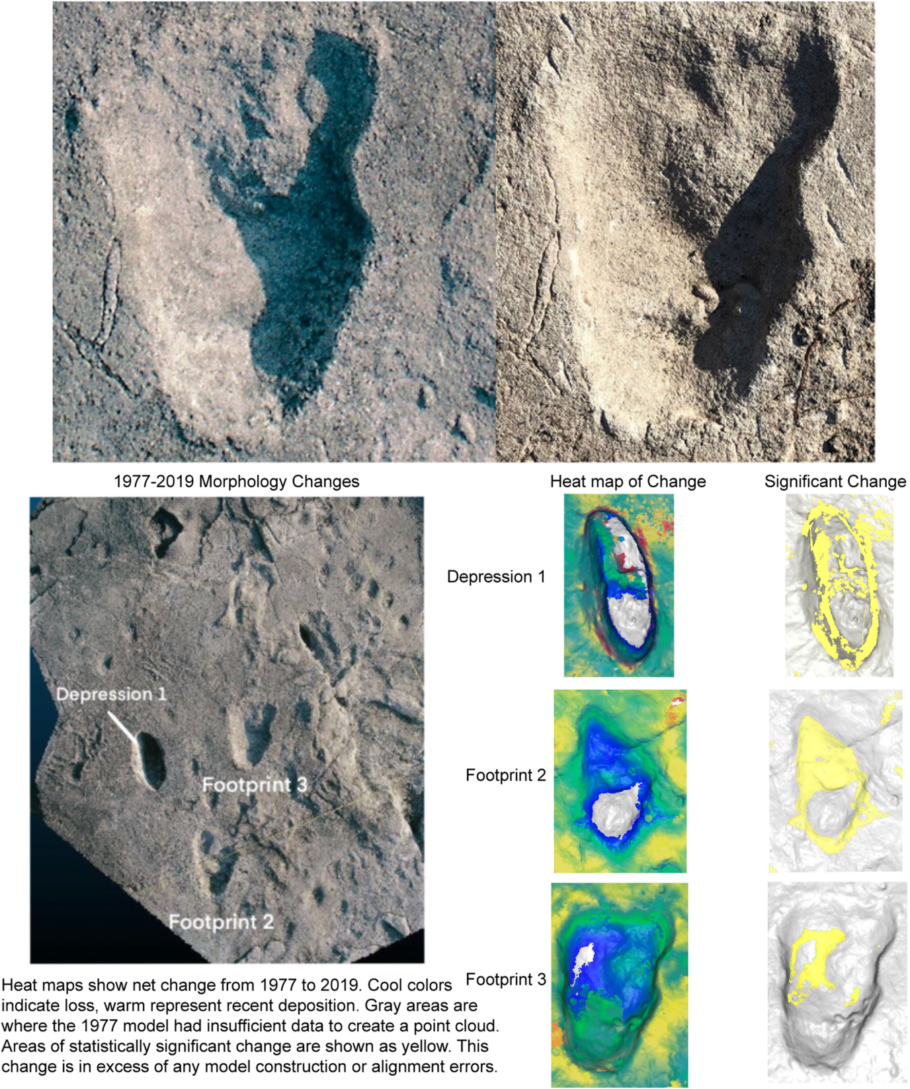
McNutt et al. 2021. Footprint evidence of early hominin locomotor diversity at Laetoli, Tanzania.
https://doi.org/10.1038/s41586-021-04187-7

Slide 21
Example: interpreting Australopithecus garhi (“surprise” in Afar language)
--a relatively new kind of Australopithecus, 2.5 MYA, later than Lucy (A.afarensis), discovered 1997 by the Berhane Asfaw- Tim White (Berkeley) team,
Middle Awash area, Ethiopia
--brain size 450 cc; the earliest tool maker?
A. garhi bones found in contemporary
deposits with nearby bones of bovids and horse
showing evidence of cut marks, from
butchering by use of stone tools
BUT no stone tools were found in
direct association—
So did A. garhi actually use tools
to slice meat off bone, etc.?
The nearest stone tools were found in
contemporary deposits at Gona,
Ethiopia, about 60 miles away
https://sites.google.com/site/discoveringmiddleawash

Slide 22
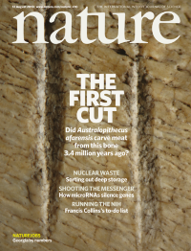
New discoveries: more than one new, EARLIER site from Ethiopia showing evidence of tool use for A. afarensis like “Lucy”
association of stone tools with Australopithecus afarensis
roughly between 2.5- 3.0 MYA
https://www.nature.com/nature/volumes/466/issues/7308

Slide 23
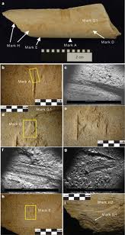
evidence from bones:
femur shaft of young bovid
individual cut marks and
clustered damage
indicating percussion
slicing and efforts to get
at bone marrow
How can one determine if such
marks were not caused by another
agent of some kind?
https://www.calacademy.org/press/releases/scientists-discover-oldest-evidence-of-stone-tool-use-and-meat-eating-among-human

Slide 24
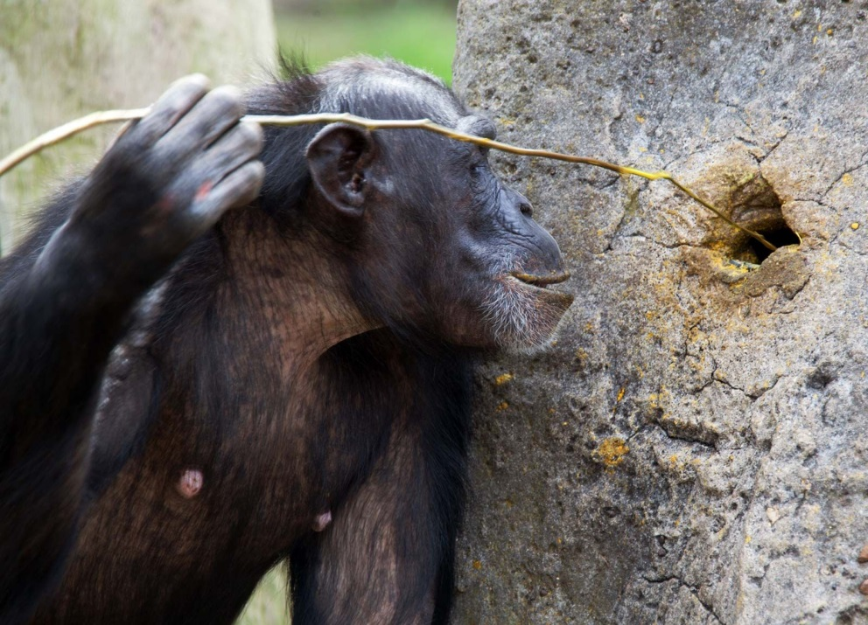
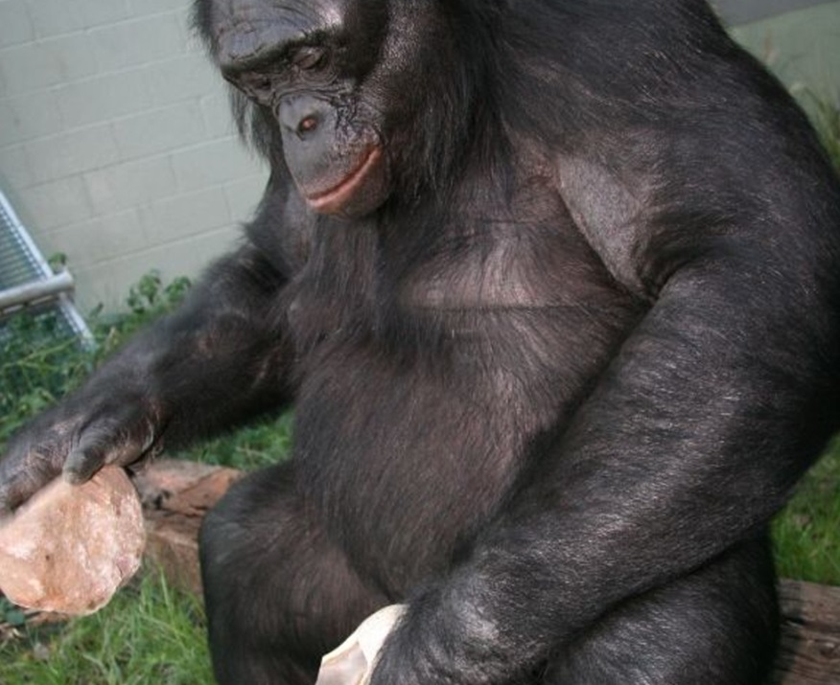
debates about the ability of chimps and bonobo to make and
use wooden and stone tools:
https://www.britannica.com/science/tool-use-animal-behaviour
https://www.insidescience.org/news/bonobo-stone-tools-competent-ancient-human

Slide 25
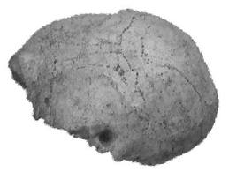
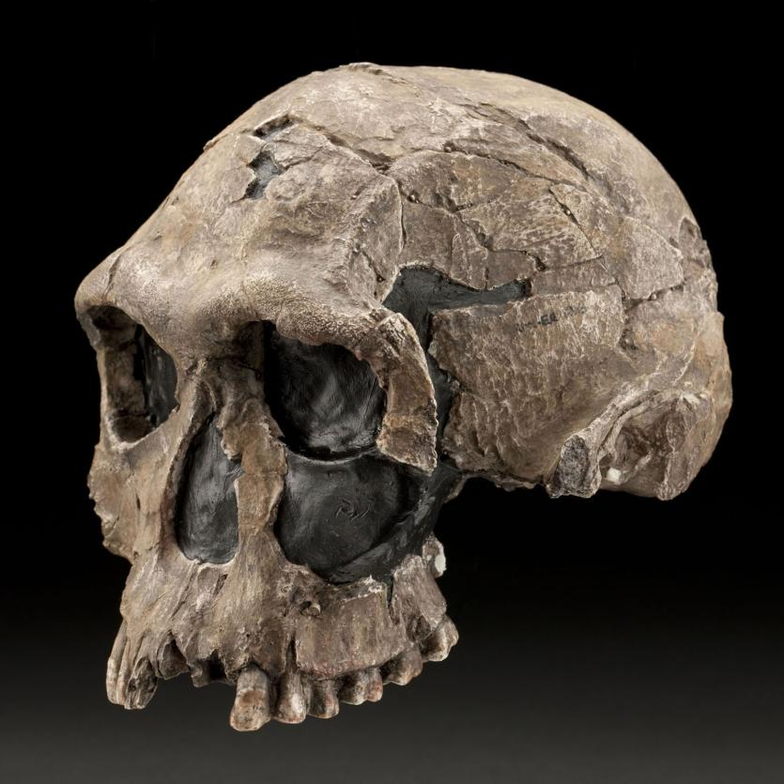
the next milestone in human physical evolution:
Homo habilis: a new Genus, Homo
Homo Genus
Larger brain to body ratio,
reduction in size of jaw
and cheek teeth
Interpretations:
tools doing more work teeth
used to do, wider variety of foods,
more processed foods, and
significance
of meat for brain development
Homo habilis
survival
on the African savanna due to expanded brain size; also flatter
face, steeper forehead
https://humanorigins.si.edu/evidence/human-fossils/fossils/knm-er-1813

Slide 26
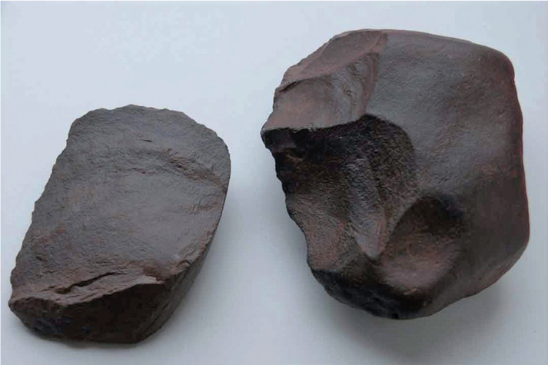
reconstruction of Homo habilis making stone tools,
larger brain size, c. 500-800 cc, 2.5-1.6 MYA
direct association of fossil hominin remains and Oldowan tools
at Olduvai Gorge and other sites in Tanzania and Kenya
Chazan, M. (2021). World prehistory and archaeology: pathways through time. Routledge, New York.

Slide 27
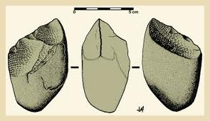
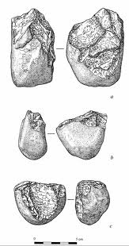
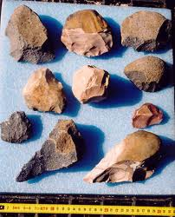
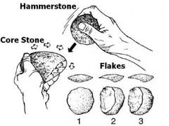
Oldowan tools (an “industry” rather than a “culture”):
“Lower Paleolithic technology”, Early Stone Age, ca. 1.9- 1.15 MYA
bifacial choppers, flake scrapers, larger scrapers, hammer stones to make tools
Evidence from signs
of retouch and bulb
of percussion
https://www.worldhistory.org/Oldowan_Tools

Slide 28
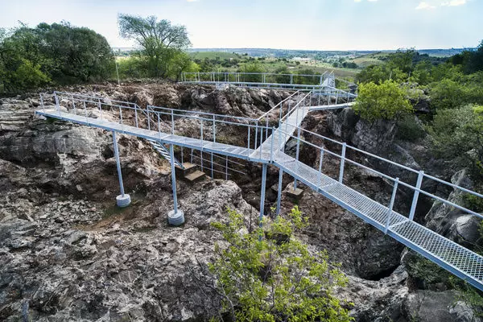
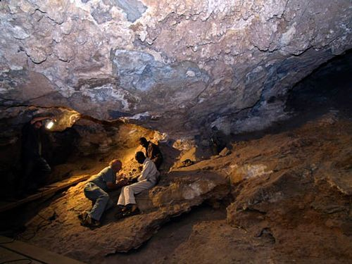
The evidence today suggests that more than one type of hominin around 2.5 MYA made and used stone tools (bone and wood also likely), even if they were not on the direct line to modern humans
Paranthropus, formerly called A.boisei (or “robustus”) in direct association with
Oldowan tools at Olduvai Gorge in Tanzania, Zinjanthropus
discovered by Louis and Mary Leakey
https://www.fineartstorehouse.com/excavation-site-sterkfontein-caves-south-africa
https://www.pinterest.com/pin/381328293421930380
sites in South Africa such as Sterkfontein and Swartkrans caves

Slide 29
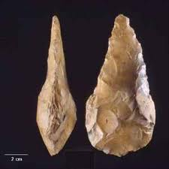
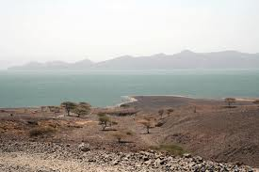
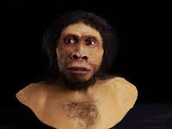
Homo ergaster 1.8 MYA --ca. 600,000 BP
--during earlier periods, Oldowan stone tools were made; later (by 1.65 MYA) more sophisticated stone tools were made, Acheulean tradition
--found at the site of Lake Turkana, northern Kenya:
“Turkana Boy site”
https://www.nationalgeographic.org/photo/kfri-turkanaboy
https://www.pathwayz.org/Tree/Plain/ACHEULEAN+TOOLS+%26+FIRE

Slide 30
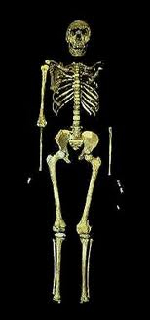
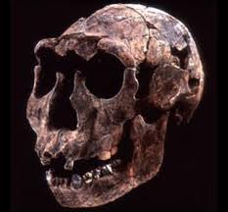
---shape of pelvis allowed identification as a male; limbs and teeth indicated he was young
--- more developed bipedalism,
---long limbs and other features suggest adaptation to a hot, dry climate
---but the skull and brain size show it is not modern:
cranial capacity 600-910 cc—not much larger than Homo habilis; large brow ridges, large jaws
currently regarded as a direct ancestor to the earliest modern humans/ Homo sapiens, found in Africa
Homo ergaster,
Turkana Boy
best preserved
hominin fossil
https://www.turkanabasin.org/turkanaboy

Slide 31
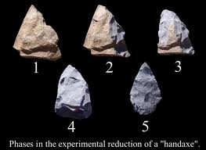
Acheulean hand axes
“bifaces”, worked on both sides; early “swiss army
knives” for many purposes
first developed in Africa, then the
technology moved with the hominins to other areas
https://www.pathwayz.org/Tree/Plain/ACHEULEAN+TOOLS+%26+FIRE

Slide 32
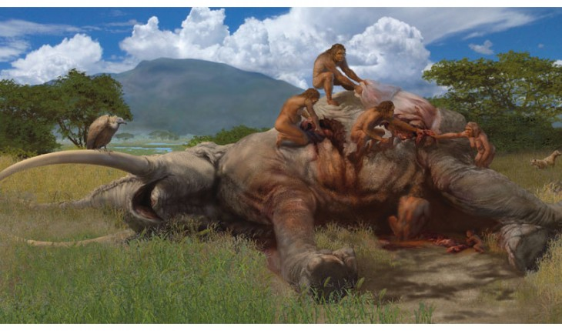
Were early hominins hunters or scavengers?
https://hominidpost.com/meat-eating-among-the-earliest-humans

Slide 33
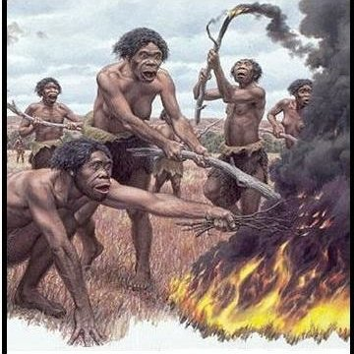
implications for the emergence of culture: cooperation for tasks and communication, food sharing, learning
investigating control of fire, food preparation
- Symbolism and rituals: the Rising Star cave system in South Africa
https://www.researchgate.net/figure/Artwork-depicting-H-erectus-hominins-igniting-a-bonfire-upon-the-open-grasslands-and_fig1_323542697

Slide 34
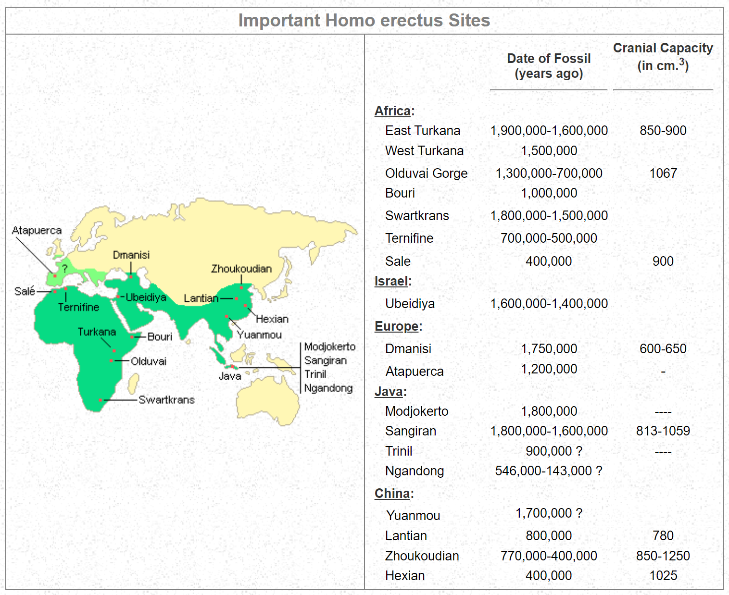
further dispersal of hominins:
Homo erectus in Asia (Indonesia and China)
https://www2.palomar.edu/anthro/homo/homo_2.htm

Slide 35
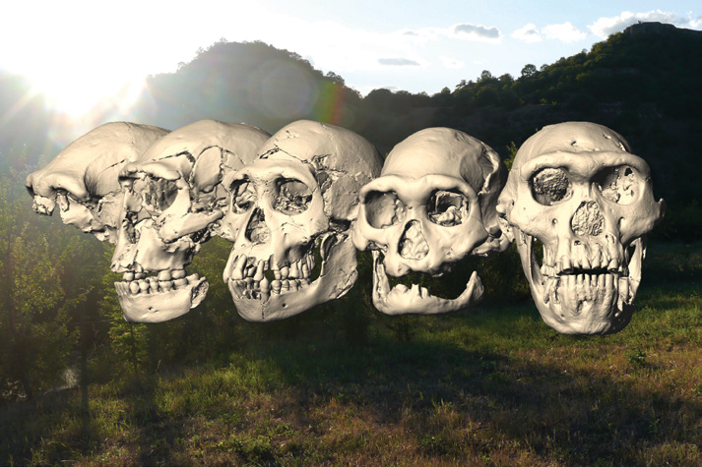
The diversity of Homo erectus: the Dmanisi site in Georgia
Chazan, M. (2021). World prehistory and archaeology: pathways through time. Routledge, New York.

Slide 36
References
Brunet ,M., et al. 2002. A new hominid from the Upper Miocene of Chad, central Africa. Nature 418(6894), 145-151
Chazan, M. (2021). World prehistory and archaeology: pathways through time. Routledge, New York.
Darwin, C. (2006). On the origin of species. Dover Publications, London.
Gunz et al. (2009) Principles for the virtual reconstruction of hominin crania. Journal of Human Evolution, 57: 48-62.
McNutt et al. 2021. Footprint evidence of early hominin locomotor diversity at Laetoli, Tanzania. https://doi.org/10.1038/s41586-021-04187-7
Renfrew, C. and Bahn, P. (2020). Archaeology: theories, methods and practice. Thames and Hudson, London.

