Slide 1
Great Civilizations of the Ancient World
Populating the Earth – early human migrations

Slide 2
Modern humans and earlier species:
Larger brain capacity (1200-1700 cc)
Globular braincase
Vertical forehead
Reduced brow ridges
Pronounced chin
Smaller teeth
Reduced body mass
Unique pelvic shape

Slide 3
physically modern humans first developed in Africa about 180,000 BP (new evidence puts it at 315,000 BP - Morocco) and then spread to other world areas, replacing other populations of hominins
Why were modern humans more successful than other species such as Neanderthals?
--further development of language?
--more sophisticated technologies for getting food and social organization?
--fully developed symbolic thought?

Slide 4
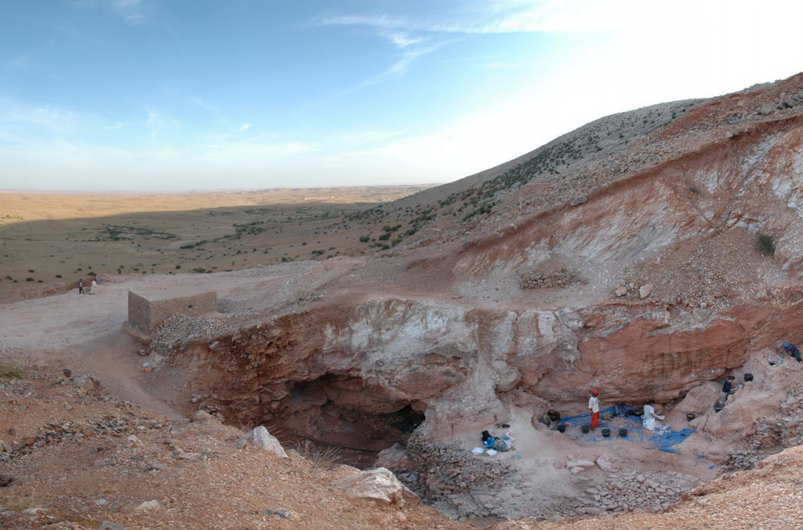
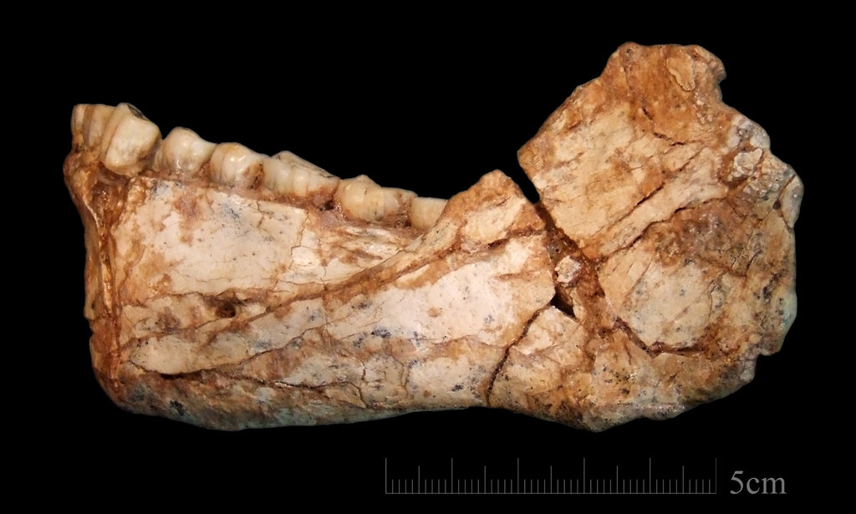
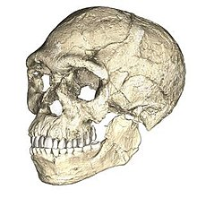
Jebel Irhoud
https://www.nature.com/articles/nature22335

Slide 5
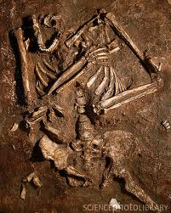
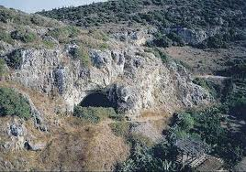
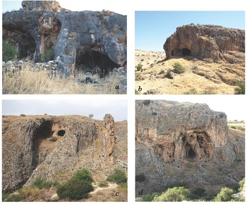
cognitive abilities of Neanderthals:
How close to modern humans were they?
intentional burial of the dead
Kebara cave, Israel: an intentionally
prepared pit for the deceased
Amud Cave, Israel:
clear case of an object
placed with the deceased—
upper jaw of deer on the
child’s pelvis
https://www.sciencephoto.com/media/395213/view/neanderthal-skeleton-kebara-cave-israel
same cave where hyoid bone found from the larynx, similar to that in modern humans: possibility of speech
https://www.cambridge.org/core/books/abs/quaternary-of-the-levant/palaeolithic-occupations-in-nahal-amud
evidence of ritual
and symbolic thought

Slide 6
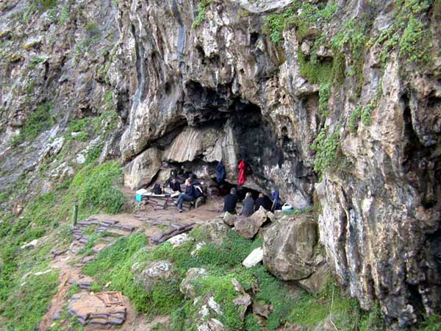
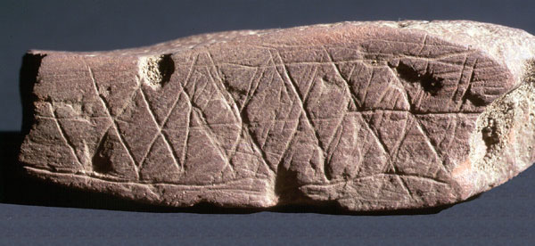
”art objects”: concepts of aesthetics
Blombos Cave, South Africa: pieces of red ochre with incised designs
about 77,000 BP: one of the oldest recognized art
finely made bone tools, bones of large deep sea fish;
small shell beads (some with pigment on them);
NEW chemical analysis of “ochre paint” : including bone marrow and charcoal as binders by Christopher Henshilwood
https://www.researchgate.net/figure/Ochres-from-the-Blombos-Cave-Evolutionary-Studies-Institute-University-of-the_fig1_323285127

Slide 7
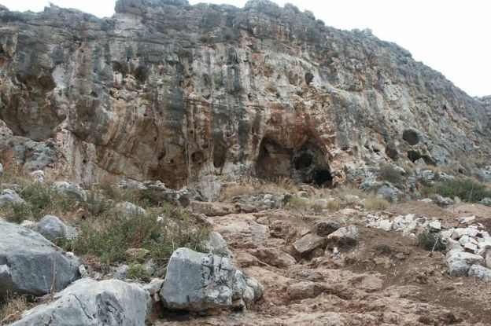
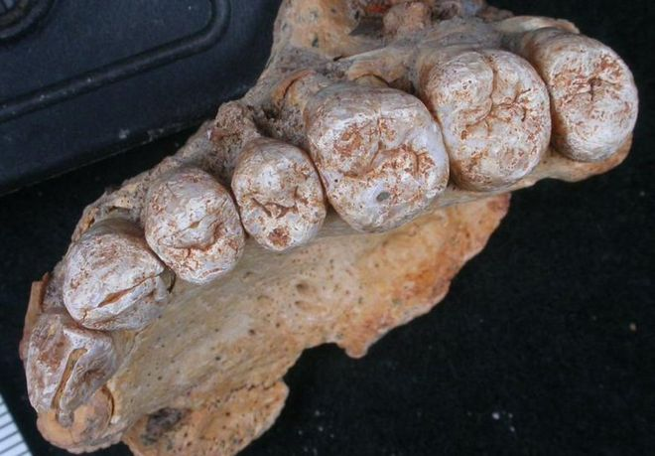
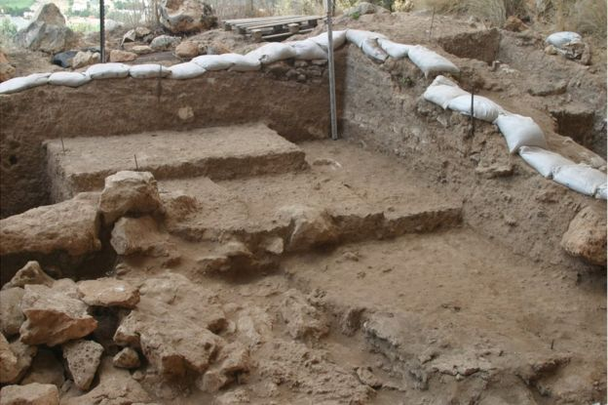
modern humans left Africa much earlier, Misliya cave, Israel
https://www.bbc.com/news/science-environment-42817323

Slide 8
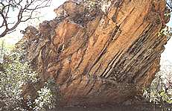
Nauwalabila I site, northern Australia, 60,000-50,000 years ago
https://www.google.com/search?q=nauwalabila+I&tbm=isch&ved=2ahUKEwj06erfquv2AhUKTpQKHeaZBeAQ2-cCegQIABAA&oq=nauwalabila+I&gs_lcp=CgNpbWcQAzIFCAAQgAQyBAgAEBg6BwgjEO8DECdQ3wJY4BtgzB9oAXAAeACAAZsBiAG8CZIBBDAuMTCYAQCgAQGqAQtnd3Mtd2l6LWltZ8ABAQ&sclient=img&ei=Mv1CYvSIGoqc0QTms5aADg&bih=781&biw=1334#imgrc=OBTUt0AL5IhJIM
Questions and skepticism regarding older (than Europe) dates

Slide 9
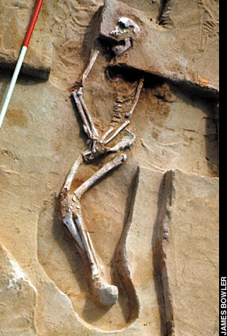
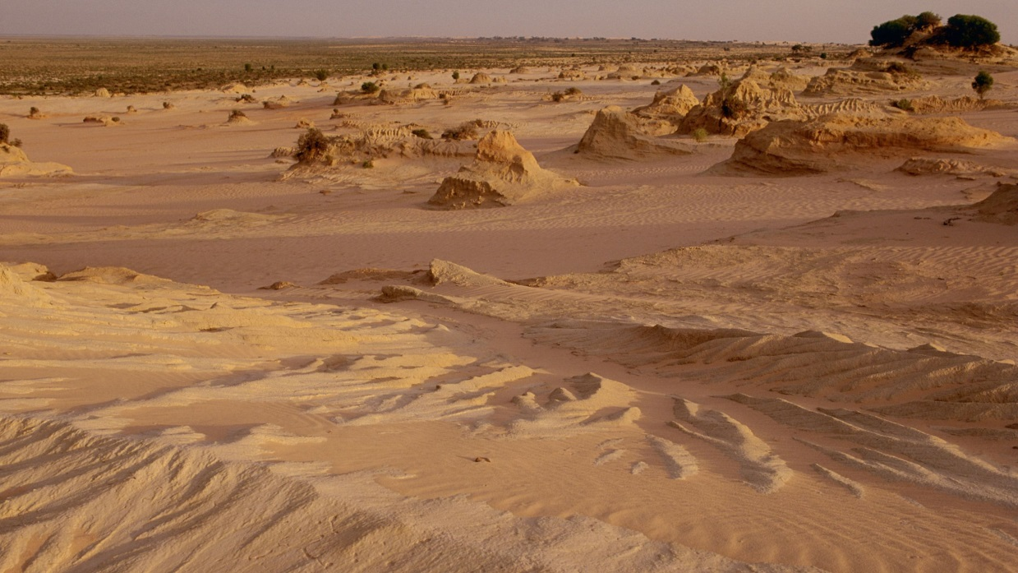
sites such as Lake Mungo
in SE Australia
ca. 40,000-50,000 BP: stone tools and 2 burials
https://www.theguardian.com/australia-news/2017/nov/14/finding-mungo-man-the-moment-australias-story-suddenly-changed
https://www.thoughtco.com/lake-mungo-australia-171519

Slide 10
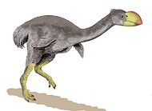
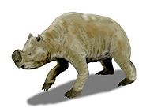
Australian Megafauna Extinction
Mass extinction about 50-40,000 BP
23 of 24 genera of large animals extinct
Overhunting by humans?
Sophisticated stone tools technology?
Versus “firestick farming”?
https://commons.wikimedia.org/wiki/File:Dromornis_BW.jpg
https://en.wikipedia.org/wiki/Zygomaturus
Dromornis
– flightless bird
3 m, 500 kg
Zygomaturus
wetland marsupial
2 m, >1000 kg
Notes:
Not climate, no clear association withstone tools and all the extinct megafauna

Slide 11
Peopling of the New World
Three models:
Clovis First: 13,500-12,500 years ago
Pre-Clovis: earlier than 13,500 years ago
Early Arrival: 30,000 years ago

Slide 12
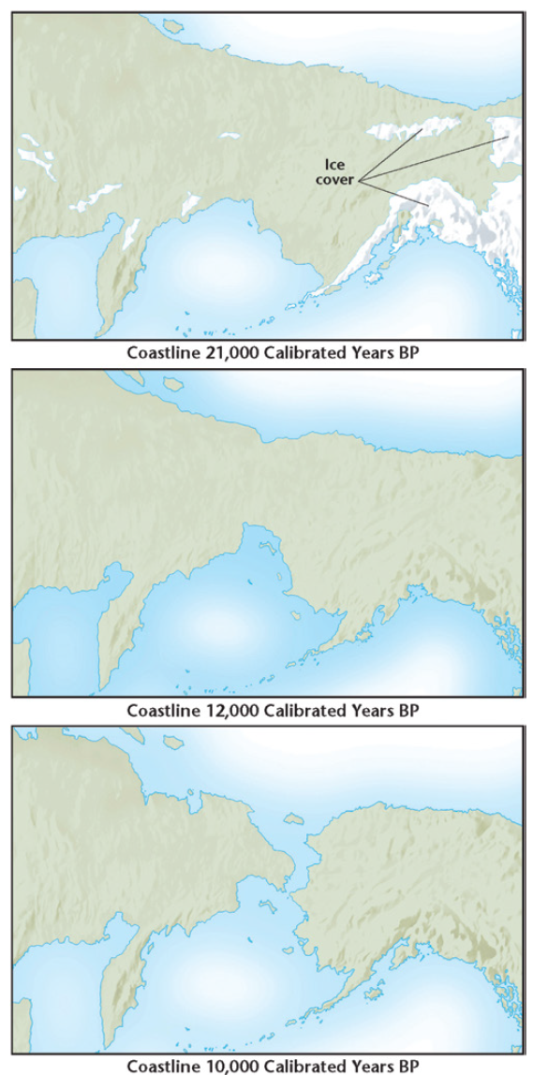
How and When?
Glacial Maximum → ↓ sea level lower by about 150m
Siberia+Alaska+Yukon = Beringia (28,000-12,000 BP)
  “Bering land bridge” about 1000 km wide
  today 37 meters bsl
Chazan, M. (2021). World prehistory and archaeology: pathways through time. Routledge, New York.

Slide 13
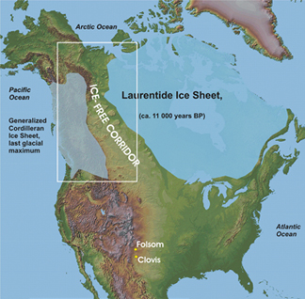
the “Ice-Free Corridor” Route, long proposed, significance of Clovis Culture
http://www.geotimes.org/feb04/feature_Revisited.html

Slide 14
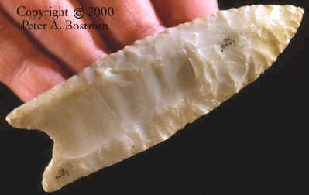
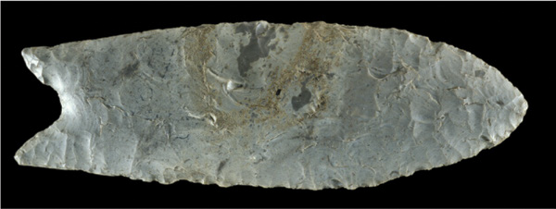
Peopling of the New World
when??
Clovis culture ca. 13,500- 12,500 BP
Folsom point
Chazan, M. (2021). World prehistory and archaeology: pathways through time. Routledge, New York.
undisputed early culture in North America: but is it the earliest??
Notes:
Ask: Why spend the time on fluting: think of both technical and less practical reasons: 1. functional: specific type of haft, increased penetrability; 2. symbolic: hunting rituals – why invest this time; 3. could be resharpened if a tip was broken –
Could it be ALL these things???? Does it have to be either/or?
More than 10,000 years ago early inhabitants of the Americas, known as Paleo-Indians, hunted large mammals such as bison, mammoth, and mastodon. The hunting of such large prey was a late development in human prehistory, as it required sophisticated stone weaponry and a kind of planning and coordination possible only with an elaborate system of communication, such as language. This diorama from the National Museum of Anthropology in Mexico City depicts Mesoamerican Paleo-Indians killing a mastodon
Currently accepted dates for Monte Verde are 12,600-11,700 rcbp (uncalibrated radiocarbon years)
[14,500-13,500 cal BP]
[12,500-11,500 BC]
Currently accepted dates for Clovis are 11,600-10,700 rcbp (uncalibrated radiocarbon years)
[13,400-12,900 cal BP]
[11,400-10,900 BC]
(text Pp. 280-282 etcetera)
[dates from Fiedel 2000]
Clovis spearpoints, such as this one from northeastern Utah, are among the oldest stone tools known in the Americas. The oldest Clovis spearpoints in North America date to about 11,500 years ago. Native Americans attached such points to shafts, making spears that could either be thrust directly at animal prey or thrown using atlatls (spear-throwers). Archaeologists believe the spearpoints were also used as multipurpose cutting tools
The Folsom culture, known from its stone tools, developed in North America about 11,000 years ago. This Folsom point comes from the New Mexico site of Blackwater Draw, where archaeologists also found the first artifacts of the Clovis, an older Native American culture. Folsom points were fluted (concave in the center) along their entire length and were attached to shafts for use as spears.

Slide 15
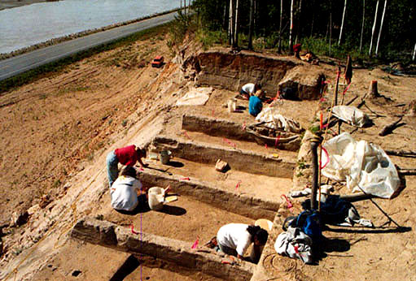
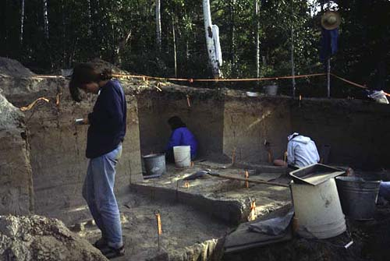
Broken Mammoth, Alaska:
a Nenana Complex Site
Ca. 14,000-12,800 BP
good preservation of animal bone, hunting wide variety of game such as elk, stone tools in association
http://dnr.alaska.gov/parks/oha/projects/brokenmammoth.htm
Notes:
Subsis: big game, esp elk, sheep, generalized subsis strateg, settlemen in small camps- best data from Broken Mammoth site – shows wide range of activ – sm family gp for wks to months to exploit res in diverse ecol zones

Slide 16
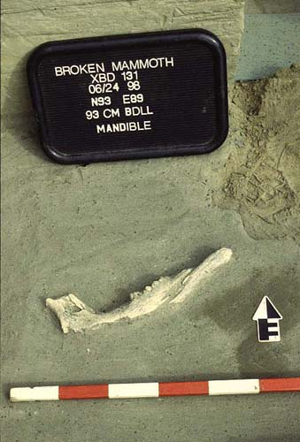
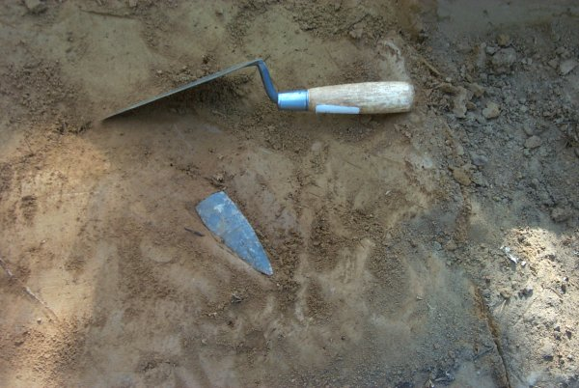
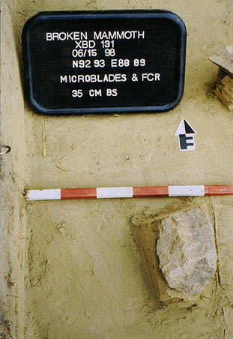
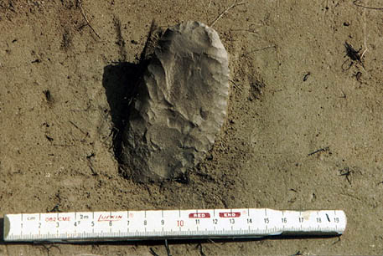
Broken Mammoth: a Nenana Complex Site
http://dnr.alaska.gov/parks/oha/projects/brokenmammoth.htm
Notes:
Subsis: big game, esp elk, sheep, generalized subsis strateg, settlemen in small camps- best data from Broken Mammoth site – shows wide range of activ – sm family gp for wks to months to exploit res in diverse ecol zones

Slide 17
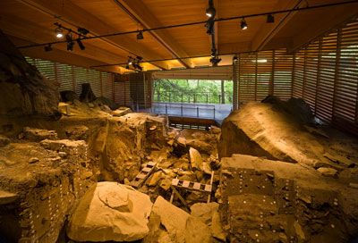
Meadowcroft Rockshelter, contested site
deeply stratified rock shelter in PA, clear living area with evidence
of stone tool production, trash, cooking food; 6 radiocarbon dates reported as 23,000-15,500 BP; possible contamination of dates
https://www.heinzhistorycenter.org/exhibits/meadowcroft-rockshelter

Slide 18
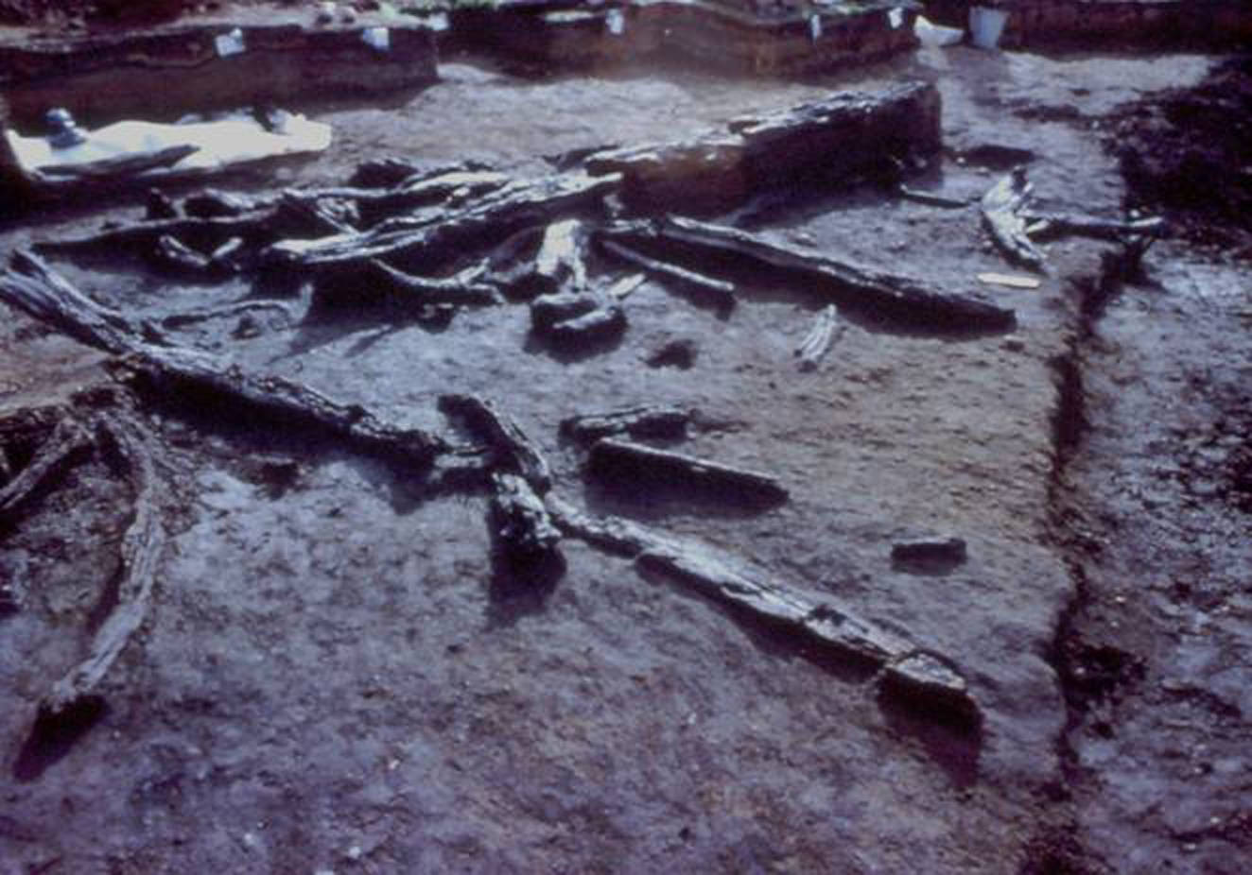
Monte Verde, Chile: site providing the strongest support for an early migration into the New World
30 radiocarbon dates show uncontested occupation by
ca. 15,000 BP;
Monte Verde:
wooden stakes to
support hide
huts, butchered animal bone
https://www.archaeology.org/issues/145-1409/features/2368-peopling-the-americas-monte-verde

Slide 19
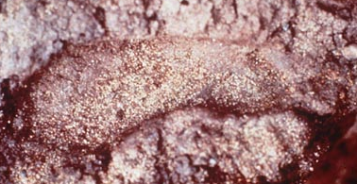
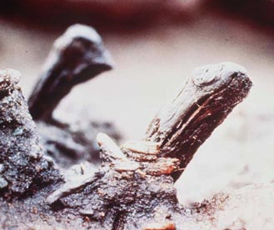
Monte Verde, Chile
Anaerobic (bog)
Hunters (mastodon, spears)
AND Gatherers (plants, digging sticks, mortars)
Wooden structures
about 30-50 people
Year round (plants, animals)
Not Big Game Hunters
Child’s footprint
Tent stakes
https://www.archaeology.org/issues/145-1409/features/2368-peopling-the-americas-monte-verde
Notes:
- - site is located in a bog environment > it is an anaerobic environment so there is no oxygen and therefore preservation is remarkable.
there is great wood preservation and there have been the remains of wooden structures excavated
- it is suggested that the settlement would have been fairly small 30 to 50 people but that it would have been year round as there is evidence of plants and animals that come into season in the four seasons
- it is clear that the people were doing some big game hunting as there is remains of mastadon, but also lots of evidence of collecting local plants
- evidence of wooden spears, but also of wooden digging sticks
- this site is very important as it gives us evidence of a much greater range of activities than the usual paleo-indian site
- traditionally remains from paleoindian sites have been mostly stone tools and animal bones leading researchers to suggest that big game hunting was the focus of paleoindian adaptation > bias
- this site challenges the notions of big game subsistence

Slide 20
Early Arrival Model
Pedra Furada in Brazil (48,000-35,000 BP)
Debates about the meaning of burnt patches—due to human action (fires?)
Are the stone objects really tools? What caused the chipping on the cobbles?

Slide 21
New World large fauna: what happened?
17 genera megafauna extinct by about 13,000 BP
Environmental decline, or Overkill?
Another unresolved issue

Slide 22
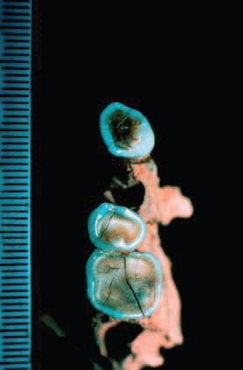
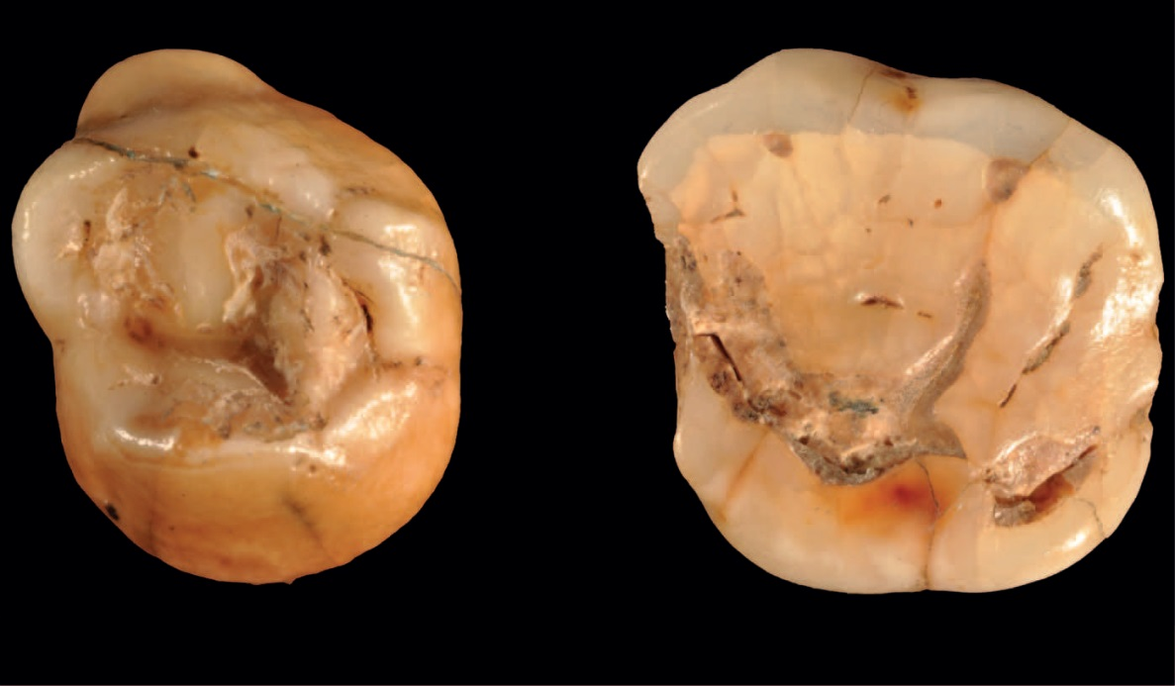
Earliest humans in Europe:
~43,000 years ago
Higham et al. (2011). The earliest evidence for anatomically modern humans in northwestern Europe. Nature, 479: 521-24.
Benazzi et al. (2011). Early dispersal of modern humans in Europe and implications for Neanderthal behavior. Nature, 479: 525-28.

Slide 23
Contributions from other fields

Slide 24
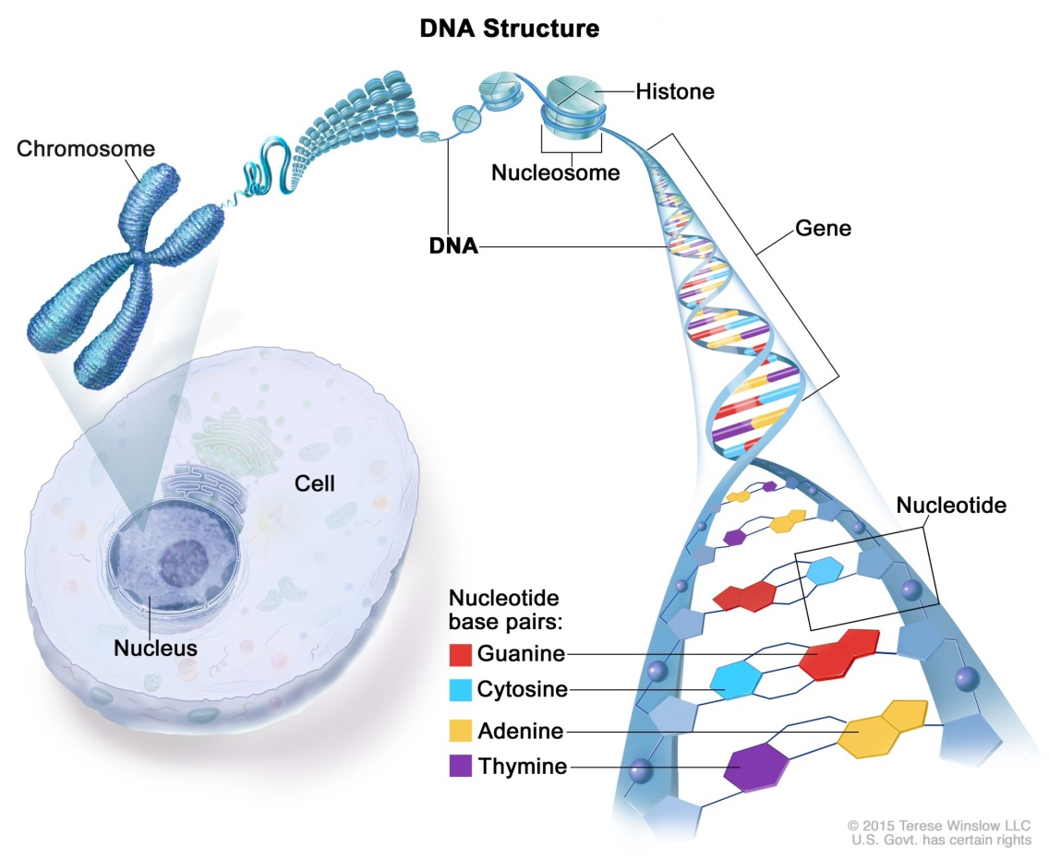

International Human Genome Project
~3.1 billion base pairs
https://www.cancer.gov/publications/dictionaries/genetics-dictionary/def/dna
https://www.nature.com/articles/d41586-021-01506-a

Slide 25
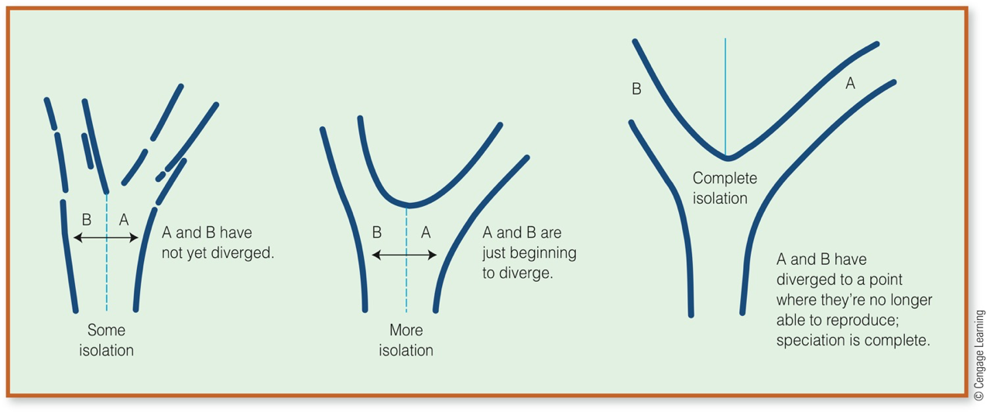
How different genetic features develop?
https://www.cengagegroup.com

Slide 26
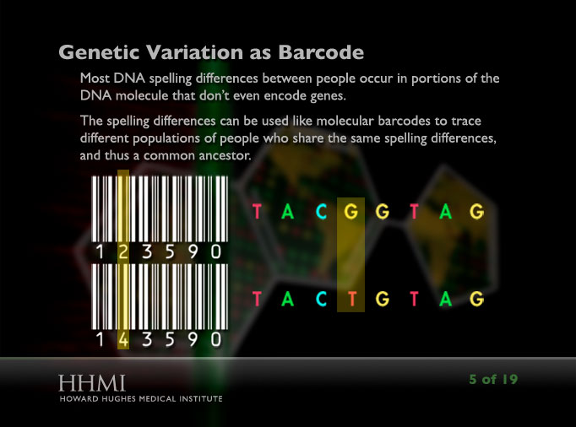
https://www.coursehero.com/file/92206120/HHMI-Using-DNA-to-trace-human-migrationdocx

Slide 27
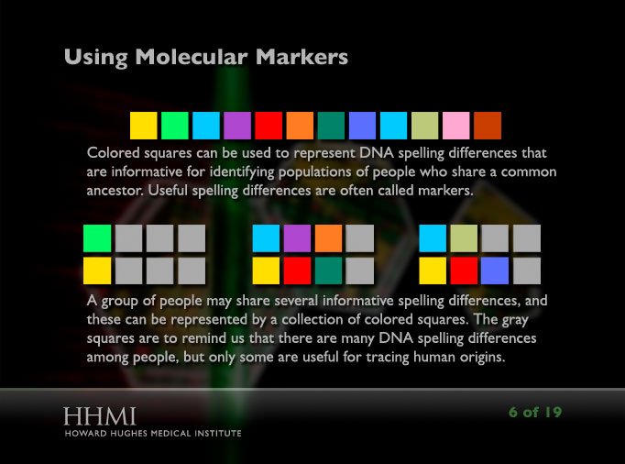
https://www.coursehero.com/file/92206120/HHMI-Using-DNA-to-trace-human-migrationdocx

Slide 28
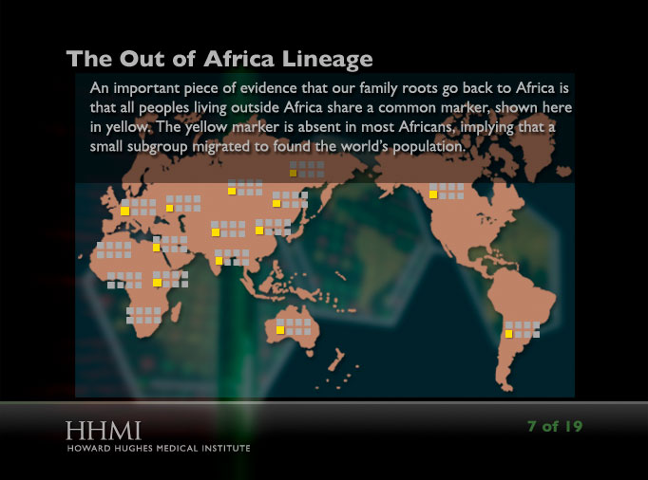
https://www.coursehero.com/file/92206120/HHMI-Using-DNA-to-trace-human-migrationdocx

Slide 29
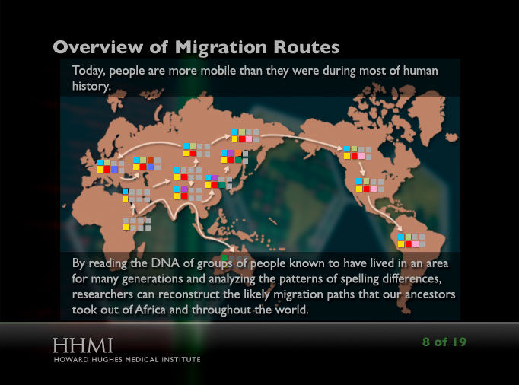
https://www.coursehero.com/file/92206120/HHMI-Using-DNA-to-trace-human-migrationdocx

Slide 30
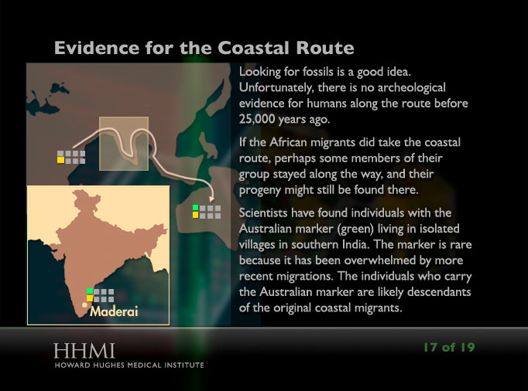
https://www.coursehero.com/file/92206120/HHMI-Using-DNA-to-trace-human-migrationdocx

Slide 31
References
Benazzi et al. (2011). Early dispersal of modern humans in Europe and implications for Neanderthal behavior. Nature, 479: 525-28.
Bird et al. (2002). Radiocarbon analysis of the early archaeological site of Nauwalabila I, Arnheim Land, Australia: implications for sample suitability and stratigraphic integrity. Quaternary Science Reviews, 21: 1061-75.
Bowler et al. (2003). New ages for human occupation and climatic change at Lake Mungo, Australia. Nature, 421: 837-40.
Dillehay, T. (1989). Monte Verde: a late Pleistocene settlement in Chile. Smithsonian Institution Press, Washington, D. C.
Henshilwood, C. et al. (2002). Emergence of Modern Human Behavior: Middle Stone Age Engravings from South Africa. American Association for the Advancement of Science (AAAS). 295 (5558): 1278–1280. doi:10.1126/science.1067575. ISSN 0036-8075
Hershkovitz et al. (2018). The earliest modern humans outside Africa. Science, 359: 456-459.
Higham et al. (2011). The earliest evidence for anatomically modern humans in northwestern Europe. Nature, 479: 521-24.
Hovers, E. et al. (2000). The Amus 7 skeleton – still a burial: response to Gargett. Journal of Human Evolution, 39: 253-60.
Mithen, S. (2006). The singing Neanderthals: the origins of music, language, mind, and body. Harvard University Press, Cambridge.
Richter, D. et al. (2017). The age of the hominin fossils from Jebel Irhoud, Morocoo, and the origins of the Middle Stone Age. Nature, 546: 293-96.
White, T. et al. (2003). Pleistocene Homo sapiens from Middle Awash, Ethiopia. Nature, 423: 742-52.
Yesner et al. (2001). Human dispersal into interior Alaska: antecedent conditions, mode of colonization, and adaptations. Quaternary Science Reviews, 20: 315-27.

