Slide 1
Great Civilizations of the Ancient World
Domestication and steps toward settled life

Slide 2
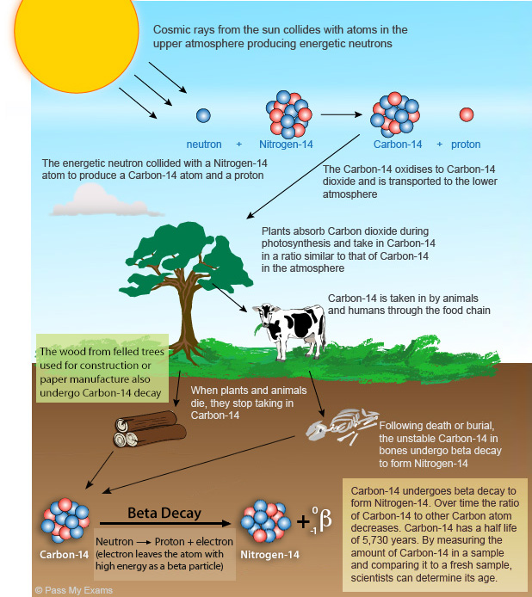
Radiocarbon dating,
Willard Libby
http://www.passmyexams.co.uk/GCSE/physics/radiocarbon-dating.html

Slide 3
the archaeology of food and drink:
---subsistence practices: wild and domesticated
foods in the diet, organization of labor by season, gender roles, whether there was specialization (such as herders versus farmers)
---food and social status: was there restricted access to any prestigious, exotic foods? was there a special way to consume food?
---food and ritual: what foods were important, and why?
---food and social identity: can we recognize ethnic differences on the basis of food remains?

Slide 4
Why did some hunting-gathering populations decide to develop agriculture—to domesticate plants and animals for food and secondary products?
Hunting and gathering was a very successful way of life for modern humans for thousands of years

Slide 5
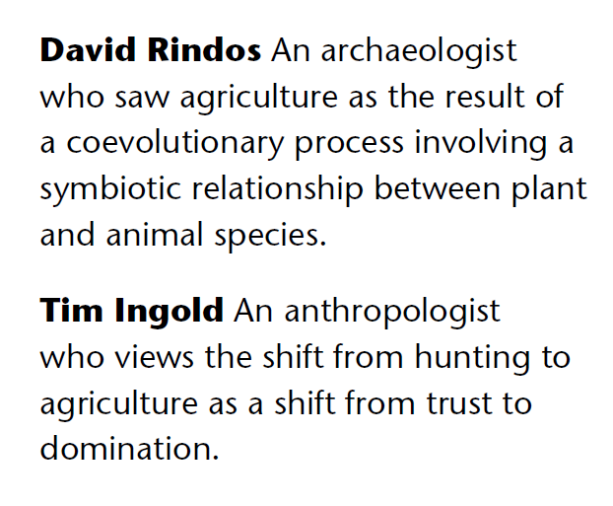
Lewis Morgan saw the transition into agriculture as shift from savagery to barbarism and as an attempt to place supremacy over nature;
Vere Gordon Childe saw Neolithic societies as active partners wit nature rather than parasites on nature.
These two, unlike Morgan and Childe, do not see domestication as an attempt for people to separate themselves from nature but as a process based on co-existence and co-arrangement

Slide 6
Ester Boserup, 1960’s: agriculture did not involve technological progress—it involved more labor, was not as efficient; population growth pushed for domestication;
Marshall Sahlins: hunter-gatherers spend less time than farmers working for their food
Mark Cohen: early agriculturalists were less healthy than hunter-gatherers, crowding let to spread of disease

Slide 7
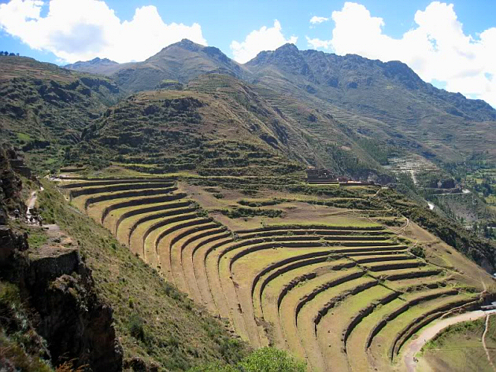
example: Inca agricultural terraces: great investment in labor
https://www.rediscovermachupicchu.com/agricultural-terraces

Slide 8
the importance of comparative collections

Slide 9
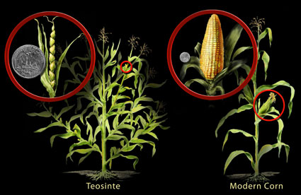
How do archaeologists recognize domestication?
domestication:
when plants and animals
are dependent on humans
for reproductive success
there are genetic and
physical changes
https://theconversation.com/did-the-first-farmers-deliberately-domesticate-wild-plants-77434
long time period required for genetic changes

Slide 10
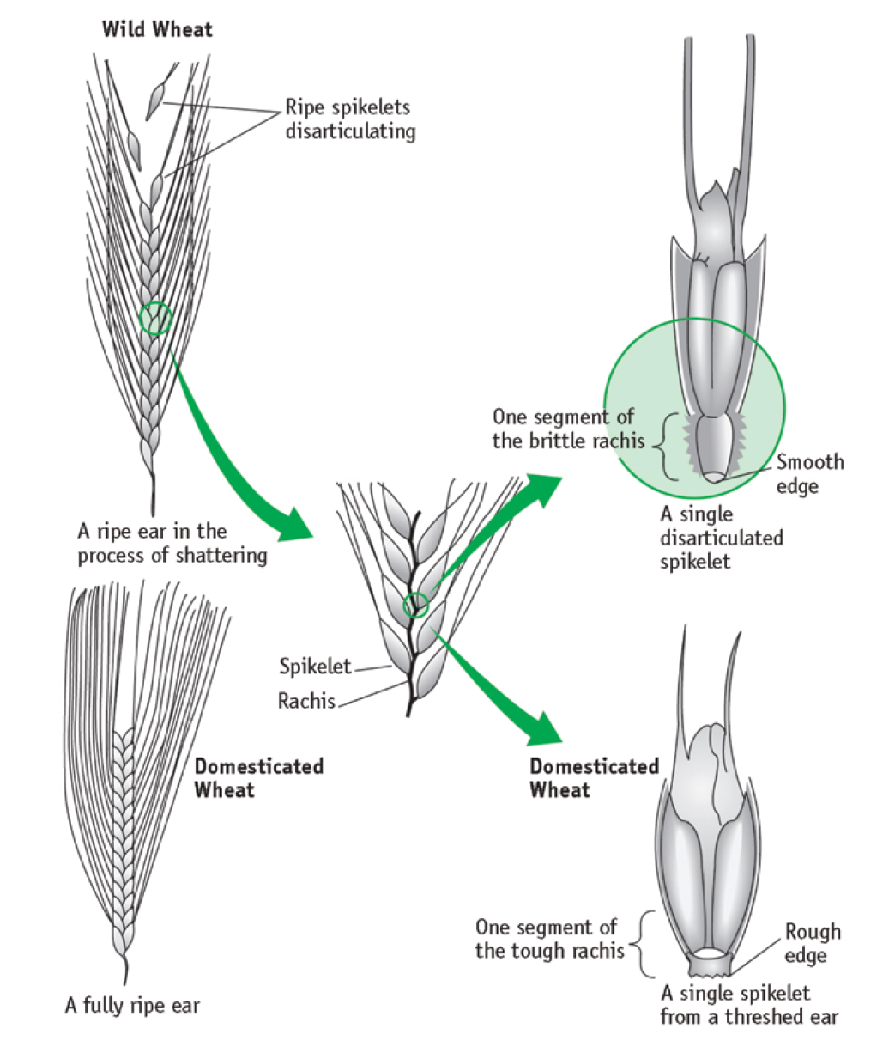
one line of evidence
for early plant domestication
In barley, brittle rachis, seeds can
be dispersed by
natural means such as wind
Versus
hardened, only humans
can disperse seeds
Chazan, M. (2021). World prehistory and archaeology: pathways through time. Routledge, New York.

Slide 11
analysis of macrobotanical remains recovered from flotation
(Naomi Miller’s article) for information on cultivation from carbonized remains: pioneering work in the Near East
---plants for food
---plants for bedding, house construction
taphonomic or site formation issues:
What kinds of plants are we missing, and why?
Which ones are preserved after burning? How did people harvest and process grains? Where did they do this?

Slide 12
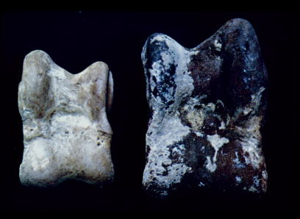
genetic and physical changes in animals:
wild versus domesticated goat ankle bone: evidence for increase in size over time
https://www.sciencedirect.com/science/article/pii/S0305440318300323
managing herds of animals for food and secondary products

Slide 13
similar issues for faunal remains:, whether wild or domestic:
Richard Redding
---information about site formation obtained from
modern hunters: their hunting, butchering, transportation,
disposal practices for body parts with the most meat versus other
body parts, presence of milking practice (residue analysis)
---the impact of excavation methods: screen size
---the importance of first developing a baseline model:
what patterns do you expect under different conditions:
ratios of species, (pastoralism?) males versus females (only a few males for breeding OR several for plowing)

Slide 14
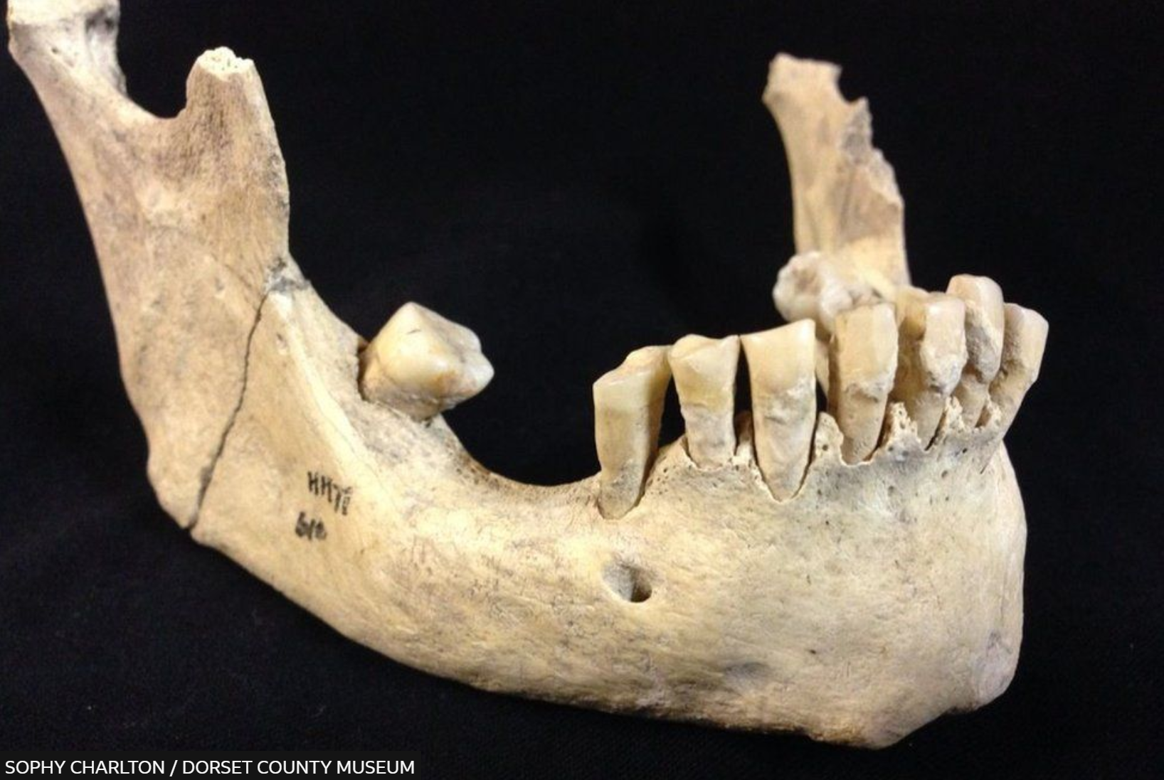
Earliest direct evidence of milk consumption, 6000 years ago
Presence of milk protein in tooth calculus
https://www.bbc.com/news/science-environment-49650806

Slide 15
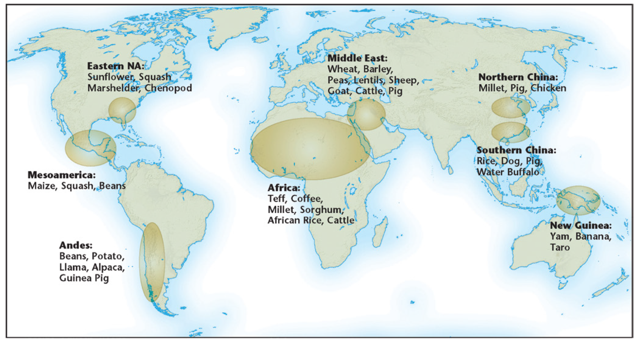
independent process of domestication in antiquity in several world areas, with profound consequences for human life such as:
focus on what types of plants, and why?
Chazan, M. (2021). World prehistory and archaeology: pathways through time. Routledge, New York.

Slide 16
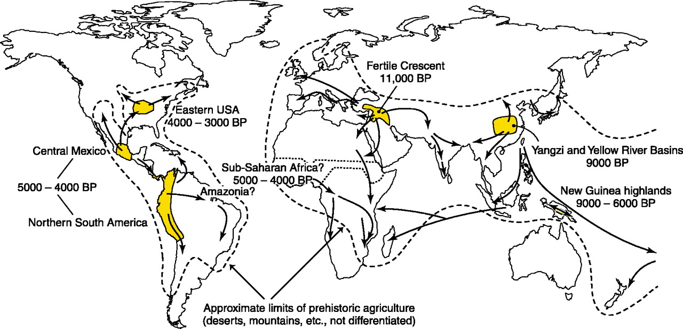
changes in thinking about the process: from a “Neolithic revolution”,
to a process with several components that took place at different times:
domestication of plants, domestication of animals, establishment of permanent villages, invention of pottery (the Near East versus other areas)
https://www.sciencedirect.com/topics/immunology-and-microbiology/domesticated-plant

Slide 17
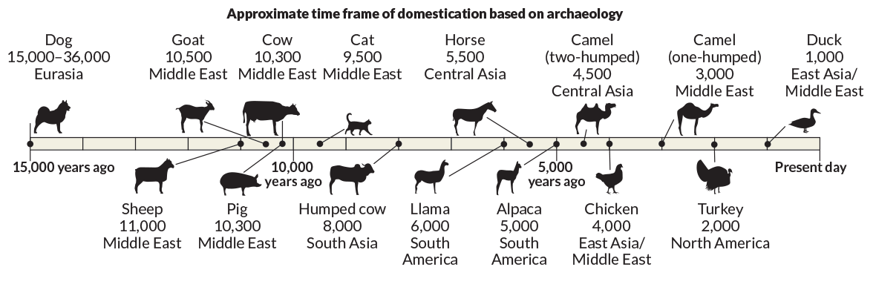
https://www.sciencenews.org/article/dna-evidence-rewriting-domestication-origin-stories

Slide 18
Domestication is not only about domestication….
Domestication
Technology
Community

Slide 19
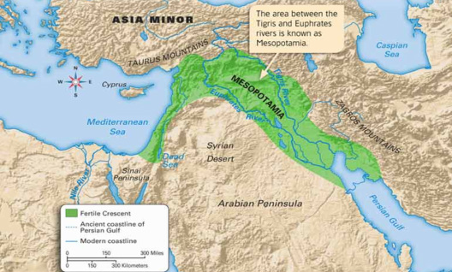
Regions of the Near East (the Fertile Crescent):
hilly flanks to the north and west, Levant
https://mrsobray.weebly.com/mesopotamiafertile-crescent.html

Slide 20
Chronology of the Transition to Agriculture in
the Middle East
Kebaran and Geometric Kebaran: 25,000 – 15,000 BP
Natufian: 15,000 – 12,000 BP
Early Neolithic: 12,000 – 8,500 BP
Late Neolithic: 8,500 – 7,000 BP

Slide 21
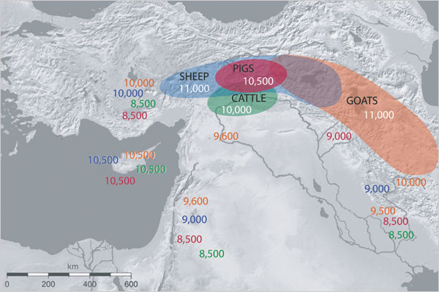
Domestication of plants and animals in the Near East
Pioneering work by Braidwoods 1948-1955 for collection
of plant and animal remains with flotation, etc.
Earliest domestication in world for rye, barley, wheat (emmer, einkorn), legumes (lentils, peas, beans)---but it was a very slow process during the Early Neolithic
ca. 12,800-8500 BP
BP dates here
https://www.researchgate.net/figure/The-origin-and-dispersal-of-domestic-livestock-species-in-the-Fertile-Crescent-Shaded_fig1_23165768

Slide 22
1. Early Epipaleolithic: 20,000-12,000 B.C. [“Mesolithic”]
Northern Israel, Ohalo II site, remarkable preservation
showing use of many wild plants; diversity in life ways
at this time period: some communities more sedentary
than others
mobile hunter-gatherers, short occupation periods of sites

Slide 23
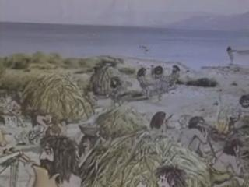
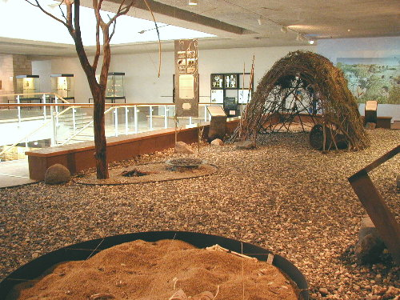
Ohalo II, northern Israel, c. 20,000 BC
https://alchetron.com/Ohalo
Broad spectrum economy
Different size of game, fishing, plant use
Binford: “collectors” that were more sedentary than other hunter-gatherers (foragers),
using “delayed return” techniques such as traps, fishing nets
https://alchetron.com/Ohalo

Slide 24
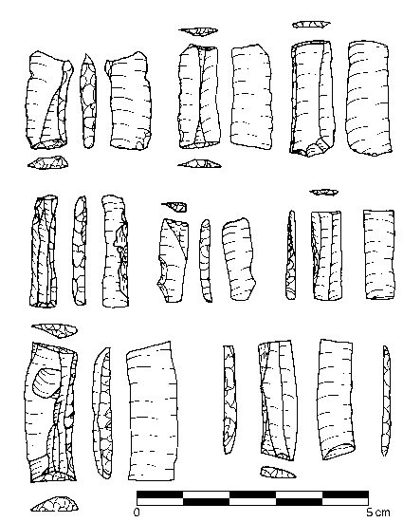
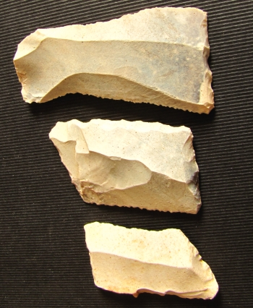
Microliths Kebaran culture, Jordan
https://www.researchgate.net/figure/Microliths-from-Geometric-Kebaran-levels-at-Wadi-Mataha-a-e-m-trapeze-rectangles-n-e-o_fig6_284228062

Slide 25
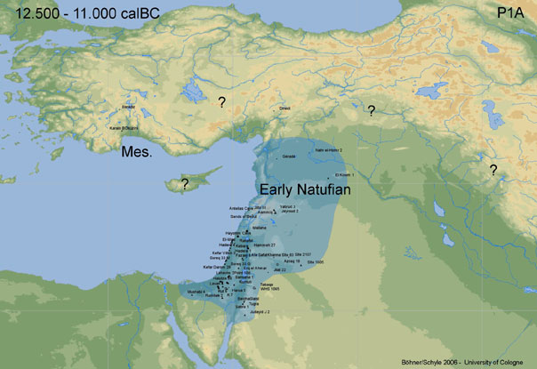
2. (Late Epipaleolithic period) c. 15,000-12,000 B.C.
Natufian culture of the Levant: more sedentary villages,
larger populations, more ground stone tools for grinding and pounding seeds; some densely populated settlements with cemeteries, evidence for trade of sea shells
https://aratta.wordpress.com/2012/12/19/the-natufians

Slide 26
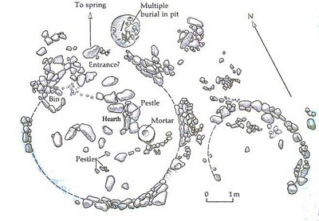
( Eynan ) Mallaha site, northern Israel
More sedentary lifeway
https://www.researchgate.net/figure/The-earlier-phases-of-occupation-at-Natufian-Mallaha-Eynan-in-the-Huleh-Valley-Note_fig4_26441196

Slide 27
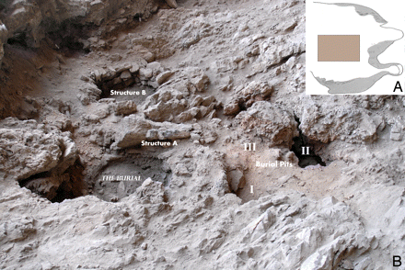
Recent discovery : Hilazon Tachtit shaman burial site, Israel, Natufian period
https://archaeology.huji.ac.il/hilazon-tachtit-cave

Slide 28
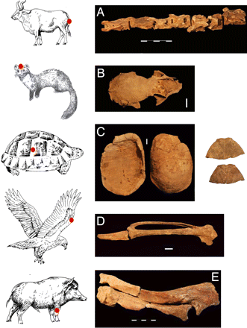
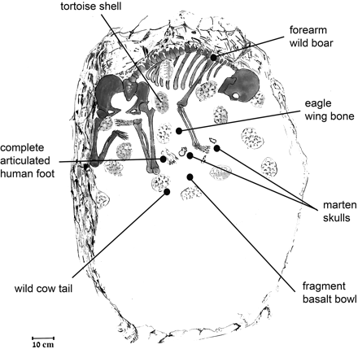
Natufian shaman
https://archaeology.huji.ac.il/hilazon-tachtit-cave

Slide 29
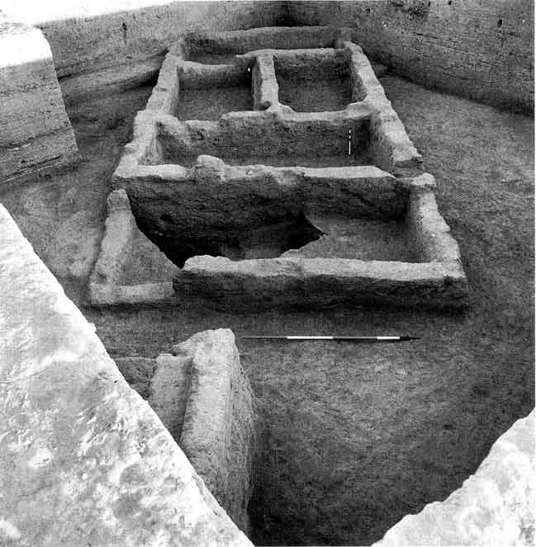
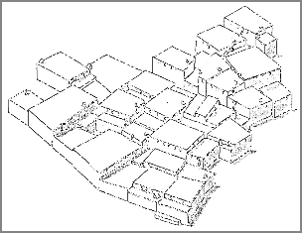
Abu Hureyra, northern Syria: occupied during the Natufian period and the later period, possible domesticated dogs
Hunt of sheep, goat, cattle
https://www.amusingplanet.com/2020/01/abu-hureyra-place-where-human-became.html

Slide 30
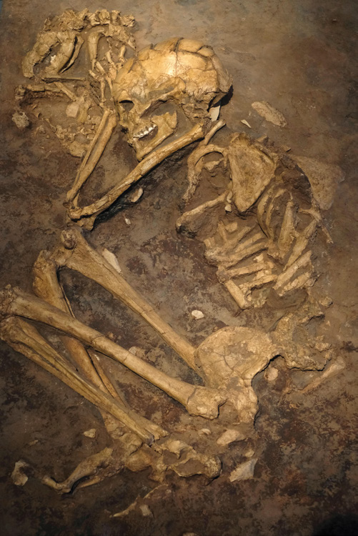
Burial of a dog together with human, Mallaha site

Slide 31
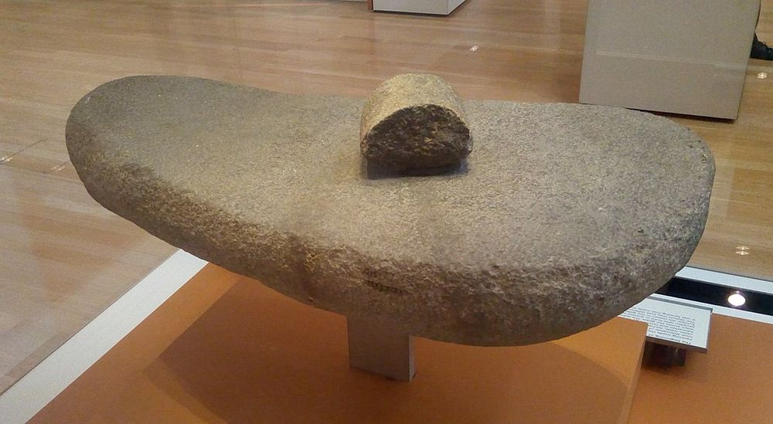
Mortar and pestle used to grind cereal grains, from the Neolithic village of Abu Hureyra
https://www.amusingplanet.com/2020/01/abu-hureyra-place-where-human-became.html

Slide 32
Next lecture:
Emergence of large-scale settlement
Emergence of communal rituals
Social complexity
Emergence of states

Slide 33
References
Boserup, E. (1965). The conditions of agricultural growth. George Allen and Unwin, London.
Charlton et al. (2019). New insights into Neolithic milk consumption through protemic analysis of dental calculus. Archaeological and Anthropological Sciences, 11: 6183-96.
Chazan, M. (2021). World prehistory and archaeology: pathways through time. Routledge, New York.
Childe, V. G. (1942). What happened in history. Penguin, Harmondsworth.
Cohen, M. (1977). The food crisis in prehistory: overpopulation and the origins of agriculture. Yale University Press, New Haven.
Ingold, T. (1980). Hunters, pastoralists, and ranchers: reindeer economics and their transformations. Cambridge University Press, Cambridge.
Miller, N. (1996). Seed eaters of the ancient Near East: human or herbivore? Current Anthropology, 37: 521-28.
Morgan, L. (1877). Ancient society: or, research in the lines of human progress from savagery, through barbarism to civilization. C. H. Kerr, Chicago.
Redding, R. (1992). Egyptian Old Kingdom patterns of animal use and the value of faunal data in modeling socioeconomic systems. Paleorient, 18: 99-107.
Renfrew, C. and Bahn, P. (2020). Archaeology: theories, methods and practice. Thames and Hudson, London.
Rindos, D. (1984). The origins of agriculture: and evolutionary perspective. Academic Press, San Diego.
Sahlins, M. (1972). Stone Age economics. Aldine-Atherton, Chicago.

