Slide 1
Great Civilizations of the Ancient World
Social complexity and emergence of states

Slide 2
The world we live in:
Centralized authority
Kings and queens
Governments

Slide 3
Centralized government or authority AND Economic inequality
Politically complex human societies

Slide 4
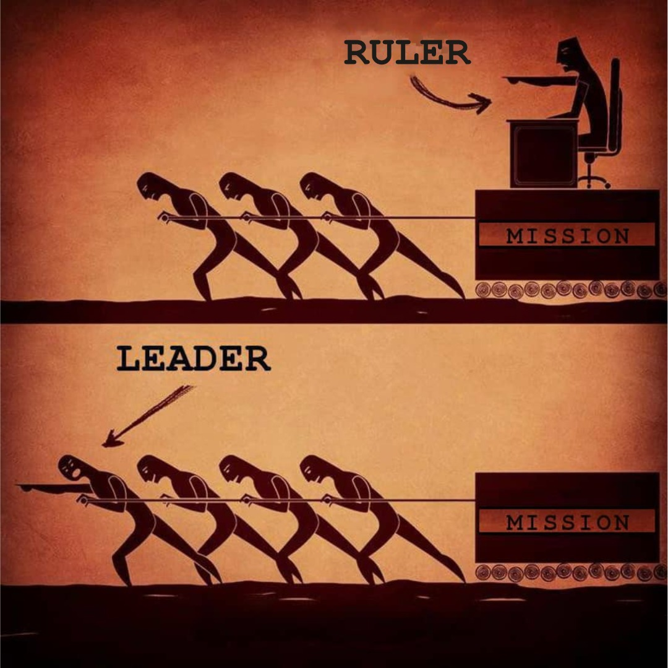
One of central themes of archaeological research
How did central authority form?
What was the source of authority?
Forces that pushed societies towards social inequality.
Legitimacy (acceptance of power): consensus or coercion?
Fundamental understandings in explaining the origins and existence of complex societies
https://vicmnigeria.com/rulership-vs-leadership

Slide 5
Questions that we will be asking during the rest of the course:
---How and why did social inequality develop?
---How and why did regional polities develop?
---Different possible sources of power: economic, military, ideological; and how did centralization of power develop in some areas?
---What was the legitimacy of authority, how people accepted the right by some to rule?
---Was this the result of coercion, or consensus, or both?

Slide 6
Morton Fried’s (1967) four types of societies
Egalitarian societies:
- status based on skills, age, gender, or combination
of these factors;
- multiple social (prestige) positions;
Ranked societies:
- fewer social positions of prestige that is not linked to age, gender,
or ability;
- presence of hierarchy but absence of real political power;
- ‘big men’ and ‘chiefs’ are focal points of collection and
redistribution of resources but do not consume more that their
neighbors;
Stratified societies:
- social and economic inequality;
- presence of exploitation: demands on labor, institutional slavery
- organization based on communities of people from different
households and kin groups;
State societies:
- organized on a ‘supra-kin’ basis;
- control over the population through legal system, military forces,
taxation, conscription;
- state’s task is to use its power to maintain social hierarchy;

Slide 7
classification of cultures by scale and
structural complexity
Elman Service , 1971
Bands: small societies, mobile hunter-gatherers
Tribes: pastoralist herders, settled farmers, larger in scale and including descent from common ancestor, loose regional organization without a strongly developed social hierarchy
Chiefdoms: larger in scale (up to 10,000), institutionalized differences in social and political rank, economic power of the chief, tribute and redistribution, religious authority, no real force to maintain order
States: represented by the earliest civilizations, large populations, centralized and institutionalized control of the society, social classes, a political economy to maintain these

Slide 8
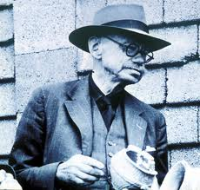
Vere Gordon Childe (1892-1957, an Australian living in Britain) pioneered research on early cultures of Europe and initiated methods for investigating social issues such as economic organization and the rise of civilization in different areas of the world
States and Urban societies
https://alchetron.com/V-Gordon-Childe

Slide 9
Increased settlement size
Concentration of wealth
Public monumentality
Writing
Representational art
Knowledge of science and engineering
Foreign trade
Full-time specialists in non-subsistence activities
Stratified society
Political organization
ISSUES: Some other areas not considered by Childe can be regarded as “civilizations”

Slide 10
Earlier research focus:
How is the development of cities, or urbanism, related to the formation of states? (societies ruled by a formal bureaucracy with the ability to use force)
More recent recognition:
The nature of urbanism varied and is not exclusively linked to states

Slide 11
emergence of hereditary social ranking, indicated by evidence such as restricted access to certain highly valued goods: possibly indicating control over parts of the economy: craft production and/or trade
Early approaches:
Simple form of organization
Complex form of organization
more recent approaches:
consideration of “agency” (theories that recognize that human beings make choices, hold intentions and take action), beliefs, efforts to identify “heterarchical”, cooperative social relations, too
(horizontal ties between people as well as vertical)
More recent approaches:

Slide 12
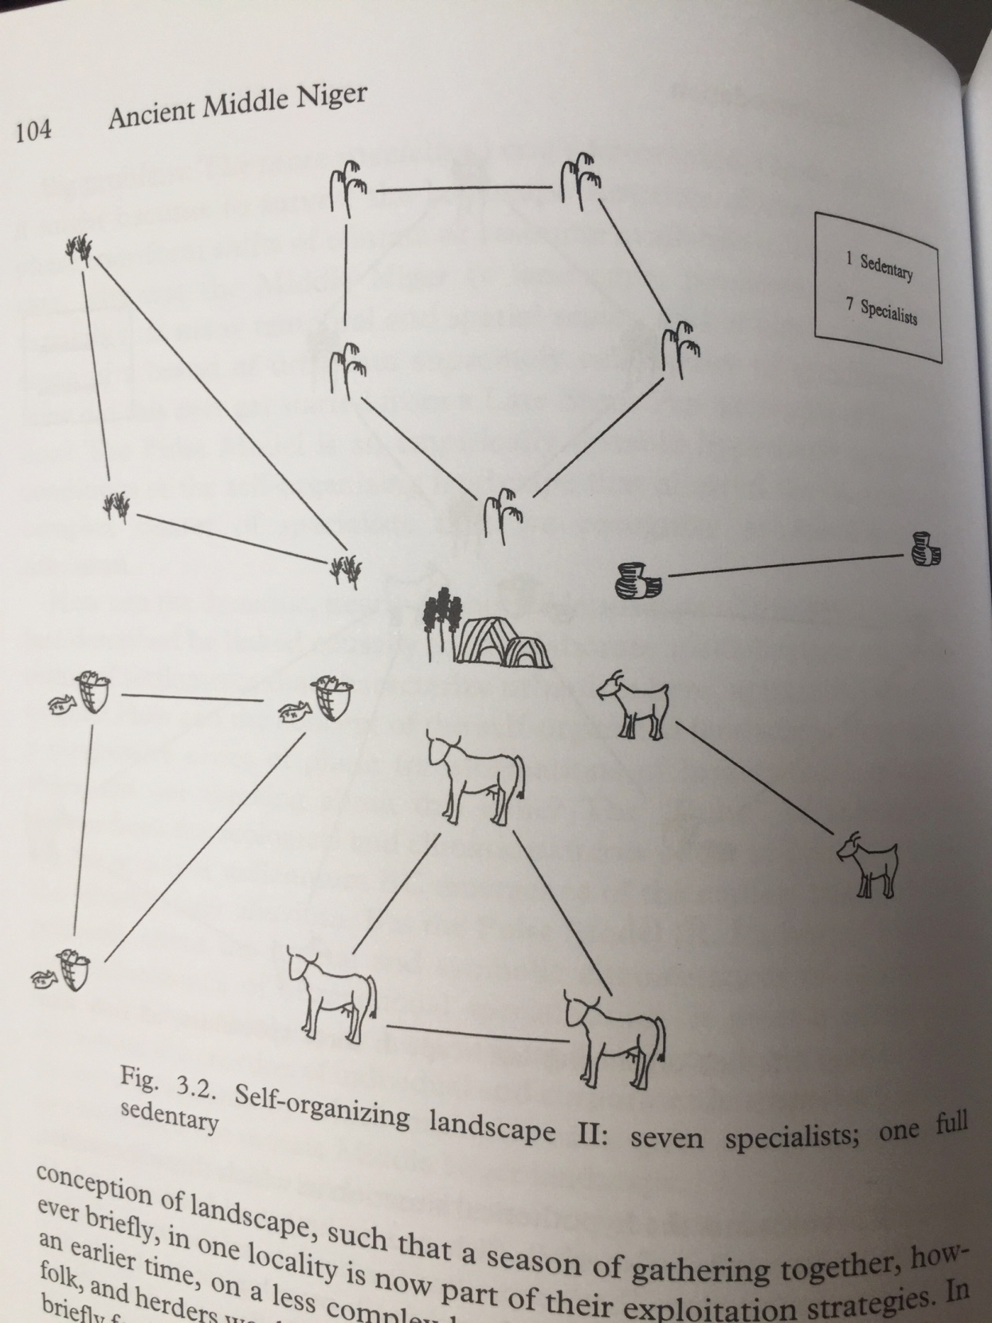
Pulse Model of Middle Niger
Research of Roderick McIntosh

Slide 13
Search for source of power:
How did some individuals gained the ability to control the actions of others?
What was the source of such influence: economic, political, hereditary status, information?
What were the mechanisms for members with power to legitimize their social position?

Slide 14
Mesopotamia
Chazan, M. (2021). World prehistory and archaeology: pathways through time. Routledge, New York.

Slide 15
Geological setting of Mesopotamia
No mineral in southern part, reeds and mud are most available
River silts are responsible for deeply buried early sites, little knowledge of Paleolithic and Neolithic of Tigris and Euphrates Valley
Extremely fertile soil

Slide 16
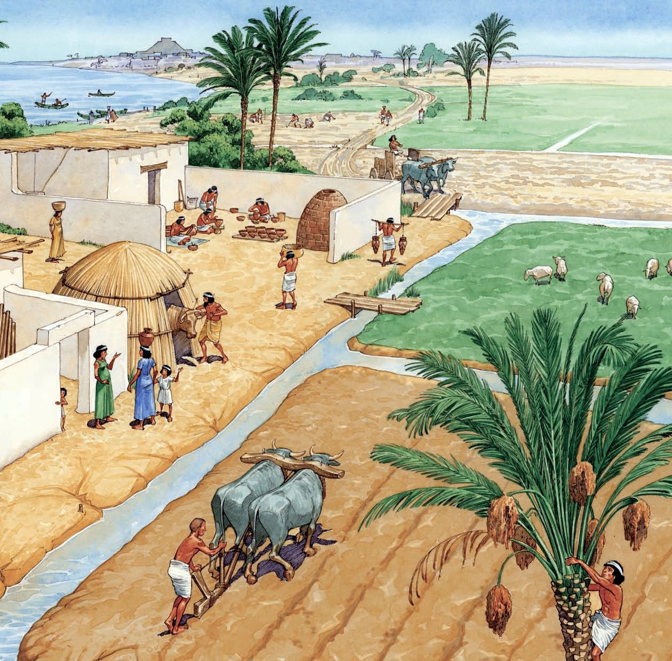
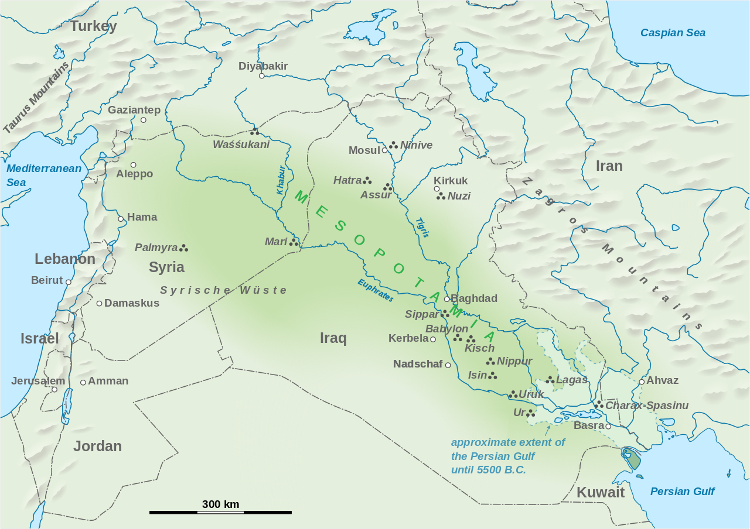
Irrigation farming
Marshlands and cities
Concentration of salt in soil, no more crops
https://elink.io/p/sumerian-technology-95f3bf2
https://en.wikipedia.org/wiki/Mesopotamia

Slide 17
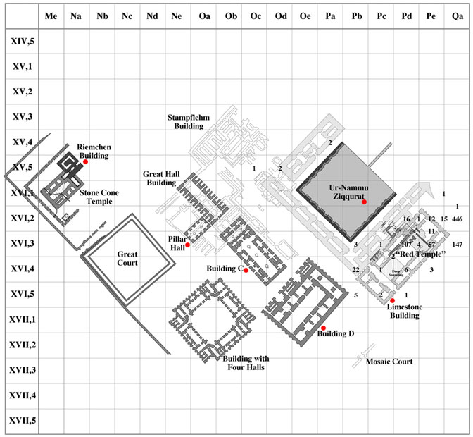
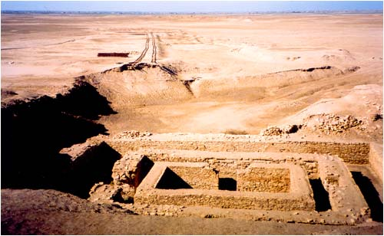
large temple precincts, Uruk: several large decorated temples (with colored cones of clay in the walls) with open courtyards
reveal central role of temples in the administration; some structures interpreted as administrative offices by priests and officials;
workshops for pottery, stone,
copper
https://routledgetextbooks.com/textbooks/9780415498647

Slide 18
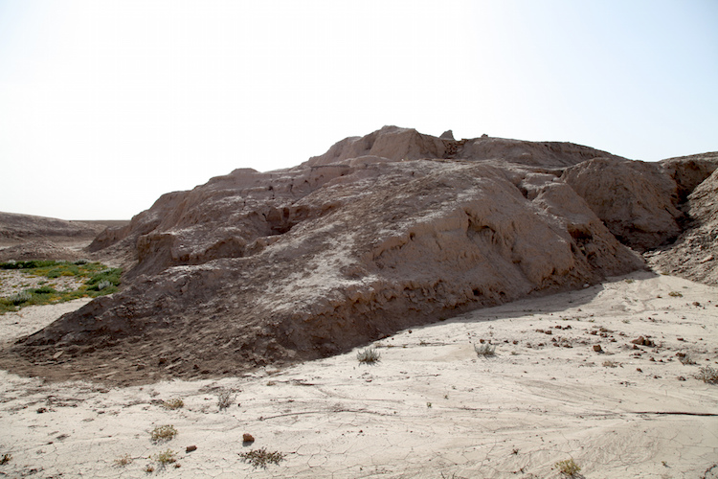
The White Temple and ziggurat, Uruk
https://www.khanacademy.org/humanities/ap-art-history/ancient-mediterranean-ap/ancient-near-east-a/a/white-temple-and-ziggurat-uruk

Slide 19
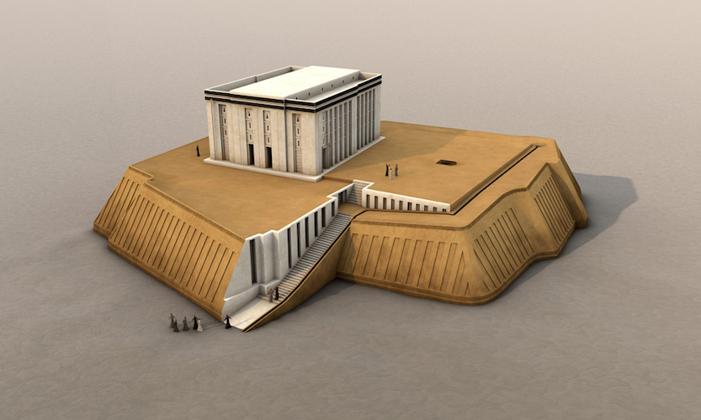
Restoration of the White Temple and ziggurat, Uruk
https://www.khanacademy.org/humanities/ap-art-history/ancient-mediterranean-ap/ancient-near-east-a/a/white-temple-and-ziggurat-uruk

Slide 20
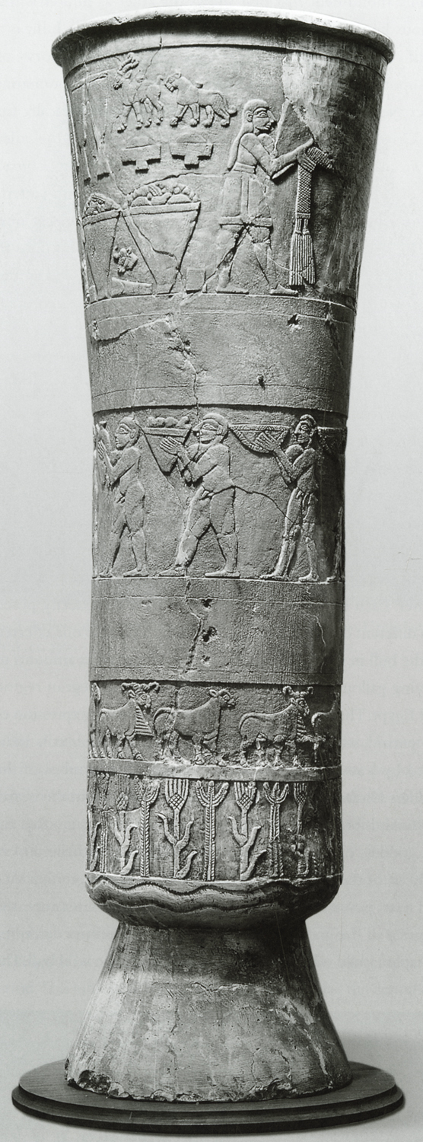
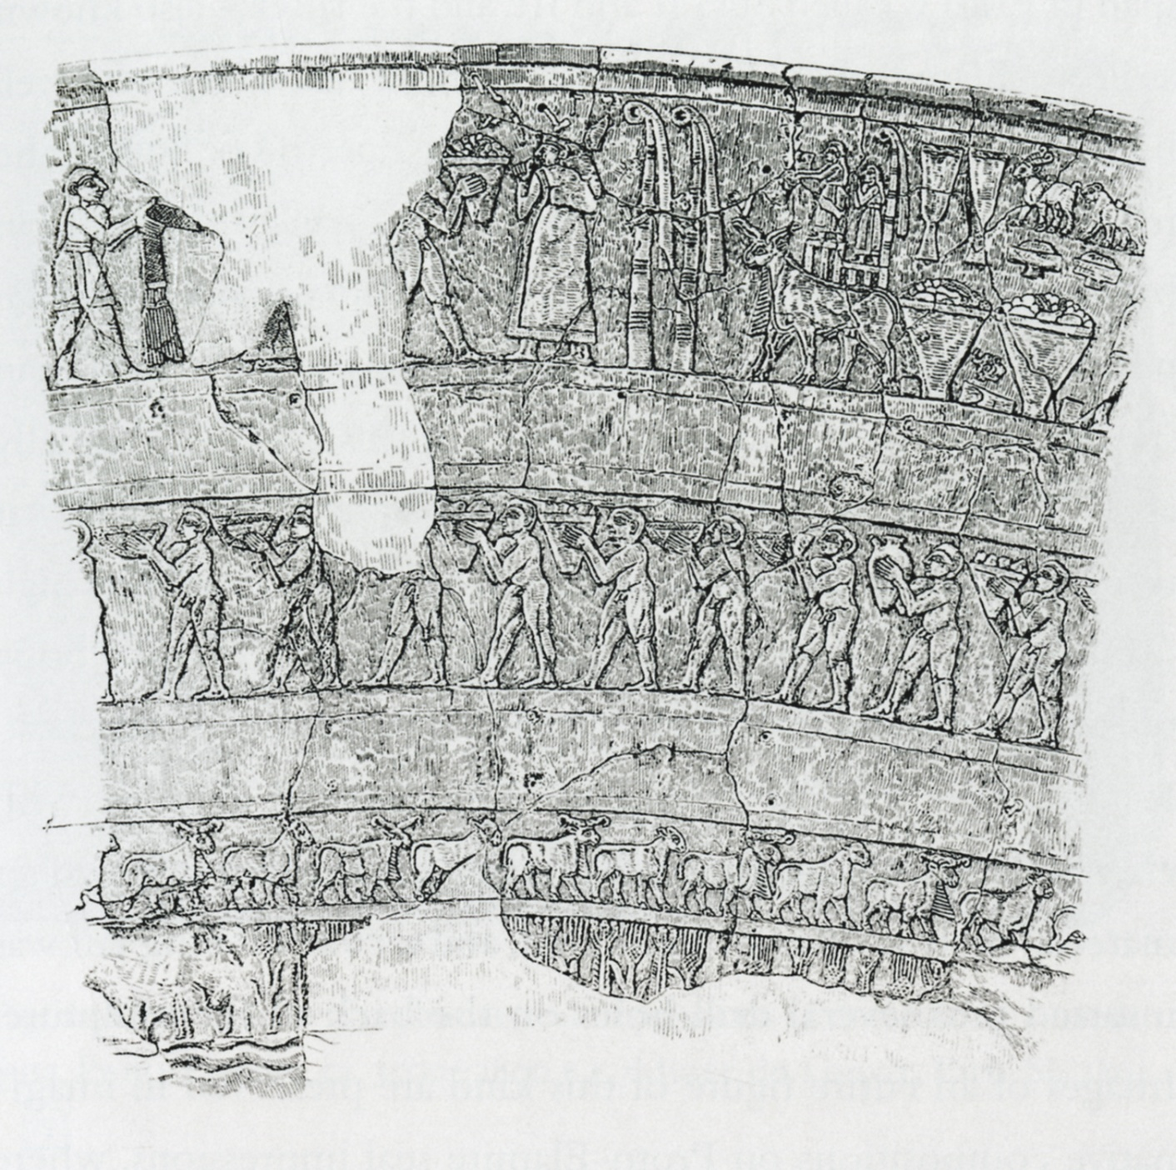
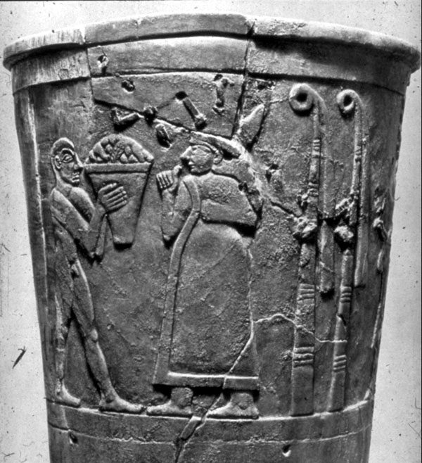
Uruk stone vase
https://www.khanacademy.org/humanities/ancient-art-civilizations/ancient-near-east1/sumerian/a/warka-vase

Slide 21
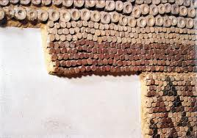
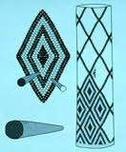
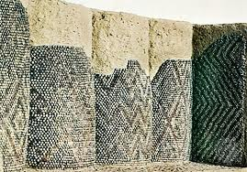
Uruk site: clay cones to produce mosaics on columns:
found in temples, palaces, and other public buildings
http://cargocollective.com/klink/history-cone-mosaic-mesopotamia

Slide 22
the elements of “early Mesopotamian civilization” did not develop at exactly
the same time:
---the urban center at Uruk with monumental architecture after 4000 BC: regarded by many as the world’s earliest city
---a state administration at Uruk, including some management of trade, religious authority of the rulers, social stratification
---writing develops later, most evident by 3200 BC: first cylinder seals and then cuneiform during the Early Dynastic Period (Early Bronze Age), 3200-2350 BC

Slide 23
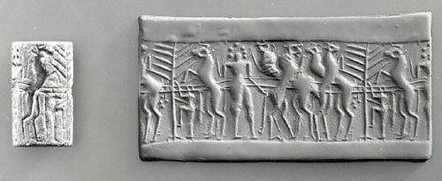
the earliest writing, ca. 3200 B.C., found only at Uruk in the form of clay cylinder seals during the late Uruk period, many in temples (rolled out impressions in clay for marking or sealing objects, showing the control of movement of goods and information by the early state official):
recorded the receipt of tribute, distribution of rations and/or wages, etc. for labor; collection of taxes and labor from conscripts, often included the names of officials
concern of administrators in temples to control aspects of the economy
https://www.metmuseum.org/art/collection/search/325553

Slide 24
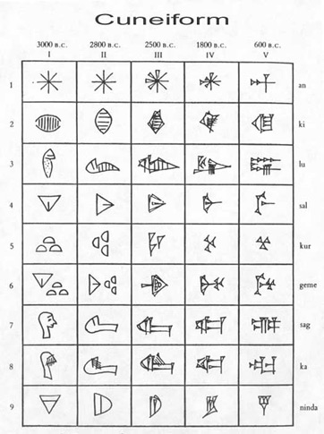
Era of several independent city states during the Early Dynastic Period (early Bronze Age), c. 3200-2350 B.C.
especially in southern Iraq, the area of the southern lowlands known as Sumer—the most powerful city state
Early Dynastic period: written records became standardized: perhaps a new method was needed to record trade transactions between communities whose citizens spoke different languages
(cuneiform) tablets also provide lists of king names and families that produced rulers over generations
https://study.com/academy/lesson/cuneiform-writing-definition-symbols-history.html

Slide 25
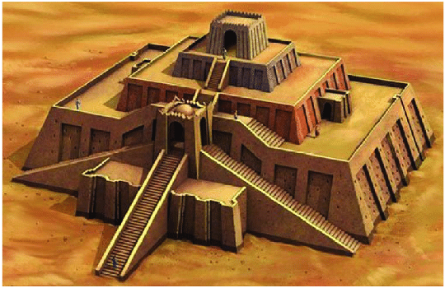
The Great ziggurat of Ur
https://www.researchgate.net/figure/Great-Ziggurat-of-Ur-southern-Iraqi_fig1_345804512

Slide 26
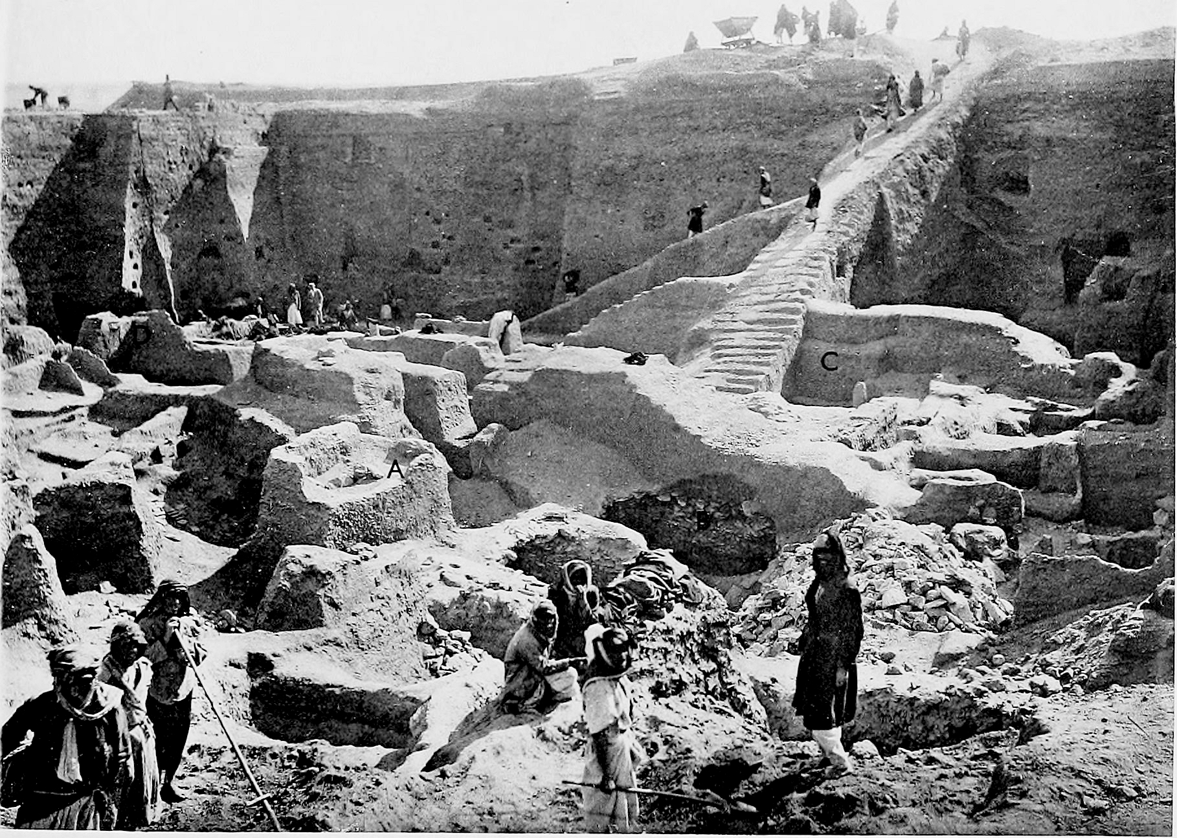
The Royal cemetery at Ur
https://en.wikipedia.org/wiki/Royal_Cemetery_at_Ur

Slide 27
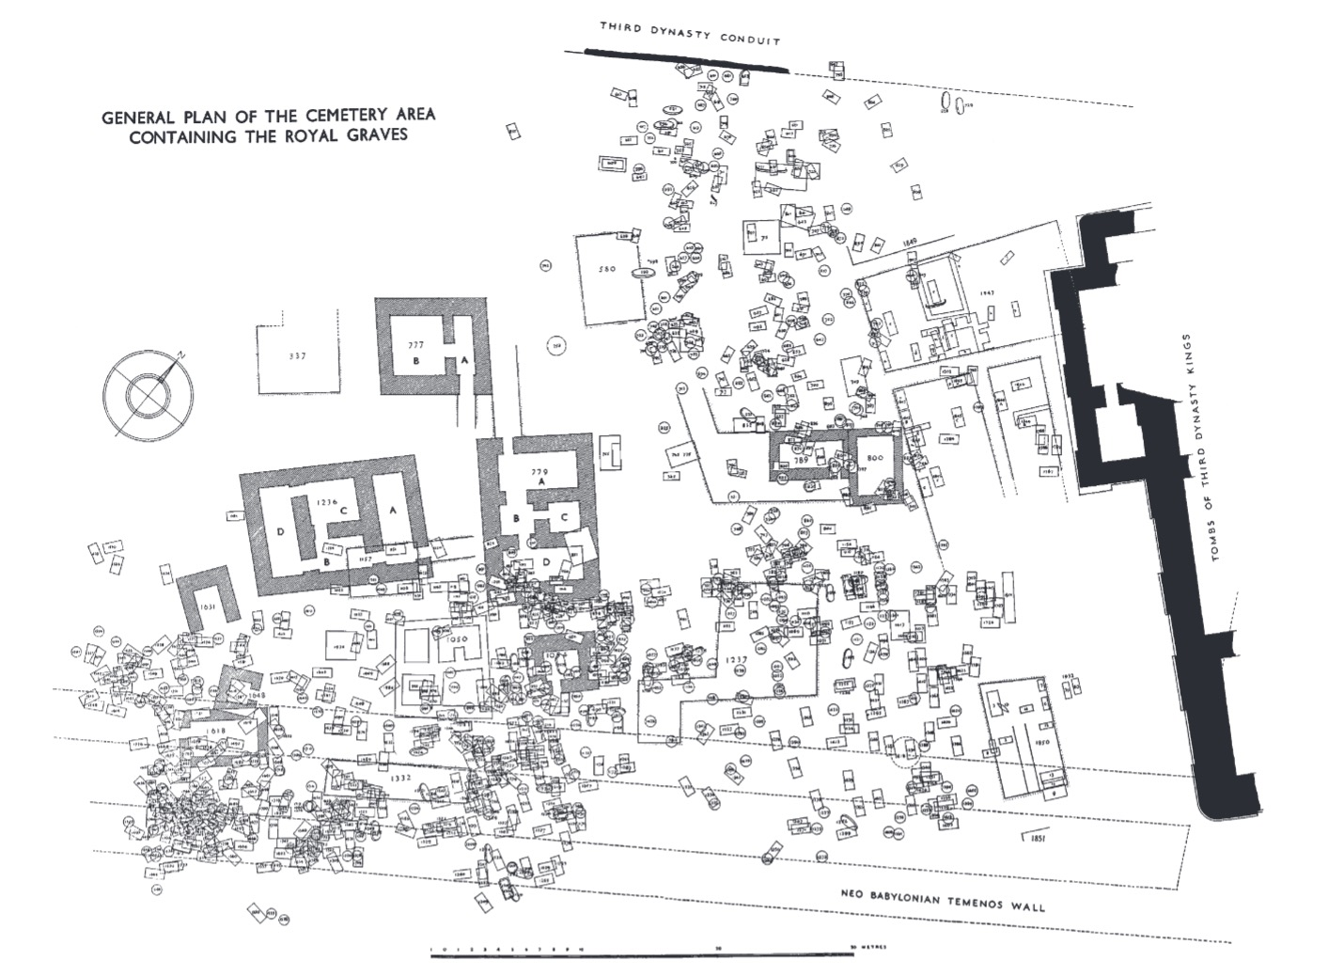
https://cnx.org/contents/uLBVvmOB@3/The-Royal-Cemetery-of-Ur-and-Sumerian-Kingship-in-Ancient-Mesopotamia

Slide 28
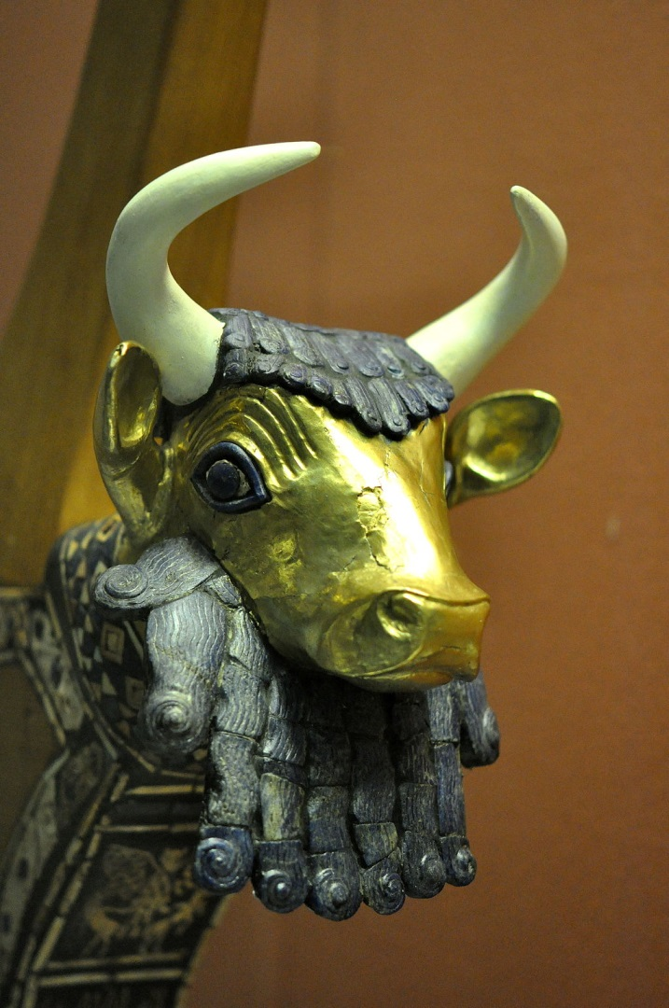
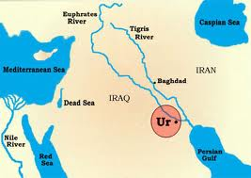
Royal cemetery at Ur located just south of the large ziggurat: artifacts of gold, lapis lazuli, silver
source areas for prestige goods: silver from
Anatolia/Turkey, gold from Egypt or Persia,
lapis lazuli from Afghanistan
https://en.wikipedia.org/wiki/Royal_Cemetery_at_Ur

Slide 29
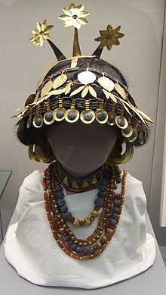
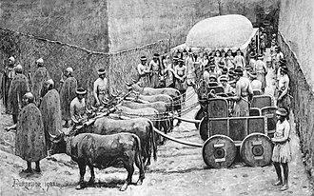
Woolley found 16 huge graves (priests and/or rulers) with human sacrificial victims (74 in one grave); elaborately constructed tombs of stone and brick;
diverse kinds of prestige goods, many imported from distant areas
in contrast, estimates of 2000—8000 graves of
of commoners in simple pits with few grave goods
https://en.wikipedia.org/wiki/Royal_Cemetery_at_Ur

Slide 30
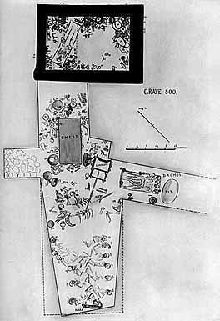
Woolley’s plan of grave 800
http://www.arth.upenn.edu/522/puabi/puabi.html

Slide 31
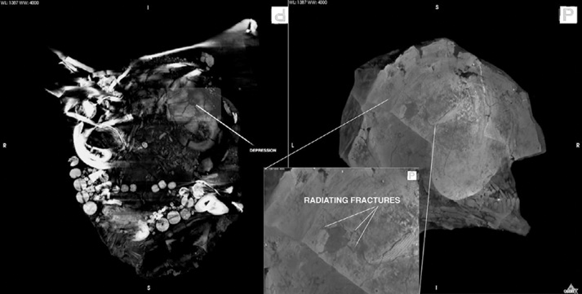
Some died voluntarily, some were forcibly killed
Chazan, M. (2021). World prehistory and archaeology: pathways through time. Routledge, New York.

Slide 32
State societies in Mesopotamia:
Emergence of large urban centers
Uruk cultural elements in many other settlements indicate Uruk expansion
Control over population was implemented using: rituals and beliefs (temples), economic factors, writing system

Slide 33
References
Fried, M. (1967). The evolution of political society: an essay in political anthropology. Random House, New York.
McIntosh, R. (2005). Ancient Middle Niger: urbanism and the self-organizing landscape. Cambridge University Press, Cambridge.
Nissen, H. (2002). Uruk: key site of the period and key site of the problem. In “Artefacts of complexity: tracking the Uruk in the Near East”, edited by J.N.Postgate, pp. 1-17. British School of Archaeology in Iraq, London.
Service, E. (1971). Primitive social organization: an evolutionary perspective, 2nd edition. Random House, New York.

