Slide 1
Great Civilizations of the Ancient World
Pre-dynastic and Dynastic Egypt

Slide 2
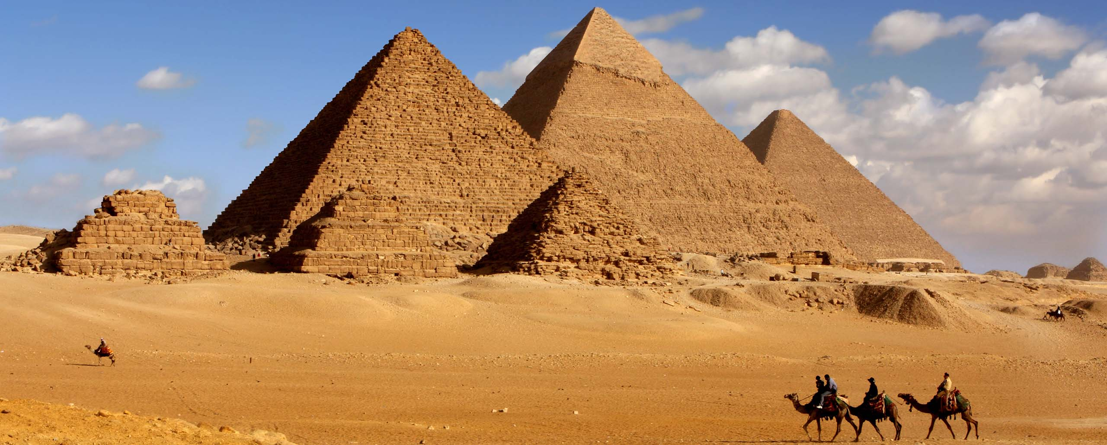
Pyramids at Giza
https://www.cazloyd.com/en/insiders-guide-egypts-pyramids-giza

Slide 3
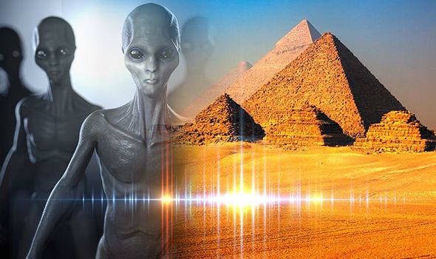
Speculations and much more
https://www.express.co.uk/news/weird/940347/Time-travel-speed-of-light-prof-aliens-built-pyramids-UFO

Slide 4
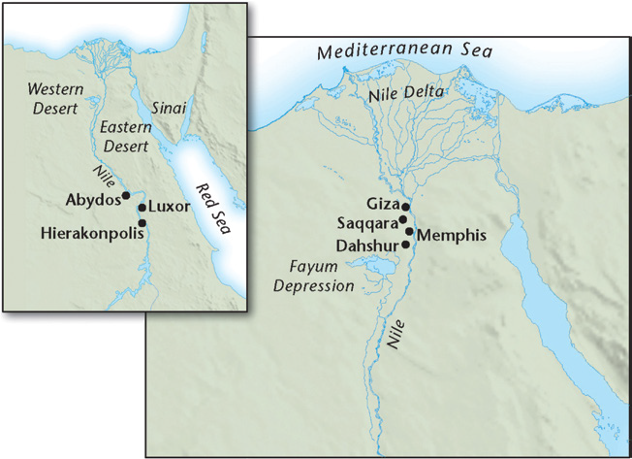
Nile River and some geographic features
Chazan, M. (2021). World prehistory and archaeology: pathways through time. Routledge, New York.

Slide 5
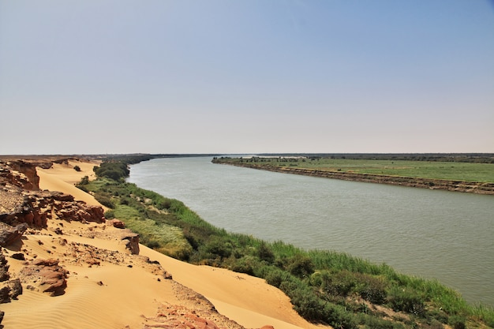
Nile River and the desert
https://www.freepik.com/premium-photo/nile-river-sahara-desert_6423072.htm

Slide 6
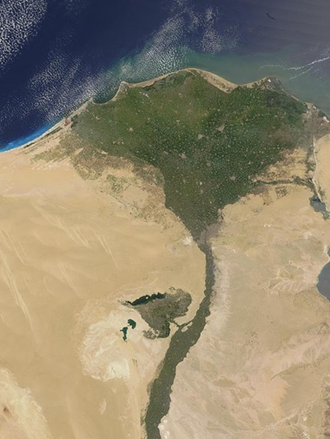
Floodplains of Nile River Valley
Consistent replenishment of soil with minerals, very different from southern Mesopotamia
Lack of natural minerals in Nile Valley and Fayum Depression, but many natural resources available in surrounding deserts (copper, gold, limestone, alabaster, granite).
https://www.unda.co.uk/news/why-are-floodplains-important-a-guide-for-developers

Slide 7
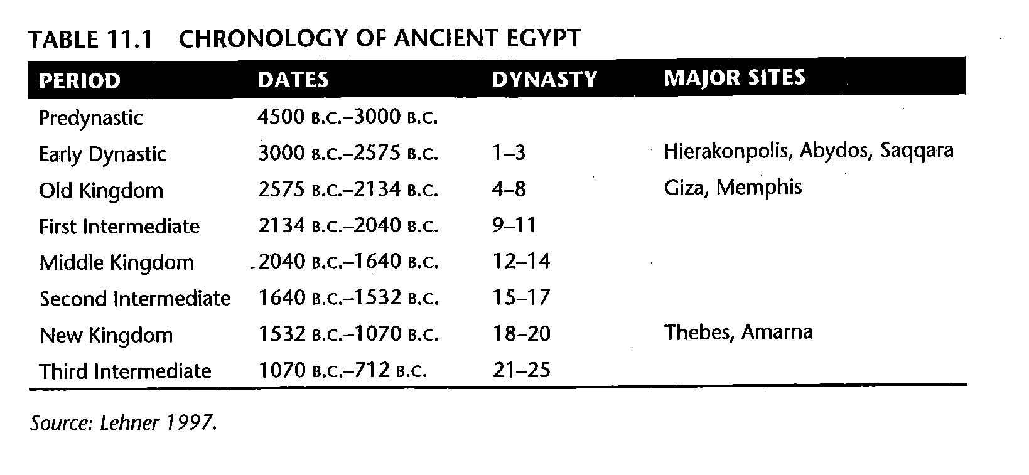
General chronology of early Egypt
Chazan, M. (2021). World prehistory and archaeology: pathways through time. Routledge, New York.

Slide 8
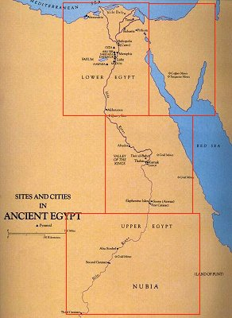
Predynastic sites in
Egypt, c. 4500-3000 B.C.:
mostly known from the middle
Nile area
Naqada I, II, III cultures
evidence for burials with prestige
goods showing emerging
social stratification,
trade with the Near East
interpreted by some scholars as
“chiefdoms”
https://www.edhelper.com/reading_comprehensions/Upper-and-Lower-Egypt.htm

Slide 9
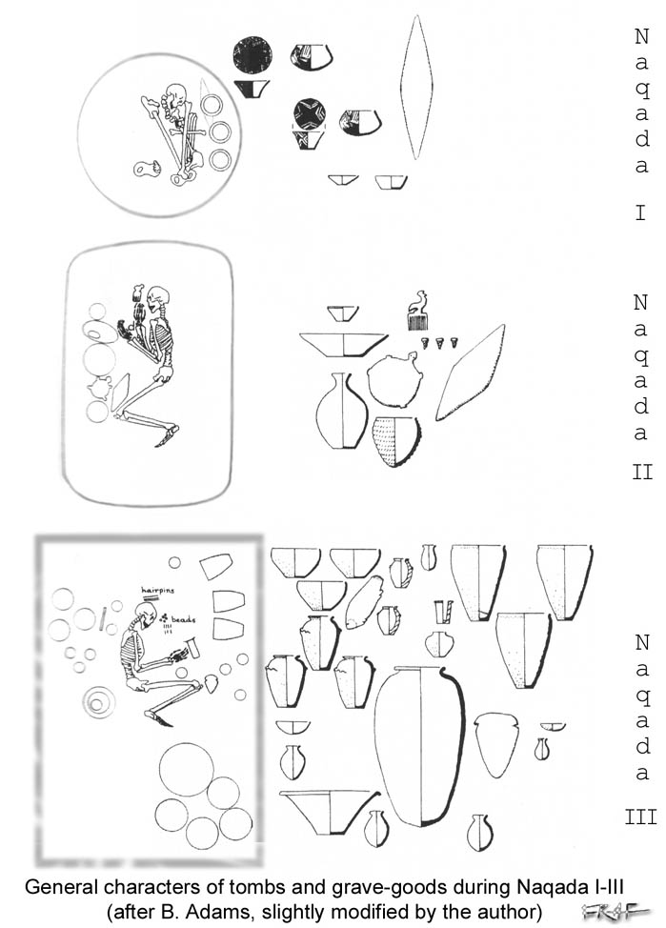
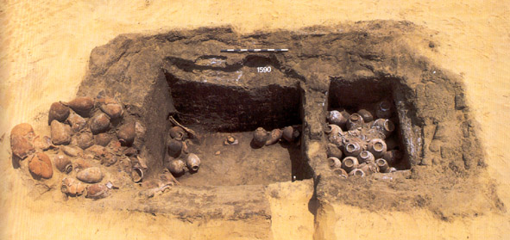
large Naqada culture burials
Presence of violence/capital punishment???

Slide 10
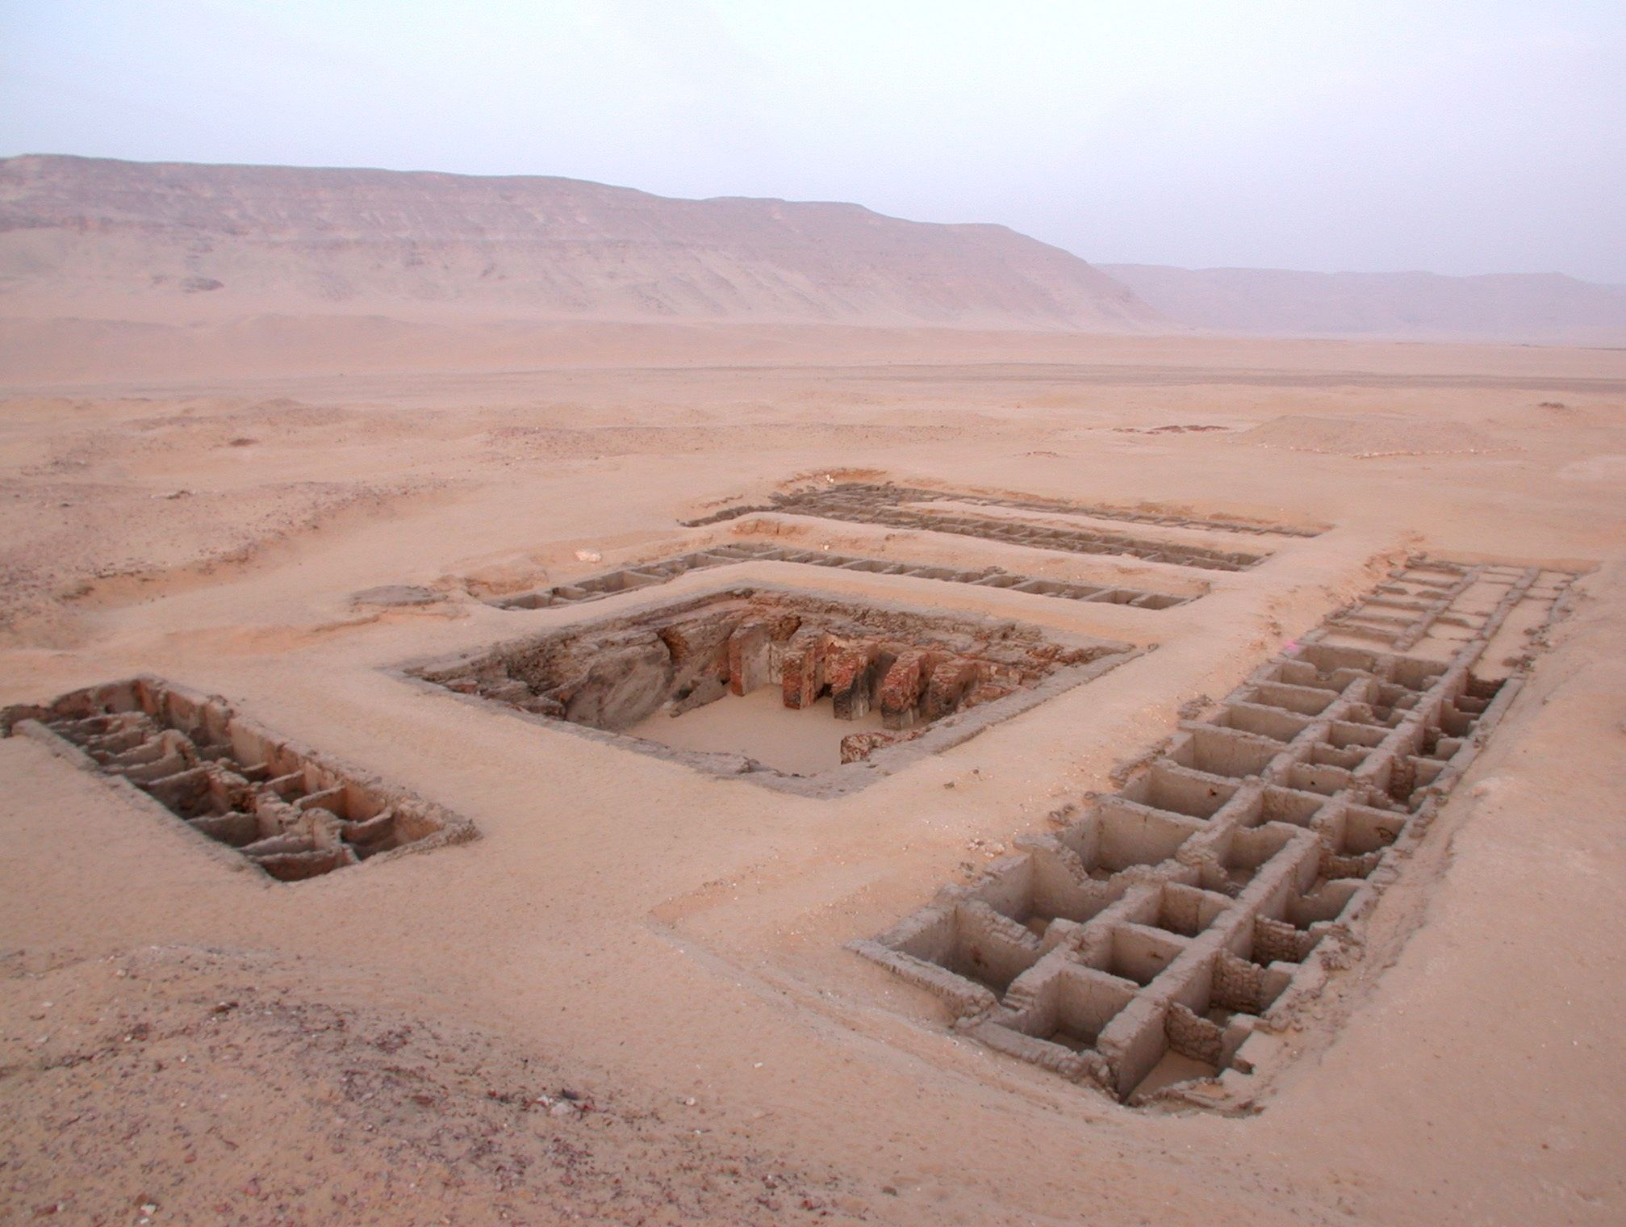
establishment of several centers during the
late pre-dynastic period: Hierakonpolis would become key
large pre-dynastic tomb at Abydos
https://www.pinterest.com/pin/458522805792348410

Slide 11
Hierankopolis facts:
Some individuals are less muscular but fed well than others
Elaborateness of some tombs and accompanied goods
Presence of animal burials (some exotic animals too, elephants): human subsidiary?
Animals treated like human: wrapped in linen

Slide 12
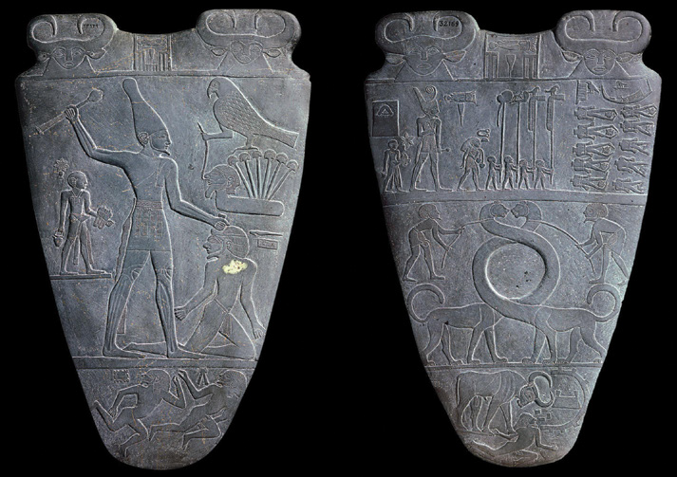
Narmer Palette, Early Dynastic period
Chazan, M. (2021). World prehistory and archaeology: pathways through time. Routledge, New York.

Slide 13
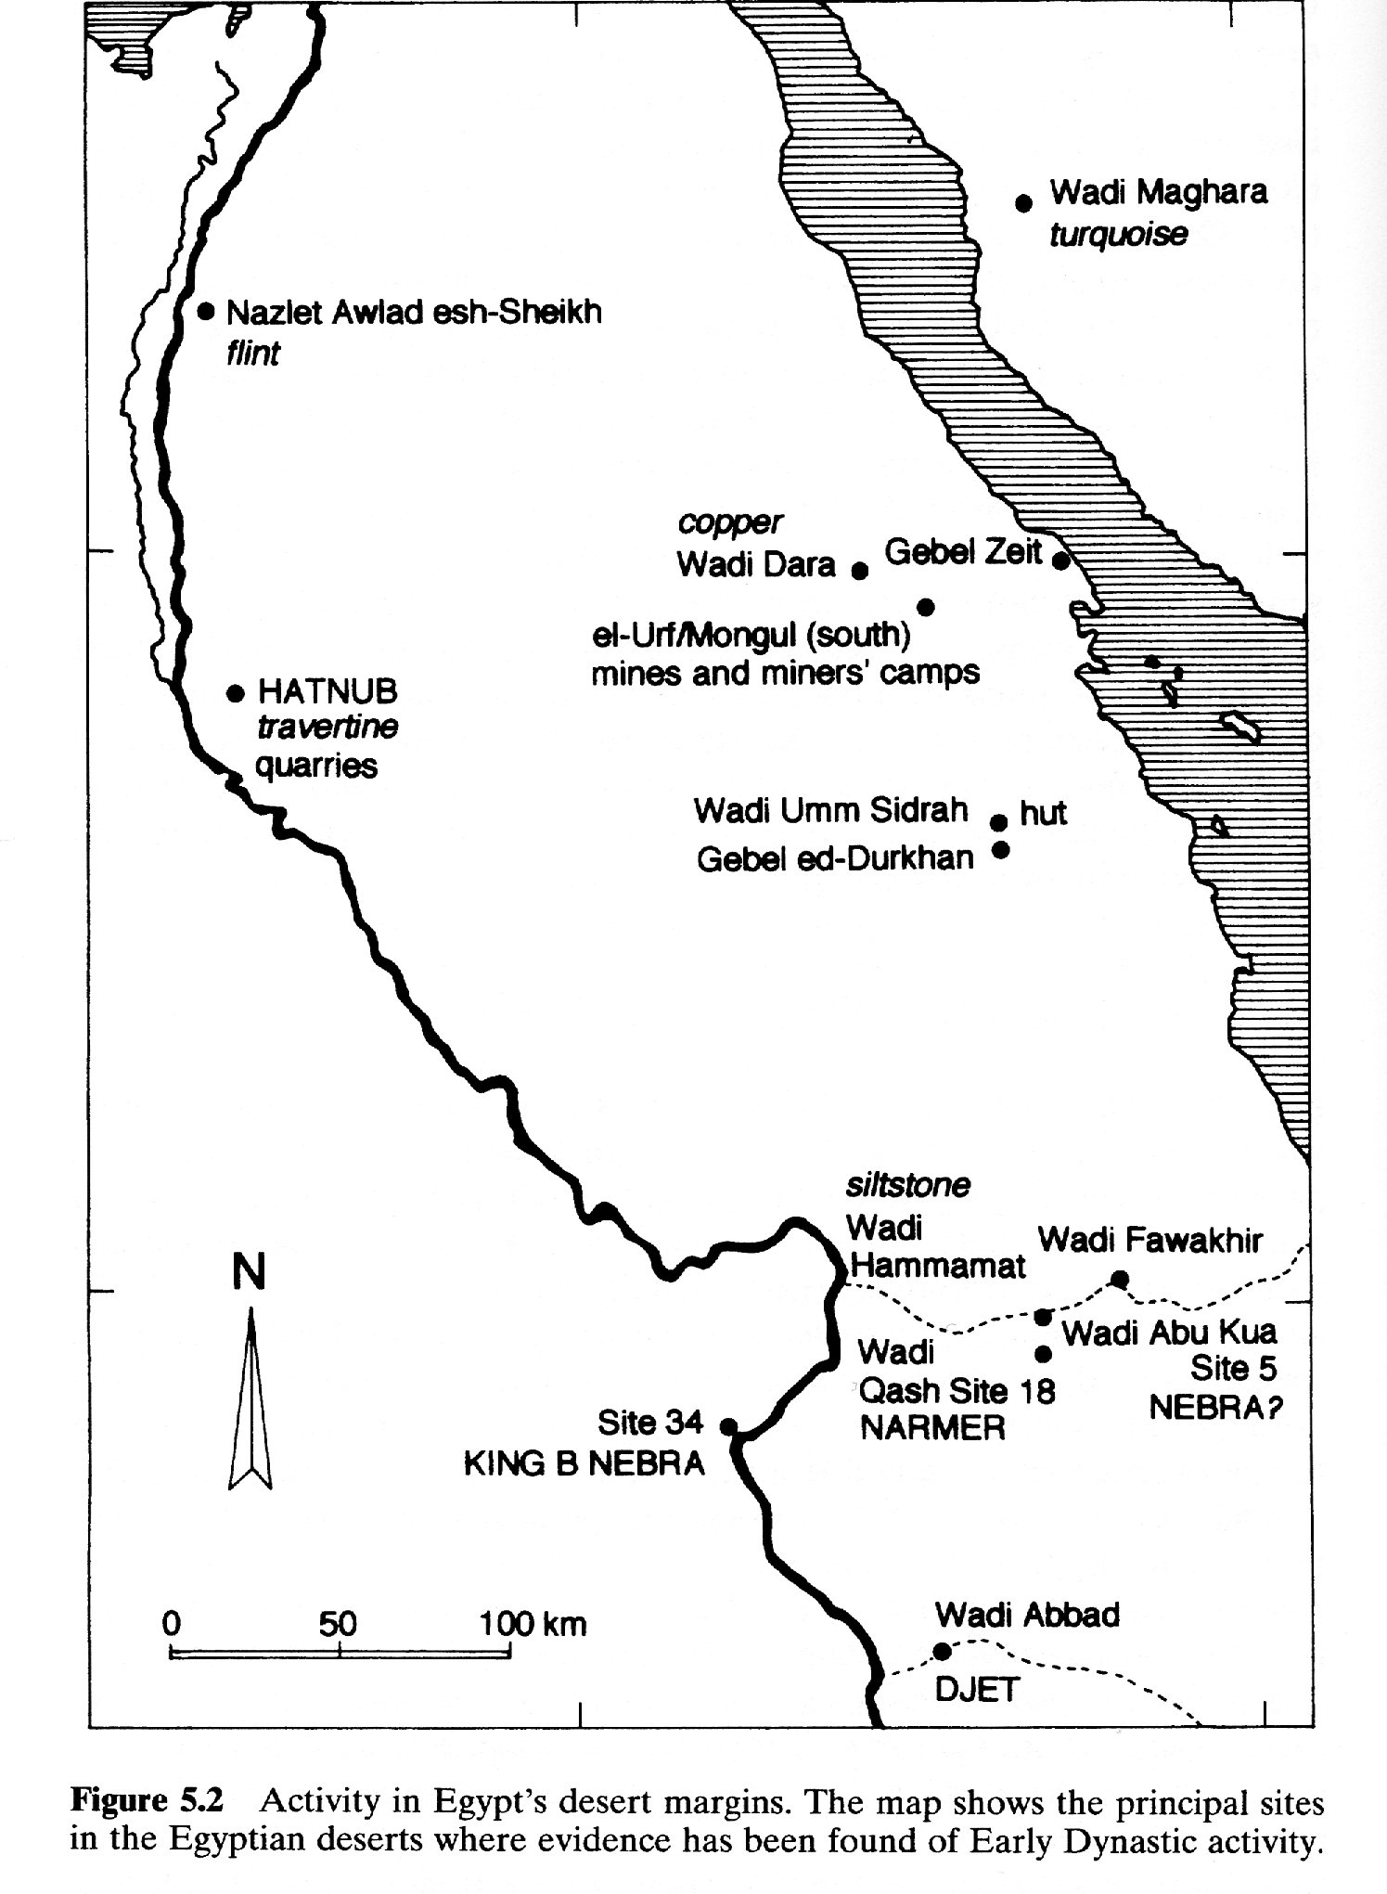
Early Dynastic period: areas for acquisition of resources
names of King Narmer and other early kings have been found on pot sherds in desert areas, indicating acknowledgment of the administration, controlled areas (at least partially), and trade
writing increased over time: early efforts to record movement of goods over long and short distances
Chazan, M. (2021). World prehistory and archaeology: pathways through time. Routledge, New York.

Slide 14
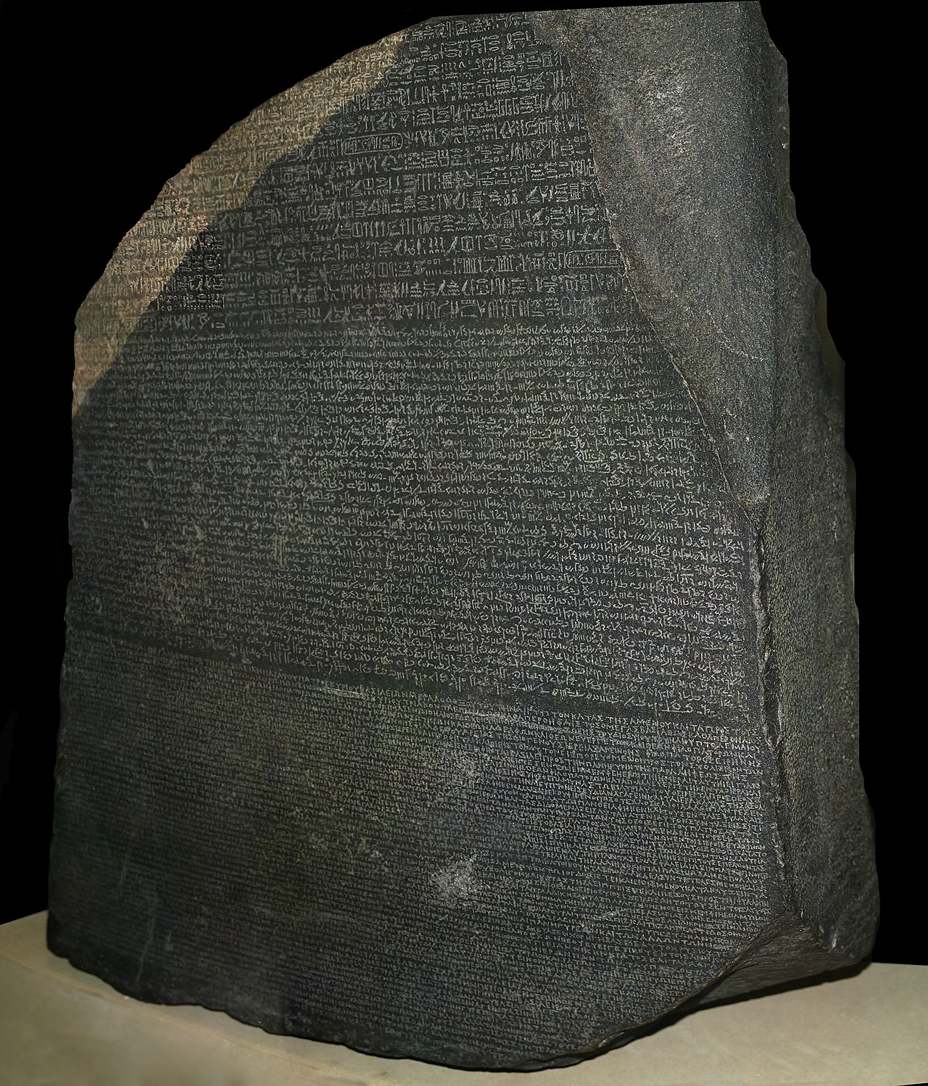
Rosetta stone
Hieroglyphic
Demotic
Ancient Greek
https://en.wikipedia.org/wiki/Rosetta_Stone

Slide 15
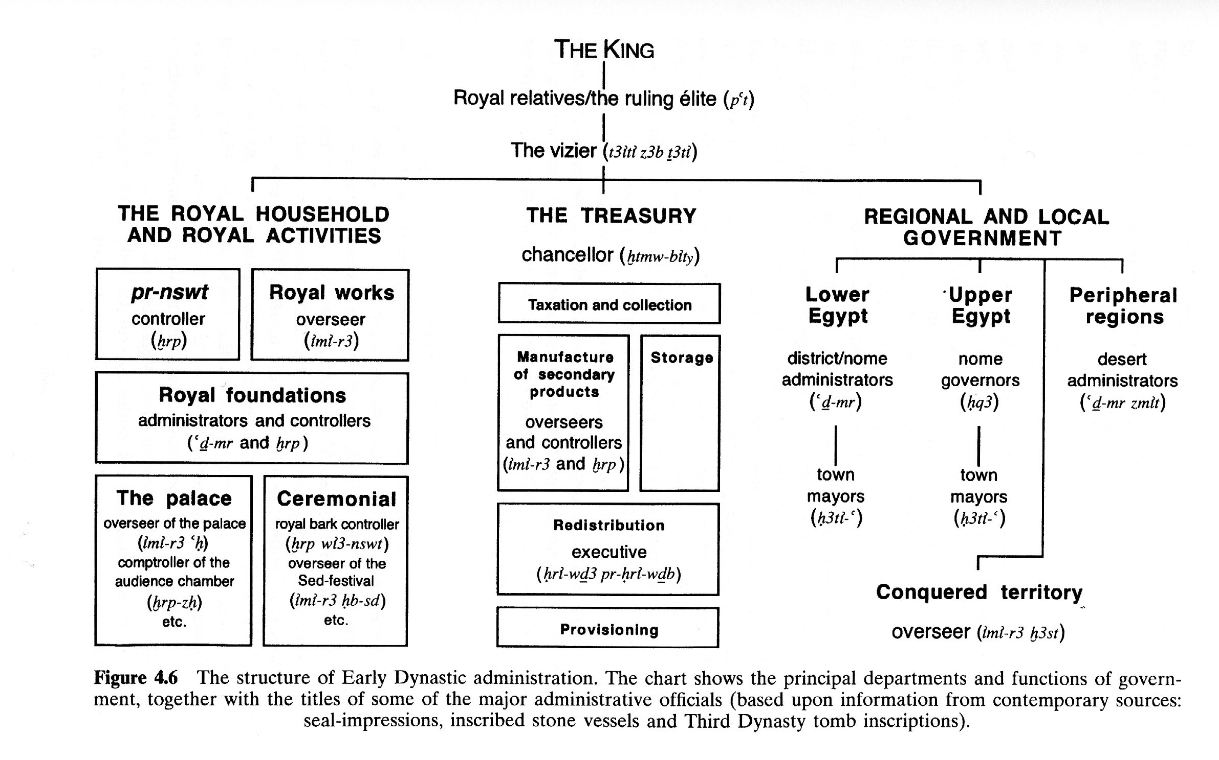
Vizier/high official titles for a man named Menka, found on a stone vessel in the stepped pyramid at Saqqara
Chazan, M. (2021). World prehistory and archaeology: pathways through time. Routledge, New York.

Slide 16
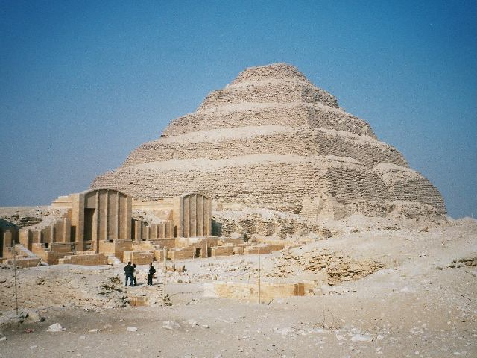
Saqqara stepped pyramid built for the 3rd Dynasty king Djoser, the earliest pyramid, required considerable organization of labor and engineering skills; representing planetary spheres the pharaoh’s soul needed to ascend in order to be one with the god Osiris, god of the dead and afterlife
initial evidence for the king as a divinity
Designed by the priest/
astronomer Imhotep,
high priest of the most important sun god Re/Ra
aligned to the 4 cardinal
directions
King Djoser was regarded as sacred, the earthly son of Ra
engravings indicate
a hidden ritual space
https://www.britannica.com/topic/Step-Pyramid

Slide 17
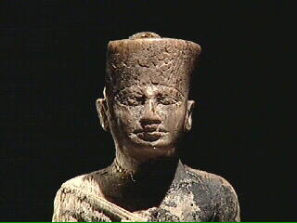
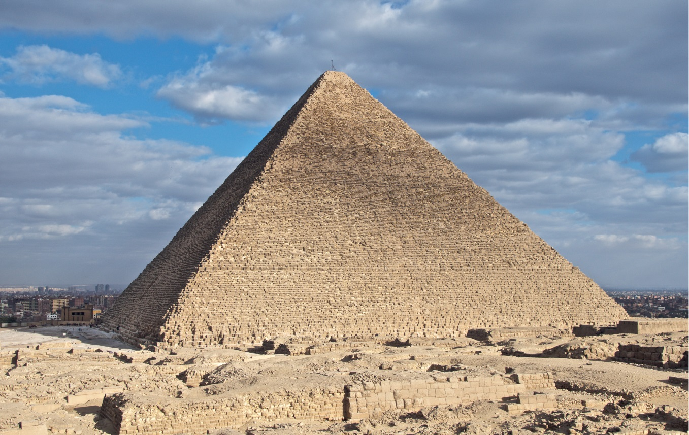
The Old Kingdom, 4th to 8th Dynasties, 2575-2134 B.C.
power continued to be centered in the Memphis area
the Pyramid of Khufu/Cheops at GIZA, about 13 acres in area, 480 feet high, built about 2528 B.C.
the concept of kingship expanded, merging worship of the sun with that of the Pharaoh, concept of “ma’at”
https://the-past.com/feature/records-of-the-pyramid-builders-discovering-eye-witness-accounts-of-a-legendary-construction-projects
2.3 million blocks
of stone, at least 2.5 tons each
Inscriptions mention that the Pharaoh’s soul needed a ladder to heaven

Slide 18
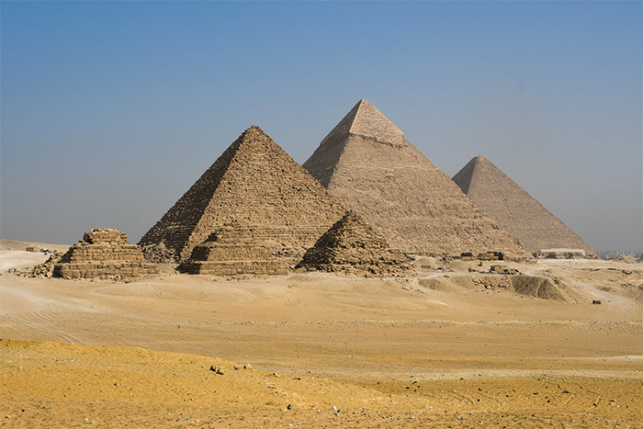
Pyramids at Giza: legitimation through display of power
https://www.world-archaeology.com/travel/travel-the-horizon-of-khufu

Slide 19
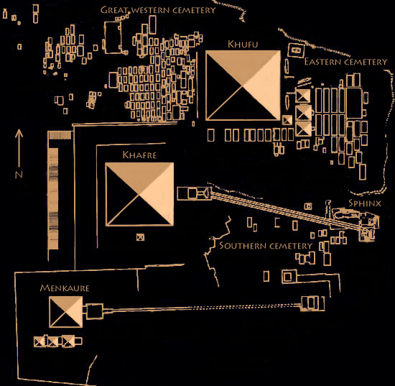
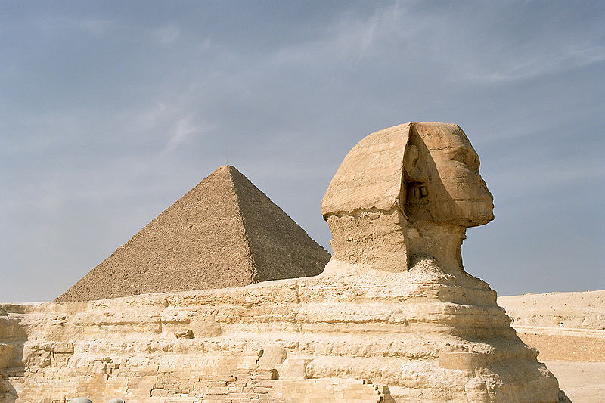
The later pharaoh Khafre added his own pyramid and associated temple to Giza; also the Sphinx depicting a lion with his head;
Then the pyramid of pharaoh Menkaure; smaller, hypothesis
that he died suddenly and it could not be finished--
pyramids in later periods were smaller—It appears that pyramid building over-extended the resources of the state.
https://www.thenotsoinnocentsabroad.com/blog/the-mystery-of-the-sphinx-and-the-valley-temple-of-khafre
Smaller, simple tombs discovered for pyramid workers; larger for supervisors; not mummified as for elites; skeletons show arthritis and other health problems
https://ancientegyptonline.co.uk/giza

Slide 20
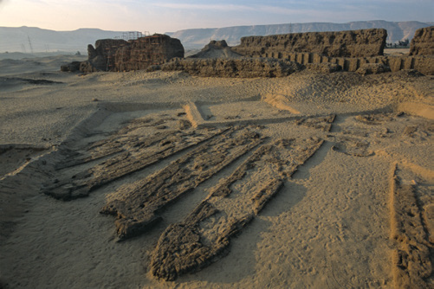
A boat built from cedar
brought from Lebanon
found in a pit at Giza;
probably this type of boat
used to bring supplies and offerings for the tomb; a stone embankment for loading and unloading ships
was found to the south;
likely harbor district
Trade was conducted by boat and by land: turquoise and copper from Sinai;
ivory and valuable stones from Nubia:
many important items from southern Africa
Chazan, M. (2021). World prehistory and archaeology: pathways through time. Routledge, New York.

Slide 21
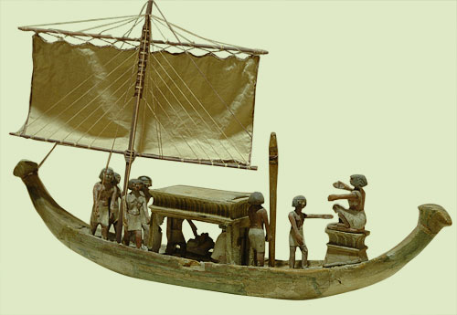
Model of a boat from a tomb
http://www.ancient-egypt.co.uk/metropolitan/pages/boat%201.htm

Slide 22
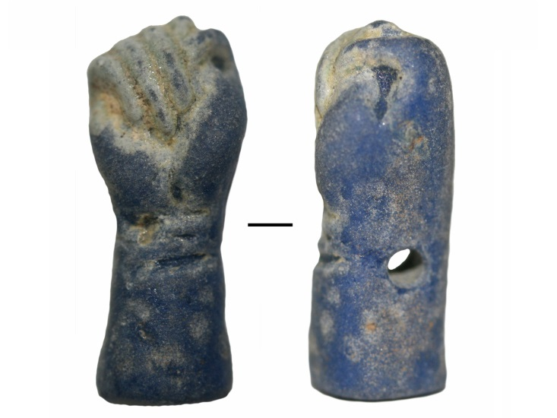
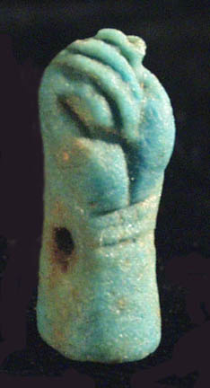
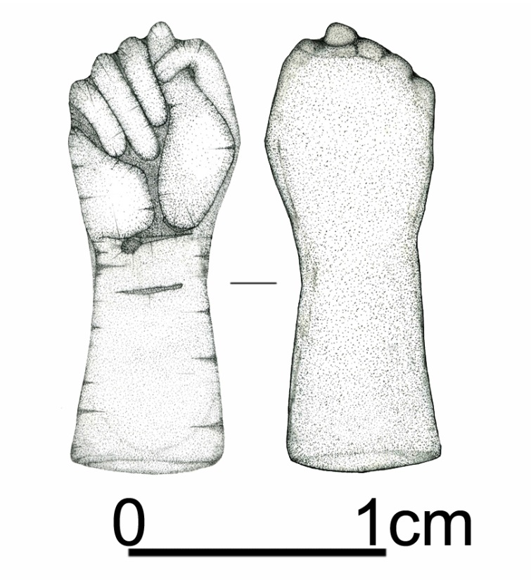
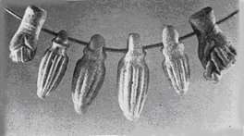
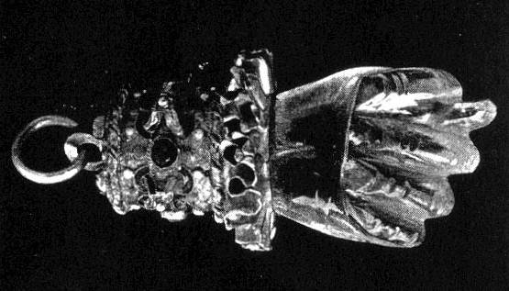
Xiongnu period burial
(209 BC- 155 AD)

Slide 23
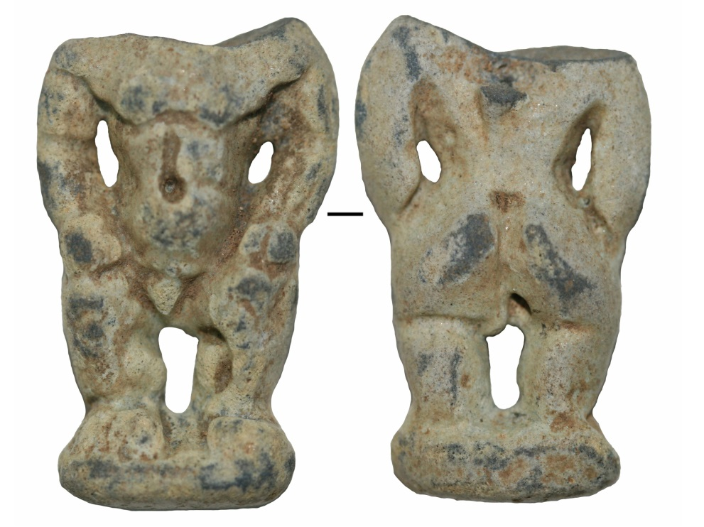
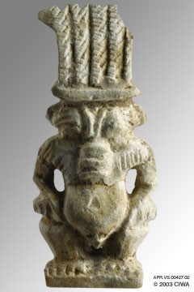
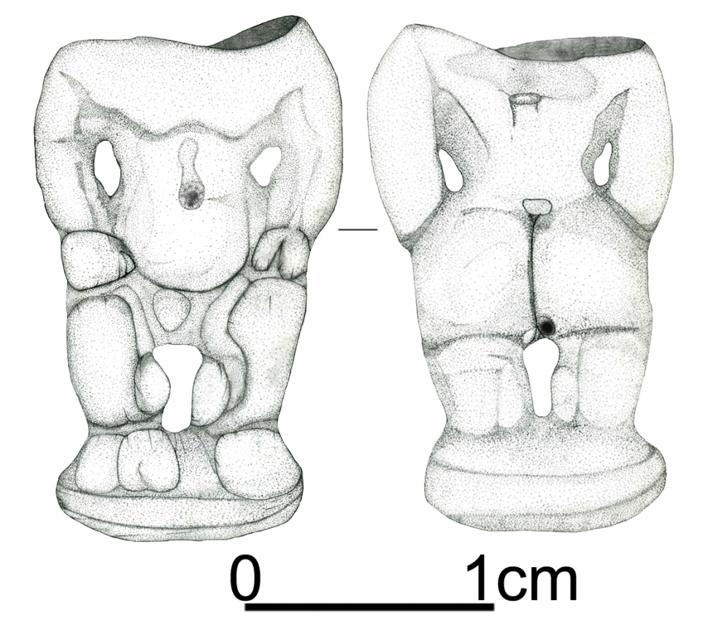
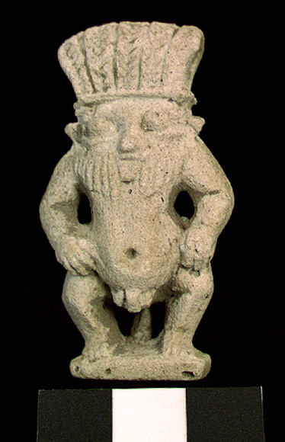
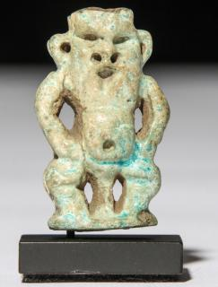
God Bes
https://www.metmuseum.org/art/collection/search/547904

Slide 24
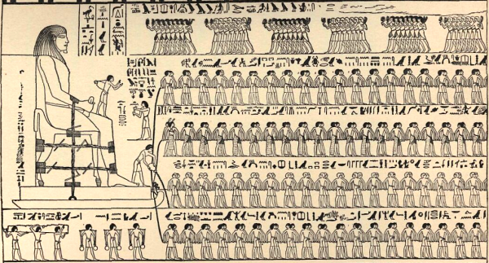
image from a tomb of corvee labor dragging a statue
The power of the state is clear, but what about the beliefs of the workers?
https://www.csmonitor.com/Science/2014/0502/Ancient-Egyptians-used-wet-sand-to-drag-massive-pyramid-stones-say-scientists

Slide 25
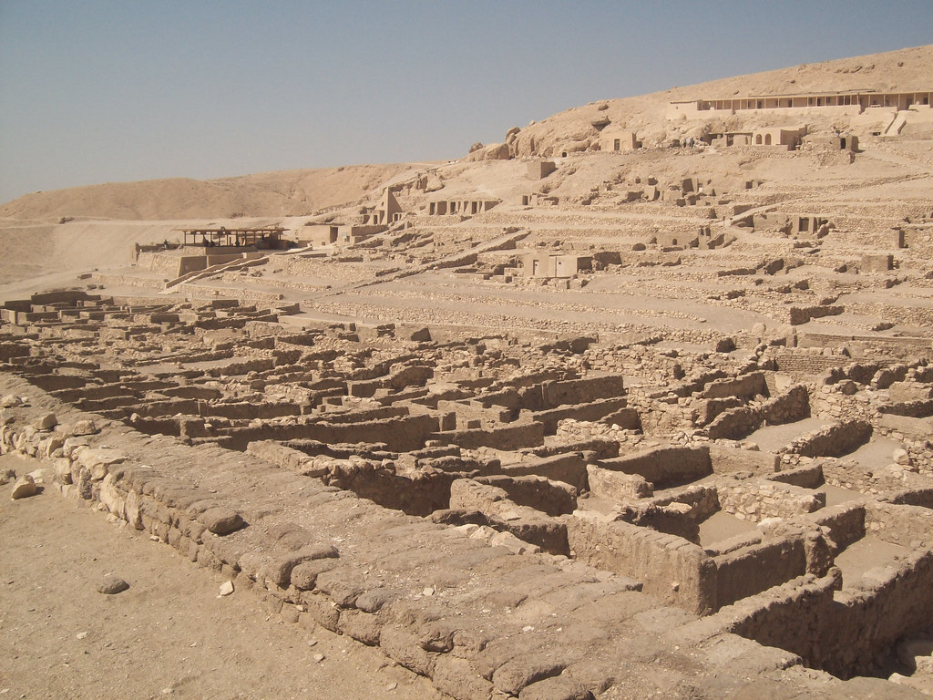
Workers’ village
https://www.flickr.com/photos/isawnyu/8252354139

Slide 26
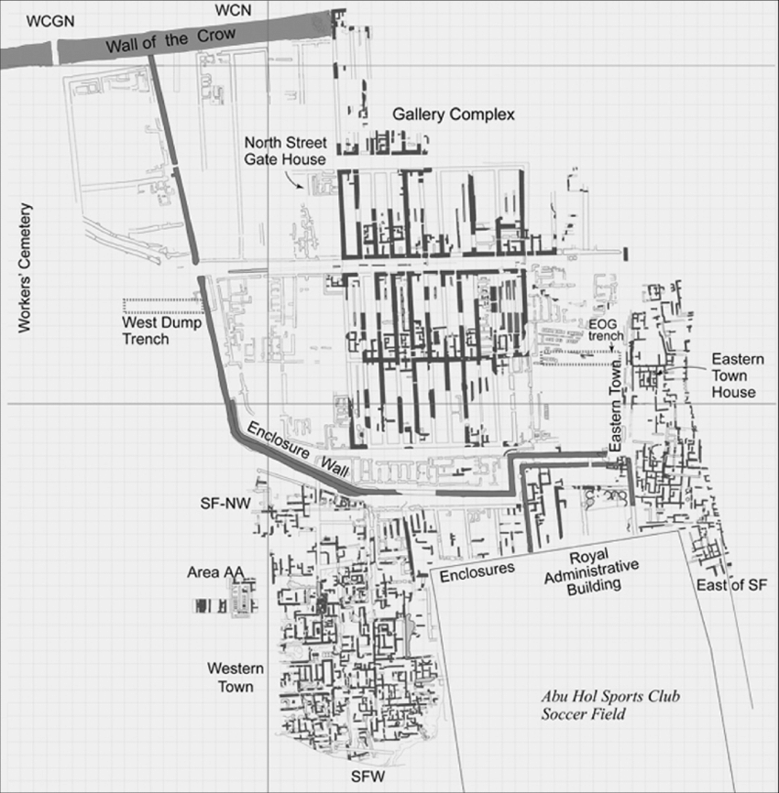
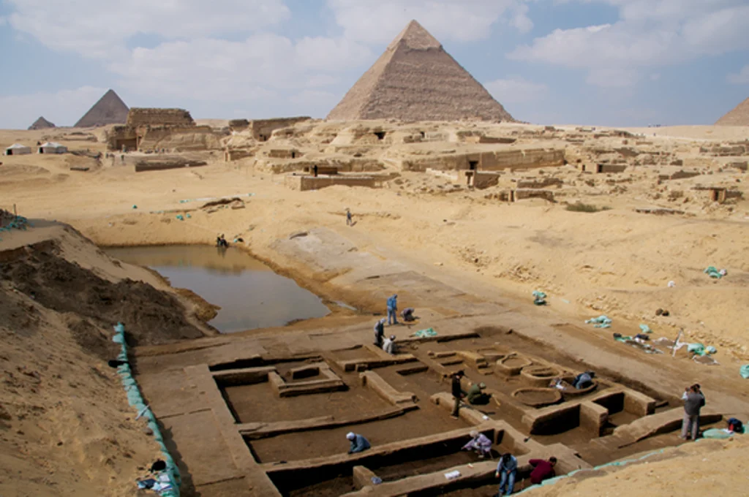
Excavations at the workers’ village
http://www.aeraweb.org/tag/giza-plateau

Slide 27
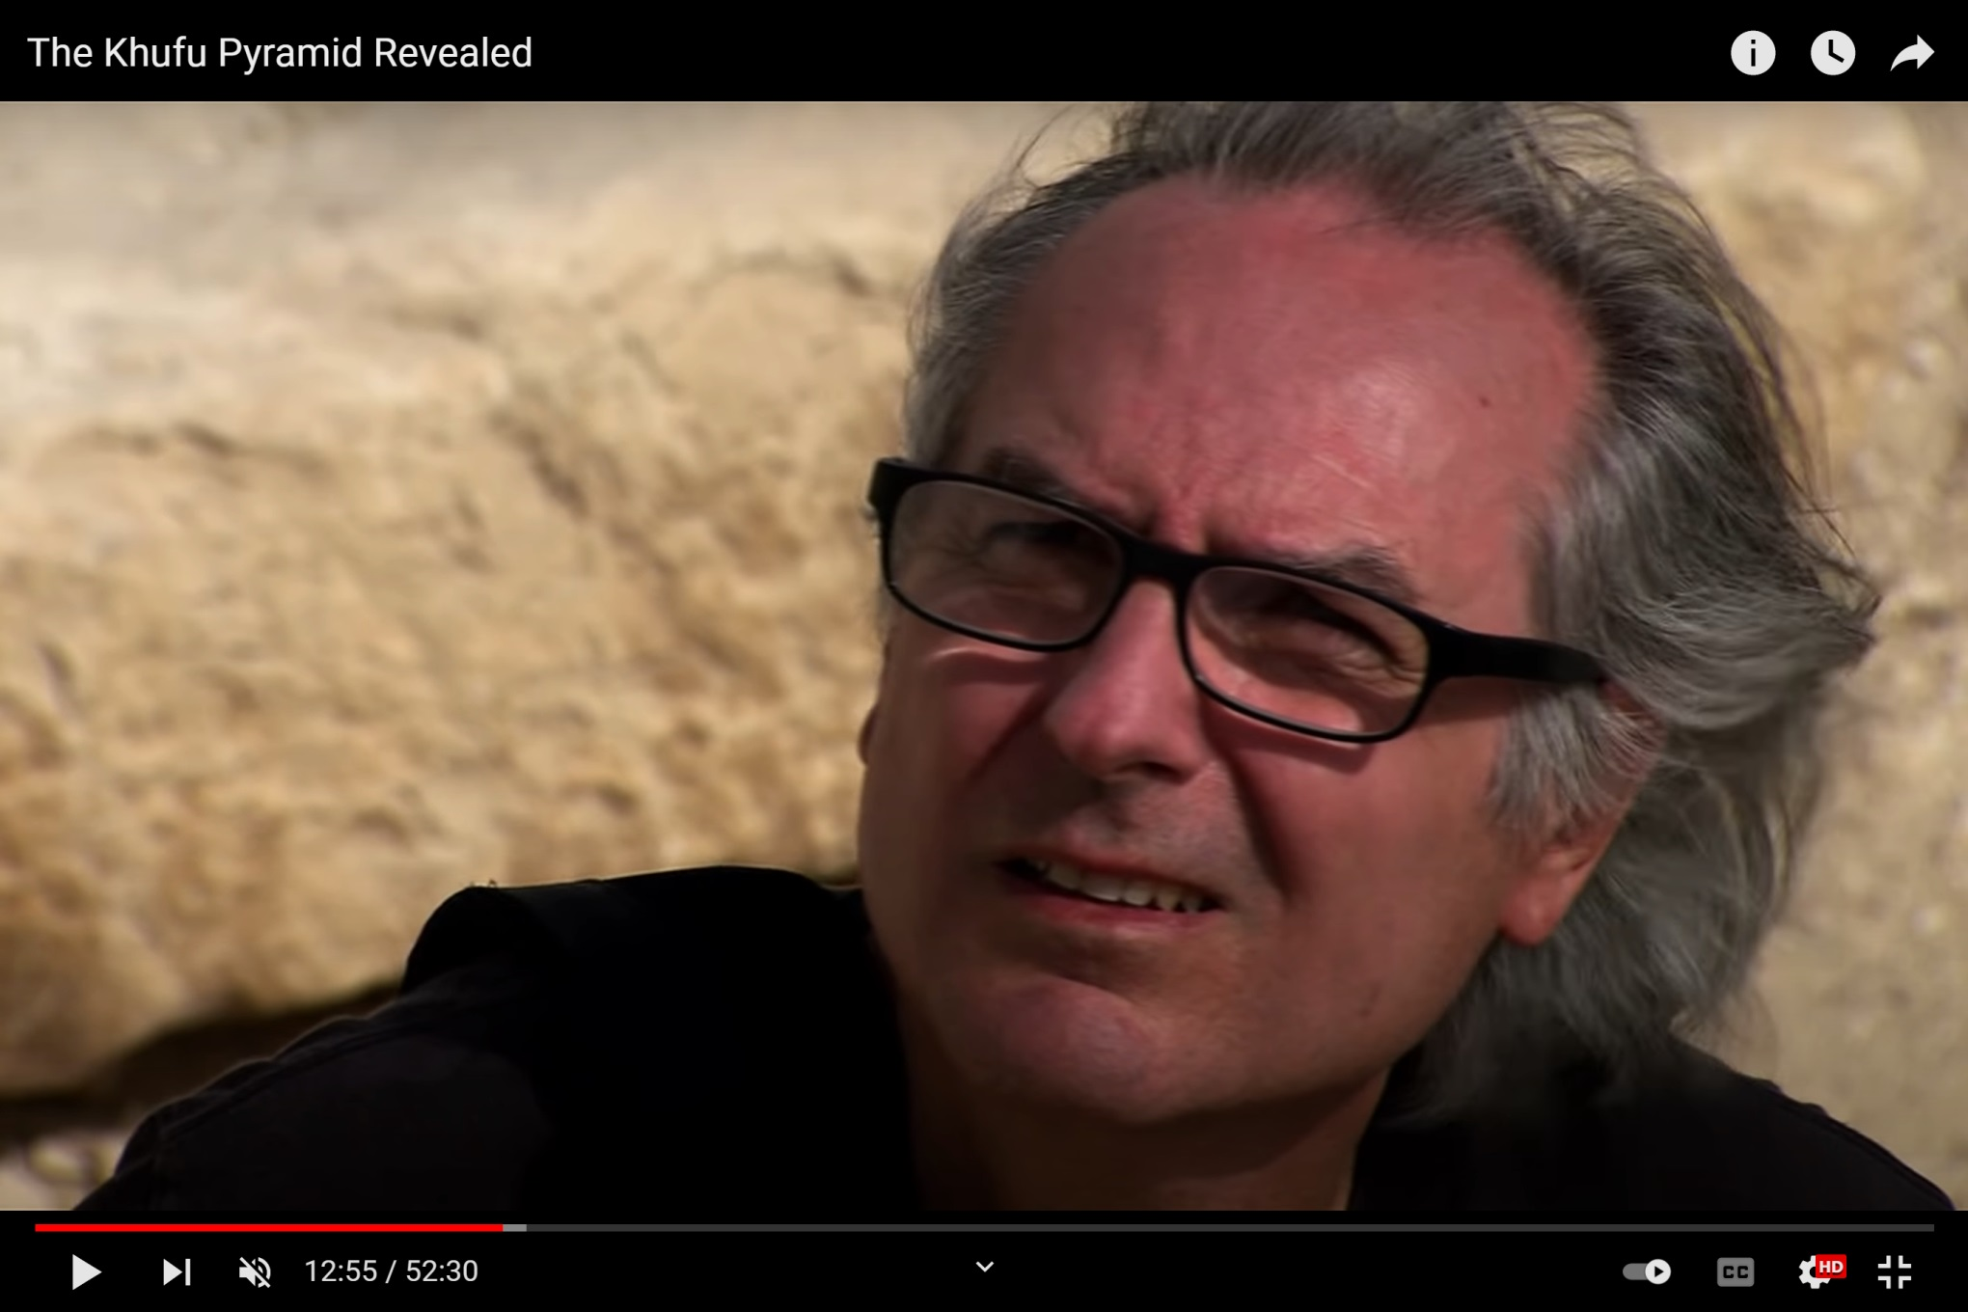
https://www.youtube.com/watch?v=eGqfdXkAQMk&t=554s

Slide 28
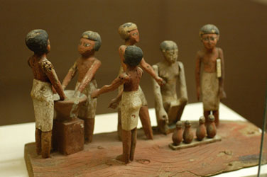
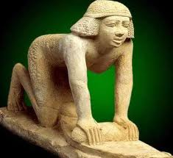
Brewing beer and baking bread from emmer wheat and barley took place
in the same areas
lightly baked bread dough was used in the mash for beer, and some beer
may have been used in the dough (beer more nutritious than water)
http://www.touregypt.net/featurestories/bread.htm

Slide 29
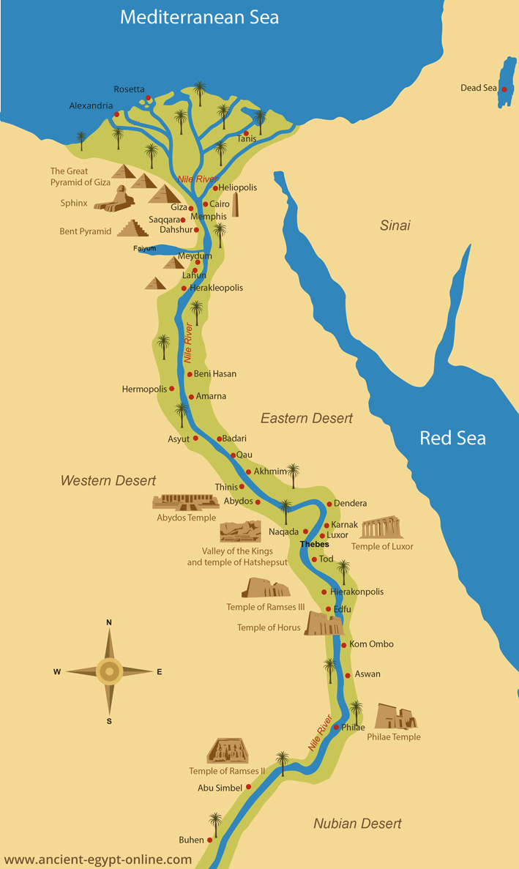
State without city?
Ritual and funerary complexes
Concentration of administration buildings
People likely lived in villages and rural areas

Slide 30
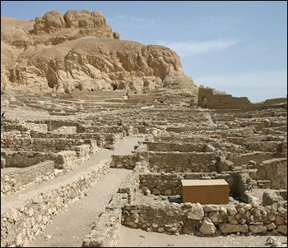
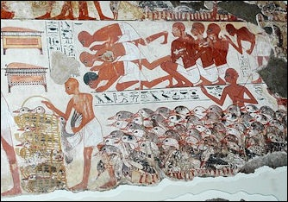
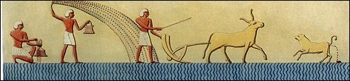
Life in village
Deir el Medina
https://factsanddetails.com/world/cat56/sub365/entry-6127.html

Slide 31
Summing up the evidence
State without urbanism
Pharaohs were seen as deities, the concept of ma’at
No evidence of coercion
Emergence of state society in ancient Egypt was not sudden phenomenon, rather is was a gradual process with deep roots to societies of Predynastic period

Slide 32
References
Allen, J. (2014). Middle Egyptian: an introduction to the language and culture of hieroglyphs, 3rd edition. Cambridge University Press, Cambridge.
Chazan, M. (2021). World prehistory and archaeology: pathways through time. Routledge, New York.
Clarke, S. and Engelbach, R. (1990). Ancient Egyptian construction and architecture. Dover Publications, New York.
Hendrickz, S. and Förster, F. (2020). Violence and the Early Egyptian state. Egypt and the Levant, 30: 77-83.
Kemp, B. (2006). Ancient Egypt: anatomy of a civilization, 2nd edition. Routledge, London.
Redding, R. (1992). Egyptian Old Kingdom patterns of animal use and the value of faunal data in modeling socioeconomic systems. Paleorient, 18: 99-107.

