Slide 1
Principles of Advertising
How advertising works PART I.
LECTURE 7 BY DR. RAPHAEL OGUTU,
Mass Communication Department,
AFRICA NAZARENE UNIVERSITY.
THE MAIN SOURCE OF REFERENCE: Advertising & IMC: Principles and Practice., Moriarty, Sandra Mitchell, Nancy D and Wells, William D. 14th edition. Pearson Prentice Hall Inc., 2009.

Slide 2
Course Goals and Objectives
Intended Learning Outcomes
At the end of this class the student should be able to :
Explain how advertising differs from the basic human communication process.
Show why communication is a key factor in advertising effectiveness
Explain Models of communication in Advertising

Slide 3
How advertising works
Advertising is a form of communication.
A message to a consumer about product.
Gets attention, provides information and sometimes a little bit of entertainment, and tries to create some kind of response, such as sales.
In reality, advertising is not a conversation. Most advertising is not as personal or as interactive as a conversation, because it relies on mass communication, which is indirect and complex.

Slide 4
How advertising works
Although other forms of marketing communication (personal selling and telemarketing) can deliver the personal contact of a conversation
In reality , however, advertising is not a conversation.
Most advertising is not as personal or as interactive as a conversation because it relies on mass communication, which is indirect and complex.
Although other forms of marketing communication such as personal selling and telemarketing can deliver the personal contact of a conversation.

Slide 5
How advertising works: Communication defined
Definitions
Communication: According to Merriam Webster dictionary, it is the act or process of transmitting information (as about ideas, attitudes, emotions, or objective behavior), exchange of information between individuals through a common system of signs, symbols, or behavior.
Human communication refers to the process of human beings responding to the symbolic behaviour of other persons.
Communication is human though other animals and creatures communicate; human communication is a complex one. Sometimes we communicate with our pets (Adler and Rodman, 2006).

Slide 6
The key characteristics of communication
Communication is human though other animals and creatures communicate; human communication is a complex one.
Communication is a process it is a continuous ongoing process.
Communication is symbolic: symbols are used to represent things, ideas, or events in ways that make communication possible. Symbols are arbitrary in nature for example why should the letters book represent the object you read.
(Adler and Rodman, 2006).

Slide 7
Types of communication
Intrapersonal communication
Is language use or thought internal to the communicator.
Intrapersonal communication is the active internal involvement of the individual in symbolic processing of messages.
The individual becomes his or her own sender and receiver, providing feedback to him or herself in an ongoing internal process.
It can be useful to envision intrapersonal communication occurring in the mind of the individual in a model, which contains a sender, receiver, and feedback loop.
In advertising it could be applied through brain storming of individual team players in an advertising communication process.
(Adler and Rodman, 2006).

Slide 8
Types of communication
Dyadic communication
Social scientists call two persons interacting a dyad and they often use the adjective dyadic to describe this type of communication it is often called Interpersonal communication.
Communication scholars in numerous ways define interpersonal communication; though most definitions involve participants who are interdependent on one another, have a shared history.
Communication channels are the medium chosen to convey the message from sender to receiver.
In advertising it could be applied in the discussion between the advertiser and the agency for the effective strategy. Also advertising by word of mouth.
(Adler and Rodman, 2006)

Slide 9
Types of communication
Organizational communication,
people working together to achieve individual or collective goals. People can relate to each other only through some form of communication.
The survival of an organization depends on individuals and groups who are able to maintain among themselves effective and continuing relationships.
The purpose of communication may range from completing a task or mission to creating and maintaining satisfying human relationships.
In advertising it could be applied in the agency through brain storming.
(Adler and Rodman, 2006).

Slide 10
Types of communication
Public communication
Occurs when a group becomes too large for all members to contribute.
One or more people are likely to deliver their remarks to the remaining members, who act as audience. It has therefore limited verbal feedback. However audiences often have a chance to ask questions and offer brief comments and their nonverbal reactions offers a wide range of clues about their reception of the speaker’s remarks.
In advertising it could be applied when agencies are pitching to the advertiser/s to secure the job of producing the advertisement/s.
(Adler and Rodman, 2006).

Slide 11
Types of communication
Mass Communication
consists of messages that are transmitted to larger, widespread audiences via electronic and print media.
Aimed at a larger audience without any personal contact between the sender and the receivers unlike the other types of communication.
Most messages here are developed or at least financed by large organizations. Less personal and more of a product.
Controlled by gate keepers who determine what messages will be delivered to consumers, how they will be constructed and when they will be delivered (Adler and Rodman, 2006).
In advertising it could be applied through traditional mass media, which are the channels of communication.

Slide 12
Types of communication
Computer- mediated communication. Communication between people that takes place through some computer connection, for example E- mail, Chat room, Telegram, Twitter, News group, instant messaging, website and blog communication.
In advertising it could be applied through the interactive media, where there is simultaneous sending and responding or feedback of information.
(Adler and Rodman, 2006).

Slide 13
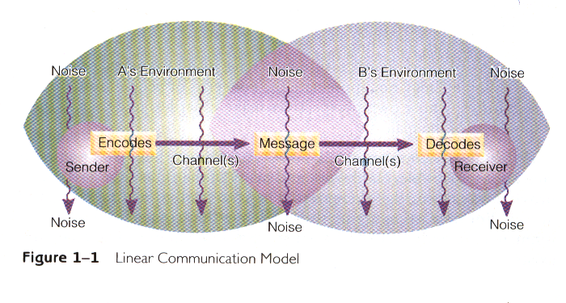
How advertising works:
Modeling communication
A model is a systematic representation of an object or event in an idealized and abstract form. Models are arbitrary by nature.
In linear communication model, communication is like giving an injection: A sender encodes ideas and feelings into some sort of message and then conveys them by means of a channel (speech, writing, and so on) into a receiver who decodes the message. (Adler and Rodman, 2006).

Slide 14
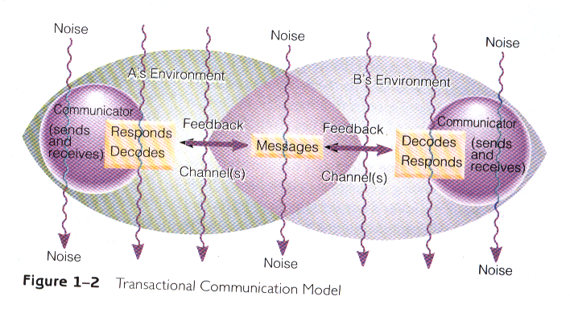
How advertising works:
Modeling communication
  The transactional model reflects the fact we usually send and receive messages simultaneously. In this model we are capable of receiving, decoding and responding to another person’s behaviour, while at the same time that person is receiving and responding to ours. (Adler and Rodman, 2006).

Slide 15
Types of noise
External noise (physical) - includes those factors outside the receiver that make it difficult to hear, as well as much other kind of distractions. For instance, too much cigarette smoke in a crowded room might make it hard for you to pay attention to another person, and sitting in the rear of an auditorium might make speaker’s remarks unclear.
Physiological noise- involves biological factors in the receivers or sender that interfere with accurate reception, these include: fatigue, illness
Psychological noise- refers to mental forces within a communicator that interfere with the ability to express or understand a message accurately. (Adler and Rodman, 2006).

Slide 16
Source Dimensions: The Sponsor, the Author, and the Persona
In advertising, who is really the source of the communication? The sponsor named in the ad?
Certainly the real-world sponsor is legally responsible for the communication and has a message to communicate to actual consumers.
To begin with, the sponsor does not usually produce the message. That is the typical role of the sponsor’s ad agency or other specialists.
These people exist in the real world but are completely invisible to the reader or viewer, even though they play a key role in composing the text and the tenor of the message.
Imaginary spokesperson (a persona) lends some voice or tone to the ad or commercial (Arens, 2005).

Slide 17
Message Dimensions: Autobiography, Narrative, and Drama
The types of messages communicated in advertising may also be multidimensional.
As artful imitations of life, advertising messages typically use one or a blend of three literary forms:
In autobiographical messages, “I” tell a story about myself to “you,” the imaginary audience eavesdropping on my private personal experience.
Other ads use narrative messages in which a third-person persona tells a story about others to an imagined audience.
Finally, in the drama message, the characters act out events directly in front of an imagined empathetic audience.
To do all this effectively requires great skill, but it’s this creativity that truly distinguishes advertising from all other forms of communication (Arens, 2005).

Slide 18
Receiver Dimensions: Implied, Sponsorial, and Actual Consumers
The receivers of advertising are also multidimensional.
First, within the text, every ad or commercial presumes some audience is there.
These implied consumers, who are addressed by the ad’s persona, are not real.
These sponsorial consumers are the gatekeepers who decide if the ad will run or not.
The fact that the sponsor’s advertising message must compete with hundreds of other commercial and noncommercial messages every day creates noise.
The sender doesn’t know how the message is received, or even if it’s received, until a consumer acknowledges it
(Arens, 2005).

Slide 19
Feedback and Interactivity
Completes the cycle, verifying that the message was received.
Feedback employs a sender–message–receiver pattern, except that it is directed from the receiver back to the source.
Because of technology; the audiences of advertising are no longer just passive receivers of impersonal mass messages but active decision makers who can control the information they want about a particular product.
Interactive media such as the Internet, they can give instantaneous, real-time feedback on the same channel used by the original message sender (Arens, 2005).

Slide 20
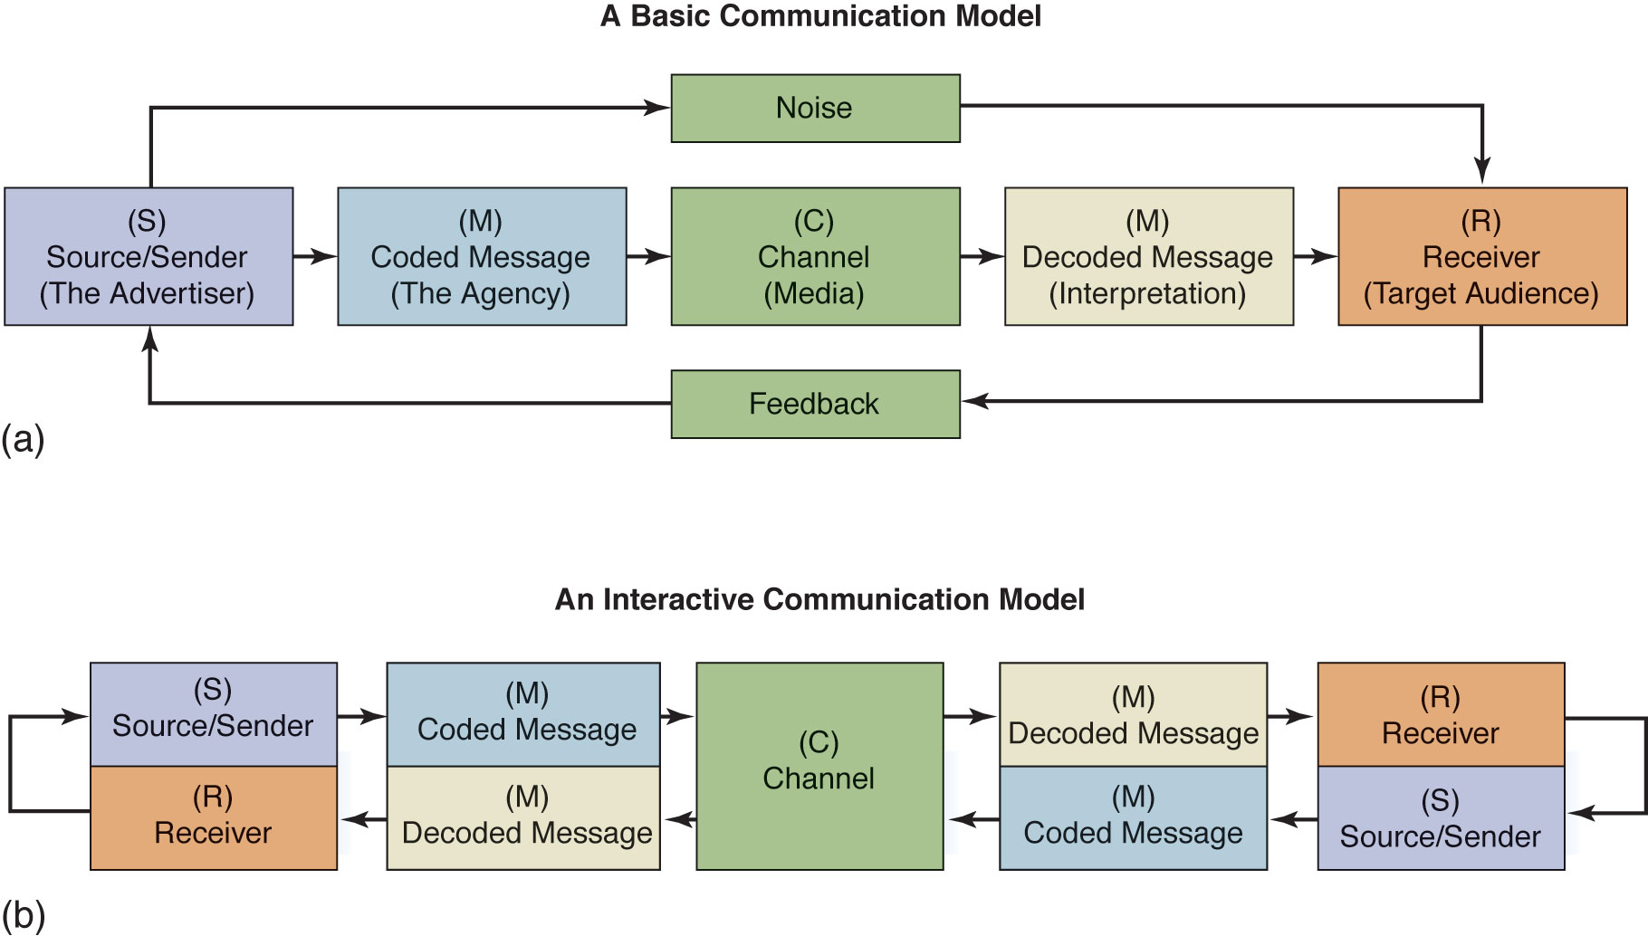
The Communication Model
Mass communication is generally a one-way process with the message moving from sender to receiver.
  The SMCR model begins with a source (S), a sender who encodes a message (M), or puts it in words and pictures. The message is presented through channels of communication (C), such as a newspaper, radio, or TV. The message is decoded, or interpreted, by the receiver (R), who is the reader, viewer, or listener.
  Feedback is obtained by monitoring the receiver’s response to the message.
Source: Moriarty, Mitchell and Wells, (2009)

Slide 21
The Interactive Communication Model
Interactive communication is two-way—a dialogue—and this is where marketing communication is headed.
  The source and receiver change positions as the message bounces back and forth between them.
  interactive communication means people are contacting companies through the Web or by phone, and they are talking to one another in a circle of comments about products and brands.
Source: Moriarty, Mitchell and Wells, (2009)

Slide 22
The Interactive Communication Model
The move toward interactivity
Interest in buzz marketing indicates that marketing communication is moving beyond two-way communication.
Consumers can now:
  react to messages with comments, phone calls, e-mail inquiries.
  Initiate communication as well as receive it.
The Internet has radically changed our conversation.
Consider the effects of:
  Texting
  Twitter
  Hashtags

Slide 23
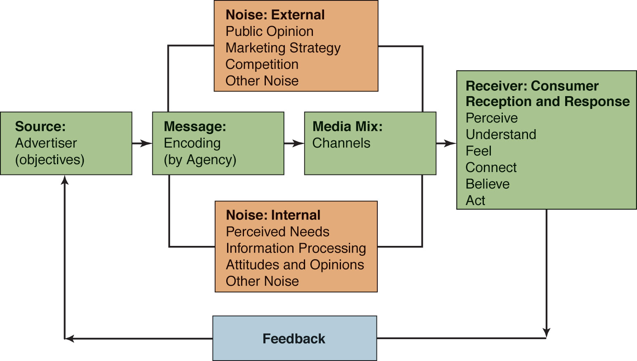
Advertising as Mass Communication
Source: Moriarty, Mitchell and Wells, (2009)

Slide 24
Advertising as Mass Communication
It starts with the advertiser (source) who communicates his objective to the advertising agency as to what he wants to accomplish with his brand through the advertisement targeting the consumer audience (receiver).
The advertising agency, in the light of their client company's objective shape the advertisement (encoding process) and incorporate certain channels of communication (the media mix) to make the advertisement go public.
The medium is the vehicle that delivers the message. In advertising, that tends to be newspapers and magazines in print, radio and television in broadcasting, the internet, and other forms of out-of-home vehicles, outdoor boards, and posters.
Source: Moriarty, Mitchell and Wells, (2009)

Slide 25
Advertising as Mass Communication
Other media are phone, fax, mugs, T-shirts, in-store signs, brochures, catalogues, shopping bags, inflatable, sidewalks, cell phones and so on. External noise in advertising includes socio-economic trends that affect the reception of message.
Internal noise include personal factors that affect the reception of an advertisement, such as the receiver’s needs, purchase history, information processing abilities, and other personal factors.
Feedback is the reaction the audience has to a message. It can be obtained through research or through customer-initiated contact with the company.
the target audience(receiver) encounters the advertisement and that is what ultimately decides the degree to which the advertiser's objectives got fulfilled. (Moriarty, Mitchell and Wells 2009)

Slide 26
Noise in Advertising
Internal noise
In advertising, noise hinders the consumer’s reception of the message.
Internal noise includes personal factors that affect the reception of an advertisement, such as the target audience’s needs, purchase history, information-processing abilities, and level of avoidance of advertising in general.
If you are to tired to listen or your attention is focused elsewhere, then your fatigue creates noise that hiders your reception of the message.
(Moriarty, Mitchell and Wells 2009)

Slide 27
Noise in Advertising
External noise:
Macro level: consumer trends (health trends harm the reception of fast-food message) and problems with product’s marketing strategy (product design, price, distribution and marketing communication
Micro level: external noise could be as simple as bad radio or TV reception, but more important factor is cluster, which is the multitude of message all competing to get consumer’s attention (difficult to get attention)
Avoid cluster and information overload
(Moriarty, Mitchell and Wells 2009)

Slide 28
The Effects Behind
Advertising Effectiveness
Good advertising—and marketing communication—is effective when it generates the advertiser’s desired response.
(Moriarty, Mitchell and Wells 2009)
Principle:
The intended consumer response is
the message’s objective, and the message is effective to the degree that it achieves
this desired response.

Slide 29
Traditional Approaches
AIDA model
AIDA (attention, interest, desire and action) is considered as the most common and long-standing explanation of advertising effect.
The ad gets attention, then it creates interest, then desire and finally stimulates action.
The model identifies four effects and makes a prediction about how they are related in a hierarchy steps.
Because AIDA assumes that consumers start with attention and wind up with a decision (referring to as a hierarchy - of - effects model)
Limitation: AIDA model is not adequate as model of the various types of effect advertising can create .
(Moriarty, Mitchell and Wells 2009)

Slide 30
Traditional Approaches
Think-feel-do model: is a simple model that answer to how advertising works.
The idea is that advertising motivates people to think about the message, feel something about the product, and do something, such as try it or buy it.
This model has been used to identify various patterns of response depending on the type of product and buying situation.
(Moriarty, Mitchell and Wells 2009)

Slide 31
Moriarty’s domains model
Domains
  Messages have various impacts on consumers simultaneously (perception, learning, and persuasion)
The idea is that a message can engage consumers’ perceptions (attention, interest), educate them (think, learn), and persuade them (change attitude and behavior) all at the same time.
(Moriarty, Mitchell and Wells 2009)

Slide 32
SUMMARY
Advertising as Mass communication
The source typically is the advertiser assisted by its agency and the receiver is the consumer who responds in some way to the message.
The message is the advertisement or other marketing communication tool.
The medium is the vehicle that delivers the message; in advertising, that tends to be newspapers and magazines in print, radio and TV in broadcasting, the Internet, and other forms of out-of-home vehicles, such as outdoor boards and posters.

Slide 33
SUMMARY
In integrated marketing communication, the media are varied and include all points of contact where a consumer receives an impression of the brand. Noise is both external and internal. External noise in advertising includes consumer trends that affect the reception of the message, as well as problems in the brand’s marketing mix and clutter in the channel. Internal noise includes personal factors that affect the reception of the message.

Slide 34
SUMMARY
Traditional approaches to advertising effects
The most common explanation of how advertising works is referred to as AIDA, which stands for attention, interest, desire, and action.
This model in all of its subsequent forms is described as a hierarchy of effects because it presumes a set of steps that consumers go through in responding to a message. A different approach, referred to as think/feel/do, recognizes that different marketing communication situations generate different patterns of responses.
Two problems are inherent in these traditional approaches: (1) the idea of predictable steps and (2) missing effects, particularly those that govern the way people respond to brands.

Slide 35
THANK YOU
LECTURE 7 BY DR. RAPHAEL OGUTU,
Mass Communication Department,
AFRICA NAZARENE UNIVERSITY.
THE MAIN SOURCE OF REFERENCE:
Advertising & IMC: Principles and Practice., Moriarty, Sandra Mitchell, Nancy D and Wells, William D. 14th edition. Pearson Prentice Hall Inc., 2009.
Contemporary Advertising. Arens, William. F., 10th Ed. McGraw Hill Higher Education. 2005
Understanding human communication. Adler, R.B. & Rodman, G. 9th edition. London: Oxford University Press. 2006.

