Slide 1
Principles of Advertising
How advertising works PART II.
LECTURE 8 BY DR. RAPHAEL OGUTU,
Mass Communication Department,
AFRICA NAZARENE UNIVERSITY.
THE MAIN SOURCE OF REFERENCE: Advertising & IMC: Principles and Practice., Moriarty, Sandra Mitchell, Nancy D and Wells, William D. 14th edition. Pearson Prentice Hall Inc., 2009.

Slide 2
Course Goals and Objectives
Intended Learning Outcomes
At the end of this class the student should be able to :
Explain the Facets Model of Advertising Effects to show how brand advertising works
Analyze the six key effects that govern consumer response to advertising messages
Apply forms of Advertising Appeals.

Slide 3
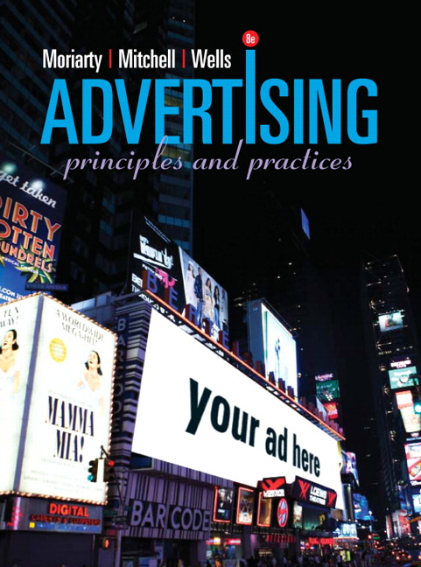
The Effects Behind Advertising Effectiveness (RECAP)
AIDA (attention, interest, desire, action)
Hierarchy of Effects (think, feel, do)
Key Advertising Effects
Facets models of effective advertising
Useful in both setting objectives and evaluating advertising effectiveness
The facets come together to make up the unique consumer response to an advertising message
SOURCE: https://www.pearson.com/us/higher-education/product/Moriarty-Advertising-8th-Edition/9780132224154.html

Slide 4
Three Models of Advertising Effect
Traditional models and Proposed model
(Moriarty, Mitchell and Wells, 2009).
Hierarchy of Effects Model
AIDA Model
  Key Advertising
  Effects Model
Perception
Attention
Think
Cognition
Association
Interest
Affective Response
Feel
Desire
Persuasion
Do
Action
Behavior

Slide 5
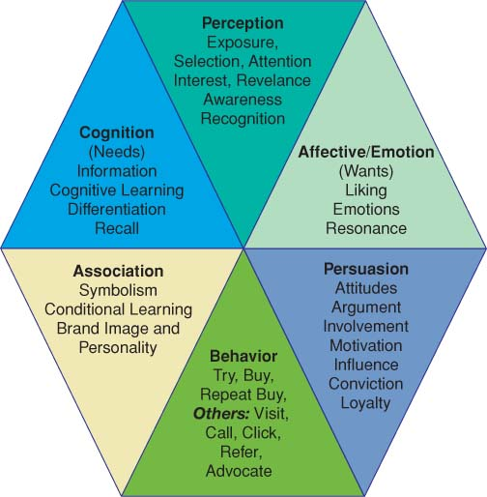
Lesson outline
WHAT IS ADVERTISING?
The Effects Behind Advertising Effectiveness
Perception
Cognition
The Affective or Emotional Response
Association
Persuasion
Behavior
These are facets, polished surfaces like those of a diamond, that come together to make up the unique consumer response to an advertising message
(Moriarty, Mitchell and Wells, 2009).

Slide 6
Perception
The process by which we receive information through our five senses and assign meaning to it
Selective perception: Consumers select messages to which they pay attention.
Components of Perception
Exposure
Selection and Attention
Interest and Relevance
Awareness
Recognition
(Moriarty, Mitchell and Wells, 2009).

Slide 7
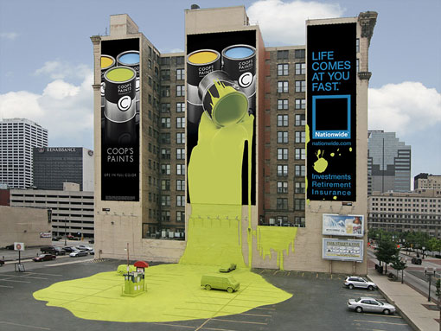
Perception
Exposure
Being seen or heard
Media planners try to find the best way to expose the target audience to the message
IMC planners consider all contacts a consumer has with a company or brand
(Moriarty, Mitchell and Wells, 2009).

Slide 8
Perception
Selection and Attention
The ability to draw attention, to bring visibility
One of advertising’s greatest strengths
Interest and Relevance
Interest
  The receiver of the message has become mentally engaged with the ad and the product
Relevance
  The message connects on some personal level

Slide 9
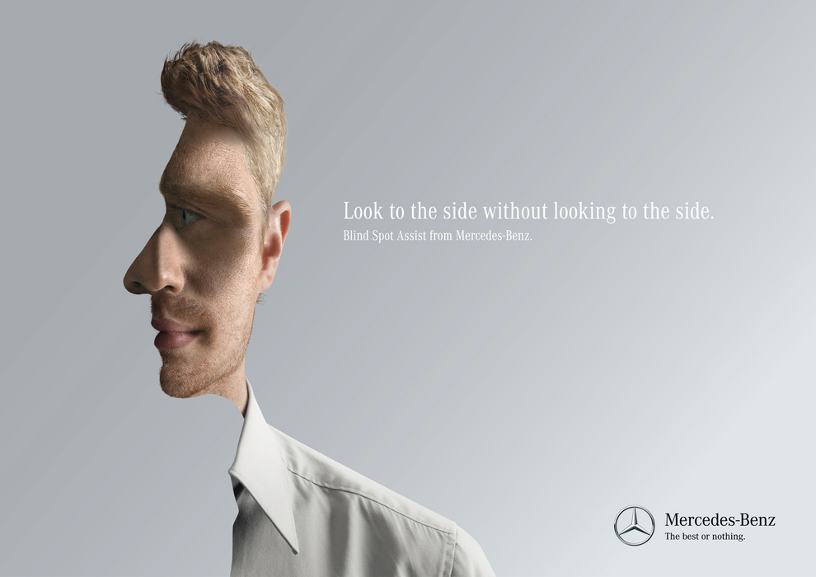
Perception
Source: Moriarty, Mitchell and Wells, (2009)

Slide 10
Perception
Awareness
Awareness: you are aware of something after having seen it or heard if before. Awareness results when an advertisement initially makes an impression
Most evaluations of advertising effectiveness include a measure of awareness as an indicator of perception
Recognition
Memory
Recognition
Recall
Aided Recognition/Recall
Unaided recognition/Recall
Memory- recognition: memory refers to the way people file information in their mind
Source: Moriarty, Mitchell and Wells, (2009)

Slide 11
Perception
Subliminal Issues in Perception
Message cues given below the threshold of perception
Designed to get past your perceptual filters by talking to your subconscious
Subliminal messages are intense enough to influence behavior
Critics claim that advertising can manipulate people subconsciously and cause them to buy things they don’t want or need
Professionals and educators believe there is no real support for subliminal advertising
Source: Moriarty, Mitchell and Wells, (2009)

Slide 12
Cognition
When a presentation of facts, information, and explanations leads to understanding
Used by consumers who want to learn everything about a product before they buy it
The key components of cognition and their roles in effectiveness are:
  Needs
  Information
  Learning
  Differentiation
  Recall
Source: Moriarty, Mitchell and Wells, (2009)

Slide 13
Cognition
Information
Facts about product performance and features
Particularly important for products that are complex, have a high price, or are high risk
advertising often provides information about products (facts about product performance and features- size, price, design, etc.
Needs
The cognitive impact of an advertising message
A cognitive ad explains how a product works and what it can do for the consumer
Needs: are something you think about
Wants: are based on feelings and desires
Source: Moriarty, Mitchell and Wells, (2009)

Slide 14
Cognition
Differentiation
Occurs when consumers understand the explanation of a competitive advantage
A consumer has to understand the features of a brand and be able to compare competing products
key function of advertising is differentiation of one brand from another.
Recall
When the consumer remembers seeing the advertisements and remembers the copy points
Ads use jingles, slogans, catchy headlines, intriguing visuals, and key visuals
recognition is a measure of perception and recall is a measure of learning or understanding

Slide 15
Cognition
Cognitive Learning
When a presentation of facts, information, and explanations leads to understanding
Used by consumers who want to learn everything about a product before they buy it
presentation of facts, information, and explanations leads to understanding.
Consumers who are trying to find information about a product before they buy it are taking the cognitive learning route.
This typically applies to large purchases, such as cars, computers, and major appliances. Learning is also a part of new product introductions.

Slide 16
The Affective or Emotional Response
Definition
Emotional responses reflects our feelings about something. Emotion is described as that stimulates wants, touches emotions, and creates feelings.
Liking
Liking a brand or ad is one of the best predictors of consumer behavior
If a consumer likes the ad, the positive feeling will transfer to the brand
Resonance
Help the consumer identify with the brand on a personal level
Stronger than liking because it involves an element of self-identification
Source: Moriarty, Mitchell and Wells, (2009)

Slide 17
The Affective or Emotional Response
Affective responses mirror our feelings about something.
“Affective” describes something that stimulates wants, touches the emotions, and elicits feelings
Wants: needs are seen as being more cognitive, and wants are described as influenced more by emotion and desire. Ex) you see a display of candy bars, you may want one, but that doesn’t mean you think about whether or not you need it
Emotions: which stir up our passions or feelings, appear in a number of forms in advertising (humor, love, fear). Ads that rely on arousing these feelings are referred as emotional appeals.
Principle:
A positive response to an ad is important because advertisers hope that liking the ad will increase liking the brand.

Slide 18

Association
Is communication through symbolism (process making symbolic connection between a brand and characteristics, qualities or lifestyles that represent the brand’s image and personality.
Service Advertising
Brand linkage reflects the degree to which the associations presented in the message, as well as the consumer's interest, are connected to the brand.
Symbolism
The brand stands for a certain quality
A bond or relationship is created based on these meanings.
Source: Moriarty, Mitchell and Wells, (2009)

Slide 19
Association
Conditioned Learning
Explains much of the impact of advertising. People learn about a product or brand in a largely non-cognitive, even non-rational way. Beer advertising directed at a young male audience often uses image of sporting events, beach parties, and good-looking women, and those image are repeated
Brand Transformation
A brand takes on meaning when it is transformed from a product into something special
Differentiated from other products in the category by virtue of its image and identity
Moriarty, Mitchell and Wells, (2009)
Brand Communication
Brand identity
Brand position
Brand personality
Brand image
Brand promise
Brand loyalty

Slide 20
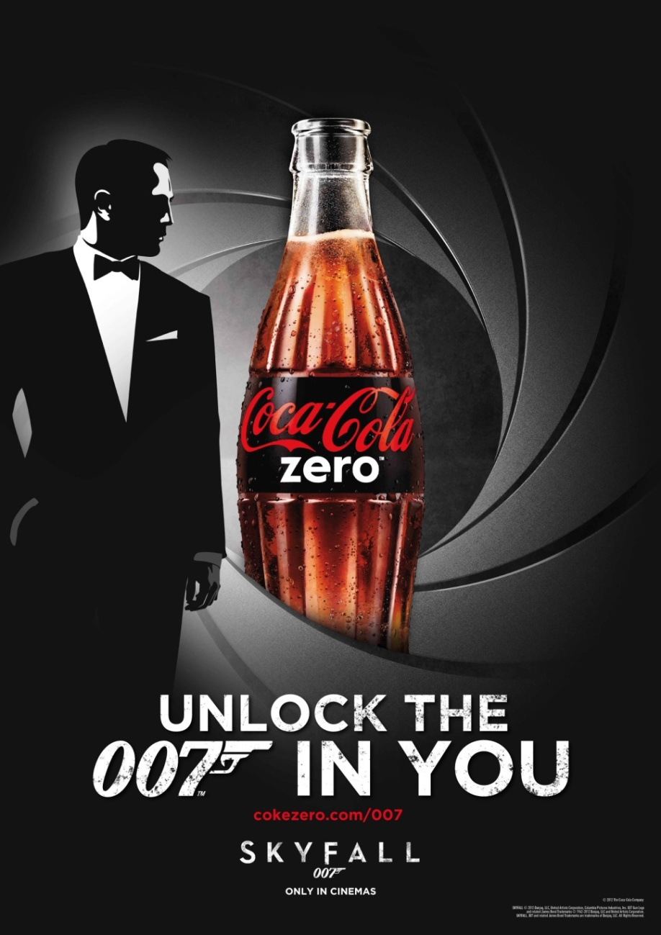
Association and Persuasion

Slide 21
Persuasion
is the conscious intent on the part of the source to influence or motivate receiver of a message to believe or do something.
Components of persuasion
Persuasion is designed to change attitudes and behavior or build beliefs.
Attitude: an inclination to react in a given way
Attitudes become beliefs when people are convinced.
Principle:
Advertising employs both rational arguments and compelling emotions to create persuasive messages.

Slide 22
Persuasion
Attitudes (positive, neutral, negative): is mental readiness to react to a situation in a given way
  Involvement:
The degree to which a consumer is engrossed in attending to an ad or making a product decision
  High involvement
  Low involvement
  Arguments:
Uses logic, reasons, and proofs to make a point and build conviction
  This complex process demands the audience “follow through” the reasoning to understand the point and reach conclusion. Because advertising deals with problems and their solutions often relies on arguments

Slide 23
Persuasion
Motivation: something (hunger, desire to be beautiful, rich) prompts a person to act in a certain way. In order to identify consumer’s level of motivation, advertising and other marketing communication (sales promotion- gifts, prizes) to encourage people to respond
Conviction and preference: effective persuasion results in conviction, which means consumers believe something to be true. In terms of advertising effects, belief is indicated when consumers develop a preference for, or an intention to try or buy a product.

Slide 24
Persuasion
Brand loyalty: is measured both attitude (preference) and by repeat purchases, is an important response that crosses over between thinking, feeling, and doing. This response is built on customer satisfaction. If you try a product, like it, you will be more likely to buy it again.
Influence: External people or events that shape attitudes and behavior.
  Opinion leaders may influence other peoples’ attitudes.
  Bandwagon appeals: messages say “everyone is doing it.”
  Word of mouth is created by strategies that engage influencers.

Slide 25
Behavior
Behavior is the action response and it can involve a number of types of action in addition to trying or buy the products
The action response
Try and buy: objective of most marketing program is sales, the consumers view of that is purchase. In customer-focused program, the goal is to motivate people to try a product or buy it (for nonprofit, not selling goods, but volunteer or donation )

Slide 26
Behavior
Contact: trying and buying are what the marketer desires, but other actions are more important measure of ad’s effectiveness. Responding by making contact with the advertiser can be important sign of effectiveness (through fee toll)
Prevention: there are social-action situations where advertising message are designed to deter behavior, such as limitation of car use due to clean –air campaign and anti-smoking and anti-drug campaign for teens
Advocate and Refer: speaking out on a brand’s behalf and referring to it when someone asks for recommendation when satisfied customers recommends a favorite brand, this is form of word- of- mouth and thus brings in more business for the brand by providing testimonials to friends, family, and colleagues on behalf of the brand

Slide 27
ADVERTISING APPEALS
communication strategies that marketing and advertising professionals use to grab attention and persuade people to buy or act.
Rhetorical theory:
“appeal” dates back to Aristotle, who identified the three main appeals of communication
  if you can establish yourself as credible (ethos), for example, you are more likely to persuade people
  Likewise, if you tugged on your audience’s heartstrings (hit their emotions, pathos) or presented a logical argument (logos), you could persuade people to act.
  SOURCE:https://thevisualcommunicationguy.com/business-communication/advertising-appeals-overview/

Slide 28

Advertising Appeals
Jennifer Aniston holding a bottle of Smart Water, you are being appealed to by Aniston’s credibility (or, at the very least, her notoriety). If it’s good enough for her, the advertisers hope you’ll think and feel, then it’s good enough for the consumer who respects and adores her.
SOURCE:https://thevisualcommunicationguy.com/business-communication/advertising-appeals-overview/

Slide 29
Advertising Appeals
Adventure appeal
Appealing to a person’s sense of adventure and excitement.
Bandwagon appeal
Appealing to people by making them feel like everyone else is doing it. Feel like since everyone else is doing something, they should to. It’s a persuasion-by-numbers tactic
Masculine/feminine appeal
Appealing to a person’s desire to be the perfect man or woman.
Music appeal
Appealing to a person’s tastes in sounds and music.
Personal ( emotional) appeal
to make a consumer feel sad, angry, excited, jealous, fearful, proud, nostalgic, or any other emotion enough to encourage them to buy, donate, or act.

Slide 30
Advertising Appeals
Brand appeal
Appealing to people who are brand-conscious and have certain proclivities towards brands.
Endorsement appeal
Appealing to people by using a celebrity they admire and recognize
Fear Appeal
the fear appeal specifically appeals to a person’s fears in order to encourage them to buy or act.
Humor appeal
humor is an effective appeal for grabbing attention and helping people remember and share information about a product or idea.
less-than-perfect
Appealing to a person’s natural tendency to think they are less-than-perfect and that they need something to improve themselves.

Slide 31
Advertising Appeals
Plain appeal persuades people that a product, service, or idea may not be as strange or radical or extraordinary as people thing, but rather that it is normal and common.
Play on Word appeal: Appealing to people through creative word choice and figures of speech.
Rational appeal makes people feel like they need something because it makes sense and seems necessary
Romantic appeal makes people feel like they will be more attractive, more desirable, and more likely to get the person of their dreams if they use a certain product or take certain actions.
Scarcity appeal: Appealing to people by making them feel that something will run out soon or is about to end.

Slide 32
Advertising Appeals
Sex appeal grabs and increase attention toward a product or service by making people feel attracted to or desirous of the people using the product. Buzz is getting people to talk about the event, idea or brand.
Snob appeal: Appealing to people by making them feel like they will experience luxury, elegance, or superior quality.
Social appeal: Appealing to a person’s sense of belonging or feeling of inclusion.
Statistics appeal: Appealing to people’s obsession of and trust in numbers.
Youth appeal: Appealing to a person’s desire to feel younger.
SOURCE:https://thevisualcommunicationguy.com/business-communication/advertising-appeals-overview/

Slide 33
SUMMARY
What is the Facets Model of Effects, and how does it ex-plain how marketing communication works? The authors believe that marketing communication works in six key ways: it is designed to help consumers (1) see and hear the message (perception), (2) feel something for the brand (emotional or affective response), (3) understand the point of the message (cognitive response), (4) connect positive qualities with the brand (association), (5) believe the message (persuasion), and (6) act in the desired ways (behavior). All of these work together to create a brand perception. An effective message, then, has a diamond-like quality that represents how the message effects work together to create the desired consumer response.

Slide 34
SUMMARY
Types of Advertising Appeals include but not limited to:
1. Emotional Appeal a) Personal Appeal b) Social Appeal c) Fear Appeal d) Humor Appeal
2. Sex Appeal
3. Music Appeal
4. Scarcity Appeal
5. Rational Appeal
6. Masculine Feminine Appeal
7. Brand Appeal
8. Snob Appeal
9. Adventure Appeal
10. Less than Perfect Appeal
11. Romance Appeal
12. Youth Appeal
13. Endorsement
14. Play on Words
15. Statistics
16. Plain Appeal
17. Bandwagon Appeal
18. Sensitivity Appeal

Slide 35
THANK YOU
LECTURE 8 BY DR. RAPHAEL OGUTU,
Mass Communication Department,
AFRICA NAZARENE UNIVERSITY.
THE MAIN SOURCE OF REFERENCE: Advertising & IMC: Principles and Practice., Moriarty, Sandra Mitchell, Nancy D and Wells, William D. 14th edition. Pearson Prentice Hall Inc., 2009.
ADVERTISING APPEALS Prepared By Nijaz N https://www.slideshare.net/nijazn/advertising-appeals-37304802 SlideShare from Scribd. 2022 retrieved on 22nd April 2022.
Advertising Appeals Overview, The Visual Communication Guy, https://thevisualcommunicationguy.com/business-communication/advertising-appeals-overview/ Newbold Communication & Design. 2022. retrieved on 22nd April 2022

