Slide 1
Principles of Advertising
Advertising Research
LECTURE 9 BY DR. RAPHAEL OGUTU,
Mass Communication Department,
AFRICA NAZARENE UNIVERSITY.
THE MAIN SOURCE OF REFERENCE: Advertising & IMC: Principles and Practice., Moriarty, Sandra Mitchell, Nancy D and Wells, William D. 14th edition. Pearson Prentice Hall Inc., 2009.

Slide 2
Course Goals and Objectives
Intended Learning Outcomes
After reading this chapter you should be able to:
Describe research and the types of strategic research.
Identify five uses of research in advertising.
Explain the stages and forms of research used in advertising and creative evaluation.
List the common research methods used in advertising.
Discuss the key challenges facing advertising research.

Slide 3
Strategic Research
Research defined
To research is to carry out a diligent inquiry or critical examination of a given phenomenon. It implies to exhaustively study, investigation or experimentation following logical sequence (Mugenda and Mugenda,2003).
“research is a process of steps used to collect and analyze information to increase our understanding of a topic or issue” This definition states that a research is a systematic way to find a solution of a problem and that solution helps in adding to the available knowledge ( Creswell, 2014).

Slide 4
Strategic Research
Purpose of Research
To search for knowledge and to add to the available body of knowledge in any.
The main purposes of research are to inform action, gather evidence for theories, and contribute to developing knowledge in a field of study.
It's a means to understand issues and increase public awareness.
It helps us succeed in business.
It allows us to disprove lies and support truths.
It is a means to find, gauge, and seize opportunities.
It promotes a love of and confidence in reading, writing, analyzing, and sharing valuable information.
It provides nourishment and exercise for the mind.
(Zarah, 2022).

Slide 5
Strategic Research
Statistics
Population is a collection of persons, things, or objects under study.
To study the population, we select a sample or a portion of the larger population.
Sampling is to select a portion (or subset) of the larger population and study that portion (the sample) to gain information about the population.
The sample must contain the characteristics of the population in order to be a representative sample.
Data is a set of observations (a set of possible outcomes)
Source: lumenlearning.com

Slide 6
Strategic Research
Statistics
Often the distinction between qualitative research and quantitative research is framed in terms of using words (qualitative) rather than numbers (quantitative), or using closed-ended questions (quantitative hypotheses) rather than open-ended questions (qualitative interview questions) ( Creswell, 2014).
Quantitative data can be separated into two subgroups: discrete and continuous. Data is discrete if it is the result of counting (such as the number of students of a given ethnic group in a class or the number of books on a shelf). Data is continuous if it is the result of measuring (such as distance traveled or weight of luggage). lumenlearning.com

Slide 7
Strategic Research
Advertising Plan
Advertising strategy begins with consumer research, or the tools for listening. It investigates issues such as attitudes, motivations, perceptions, behaviors and so on. The following are types of research used in planning advertising and marketing communication:
  Market research
  Consumer research
  Advertising research
  IMC research
  Strategic research
  Source: Moriarty, Mitchell and Wells, (2009)

Slide 8
Research Used in
Planning Advertising
Market research
compiles information about the product, the product category, competitors, and other details of the marketing environment.
Helps managers make marketing decisions, companies develop systematic procedures for gathering, recording, and analyzing new information.
It helps identify consumer needs and market segments
useful in financial planning, economic forecasting, and quality control.
Source: Moriarty, Mitchell and Wells, (2009) ; Arens. W, Weigold and Arens . C, (2011)

Slide 9
Research Used in
Planning Advertising
Advertising research
focuses on all the elements of advertising—message, media, evaluation, and competitors’ advertising.
Before developing any advertising campaign, a company needs to know how people perceive its products, how they view the competition, what brand or company image would be most credible, and what ads offer the greatest appeal.
uncovers the information needed for making advertising decisions.
it is the systematic gathering and analysis of information to help develop or evaluate advertising strategies, individual ads, and whole campaigns.
Source: Moriarty, Mitchell and Wells, (2009) ; Arens. W, Weigold and Arens . C, (2011)

Slide 10
Research Used in
Planning Advertising
Consumer research
  is used to identify people who are in the market for the product.
  helps businesses or organizations understand customer psychology and create detailed purchasing behavior profiles.
Strategic research
  uncovers critical information that becomes the basis for strategic planning decisions.
  allows research on important topics such as segmentation, positioning, new product development, and product/service quality to be placed into a broader framework.
Source: Moriarty, Mitchell and Wells, (2009)

Slide 11
Research Used in
Planning Advertising
IMC research
  Integrated marketing communication (IMC) can be defined as the process used to unify marketing communication elements, such as public relations, social media, audience analytics, business development principles, and advertising, into a brand identity that remains consistent across distinct media channels.
  Therefore IMC research assembles information to plan the use of a variety of marketing communication tools.
Source: Moriarty, Mitchell and Wells, (2009)

Slide 12
Types of Research
Primary Research
  Information collected for the first time from original sources, such as primary research suppliers
  Firms that specialize in interviewing, observing, recording, and analyzing the behavior of those who purchase or influence the purchase of a particular good or service are called primary research suppliers, A.C. Neilsen, Simmons Market Research Bureau (SMRB), Mediamark Research Inc. (MRI)
Principle:
Information that is collected for the first time from original sources is called primary research.
Source: Moriarty, Mitchell and Wells, (2009)

Slide 13
Types of Research
Secondary Research
  Background research using available published information
Sources include:
(1) Government Organizations—many of the statistics provided come from census records on the population’s size, geographic distribution, age, income, occupation, etc.
(2) Trade Associations—many industries support trade associations that gather and distribute information of interest to association members.
(3) Secondary Research Suppliers—Gather and organize existing information around specific topic areas or other interested parties.
(4) Secondary Information on the Internet—web sites are vital.

Slide 14
Categories of Research Tools
Quantitative Research
  Delivers numerical data such as numbers of users and purchases, their attitudes and knowledge, their exposure to ads, and other market-related information
  Use large sample sizes (100-1,000) and random sampling to conduct surveys and studies that track, count or measure things like sales and opinions
  quantitative research is usually designed to either accurately count something, such as sales levels, or to predict something, such as attitudes.
  Source: Moriarty, Mitchell and Wells, (2009)

Slide 15
Categories of Research Tools
Qualitative Research
  Explores underlying reasons for consumer behavior
  Tools include observation, ethnographic studies, in-depth interviews, and case studies
  Used early in the process of developing advertising plans, message, and strategy
  Exploratory in nature and designed for generating insights, as well as questions and hypotheses for more research
  qualitative research should not be used to draw conclusions, which is the province of quantitative research, but instead to better understand a market and generate hypotheses that we can test with quantitative methods. Source: Moriarty, Mitchell and Wells, (2009)

Slide 16
Categories of Research Tools
Experimental Research
  Scientifically tests hypotheses by comparing different message treatments and how people respond to them.
  Reactions may be electronically recorded using MRI or EEG machines, or eye-scan tracking devices to measure emotional responses.
  Neuro-marketing is a subfield of experimental research in which planners try to determine how the brain and emotions react to various stimuli.

Slide 17
Steps in the Research Process
1. Analyze situation
and define problem
2. Conduct informal
(exploratory) research
Primary Data
Internal
Secondary Data
External
3. Establish research
objectives
4. Conduct formal
research
Qualitative
Quantitative
5. Interpret and report
findings
Arens. W, Weigold and Arens . C, (2011)

Slide 18
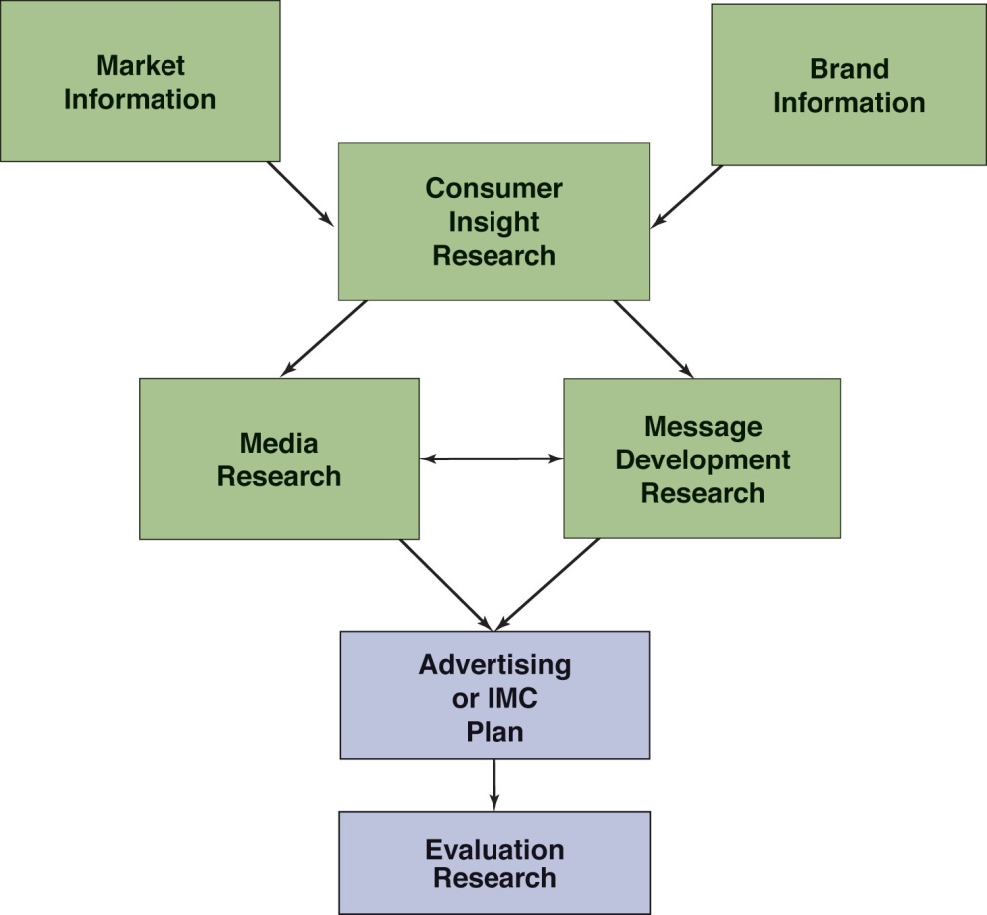
Uses of Research
Research firms and departments collect and disseminate secondary research data and conduct primary research for advertising.
The need for research-based information in advertising has increased as markets have become more fragmented and saturated, and as consumers become more demanding.
.
Moriarty, Mitchell and Wells, (2009)

Slide 19
Uses of Research:
Market Information
Marketing research involves conducting surveys, in-depth interviews, observation, and focus groups to use in developing a marketing plan and later an advertising plan.
  Market research is used to gather information about a particular market.
Market information includes consumer perceptions of the brand, product category, and competitors’ brands.
Brand information includes an assessment of the brand’s role and performance in the marketplace—leader, follower, challenger.
  Also investigates how people perceive brand personalities and images.

Slide 20
Uses of Research:
Consumer Insight Research
Both the creative team and media planners need to know as much as they can about the people they are trying to reach.
Researchers try to find out what motivates people to buy a product or become involved with a brand.
The goal is to find a key consumer insight that members of the target audience will respond to.
In association tests, people are asked what they think of when they hear certain cues. Their responses help form a network of associations.
  Neuro-marketing is a subfield of experimental research in which planners try to determine how the brain and emotions react to various stimuli.

Slide 21
Uses of Research:
Media Research
Media planners and account planners decide which media formats will help accomplish the advertising objectives.
Media research gathers information about all the possible media and marketing communication tools that might be used to deliver a message
Researchers then match that information to what is known about the target audience.

Slide 22
Uses of Research: Message Development Research
Planners, account managers, media researchers, and the creative team conduct their own informal and formal research.
Writers and art directors often conduct their own informal research—visit stores, talk to salespeople, watch buyers, look at client’s past ads and competitors ads.
Concept testing is used during the creative process to evaluate the relative power of various creative ideas.
Writers and art directors often conduct their own informal research. They may:
visit stores
talk to salespeople
watch buyers
look at client’s past advertising
look at competitors’ past advertising

Slide 23
Uses of Research:
Evaluation Research
Evaluates an ad for effectiveness after it has been developed and produced; before and after it runs as part of a campaign.
Pretesting is research on a finished ad before it runs in the media.
Evaluative research (also called copy testing) is done during and after a campaign.
Memory can be measured using:
  Aided recognition (or recall)
  Unaided recognition (or recall)

Slide 24
Background Research
Used by planners to get familiar with the market situation and aid in message development:
  Brand experience—learn about brand’s history, plans for the future, and relationship with customers.
  Competitive analysis—try other brands to compare.
  Advertising audit—collect and assess client’s and competitors’ advertising, plus related products.
  Content analysis—review competitors’ approaches and strategies; compare your position to theirs.
  Semiotic analysis—analyze signs and symbols in a message to find deeper meanings and how they related to target markets (“Easy Button”).
  Customer contact conversations—monitors customer service, technical service, or inbound telemarketing calls to gain market intelligence.

Slide 25

Consumer Research
Used to better understand how users, prospects, and non-users of a brand think and behave.
  Uncover “whys of the buys”
  Then, we can identify segments and targets, as well as profiles of customers and potential customers
Association research seeks to find out what people associate with a brand; to determine their “network of associations.”
  Taco Bell is fast, cheap, Mexican
  Arby’s is fast, cheap, roast beef

Slide 26
Ways of contact: quantitative methods
Survey Research
  A quantitative method using structured interviews to ask a large number of people the same question
  For accuracy, researchers select a random sample to represent the entire group (population).
  Collection methods include telephone, door to door, the Internet, mail.
  Phone surveys are commonly used. Often they come from commercial call centers where many people hired by a research company staff a bank of phones.
  New techniques like using SurveyMonkey and Google forms. Survey Monkey is an internet programme and hosting site that enables a person to develop a survey for use over the internet.

Slide 27
Ways of contact: qualitative methods
In-depth Interviews
  A qualitative method using one-on-one interviews asking open-ended questions.
  Interviews are more flexible and unstructured.
  Use smaller sample sizes so results cannot be generalized to the population.
  In-depth interviews are conducted one on one with open-ended questions that permit the interviewee to give thoughtful responses.

Slide 28
Ways of Contact
In-depth Interviews
  A qualitative method using one-on-one interviews asking open-ended questions
  Flexible and unstructured
  Use smaller sample sizes so results cannot be generalized to the population
Focus Groups
  A qualitative method in which a small group of users or potential gather around a table (or online) to discuss a topic (product, brand, or ad)
  Directed by a moderator, observed by client and agency
  Expert groups or friendship panels

Slide 29
Ways of Contact
Focus Groups
  A qualitative method where a small group of users or potential users gather around a table (or online) to discuss a topic (product, brand, or advertising)
  Directed by a moderator, observed by client and agency personnel
  Specific types include expert groups or friendship panels
Observation Research
  A qualitative method using video, audio, and cameras to record consumers’ behavior where they live, work, shop, and play.
  Closer and more personal than quantitative research

Slide 30
Ways of Contact
Ethnographic Research
  A qualitative method in which the researcher becomes involved in the lives and culture of a group being studied.
  Families may videotape their lives or a researcher may go to a rally.
Diaries
  Consumer are asked to record activities, such as media usage.
  Provide a more realistic, normal representation than surveys or interviews.

Slide 31
Ways of Contact
Other Qualitative Methods
Word association
Fill in the blanks
Sentence completion
Purpose-driven games
Theater techniques
Sculpting and movement techniques
Story elicitation
Artifact creation
Photo elicitation
Photo sorts
Metaphors

Slide 32
Choosing a Research Method
Validity means the research actually measures what it says it measures.
  Poorly worded questions and samples that don’t represent the population hurt validity.
Reliability means you can run the same test again and get the same answer.
Three objectives of advertising research:
  Test hypotheses
  Get information
  Get insights
Quantitative methods are better at gathering data, and qualitative methods are better at uncovering reasons and motives.

Slide 33
Research Trends and Challenges
Globalization
  The challenge is how to arrive at an intended message without cultural distortions or insensitivities.
Media Changes
  As technology changes, old research measures become less valid.
  Researchers and planners use multiple product messages in multiple media vehicles to deliver different effects.
  New media is allowing for more permission and relationship marketing.
Embedded Research
  The research is part of a real purchase and use situation.
  Call center personnel, personal shoppers, and the Internet gather information and feed it back to planning and marketing.
Insightful Analysis
  The goal of research is to make sense of the findings to uncover unexpected insights into consumers, products, or the marketplace.

Slide 34
SUMMARY
Secondary research is background research that gathers already published information, and primary research is original research findings collected for the first time from original sources.
Quantitative research is statistical and uses numerical data to investigate how people think and behave; qualitative research is exploratory and uses probing techniques to gain insights and identify questions and hypotheses for further quantitative research. Experimental research tests hypotheses using carefully designed experiments.
Research is used to (1) develop an analysis of the marketing situation, (2) acquire consumer information and in-sights for making targeting decisions, (3) identify information about available media to match the media to the target audience, and (4) develop message strategies and evaluate their effectiveness.

Slide 35
SUMMARY
Survey research is used to amass quantities of responses from consumers about their attitudes and behaviors. In-depth interviews probe the reasons and motivations consumers. Focus groups are group interviews that operate like a conversation. Panels are long-running consumer groups that permit tracking of attitude and behavior changes. Observation research happens in the store or home where researchers watch how consumers behave. Ethnographic research is an anthropological technique that involves the researcher in participating in the day-to-day lives of consumers. Diaries are records of consumers’ behavior, particularly their media use. A number of other qualitative methods are used to creatively uncover patterns in the way consumers think and act.

Slide 36
SUMMARY
Globalization complicates the way research is conducted for global products because it adds a cultural dimension and varied legal restrictions.
Media fragmentation and convergence complicate the process of determining media effects. New research techniques are being created as a result of new media technology as well as the Internet, which offers opportunities for virtual inter-views.
Embedded research is a way to get immediate feedback that comes from the process of buying or using the product. Beyond the accumulation of numbers and information, the search for insight is a driving force in advertising research.

Slide 37
THANK YOU
LECTURE 9 BY DR. RAPHAEL OGUTU,
Mass Communication Department,
AFRICA NAZARENE UNIVERSITY.
THE MAIN SOURCES OF REFERENCE:
Advertising & IMC: Principles and Practice., Moriarty, Sandra Mitchell, Nancy D and Wells, William D. 14th edition. Pearson Prentice Hall Inc., 2009.
Research Design: Qualitative Quantitative and Mixed Methods Approaches. Creswell, J. W. 4th Ed. Sage Publications., 2014.
Research Methods: Quantitative and Qualitative Approaches. Mugenda, O and Mugenda, A. Nairobi: Acts Press. 2003.

