Slide 1
Principles of Advertising
PRINT MEDIA: Effective Advertising Media
LECTURE 11 BY DR. RAPHAEL OGUTU,
Mass Communication Department,
AFRICA NAZARENE UNIVERSITY.
THE MAIN SOURCE OF REFERENCE: Advertising & IMC: Principles and Practice., Moriarty, Sandra Mitchell, Nancy D and Wells, William D. 14th edition. Pearson Prentice Hall Inc., 2009.

Slide 2
Course Goals and Objectives
Intended Learning Outcomes
At the end of this class the student should be able to :
Identify the strengths and weaknesses of newspapers
Describe the key factors that advertisers should know to make effective decisions about advertising in magazines
Analyze why packaging is such an important advertising opportunity
Discuss factors that advertisers should consider in making out-of-home media decisions
Outline the factors that advertisers use to make decisions about using directory advertising

Slide 3
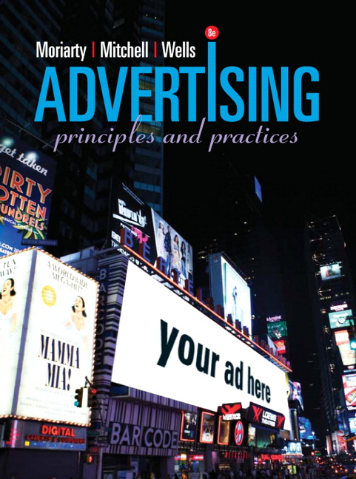
What is print advertising?
Ads in newspapers, magazines, brochures, posters, outdoor
More information, richer imagery, and longer messages than broadcast
Often used to generate cognitive responses
More flexible, less fleeting, and more engaging when targeted to special interest audiences
Can engage the senses of sight, touch (different types of paper and other surfaces), and smell (scratch and sniff in magazines and newspapers).
SOURCE: https://www.pearson.com/us/higher-education/product/Moriarty-Advertising-8th-Edition/9780132224154.html

Slide 4
Print Media Characteristics
Print advertising includes print promotional messages in newspapers, magazines, brochures, posters, outdoor
They generally provide more information, richer imagery, and longer messages than broadcast
Reading a publication is more flexible than watching or listening to broadcast because they can stop and reread sections out of order, or move through the publication at their own speed and on their own time.

Slide 5
Print Media Characteristics
In terms of Facet Model of Advertising, print often used to generate cognitive responses
It is therefore more flexible, less fleeting, and more engaging when targeted to special interest audiences
Magazines and newspapers have expanded their message delivery online but billions of dollars are still spent on traditional print media.

Slide 6
Newspaper Basics
WHAT IS ADVERTISING?
Newspaper’s primary function is news, making it appropriate for ads that announce sales, events, or other news.
Readership is declining, especially among younger people.
Newspapers are a local, mass medium.
Market selectivity allows newspapers to target specific consumer groups.
  (Moriarty, Mitchell and Wells, 2009).
Principle:
A basic principle of newspaper publishing
is that people read newspapers as much for the ads as they do for the news stories.

Slide 7
Newspaper Basics:Newspaper Categories
By Frequency
Daily
Weekly
By Size
Standard
Tabloid
SAU System
By Audience
Ethnic
Business/ Financial
Groups/ Professions
Newspapers used to offer about 400 different ad sizes. But in 1984, the industry introduced the standard advertising unit (SAU) system, which standardized the newspaper column width, page sizes, and ad sizes. An SAU column inch is 2¹/₁₆ inches wide by 1 inch deep. There are now 56 standard ad sizes for standard papers and 32 for tabloids. Virtually all dailies converted to the SAU system (some at great expense) and so did most weeklies.
(Arens, W., Weigold, and Arens, C., 2011.)

Slide 8
Newspaper Basics
Types of Circulation:
Subscription
  Individuals and companies sign up to receive a publication over a specified time for a certain fee.
Single Copy sales
  Copies sold at newsstands
Third Party
  Copies bought by hotels, restaurants, airlines that are distributed to guests
(Moriarty, Mitchell and Wells, 2009.)

Slide 9
Newspaper Basics
Frequency of Publication
Dailies
  About 1,500 dailies in the United States, usually published in cities and larger towns.
Weeklies
  About 6,700 serving towns, suburbs, and smaller cities.
Sunday editions
  Approximately 30% of dailies and a few weeklies also publish Sunday editions.
Business or organization newspapers
  May be published weekly, monthly, quarterly, bimonthly (every other month), or semimonthly (twice a month).
NOTE: These statistics are for United States of America, however, each country has their own , you could investigate about your own country
(Moriarty, Mitchell and Wells, 2009).

Slide 10
Newspaper Basics
Editions
Morning
  Yesterday’s events, advance coverage of today’s events
Evening
  Today’s events (up till mid-day) and advance stories for tomorrow
All-Day
  Frequent updates with different editions published during the day
Special Interest
  Ethnic such as Spanish language, Asian, and African American; also upscale neighborhoods by zip code

Slide 11
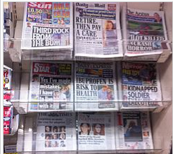
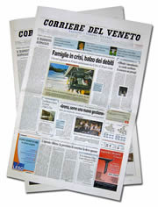
Newspaper Basics
Newspaper Format and Size
Newspaper advertising is sold based on the size of the ad space and the newspaper’s circulation.
Broadsheet
  Standard size generally 22 inches deep and 14 inches wide with eight columns
Tabloid
  Half the size of a broadsheet with five or six 2-inch columns
Source: Moriarty, Mitchell and Wells, (2009)

Slide 12
Newspaper Basics
Newspaper Ad Sales
Ads are sold based on size of the space.
  Local advertisers and volume buyers get discounts; national advertisers pay a premium
Sales are handled locally by the sales staff of the newspaper; however, newspaper representatives (called “reps”) sell space for many different newspapers.
This saves an advertiser or its agency from the need to make a multitude of buys to run a national or regional campaign in newspapers. The system is known as one-order, one-bill.
Source: Moriarty, Mitchell and Wells, (2009)

Slide 13
Newspaper Basics
The introduction of SAU (Standard Ad Units) in the 80s made national buying much easier, because each paper had its own peculiar size guidelines for ads, making it difficult to prepare one ad that would fit every newspaper.
Some newspapers offer large advertisers hybrid rates (between local and national).
Cooperative or Co-op advertising is an arrangement between the advertiser and the retailer whereby the retailer buys the ad and the manufacturer pays half—or a portion de-pending on the amount of space the manufacturer’s brand occupies. Source: Moriarty, Mitchell and Wells, (2009)

Slide 14
Newspaper Basics
Types of Newspaper Advertising
National vs. Local
Classified
  Advertising by individuals to sell their personal goods and advertising by local businesses. e.g. “Real Estate” “Car”
Display
  1) Run-of-paper(ROP): ad can be appeared anywhere except the editorial page
  2) Preferred-position rate: select the position
Supplements
  Usually independently published, syndicated, magazine-style publications that are sold to newspapers and inserted on Sunday.
  Free-standing inserts (FSI) are preprinted advertisements, such as the grocery ads, that are inserted into the newspaper for a fee.
Source: Moriarty, Mitchell and Wells, (2009)

Slide 15
Newspaper Basics
Newspaper Readership Measurement
About half of American adults read the newspaper daily.
Newspaper readers are older with higher incomes and education levels.
Newspapers measure their audiences to attract advertisers who want to reach their readers.
  Audit Bureau of Circulation (ABC)—independently verifies statements about newspaper circulation statistics.
  Simmons—annually measures readership profiles in approximately 70 of the nation’s largest cities.
Source: Moriarty, Mitchell and Wells, (2009)

Slide 16
Newspaper Basics
Advantages
Range of market coverage
Comparison shopping
Positive consumer attitudes
Flexibility
Interaction of national and local
Disadvantages
Short life span
Clutter
Limited coverage of certain groups
Poor reproduction

Slide 17
Newspaper Basics
Newspaper Industry Trends
Readership is declining, particularly among young people.
Newspaper production costs are increasing.
Internet delivery is becoming a growth area for the industry.
  Stories are delivered through smart phones, Tablets, PCs, laptops, I phones.
Visit the Site
Source: Moriarty, Mitchell and Wells, (2009)

Slide 18
Magazine Basics
Over 92% of all U.S. adults read one magazine per month, spending 44 minutes per issue.
Quality of reproduction is their greatest strength.
Over half of all new magazines fail.
Most magazines focus on niche markets related to hobbies, sports, business, and professions.
Zines, online versions of traditional magazines, represent the greatest growth area.
Principle:
If you want to start a successful magazine, create a special-interest publication aimed at a narrow or niche audience.
Source: Moriarty, Mitchell and Wells, (2009)

Slide 19
Magazine Basics
Types of Magazines
Consumer Magazines
  Aimed at consumers who buy products for personal use.
Business Magazines
  Trade papers are aimed at retailers, wholesalers, and other distributors; e.g., Chain Store Age
  Industrial magazines are aimed at manufacturers; e.g., Concrete Construction.
  Professional magazines are aimed at physicians, lawyers, and other professionals; e.g., National Law Review, Media Week.
  Farm magazines are aimed at those working in agriculture; e.g., Farm Journal and Feed and Grain.
By Content
Consumer
Farm
Business
By Reach or Geography
Local
Regional
National
By Size
Large
Flat
Standard
Small or pocket
Source: Moriarty, Mitchell and Wells, (2009) : Arens, W., Weigold, and Arens, C., (2011.)

Slide 20
Magazine Basics
Classifications of Magazines
Vertical vs. horizontal publications
  Vertical: contains stories about and info about an industry
  Horizontal: deals with business functions across industries
Geography
  National, regional editions (e.g., Los Angeles Magazine, Southern Living’s southwestern edition zoned editions of national magazines)
Demographics
  Age, income, occupation, etc. (e.g., Newsweek’s college edition and Time’s editions for business executives and doctors)
Editorial Content
  General (Reader’s Digest), women’s (Family Circle), shelter (House Beautiful), business (Forbes), and special interest (Ski).

Slide 21
Magazine Basics
Political Advertising
  Politicians - vote for them or their ideas
–Interactive advertising: delivered to individual consumers who have access to a computer and the Internet
-Nonprofit Advertising. Advertisements for non-profit organizations such as Charities, foundations, associations, hospitals, museums and religious institutions, they are directed to their members, customers and volunteers, as well as for donations and other forms of program participation.
Moriarty, Mitchell and Wells, (2009)

Slide 22
Magazine Basics
Classifications of Magazines
Physical Characteristics
  The most common sizes are 8 1/2 x 11 inches and 6 x 9 inches, which allows for fewer visuals and less copy.
Ownership
  Some are owned by publishing companies (Conde Nast owns Glamour, Gourmet, Vanity Fair) and others by organizations (AARP).
Distribution and Circulation
  Traditional delivery—through newsstand purchases or home delivery via the U.S. Postal Service
  Nontraditional delivery or controlled circulation — hanging bagged copies on doorknobs, inserting in newspapers (such as Parade delivering through professionals’ offices (doctors and dentists), direct delivery (company or airplane), and electronic delivery
Moriarty, Mitchell and Wells, (2009)

Slide 23


Magazine Basics
Magazine Advertising: Format
Premium positions
  Back cover, inside covers
Double-page spread
  Two ad pages facing each other
Bleed page
  Color goes to edge of the page
Gatefold
  More than two connected pages that fold in on themselves
Special ad page or section that looks like editorial
Multiple-page photo essay
Fractional page space
  vertical or horizontal half-page, half-page double spread Moriarty, Mitchell and Wells, (2009)

Slide 24


Magazine Basics
Distribution
Traditional delivery
  Through newsstand purchases or home delivery
Nontraditional delivery (controlled circulation)
  Hanging bagged copies on doorknobs
  Inserting magazines in newspapers
  Delivering through professionals
  Direct delivery
Technology
Selective binding and ink-jet imaging allow for personalization
Satellite transmission and computerized editing allow for regional editions with regional advertising
Moriarty, Mitchell and Wells, (2009)

Slide 25
Magazine Basics
Magazine Readership Measurement
Magazine rates are based on guaranteed circulation a publisher promises to provide.
Readership represents total audience which includes pass-along readers.
Objective, outside measurement companies:
  Audit Bureau of Circulation—independently verifies statements about magazine circulation statistics.
  Media Mark—MRI measures readership for many popular national and regional magazines.
  Simmons Market Research Bureau—provides psychographic data on readers plus what products they buy.
  Companies like Starch, Gallup & Robinson provide audience size and behavior information.

Slide 26
Magazine Basics
Advantages
Target audience
Audience receptivity
Long life span
Format
Visual quality
Sales promotions
Disadvantages
Limited flexibility
Lack of immediacy
High cost
Distribution
Magazine Advertising Trends
Product placement, although opposed by the The Magazine Editors Association, will happen.
Online technology has led to online magazines.
Traditional formats provide interesting writing that’s portable.
The questions is: What works best for the media strategy for a particular target audience?

Slide 27
Directory Advertising
Directories list people or companies, phone numbers, and addresses.
About 90% of the people who consult the Yellow Pages follow up with action.
Retailers can buy display space for larger ads, but directories can be cluttered.
7,500 directories for professional and interest groups
Principle:
The principle behind directory advertising is that it is directional—it tells people who already are in the target market where to go to get the product or service they want.
Moriarty, Mitchell and Wells, (2009)

Slide 28
Directory Advertising
Books that list names, phone numbers, and addresses of people or companies
Advantages
Consumers initiate the search process
Inexpensive
Flexibility
Long life
Disadvantages
Competitive clutter
Consumers who cannot easily use directories
Moriarty, Mitchell and Wells, (2009)

Slide 29
Out-of-Home Advertising
Out-of-Home or OOH includes billboards, hot-air balloons, buses, posters on walls, kiosks, blimps, airport displays.
Ranks second to the Internet in terms of growth.
It’s situational: can target specific people at a specific time when they’re most interested.
Consider buying: location, target, traffic count
Ranks second to the Internet in terms of growth.
It’s situational: can target specific people at a specific time when they’re most interested.
Moriarty, Mitchell and Wells, (2009)

Slide 30
Out-of-Home Advertising:
Outdoor Advertising
Outdoor includes street and highway advertising, plus posters in public locations.
Two primary uses of outdoor:
  As reminder advertising (e.g., McDonald’s)
  As a directional (e.g., hotels, gas stations)
probably the first advertising medium ever used, dating back more than 5,000 years to when hieroglyphics on obelisks directed travelers.
In the Middle Ages, bill posting was an accepted form of advertising in Europe. And in the nineteenth century, it evolved into a serious art form, thanks to the poster paintings of both Manet and Toulouse-Lautrec.
Today, around the globe, marketers use outdoor media for the same reasons.

Slide 31
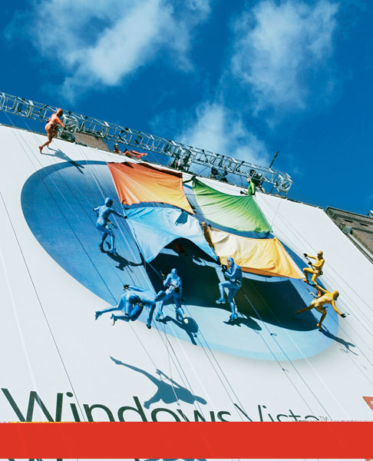
Out-of-Home Advertising:
Outdoor Advertising
Size and Format
  Printed poster bulletin—posted like wallpaper
  Painted bulletin — on signs, buildings, roofs, mountains
  Extensions/cutouts — go beyond border of rectangle
  Digital displays — use wireless technology to change message
  Message is about 8 to 10 words
Buying outdoor
  Sold in “showings”
  Based on traffic counts
  Boards are rented for 30 days
Moriarty, Mitchell and Wells, (2009)

Slide 32



Out-of-Home Advertising
On-premise signs
  Identify a store
  Directional and informational
  Help locate businesses
Posters
  Used on buildings, kiosks, vehicles, and bulletin boards
  Usually have few words
  Kiosks are designed for posters
Transit advertising
  Ads on buses, taxis, and moving billboards
  Interior and exterior
Moriarty, Mitchell and Wells, (2009)

Slide 33
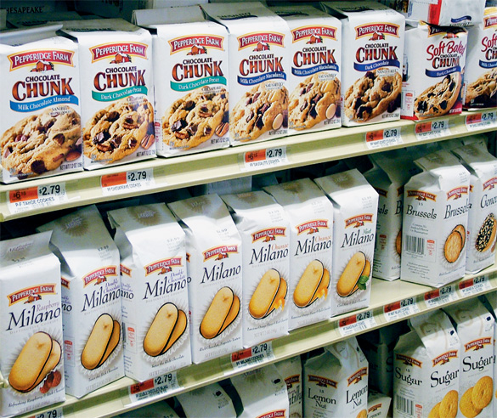


Packaging
Both a container and a communication vehicle
Constant brand reminder once at home or office
Presents brand image and communicates critical benefits information
Can deliver benefits like recipes
The last ad a customer sees before making the decision to buy
Moriarty, Mitchell and Wells, (2009)

Slide 34
Using Print and Out-of-Home
Use newspaper for announcements of something new, or for targeting local markets.
Use magazines for targeting people with special interests; they’re also good for brand image or longer explanations.
Use outdoor for people on the move to provide directional information; also good for brand reminders.
Use directories to catch people when they’re shopping.
Principle:
A package is the last ad a customer sees before making a decision on which brand to buy.

Slide 35
SUMMARY
Print Media Advantages and Limitations
Newspaper Advertising
Advantages
Good for news announcements
Good market coverage
Good for comparison shopping
Positive consumer attitudes
Good to reach educated and affluent consumers
Flexibility—geographic; scheduling
Magazine Advertising
Advantages
High production values
Targets consumers’ interests—
specialized audiences
Receptive audience
Long life span
Format encourages creativity
Good for brand messages
Good for complex or in-depth messages
Limitations
Short life span
Clutter
Limited reach for certain groups
Poor production values
Limitations
Long lead times—limited flexibility
Lack of immediacy
High cost
Sometimes limited distribution

Slide 36
SUMMARY
Directory Advertising
Advantages
Directional: consumers go to directories for shopping information
Inexpensive
Good ROI of 1:15—every dollar spent of an ad produces $145 in revenue
Flexible in size, colors, formats
Long life
Outdoor Advertising, Including Transit
Advantages
Good situational medium
Directional
Brand reminder medium
High-impact—larger than life
Least expensive
Long Life
Limitations
Lack of flexibility—can be a long time before a change can be made
Competitive clutter and look-alike ads
Low production quality
Limitations
Traffic moves quickly
Can’t handle complex messages—designs must be simple
May be easy to miss (depending on location)
Some criticize outdoor ads for “polluting” the landscape
Transit lacks the size advantage of other outdoor media
Moriarty, Mitchell and Wells, (2009)

Slide 37
Packaging
Advantages
Stimulates point-of-purchase decision making
Last ad a consumer sees
In-home is brand reminder on shelf
Bill boarding effect can dominate shelf
Reinforces brand advertising
Delivers product information
Moriarty, Mitchell and Wells, (2009)
Limitations
Cluttered environment
Shelf space may be limited
Can get inconvenient
placement—such as
bottom shelf
Limited space needs simple message

Slide 38
SUMMARY
Newspapers are great for announcements of news. They also provide local market coverage with some geographic flexibility, plus an interaction with national news and the ability to reach shoppers who see the paper as a credible source.
Magazines reach special-interest audiences who have a high level of receptivity to the message. People read them slowly, and they have long life and great image reproduction.
Out-of-home media includes everything from billboards to hot-air balloons. A common out-of-home medium is outdoor advertising, which refers to billboards along streets and highways as well as posters. Moriarty, Mitchell and Wells, (2009)

Slide 39
THANK YOU
LECTURE 11 BY DR. RAPHAEL OGUTU,
Mass Communication Department,
AFRICA NAZARENE UNIVERSITY.
THE MAIN SOURCE OF REFERENCE:
  Advertising & IMC: Principles and Practice., Moriarty, Sandra Mitchell, Nancy D and Wells, William D. 14th edition. Pearson Prentice Hall Inc., 2009.
Contemporary Advertising and integrated marketing communications. Arens, William. F., Weigold, Michael. F., and Arens, Christian. 13th Ed. McGraw Hill Higher Education. 2011.

