Slide 1
Principles of Advertising
BROADCAST MEDIA: Effective Advertising Media
LECTURE 12 BY DR. RAPHAEL OGUTU,
Mass Communication Department,
AFRICA NAZARENE UNIVERSITY.
THE MAIN SOURCE OF REFERENCE: Advertising & IMC: Principles and Practice., Moriarty, Sandra Mitchell, Nancy D and Wells, William D. 14th edition. Pearson Prentice Hall Inc., 2009.

Slide 2
Course Goals and Objectives
Intended Learning Outcomes
At the end of this class you should be able to :
Describe the structure of radio, how it is organized, its use as an advertising medium, its audience, and its advantages and disadvantages
Explain the structure of television, how it is organized, its use as an advertising medium, the TV audience, and its advantages and disadvantages
Discuss how advertisers use product placement, film, and video
Analyze the advantages and disadvantages of using product placements

Slide 3
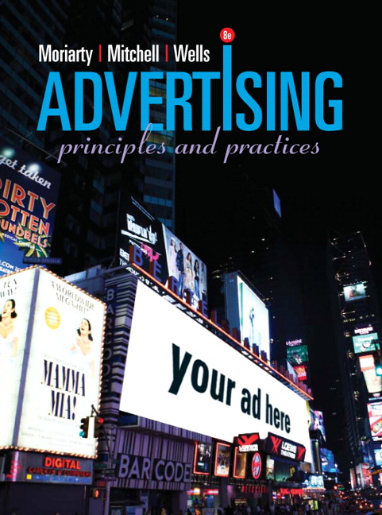
Broadcast Media Basics
Media than transmits sounds or images electronically.
  Radio, TV, video, movie, cell phones
Bought in time (seconds, minutes)
Messages are fleeting.
Engage sight and sound; more entertaining.
Radio advertising engages the imagination and television creates powerful brand imagery.
Both radio and TV use emotion and repetition to intensify memory.
SOURCE: https://www.pearson.com/us/higher-education/product/Moriarty-Advertising-8th-Edition/9780132224154.html

Slide 4


Radio Basics
More than 10,000 commercial radio stations, mostly serving local markets.
Radio industry growth is flattening, with only a 5% increase in national ad spending for 2007, and only a 1% decrease in local ad spending.
Radio Advertising
“ Theatre of Mind”
Relies on the listener’s mind to fill in the visual element
Delivers a high level of frequency
Radio commercials lend themselves to repetition

Slide 5
Radio Basics
Radio Industry Structure
AM/FM
  FM signal travels about 50 miles; better tonal quality
  AM signal travels up to 600 miles; poor tonal quality
Public Radio
  National Public Radio affiliates target the affluent
  Primarily non-commercial; accept corporate “sponsorships”
Cable Radio
  Usually commercial-free, subscribers pay $7–$12/mo.
Satellite Radio
  Requires special radio, subscribers access around 100 stations
LPFM (Low-Power FM)
  Nonprofit, noncommercial, reaches 3–5 miles
Web Radio/Webcasting
  Audio streaming through Web site, offers diversity, small audiences, very localized
  (Moriarty, Mitchell and Wells, 2009).

Slide 6
Radio Basics
The Radio Audience
Highly segmented by type of music, format
Station fans
  Largest segment
  A clear preference for one or two stations
Radio fans
  May listen to four or five stations per week
  Show no preference for one particular station
(Moriarty, Mitchell and Wells, 2009. P55).
Listeners divided into segments
  Station fans (largest group), women 25–54
  Radio fans (1/3 of listeners), under 35 and women 55+
  Music fans, (11%), men 25–54 plus older adults
  News fans, mainly 35+
Audiences grouped by dayparts
  Morning Drive Time: 6–10 a.m.
  Mid-Day: 10 a.m.–3 p.m.
  Evening Drive Time: 3– 7 p.m.
  Evening: 7 p.m.–midnight
  Late Night: midnight– 6 a.m.
Principle:
Media planners use radio for tight targeting of narrow, highly segmented markets.

Slide 7
Radio Basics
Radio Audience Measurement
Dayparts
  Typical radio programming day is divided into five segments called dayparts
Coverage (number of homes able to pick up station; tuned in or not). The number of homes in a geographic area that are able to pick up the station clearly
Ratings-The percentage of homes actually tuned in to a particular station
(percent of homes tuned to a station)
Audience Rating Services:
  Arbitron Ratings Company: estimates audiences for 250 markets in United States
  RADAR (Radio’s All-Dimension Audience Research): estimates audiences for both local and network radio
(Moriarty, Mitchell and Wells, 2009).

Slide 8
Radio Advertising
Radio Advertising:
Delivers high frequency using jingles for repetition.
Has the power to engage the imagination and communicate on a more personal level than other forms of media
Uses drama to engage the imagination as in public service announcements (PSAs) which are created free by agency personnel and run broadcast free by media.
Principle:
Radio advertising has the power to engage the imagination and communicate on a more personal level than other forms of media.

Slide 9
Radio Revenue Categories
Network Radio Advertising
  Group of local affiliates connected to one or more national networks (ABC, CBS, Westwood One, Unistar, Clear Channel)
  National medium for food, beverages, cars, over-the-counter drugs
  Growth has contributed to increase in syndicated radio
Spot Radio Advertising
  Advertiser places ads with an individual station, not a network
  Makes up nearly 80% of all radio advertising due to flexibility.
  Messages can be tailored for particular audiences
  Flexibly in content, timing, and rates
Syndicated Radio Advertising
  Offers advertisers a variety of high-quality, specialized, and usually original programs
  Advertisers value syndicated programming because of the high level of audience loyalty (the Paul Harvey show)
Source: Moriarty, Mitchell and Wells, (2009)

Slide 10
Using Radio Effectively
Advantages
Highly targeted and inexpensive
Excellent reminder/reinforcement capabilities
Builds frequency through repetition
Targets audiences through specialized programming
Sparks imagination through “theater of the mind”
Messages have higher level of acceptance than TV due to loyalty of listeners to programs/stations
Timing is critical
Radio advertising must “break through” the clutter
Lack of visuals hinder demonstration of products
Source: Moriarty, Mitchell and Wells, (2009)

Slide 11

Using Radio Effectively
Limitations/ Disadvantages
Listener inattentiveness; may just be on in the background
Lack of visuals
Clutter
May have buying difficulties for local buys
Lack of control: talk show content is unpredictable and may be critical
Source: Moriarty, Mitchell and Wells, (2009)

Slide 12
Trends in Radio Advertising
Mini CDs are embedded in soft drink cup lids at theaters and theme parks.
Audio messages can address supermarket shoppers from the shelf.
Podcasting can be heard by those with portable media players.
Unlike terrestrial radio, internet radio broadcasts through the internet, so the market is much wider, sometimes even global
Using the geolocation and information tracking, factors like mood, number of listening hours, and the total number of listeners can be tracked online.
In as much as digital radio is available to more people, it still needs the internet to work.
Source: Moriarty, Mitchell and Wells, (2009)

Slide 13
Television Basics
Trends in Television Advertising
Television is pervasive.
  98% of U.S. homes have at least one television; 60% have three or more televisions.
Parents and early childhood experts are concerned about children’s TV use.
  U.S. kids spend about 4 hours/day watching TV
Television advertising is tied to television programming, so its effectiveness is determined by the popularity of the television program.
Principle:
Television advertising is tied to television programming and its effectiveness is determined by the popularity of the television program.
Source: Moriarty, Mitchell and Wells, (2009)

Slide 14
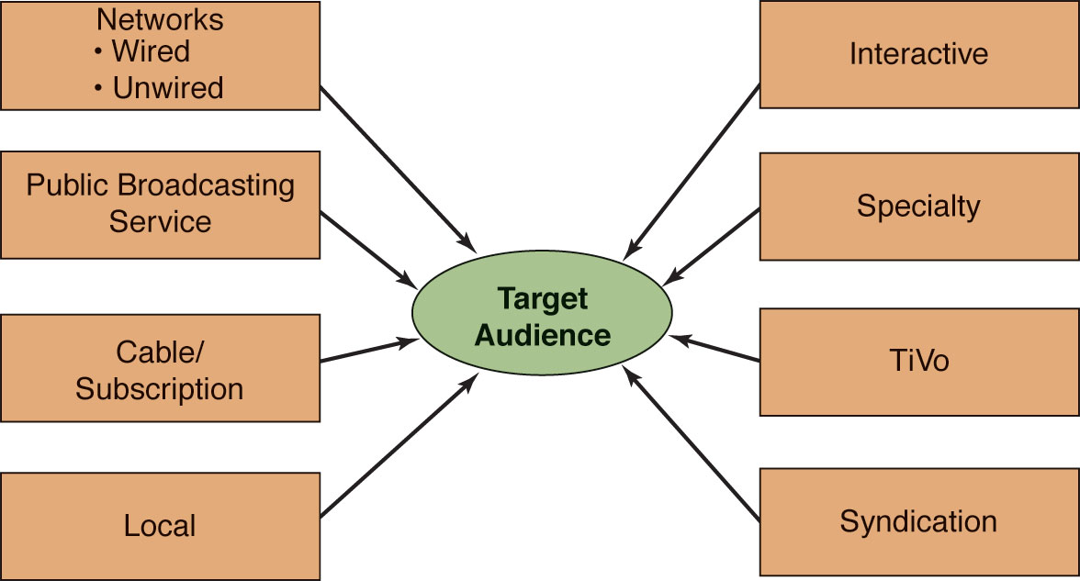
Television Industry Structure
Source: Moriarty, Mitchell and Wells, (2009)

Slide 15
Television Industry Structure
Network TV
A broadcast network is a distribution system that provides television content to its affiliated stations. Currently, there are four national, over-the-air television networks in the United States (check in your country).
Two+ stations broadcasting same program from a single source.
Program service with 15+ hours of prime-time programs per week, 8–11 p.m.
Local and national advertising (plus some regional) pay for station and network operations.
Networks originate programs; provide them to local affiliates’ audiences
Network audiences, especially young men, are eroding.

Slide 16

Cable and Subscription Television
Initially to improve reception.
Now provides highly targeted, special interest programs.
Stealing ad revenue from network TV.
Independent cable networks and superstations (e.g., CNN, ESPN) provide 8% of cable programs.
Network cable vs. local cable.

Slide 17
Local Television
Independent stations are not affiliated with networks.
Advertisers are local retailers, financial institutions, automobile dealers, restaurants, supermarkets.
Usually bought station by station.
National retailers may place spot buys, city-by-city, to match product distribution, supplement national buys, or launch a new product in selected cities.

Slide 18
Public Television
Formerly commercial free, now offers program sponsorships
Reaches an otherwise difficult-to-reach target—the well-educated, affluent household
No price or quality comparisons, or ask for purchase
Run only during 2.5-minute program breaks
Principle:
If you want to reach an otherwise difficult-to-reach target—the well-educated, affluent household—one way to do it is to use public television program sponsorships.

Slide 19
Distribution Formats
Low-power television (LPTV)
  15-mile radius outlet for those underserved by full-power stations; hotels and restaurants
Pay-per-view
  Via satellite, usually major sporting and music events
Program Syndication
  Independent TV and cable stations purchase reruns
  First-run syndication—current shows are purchased from networks by syndication distributors, (e.g., Viacom) and resold while new episodes are still being produced
Moriarty, Mitchell and Wells, (2009)

Slide 20
New Technology
Interactive Television
  TV set with computer capabilities; uses broadband
High-Definition TV (HDTV)
  Playback of movie quality, high-resolution images
  Content must be broadcast in HDTV format
Digital Video Recorders (DVRs)
  Replay TV and TiVo in 1999
  Users record favorite shows and watch them whenever
  Commercials can be skipped
MDS (multipoint distribution system
STV (subscription television)
SMATV (satellite master antenna television) uses a satellite dish to capture signals for TV sets in apartment buildings etc.
IPTV (Internet Protocol Television) uses a broadband connection to deliver a digital TV service. Source: Arens, Weigold and Arens (2011); Moriarty, Mitchell and Wells, (2009)

Slide 21
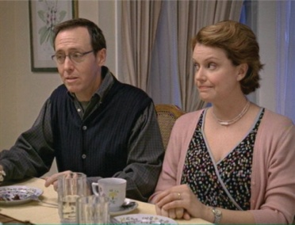
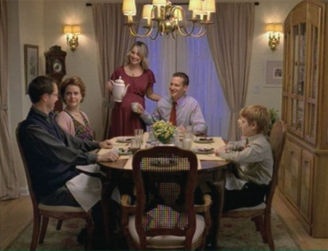
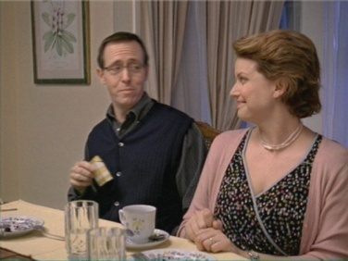
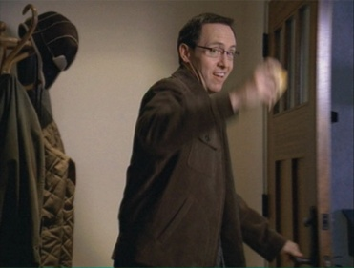

The Television Audience
Many advertisers still consider TV their primary advertising medium
Challenges faced by advertisers include viewers switching, zipping through ads, or avoiding them entirely with TiVo
Advertisers must learn to address “clutter” by creating breakthrough messages

Slide 22
TV Audience Measurement
Households Using Television (HUT) measures exposure based on houses with sets on.
Impressions—the number of viewers watching a program—measured by:
  Ratings: converts gross impressions to a percentage; one ratings point equals 1% of all the nation’s TV homes
  Share: share of audience is percent of viewers based on the number of sets turned on
Nielsen measures national and local audiences using people meters and viewer diaries

Slide 23
Television Advertising
Tells stories, engages emotions, creates fantasies, has great visual impact
Demonstrates how things work
Brings brand images to life and adds personality to a brand
Principle:
If you are going to use television, design a message that takes advantage of its visual and emotional impact.

Slide 24
Forms of TV Advertising
Network Advertising (through affiliates)
  Sponsorships
  Participations
  Spot announcements
Local Affiliates
  Local sponsorships
  Spot announcements
  Local spots
Cable Systems
  System (national) spots
  Local spots
Interactive Television
  National spots
  Local spots

Slide 25
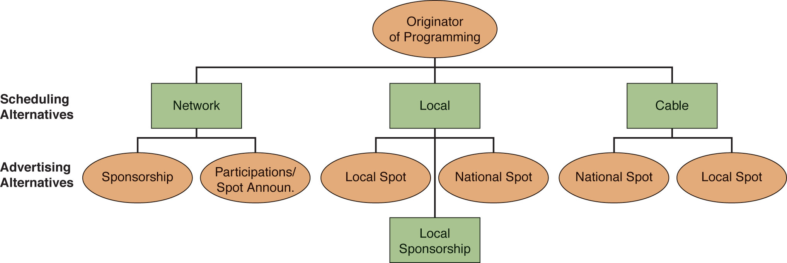
Forms of TV Advertising
Sponsorships
  Advertiser assumes total financial responsibility for producing the program and providing the commercials
Participations
  Advertisers pay for 10, 15, 20, 30, or 60 seconds of commercial time during a program
Spot Announcements
  Commercials, sold by local affiliates to local, regional, and national advertisers, that appear in the breaks between programs
  Price based on program rating and daypart

Slide 26
Using Television Effectively
Although network audiences have splintered, TV’s mass appeal and wide reach make it cost-effective for delivering a mass media message to a large audience.
Creates “buzz” when friends talk about favorite programs.
Strong visual and emotional impact, creating “engagement.”
Good for messages that need action, movement, demonstration, drama.
Commercial breaks are cluttered and viewers often leave sets.
Wasted reach — messages reach consumers not in the target market.
Viewers zip (fast forward) or zap (change channels) to avoid commercials.
Advertising time and production costs are expensive .
Clutter, intrusiveness, and irritation.

Slide 27
Using Television Effectively
ADVANTAGES
Pervasiveness; in most every home
High level of viewing
Reaches a mass national
audience although can be
targeted by programs
High impact: has audio, video, motion,
music, color, high drama
Cost efficient
LIMITATION OR DISADVANTAGES
Clutter—cable offers a large number of channels
High production costs
Wasted reach
Inflexibility; can’t easily make last-minute changes
Intrusiveness—some audience resistance to advertising leads to zipping and zapping

Slide 28
Changes and Trends in Broadcast Advertising
New forms of television advertising:
  Sponsorships
  Product placement
  Advertiser-controlled programming
Battle for control over who will control digital TV technology between telecommunication industry and cable industry.
Convergence and blurring of media as video images are being moved to the Internet.
Advertisers considering new delivery methods like streaming Web video and cell phones.
Watching TV shows on the Web.
TV becoming an increasingly fragmented medium, making it harder to reach mass audiences.
Principle:
As the number of commercial messages increases, the visibility and persuasiveness of television advertising diminishes.

Slide 29

Other Broadcast Forms
Film and Video
Movie theaters trailers reach captive audiences
Push for Truth PSAs before movies with smoking
DVD/video distributors placing ads before movies
Promotional video networks in stores, offices, truck stops, etc.
Marketers producing video clips to run on cable video-on-demand, company Web sites, MySpace, video.google.com, YouTube.com

Slide 30

Other Broadcast Forms
Product placement
company pays for verbal or visual brand exposure in a movie or TV program.
Less intrusive .
Product is the star (e.g., BMW Z28 in the James Bond movie, The World Is Not Enough.
Celebrities demonstrate product in natural setting.
Unexpected; occurs when viewer resistance is down.
May go unnoticed; may not match movie or audience; and movie may not be successful.

Slide 31
Broadcast Media Advantages and Limitations
Movie Advertising
Advantages
Captive audience
No need for intrusiveness because audience can’t do multi-tasking
High impact
Product Placement
Advantages
Not as intrusive
If product fits the story line, can be a naturalistic demonstration or testimony
Association with celebrities
Association with glitzy movie, hopefully a well-liked film
Limitations
Audience resistance is high; hates being a captive audience
Expensive; needs high value production
Limitations
Can get lost in the story
Poor match between product and movie storyline
Movie turns out to be a dud

Slide 32
Using Broadcast Advertising
Use Radio If…
Local business
Highly targeted audience
Have small budget
Timing consideration
Align interests with program
Personal message with human voice
Works in musical form or strong in mental imagery
Need reminder message
Use Television If…
Want wider mass audience
Align interests with program
Have Good budget
Product needs both sight and sound
Prove something to audience
Halo effect
Create or reinforce brand image and personality

Slide 33
Using Broadcast Advertising
Use Movie Ads If…
National brand
Have budget to do high-quality commercials
Want to associate brand with movie stars
Movie audience matches brand’s target audience
Substantial visual impact and quality production
Use Placement If…
Want to associate brand with stars and story
Viewing audience matches brand’s target audience
Natural fit between product and storyline
Opportunity for brand as star
Appeals to stakeholders
Supporting ad campaign

Slide 34
SUMMARY
The traditional radio stations are found on AM and FM and primarily serve local markets. AM and FM are only the beginning of the radio listener’s options, which also include public radio, cable and satellite radio, low-powered stations, and Web radio. Radio dramas engage the imagination, but radio is primarily a music-driven medium, which serves audiences defined by their musical tastes. Listeners can have a very intimate relationship with radio and can be quite loyal to their favorite stations, but radio also serves as background.

Slide 35
SUMMARY
Television is useful as a marketing communication medium because it works like a movie with story, action, emotions, and visual impact. TV audiences are fragmented, often irritated by advertising, and prone to avoidance. Audiences are measured in terms of ratings and share. TV’s greatest advantage is that it is pervasive and cost efficient when reaching a large number of viewers.
Movie theaters sell time for advertisements before their films. Marketing communication messages are also carried on discs, such as DVDs and Blu-ray, as well as in lobbies and other public spaces. Video-generated commercials, sponsored programs, and announcements can also be seen in supermarkets, transit stations, and waiting rooms.

Slide 36
THANK YOU
LECTURE 12 BY DR. RAPHAEL OGUTU,
Mass Communication Department,
AFRICA NAZARENE UNIVERSITY.
THE MAIN SOURCES OF REFERENCE:
Advertising & IMC: Principles and Practice., Moriarty, Sandra Mitchell, Nancy D and Wells, William D. 14th edition. Pearson Prentice Hall Inc., 2009.
Contemporary Advertising and integrated marketing communications. Arens, William. F., Weigold, Michael. F., and Arens, Christian. 13th Ed. McGraw Hill Higher Education. 2011.

