Slide 1
Principles of Advertising
Internet and Nontraditional media
LECTURE 13 BY DR. RAPHAEL OGUTU,
Mass Communication Department,
AFRICA NAZARENE UNIVERSITY.
THE MAIN SOURCE OF REFERENCE: Advertising & IMC: Principles and Practice., Moriarty, Sandra Mitchell, Nancy D and Wells, William D. 14th edition. Pearson Prentice Hall Inc., 2009.

Slide 2
Course Goals and Objectives
Intended Learning Outcomes
At the end of this class you should be able to :
Determine the difference between interactive media and more conventional mainstream media
Explain how the Internet works as a business and as marketing communications
Discuss how Internet advertising works
Discuss how e-mail advertising works
Show how the different forms of interactive and alternative media are changing the way advertising works

Slide 3
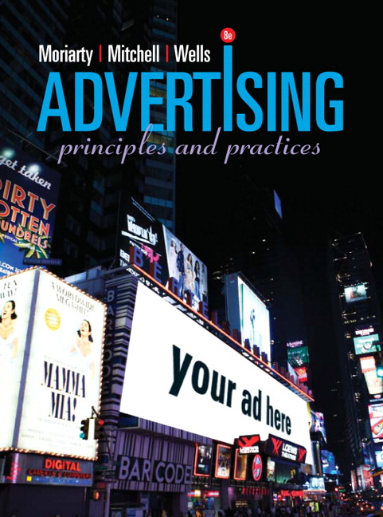

eBay Revolutionizes the Marketplace
eBay founder Pierre Omidyar sold a broken laser pointer via the Internet for $13.83 in 1995.
After building business by word of mouth, the first eBay ad campaign ran in 2002.
eBay’s campy “Do It eBay” campaign was followed by the “it” campaign
SOURCE: https://www.pearson.com/us/higher-education/product/Moriarty-Advertising-8th-Edition/9780132224154.html

Slide 4
Interactive Media: Web 2.0
Media planners are trying to understand how the rapidly changing media landscape will affect advertising.
Web 2.0 refers to the trend toward social networking and entertainment sites.
The convergence and blurring of media forms is challenging media planners.
Big media companies are acquiring Internet businesses to extend their online offerings and allow cross-media promotions.
For an example of convergence, go to: www.BudgetTravel.msnbc.com

Slide 5
Internet basics
WHAT IS ADVERTISING?
Internet: a linked system of international computer networks.
World Wide Web: the information interface that allows people to access the Internet through an easy-to-use graphical format.
The Internet is still evolving and is driven by innovation.
It is useful for communicating brand information, but any problem can travel around the world instantly.
  (Moriarty, Mitchell and Wells, 2009).

Slide 6
Internet basics
Why has the Internet become so important to consumers and marketers in such a short time?
Here are a few reasons:
  Information: Internet users have access to a wealth of information, not only about brands and companies, but also about trends, future developments, and product reviews.
  Choice: The Internet offers more choices and consumers can easily do comparative shopping online.
  Accessibility: The majority of the population has access to computers, and individuals who do not can go online at work or public locations
  Speed: with high-speed connection services, information travels across the Internet almost instantaneously and is carried to almost all parts of the globe.

Slide 7
Internet Advertising Formats
Company Web site/home page is the online face it presents to the public
URLs (Uniform Resource Locator) and domain names or a global address that identifies a specific location in cyberspace on the web where a document or Web site lives.
Portals (e.g., Yahoo! or Google) is a site that provides doors or links, to other Websites.
Search Engines. Google is the biggest search engine used to find information and access other sites.

Slide 8
Internet Advertising Formats
Chat Rooms. Groups of people with special interest can contact one another and exchange their opinions and experiences through chat rooms, which are sites located online, sometimes as part of an organization’s website, but sometimes completely independent of any company.
Blogs is a diary-like web page created by individuals to talk about things that interests them.
Vlogs (e.g., Rocketboom.com) or Video blogs are visual essays available online.
Netcasting (e.g., Blip.tv) it is a technology that makes it possible to broadcast TV and radio online.

Slide 9
The Internet audience
Internet use has expanded over the years to sites that appeal to almost any age or interest group.
The most sought-after group is the hard-to-reach youth audience, particularly young males.
The Internet is the ultimate niche medium because it appeals to people’s specific interests.
Principle:
The Internet is the ultimate niche medium because it appeals to people’s specific interests.

Slide 10
Internet marketing
The Internet has created new ways to do business.
Many companies sell products online, particularly to the B2B market.
Consider:
  Amazon.com
  eBay
  iTunes
These companies exist only as online businesses. They are Internet brands.
The Internet has vastly increased person-to-person commerce, in which individuals who have things to sell are connected with people interested in buying.
Source: Moriarty, Mitchell and Wells, (2009)

Slide 11
What are the functions of Internet marcom?
E-business or e-commerce
  Businesses use it to sell products, manage their operations.
The information role
  Includes online publishing, encyclopedias
  www.ezinearticles.com uses only reader-generated content.
The entertainment role
  Includes games, fashion, music, videos, YouTube, SecondLife (avatars)
The social role
  Social networking allows users to express themselves, interact with friends, and publish their own content.
  Examples include Facebook and MySpace.
The word-of-mouth role
  Creates a dialogue with customers.
  Stimulates conversation between customers and potential customers
Source: Moriarty, Mitchell and Wells, (2009)

Slide 12
The Internet and Marketing Communication
Advertising resources
  Search engines e.g. google, sanook
Chat rooms e.g. MSN
Blogs
Youtube
Intranet
  Internal communication systems that connect employees
Extranets
  Communication systems that connect a company and its employees to key external stakeholders
E-business
  All the hardware, software, and computer know-how that provides a platform for businesses that use the Internet to sell products
Source: Moriarty, Mitchell and Wells

Slide 13
Internet Advertising
Internet ad spending is growing in double-digit percentages, vs. traditional media in the 2–5% range.
Predictions are that online advertising will grow to $25 billion in 2010 from $15.9 billion in 2007.
90% of Internet advertising is on a small group of large, established news media like nytimes.com, WSJ.com, and ESPN.com.
DoubleClick, an Internet advertising service, places more than 60 billion online ads per month.
The United States overwhelmingly outspends the rest of the world in Internet advertising. However in only three countries—Norway, Sweden, and the United Kingdom—is the share of online ad spending 10 percent or greater.
Source: Arens, Weigold, and Arens, 2011;Moriarty, Mitchell and Wells, 2009.

Slide 14
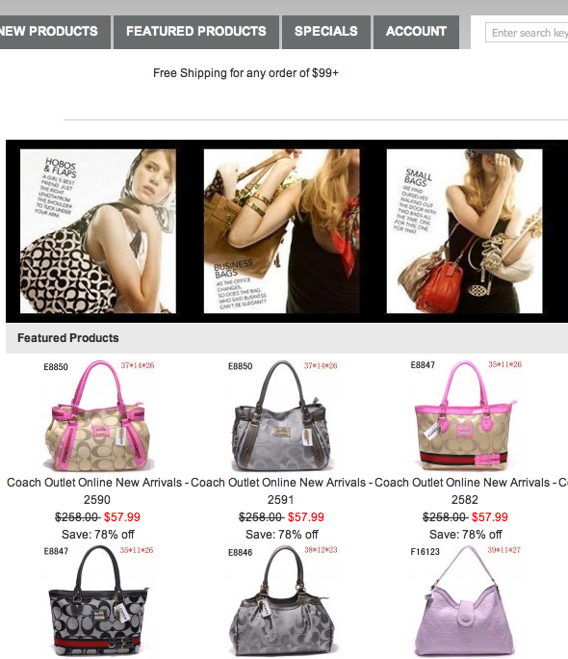
Purposes of Internet Advertising
Brand reminder to people visiting a Web site
Like an ad in traditional media, delivering information or a persuasive message
Driving traffic to the Web site by enticing people to click on a banner or button
Source: Moriarty, Mitchell and Wells, (2009)

Slide 15
Internet Advertising Formats
Banner Ads are small ads on other Web pages on which people can click to move to the advertised web site.
  The overall “Click through” rates range from 1% to7% the difference lies in creativity and attention- getting power of the banner ad.
Skyscrapers
  Extra-long, skinny ads running down the right or left side of a Web site; response rates can be 10 times higher than the traditional banner ads
Pop-ups and pop-behinds bust open on the computer screen either in front of or behind the opening page of the Web site.
  They are seen as intrusive, annoying, and some advertisers have moved away from this format.

Slide 16
Internet Advertising Formats
Minisites allow the advertiser to market their products without sending people away from the site they are visiting.
  Don’t have to leave current site; response rates about 5%
Superstitials are thought of as “the Internet’s commercial,” designed to work like TV ads.
  When you go from one page on a Web site to another, a 20-second video commercial appears in a window.
Widgets are tiny computer programs that allow people to create and insert professional looking content into their personal web sites.
  They include brand-sponsored news notes, book or music covers, weather feeds, calculators, and other gadgets

Slide 17
Internet Advertising Formats
Online video ads
Multiple formats have forced advertisers struggle to find the best platforms.
The lack of standardization have raised agencies’ production costs as they try to adapt to new formats.
Search advertising
Search engine advertising is driven by keywords that consumers use to search for information.
Search marketing enables marketers to position brand messages adjoining the list of sites compiled in responses to a keyword search by search engines.
Because consumers initiate the search, the adjoining ads are not perceived to be as intrusive as other forms of advertising.

Slide 18
Types of internet advertising
Animation Boosts Click-Throughs
Use of technology like Flash and Java script can double click-through rates
Games, contests, interviews, and music videos
Email advertising
It’s inexpensive and easy
Permission marketing—asking potential consumers permission to send email.
  Opt in and opt out
Viral marketing—uses email to circulate a message among family and friends.
Spam—bulk email; unsolicited messages sent to email boxes.
Can be profitable.

Slide 19
New Internet Practices
E-business/e-commerce
  Businesses sell products, manage their businesses
Information Role
  Online publishing, encyclopedias
Entertainment Role
  Games, fashion, music, videos, YouTube, SecondLife (avatars)
Social Role
  MySpace Facebook
Dialogue Role
  Create two-way communication with customers
  Create buzz or word of mouth between customers and potential customers
Moriarty, Mitchell and Wells, (2009)

Slide 20
Internet Advertising Issues
Measurement
  Feedback is rapid, but with no standards for measurement.
  Hits, viewers, unique viewers, and page views don’t offer insight about motivation or attention.
  Consumer response is measured by click-throughs.
  Internet measurement may become more like TV with daypart data, and reach and frequency tools.
Internet Targeting and Privacy
  Cookies track your movements online and report back to site owners who store or sell your information.
  Privacy policies outline how/if data is collected and used.
Principle:
Companies that keep track of their customers’ online behavior are better able to personalize their advertising messages

Slide 21
Types of online marketing communication
Websites
Also called a home page, a website is the online face a company presents to the public.
Websites blur the distinction between advertising, direct marketing and public relations.
Stickiness: the degree to which a website encourages visitors to “stick around.”
Navigation: The ease with which users can locate and move through your website.
Check out these two highly “sticky” websites:
www.CampbellsKitchen.com
http://tdi.vw.com

Slide 22
Types of online marketing communication
E-mail communication
E-mail is a very inexpensive form of advertising.
Viral marketing uses e-mail, Facebook, and Twitter to circulate a message among family and friends.
Remember “The Diet Coke/Mentos Experiment?” The viral advertising generated boosted Mentos mint sales by 15 percent!

Slide 23
Changes and Trends
Increased bandwidth makes it easier to download rich media images
Rich media is interactive ads that use sound, still images, and full-motion video
Streaming video is moving images transmitted online and received through modems to computers
Internet ad sales
In 2009, the market for online display ads was estimated at $21 billion per year.
Google has been the most successful at attracting advertising.
Selling online advertising space is complicated. Rates and services vary widely.
Middlemen companies act as brokers, packaging online ad space across different sites.

Slide 24
Internet Advertising Advantages
Relatively inexpensive.
Reaches people who aren’t watching TV or reading newspapers.
Internet advertising is easy to track and effective at reaching highly targeted audiences.
Advertisers can customize and personalize messages.
For B2B, Internet advertising can provide sales leads or actual sales.
Small companies can easily and economically “look big” and compete with larger companies.

Slide 25
Internet Advertising Disadvantages
Strategic and creative experts aren’t able to consistently produce effective ads and to measure their effectiveness.
Clutter may even be worse than in other media.
No standards for measurements
The nature of a lot of display advertising is intrusive, so pop-up blockers can often prevent ads from being served as they were intended by the advertisers.
Connection speed or Bandwidth can also be an issue, although this is a shrinking problem.
Consumers are suffering from advertising fatigue, so while new technologies can provide great results, as soon as the market moves mainstream, it can get saturated. Consumers are increasingly ignoring advertisements.

Slide 26
Nontraditional Media Definitions
New media
  New electronic forms of media
Alternative media
  Nontraditional or unexpected communication tools and events
The media person’s search for new ways to deliver messages is just as creative as the creative person’s search for new advertising ideas.
Because teens are often the first to use new media forms, finding new media is especially important for advertisers trying to reach the youth market.
Principle:
The media person’s search for new ways to deliver messages is just as creative as the creative person’s search for new advertising ideas.

Slide 27
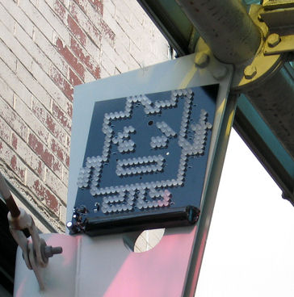
Guerilla Marketing
Unconventional, low-budget brand activities
Get people where they live and work and play, create a personal connection
Intended to create buzz on a limited budget
Usually has limited reach but potential high “targetability”
2007 Cartoon Network’s Aqua Teen Hunger Force promo created a bomb scare in Boston
An LED display resembling the cartoon character Ignignokt from Aqua Teen Hunger Force

Slide 28

Advertainment
When companies integrate brands into the theme of TV shows
  FedEx in Castaway
  GEICO cavemen show
Also called branded entertainment
Situational or contextual ads
  Embedded in specific programs
  Harder for the viewer to dismiss as ads
  Product is a character in the program
  e.g. situation comedy, game shows, etc.
  Moriarty, Mitchell and Wells, (2009)

Slide 29
Video Games
A developing, major new medium for advertisers to target 12- to 34-year-old males (some girls).
Opportunities to create online games as well as place products within video games.
Planners and buyers are asking for standardized independent data that prove effectiveness.
Website visitors or viewers watching video downloads also confront a variety of online video ads.
  Because there are some 30 formats available, advertisers who want to use video are struggling to find the best platform for their ads.
  The most common are in a pre-roll format, which forces viewers to watch a video ad before viewing video clips.

Slide 30

Wi-Fi and Mobile Marketing
Cell phones feature new products like graphic faceplates and specialty ring tones, and can play videos supported by advertising.
Mobile marketing uses wireless media to deliver content and encourage direct response.
Text messaging and instant messaging.
Hybrid technologies like podcasting.
Source: Moriarty, Mitchell and Wells, (2009)

Slide 31
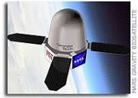
Nonelectronic New Media
Ads are appearing on backs of toilet stalls, eggs cartons, apples, subway turnstiles, pizza boxes, airline seatbacks, motion sickness bags, the bottoms of flip-flops, NASCAR race cars.
NASA considering printing emblems and logos on space shuttle and space station.
YourNameIntoSpace.org will put your logo on satellites.
http://www.spaceref.com/news/viewsr.html?pid=22502

Slide 32
Social media tools
Video and image sharing
Using this type of social media, users can post videos and photographs.
YouTube is the Goliath of this genre. It now plays more than 100 million clips per day.
Skype is a video chat service that works like a video phone.
Popular TV programs and commercials are often uploaded to YouTube pages as viral videos.

Slide 33
Social media tools
Social networks
These link friends, fans, or others who share interest in some topic.
MySpace pioneered the concept, but has lost market share to Facebook in recent years.
Social media users tend to be younger and female.
Companies and brands now have Facebook and MySpace pages with their own brand profiles.
Social media marketing can increase a brand’s Web presence and help manage its Internet image.

Slide 34
Social media tools
Blogs, micro-blogs and chat rooms
A blog is a diary-like Web page created by individuals to talk about things that interest them.
Blogs are produced by some 100 million people worldwide.
Corporations use blogs to engage stakeholders.
However, bogs take a lot of time. Many bloggers run out of steam or move to social media.
They are sometimes criticized as “stealth advertising.”
Twitter has pioneered the mini-blog with 140-character posts, called “tweets.”
Groups of people with common interests can meet and share their experiences through chat rooms.

Slide 35
Social media tools
Social media strategies
Marketers are working to find the best ways to use social media and take advantage of its strengths.
Search ads combined with social media campaigns generate the highest-level results.
Marketers who use social media recognize the value in conversations and customer relationship-building communication.

Slide 36
SUMMARY
The roles played by Internet communication include providing information and entertainment, connecting people socially, and generating word-of-mouth communication. Most corporations have websites in which they describe their organization and, in some cases, make it possible to buy products online. E-mail is used by companies to reach customers and prospects with commercial messages and also by customers and other stakeholders to contact the company. The Internet also provides different kinds of advertising opportunities that appear on websites and search engines. Social media offer another way people can stay in touch and that includes companies who use such media as Facebook and Twitter to connect with their customers.

Slide 37
THANK YOU
LECTURE 13 BY DR. RAPHAEL OGUTU,
Mass Communication Department,
AFRICA NAZARENE UNIVERSITY.
THE MAIN SOURCES OF REFERENCE:
Advertising & IMC: Principles and Practice., Moriarty, Sandra Mitchell, Nancy D and Wells, William D. 14th edition. Pearson Prentice Hall Inc., 2009.
Contemporary Advertising and integrated marketing communications. Arens, William. F., Weigold, Michael. F., and Arens, Christian. 13th Ed. McGraw Hill Higher Education. 2011.

